Slide 1
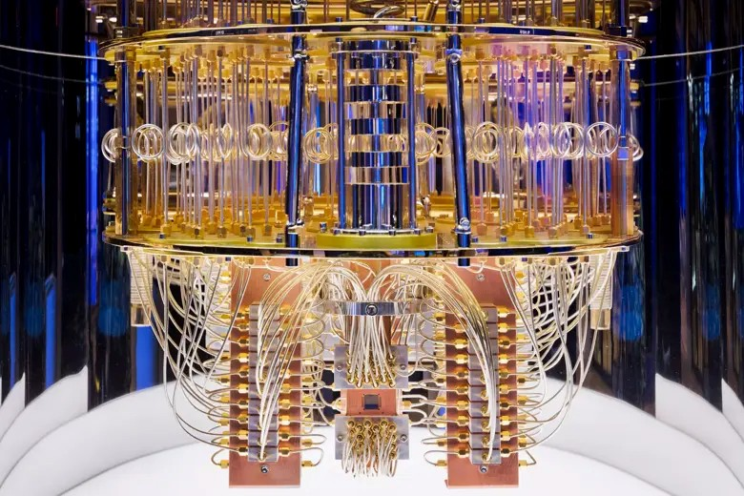
Quantum Correlations For Achieving Quantum Advantage in Machine Learning
Presented By:
Sadia Afrin Purba
Dept. of Elect. and Comp. Eng.
Temple University
Submitted to:
Advisor:
Dr. Joseph Picone, Dept. of Electrical and Computer Engineering
Committee:
Dr. Iyad Obeid, Dept. of Electrical and Computer Engineering
Dr. Chang-Hee Won, Dept. of Electrical and Computer Engineering
Dr. Andrew Spence, Dept. of Bioengineering

Slide 2
Introduction
Quantum refers to the principles of quantum mechanics, the physics governing subatomic particles like electrons and photons.
Quantum mechanics deals with two fundamental properties of subatomic particles. They are superposition and entanglement.
In this proposal, we focus on quantum entanglement, which is the strongest form of quantum correlation for analyzing machine learning systems.
  Quantum entanglement is the quantum state of each particle in a group cannot be described independently, even when the particles are separated by a large distance.
  Imagine two coins in completely isolated rooms. In classical physics, flipping the first coin gives absolutely no information about the second coin; their probabilities are entirely independent.
  However, if these were “quantum coins” in a maximally entangled state, measuring the first coin and seeing “heads” would instantaneously guarantee that the second coin also reads “heads”.

Slide 3
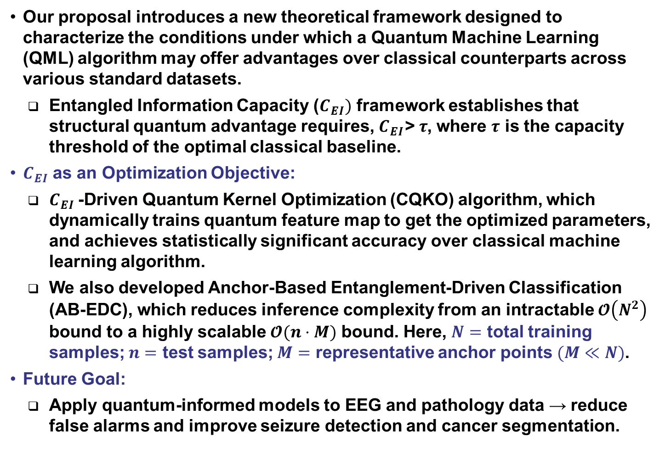
Proposed Contributions
Our proposal introduces a new theoretical framework designed to characterize the conditions under which a Quantum Machine Learning (QML) algorithm may offer advantages over classical counterparts across various standard datasets.
  Entangled Information Capacity ($C_{EI})$ framework establishes that structural quantum advantage requires, $C_{EI}\text{> }τ$, where $τ$ is the capacity threshold of the optimal classical baseline.
$C_{EI}$ as an Optimization Objective:
  $C_{EI}$-Driven Quantum Kernel Optimization (CQKO) algorithm, which dynamically trains quantum feature map to get the optimized parameters, and achieves statistically significant accuracy over classical machine learning algorithm.
  We also developed Anchor-Based Entanglement-Driven Classification (AB-EDC), which reduces inference complexity from an intractable $𝓞\left(N^{2}\right)$ bound to a highly scalable $𝓞(n⋅M)$ bound. Here, $N=$ total training samples; $n=$ test samples; $M=$ representative anchor points $(M≪N)$.
Future Goal:
  Apply quantum-informed models to EEG and pathology data → reduce false alarms and improve seizure detection and cancer segmentation.

Slide 4
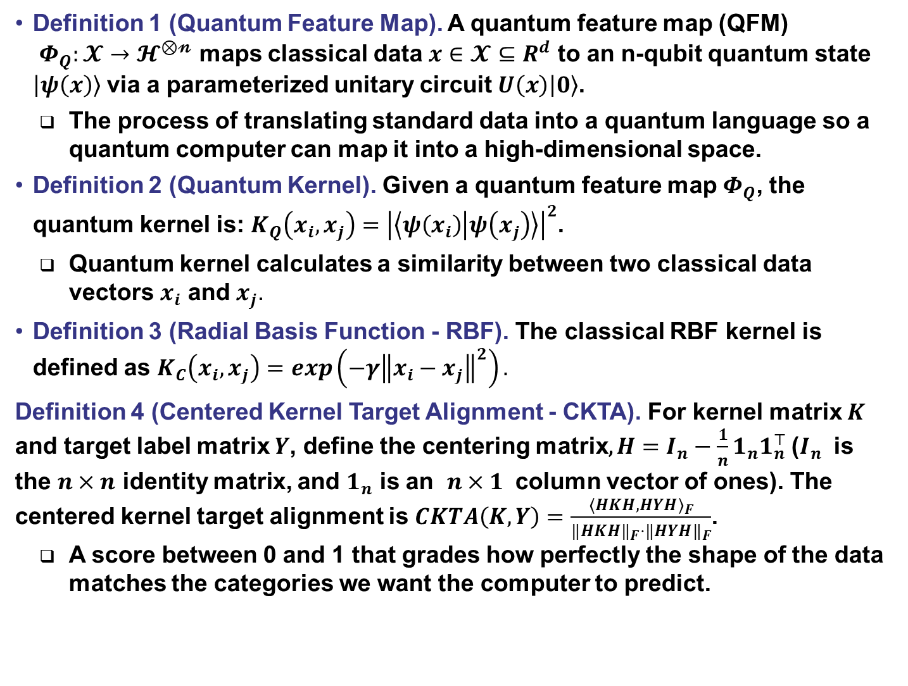
Definitions (1/4)
Definition 1 (Quantum Feature Map). A quantum feature map (QFM)
$Φ_{Q}:𝓧→𝓗^{⊗𝓷}$ maps classical data $x∈𝓧⊆R^{d}$ to an n-qubit quantum state $\left|ψ\left(x\right)\right\rangle$ via a parameterized unitary circuit $U\left(x\right)\left|0\right\rangle$.
  The process of translating standard data into a quantum language so a quantum computer can map it into a high-dimensional space.
Definition 2 (Quantum Kernel). Given a quantum feature map $Φ_{Q}$, the quantum kernel is: $K_{Q}\left(x_{i},x_{j}\right)={\left|\left\langle ψ\left(x_{i}\right) | ψ\left(x_{j}\right)\right\rangle \right|}^{2}$.
  Quantum kernel calculates a similarity between two classical data vectors $x_{i}$ and $x_{j}$.
Definition 3 (Radial Basis Function - RBF). The classical RBF kernel is defined as $K_{C}\left(x_{i},x_{j}\right)=\exp\left(−γ{\left\|x_{i}−x_{j}\right\|}^{2}\right).$
Definition 4 (Centered Kernel Target Alignment - CKTA). For kernel matrix $K$ and target label matrix $Y$, define the centering matrix, $H=I_{n}−\frac{1}{n}1_{n}1_{n}^{⊤}$($I_{n}$ is the $n×n$ identity matrix, and $1_{n}$ is an $n×1$ column vector of ones). The centered kernel target alignment is $CKTA\left(K,Y\right)=\frac{⟨HKH,HYH⟩_{F}}{‖HKH‖_{F}⋅‖HYH‖_{F}}$.
  A score between 0 and 1 that grades how perfectly the shape of the data matches the categories we want the computer to predict.

Slide 5
The Physical Reality of Entanglement
The 90-Year Journey to Prove Einstein Wrong
  1935 (The Skepticism): Albert Einstein publishes the famous EPR paper, arguing that quantum entanglement is impossible.
  1964 (The Test): John Bell invents a mathematical boundary—Bell’s Theorem—creating the first path to actually test if quantum entanglement is real.
  1969 – 1982 (The Proof): John Clauser and others propose the Clauser–Horne–Shimony–Holt (CHSH) inequality to make Bell’s test practical. By 1982, Alain Aspect conducts a landmark experiment proving the violation of Bell’s limit.
  2022 (The Nobel Prize): Clauser, Aspect, and Anton Zeilinger are awarded the Nobel Prize in Physics. Quantum entanglement is irrefutably real.
Bell’s theorem mathematically limits the correlation between classically independent, disconnected objects.
Violating the CHSH inequality shatters this limit, proving the system possesses non-local connections impossible under classical physics.
Machine learning is fundamentally about finding hidden patterns, structures, and correlations in data. Classical computers are permanently locked behind the classical limit.
By encoding data into quantum systems that can exhibit quantum correlations, we open the door to richer representational structures that may be difficult for classical models to capture efficiently.

Slide 6
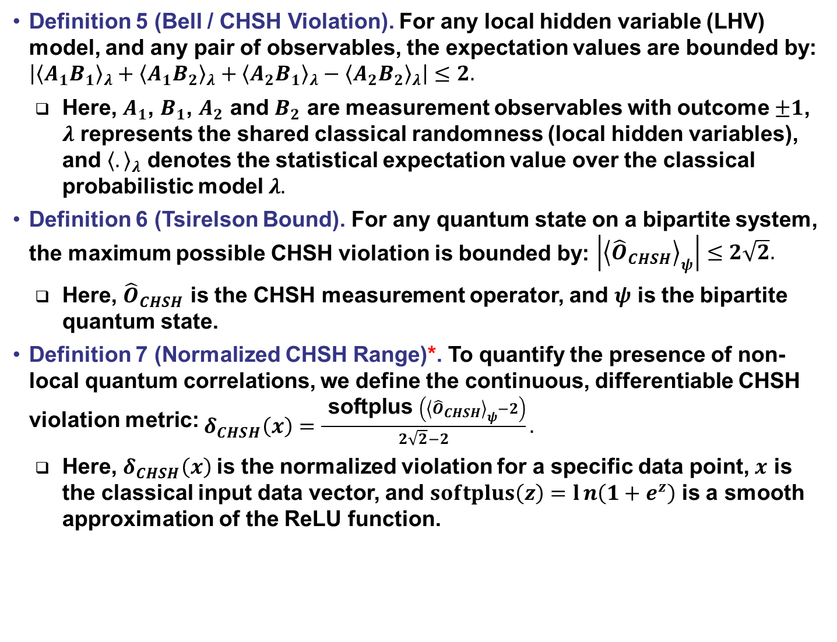
Definitions (2/4)
Definition 5 (Bell / CHSH Violation). For any local hidden variable (LHV) model, and any pair of observables, the expectation values are bounded by: $\begin{aligned}\left|{\left\langle A_{1}B_{1}\right\rangle }_{λ}+{\left\langle A_{1}B_{2}\right\rangle }_{λ}+{\left\langle A_{2}B_{1}\right\rangle }_{λ}−{\left\langle A_{2}B_{2}\right\rangle }_{λ}\right|≤2.\end{aligned}$
  Here, $A_{1}$, $B_{1}$, $A_{2}$ and $B_{2}$ are measurement observables with outcome $±1$, $λ$ represents the shared classical randomness (local hidden variables), and ${\left\langle .\right\rangle }_{λ}$ denotes the statistical expectation value over the classical probabilistic model $λ.$
Definition 6 (Tsirelson Bound). For any quantum state on a bipartite system, the maximum possible CHSH violation is bounded by: $\begin{aligned}\left|{\left\langle {\hat{O}}_{CHSH}\right\rangle }_{ψ}\right|≤2\sqrt{2}. \end{aligned}$
  Here, ${\hat{O}}_{CHSH}$ is the CHSH measurement operator, and $ψ$ is the bipartite quantum state.
Definition 7 (Normalized CHSH Range)*. To quantify the presence of non-local quantum correlations, we define the continuous, differentiable CHSH violation metric: $\begin{aligned}δ_{CHSH}\left(x\right)=\frac{ \text{softplus} \left({\left\langle {\hat{O}}_{CHSH}\right\rangle }_{ψ}−2\right)}{2\sqrt{2}−2}. \end{aligned}$
  Here, $δ_{CHSH}\left(x\right)$is the normalized violation for a specific data point, $x$ is the classical input data vector, and $softplus\left(z\right)=ln\left(1+e^{z}\right)$ is a smooth approximation of the ReLU function.

Slide 7
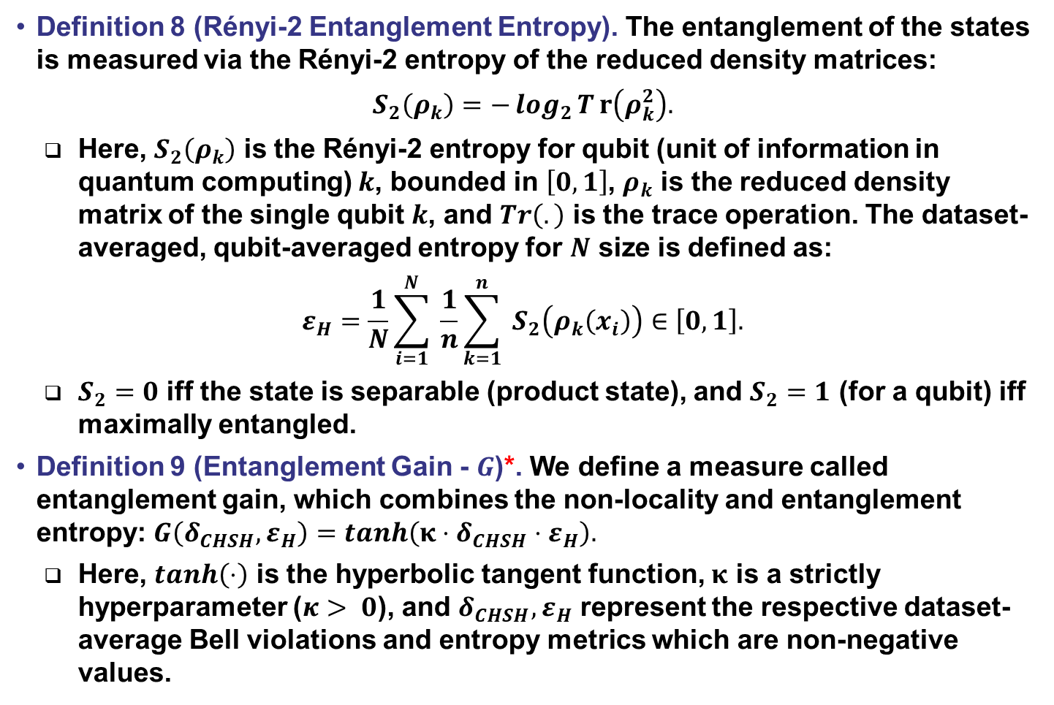
Definitions (3/4)
Definition 8 (Rényi-2 Entanglement Entropy). The entanglement of the states is measured via the Rényi-2 entropy of the reduced density matrices:
$$\begin{aligned}S_{2}\left(ρ_{k}\right)=−\log_{2}{T}r\left(ρ_{k}^{2}\right). \end{aligned}$$
  Here, $S_{2}\left(ρ_{k}\right)$ is the Rényi-2 entropy for qubit (unit of information in quantum computing) $k$, bounded in $\left[0,1\right]$, $ρ_{k}$ is the reduced density matrix of the single qubit $k$, and $Tr\left(.\right)$ is the trace operation. The dataset-averaged, qubit-averaged entropy for $N$ size is defined as:
$$\begin{aligned}ε_{H}=\frac{1}{N}\sum_{i=1}^{N}{ }\frac{1}{n}\sum_{k=1}^{n}{ }S_{2}\left(ρ_{k}\left(x_{i}\right)\right)∈\left[0,1\right]. \end{aligned}$$
  $S_{2}=0$ iff the state is separable (product state), and $S_{2}=1$ (for a qubit) iff maximally entangled.
Definition 9 (Entanglement Gain - $G$)*. We define a measure called entanglement gain, which combines the non-locality and entanglement entropy:$G\left(δ_{CHSH},ε_{H}\right)=tanh\left(κ⋅δ_{CHSH}⋅ε_{H}\right).$
  Here, $tanh\left(⋅\right)$ is the hyperbolic tangent function, $κ$ is a strictly hyperparameter ($κ> 0$), and $δ_{CHSH},ε_{H}$ represent the respective dataset-average Bell violations and entropy metrics which are non-negative values.

Slide 8
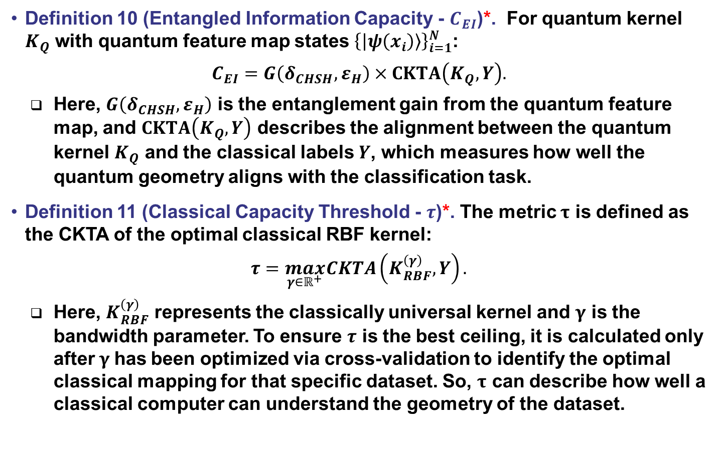
Definitions (4/4)
Definition 10 (Entangled Information Capacity - $C_{EI}$)*. For quantum kernel $K_{Q}$ with quantum feature map states ${\left\{\left|ψ\left(x_{i}\right)\right\rangle \right\}}_{i=1}^{N}$:
$$\begin{aligned}C_{EI}=G\left(δ_{CHSH},ε_{H}\right)×CKTA\left(K_{Q},Y\right). \end{aligned}$$
  Here, $G\left(δ_{CHSH},ε_{H}\right)$ is the entanglement gain from the quantum feature map, and $CKTA\left(K_{Q},Y\right)$ describes the alignment between the quantum kernel $K_{Q}$ and the classical labels $Y$, which measures how well the quantum geometry aligns with the classification task.
Definition 11 (Classical Capacity Threshold - $τ$)*. The metric $τ$ is defined as the CKTA of the optimal classical RBF kernel:
$$\begin{aligned}τ=\max_{γ∈ℝ^{+}} CKTA\left(K_{RBF}^{\left(γ\right)},Y\right). \end{aligned}$$
  Here, $K_{RBF}^{\left(γ\right)}$ represents the classically universal kernel and $γ$ is the bandwidth parameter. To ensure $τ$ is the best ceiling, it is calculated only after$γ$has been optimized via cross-validation to identify the optimal classical mapping for that specific dataset. So, $τ$ can describe how well a classical computer can understand the geometry of the dataset.

Slide 9
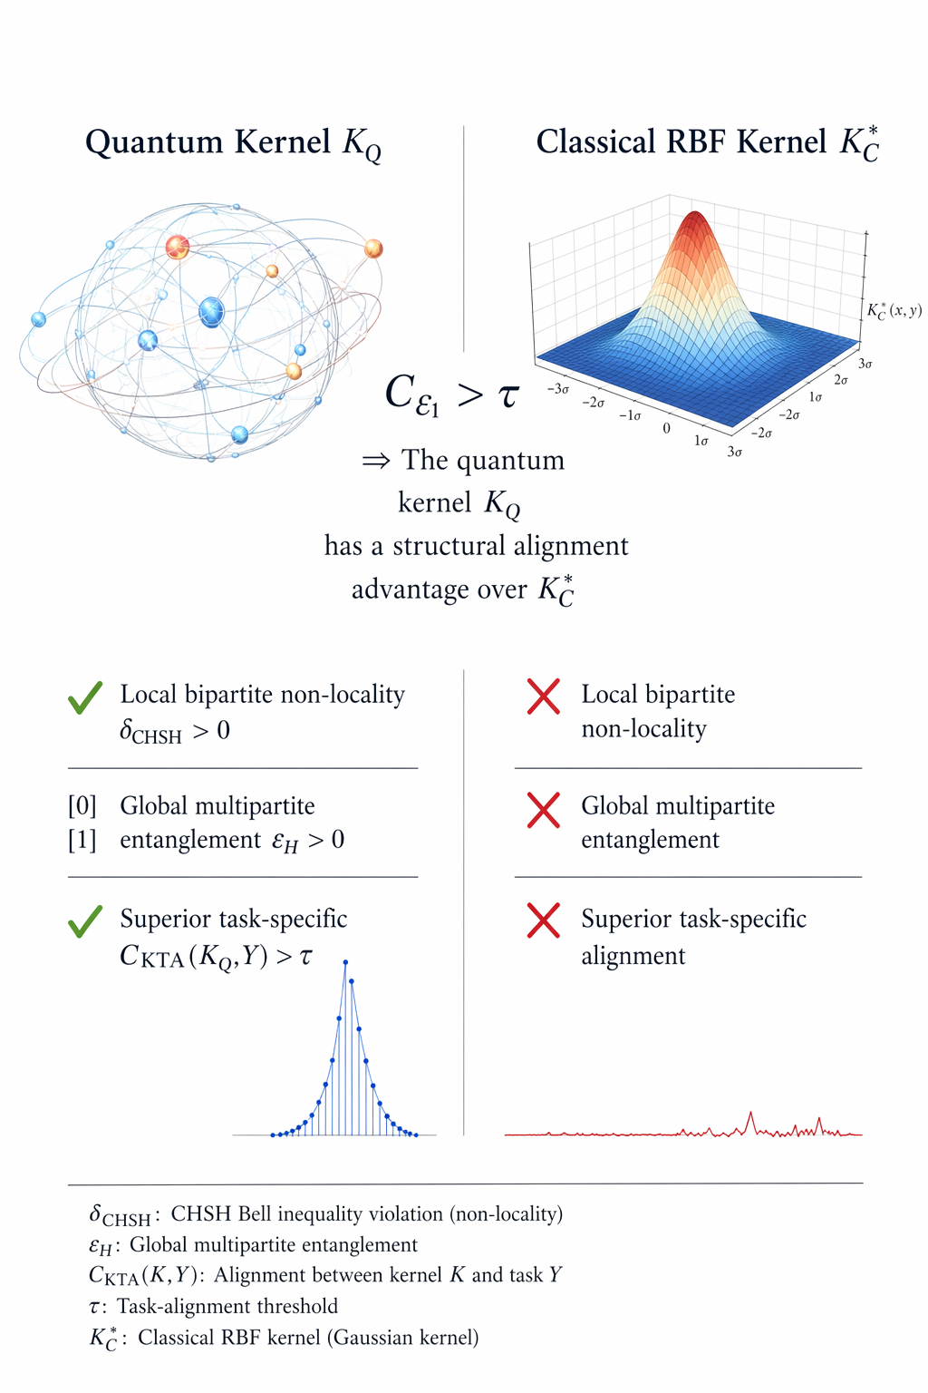
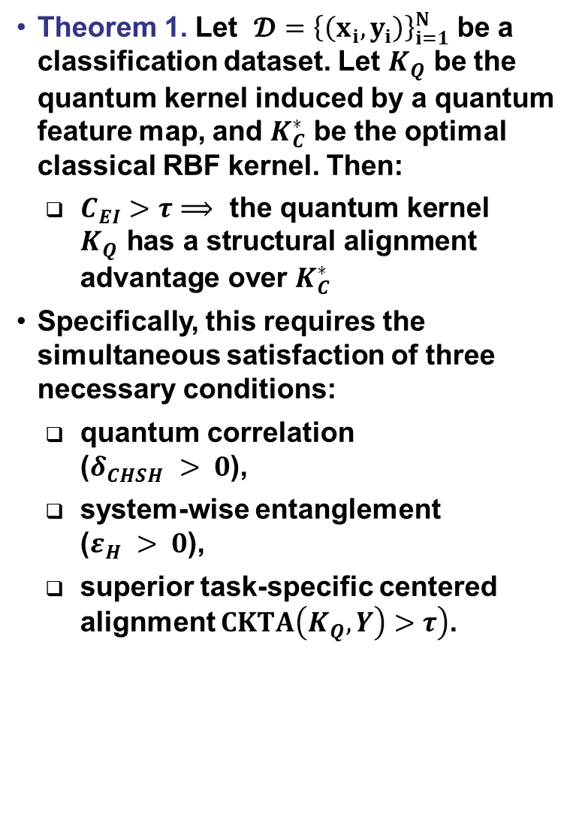
Entangled Information Capacity (EIC) Criterion
Theorem 1. Let $𝓓={\left\{\left(x_{i},y_{i}\right)\right\}}_{i=1}^{N}$ be a classification dataset. Let $K_{Q}$ be the quantum kernel induced by a quantum feature map, and $K_{C}^{∗}$ be the optimal classical RBF kernel. Then:
  $C_{EI}>τ⟹ \text{the} \text{quantum} \text{kernel} K_{Q} \text{has} \text{a} \text{structural} \text{alignment} \text{advantage} \text{over} K_{C}^{∗}$
Specifically, this requires the simultaneous satisfaction of three necessary conditions:
  quantum correlation
  ($δ_{CHSH} > 0$),
  system-wise entanglement
  ($ε_{H} > 0$),
  superior task-specific centered alignment $\left.CKTA\left(K_{Q},Y\right)>τ\right)$.

Slide 10
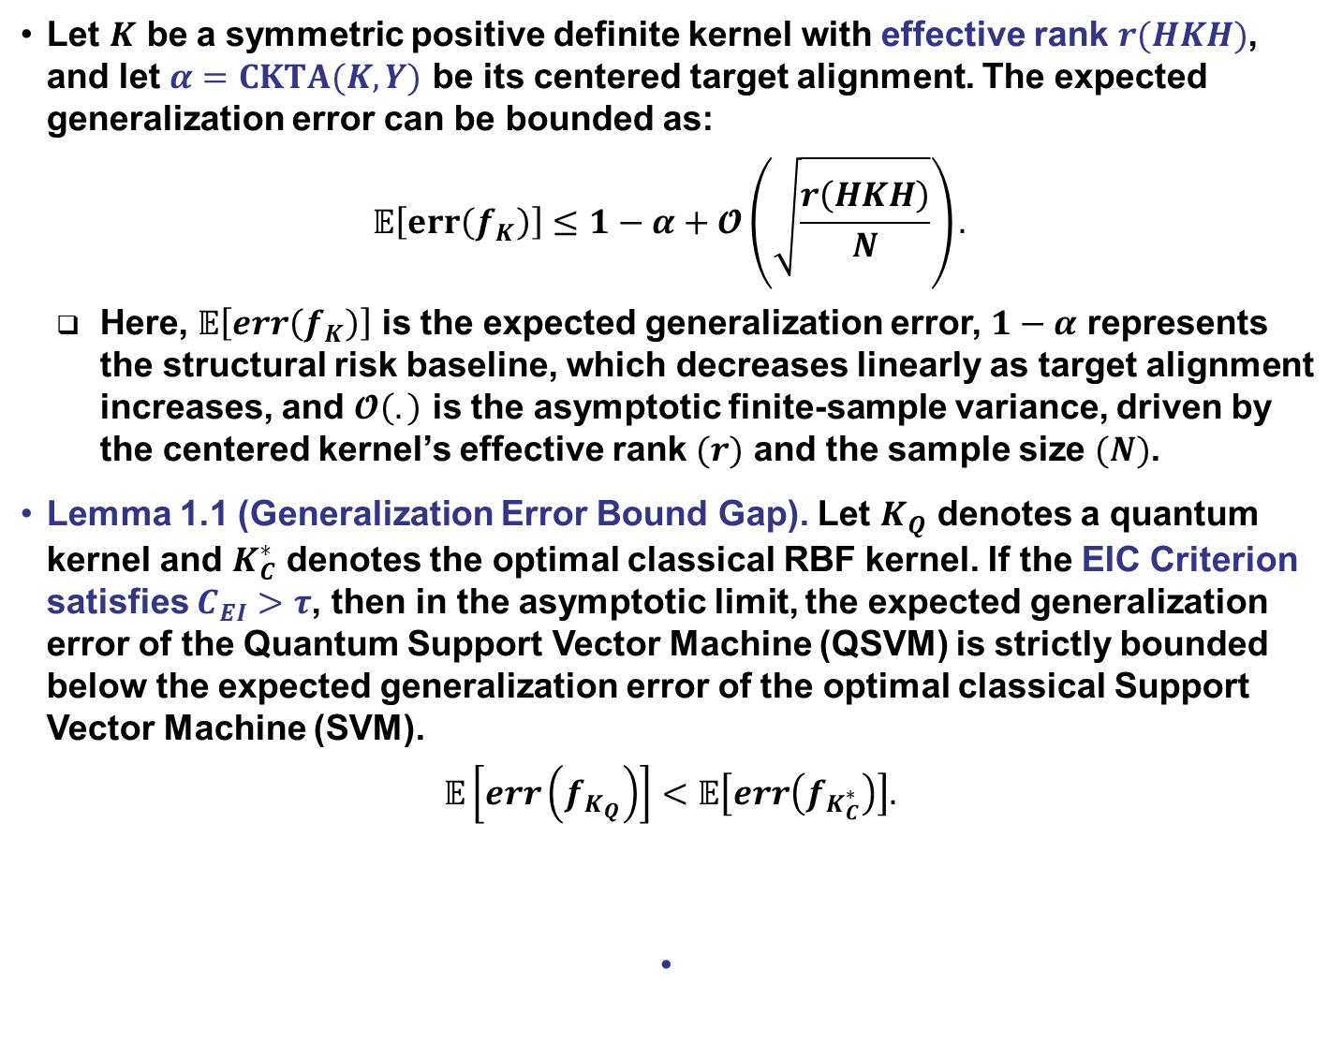
Asymptotic Alignment Error Bound
Let $K$ be a symmetric positive definite kernel with effective rank $r(HKH)$, and let $α=CKTA(K,Y)$ be its centered target alignment. The expected generalization error can be bounded as:
$$\begin{aligned}𝔼\left[err\left(f_{K}\right)\right]≤1−α+𝓞\left(\sqrt{\frac{r\left(HKH\right)}{N}}\right).\#\#\#\#\# \end{aligned}$$
  Here, $𝔼\left[err\left(f_{K}\right)\right]$ is the expected generalization error, $1−α$ represents the structural risk baseline, which decreases linearly as target alignment increases, and $𝓞\left(.\right)$ is the asymptotic finite-sample variance, driven by the centered kernel’s effective rank $(r)$ and the sample size $(N)$.
Lemma 1.1 (Generalization Error Bound Gap). Let $K_{Q}$ denotes a quantum kernel and $K_{C}^{∗}$ denotes the optimal classical RBF kernel. If the EIC Criterion satisfies $C_{EI}>τ$, then in the asymptotic limit, the expected generalization error of the Quantum Support Vector Machine (QSVM) is strictly bounded below the expected generalization error of the optimal classical Support Vector Machine (SVM).
$$\begin{aligned}𝔼\left[err\left(f_{K_{Q}}\right)\right]<𝔼\left[err\left(f_{K_{C}^{∗}}\right)\right].\#\#\#\#\#\#\#\#\#\# \end{aligned}$$

Slide 11
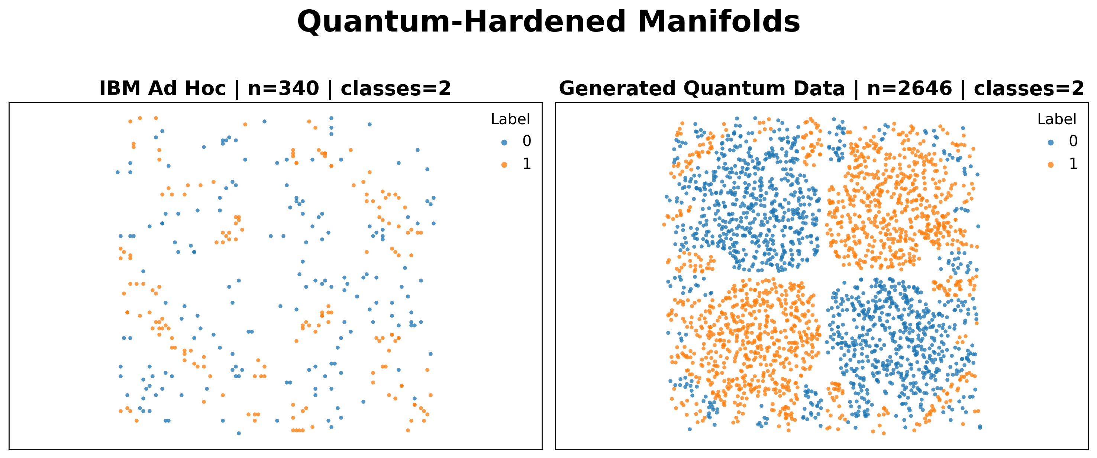
Empirical Evaluation (1/9)
IBM Ad-hoc dataset is a standard foundational benchmark, it utilizes a high-depth quantum circuit to create complex feature space correlations that optimal classical RBF kernels cannot efficiently resolve.
We also use a new custom dataset that was explicitly generated using a non-linear two-qubit feature map
Our empirical evaluation considers five well-established quantum feature maps alongside one custom feature map (Artifical-Entangled-2Q).

Slide 12
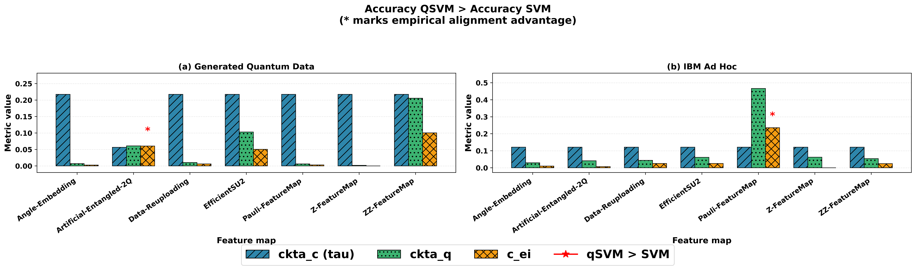
Empirical Evaluation (2/9)
Experimental Expectations and Theorem 1: We expect Theorem 1 to hold, correctly predicting structural quantum advantage where appropriate.
  The Pauli-FeatureMap is expected to excel on the IBM Ad Hoc dataset because its internal structure perfectly matches the mathematical process originally used to create the data’s complex patterns.
  Similarly, we expect optimal performance on the Generated Quantum Data when using our custom feature map, as it perfectly aligns with the dataset's underlying entangled generation process.
QSVM outperforms the optimal classical SVM on both Generated Quantum Data (95.85% vs. 79.90%) and the IBM Ad-hoc dataset (100.00% vs. 90.20%).

Slide 13
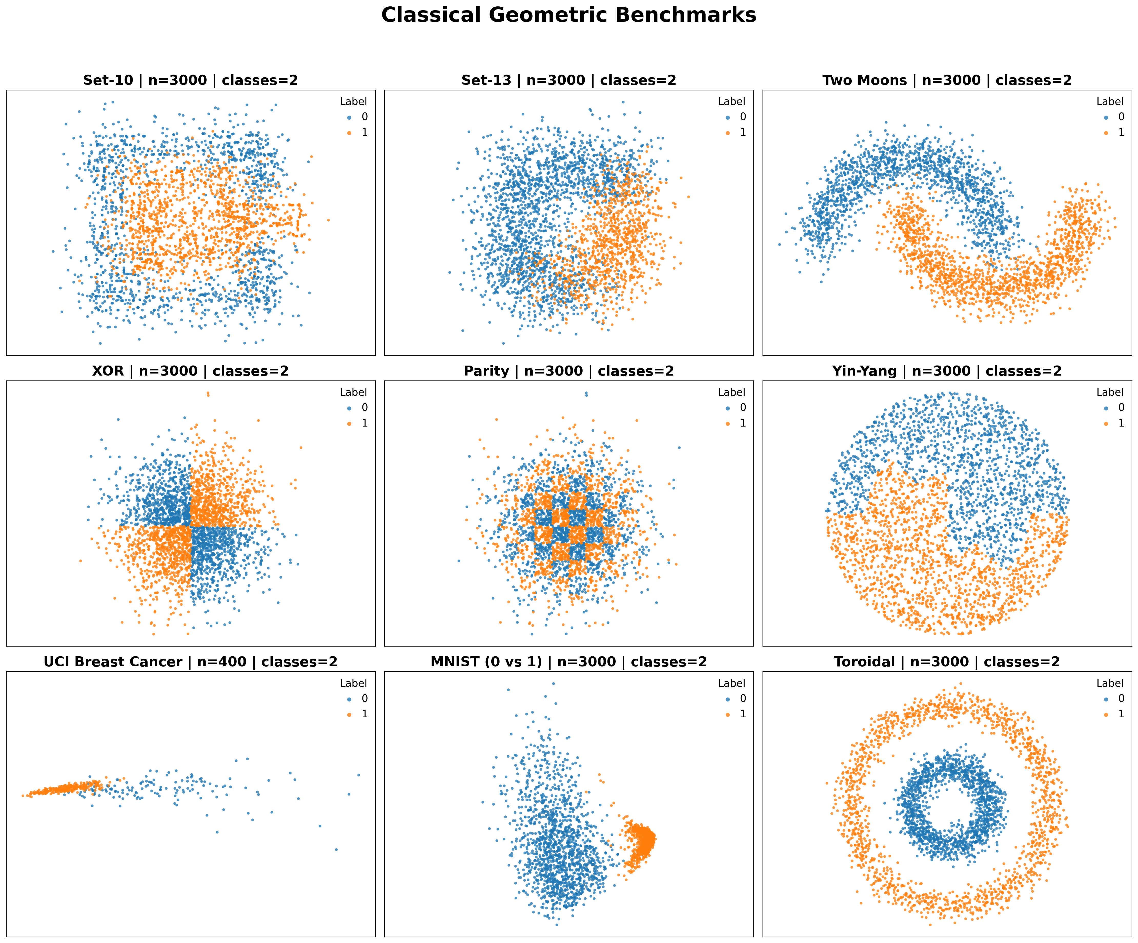
Empirical Evaluation (3/9)
Set-10 and Set-13 were generated by our lab due to their classification difficulty for common ML algorithms, while the rest are common benchmark datasets.

Slide 14
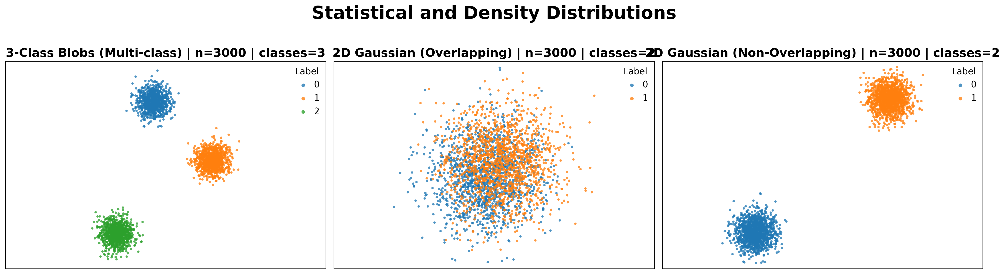
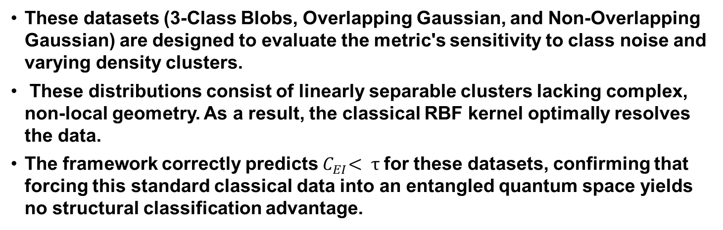
Empirical Evaluation (4/9)
These datasets (3-Class Blobs, Overlapping Gaussian, and Non-Overlapping Gaussian) are designed to evaluate the metric's sensitivity to class noise and varying density clusters.
These distributions consist of linearly separable clusters lacking complex, non-local geometry. As a result, the classical RBF kernel optimally resolves the data.
The framework correctly predicts${ C}_{EI}< τ$ for these datasets, confirming that forcing this standard classical data into an entangled quantum space yields no structural classification advantage.

Slide 15
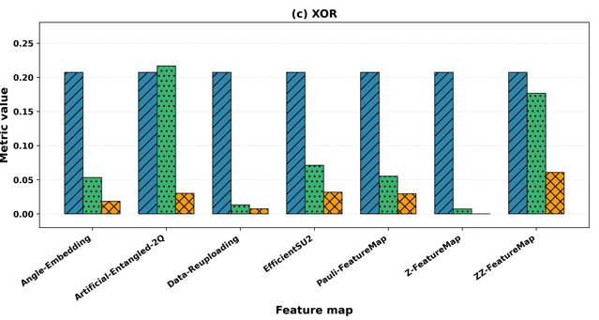
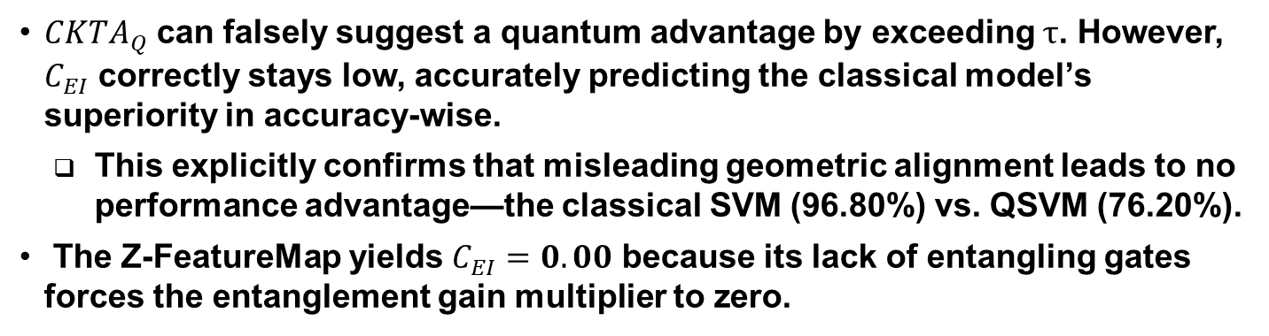
Empirical Evaluation (5/9)
$CKTA_{Q}$ can falsely suggest a quantum advantage by exceeding $τ$. However, $C_{EI}$ correctly stays low, accurately predicting the classical model’s superiority in accuracy-wise.
  This explicitly confirms that misleading geometric alignment leads to no performance advantage—the classical SVM (96.80%) vs. QSVM (76.20%).
The Z-FeatureMap yields $C_{EI}=0.00$ because its lack of entangling gates forces the entanglement gain multiplier to zero.

Slide 16
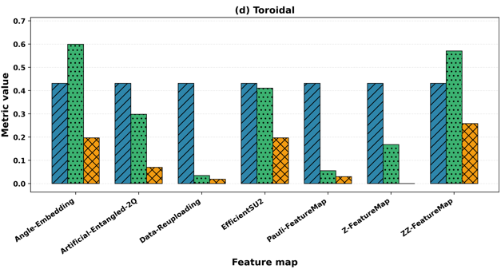
Empirical Evaluation (6/9)
For toroidal dataset, any quantum algorithm is unnecessary, because the classical RBF could get perfect classification score.
  Angle-Embedding: QSVM (100.00%) vs SVM (100.00%)
  ZZ-FeatureMap: QSVM (73.00%) vs SVM (100.00%)

Slide 17
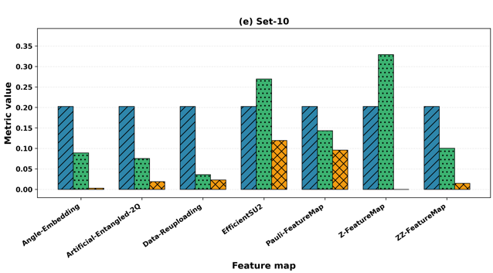
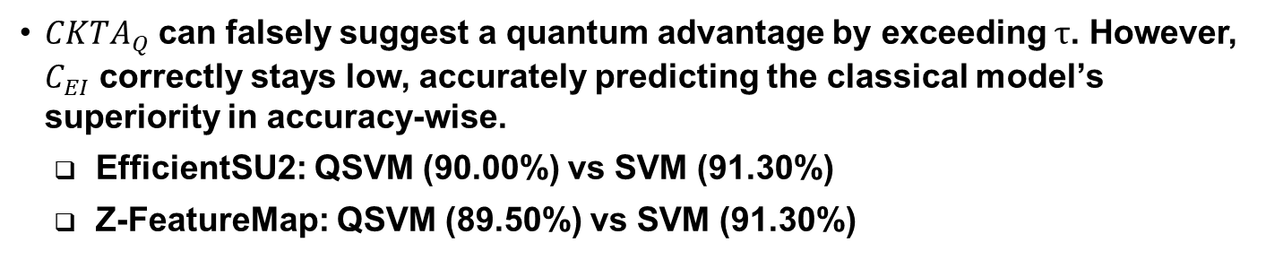
Empirical Evaluation (7/9)
$CKTA_{Q}$ can falsely suggest a quantum advantage by exceeding $τ$. However, $C_{EI}$ correctly stays low, accurately predicting the classical model’s superiority in accuracy-wise.
  EfficientSU2: QSVM (90.00%) vs SVM (91.30%)
  Z-FeatureMap: QSVM (89.50%) vs SVM (91.30%)

Slide 18
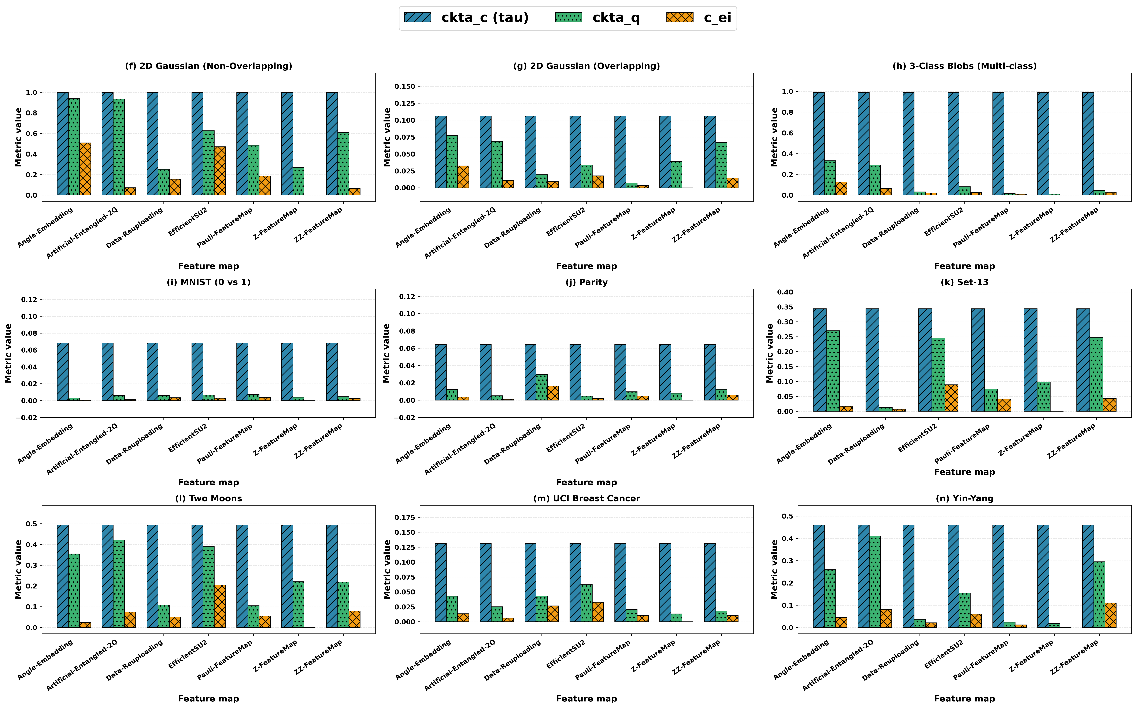
Empirical Evaluation (8/9)

Slide 19
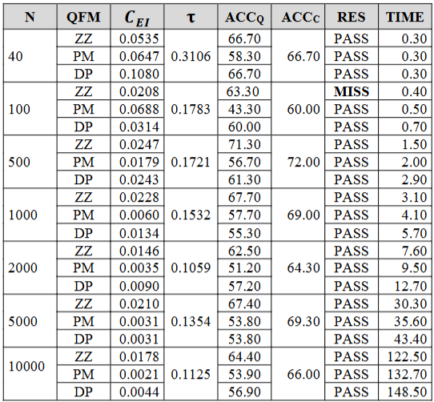
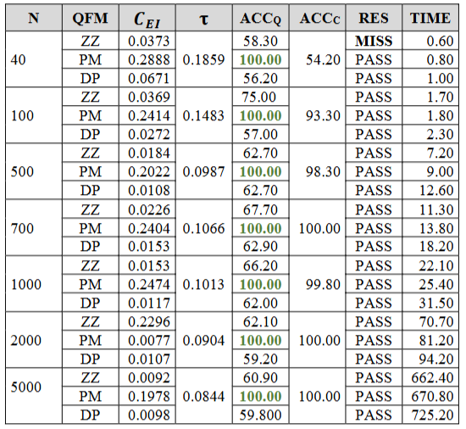
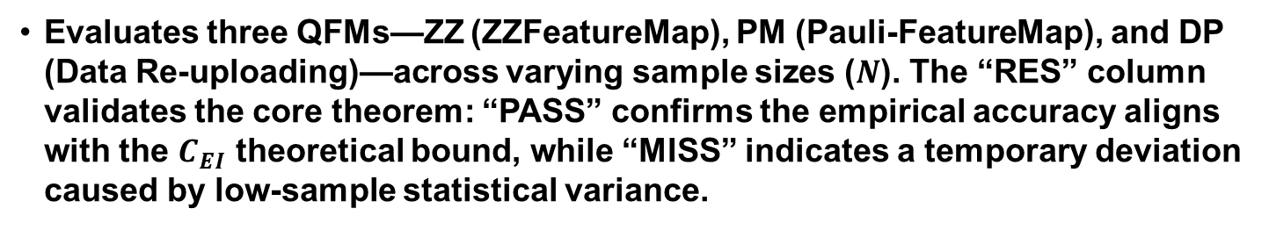
Empirical Evaluation (9/9)
Evaluates three QFMs—ZZ (ZZFeatureMap), PM (Pauli-FeatureMap), and DP (Data Re-uploading)—across varying sample sizes ($N$). The “RES” column validates the core theorem: “PASS” confirms the empirical accuracy aligns with the $C_{EI}$ theoretical bound, while “MISS” indicates a temporary deviation caused by low-sample statistical variance.
Table 01. Scaling analysis for the 2D Overlapping Gaussian dataset.
Table 02. Scaling analysis for the IBM Ad-hoc dataset.

Slide 20
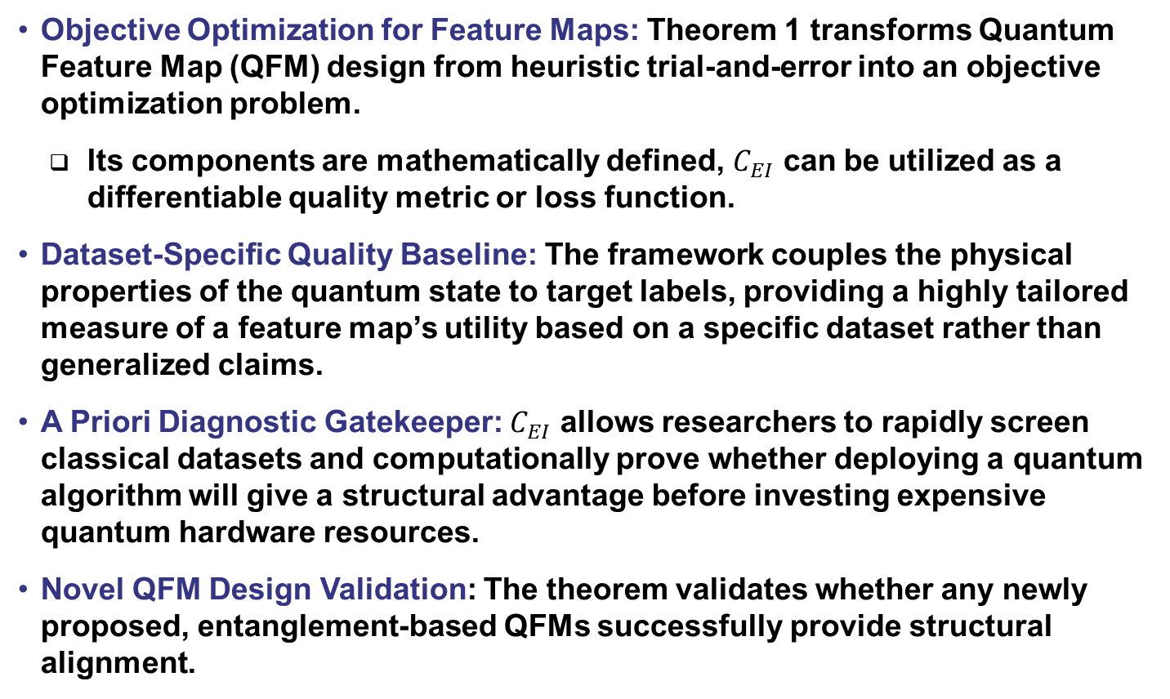
Impacts of Theorem 1
Objective Optimization for Feature Maps: Theorem 1 transforms Quantum Feature Map (QFM) design from heuristic trial-and-error into an objective optimization problem.
  Its components are mathematically defined, $C_{EI}$ can be utilized as a differentiable quality metric or loss function.
Dataset-Specific Quality Baseline: The framework couples the physical properties of the quantum state to target labels, providing a highly tailored measure of a feature map’s utility based on a specific dataset rather than generalized claims.
A Priori Diagnostic Gatekeeper: $C_{EI}$ allows researchers to rapidly screen classical datasets and computationally prove whether deploying a quantum algorithm will give a structural advantage before investing expensive quantum hardware resources.
Novel QFM Design Validation: The theorem validates whether any newly proposed, entanglement-based QFMs successfully provide structural alignment.

Slide 21
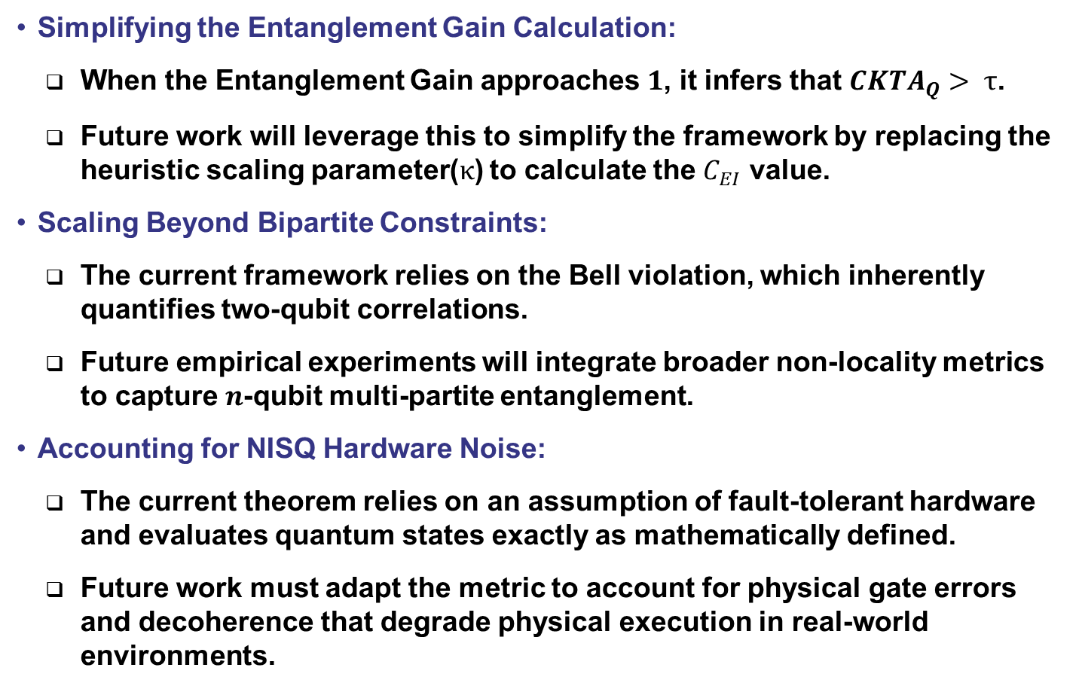
Future Directions of Theorem 1
Simplifying the Entanglement Gain Calculation:
  When the Entanglement Gain approaches $1$, it infers that $CKTA_{Q}> τ$.
  Future work will leverage this to simplify the framework by replacing the heuristic scaling parameter($κ$) to calculate the $C_{EI}$ value.
Scaling Beyond Bipartite Constraints:
  The current framework relies on the Bell violation, which inherently quantifies two-qubit correlations.
  Future empirical experiments will integrate broader non-locality metrics to capture $n$-qubit multi-partite entanglement.
Accounting for NISQ Hardware Noise:
  The current theorem relies on an assumption of fault-tolerant hardware and evaluates quantum states exactly as mathematically defined.
  Future work must adapt the metric to account for physical gate errors and decoherence that degrade physical execution in real-world environments.

Slide 22
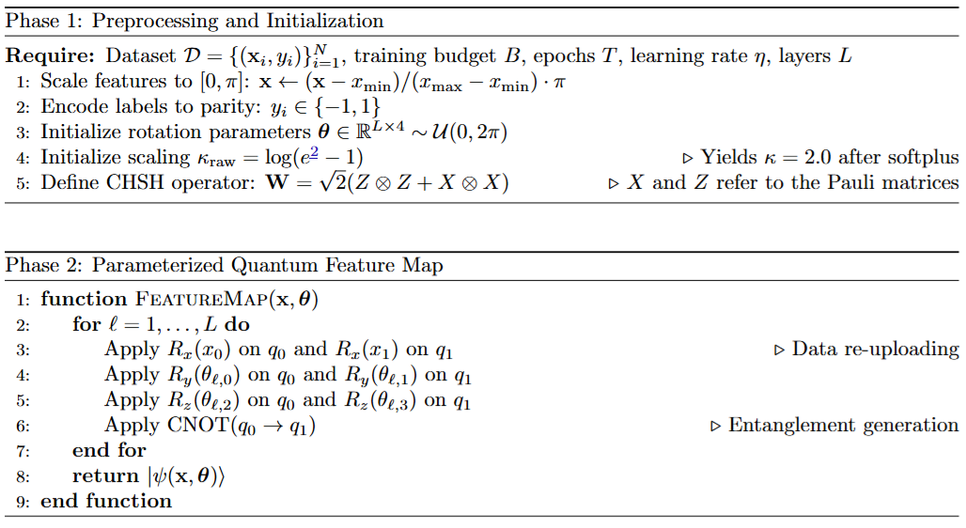
$C_{EI}$-Driven Quantum Kernel Optimization (CQKO) (1/3)

Slide 23
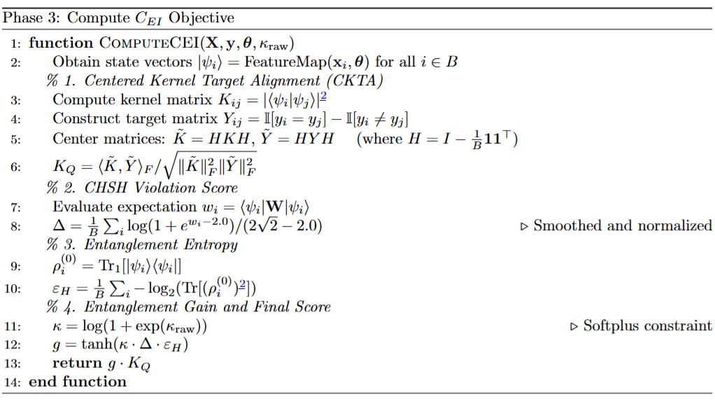
$C_{EI}$-Driven Quantum Kernel Optimization (CQKO) (2/3)

Slide 24
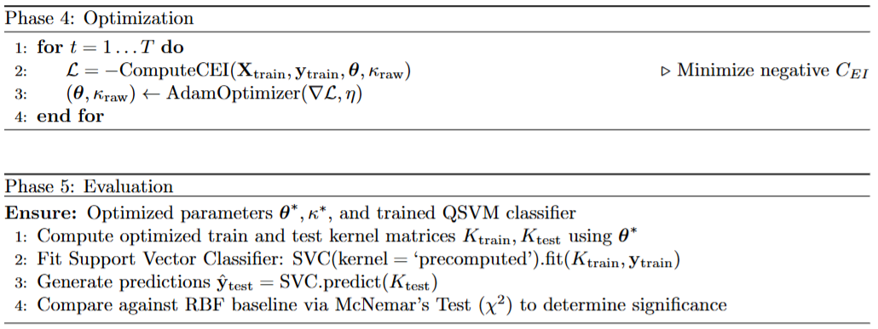
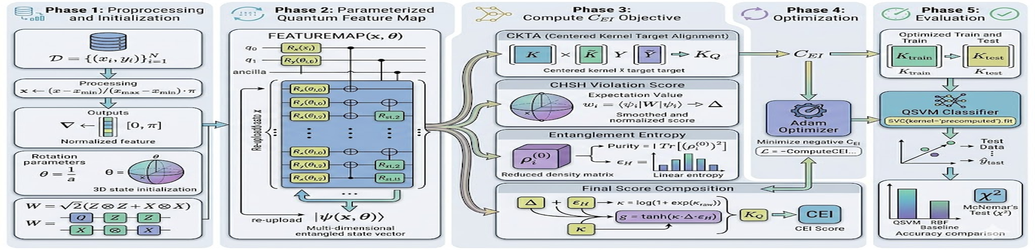
$C_{EI}$-Driven Quantum Kernel Optimization (CQKO) (3/3)

Slide 25
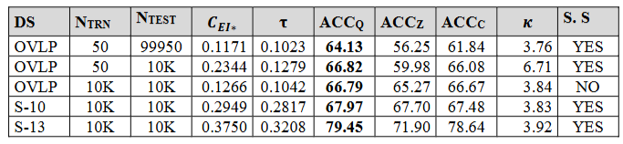
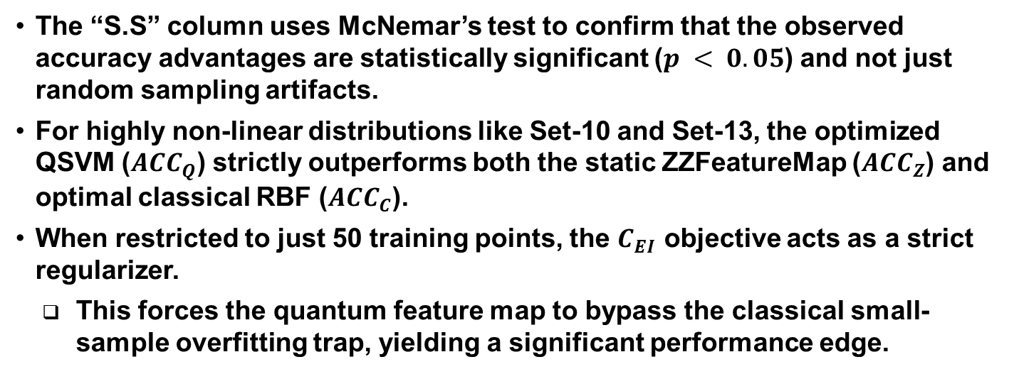
Result Analysis of CQKO
The “S.S” column uses McNemar’s test to confirm that the observed accuracy advantages are statistically significant ($p < 0.05$) and not just random sampling artifacts.
For highly non-linear distributions like Set-10 and Set-13, the optimized QSVM ($ACC_{Q}$) strictly outperforms both the static ZZFeatureMap ($ACC_{Z}$) and optimal classical RBF ($ACC_{C}$).
When restricted to just 50 training points, the $C_{EI}$ objective acts as a strict regularizer.
  This forces the quantum feature map to bypass the classical small-sample overfitting trap, yielding a significant performance edge.
Table 04. Comparative performance analysis of the CQKO-driven QSVM ($ACC_{Q}$) against a static QFM ($ACC_{Z}$) and an optimal classical RBF SVM ($ACC_{C}$).

Slide 26
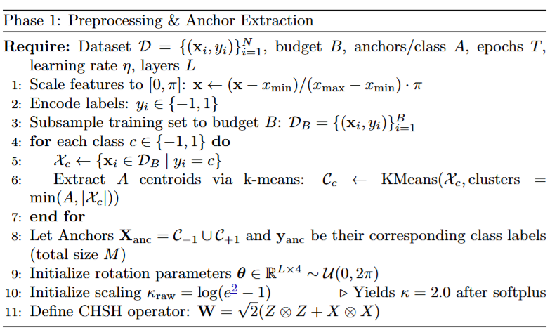
Anchor-Based Entanglement-Driven Classification (AB-EDC)

Slide 27
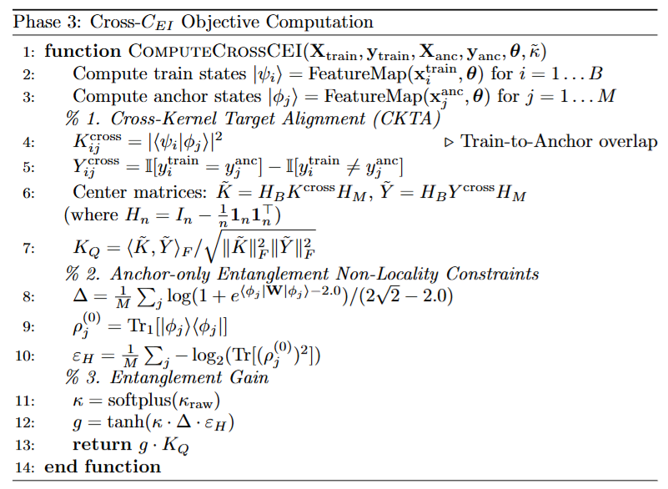
Anchor-Based Entanglement-Driven Classification (AB-EDC)

Slide 28
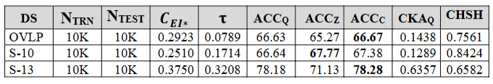
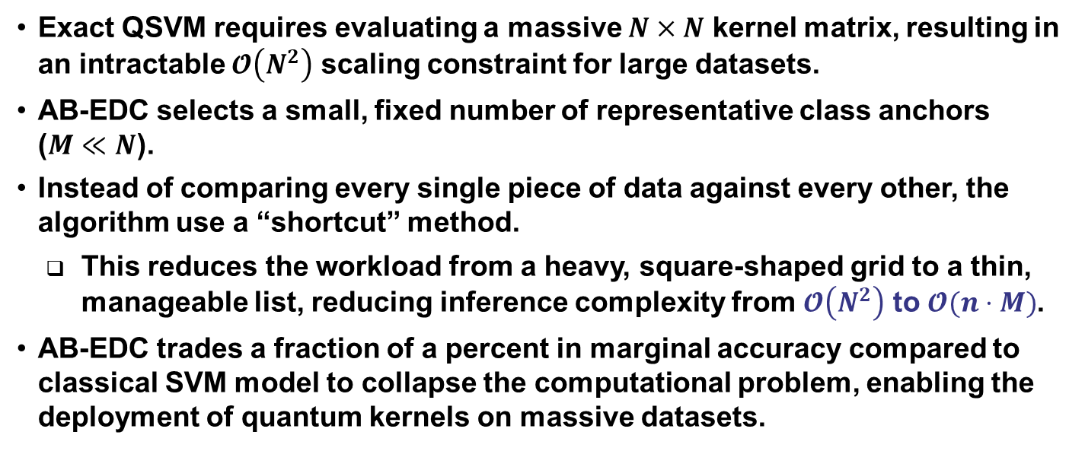
Result Analysis of AB-EDC
Exact QSVM requires evaluating a massive $N×N$ kernel matrix, resulting in an intractable $𝓞\left(N^{2}\right)$ scaling constraint for large datasets.
AB-EDC selects a small, fixed number of representative class anchors
($M≪N$).
Instead of comparing every single piece of data against every other, the algorithm use a “shortcut” method.
  This reduces the workload from a heavy, square-shaped grid to a thin, manageable list, reducing inference complexity from $𝓞\left(N^{2}\right)$ to $𝓞(n⋅M)$.
AB-EDC trades a fraction of a percent in marginal accuracy compared to classical SVM model to collapse the computational problem, enabling the deployment of quantum kernels on massive datasets.
Table 05. Comparative performance analysis of the AB-EDC-driven QSVM ($ACC_{Q}$) against a static QFM ($ACC_{Z}$) and an optimal classical RBF SVM ($ACC_{C}$).

Slide 29
Research Proposal (1/2)
Problem Statement: There is a critical need to precisely localize temporal seizure onsets from continuous EEG signals and accurately microsegment cancerous regions within gigapixel Whole Slide Images (WSIs).
Open-Source Datasets:
  EEG: TUSZ (TUH EEG Seizure Corpus).
  Digital Pathology: TUBR and FCBR corpora.
Current High-Level Architecture:
  Divide continuous EEG signals and DPATH images into discrete frames.
  Execute frame-level classification.
  Apply heuristic aggregator algorithms to compile frames into final temporal/spatial segmentations.
Baseline Limitations:
  EEG Performance: Severe false alarm rates due to the misclassification of benign rhythmic patterns as seizures. Baseline metrics yield a Sensitivity of 37.95%, and 3.92 False Alarms/24 hours.
  DPATH Performance: On TUBR, the baseline MDICE score is 51.10%, and on FCBR, the MDICE is 46.02%.

Slide 30
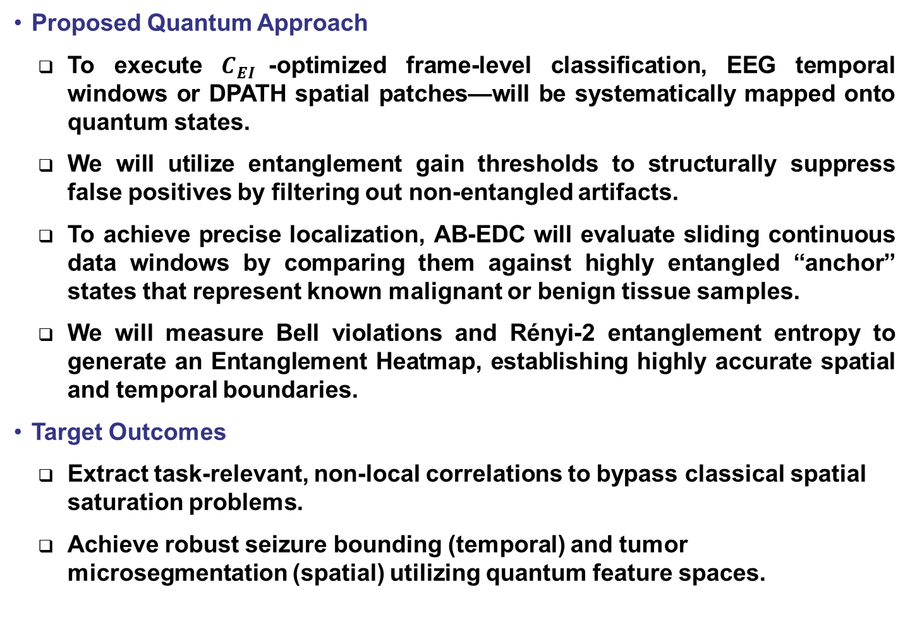
Research Proposal (1/2)
Proposed Quantum Approach
  To execute $C_{EI}$-optimized frame-level classification, EEG temporal windows or DPATH spatial patches—will be systematically mapped onto quantum states.
  We will utilize entanglement gain thresholds to structurally suppress false positives by filtering out non-entangled artifacts.
  To achieve precise localization, AB-EDC will evaluate sliding continuous data windows by comparing them against highly entangled “anchor” states that represent known malignant or benign tissue samples.
  We will measure Bell violations and Rényi-2 entanglement entropy to generate an Entanglement Heatmap, establishing highly accurate spatial and temporal boundaries.
Target Outcomes
  Extract task-relevant, non-local correlations to bypass classical spatial saturation problems.
  Achieve robust seizure bounding (temporal) and tumor microsegmentation (spatial) utilizing quantum feature spaces.

Slide 31

Research Plan (1/3)
May 15 - June 30:
  Complete data preparation and standardization for the frame-level extraction of the TUSZ Seizure Corpus and the DPATH (TUBR) breast cancer subsets.
  Establish classical capacity threshold for both datasets.
  Draft the journal publication detailing the proposed $C_{EI}$ framework.
July 01 - August 30:
  Execute the $C_{EI}$-Driven Quantum Kernel Optimization on the TUSZ and DPATH datasets.
  Tune the steepness hyperparameter ($κ$) to balance entanglement gain.
  Ensure that the theoretical $C_{EI}$ against quantum hardware noise simulation profiles.
September 01 - October 31:
  Evaluate the optimized QSVM on the test sets for frame-level classification.
  Analyze false positive reduction rates, specifically tracking model behavior against delta range slowing patterns in EEGs and benign tissue noise in pathology slides.
  Draft the journal publication detailing the proposed $C_{EI}$ driven kernel optimization algorithms.
November 01 - December 31:
  Implement the Anchor-Based EDC algorithm for localization tasks.
  Generate spatial Entanglement Heatmaps for the TUSZ.
  Diagnose and debug problems related to the TUSZ experiments.

Slide 32
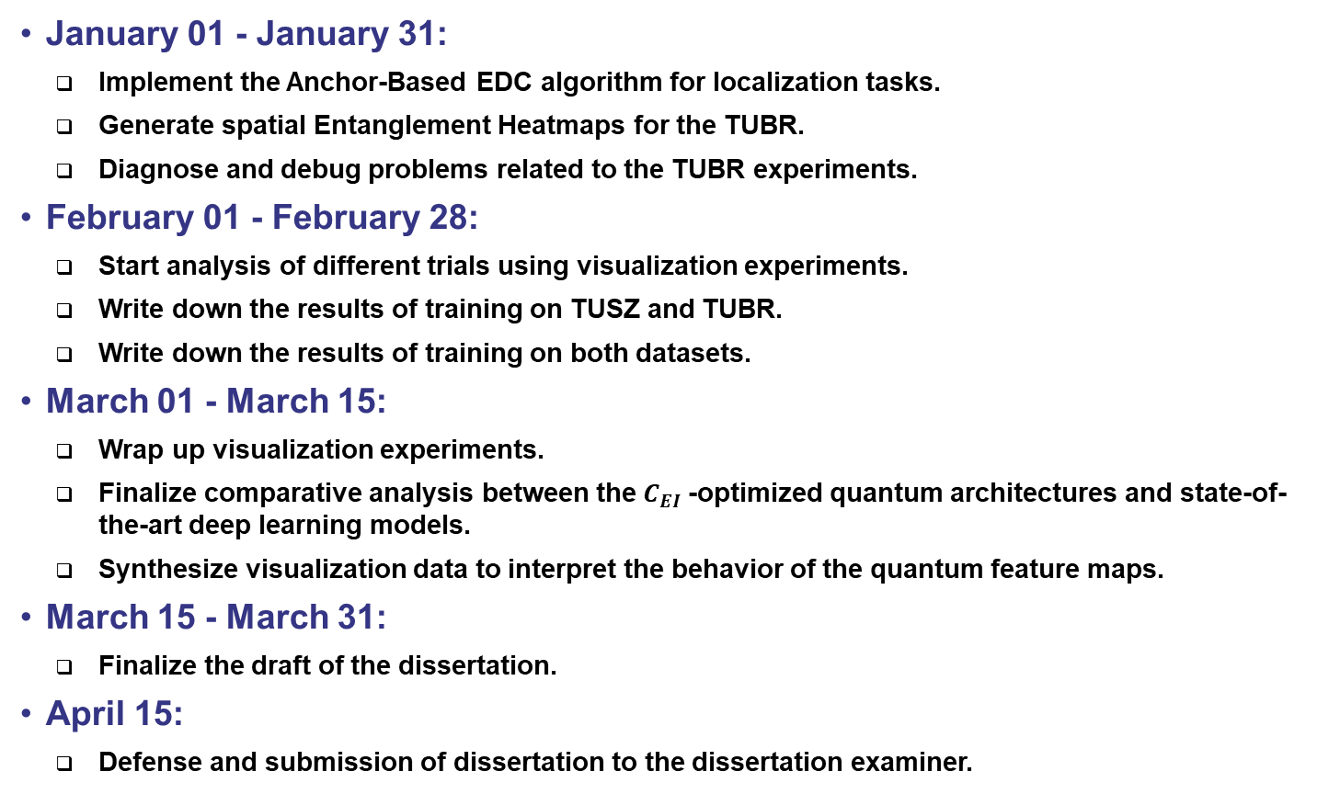
Research Plan (2/3)
January 01 - January 31:
  Implement the Anchor-Based EDC algorithm for localization tasks.
  Generate spatial Entanglement Heatmaps for the TUBR.
  Diagnose and debug problems related to the TUBR experiments.
February 01 - February 28:
  Start analysis of different trials using visualization experiments.
  Write down the results of training on TUSZ and TUBR.
  Write down the results of training on both datasets.
March 01 - March 15:
  Wrap up visualization experiments.
  Finalize comparative analysis between the $C_{EI}$-optimized quantum architectures and state-of-the-art deep learning models.
  Synthesize visualization data to interpret the behavior of the quantum feature maps.
March 15 - March 31:
  Finalize the draft of the dissertation.
April 15:
  Defense and submission of dissertation to the dissertation examiner.

Slide 33
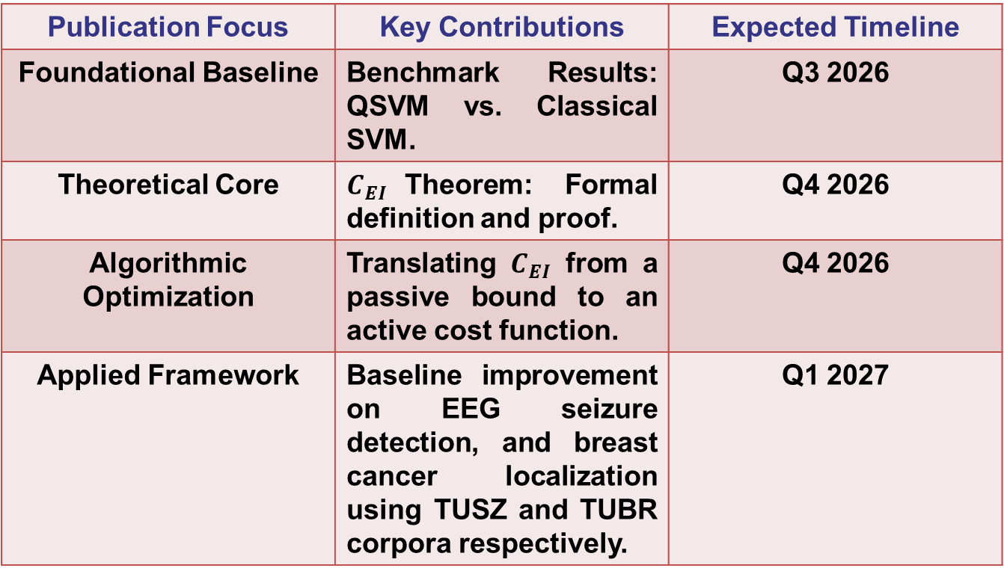
Research Plan (3/3)
Publication Focus | Key Contributions | Expected Timeline
Foundational Baseline | Benchmark Results: QSVM vs. Classical SVM. | Q3 2026
Theoretical Core | $C_{EI}$Theorem: Formal definition and proof. | Q4 2026
Algorithmic Optimization | Translating $C_{EI}$ from a passive bound to an active cost function. | Q4 2026
Applied Framework | Baseline improvement on EEG seizure detection, and breast cancer localization using TUSZ and TUBR corpora respectively. | Q1 2027

Slide 34
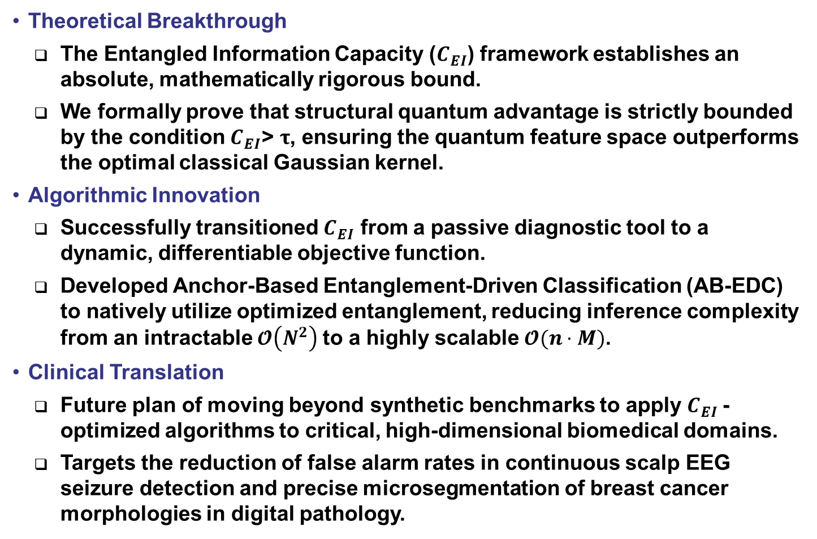
Conclusion
Theoretical Breakthrough
  The Entangled Information Capacity ($C_{EI}$) framework establishes an absolute, mathematically rigorous bound.
  We formally prove that structural quantum advantage is strictly bounded by the condition $C_{EI}\text{> }τ$, ensuring the quantum feature space outperforms the optimal classical Gaussian kernel.
Algorithmic Innovation
  Successfully transitioned $C_{EI}$ from a passive diagnostic tool to a dynamic, differentiable objective function.
  Developed Anchor-Based Entanglement-Driven Classification (AB-EDC) to natively utilize optimized entanglement, reducing inference complexity from an intractable $𝓞\left(N^{2}\right)$to a highly scalable $𝓞(n⋅M)$.
Clinical Translation
  Future plan of moving beyond synthetic benchmarks to apply $C_{EI}$-optimized algorithms to critical, high-dimensional biomedical domains.
  Targets the reduction of false alarm rates in continuous scalp EEG seizure detection and precise microsegmentation of breast cancer morphologies in digital pathology.

Slide 35
Acknowledgement
Image Credits. Generative AI (Google Gemini) was utilized to create the visual representations shown in Slide 8 and Slide 23.

Slide 36
References (1/3)
[1] M. A. Nielsen and I. L. Chuang, Quantum Computation and Quantum Information: 10th Anniversary Edition. Cambridge University Press, 2010.
[2] C. Cortes and V. Vapnik, “Support-vector networks,” Machine Learning, vol. 20, no. 3, pp. 273–297, 1995, doi: 10.1007/BF00994018.
[3] J. S. Bell, “On the Einstein Podolsky Rosen paradox,” Physics Physique Fizika, vol. 1, no. 3, pp. 195–200, Nov. 1964, doi: 10.1103/PhysicsPhysiqueFizika.1.195.
[4] J. F. Clauser, M. A. Horne, A. Shimony, and R. A. Holt, “Proposed Experiment to Test Local Hidden-Variable Theories,” Phys. Rev. Lett., vol. 23, no. 15, pp. 880–884, Oct. 1969, doi: 10.1103/PhysRevLett.23.880.
[5] M. Schuld, R. Sweke, and J. J. Meyer, “Effect of data encoding on the expressive power of variational quantum-machine-learning models,” Phys. Rev. A, vol. 103, no. 3, p. 032430, Mar. 2021, doi: 10.1103/PhysRevA.103.032430.
[6] J. Kübler, S. Buchholz, and B. Schölkopf, “The Inductive Bias of Quantum Kernels,” in Advances in Neural Information Processing Systems, Curran Associates, Inc., 2021, pp. 12661–12673. Accessed: Mar. 30, 2026. [Online]. Available: https://proceedings.neurips.cc/paper/2021/hash/69adc1e107f7f7d035d7baf04342e1ca-Abstract.html
[7] A. Abbas, D. Sutter, C. Zoufal, A. Lucchi, A. Figalli, and S. Woerner, “The power of quantum neural networks,” Nat Comput Sci, vol. 1, no. 6, pp. 403–409, Jun. 2021, doi: 10.1038/s43588-021-00084-1.
[8] H.-Y. Huang et al., “Power of data in quantum machine learning,” Nat Commun, vol. 12, no. 1, p. 2631, May 2021, doi: 10.1038/s41467-021-22539-9.
[9] C. Ortiz Marrero, M. Kieferová, and N. Wiebe, “Entanglement-Induced Barren Plateaus,” PRX Quantum, vol. 2, no. 4, p. 040316, Oct. 2021, doi: 10.1103/PRXQuantum.2.040316.

Slide 37
References (2/3)
[10] V. Havlíček et al., “Supervised learning with quantum-enhanced feature spaces,” Nature, vol. 567, no. 7747, pp. 209–212, Mar. 2019, doi: 10.1038/s41586-019-0980-2.
[11] C. Cortes, M. Mohri, and A. Rostamizadeh, “Algorithms for learning kernels based on centered alignment,” J. Mach. Learn. Res., vol. 13, no. 1, pp. 795–828, Mar. 2012.
[12] B. Schölkopf and A. J. Smola, Learning with Kernels: Support Vector Machines, Regularization, Optimization, and Beyond. Accessed: Mar. 31, 2026. [Online]. Available: https://direct.mit.edu/books/monograph/1821/Learning-with-KernelsSupport-Vector-Machines
[13] C. A. Micchelli, Y. Xu, and H. Zhang, “Universal Kernels,” J. Mach. Learn. Res., vol. 7, pp. 2651–2667, Dec. 2006.
[14] B. S. Cirel’son, “Quantum generalizations of Bell’s inequality,” Lett Math Phys, vol. 4, no. 2, pp. 93–100, Mar. 1980, doi: 10.1007/BF00417500.
[15] C. Cortes, M. Mohri, and A. Rostamizadeh, “Generalization bounds for learning kernels,” in Proceedings of the 27th International Conference on International Conference on Machine Learning, in ICML’10. Madison, WI, USA: Omnipress, 2010, pp. 247–254.
[16] O. M. William Wolberg, “Breast Cancer Wisconsin (Diagnostic).” UCI Machine Learning Repository, 1993. doi: 10.24432/C5DW2B.
[17] Y. LeCun, C. Cortes, and Burges, “MNIST Database of Handwritten Digits.” UCI Machine Learning Repository, 1998. doi: 10.24432/C53K8Q.
[18] J. Picone, “set-10.” Accessed: Feb. 20, 2023. [Online]. Available: https://portal.gdc.cancer.gov/
[19] J. Picone, “set-13.” Accessed: Apr. 03, 2026. [Online]. Available: https://isip.piconepress.com/courses/temple/ece_8527/resources/data/set_13/
[20] “Data encoding,” IBM Quantum Learning. Accessed: Apr. 01, 2026. [Online]. Available: https://quantum.cloud.ibm.com/learning/en/courses/quantum-machine-learning/quantum.cloud.ibm.com/learning/en/courses/quantum-machine-learning/data-encoding

Slide 38
References (3/3)
[21] A. Pérez-Salinas, A. Cervera-Lierta, E. Gil-Fuster, and J. I. Latorre, “Data re-uploading for a universal quantum classifier,” Quantum, vol. 4, p. 226, Feb. 2020, doi: 10.22331/q-2020-02-06-226.
[22] “McNemar’s test,” Wikipedia. Oct. 25, 2025. Accessed: Apr. 02, 2026. [Online]. Available: https://en.wikipedia.org/w/index.php?title=McNemar%27s_test&oldid=1318721869
[23] I. Obeid and J. Picone, “The Temple University Hospital EEG Data Corpus,” in Augmentation of Brain Function: Facts, Fiction and Controversy. Volume I: Brain-Machine Interfaces, 1st ed., vol. 10, M. A. Lebedev, Ed., Lausanne, Switzerland: Frontiers Media S.A., 2016, pp. 394–398. doi: 10.3389/fnins.2016.00196.
[24] D. Hackel et al., “Enabling Microsegmentation: Digital Pathology Corpora for Advanced Model Development,” in Signal Processing in Medicine and Biology: Applications of Artificial Intelligence in Medicine and Biology, vol. 1, New York City, New York, USA: Springer, 2026, p. 50. [Online]. Available: https://isip.piconepress.com/publications/book_sections/2026/springer/dpath/
[25] M. Bagritsevich and D. Hackel, “Special Cases in the Temple University Hospital Digital Pathology Corpus: Breast Tissue Subset,” in NEDC Special Seminar, Temple University, Philadelphia, Pennsylvania, USA, Sep. 2024, pp. 1–15. url: https://isip.piconepress.com/publications/presentations_misc/2024/nedc/dpath/.
[26] M. Bagritsevich, D. Hackel, I. Obeid, and J. Picone, “Annotation of the Fox Chase Cancer Center Digital Pathology Corpus,” in Proceedings of the IEEE Signal Processing in Medicine and Biology Symposium, Philadelphia, Pennsylvania, USA: IEEE, Dec. 2024, pp. 1–4. doi: 10.1109/SPMB62441.2024.10842255.
[27] A. Einstein, B. Podolsky, and N. Rosen, “Can Quantum-Mechanical Description of Physical Reality Be Considered Complete?,” Phys. Rev., vol. 47, no. 10, pp. 777–780, May 1935, doi: 10.1103/PhysRev.47.777.

Slide 39
Thank You!

Slide 40
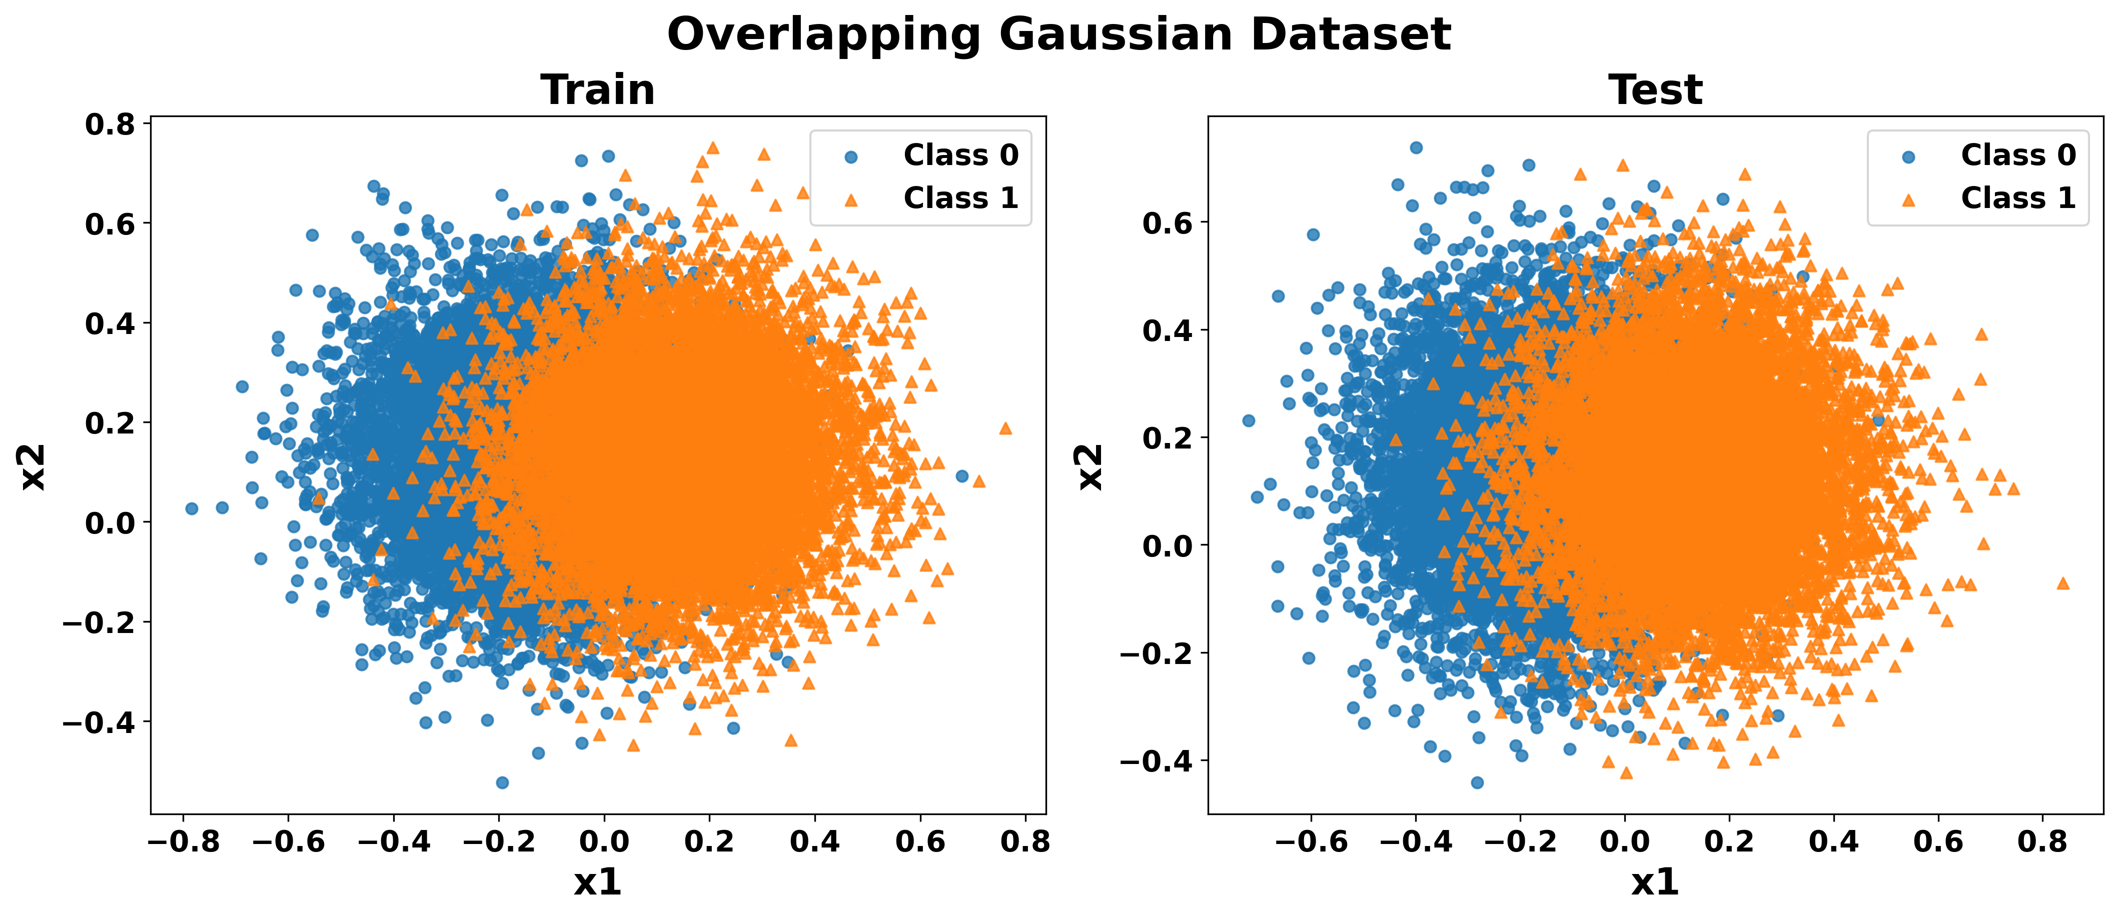
Motivation (1/3)
Extensive Benchmarking: Evaluated Quantum Support Vector Machines (QSVM) against Classical SVMs across multiple datasets.
Cross-Distribution Testing: Models trained on Gaussian data were evaluated on diverse test distributions (e.g., blobs, circles, moons) to measure true generalization.
The Core Bottleneck: Relying on heuristic trial-and-error for quantum feature maps is unsustainable; a mathematical metric is required to prove a genuine quantum advantage.

Slide 41
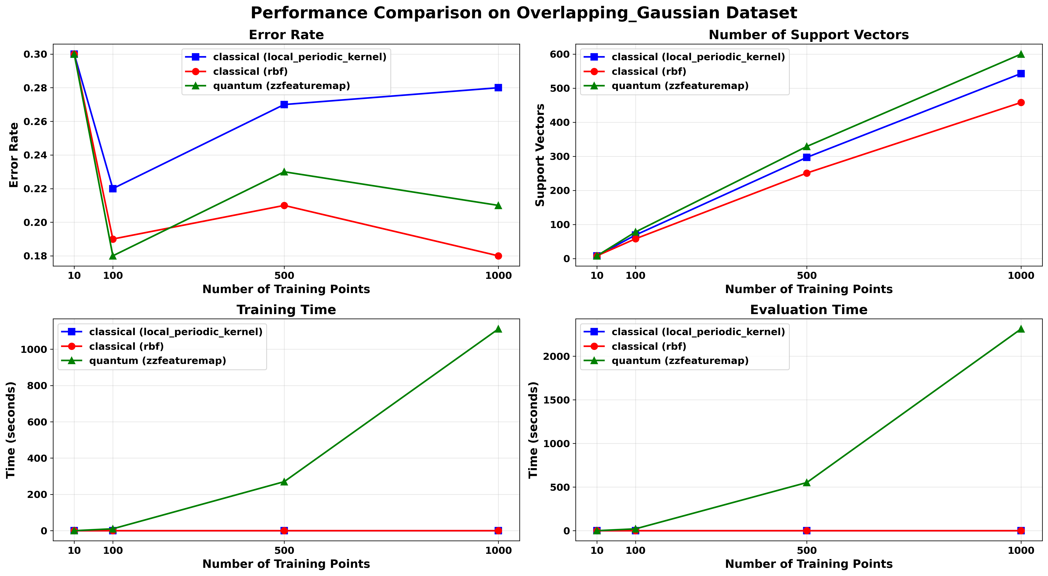
Motivation (2/3)

Slide 42
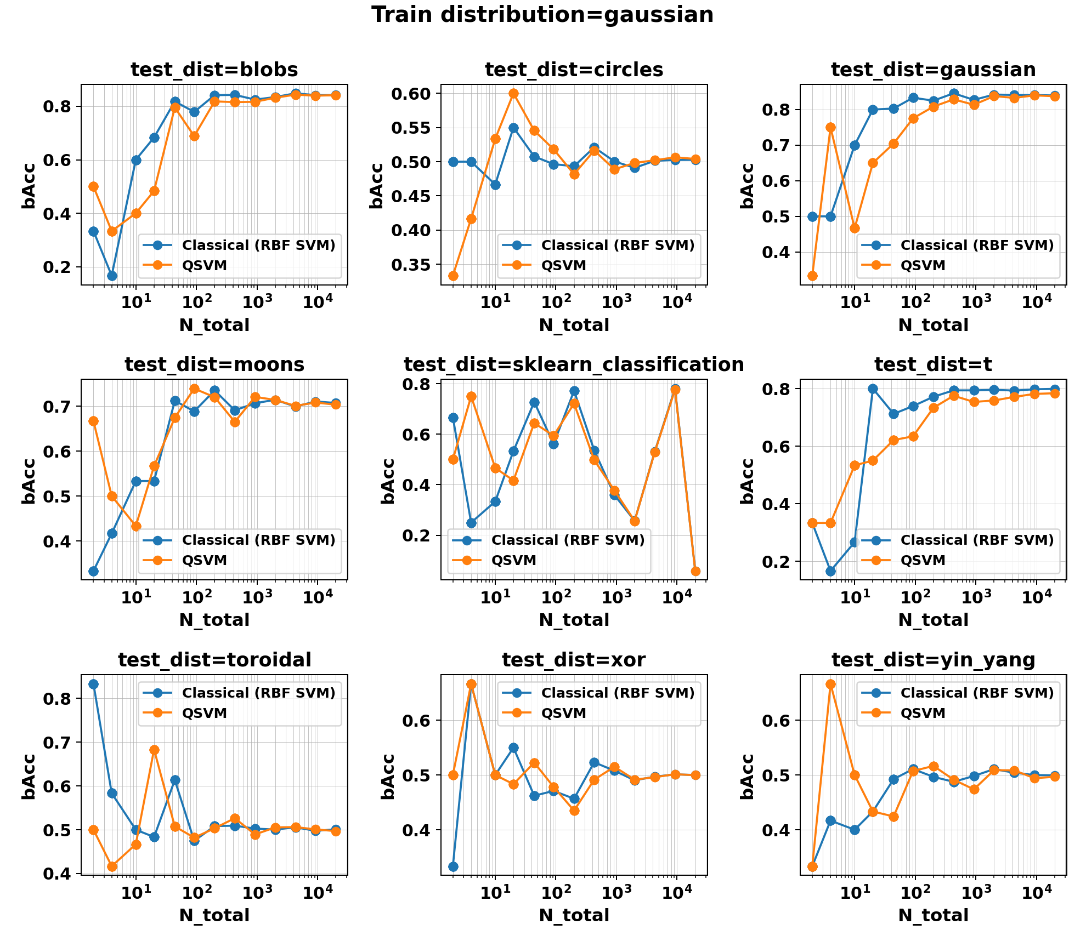
Motivation (3/3)
bAcc stands for balanced-accuracy; higher is better.

Slide 43
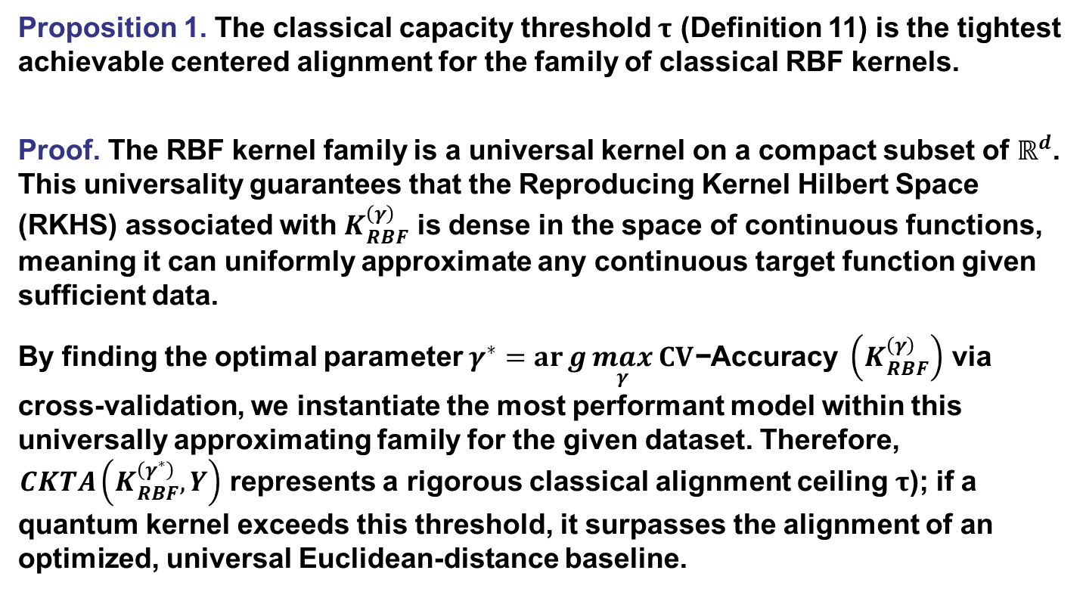
Proof of Theorem 1 (1/6)
Proposition 1. The classical capacity threshold $τ$ (Definition 11) is the tightest achievable centered alignment for the family of classical RBF kernels.
Proof. The RBF kernel family is a universal kernel on a compact subset of $ℝ^{d}$. This universality guarantees that the Reproducing Kernel Hilbert Space (RKHS) associated with $K_{RBF}^{\left(γ\right)}$ is dense in the space of continuous functions, meaning it can uniformly approximate any continuous target function given sufficient data.
By finding the optimal parameter $γ^{∗}=arg{\max_{γ}} CV\text{−}\text{Accuracy} \left(K_{RBF}^{\left(γ\right)}\right)$ via cross-validation, we instantiate the most performant model within this universally approximating family for the given dataset. Therefore, $CKTA\left(K_{RBF}^{\left(γ^{∗}\right)},Y\right)$ represents a rigorous classical alignment ceiling $τ$); if a quantum kernel exceeds this threshold, it surpasses the alignment of an optimized, universal Euclidean-distance baseline.

Slide 44
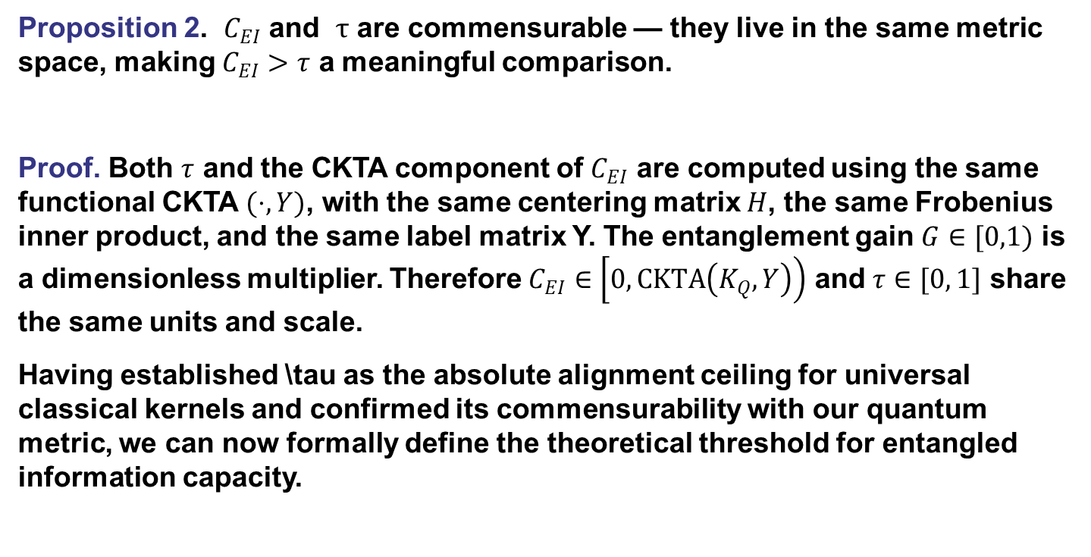
Proof of Theorem 1 (2/6)
Proposition 2. $C_{EI}$ and $τ$ are commensurable — they live in the same metric space, making $C_{EI}>τ$ a meaningful comparison.
Proof. Both $τ$ and the CKTA component of $C_{EI}$ are computed using the same functional CKTA $(⋅,Y)$, with the same centering matrix $H$, the same Frobenius inner product, and the same label matrix Y. The entanglement gain $G∈[0,1)$ is a dimensionless multiplier. Therefore $C_{EI}∈\left[0,CKTA\left(K_{Q},Y\right)\right)$ and $τ∈[0, 1]$ share the same units and scale.
Having established \tau as the absolute alignment ceiling for universal classical kernels and confirmed its commensurability with our quantum metric, we can now formally define the theoretical threshold for entangled information capacity.

Slide 45
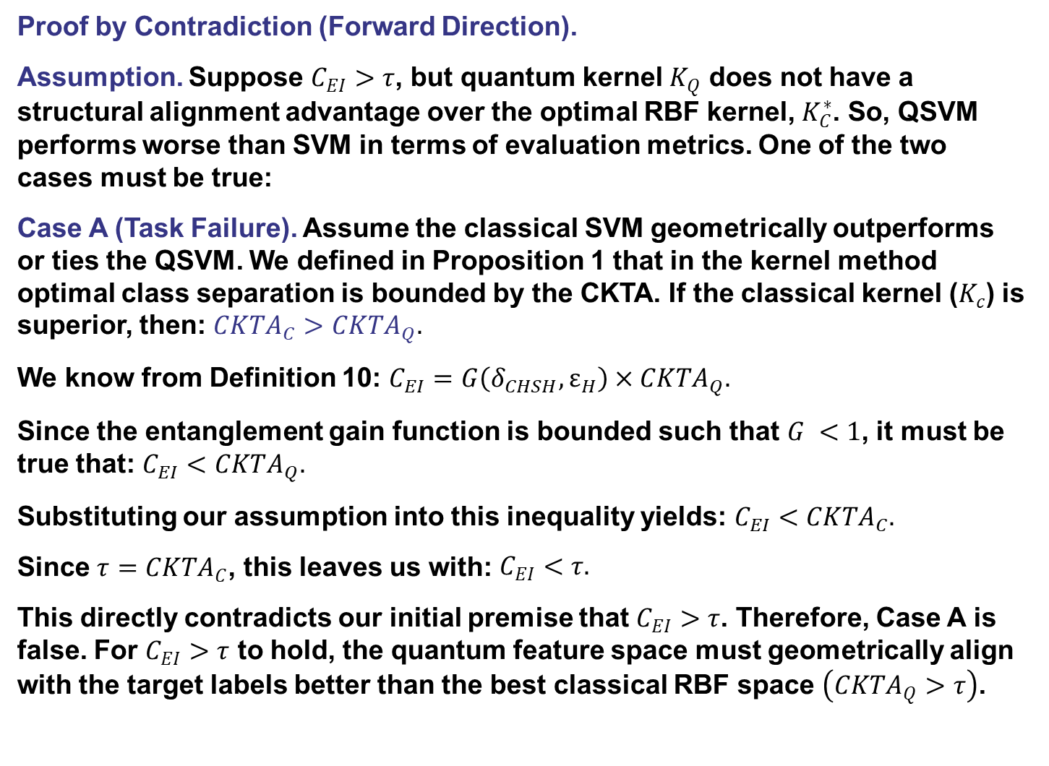
Proof of Theorem 1 (3/6)
Proof by Contradiction (Forward Direction).
Assumption. Suppose $C_{EI}>τ$, but quantum kernel $K_{Q}$ does not have a structural alignment advantage over the optimal RBF kernel, $K_{C}^{∗}$. So, QSVM performs worse than SVM in terms of evaluation metrics. One of the two cases must be true:
Case A (Task Failure). Assume the classical SVM geometrically outperforms or ties the QSVM. We defined in Proposition 1 that in the kernel method optimal class separation is bounded by the CKTA. If the classical kernel ($K_{c}$) is superior, then: $CKTA_{C}>CKTA_{Q}.$
We know from Definition 10: $C_{EI}=G\left(δ_{CHSH},ε_{H}\right)×CKTA_{Q}.$
Since the entanglement gain function is bounded such that $G <1$, it must be true that: $C_{EI}<CKTA_{Q}.$
Substituting our assumption into this inequality yields: $C_{EI}<CKTA_{C}.$
Since $τ=CKTA_{C}$, this leaves us with: $\begin{aligned}C_{EI}<τ. \end{aligned}$
This directly contradicts our initial premise that $C_{EI}>τ$. Therefore, Case A is false. For $C_{EI}>τ$ to hold, the quantum feature space must geometrically align with the target labels better than the best classical RBF space $\left(CKTA_{Q}>τ\right)$.

Slide 46
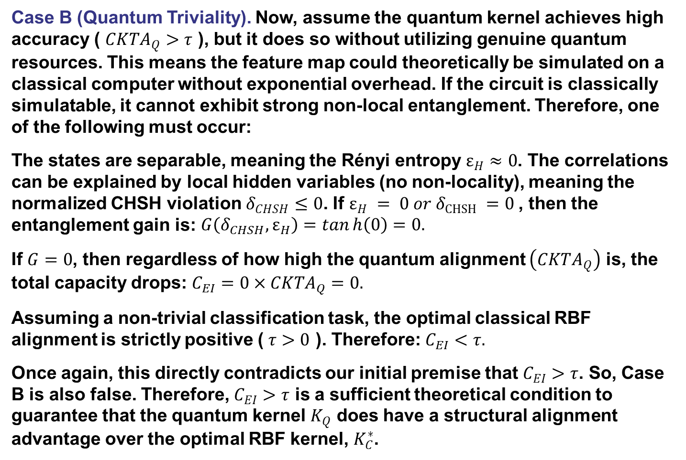
Proof of Theorem 1 (4/6)
Case B (Quantum Triviality). Now, assume the quantum kernel achieves high accuracy ( $CKTA_{Q}>τ$ ), but it does so without utilizing genuine quantum resources. This means the feature map could theoretically be simulated on a classical computer without exponential overhead. If the circuit is classically simulatable, it cannot exhibit strong non-local entanglement. Therefore, one of the following must occur:
The states are separable, meaning the Rényi entropy $ε_{H}≈0$. The correlations can be explained by local hidden variables (no non-locality), meaning the normalized CHSH violation $δ_{CHSH}≤0$. If $ε_{H} = 0 or δ_{CHSH} =0$, then the entanglement gain is: $\begin{aligned}G\left(δ_{CHSH},ε_{H}\right)=tanh\left(0\right)=0. \end{aligned}$
If $G=0$, then regardless of how high the quantum alignment $\left(CKTA_{Q}\right)$ is, the total capacity drops: $C_{EI}=0×CKTA_{Q}=0.$
Assuming a non-trivial classification task, the optimal classical RBF alignment is strictly positive ( $τ>0$ ). Therefore: $C_{EI}<τ.$
Once again, this directly contradicts our initial premise that $C_{EI}>τ$. So, Case B is also false. Therefore, $C_{EI}>τ$ is a sufficient theoretical condition to guarantee that the quantum kernel $K_{Q}$ does have a structural alignment advantage over the optimal RBF kernel, $K_{C}^{∗}$.

Slide 47
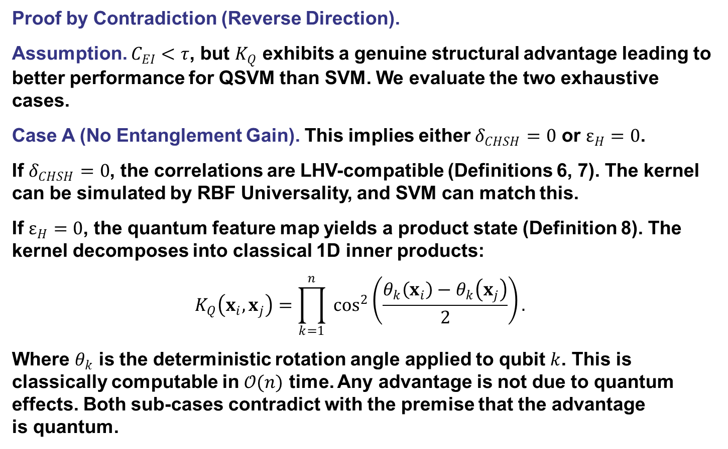
Proof of Theorem 1 (5/6)
Proof by Contradiction (Reverse Direction).
Assumption. $C_{EI}<τ$, but $K_{Q}$ exhibits a genuine structural advantage leading to better performance for QSVM than SVM. We evaluate the two exhaustive cases.
Case A (No Entanglement Gain). This implies either $δ_{CHSH}=0$ or $ε_{H}=0$.
If $δ_{CHSH}=0$, the correlations are LHV-compatible (Definitions 6, 7). The kernel can be simulated by RBF Universality, and SVM can match this.
If $ε_{H}=0$, the quantum feature map yields a product state (Definition 8). The kernel decomposes into classical 1D inner products:
$$\begin{aligned}K_{Q}\left(x_{i},x_{j}\right)=\prod_{k=1}^{n}{ }\cos^{2}\left(\frac{θ_{k}\left(x_{i}\right)−θ_{k}\left(x_{j}\right)}{2}\right). \end{aligned}$$
Where $θ_{k}$ is the deterministic rotation angle applied to qubit $k$. This is classically computable in $𝒪(n)$ time. Any advantage is not due to quantum effects. Both sub-cases contradict with the premise that the advantage is quantum.

Slide 48
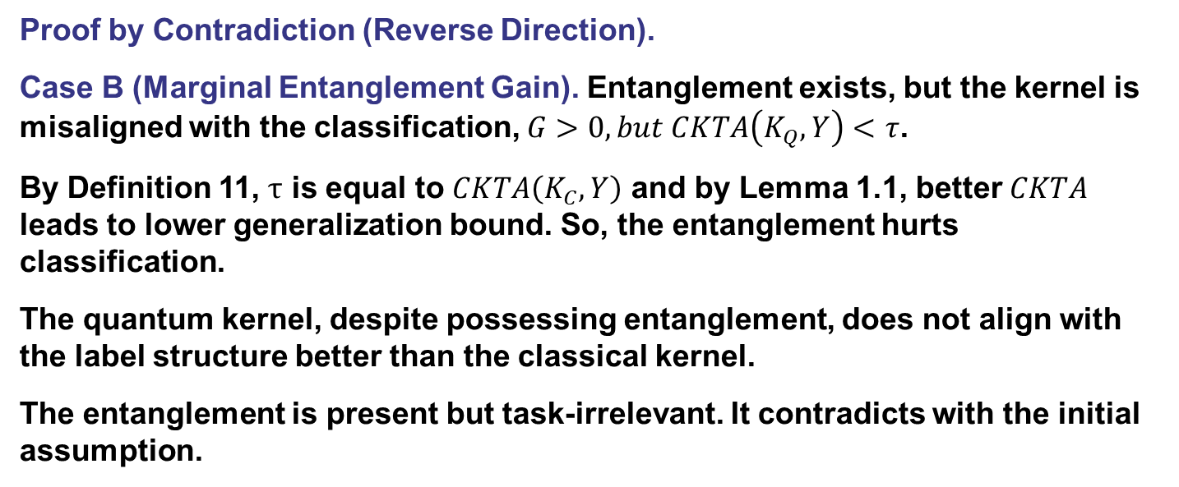
Proof of Theorem 1 (6/6)
Proof by Contradiction (Reverse Direction).
Case B (Marginal Entanglement Gain). Entanglement exists, but the kernel is misaligned with the classification, $G>0,but CKTA\left(K_{Q},Y\right)<$ $τ$.
By Definition 11, $τ$ is equal to $CKTA\left(K_{C},Y\right)$ and by Lemma 1.1, better $CKTA$ leads to lower generalization bound. So, the entanglement hurts classification.
The quantum kernel, despite possessing entanglement, does not align with the label structure better than the classical kernel.
The entanglement is present but task-irrelevant. It contradicts with the initial assumption.

Slide 49
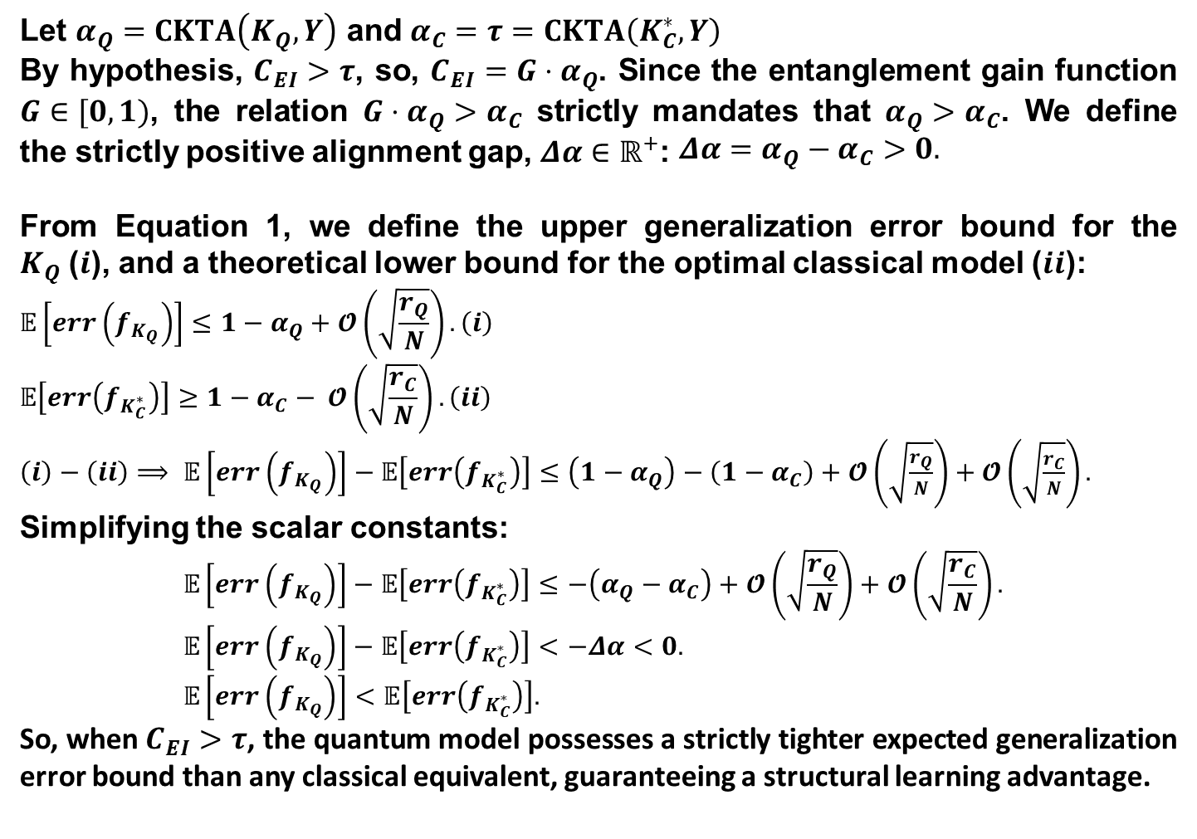

Proof of Lemma 1.1
Let $α_{Q}=CKTA\left(K_{Q},Y\right)$ and $α_{C}=τ=CKTA\left(K_{C}^{∗},Y\right)$
By hypothesis, $C_{EI}>τ$, so, $C_{EI}=G⋅α_{Q}$. Since the entanglement gain function $G∈[0,1)$, the relation $G⋅α_{Q}>α_{C}$ strictly mandates that $α_{Q}>α_{C}$. We define the strictly positive alignment gap, $Δα∈ℝ^{+}$: $\begin{aligned}Δα=α_{Q}−α_{C}>0. \end{aligned}$
From Equation 1, we define the upper generalization error bound for the $K_{Q}$($i$), and a theoretical lower bound for the optimal classical model ($ii$):
$$\begin{aligned}𝔼\left[err\left(f_{K_{Q}}\right)\right]≤1−α_{Q}+𝓞\left(\sqrt{\frac{r_{Q}}{N}}\right).\#\left(i\right)\end{aligned}$$
$$\begin{aligned}𝔼\left[err\left(f_{K_{C}^{∗}}\right)\right]≥1−α_{C}− 𝓞\left(\sqrt{\frac{r_{C}}{N}}\right). \#\left(ii\right)\end{aligned}$$
$\left(i\right)−\left(ii\right)$ $⟹ \begin{aligned}𝔼\left[err\left(f_{K_{Q}}\right)\right]−𝔼\left[err\left(f_{K_{C}^{∗}}\right)\right]≤\left(1−α_{Q}\right)−\left(1−α_{C}\right)+𝓞\left(\sqrt{\frac{r_{Q}}{N}}\right)+𝓞\left(\sqrt{\frac{r_{C}}{N}}\right).\end{aligned}$
Simplifying the scalar constants:
$$𝔼\left[err\left(f_{K_{Q}}\right)\right]−𝔼\left[err\left(f_{K_{C}^{∗}}\right)\right]≤−\left(α_{Q}−α_{C}\right)+𝓞\left(\sqrt{\frac{r_{Q}}{N}}\right)+𝓞\left(\sqrt{\frac{r_{C}}{N}}\right).$$
$$𝔼\left[err\left(f_{K_{Q}}\right)\right]−𝔼\left[err\left(f_{K_{C}^{∗}}\right)\right]<−Δα<0.$$
$$𝔼\left[err\left(f_{K_{Q}}\right)\right]<𝔼\left[err\left(f_{K_{C}^{∗}}\right)\right].$$
So, when $C_{EI}>τ$, the quantum model possesses a strictly tighter expected generalization error bound than any classical equivalent, guaranteeing a structural learning advantage.
$$≅0$$

Slide 50
Difference From Existing Research (1/2)
The Landscape of Existing Research
  Expressivity vs. Trainability: Schuld et al. (2021) established that parameterized quantum circuits operate as highly expressive multidimensional Fourier series. Kubler et al. (2021) demonstrated this expressivity only yields an advantage when governed by a strict inductive bias; otherwise, it projects data into unlearnable noise.
  The Power of Data: Huang et al. (2021) established the Geometric Difference to rigorously bound prediction error based on the spatial separation between quantum and classical kernel matrices.
Limitations
  Relative Baselines: Works like Huang et al. (2021) rely on relative geometric baselines, comparing quantum algorithms against classical ones rather than absolute limits.
  State Agnosticism: Existing metrics evaluate kernel matrices while ignoring the physical quantum state, allowing unentangled product states to be mistakenly identified as classically intractable.
  The Barren Plateau Trap: Without strict inductive biases, unstructured multi-qubit entanglement collapses the gradient landscape, halting optimization entirely.

Slide 51

Difference From Existing Research (2/2)
Novel Contributions
  Absolute Bounds: Introduces the Entangled Information Capacity ($C_{EI}$) framework to replace relative geometric baselines with an absolute information-theoretic limit.
  Unifying Geometry and Physics: Mathematically binds geometric alignment (Centered Kernel Target Alignment) with physical quantum non-locality (CHSH violations and Rényi-2 entanglement entropy).
  A Provable Threshold: Formally proves that a structural quantum advantage is strictly bounded by the condition $C_{EI}\text{> }τ$, where $τ$ is the classical Gaussian kernel's capacity threshold.
  Trainable Objective: Transitions $C_{EI}$ from a passive diagnostic tool into a differentiable objective function, enabling algorithms to dynamically train quantum circuits to maximize both class separation and global entanglement.
  Mitigating Barren Plateaus: Demonstrates that utilizing a tunable heuristic scaling parameter ($κ$) within the objective function dynamically shapes the gradient landscape, providing a mechanism to pull the model out of barren plateaus.

