Slide 1
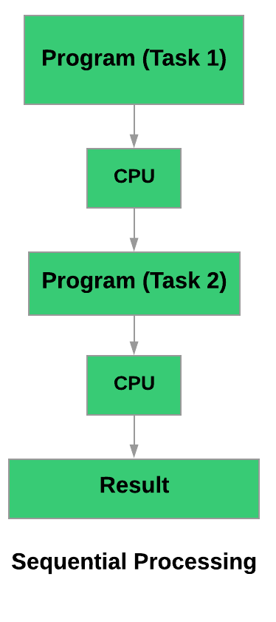
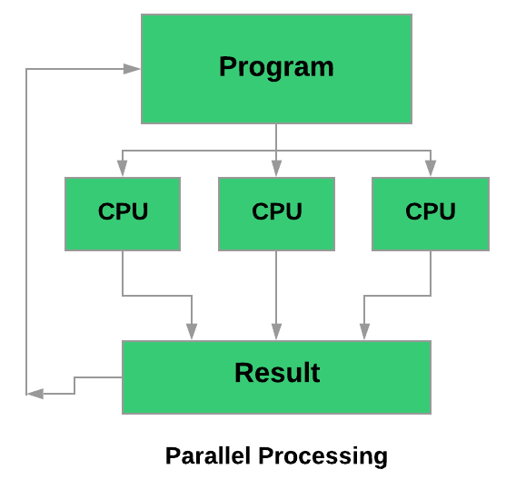
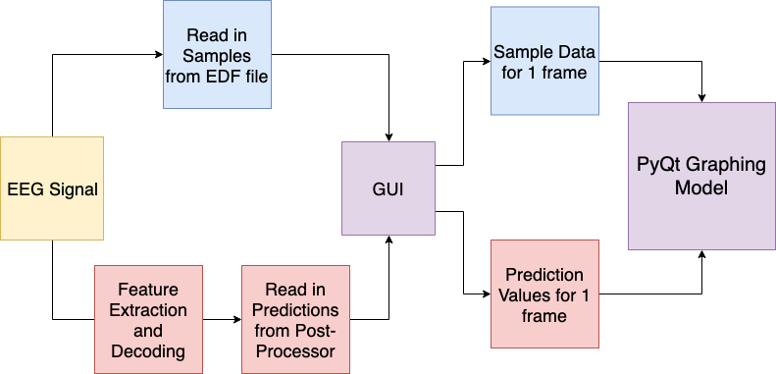
Real-Time Visualization Demo for EEG Analysis
N. Shawki, T. Elseify, M.Miranda, T. Cap, I. Obeid and J. Picone
The Neural Engineering Data Consortium, Temple University
College of Engineering
Temple University
www.nedcdata.org
Abstract
An electroencephalogram (EEG) is a test that detects the electrical activity found in the brain using electrodes placed onto the scalp.
A visualization tool in development to allow users to view EEG signals constantly updating while a file is read. Alongside the constant updating signal the tool would also include predictions and create a file of the full EEG signal.
The tool takes on a multiprocessing parallel processor approach to reduce the delay in the system.
The tool is currently balancing the specifics for sensitivity and specificity to lower the false alarm rate.
This visualization tool is written in PyQt, which allows for Graphical User Interface programming that is supported across multiple platforms. Currently, our window consists of 15 frames all at one second totaling up to 15 seconds per window.
Benefits of a Real-Time model
The amount of data surrounding EEG studies are both beneficial and a slight inconvenience for medical professionals.
Manually scanning and interpreting EEGs is time-consuming and can require hours to days for accurate results. Alongside the time cost, it is also an expensive task since it requires highly trained medical professionals.
Real-time streaming EEG data allows the practitioner to be more efficient by looking at the data and determining if there are seizure-like activities.
The predictions also allow the user to have more directed attention to the areas of the EEG data that have a higher confidence level for seizures and spend less time parsing through artifact and non-seizure activity.
Overall this model is a combination of brain monitoring and automatic EEG analysis that can provide the clinics a decision support tool used to speed up diagnosis and help in intensive care units.
Multiprocessing
A real-time system requires heavy computation meaning sequential processing slows the overall process down and causes delays in the model.
One way to overcome this was by using the multiprocessing method. This allows us to have access to different parts of the CPU and have different paths of memory that are not directly connected.
The library we are using is the standard Multiprocessing module most commonly used for efficient parallel processing.
This reduces the time delay and syncs both streams of data so they both output 1 second of data.
Future Work
Currently, the software is in development and is being tested on single channel signals.
It will also focus on visuals such as saving a fully updated graph after completely running through the first stream of data.
Future work will consist of plotting multichannel data with proper labels and confidence from the postprocessor.
It will also consist of a slow-motion option allowing the technicians more time to look at the signals and fully evaluate the target area.
It will also include a fully optimized parallel processing where one process can generate one second of sample data paired with a frame worth of accurate prediction values.
Clinical EEG Data
EEG signals are stored as sampled data signals in an EDF format. They are typically sampled at 250 Hz.
A montage is used to redefine channels as the difference of channel voltages. This kind of differential analysis reduces noise. This is done prior to the data stream entering our model for simplicity.
Overview of the Visualization Software
The signal viewer loads EEG signals in a European Data Format (EDF). This is done in an increment of one second to have a frame worth of data for every prediction. Currently, our system is being tested in a sine wave generator, plotting 250 samples with a mock array of predictions.
Method
In order to emulate a real-time system we stream an EDF signal frame-by-frame for all channels which is 0.1 second of data per frame.
Then, a real-time feature extraction module takes place and calculates 0.2 seconds of center-aligned windows.
In total, the feature extraction module produces a 26-feature vector per each frame and has a delay of 1 second.
These features are then sent to a real-time decoder module where the features are sent to our channel-based LSTM seizure detection model. This outputs the start/stop times and the seizure/background predictions.
It then passes that data to the postprocessor which reads the hypotheses for each channel for one frame (1 second). It takes eight seconds of results for all channels and produces an overall decision for the current frame consisting of a label and confidence.
The visualizer will take the overall decision along with the input EEG signal. It will update as real-time streaming data is received and will overlay the decision on top of the signals.
The Postprocessor
The purpose of the postprocessor is to test how accurate the results are, in this case how accurate the confidence of an event is at certain parts of the signal.
These are categorized by the sensitivity and the specificity of the post-processor.
Sensitivity measures the proportion of actual positives that are correctly identified.
Specificity measures the proportion of actual negatives that are correctly identified.
Currently our post- processor is sitting at:
PyQt
The graphical display is based in PyQt, which is a python extension of the cross-platform Qt application framework.
We chose PyQtGraph because of its fast interactive graphics for displaying data.
It makes use of the Qt GUI platform for its high-performance graphics and uses NumPy for the number-crunching making it fast enough for real-time updates.
Summary
The visualization tool is currently being developed to allow users to stream EDF files into the software alongside prediction values for every frame of data.
It is initially being worked on sine waves in order to refine the use of PyQtGraph and the module Multiprocessing.
The real-time model is taking a parallel processing approach to minimize the delay between computations and graphing.
Users will be able to save the visualization after the initial stream for future reference and will be able to run a slow-motion version of the stream.
Currently, the postprocessor is working at a rate of 16.9 false alarms per 24 hours.
Acknowledgements
This research was also supported in part by a grant from the Temple University College of Engineering Research Experience for Undergraduates program.
Sensitivity (TPR, Recall): | 31.81%
Specificity (TNR): | 93.31%
False Alarm Rate: | 16.94 per 24 hours

