Slide 1
Output
Common Variables
Cropped Bank Images
FDIC SDI
By Quarter
Intermediate
Full Variables
Full-Length Bank Images
Notes:
From SDI to Cropped Bank Images
Dave

Slide 2
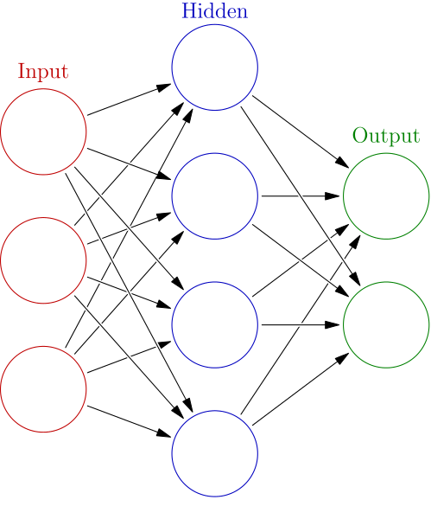
Input
Neural Network Parameter Estimation
Training Data (400/400)
Cropped Bank Images (500/500)
Testing Data (100/100)
Predicted Classification
Model Validation
Reference Classification
Confusion Matrix
Bank Health Label
100
100
0
0
Bank Health Label
Notes:
From Cropped Bank Images to Performance Evaluation Using Confusion Matrix
Dave

Slide 3
Bank Image
Production
2D-Convolution
2D-Maxpooling
2D-Convolution
800@3*3*32
800@2*2*32
800@3*3*32
800@20*60*1
Banks
FDIC SDI
By Quarter
Quarters
Bank Variables
Flatten
2D-Maxpooling
2D-Convolution
2D-Maxpooling
800@14
800@2*2*32
800@3*3*32
800@2*2*32
Classifications
800@1
Predicted Classification
Bank Health Label
Notes:
Silvia

Slide 4
SILVIA’S REFERENCE DIAGRAMS

Slide 5
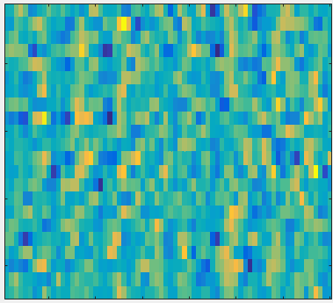
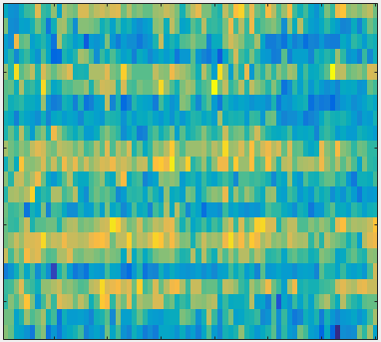
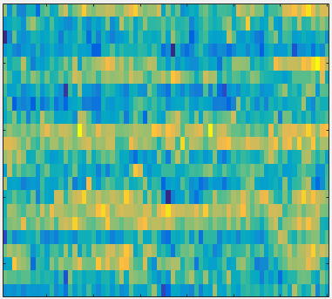
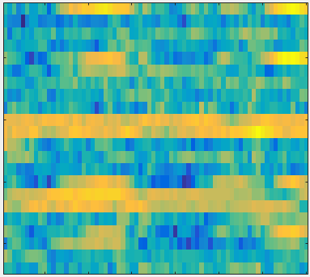
Input Layer
Convolution Layer
Pooling Layer
Flatten
Fully Connected Layer
Activation:
Pooling Operator:
$$f\left(x\right)=max⁡(0,x)$$
$$y_{i,j}=\max_{m,n∈[0,p] }{(x_{i+m,i+n})}$$
features
Dropout
.
.
.
.
.
.
channels
time
Notes:
Silvia

Slide 6
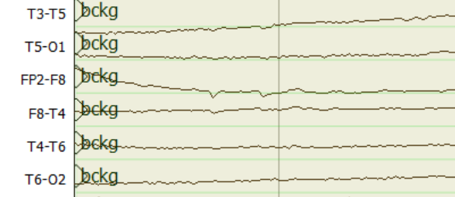
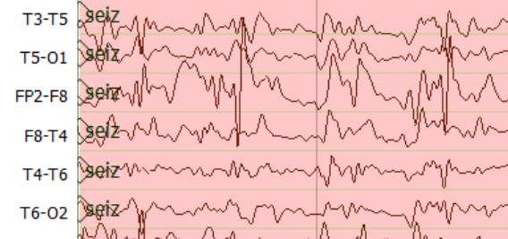
Epoch Posteriors
Sequential Modeler
Temporal and Spatial Context Analysis by Deep Learning
Feature Extraction
$$a_{11}$$
$$a_{22}$$
$$a_{33}$$
$$y$$
$$z$$
$$a_{12}$$
$$g_{θ′}$$
$$a_{23}$$
TUH EEG
$$b_{1}(x)$$
$$b_{2}(x)$$
$$b_{3}(x)$$
$$f_{θ}$$
$L_{H}$(x,z)
Corpus
Hidden Markov Models
$$\tilde{x}$$
$$x$$
Stacked Denoising Autoencoders
Post Processor
Output
$$a$$
$$a$$
S1
S2
$$b$$
$$c$$
$$b$$
$$a$$
S3
S4
$$d$$
Epoch Label
Finite State Machine for Language Model
Notes:
Silvia

Slide 7
Input Layer
Convolution
Convolution
Maxpooling
Convolution
Convolution
16@70*22
16@68*20
16@34*10
32@34*10
32@32*8
features
.
.
.
channels
time
Flatten
Maxpooling
Convolution
Convolution
Maxpooling
64@7*1
64@14*2
64@16*4
32@16*4
Output
.
.
.
Notes:
Silvia

Slide 8
Feature
Extraction
Sequential Modeler
$$o_{t}$$
Output Gate
Time Steps
$$i_{t}$$
Input Gate
Output
Incremental PCA
Time Steps
$$c_{t}$$
$$h_{t}$$
TUH EEG
channels
Corpus
25 First principal components
Feature Length
$$f_{t}$$
Forget Gate
Learning log-term dependencies with LSTM
Notes:
Silvia

Slide 9
Feature
Extraction
2D-Convolution
2D-Maxpooling
2D-Convolution
2D-Maxpooling
210@22*26*16
210@11*13*16
210@11*13*32
210@5*6*32
210@22*26*1
Time Steps
TUH EEG
Corpus
channels
Feature Length
1D-Convolution
Flatten
2D-Maxpooling
2D-Convolution
210@16
210@384
210@2*3*64
210@5*6*64
Post Processor
Sequential Modeler
$$o_{t}$$
Output Gate
$$i_{t}$$
Input Gate
Output
$$h_{t}$$
$$c_{t}$$
1D-Maxpooling
$$f_{t}$$
Forget Gate
26@16
Learning log-term dependencies with B- LSTM
Notes:
Silvia

