Slide 1
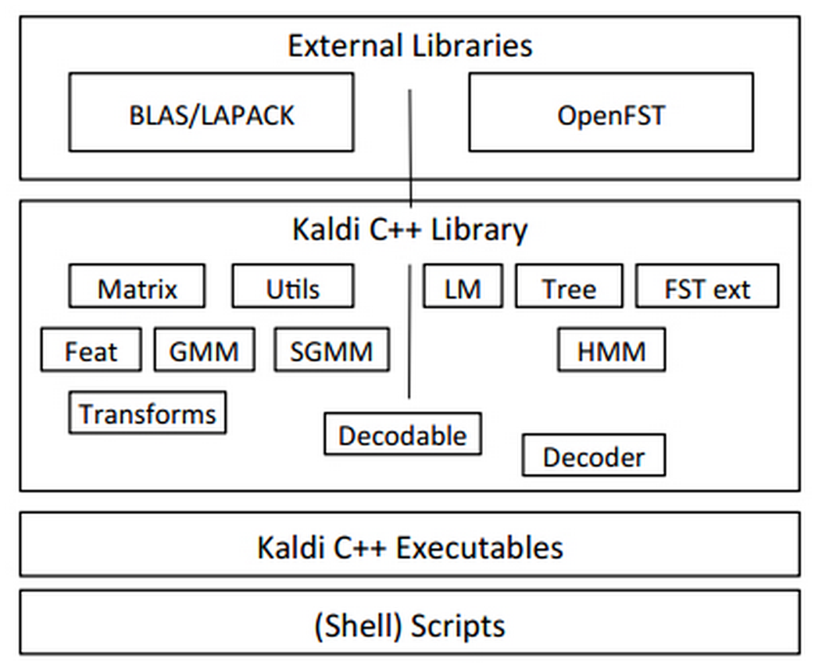
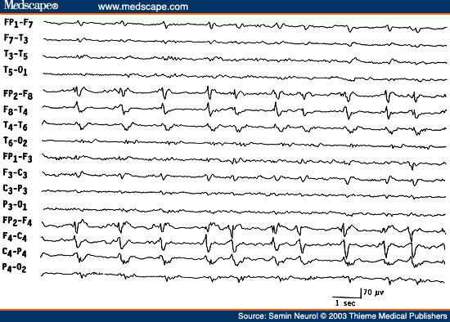
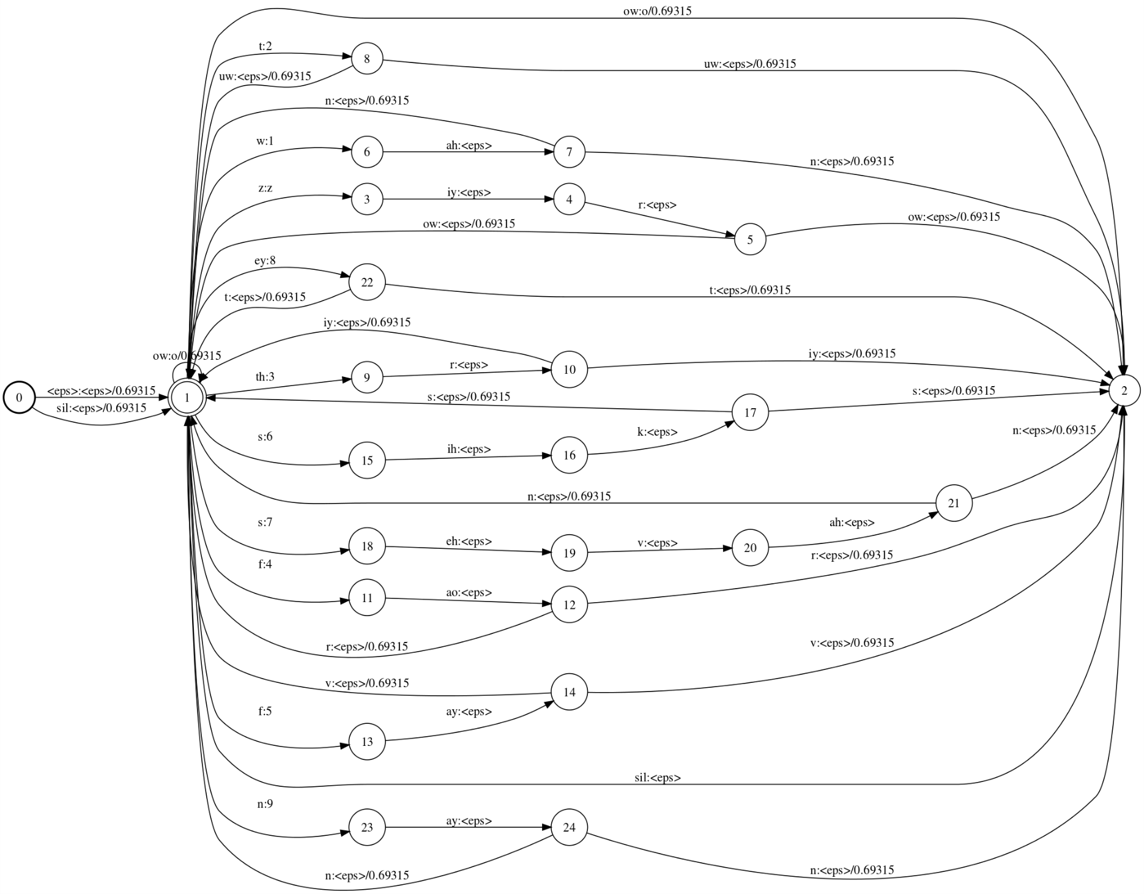
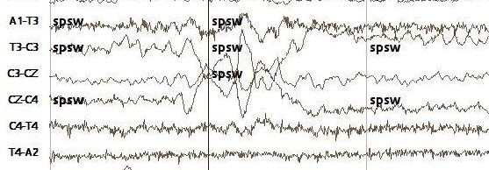
EEG Recognition Using The Kaldi Speech Recognition Toolkit
Jonatas Macedo Soares, Fabricio Goncalves, Dr. Iyad Obeid and Dr. Joseph Picone The Neural Engineering Data Consortium, Temple University
College of Engineering
Temple University
www.isip.piconepress.com
Abstract
The goal of this research is to adapt the Kaldi toolkit to the recognition of EEG signal events.
Kaldi is a popular open source speech recognition system that supports a finite state transducer approach to acoustic modeling, and includes a powerful deep learning module.
Six types of EEG events are detected: signal events (GPED, PLED, SPSW) and background events (ARTF, EYEM, BCKG).
As a first step, we reproduced several well-known speech recognition experiments and exceeded our previous best performance on these tasks.
Performance on a new task, AlphaDigits, however, was problematic.
Performance on a baseline EEG task based on the TUH EEG Corpus was significantly lower than our baseline based on hidden Markov models (a detection error rate of 63% vs. 33%).
Kaldi: Open Source Speech Recognition
Our baseline EEG and speech recognition technology uses a hidden Markov model (HMM) based approach to acoustic modeling and a dynamic programming (DP) beam search for language modeling.
Kaldi is an open source speech recognition toolkit which uses finite state transducers (FST) for both acoustic and language modeling. Both tasks are integrated into a single large transducer.
Kaldi has excelled at very large vocabulary recognition and has become a popular alternative to other open source tools.
It is based on the AT&T OpenFst toolkit and supports deep learning.
An FST is a machine that maps a sequence of inputs to a sequence of outputs. Kaldi uses FSTs for both acoustic and language modeling. For example, a lexicon converts words to phonemes. An acoustic model converts phonemes to states:
Baseline Experiments
Three speech databases were used in this research to obtain a better understanding of Kaldi:
TIDigits: Men, women, boys and girls reading digit strings of varying lengths.
Resource Management (RM): A medium-sized vocabulary with 1,000 sentence patterns and bigram perplexity of 60.
AlphaDigits (AD): letters and numbers spoken over the telephone.
TIDigits:
Resource Management:
AlphaDigits:
Baseline EEG Experiments
In this experiment, we used the same features generated by HTK (.htk files).
Originally, there were used 264 .htk files for training and 264 for evaluation. From those files, 2902 segments and 1658 segments were generated for training and evaluation respectively, where each segment corresponds to a 1-second event.
Kaldi formatted feature files were then generated by extracting features from the HTK files for the corresponding segments.
These features files consisted of two files: an archive (.ark) file and a script (.scp) file. ARK is a binary file that contains the feature vectors. SCP is a script file that defines the location of the features.
There are six models, with approximately 5 mixtures per state, for the classification of all six events (GPED, PLED, SPSW, ARTF, EYEM, BCKG).
In this experiment, the lexicon FST maps one symbol per event as if each event were a word with only one phoneme.
In this experiment we use Kaldi (and ISIP/HTK) to compute likelihoods; no language model is used.
Results
Table 4 presents a comparison of the detection error rate for all six classes of events for closed and open-loop testing:
In Table 4 we see that the error rate for Kaldi is about twice as high as the baseline system.
In Table 7, we see that many of the errors are associated with the background classes and can be ignored. SPSW has the highest error rate due to the fact that these events occur less frequently.
Evaluation Set | ISIP/HTK | Kaldi
Training | 19.0% | 35.58%
Test | 33.2% | 61.03%
Table 4: Detection error rates for the TUH EEG Corpus
Ref/Hyp: | artf: | bckg: | eyem: | gped: | pled: | spsw:
artf: | 128 (61.84%) | 79 (38.16%) | 0 (0.00%) | 0 (0.00%) | 0 (0.00%) | 0 (0.00%)
bckg: | 160 (17.45%) | 718 (78.30%) | 0 (0.00%) | 23 (2.51%) | 13 (1.42%) | 3 (0.33%)
eyem: | 3 (5.66%) | 0 (0.00%) | 45 (84.91%) | 2 (3.77%) | 3 (5.66%) | 0 (0.00%)
gped: | 1 (0.80%) | 1 (0.80%) | 3 (2.40%) | 67 (53.60%) | 51 (40.80%) | 2 (1.60%)
pled: | 7 (5.22%) | 1 (0.75%) | 7 (5.22%) | 25 (18.66%) | 88 (65.67%) | 6 (4.48%)
spsw: | 15 (11.36%) | 17 (12.88%) | 15 (11.36%) | 54 (40.91%) | 30 (22.73%) | 1 (0.76%)
Acoustic Model | ISIP/HTK | Kaldi
Monophones | 2.95% | 1.00%
Triphones | 0.57% | 0.40%
Triphones (LDA) | N/A | 0.30%
Table 1: A comparison of results on TIDigits
Table 5: Confusion matrix for ISIP/HTK
Ref/ Hyp: | artf | bckg | eyem | gped | pled | spsw | del
artf | 93 (44.93%) | 84 (40.58%) | 0 (0.00%) | 11 (5.31%) | 2 (0.97%) | 0 (0.00%) | 17 (8.21%)
bckg | 312 (34.02%) | 400 (43.62%) | 0 (0.00%) | 80 (8.72%) | 10 (1.09%) | 15 (1.64%) | 100 (10.91%)
eyem | 4 (7.55%) | 1 (1.89%) | 39 (73.58%) | 4 (7.55%) | 3 (5.66%) | 0 (0.00%) | 2 (3.77%)
gped | 12 (9.60%) | 3 (2.40%) | 5 (4.00%) | 48 (38.40%) | 44 (35.20%) | 8 (6.40%) | 5 (4.00%)
pled | 17 (12.69%) | 2 (1.49%) | 14 (10.45%) | 24 (17.91%) | 59 (44.03%) | 11 (8.21%) | 7 (5.22%)
spsw | 23 (17.42%) | 24 (18.18%) | 14 (10.61%) | 27 (20.45%) | 17 (12.88%) | 4 (3.03%) | 23 (17.42%)
ins | 14 | 7 | 1 | 6 | 3 | 1
Introduction
Electroencephalography (EEG) measures the electrical activity in the brain and is used to diagnose patients suffering from epilepsy and strokes.
We use a maximum likelihood approach for classifying 1 second epochs of an EEG signal into:
Signal Events: generalized periodic epileptiform discharge (GPED), periodic lateralized epileptiform discharge (PLEDs), spike and sharp wave (SPSW)
Noise Events: artifact (ARTF), eye movement (EYEM), and background activity (BCKG).
Spikes and sharp waves are particularly important for accurate diagnoses of brain disorders:
Acoustic Model | ISIP/HTK | Kaldi
Monophones | 22.06% | 8.73%
Triphones | 10.04% | 3.57%
Table 2: A comparison of results on RM
Acoustic Model | HTK | Kaldi
Monophones | 12.2% | 20.86%
Triphones | 10.5% | 17.22%
Table 6: Confusion matrix for Kaldi
Ref/ Hyp: | bckg: | gped: | pled: | spsw: | del
bckg: | 933 (79.27%) | 95 (8.07%) | 15 (1.27%) | 15 (1.27%) | 119 (10.11%)
gped: | 20 (16.00%) | 48 (38.40%) | 44 (35.20%) | 8 (6.40%) | 5 (4.00%)
pled: | 33 (24.63%) | 24 (17.91%) | 59 (44.03%) | 11 (8.21%) | 7 (5.22%)
spsw: | 61 (46.21%) | 27 (20.45%) | 17 (12.88%) | 4 (3.03%) | 23 (17.42%)
Figure 3: An overview of Kaldi
Table 3: A comparison of results on AD
Table 7: 4-way confusion matrix on Kaldi
Summary
Kaldi demonstrates significant potential on well-known tasks provided as demos (e.g., RM).
Kaldi’s generic algorithms and universal recipes make it straightforward to work on new tasks.
Performance on a new task (AD), however, is significantly below state of the art.
Performance on EEG data is also below our previously published levels of performance.
Acknowledgement
This research was also supported by the Brazil Scientific Mobility Program (BSMP) and the Institute of International Education (IIE).
Figure 1: PLEDs occurring in the left hemisphere
Figure 2: An example of a spike
Figure 4: Lexicon FST for TIDigits

