Slide 1
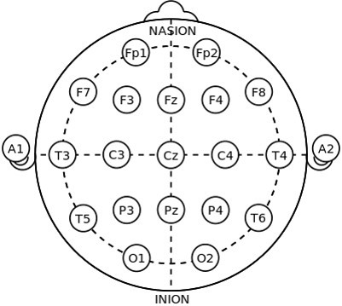
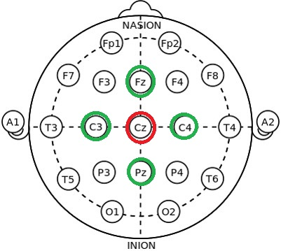
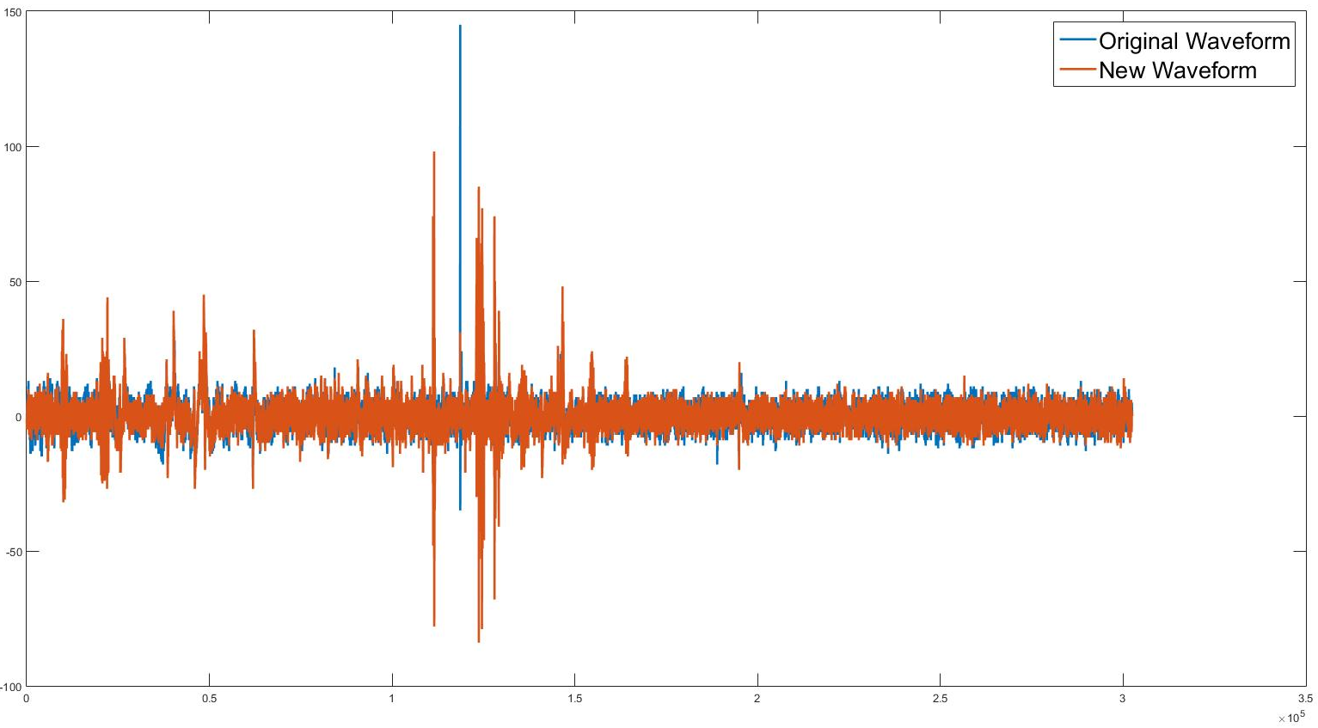
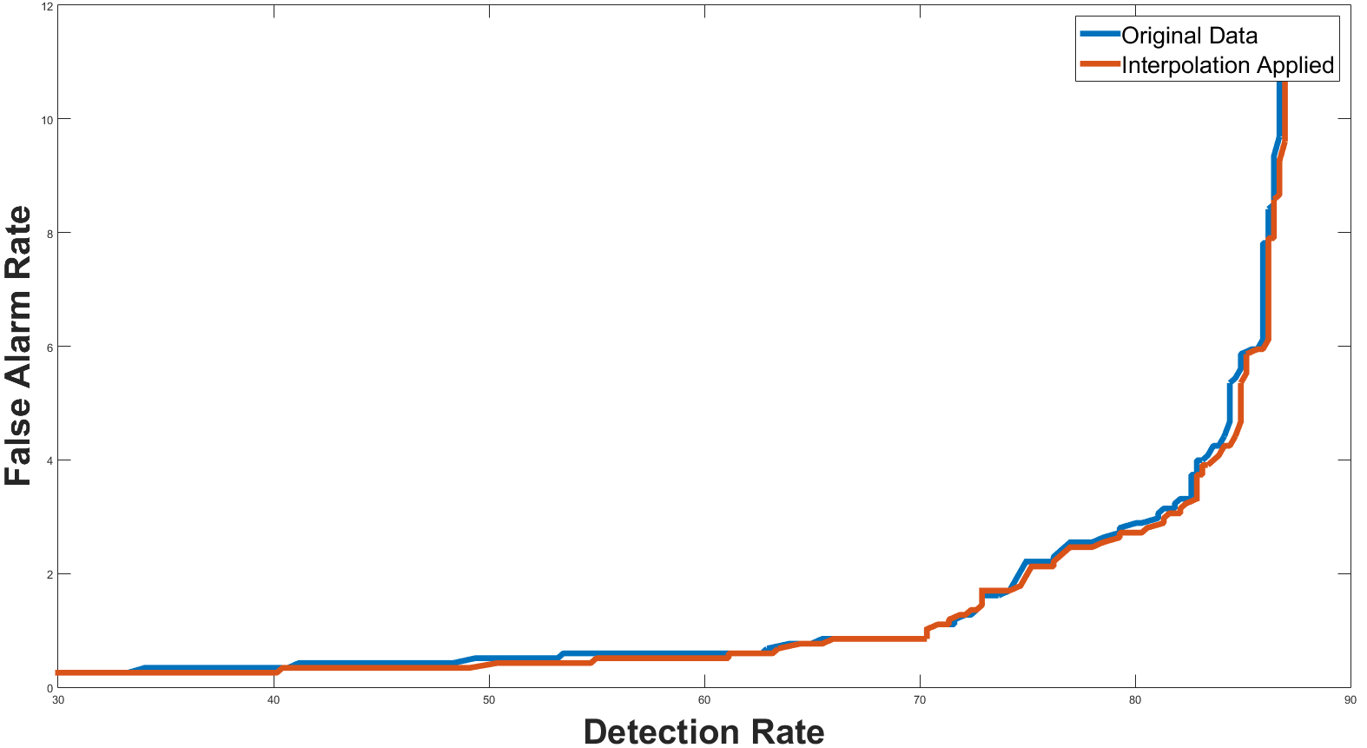
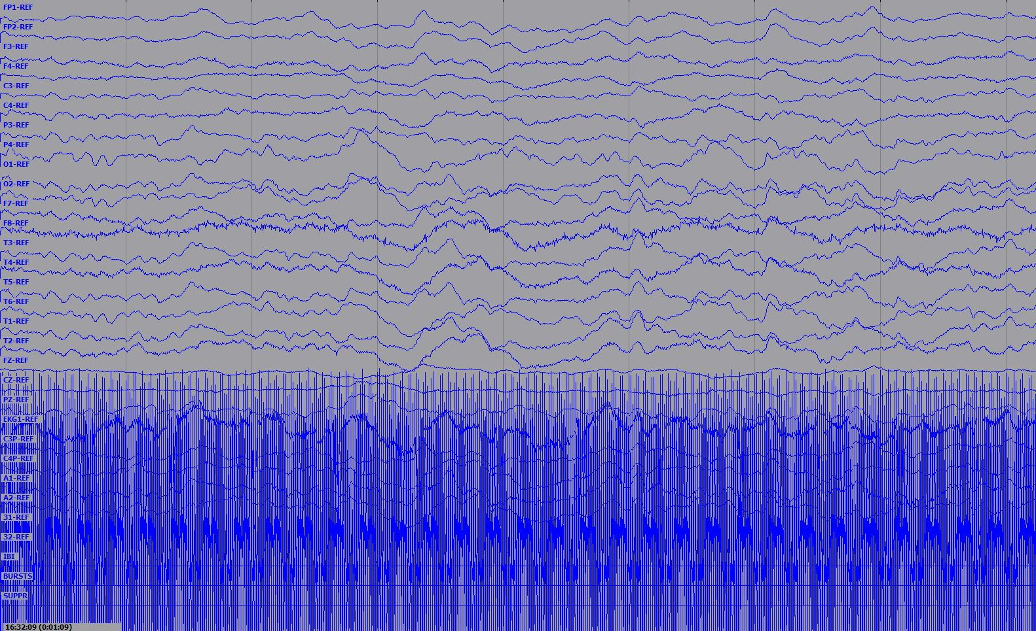
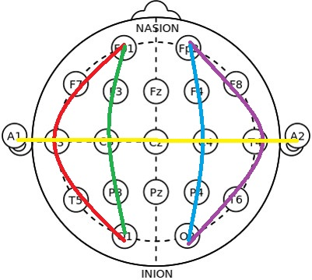
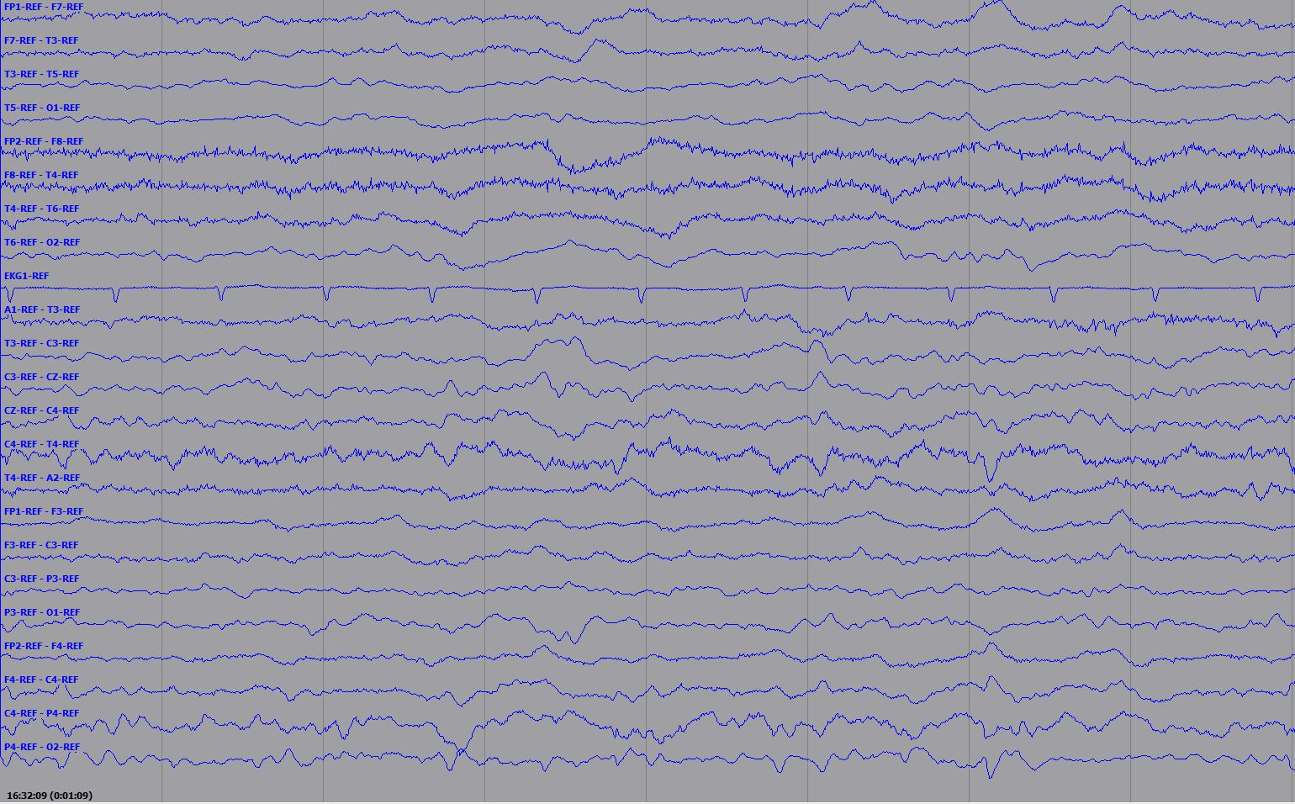
Generation of eeg channels using spatial interpolation
Fabricio Goncalves, Gabriella Suarez, Dr. Iyad Obeid and Dr. Joseph Picone
The Neural Engineering Data Consortium, Temple University
College of Engineering
Temple University
www.isip.piconepress.com
Abstract
The TUH EEG Corpus includes over 15,000 patients, 20,000+ sessions, 50,000+ EEGs and de-identified clinical information.
We are developing a system, AutoEEGTM, that generates time-aligned markers indicating points of interest in the signal, and then produces a summarization based on a statistical analysis of these markers.
About 15% of the sessions are missing a critical channel and cannot be viewed using a TCP montage, which is one of the preferred montage views by the neurologists.
We can use interpolation of channels that are spatially close to synthesize the missing channels.
We evaluated interpolation performance by conducting a classification experiment on the interpolated channels.
A set of EEGs containing all channels required for a TCP montage was chosen. The channels in which most of the EEG events occur were selected. The original channels were replaced by interpolated channels.
Experiments show there was no degradation in performance due to interpolation.
Interpolation Method
The averaging of the discrete points in the adjacent channels is the method used for interpolation.
The averaging algorithm was implemented in C++.
The electrodes used in the EEG recording are placed according to a standard layout known as a 10-20 system.
The original channels were replaced by data approximated using the interpolation algorithm.
AutoEEGTM was used to detect events on the interpolated channels.
The TUH EEG Corpus was analyzed to determine which EEG sessions support the TCP montage.
Recordings with a proper TCP montage channel specification were used.
Preliminary Experiments
AutoEEGTM uses machine learning algorithms based on hidden Markov models and deep learning are used to learn mappings of EEG events to diagnoses.
The system accepts multichannel EEG raw data files as input. The output is a probability vector containing the likelihood of each event.
One channel from each EEG was replaced by its corresponding interpolated values, and the change in classification performance was measured.
Performance Analysis
Table 2. Error Confusion Matrix for the Original Channels
 | ARTF | BCKG | EYEM | GPED | PLED | SPSW
ARTF | 61.84% | 38.16% | 0% | 0% | 0% | 0%
BCKG | 17.45% | 78.30% | 0% | 2.51% | 1.42% | 0.33%
EYEM | 5.66% | 0% | 84.91% | 3.77% | 5.66% | 0%
GPED | 0.80% | 0.80% | 2.40% | 53.60% | 40.80% | 1.60%
PLED | 5.22% | 0.75% | 5.22% | 18.66% | 65.67% | 4.48%
SPSW | 11.36% | 12.88% | 11.36% | 40.91% | 22.73% | 0.76%
Figure 2. The 10-20 System
Table 3. Confusion Matrix for Interpolated Channels
 | ARTF | BCKG | EYEM | GPED | PLED | SPSW
ARTF | 61.84% | 38.16% | 0% | 0% | 0% | 0%
BCKG | 17.78% | 78.08% | 0% | 2.62% | 1.20% | 0.33%
EYEM | 3.77% | 1.89% | 83.02% | 3.77% | 7.55% | 0%
GPED | 1.60% | 0.80% | 1.60% | 48.80% | 45.60% | 1.60%
PLED | 5.22% | 0.75% | 5.22% | 18.66% | 65.67% | 4.48%
SPSW | 11.36% | 12.88% | 10.61% | 41.67% | 22.73% | 0.76%
Figure 3. Adjacent Channel Selection
Original Waveform
TUH EEG Corpus Data Analysis
38,437 files from the Corpus were analyzed.
3,738 of these EEGs do not contain the proper channel assignments specified in the TCP montage.
The majority of these files contained data that could be easily remapped onto the TCP montage.
21 sessions (28 files) did not have the proper channel assignments to support a TCP montage.
Our goal is to use interpolation to allow these 28 files to be viewed in a TCP montage.
Table 4. Error Rates
Interpolated Waveform
 | Original Channels | Interpolated Channels
Error Rate | 33.23% | 33.80%
Introduction
Electroencephalogram is a form of brain imaging that measures the spatial distribution of voltage fields on the scalp and their variation over time.
A montage is a representation of an EEG in which adjacent channels are differenced to reduce noise. The channel configuration is shown in Figure 1.
Interpreting such electroencephalograms is time-consuming and can be hard to interpret depending on the montage used.
Temporal Central Parasagittal (TCP) is a common montage used to analyze the EEGs. It covers most of the cerebral cortex in T (red and purple) and P (green and blue), and C (yellow) helps with localization of events.
While recording an EEG, some electrodes may detach, contain noise, or be mislabeled, preventing the application of a TCP montage.
Spatial Interpolation involves using sample values in close proximity to the missing channel to reconstruct the missing data.
In this paper, we present the results on a simple averaging approach to interpolation.
Figure 4. An Example of a PLED Event
Original Waveform
Table 1. TCP Montage Compatibility for TUH EEG
Supporting TCP Montage | 90.27%
Lacking TCP Montage Channels | 9.73%
Interpolated Waveform
Figure 7. Detection Error Tradeoff Curve
C++ Software Implementation
AutoEEGTM include a C++ based set of tools that implement common DSP algorithms for feature extraction and postprocessing of features using a data-driven approach.
This DSP software also performs common I/O functions and implements montages.
Interpolation was implemented within our general purpose feature extraction module, gen_feats, which can be configured via a parameter file.
New variables were added to specify the desired interpolation algorithm, the new channel label, and select the adjacent channels used to generate the new signal.
Existing classes, Edf and Fe, were modified to accept the new parameter file format and compute the interpolated signal.
Figure 5. An Example of a GPED Event
Summary
Generating EEG missing channels using a simple averaging approach to interpolation has been shown to be effective.
Future work will include the investigation of new interpolation techniques based on information theoretic approaches such as independent components analysis and spline analysis.
Adaptation approaches based on linear transformations estimated using maximum likelihood techniques will also be evaluated.
Acknowledgements
This research was supported by the Brazil Scientific Mobility Program (BSMP) and the Institute of International Education (IIE).
Original Waveform
Interpolated Waveform
Figure 1. The TCP Montage
Figure 6. An Example of an SPSW Event

