Slide 1
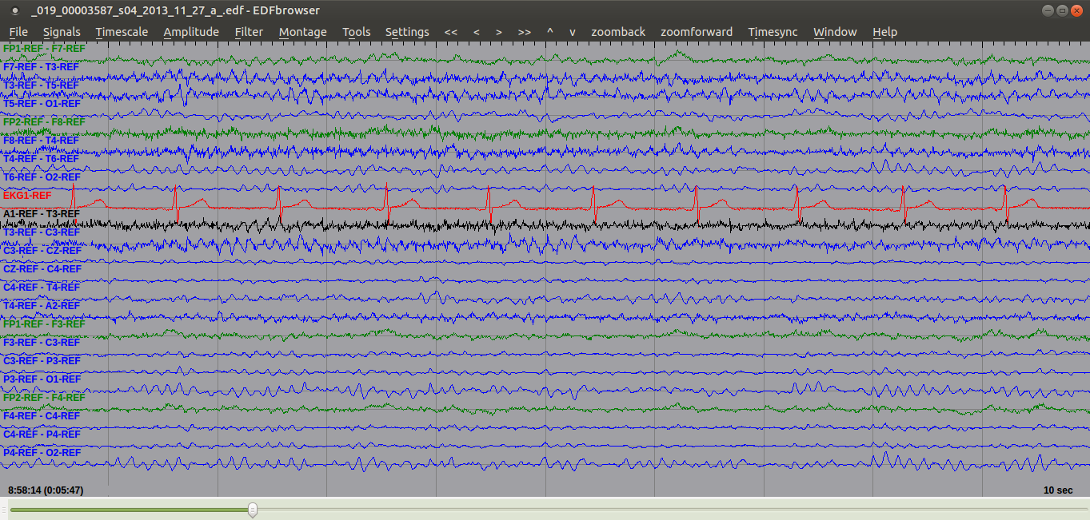
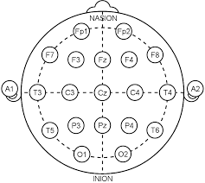
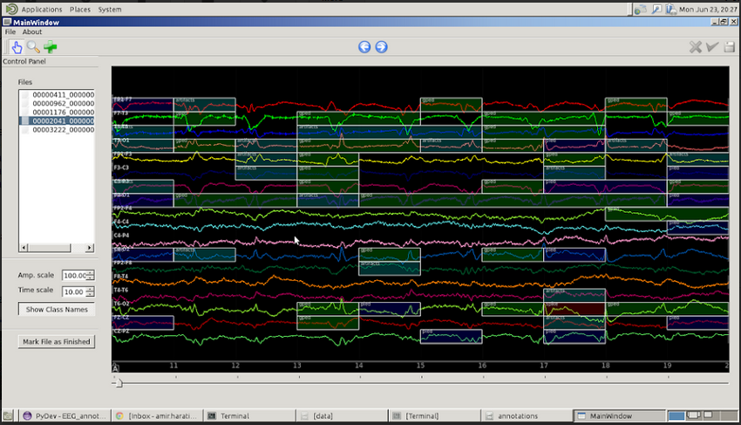
CLASSIFICATION OF SLEEP EVENTS IN EEGS USING HIDDEN MARKOV MODELS
Lucas Santana, Francisco Parente, David Jungrais, Dr. Iyad Obeid and Dr. Joseph Picone
The Neural Engineering Data Consortium, Temple University
College of Engineering
Temple University
www.isip.piconepress.com
Abstract
The goal of this work is to develop an automated system to detect sleep events in EEGs. Three states were considered: sleep, drowsy and awake.
A machine learning approach based on hidden Markov models, maximum likelihood decoding and big data was used to classify data.
The system was developed using the TUH EEG Corpus, which consists of 12 years of clinical data collected at Temple University Hospital.
… state something about how much of the data was manually annotated …
… state something about your baseline results …
Methods
The first step were select EEGs from the TUH EEG Corpus.
Based on the reports on each EEG we got a previous idea about exam.
To visualize the EEG we used the EDF Browser Software. A free license software to read EEG signals.
Our software tool called annotator were used to mark and select the evens that we were looking for: awake, sleep and drowsy.
The final steps were convert the files generated by annotator(.rec) to .lab, start an training to o evaluate a model.
In the end 300 EDF files were used on the training.
All events in the EDF files were annotated by hand using our tool.
For each EDF files were generates one .rec file with the time position of each event(sleep, drowsy and awake)
Each .rec file were converted to 22 .lab files. Each .lab file represent the 22 channels during the electroencephalogram
Corpus Statistics
Were analized 426 EEG. From Those 200 sessions were used to mark the sleep states.
All EEGs were obtained from the Corpus randomly based on medical reports.
For each EDF file were genereted 22 .lab files. Each one represents all the 22 channels in the EEG.
A TCP Montage were used in displace all the channels. The 22 channels, and the rellations between then are shown on the Fig.5.
Future work
In the future reduce false-positive indentifications of pathological events.
Improve this model to make other detections of sleep.
Results
Number Label | Stage
6 | Sleep
7 | Awake
8 | Drowsy
Fig. 4: Table of events used to mark on annotator
Introduction
The electroencephalogram (EEG) is responsible for measuring electrical brain activity. Complicated statistical and mathematical analysis are the primary tools in neuroscience.
There are to many kinds of patterns presents in a electroencephalographic (EEG) activity. We must be able to identify them with appropriate accuracy
Some patterns are just background, we have to discard them and analyze what is our own interest.
During a EEG exam, electrodes are displaced on the scalp to monitor, the patient, brain activity (brain waves).
The 10-20 system is an international method used to describe the position of electrodes on the scalp.
The letter present on the Fig.1 (F,T,C and P) represents frontal, temporal, central and parietal lobes respectively.
Fig. 2: EDF Browser
Summary
The TUH EEG Corpus is a huge EEG database, which improves the accuracy of our stastical models.
Medical analysis of EEG is time-consuming and subjective.
This work can be used to reduce the time of EEG analysis
Big data and machine learning offer the potential to deliver much higher performance solutions.
Classification of sleep events can be used in the future to detect Sleep Spindles.
Acknowledgements
This research was supported by the Brazil Scientific Mobility Program (BSMP) and the Institute of International Education (IIE).
Fig.5: 10-20 System
Fig.1: 10-20 System
Fig. 3: Annotator Software

