Slide 1
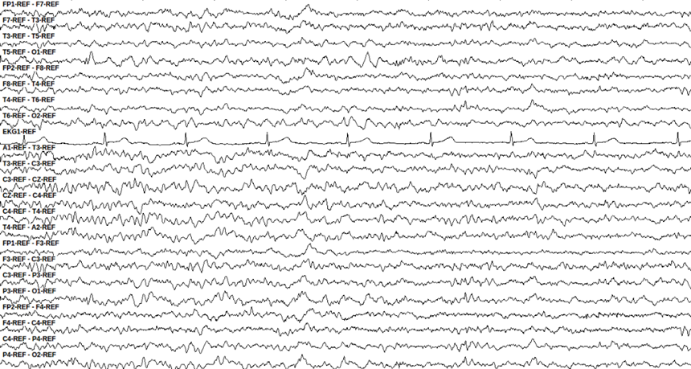
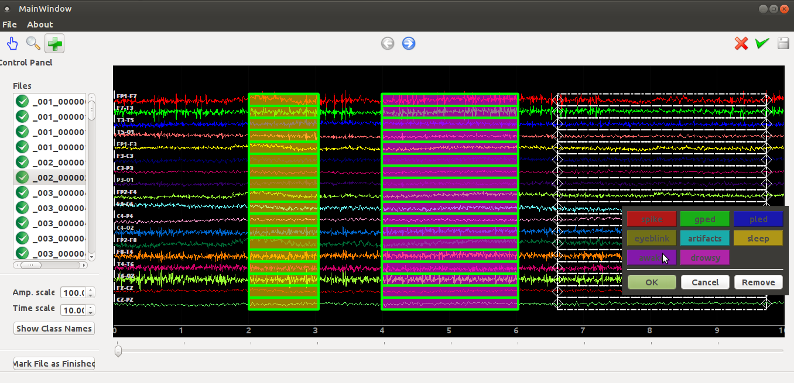
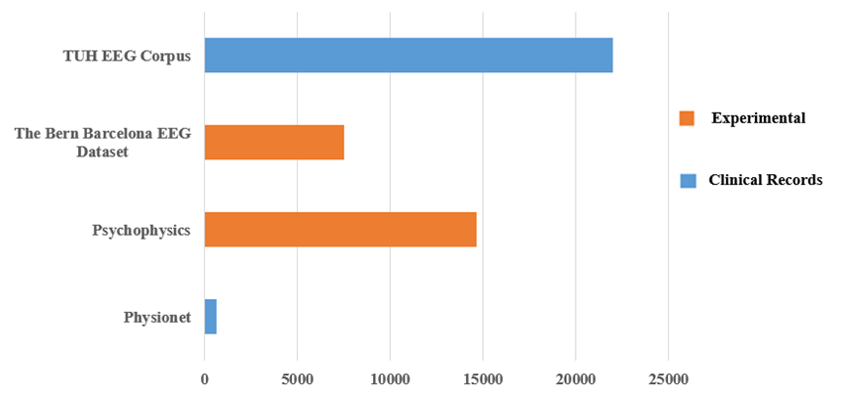
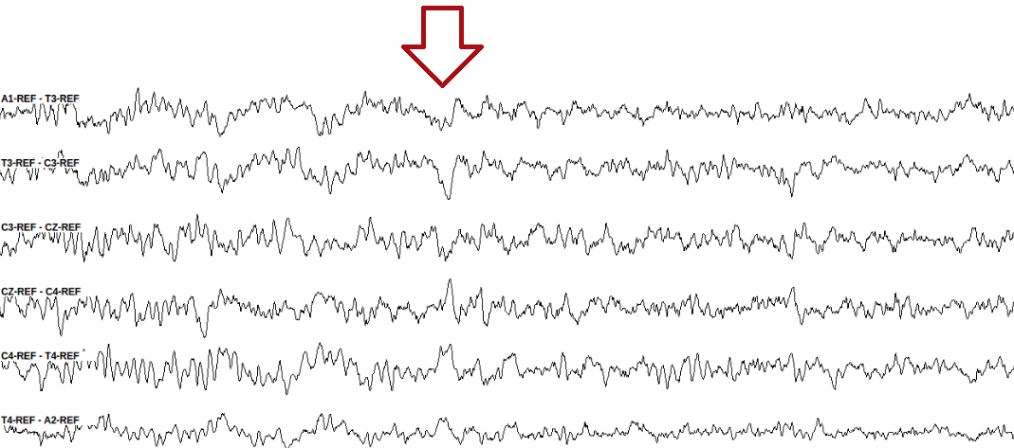
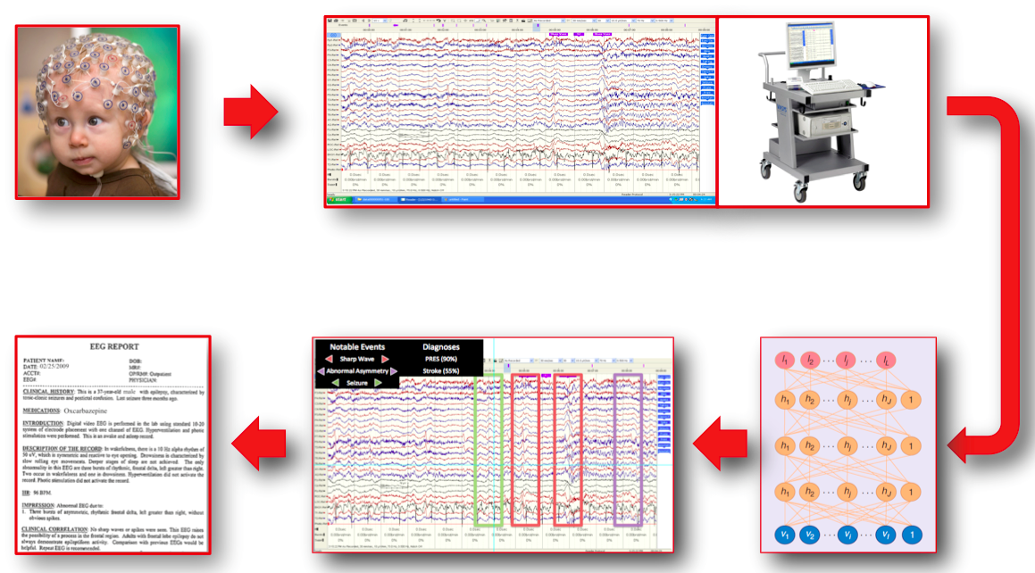
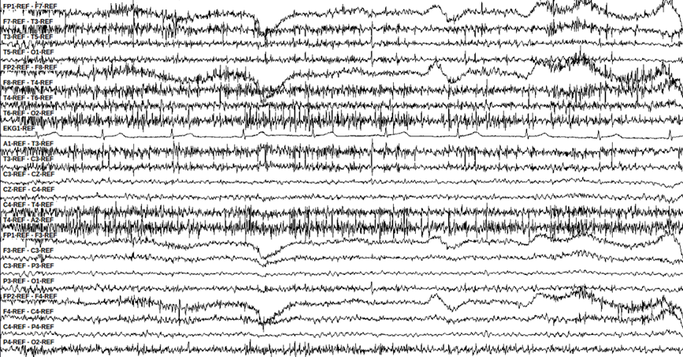
DETECTION OF SLEEP STATE USING MACHINE LEARNING ON BIG DATA
Francisco Raimundo Albuquerque Parente, Lucas Santana, David Jungreis, Dr. Iyad Obeid and Dr. Joseph Picone
The Neural Engineering Data Consortium, Temple University
College of Engineering
Temple University
www.isip.piconepress.com
Abstract
Automatic detection of sleep state is an important queue in accurate detection of sleep conditions.
The analysis of EEGs is a difficult time-consuming task with only moderate inter-observer agreement.
Other obstacles include the presence of noise and artifacts as well as amplitude changes.
We are developing a recognition system to detect whether or not a patient is sleepy, awake or drowsy.
We developed a corpus of 426 EEGs in which 200 contain sleep events. This was partitioned into 150 EEGs for training and 50 EEGs for evaluation.
Preliminary results showed that automatic detection of sleep state on big data can be comparable with medical reports.
Methodology
EEG sessions were identified based on the presence of relevant comments in the EEG reports:
“Vertex waves and spindles were seen in stage II sleep”
“This is an abnormal awake and asleep 21-minute EEG due to intermittent left temporal moderate slowing”
“During sleep, symmetrical vertex waves and sleep spindles are captured”
We manually identified and annotated sleep, drowsy and awake events in each selected EEG signal:
A sleep condition is indicated by the presence of vertex waves:
Occur most frequently during late stage 1 and stage 2 sleep;
Are identified as distinctive V-shaped waveforms with peaks between 100 – 200 µV;
When the patient is awake, we observe artifacts and irregular signal patterns:
These events typically occur on all channels since the entire brain is awake.
The signal amplitude varies depending upon a patient’s movements.
Inversion of polarity in the channels associated with eye movement indicates drowsiness:
Signals on channels FP1-F7 and F7-T3 converge and signals on channels FP2-F8 and F8-T4 diverge.
We used an internal annotation tool to manually label data:
Machine Learning Approach
We designed a system to distinguish between wakefulness, drowsiness and sleep.
Previously, a pilot experiment was conducted on a small data set of 12 EEG sessions for training and an independent set of 12 EEGs for evaluation. This data contains a rich variety of signal events. ← you didn’t use this for your experiments, so why are you mentioning it?
We created another, bigger dataset with 426 EEGs, of which 200 EEGs contained sleep events. 75% of it was used for training and 25% for evaluation. (75% of 200 or 75% of 426?)
Feature extraction was performed using a standard filter bank approach based on cepstral coefficients.
Our database contains EEGs sampled at 250Hz and the epoch consists of a set of information from 22 channels, since we are using TCP montage.
Machine learning algorithms based on hidden Markov models (HMM) and deep learning are used to learn mappings of EEG events to diagnosis.
We use maximum likelihood approach in order to estimate our model parameters.
Results
[ machine learning results]
Figure 6. A drowsy event
Introduction
The emergence of big data and machine learning is enabling the ability to automatically learn how to interpret EEGs from a big data archive.
The TUH EEG Corpus is the largest and most comprehensive publicly-released corpus representing 12 years of clinical data collected at Temple Hospital.
There are many kinds of patterns presents in a electroencephalographic activity. We must be able to identify them with reasonable accuracy.
Automatic interpretation of EEGs involves the use of advanced machine learning algorithms trained on large amounts of data:
Figure 3. A typical sleep event
Figure 6. An EEG annotation tool
Figure 1. A comparison of the TUH EEG Corpus to other publicly available resources
Figure 4. The signals change their polarity in channels C3-CZ and CZ-C4
Summary
We developed a database consisting of a huge and uncorrelated set of EEGs for training and evaluation.
We analyzed 200 EEGs containing sleep events: 75% for training and 25% for evaluation.
This work is based on several analysis in an enormous EEG dataset, with only moderate inter-observer agreement.
Future work will include the detection of sleep spindles based on analysis of medical reports and the presence of characteristic waveforms in EEG signals.
Acknowledgements
This research was supported by the Brazil Scientific Mobility Program (BSMP) and the Institute of International Education (IIE).
Figure 2. Automatic interpretation of EEGs
Figure 5. An awake event

