Slide 1
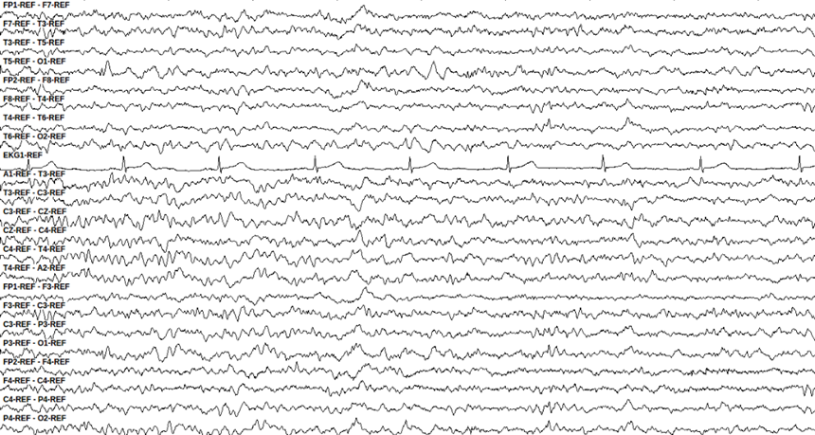
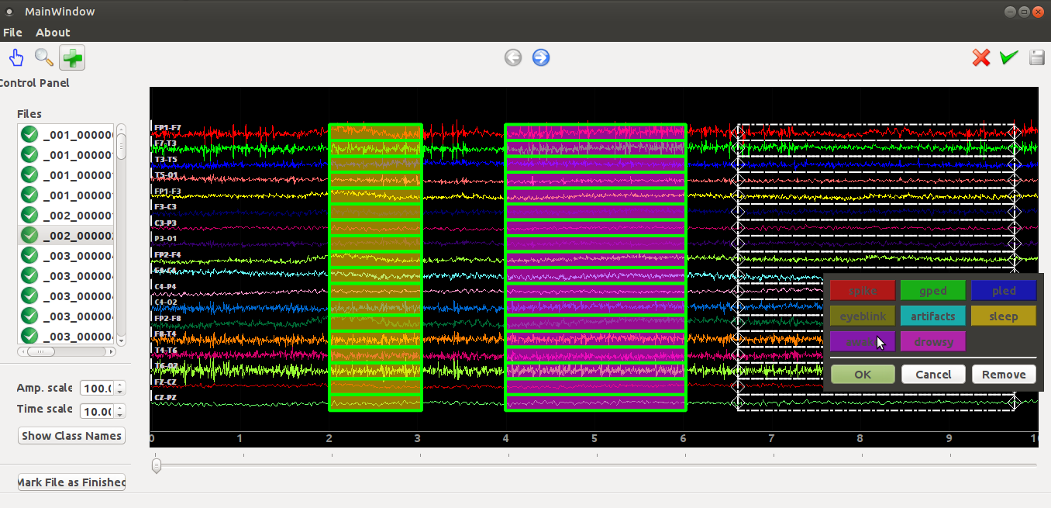
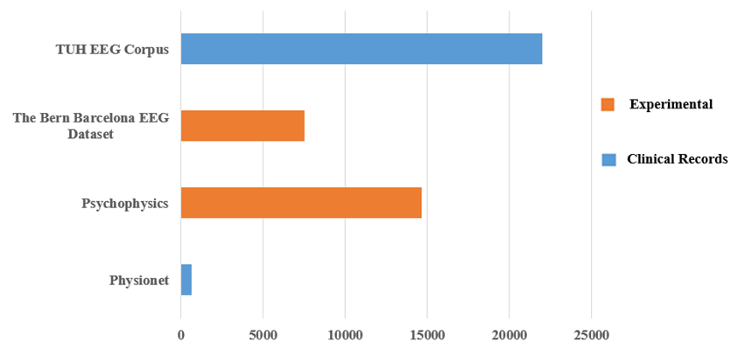
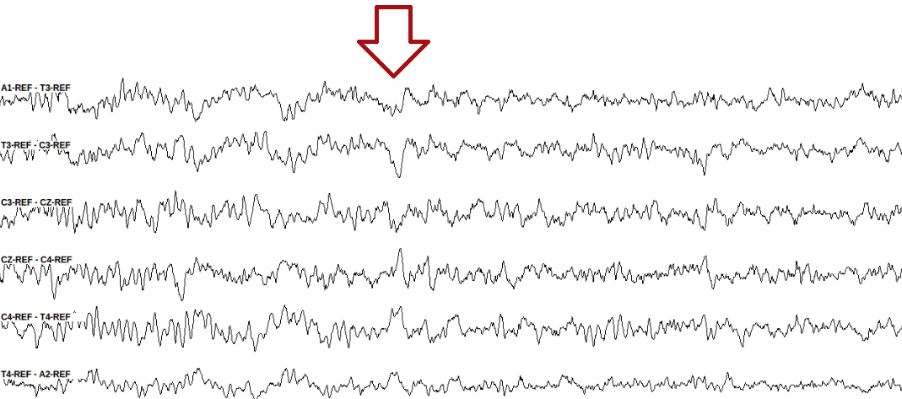
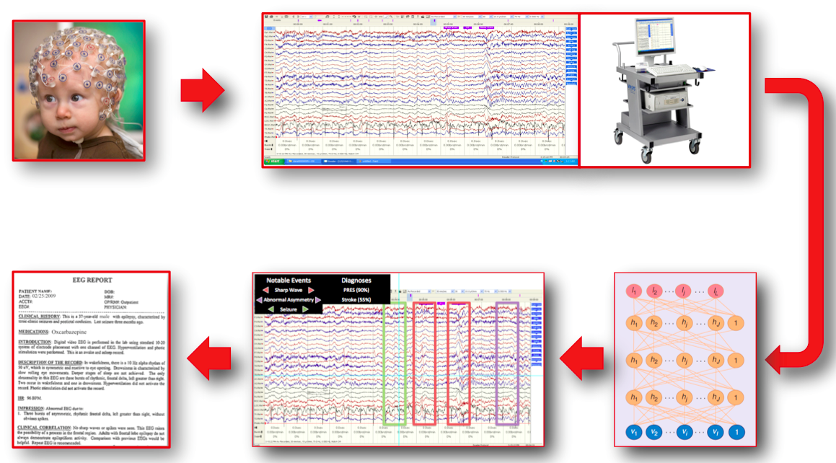
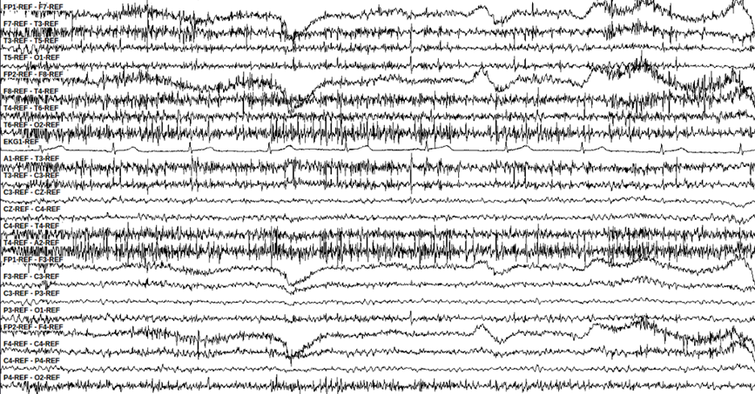
DETECTION OF SLEEP STATE USING MACHINE LEARNING ON BIG DATA
Francisco Raimundo Albuquerque Parente, Lucas Santana, David Jungreis, Dr. Iyad Obeid and Dr. Joseph Picone
The Neural Engineering Data Consortium, Temple University
College of Engineering
Temple University
www.isip.piconepress.com
Abstract
Automatic detection of sleep state is an important queue in accurate detection of sleep conditions.
The analysis of EEGs is a difficult time-consuming task with only moderate inter-observer agreement.
Other obstacles include the presence of noise and artifacts as well as amplitude changes.
We are developing a recognition system to detect whether or not a patient is sleepy, awake or drowsy.
We developed a corpus of 426 EEGs in which 200 contain sleep events. This was partitioned into 150 EEGs for training and 50 EEGs for evaluation.
Preliminary results showed that automatic detection of sleep state on big data can be comparable with medical reports.
Methodology
EEG sessions were identified based on the presence of relevant comments in the EEG reports:
“Vertex waves and spindles were seen in stage II sleep”
“This is an abnormal awake and asleep 21-minute EEG due to intermittent left temporal moderate slowing”
“During sleep, symmetrical vertex waves and sleep spindles are captured”
We manually identified and annotated sleep, drowsy and awake events in each selected EEG.
A sleep condition is indicated by the presence of vertex waves:
Occur most frequently during late stage 1 and stage 2 sleep;
Are identified as distinctive V shaped wave forms with peaks between 100-200µV;
Patient is awake when we observe artifacts and irregular signal patterns
These events typically occur on all channels since the entire brain is awake.
Signal amplitude varies depending upon patient’s movements.
Inversion of polarity in the channels associated with eye movement indicates drowsiness:
Signals on channels FP1-F7 and F7-T3 converge and signals on channels FP2-F8 and F8-T4 diverge.
The characteristic signal behavior on Figure 6 indicates the patient is drowsy.
We used an internal annotation tool to manually label data:
Machine Learning Approach
We set up our system to distinghish between awakefulness, drowsiness and sleep.
Previously, a pilot experiment was conducted on a small data set of 12 EEG sessions for training and an independent set of 12 EEGs for evaluation. This data contains a rich variety of signal events.
This small set was chosen so that parameter tuning experiments could be conducted quickly.
We created another and bigger dataset with 426 EEGs to detect sleep states accurately.
We observed 200 sleep events in the bigger dataset and used 75% of it for training and 25% for evaluation. We can vary these rates based on our experiment performance.
After prepare the data using our software tool, we perform feature extraction, training and decoding, whose output has the hypothesis against the models.
After rescoring, we analyze and compare the confusion matrixes in order to evaluate the performance.
Results
[ machine learning results]
Figure 6. A drowsy event
Introduction
The emergence of big data and machine learning is enabling the ability to automatically learn how to interpret EEGs from a big data archive.
The TUH EEG Corpus is the largest and most comprehensive publicly-released corpus representing 12 years of clinical data collected at Temple Hospital.
Previously released data resources in this area are mostly represented by experimentally acquired recordings. Figure 1 shows the comparison between the TUH EEG Data Corpus and other resources.
Automatic interpretation of EEGs involves the use of advanced machine learning algorithms trained on large amounts of data:
Figure 3. A typical sleep event
Figure 6. An EEG annotation tool
Figure 1. A comparison of the TUH EEG Corpus to other publicly available resources
Summary
We developed a database consisting of a huge and uncorrelated set of EEGs for training and evaluation.
We analyzed 426 EEGs containing 200 sleep events: 75% for training and 25% for evaluation.
This work is based on several analysis in an enormous EEG dataset, with only moderate inter-observer agreement.
Future work will include the detection of sleep spindles based on analysis of medical reports and the presence of characteristic waveforms in EEG signals.
Acknowledgements
This research was supported by the Brazil Scientific Mobility Program (BSMP) and the Institute of International Education (IIE).
Figure 4. The signals change their polarity around the channels C3-CZ and CZ-C4.
Figure 2. Automatic interpretation of EEGs
Figure 5. An awake event

