Slide 1
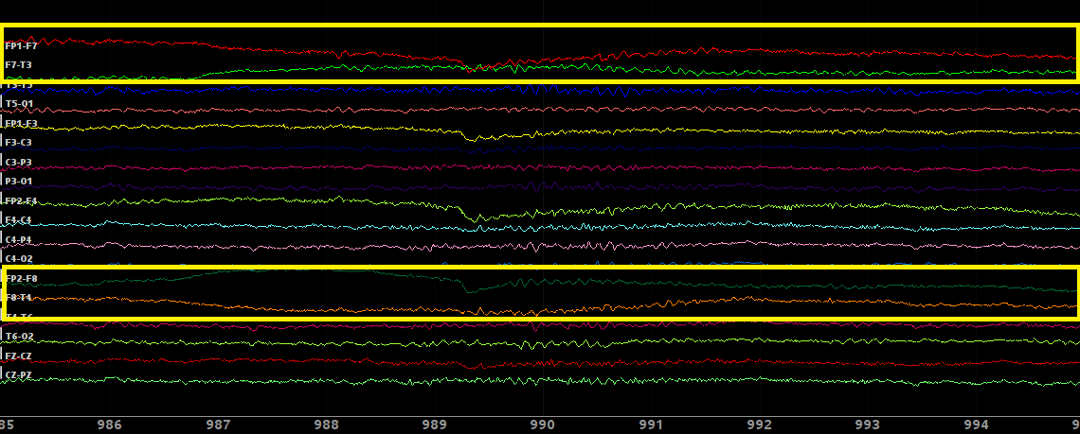
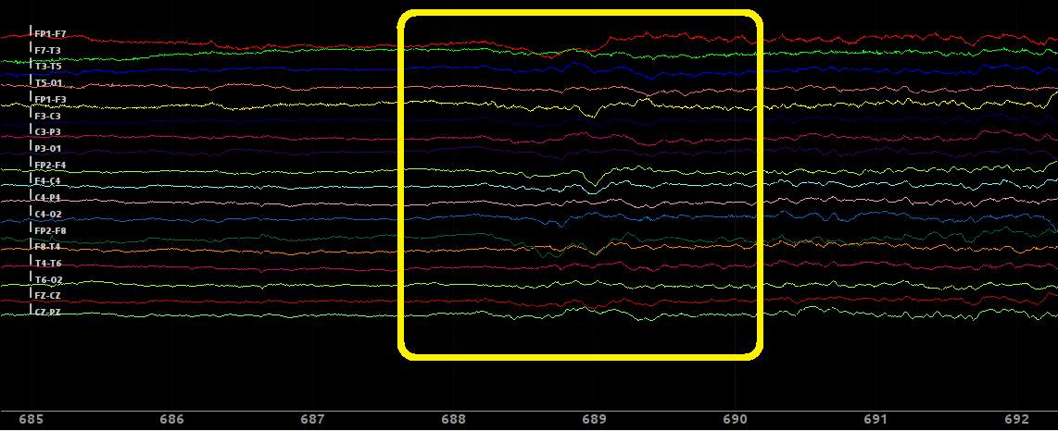
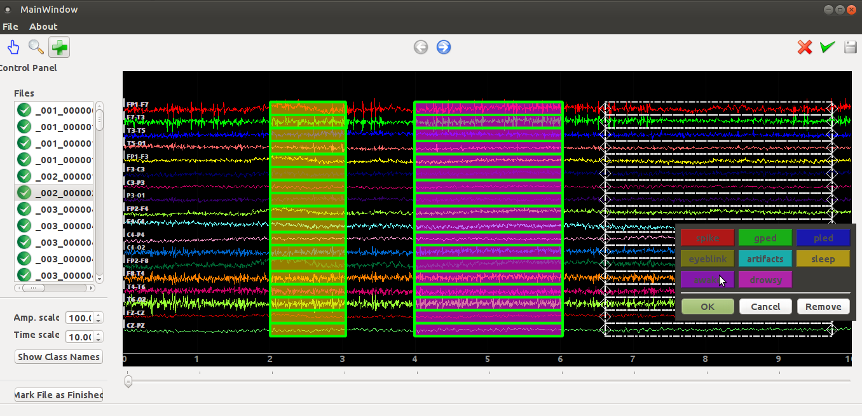
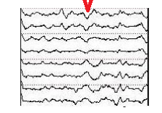
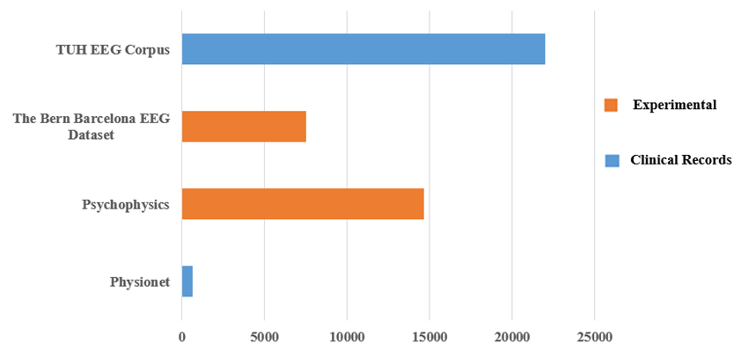
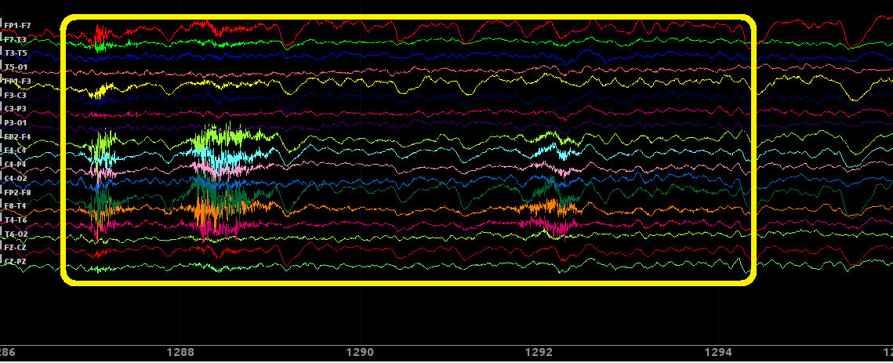
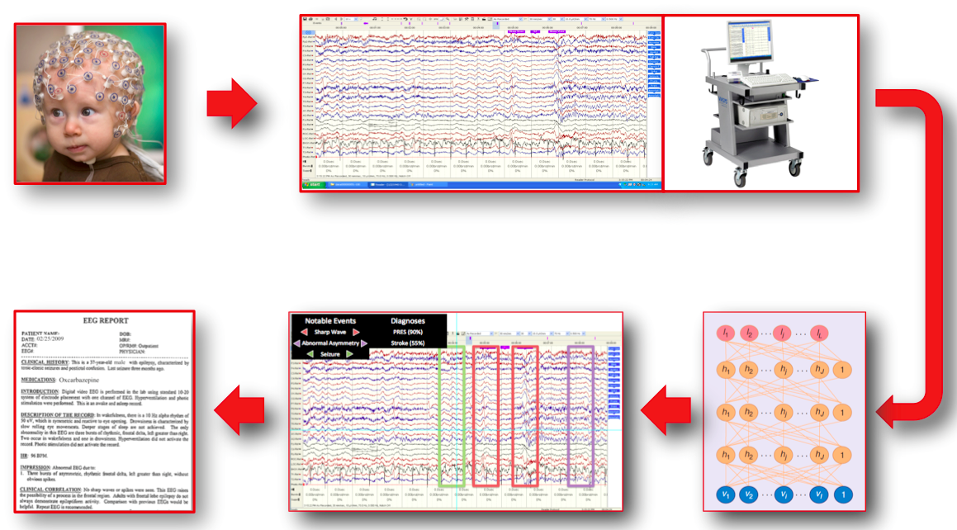
DETECTION OF SLEEP STATE USING MACHINE LEARNING ON BIG DATA
Francisco Raimundo Albuquerque Parente, Lucas Santana, David Jungreis, Dr. Iyad Obeid and Dr. Joseph Picone
The Neural Engineering Data Consortium, Temple University
College of Engineering
Temple University
www.isip.piconepress.com
Abstract
Automatic detection of sleep state is an important queue in accurate detection of sleep conditions.
The analysis of EEGs is a difficult time-consuming task with only moderate inter-observer agreement.
Other obstacles include the presence of noise and artifacts as well as amplitude changes.
We are developing a recognition system to detect whether or not a patient is sleepy, awake or drowsy.
We developed a corpus of 426 EEGs in which 200 contain sleep events. This was partitioned into 150 EEGs for training and 50 EEGs for evaluation.
… state something about your results in three lines …… state something about your results in three lines …
Methodology
EEG sessions were identified based on the presence of relevant comments in the EEG reports:
… show three examples from reports
… show three examples from reports
… show three examples from reports
We manually identified and annotated sleep, drowsy and awake events in each selected EEG.
A sleep condition is indicated by the presence of vertex waves:
Occur most frequently during late stage 1 and stage 2 sleep;
Are identified as distinctive V shaped wave forms with peaks between 100-200µV;
Localized over midline areas of cortex.
Patient is awake when we observe artifacts and irregular signal patterns:
Describe on what channels these events typically occur in two lines…
Add another two-line comments … add another two-line comment
Inversion of polarity in the channels associated with eye movement indicates drowsiness:
… rewrite this comment… it does’t make sense …The patient is looking at the left side in a drowsiness condition.
We used an internal annotation tool to manually label data:
Machine Learning Approach
You need to describe your machine learning system in the remainder of this panel …
Results
[ this panel needs to focus on your machine learning results]
Redo this to have a black signal on white background… zoom this up to support your comment below
Redo this to have a black signal on white background
Figure 6. A drowsy event
Introduction
The emergence of big data and machine learning is enabling the ability to automatically learn how to interpret EEGs from a big data archive.
The TUH EEG Corpus is the largest and most comprehensive publicly-released corpus representing 12 years of clinical data collected at Temple Hospital.
Previously released data resources in this area are mostly represented by experimentally acquired recordings. Figure 1 shows the comparison between the TUH EEG Data Corpus and other resources.
Automatic interpretation of EEGs involves the use of advanced machine learning algorithms trained on large amounts of data:
Figure 3. A typical sleep event
Figure 6. An EEG annotation tool
Redo this figure with a higher resolution view of a vertex wave
Figure 3. Vertex Waves.
Figure 1. A comparison of the TUH EEG Corpus to other publicly available resources
Figure 4. … describe what you are seeing …
Summary
… summarize the database development (specific to sleep annotations) …
Summarize your quantitative results….
Summarize your main findings about the difficulty of this problem
Future work will include the detection of sleep spindles by … state how you will do this …
Acknowledgements
This research was supported by the Brazil Scientific Mobility Program (BSMP) and the Institute of International Education (IIE).
Redo this to have a black signal on white background
Figure 5. An awake event
Figure 2. Automatic interpretation of EEGs

