Slide 1
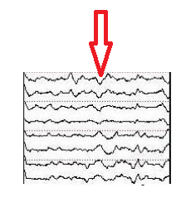
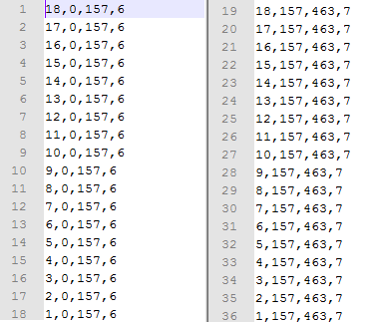
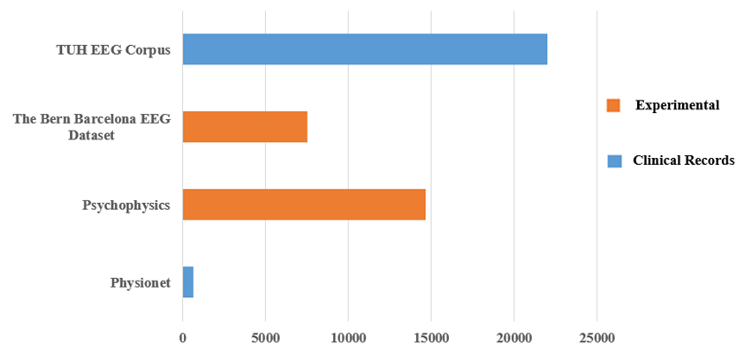
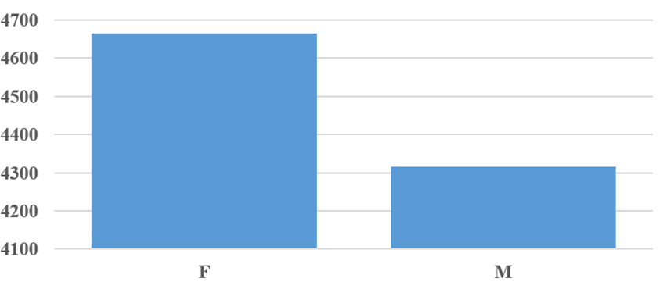
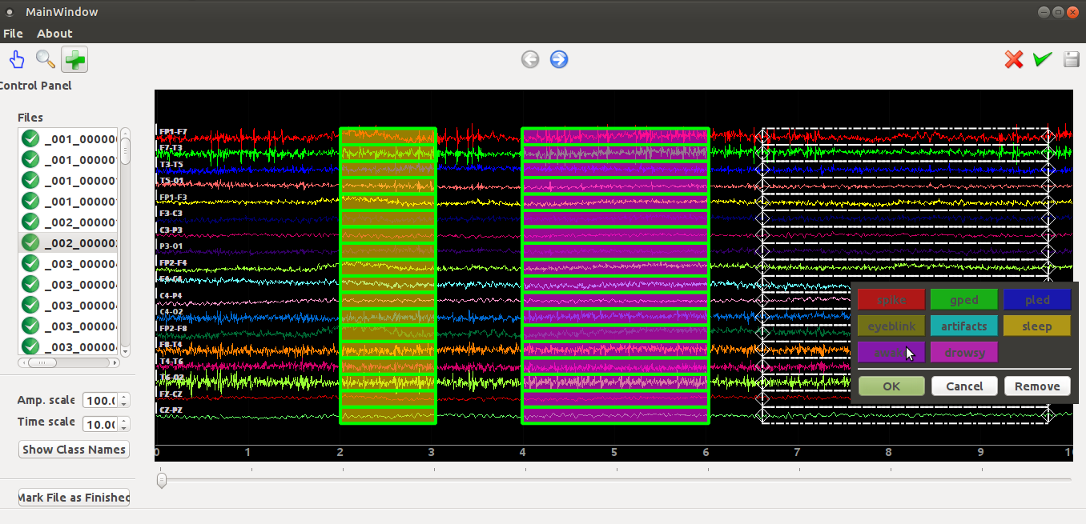
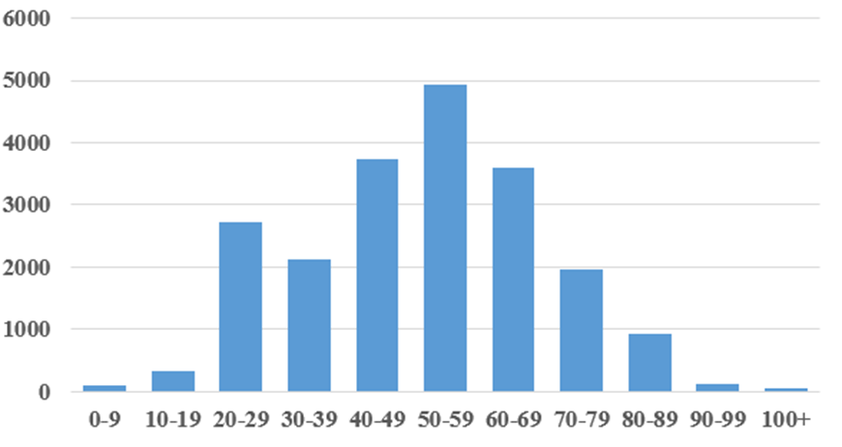
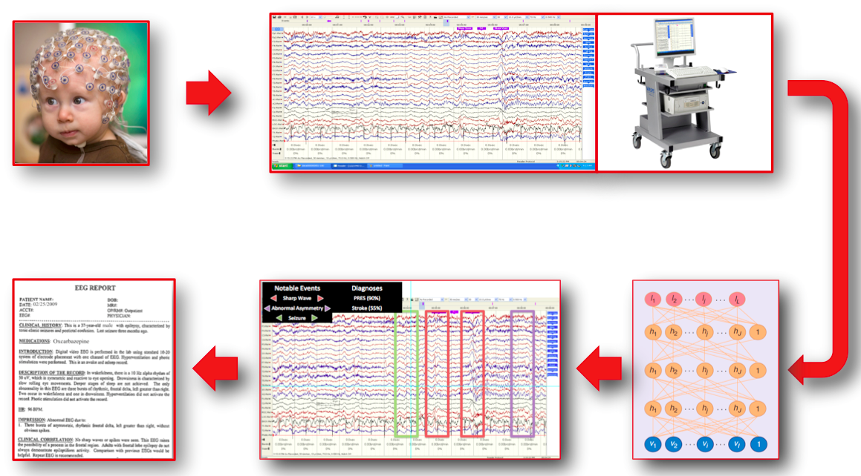
DETECTION OF SLEEP STATE USING MACHINE LEARNING ON BIG DATA
Francisco Raimundo Albuquerque Parente, Lucas Santana, David Jungreis, Dr. Iyad Obeid and Dr. Joseph Picone
The Neural Engineering Data Consortium, Temple University
College of Engineering
Temple University
www.isip.piconepress.com
Abstract
Automatic detection of sleep state is important to enhance the quick diagnostic of sleep conditions
The analysis of EEGs is a difficult time-consuming task with only moderate inter-observer agreement.
Other obstacles include the presence of noise and artifacts as well as amplitude changes
We are developing a recognition system to detect whether or not a patient is sleepy, awake or drowsy.
Our software will help neurologists in the prognostic of diseases related to sleep conditions.
We use our tool, Annotator, in order to mark EEGs with the correct situation of a patient.
We analyzed 426 EEGs of deidentified patients in which 200 contain sleep events.
Methods
We filter patient’s EEGs available in the Corpus whose reports describe the ocurrence of sleep states.
We identify and annotate asleep, drowsy and awake events in each selected EEG by subjective analysis.
Information about waveform frequency and shape is combined with the age of the patient and the chnnel location on the scalp to determine significance.
Sleep condition in EEG is also indicated by the presence of vertex waves:
Occur most frequently during late stage 1 and stage 2 sleep;
Are identified as distinctive V shaped wave forms with peaks between 100-200µV;
Localized over midline areas of cortex.
Methodology
EEG signal files had to be manually annotated using our software tool.
We marked all channels with the proper state for each occurrence of wakefulness, drowsiness and sleep.
We have annotated 200+ sections with clear sleep states.
Corpus Statistics
It includes over 15,000 patients, 20,000+ sessions, 50,000+ EEGs and deidentified clinical information.
Healthcare records are private. Table 2 shows an example of EEG header with omitted information.
The following tables present some statistics about the corpus:
Results
70% of the patients have only 1 EEG recording, 27% have between 2 and 5 sessions, and 3% have more than 5 sessions.
Our analysis involved a large set of EEGs collected from the TUH EEG corpus.
All 300 EDF files were annotated using the labels Sleep, Drowsy and Awake.
Annotator provides REC files as its output. This stardard id shown in Figure 7.
We converted all files into LAB format in order to perform the next steps of training and evaluation.
Field | Description | Example
1 | Version Number | 0
2 | Patient ID | TUH123456789
3 | Gender | M
4 | Date of Birth | 57
8 | Firstname_Lastname | TUH123456789
11 | Startdate | 01-MAY-2010
13 | Study Number/ Tech. ID | TUH123456789/MJJ X
14 | Start Date | 01.05.10
15 | Start Time | 11.39.35
16 | Number of Bytes in Header | 6400
17 | Type of Signal | EDF+C
19 | Number of Data Records | 207
20 | Dur. of a Data Record (Sec) | 1
21 | No. of Signals in a Record | 24
27 | Signal[1] Prefiltering | HP:1.000 Hz LP:70.0 Hz N:60.0
28 | Signal[1] No. Samples/Rec. | 250
Description | Number
Total EEGs Analyzed | 426
Total EEGs with Sleep Event | 200
Total EDFs with Sleep Event | 300
Table 5. Data Set.
Introduction
The emergence of big data and machine learning is enabling the ability to automatically learn how to interpret EEGs from a big data archive.
The TUH EEG Corpus is the largest and most comprehensive publicly-released corpus representing 11 years of clinical data collected at Temple Hospital.
Previously released data resources in this area are mostly represented by experimentally acquired recordings. Figure 1 shows the comparison between the TUH EEG Data Corpus and other resources.
Electroencephalography is increasingly being used for preventive diagnostic procedures.
We identify and extract features of EEG signals available on the Corpus in order to train models and detect sleep states.
Figure 3. Vertex Waves.
Table 2. Example of EEG Header.
Figure 7. REC Format.
Figure 1. TUH EEG Corpus and others.
Summary
ML and big data are emerging approaches to explore EEGs automatically.
The TUH EEG Corpus is a huge EEG database, which improves the accuracy of our statistical models.
Medical analysis of EEGs is time-consuming and subjective since it involves human interpretation of signals.
Future work will include the detection of sleep spindles, which can help neurologists in the preventive prognostic of some diseases, such as dementia.
Acknowledgements
This research was supported by the Brazil Scientific Mobility Program (BSMP) and the Institute of International Education (IIE).
Figure 5. Count of ID by Gender.
Figure 4. Software Annotator.
Numeric Label | Name
6 | Sleep
7 | Awake
8 | Drowsy
Figure 2. EEG Analysis.
Table 1. Sleep State Labels.
Figure 6. Age Distribution.

