Slide 1
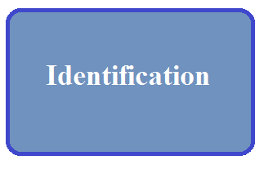
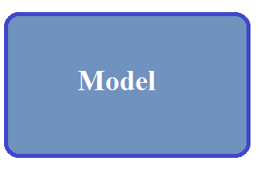
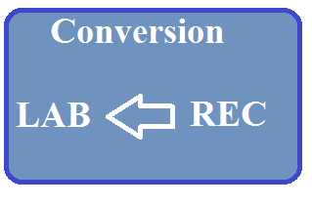
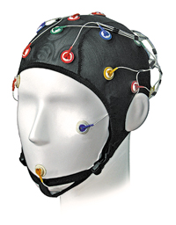
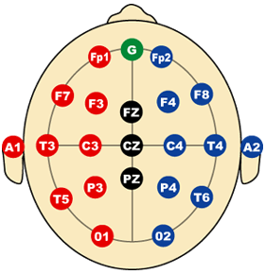
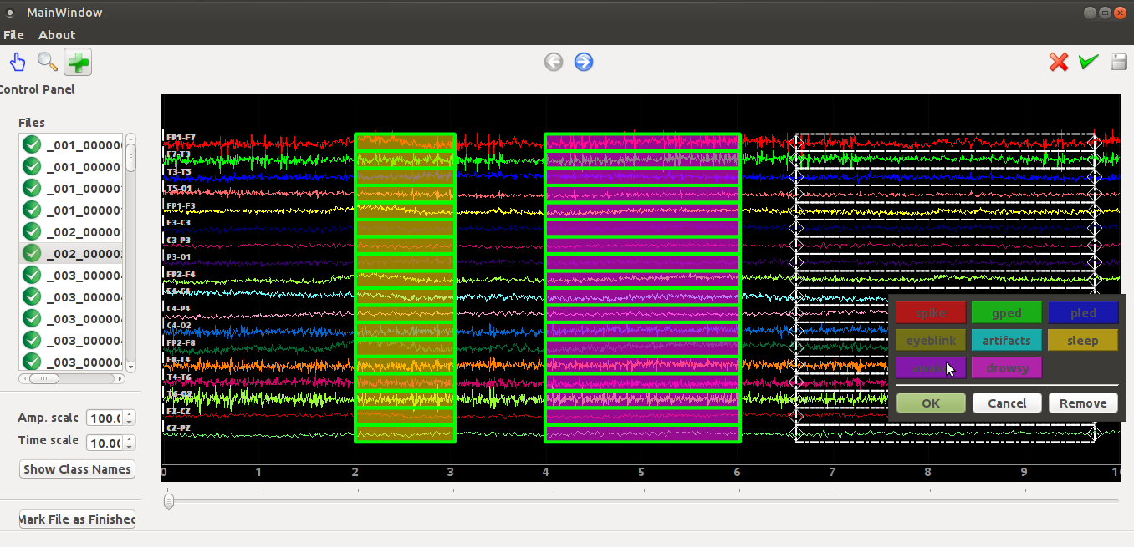
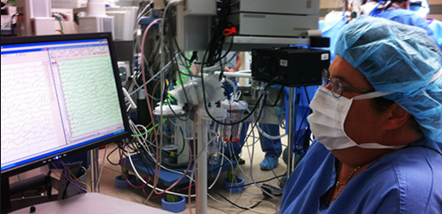
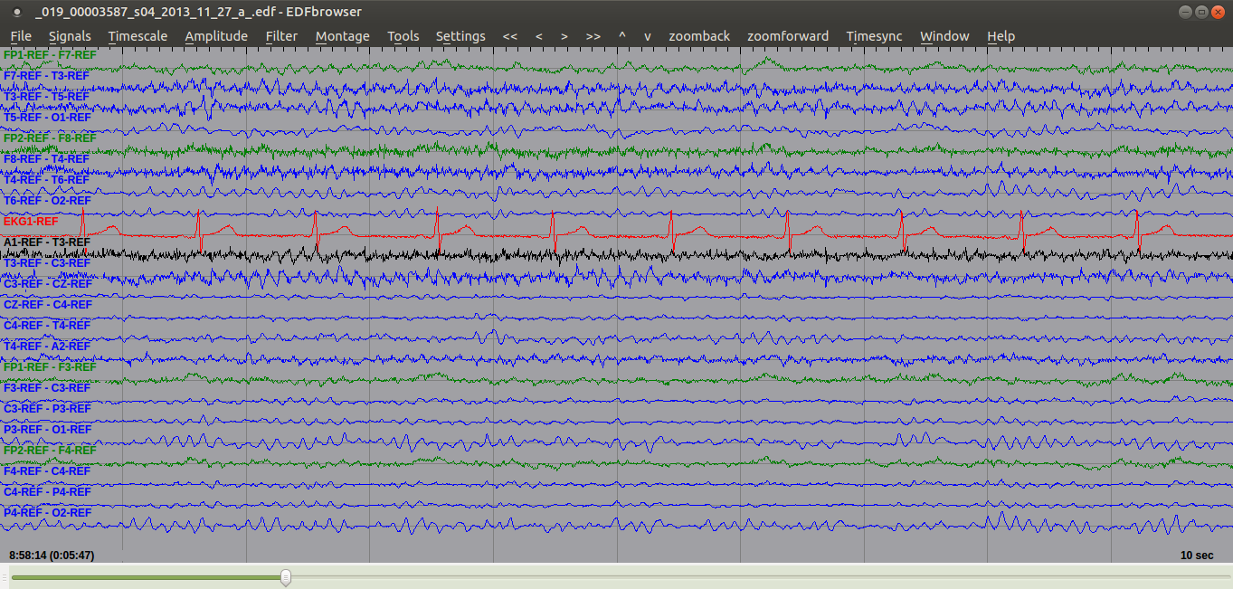
detection of sleep state using machine learning on big data
Francisco Raimundo Albuquerque Parente, Lucas Santana, Dave Jungreis, Dr. Iyad Obeid and Dr. Joseph Picone
Deparment of Electrical and Computer Engineering, Temple University
www.nedcdata.org
Abstract
Machine learning techniques enable the automatic interpretation of EEGs available on big data archive.
The TUH EEG Corpus contains over 50,000 thousands of EEGs, such of them exhibiting sleep events.
We are developing a recognition system to detect whether or not a patient is sleepy, drowsy or awake.
Our goals are training, evaluation and implementation of accurate models with reliable outcomes.
Methods
We filter patient’s EEGs available in the Corpus whose reports describe the ocurrence of sleep states.
We identify and annotate asleep, drowsy and awake events in each selected EEG by subjective analysis.
After format conversion, we have training and evaluation in order to successfully and automatically recognize the sleepy situation of a patient.
Fig. 2: Fluxogram of Methods.
Corpus Statistics
300+ EEGs have been analyzed.
All EEGs were obtained from the Corpus randomly based on medical reports.
Table 1: Example EEG information.
Table 2: Labels used to mark events on Annotator.
Conclusions
The TUH EEG Corpus is a huge EEG database, which improves the accuracy of our stastical models.
ML and big data are powerful resources to explore EEGs automatically.
Medical analysis of EEG is time-consuming and subjective.
Our recognition system helps neurologists in the prognostic of diseases related to sleep conditions.
Automatic detection of sleep states enhance the quick diagnostic of sleep disorders.
In future work, the automatic detection of sleep spindles will help neurologists in the preventive prognostic of some diseases, such as dementia.
Field | Description | Example
1 | Version Number | 0
2 | Patient ID | TUH123456789
3 | Gender | M
4 | Date of Birth | 57
8 | Firstname_Lastname | TUH123456789
11 | Startdate | 01-MAY-2010
13 | Study Number/ Tech. ID | TUH123456789/TAS X
14 | Start Date | 01.05.10
15 | Start Time | 11.39.35
16 | Number of Bytes in Header | 6400
17 | Type of Signal | EDF+C
19 | Number of Data Records | 207
20 | Dur. of a Data Record (Secs) | 1
21 | No. of Signals in a Record | 24
27 | Signal[1] Prefiltering | HP:1.000 Hz LP:70.0 Hz N:60.0
28 | Signal[1] No. Samples/Rec. | 250
Introduction
Electroencephalography (EEG) is a technique clinically implemented for the diagnosis of patient’s conditions, such as sleep disorders.
The analysis of EEG signals is time consuming with moderate inter-observer agreement rate.
We identify and extract features of EEG signals available on the Corpus in order to train models and detect sleep states.
Patient Montage
Observation EEG
Fig. 1: EEG Analysis.
Results
EEG signal files had to be manually annotated using our software tool.
We marked all channels with the proper state for each occurrence of wakefulness, drowsiness and sleep.
We have annotated 200+ sections with clear sleep states.
Fig. 3: Software Annotator.
References
Podgorelec, Vili. “Analyzing EEG Signals with Machine Learning for Diagnosing Alzheimer's Disease”. Electronika ir Elektronika, 10/2012; 18(8):61-64. DOI: 10.5755/j01.eee.18.8.2627.
Costa, João, Manuel Ortigueira, Arnaldo Batista, and Teresa Paiva. "Sleep Spindles Detection: a Mixed Method using STFT and WMSD." International Journal of Bioelectromagnetism (2012), Vol. 14, No. 4, pp. 229 - 233.
Numeric Label | Name
1 | Spike
2 | GPED
3 | Pled
4 | Eyeblink
5 | Artifacts
6 | Sleep
7 | Awake
8 | Drowsy
Acknowledgements
This research was also supported by the Brazil Scientific Mobility Program (BSMP) and the Institute of International Education (IIE).

