Slide 1
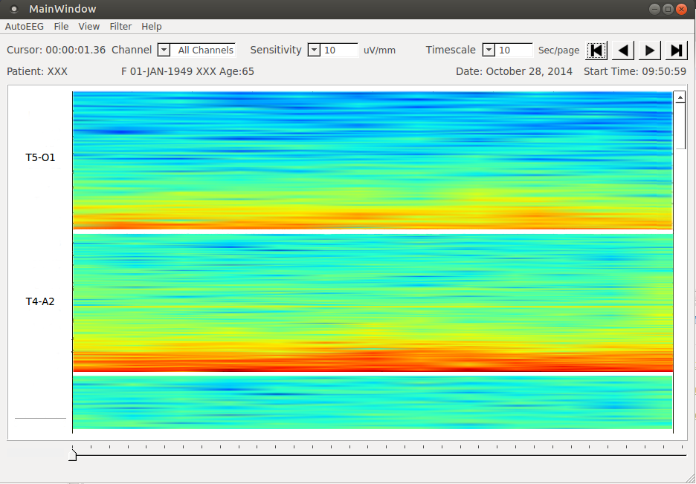
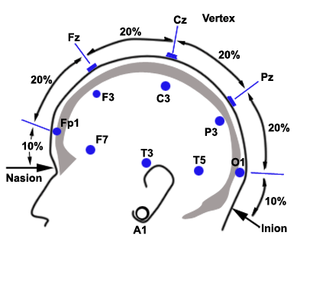
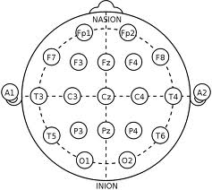
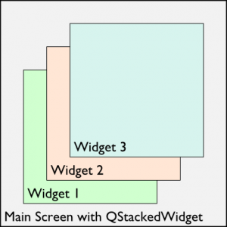
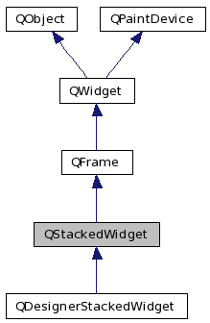
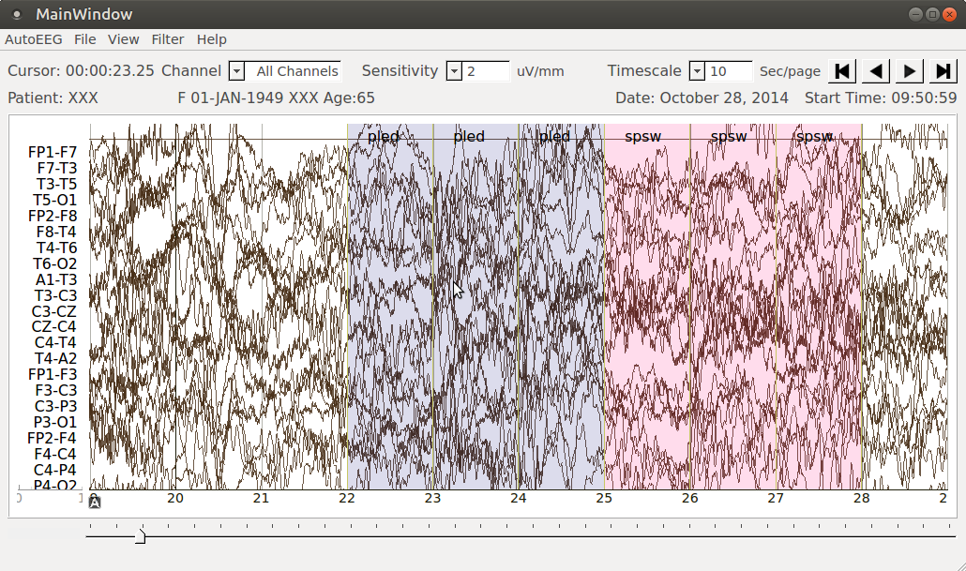
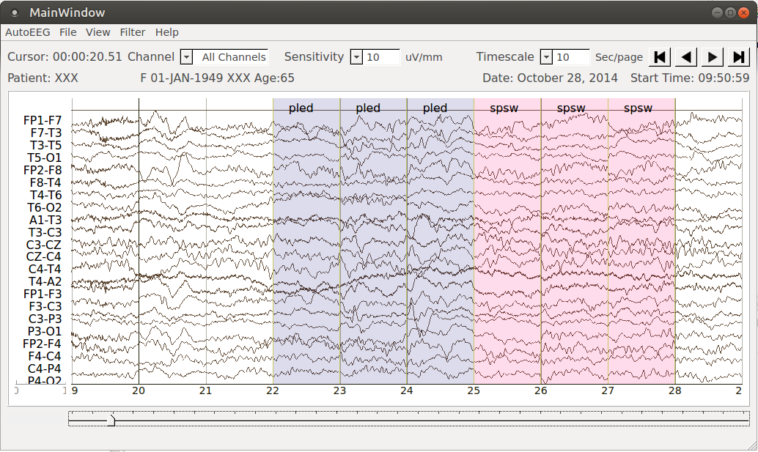
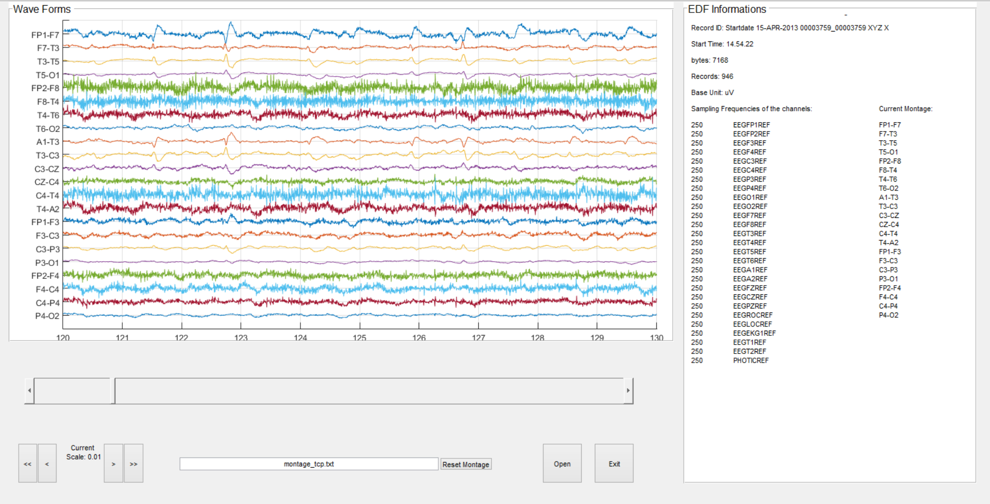
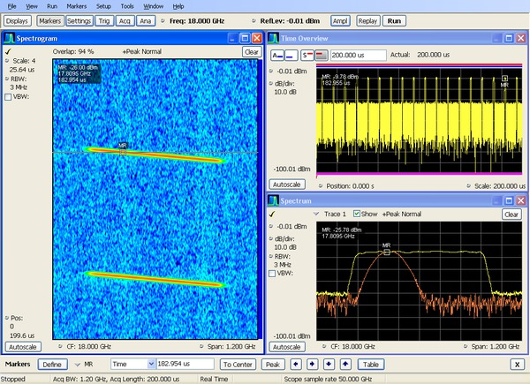
A Live-Input Demonstration System for AUTOEEGTM
Lucas Cotta, Meysam Golmohammadi, Dr. Iyad Obeid and Dr. Joseph Picone
The Neural Engineering Data Consortium, Temple University
www.isip.piconepress.com
College of Engineering
Temple University
Abstract
An electroencephalogram (EEG) measures electrical brain activity along the surface of the scalp. These signals are extremely noisy making automated interpretation challenging.
We are developing a system, AutoEEGTM, that generates time-aligned markers indicating points of interest in the signal. In this project, we present a live-input demonstration system that computes and visualizes these markers.
AutoEEGTM processes EDF files, generates annotation files, displays EEG waveforms and accepts live input. Signal processing options include selection of a montage and filtering.
The goal of this project was to add a spectrogram feature to the system and to reorganize the manner in which various views of the signal were organized.
A systematic design was developed based on the QStackedWidget implementation which made transitions between the views smooth and efficient.
Spectrograms can be powerful visualization tools for localized and characterizing transient events such as spikes and sharp waves.
Data Acquisition
An EEG measurement represents a difference between the voltages at two electrodes. The signal is usually displayed using a montage which is essentially a differential view of the signals.
Software Overview
A demonstration system was previously developed for AutoEEGTM that only displayed waveforms and annotations:
On the use case view, all the possible functionalities are utilized by the actor without hierarchical access. The entries are related to each patient.
On the logical view, the user Interface contains methods for each of the features that the actors use to communicate with the system on the main class. They are mainly three views: waveform, spectrogram and the combination of both.
On the process view the EDF reading occurs in a separated class. The data processing occurs on the main class. Each one of the views (GUI) are represented by their respective class.
The process of raw files, independent component analysis, ephoching, time frequency, bash scripting, and data exporting perfectly match with python use on this project. It runs in all systems license free.
Combined with the PYQT toolkit the application can be developed with clean design and powerful API. The PyQt includes abstractions, parallel processing, SQL databases, XML, a multimedia framework, and a rich collection of GUI widgets. Which perfect match with our application needs.
Signal Visualizations Using Views
The architecture was modified to accommodate three views of signal: waveform, spectrogram, waveform plus spectrogram.
The use QStackedWidget made it easy to switch between the different views:
Model–view–controller (MVC) is a software architectural pattern for implementing user interfaces. It divides a given software application into three interconnected parts, so as to separate internal representations of information from the ways that information is presented to or accepted from the user.
Following the MVC architecture, all the views are generated and stacked at the start of the application.
Only one widget is visible at a time and they fade according to the user choice.
The views transitions occurs effortless among each other with a low computational cost and high usability, making the user experience intuitive, fast and with simple navigation.
Spectrogram
A spectrogram is a visual representation of the spectrum of frequencies in a signal. The spectrogram image processing technique is used to analyze EEG signals.
The technique used to analyse signal in time-frequency based is Short Time Fourier Transform (STFT). The STFT is to perform a FT on the signal, then mapping the signal into a two-dimensional function of frequency and time.
In the computation of the spectrogram function the data are split into NFFT length segments and the spectrum of each section is computed.
Examples
Spectrogram:
Waveforms:
The impact of different views, with different labels, time scaling, sensitivity makes an enormous improvement on the diagnoses' speed.
With a user-friendly interface and visual tools as spectrogram, the analysis can be deployed faster by the doctors and more pertinence.
The machine learning can evaluate and interpreter a huge amount of data in a short period of time.
Introduction
There are several open source tools to visualize EEG signals including EDFBrowser and a MATLAB extension:
Our AutoEEG demonstration system is a cross-platform visualization tool developed in Python based on the PyQt graphics libraries.
This tool displays annotations and accepts live inputs. Users can interact with the data by controlling a variety of parameters including the montage, filters, time scales and sensitivities.
The annotated signal makes EEG data searchable, allowing neurologists to read EEGs more quickly.
Commercial tools support limited frequency domain analysis including spectral slices and spectrograms:
Summary
The AutoEEGTM demonstration tool has been augmented to support standard functions such as print/save to PDF, and more sophisticated functions such as a spectrogram.
The reusability and extensibility of the code has improved dramatically by incorporating a stacked widget approach.
Spectrograms are a very valuable tool for improving the accuracy and efficiency of manual EEG analysis.
Acknowledgements
This research was also supported by the Brazil Scientific Mobility Program (BSMP) and the Institute of International Education (IIE).
Notes:
1

