Slide 1
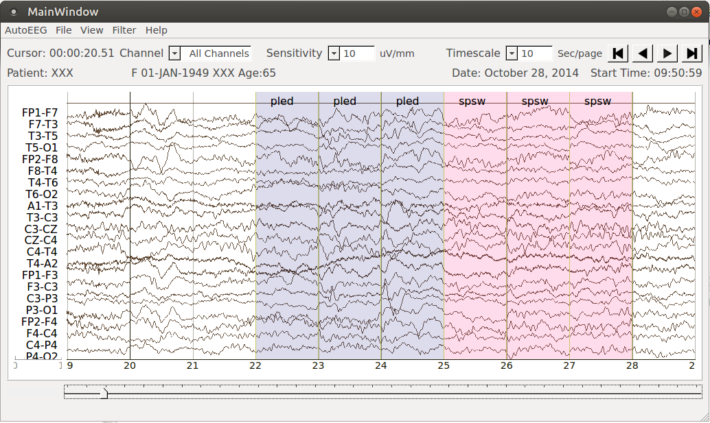
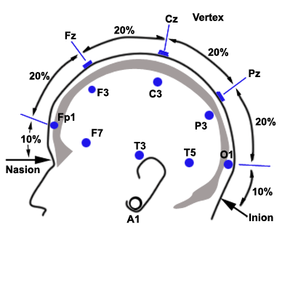
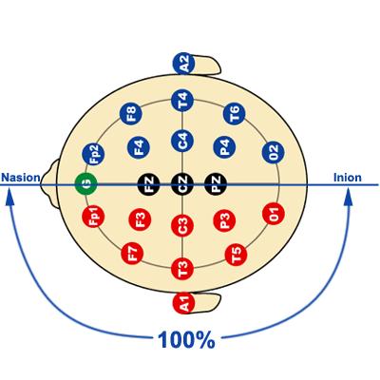
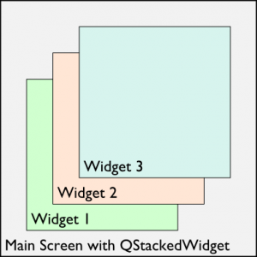
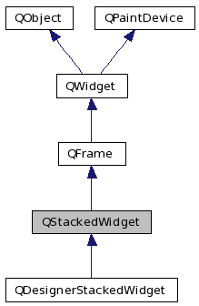
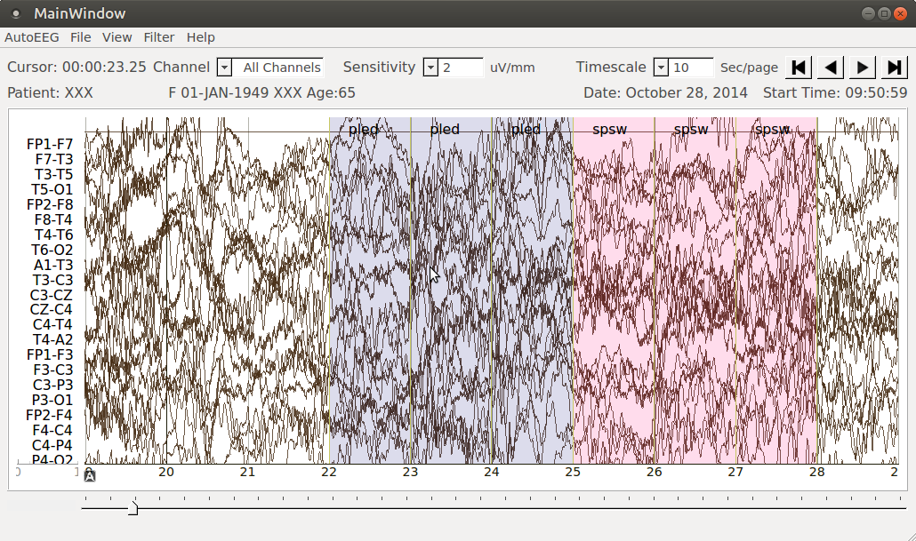
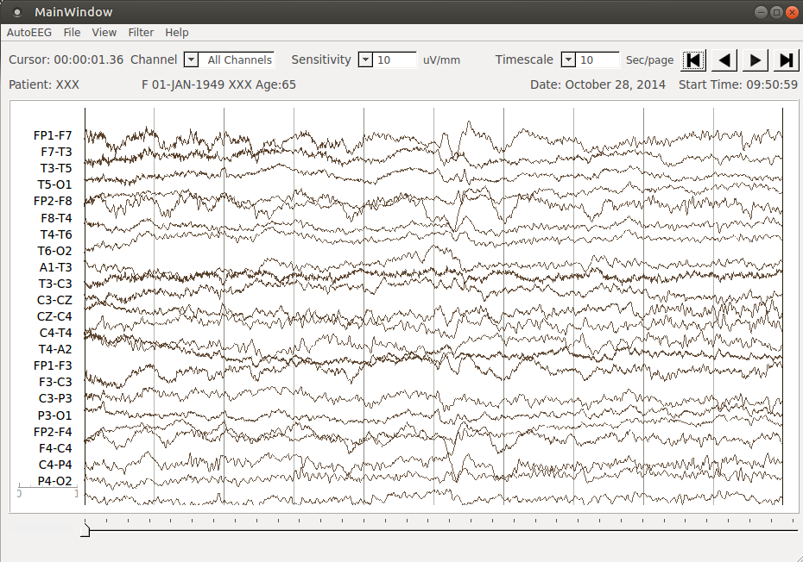
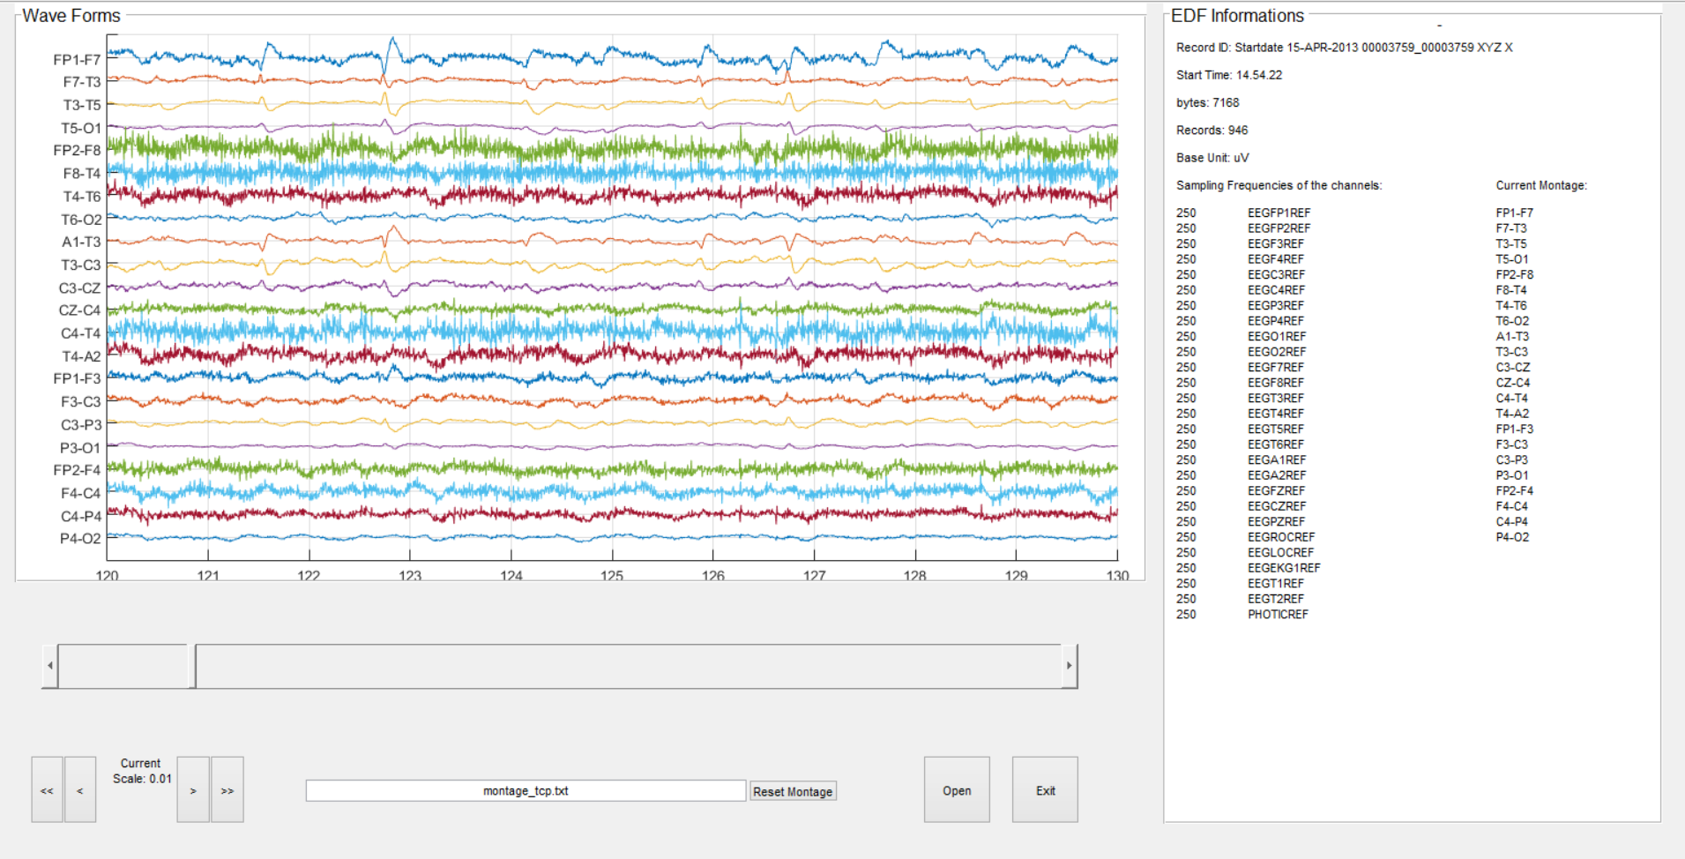
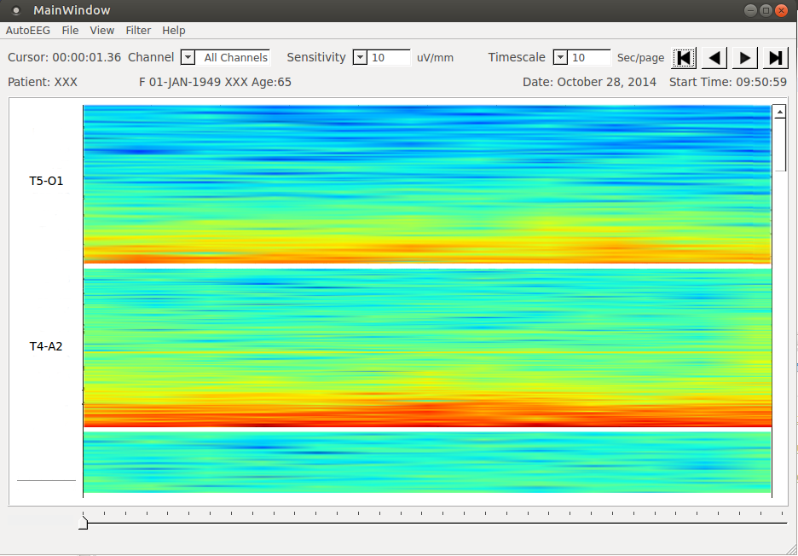
A Live-Input Demonstration System for AUTOEEGTM
Lucas Cotta, Lucas Santana, Meysam Golmohammadi, Dr. Iyad Obeid and Dr. Joseph Picone
The Neural Engineering Data Consortium, Temple University
www.isip.piconepress.com
College of Engineering
Temple University
Abstract
An electroencephalogram (EEG) measures electrical brain activity along the surface of the scalp. These signals are extremely noisy making automated interpretation challenging.
We are developing a system, AutoEEGTM, that generates time-aligned markers indicating points of interest in the signal. In this project, we present a live-input demonstration system that computes and visualizes these markers.
AutoEEGTM processes EDF files, generates annotation files, displays EEG waveforms and accepts live input. Signal processing options include selection of a montage and filtering.
The goal of this project was to add a spectrogram feature to the system and to reorganize the manner in which various views of the signal were organized.
A systematic design was developed based on the QStackedWidget implementation which made transitions between the views smooth and efficient.
Spectrograms can be powerful visualization tools for localized and characterizing transient events such as spikes and sharp waves.
Data Acquisition
An EEG measurement represents a difference between the voltages at two electrodes. The signal is usually displayed using a montage which is essentially a differential view of the signals. computed by differencing adjacent channels (use Dave J.’s view of a TCP montage)
Software Overview
A demonstration system was previously developed for AutoEEGTM that only displayed waveforms and annotations:
The software architecture are on an underlying Unified Modeling Language (UML) model.
Discuss the deficiencies of the current design in details using two bullet points here…
Discuss the deficiencies of the current design in details using two bullet points here…
Signal Visualizations Using Views
The architecture was modified to accommodate three views of signal: waveform, spectrogram, waveform plus spectrogram.
The use QStackedWidget made it easy to switch between the different views:
… what is the MVC architecture …
Following the MVC architecture, all the views are generated and stacked at the start of the application.
Only one widget is visible at a time and they fade according to the user choice.
The views transitions occurs effortless among each other with a low computational cost and high usability, making the user experience intuitive, fast and with simple navigation.
… rewrite this in three lines (one sentence) explaining sub-widgets and smooth shifting …
Spectrogram
Give a synopsis of the spectrogram feature in terms of parameters and capabilities… three lines… three lines…
Make another nice point about this feature such as how fast it is (xRT)… two lines… two lines…
Examples
Annotated Waveforms:
Waveforms and Spectrograms:
One summary point… three lines … three lines … three lines…. three lines … three lines … three lines…. three lines … three lines … three lines….
Second summary point… three lines … three lines … three lines…. three lines … three lines … three lines…. three lines … three lines … three lines….
Third summary point… three lines … three lines … three lines … three lines … three lines … three lines … three lines …
New screenshot with channel labels
Introduction
There are several open source tools to visualize EEG signals including EDFBrowser and a MATLAB extension:
Our AutoEEG demonstration system is a cross-platform visualization tool developed in Python based on the PyQt graphics libraries.
This tool displays annotations and accepts live inputs. Users can interact with the data by controlling a variety of configuration parameters including the montage, filters, time scales and sensitivities.
The annotated signal makes EEG data searchable, allowing neurologists to read EEGs more quickly.
Commercial tools support limited frequency domain analysis including spectral slices and spectrograms:
[… show a picture here of existing frequency display tools for NicVue. Meysam and Silvia can help with that….]
Waveform plus spectrogram
This screenshot needs to show annotations!
Summary
The AutoEEGTM demonstration tool has been augmented to support standard functions such as print/save to PDF, and more sophisticated functions such as a spectrogram.
The reusability and extensibility of the code has improved dramatically by incorporating a stacked widget approach.
Spectrograms are a very valuable tool for improving the accuracy and efficiency of manual EEG analysis.
Acknowledgements
This research was also supported by the Brazil Scientific Mobility Program (BSMP) and the Institute of International Education (IIE).
This graphic needs to show a diagram describing the existing architecture.
Need a much better image of the spectrogram.
Notes:
1

