Slide 1
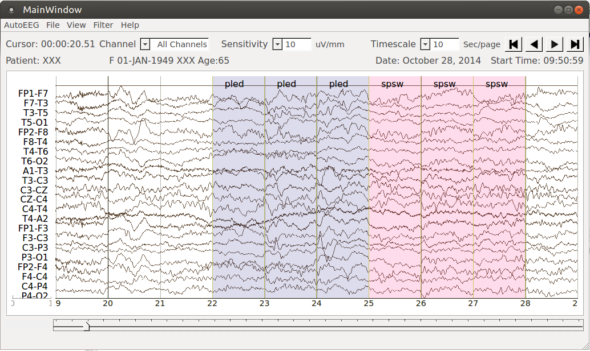
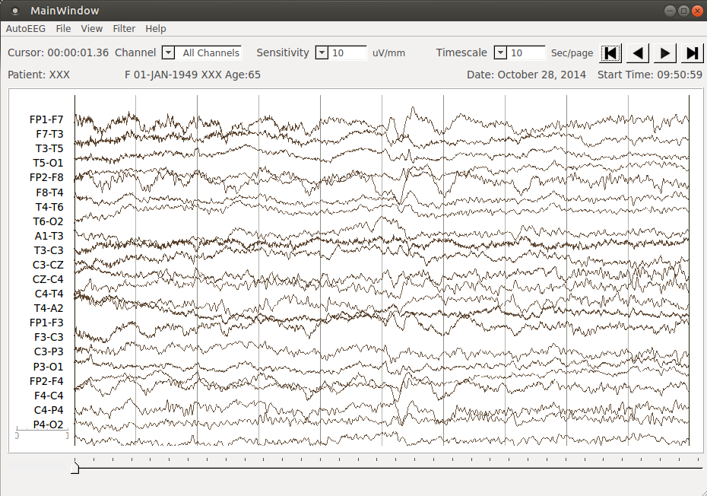
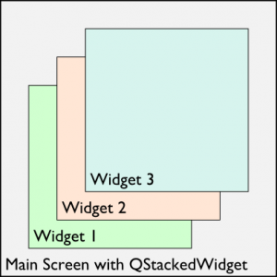
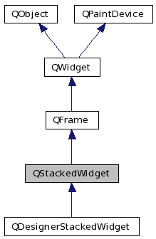
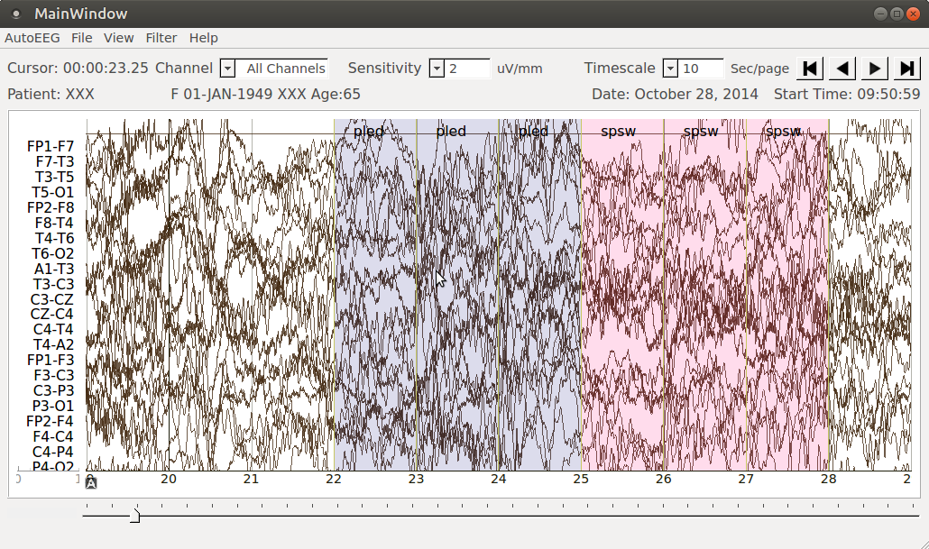
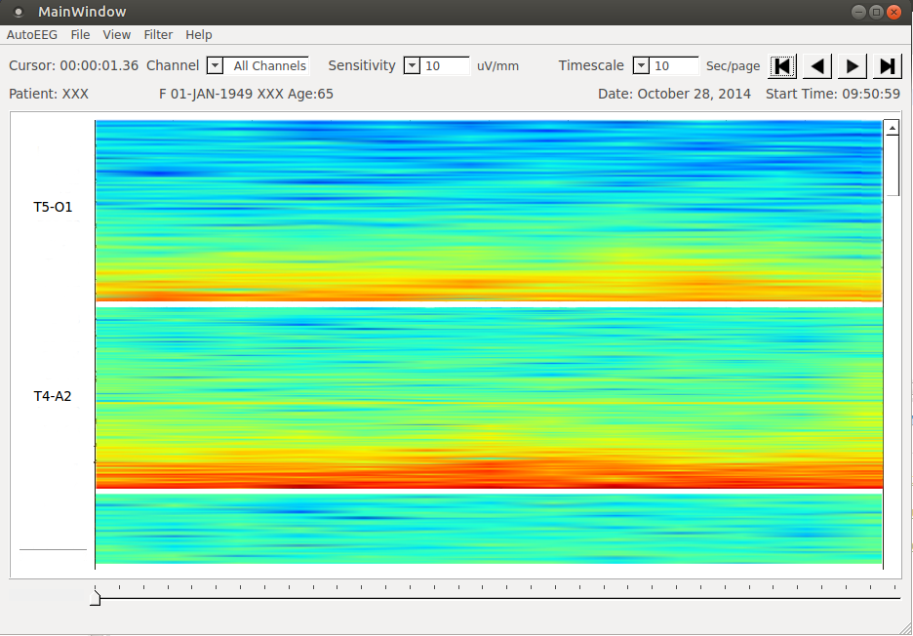
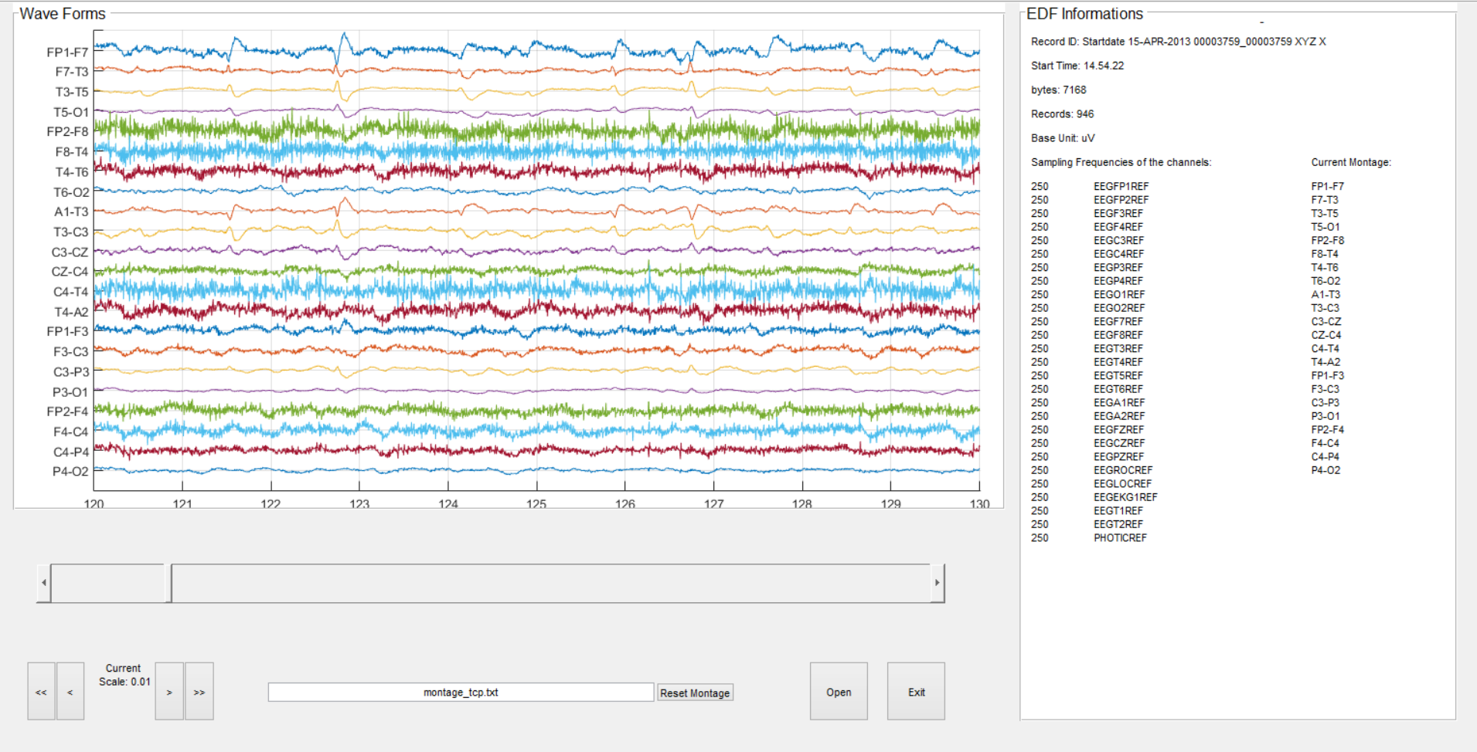
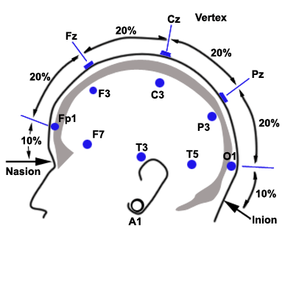
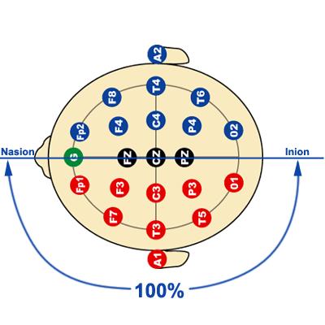
A Live-Input Demonstration System for AUTOEEGTM
Lucas Cotta, Lucas Santana, Meysam Golmohammadi, Dr. Iyad Obeid and Dr. Joseph Picone
The Neural Engineering Data Consortium, Temple University
College of Engineering
Temple University
www.isip.piconepress.com
Abstract
The electroencephalogram (EEG) is responsible for measuring electrical brain activity along the surface of the scalp. These signals are noisy making automated interpretation challenging.
We are developing a system, AutoEEGTM, that generates time-aligned markers indicating points of interest in the signal. In this project, we present a live-input demonstration system that computes and visualizes these markers.
Processing the EDF files, Auto-EEG generates annotation files, shows EEG signals, accepts live inputs and process data. Implementing filters and adjustable time scales.
Although the application had useful features, there was usability lack. The design should organize the user interface purposefully, in meaningful ways based on clear, consistent models.
A conceptional and systematic design approach was developed standing out the user experience. The transitions become effortless with the QStackedWidget implementation.
The graphic representation of the spectrum, spectrogram, is essential to take a quick look at the data and analyze the overall big picture.
Software Overview
A demonstration system was developed for AutoEEGTM that displays annotations and allows users to process new data:
The software architecture are on an underlying Unified Modeling Language (UML) model.
On the use case view, all the possible functionalities are utilized by the actor without hierarchical access. The entries are related to each patient.
On the logical view, the user Interface contains methods for each of the features that the actors use to communicate with the system on the main class. They are mainly three views: waveform, spectrogram and the combination of both.
On the process view the EDF reading occurs in a separated class. The data processing occurs on the main class. Each one of the views (GUI) are represented by their respective class.
The process of raw files, independent component analysis, ephoching, time frequency, bash scripting, and data exporting perfectly match with python use on this project. It runs in all systems license free.
Combined with the PYQT toolkit the application can be developed with clean design and powerful API. The PyQt includes abstractions, parallel processing, SQL databases, XML, a multimedia framework, and a rich collection of GUI widgets. Which perfect match with our application needs.
Data Acquisition
An EEG measurement represents a difference between the voltages at two electrodes. The signal is usually displayed using a montage which is essentially a differential view of the signals computed by differencing adjacent channels (use Dave J.’s view of a TCP montage)
Views
The architecture was specifically changed to accommodate multiple views. The used of the QStackedWidget makes it easy to switch between the different views in the application.
Following the MVC architecture, all the views are generated and stacked on the application start. Only one widget is visible at a time and they fade according to the user choice.
The views transitions occurs effortless among each other with a low computational cost and high usability, making the user experience intuitive, fast and with simple navigation.
The application offers different views according to the needs. Waveform, spectrogram and montage. Those views contain specific approaches that facilitates the understanding of the patient data without massive work from the neurologist's end.
The class responsible handle the selection of the visible sub widget that should slide in. Whenever this is called, the currently shown sub-widget is smoothly shifted out.
Examples
Labeling:
Changing sensitivity:
The impact of different views, with different labels, time scaling, sensitivity makes an enormous improvement on the diagnoses' speed. With a user-friendly interface and visual tools as spectrogram, the analysis can be deployed faster by the doctors and more pertinence, once that the machine learning can evaluate and interpreter a huge amount of data in a short period of time.
Introduction
EDFBrowser and MATLAB are free, opensource, multiplatform, which works as universal viewer and toolbox intended for timeseries storage files like EEG. As the application below:
However the need of an application that displays the annotation and accepts live inputs, changeable time scale and sensitivity per channel with visual interface still exists.
The application can open EDF file, showing EEG signals and their related annotations with the possibility of different views, which optimize the data analysis.
Auto-EEG uses TCP as the default montage format for EDF files. A new montage definition can be set by the user.
The annotations can be searched based on the filters status and be showed in two modes: events and labels.
Summary
Some functions such as printing the EEG waveforms were implemented and the new architecture of views allows for different system's views.
The spectrogram function generated from each channel can be used as a visual tool for quick analysis.
Changing the application structure from different views can be added without big modifications on the code, from now. The re-usability is very high.
Acknowledgements
This research was also supported by the Brazil Scientific Mobility Program (BSMP) and the Institute of International Education (IIE).
Notes:
1

