Slide 1
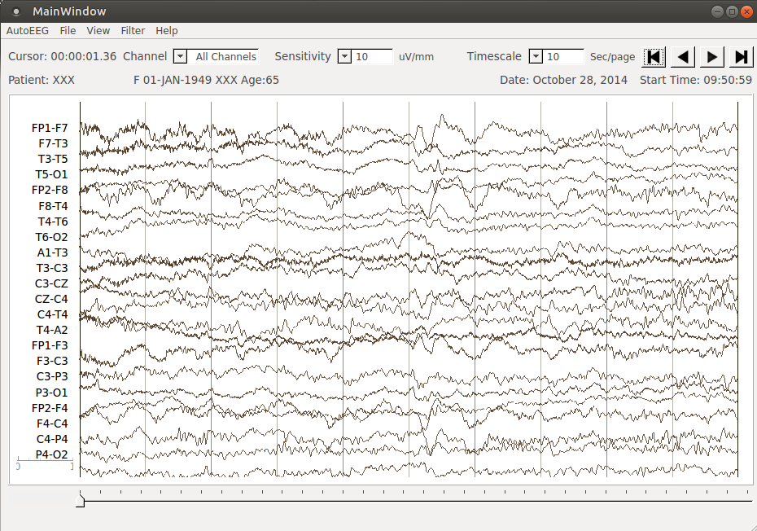
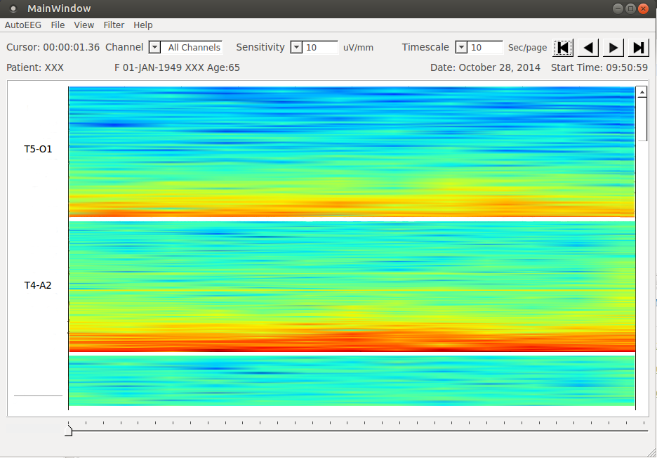
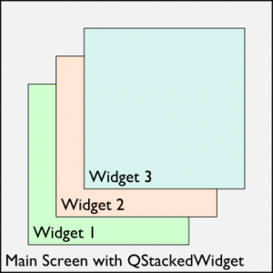
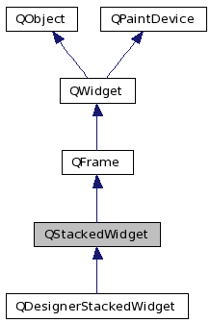
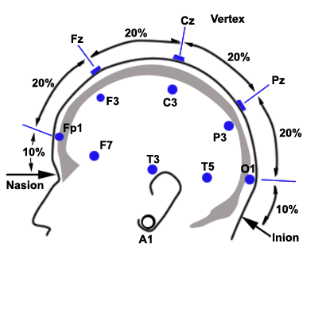
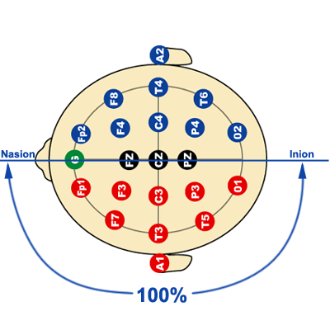
A Live-Input Demonstration System for AUTOEEGTM
Lucas Cotta, Lucas Santana, Meysam Golmohammadi, Dr. Iyad Obeid and Dr. Joseph Picone
The Neural Engineering Data Consortium, Temple University
www.isip.piconepress.com
College of Engineering
Temple University
Abstract
The electroencephalogram (EEG) is responsible for measuring electrical brain activity along the surface of the scalp. These signals are noisy making automated interpretation challenging.
We are developing a system, AutoEEGTM, that generates time-aligned markers indicating points of interest in the signal. In this project, we present a live-input demonstration system that computes and visualizes these markers.
Explain what autoeeg in its previous state was in three lines…Explain what autoeeg in its previous state was in three lines…
Explain the motivation behind your proposed changes in three lines…Explain the motivation behind your proposed changes in three lines
Explain how you made these changes… what techniques were used to implement these changes…get technical…
Explain the impact spectrograms will have on clinical science… in three lines… Explain the impact spectrograms will have on clinical science…
Software Overview
A demonstration system was developed for AutoEEGTM that displays annotations and allows users to process new data:
Give an overview of the current software architecture…
Describe the implementation in Python and how it leverages the PyQT toolkit (and why that was chosen).
Data Acquisition
An EEG measurement represents a difference between the voltages at two electrodes. The signal is usually displayed using a montage which is essentially a differential view of the signals computed by differencing adjacent channels (use Dave J.’s view of a TCP montage)
Views
This panel should focus on your changes to the architecture to accommodate multiple views and the specifics of the spectrogram display. Explain these things in detail.
The application offers different views according to the needs. Waveform, spectrogram and montage. Those vies all contain specific approaches that facilitates the understanding of the patient data without massive work from the neurologist's end.
The application's views is based on the the QStackedWidget class, which provides a stack of widgets where only one widget is visible at a time. The class can also be used as a top level widget.
Examples
This panel should show some examples of spike waveforms and the corresponding spectrograms.
Talk about impact…
Introduction
You need to talk about alternate visualization solutions such as our MATLAB code, EDFBrowser, etc.
Show a screenshot of Pedro’s most recent version of the MATLAB tools and a screenshot of EDF Browser
Discuss the need for a demo that displays our annotations and accepts live input.
Fill up this panel with intro materials.
Summary
Two bullet points summarizing your contributions. Each of these should be three lines long. Each of these should be three lines long.
Two bullet points summarizing your contributions. Each of these should be three lines long. Each of these should be three lines long.
One point about future work - three lines long…One point about future work - three lines long…One point about future work - three lines long…
Acknowledgements
This research was also supported by the Brazil Scientific Mobility Program (BSMP) and the Institute of International Education (IIE).
Notes:
1

