Slide 1
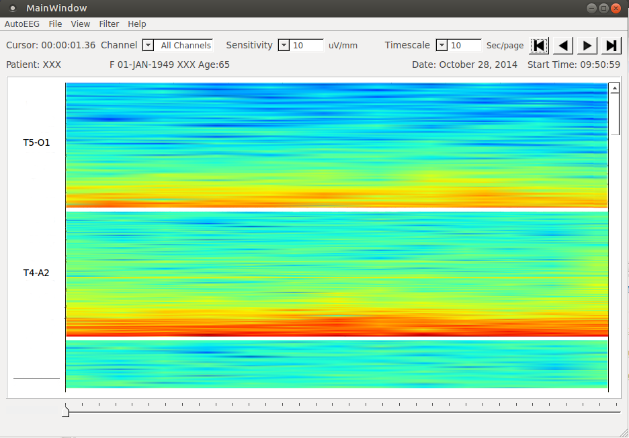
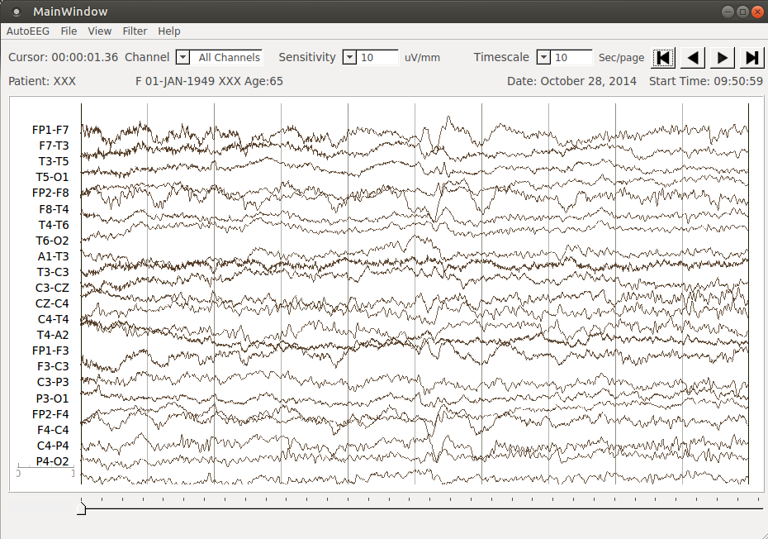
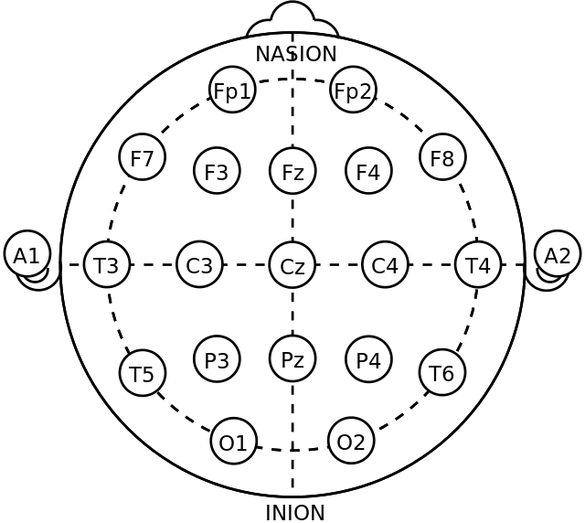
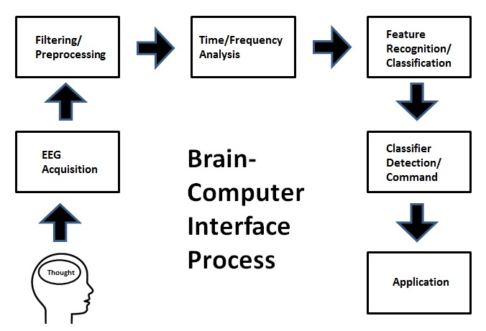
Auto-EEG Demo: a user-friendly application for EEG analysis
Lucas Cotta, Lucas Santana, Meysam Golmohammadi, and Dr. Joseph Picone
Electrical & Computer Engineering, Temple University
www.nedcdata.org
engineering.temple.edu
Abstract
The electroencephalogram (EEG) is responsible for measuring electrical brain activity. Complicated statistical and mathematical analysis are the primary tools in neuroscience. Combined with big data and deep learning, the ability to automatically learn how to interpret EEGs increases even more. On the application side, the complexity increases simultaneously with the decrease of the usability. The EEG analysis is harmless and relatively inexpensive, also it's the most important investigation in the diagnosis and management of epilepsies. His optimization helps neuroscientists' diagnoses through the generation of reliable data.
We are developing a system, Auto-EEG, that generates time aligned markers indicating points of interest in the signal, which then produces a summarization of its findings based on a statistical analysis of this markers in a friendly interface.
The application is more than functional, it's user-friendly to support the decision making.
Software Overview
The training uses machine learning algorithms based on hidden Markov models and deep learning to learn mappings of EEG events to help with doctors' analysis.
The software is written almost entirely in python. Its interface is designed in QT Design, which generates python files for the the GUI. Auto-EEG also uses Shell scripts, which makes the software portable and a cross-platform application.
The programming language and scripts combined are a powerful noncommercial license with high performance to analyze huge amounts of data.
Data Processing
The data is processed by machine algorithms based on hidden Markov models and deep learning. They are then utilized to learn mappings of EEG events to better assist diagnosis.
The inputs are file formated for archival, exchange of sleep and EEG data (multichannel raw data) needs.
The machine training is responsible for reliably labeling the files with different labels and generating a varying set of views that help in decision making.
Views
The application offers different views according to the needs. Waveform, spectrogram and montage. Those vies all contain specific approaches that facilitates the understanding of the patient data without massive work from the neurologist's end.
Figure 3. Machine learning based on Hidden Markov models
Figure5. Auto-EEG Spectrogram view
Human–computer Interaction
Demo is driven by its interface, a generic environment structure encompassing the interface in which specific functions were implemented.
It's also contextual rather than linear: the multiple features from the software are not listed in long menus. The interface is very intuitive for those who are knowledgeable about the EEG features. These features are accessible only when needed, therefore eliminating the typical pop-up menus which can then allow the interface to be more intuitive, faster, and increase comprehension.
Summary
Application for EEG analysis with a friendly user interface.
Reliably and replicate data processing.
Big data and machine learning offer the potential to deliver much higher performance solutions.
Acknowledgements
College of Engineering, Temple University
This research was also supported by the
Brazil Scientific Mobility Program (BSMP)
and the Institute of International Education
(IIE)
Meysam Golmohammadi, Master.
Joseph Picone, Ph.D.
Introduction
Although EEG instrumentation is becoming more common in research centers, the software availability and standardization remain limited or with a very low usability compared to the other functional brain imaging modalities.
The acceptance seems to be very hard, once that the technological challenges repel the adoption of the tools by the users.
The user’s needs for analysis and visualization of EEG data vary depending on their application.
For instance, the raw recordings can be used to identify abnormal brain activity or seizure events.
The software solution would be beneficial to the imaging community and provide automation, standardization and reproducibility of the EEG analysis, with the possibility of importing large amounts of data to mathematical and visual analysis
Figure1. Auto-EEG Waveform
Figure1. TCP montage format
Figure 4. Brain-Computer interface
Notes:
1

