Slide 1
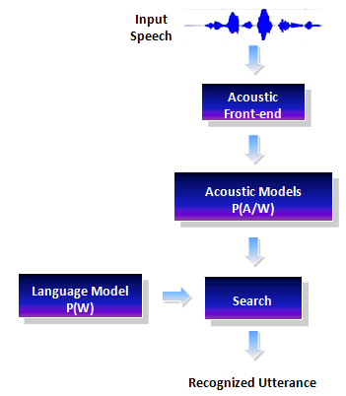
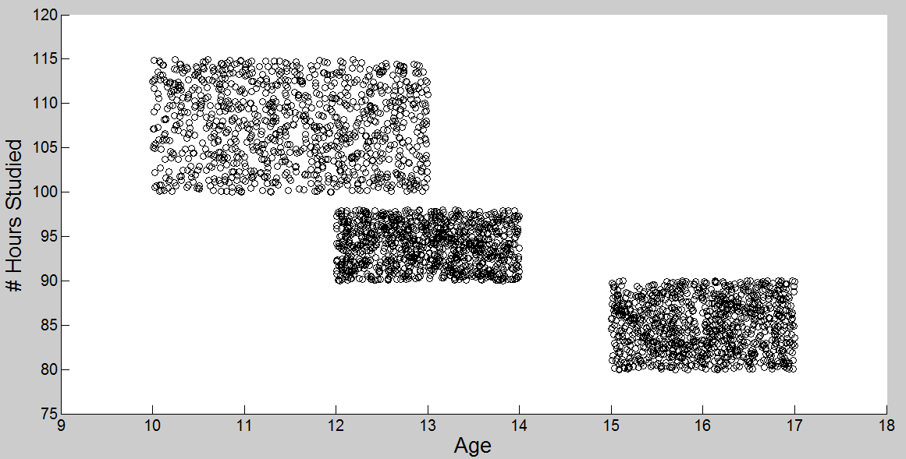
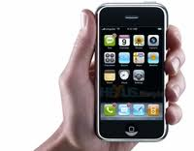
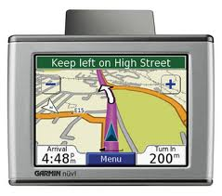
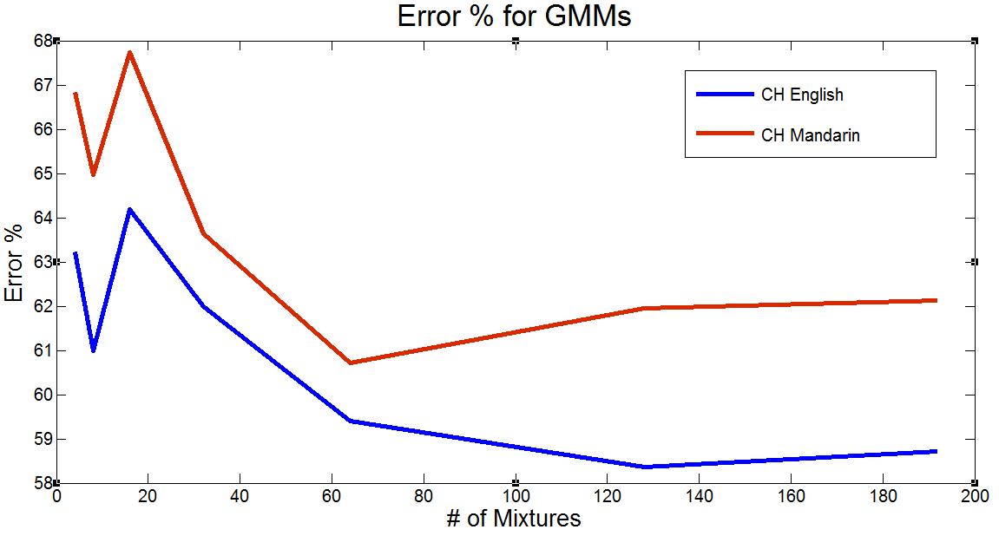
College of Engineering
Temple University
Variational Inference Algorithms for Acoustic Modeling in Speech Recognition
www.isip.piconepress.com
John Steinberg and Dr. Joseph Picone Department of Electrical and Computer Engineering, Temple University
Abstract
The focus of this work is to assess the performance of three new variational inference algorithms for the acoustic modeling task in speech recognition:
Accelerated variational Dirichlet process mixtures (AVDPM)
Collapsed variational stick breaking (CVSB)
Collapsed Dirichlet priors (CDP).
Speech recognition (SR) performance is highly dependent on the data it was trained on. Our goal is to reduce the complexity and sensitivity of training.
Dirichlet Processes Mixtures (DPMs) can learn underlying structure from data and can potentially help improve a system’s ability to generalize to unseen data. Inference algorithms are needed to make calculations tractable for DPMs.
Speech Recognition Systems
English vs. Mandarin: A Phonetic Comparison
Probabilistic Modeling: DPMs and Variational Inference
What is a phoneme?
An Example
Training Features:
# Study Hours
Age
Training Labels
Previous grades
about
Word
a – bout
Syllable
ax –b – aw – t
Phoneme
How many classes are there? 1? 2? 3?
[1]
QUESTION: Given a new set of features, what is the predicted grade?
Applications
English
~10,000 syllables
~42 phonemes
Non-Tonal Language
Mandarin
~1300 syllables
~92 phonemes
Tonal Language
4 tones
1 neutral
7 instances of “ma”
Other Applications
Translators
Prostheses
Lang. Educ.
Media Search
Variational Inference
DPMs require ∞ parameters
Variational inference is used to estimate DPM models
Dirichlet Processes
DPMs model distributions of distributions
Can find the best # of classes automatically!
National
Intelligence
Auto/GPS
Mobile
Technology
Experimental Setup
Gaussian Mixture Models
Variational Inference Results
Conclusions
DPMs can optimize the # of mixtures for GMMs
AVDPM, CVSB, and CDP yield slightly improved error rates over GMMs with fixed #’s of mixtures
AVDPM, CVSB, and CDP found much fewer # ‘s of mixtures than GMMs with fixed #’s of mixtures
CH-E and CH-M performance gap is due to the number of class labels.
Future Work
Assess computational complexity of AVPDM, CVSB, and CDP (CPU time)
Compare error rates on CH-E and CHM to results from TIMIT
Evaluate effects of collapsing the label set in Mandarin to further reduce error rates
Why English and Mandarin?
Phonetically very different
Can help identify language specific artifacts that affect performance
CH-E
CH-M
CALLHOME English
*This experiment has not been fully completed yet and this number is expected to dramatically decrease
k | Error (%) (Val / Evl)
4 | 63.23% / 63.28%
8 | 61.00% / 60.62%
16 | 64.19% / 63.55%
32 | 62.00% / 61.74%
64 | 59.41% / 59.69%
128 | 58.36% / 58.41%
192 | 58.72% / 58.37%
k | Error (%) (Val / Evl)
4 | 66.83% / 68.63%
8 | 64.97% / 66.32%
16 | 67.74% / 68.27%
32 | 63.64% / 65.30%
64 | 60.71% / 62.65%
128 | 61.95% / 63.53%
192 | 62.13% / 63.57%
Algorithm | Best Error Rate: CH-E | Avg. k per Phoneme
GMM | 58.41% | 128
AVDPM | 56.65% | 3.45
CVSB | 56.54% | 11.60
CDP | 57.14% | 27.93*
Corpora:
CALLHOME English (CH-E), CALLHOME Mandarin (CH-M)
Conversational telephone speech
~300,000 (CH-E) and ~250,000 (CH-M) training samples respectively
CALLHOME Mandarin
Paradigm:
Compare DPMs to a baseline Gaussian mixture model (GMM)
Optimize system parameters such as the number of mixtures and word error rate
Compare model complexity
Algorithm | Best Error Rate: CH-M | Avg. k per Phoneme
GMM | 62.65% | 64
AVDPM | 62.59% | 2.15
CVSB | 63.08% | 3.86
CDP | 62.89% | 9.45
Notes:
This poster template is from http://www.swarthmore.edu/NatSci/cpurrin1/posteradvice.htm. It is free, free, free for non-commercial use. But if you really like it, I’m always thrilled to get postcards from wherever you happen to be presenting your poster. Or, send me cookies! My kids made me put that last sentence in. Have fun. Sincerely, Colin Purrington, Department of Biology, Swarthmore College, Swarthmore, PA 19081, USA. Email: cpurrin1@swarthmore.edu

