Slide 1
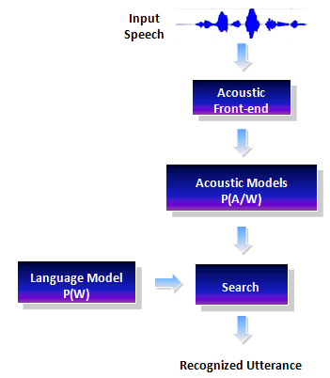
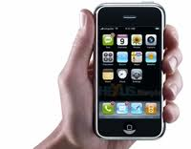
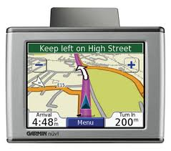
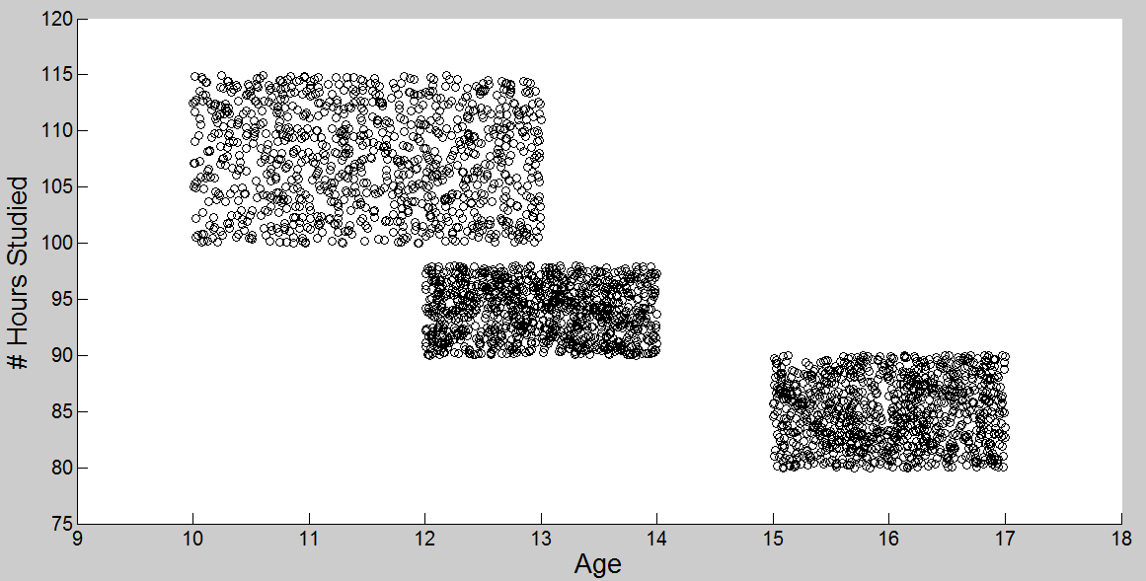
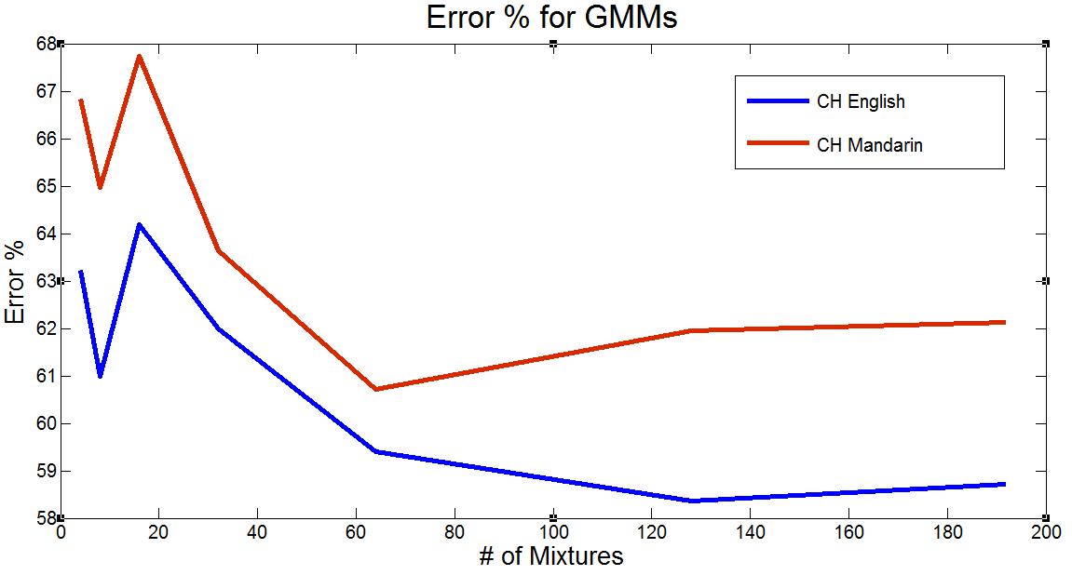
College of Engineering
Temple University
Variational Inference Algorithms for Acoustic Modeling Using the CALLHOME English and Mandarin Corpora
John Steinberg & Dr. Joseph Picone Department of Electrical and Computer Engineering, Temple University, Philadelphia, Pennsylvania
Abstract
The focus of this work is to assess the performance of new variational inference algorithms for acoustic modeling in speech recognition: Accelerated variational Dirichlet process mixtures (AVDPM), collapsed variational stick breaking (CVSB, and collapsed Dirichlet priors (CDP).
Historically, speech recognition performance is highly dependent on the data it was trained on. Systems trained on clean, studio recorded data do not generalize well when tested on data from audio collected from Youtube, telephone speech, or other noisy sources. These 3 algorithms can learn the underlying structure directly from the data and can potentially be used to improve speech recognition systems’ performance in a wider variety of test conditions.
This poster will discuss
Applications of speech recognition
A phonetic comparison of English vs. Mandarin
Dirichlet Processes and variational inference algorithms
Preliminary comparisons to baseline recognition experiments
Speech Recognition Systems
English vs. Mandarin: A Phonetic Comparison
Probabilistic Modeling: DPMs and Variational Inference
What is a phoneme?
An Example
Training Features:
# Study Hours
Age
Training Labels
Previous grades
How many classes are there? 1? 2? 3?
Dirichlet Processes
Model distributions of distributions
Can find the optimal number of classes automatically!
About
Word
a – bout
Syllable
ax –b – aw – t
Phoneme
[1]
English
# syllables: ~10,000
# phonemes : ~42
Non-Tonal Language
Mandarin
# syllables: ~1,300
# phonemes: ~92
Tonal Language
4 distinct tones, 1 neutral
7 instances of “ma”
QUESTION: Given a new set of features, what is the predicted grade?
Speech Recognition Applications
Variational Inference
DPMs require too many calculations
Variational inference is used to estimate DPM models
Auto/GPS
Other Applications
Translators
Prostheses
Language Educ.
Multimedia Search
Mobile
Technology
National
Intelligence
The Data & Setup
Gaussian Mixture Models
Variational Inference Results
Conclusions
These variational inference algorithms can find the underlying number of mixtures for each individual phoneme rather than applying the same number to all phonemes.
These variational inference algorithms yield comparable performance to GMMs but with significantly fewer mixtures
The discrepancy between Mandarin and English performance is most likely due to the number of class labels.
Results can possibly be improved by reducing number of class sizes (i.e. phoneme labels).
References
[1] Picone, J. (2012). HTK Tutorials. Retrieved from http://www.isip.piconepress.com/projects/htk_tutorials/
[2] Kurihara, K., Welling, M., & Teh, Y. W. (2007). Collapsed Variational Dirichlet Process Mixture Models. Twentieth International Joint Conference on Artificial Intelligence.
[3] Kurihara, K., Welling, M., & Vlassis, N. (2006). Accelerated Variational Dirichlet Process Mixtures. NIPS.
4] Frigyik, B., Kapila, A., & Gupta, M. (2010). Introduction to the Dirichlet Distribution and Related Processes. Seattle, Washington, USA. Retrieved from https://www.ee.washington.edu/techsite/papers/refer/UWEETR-2010-0006.html
Why English and Mandarin?
Phonetically very different
Can help identify language specific artifacts that affect performance
Goal: To create a new acoustic model that generalizes well for diverse datasets
CALLHOME English
CALLHOME Mandarin
CALLHOME English
*This experiment has not been fully completed yet and this number is expected to dramatically decrease
# of Mixtures | Misclassification Error (%) (Val / Evl)
4 | 63.23% / 63.28%
8 | 61.00% / 60.62%
16 | 64.19% / 63.55%
32 | 62.00% / 61.74%
64 | 59.41% / 59.69%
128 | 58. 36% / 58.41%
192 | 58.72% / 58.37%
# of Mixtures | Misclassification Error (%) (Val / Evl)
4 | 66.83% / 68.63%
8 | 64.97% / 66.32%
16 | 67.74% / 68.27%
32 | 63.64% / 65.30%
64 | 60.71% / 62.65%
128 | 61.95% / 63.53%
192 | 62.13% / 63.57%
Algorithm | Best Error Rate: CALLHOME English | Average # of Mixtures per Phoneme
GMM | 58.41% | 128
AVDPM | 56.65% | 3.45
CVSB | 56.54% | 11.60
CDP | 57.14% | 27.93*
Corpora:
CALLHOME English, CALLHOME Mandarin
Conversational telephone speech
~300,000 (CH-E) and ~250,000 (CH-M) training samples respectively
42 (CH-E) and 92 (CH-M) labels respectively
CALLHOME Mandarin
Algorithm | Best Error Rate: CALLHOME Mandarin | Average # of Mixtures per Phoneme
GMM | 62.65% | 64
AVDPM | 62.59% | 2.15
CVSB | 63.08% | 3.86
CDP | 62.89% | 9.45
Basic Setup:
Compare results of DPMs to the more commonly used Gaussian mixture model
Find the optimal # of mixtures
Find error rates
Compare model complexity
Notes:
This poster template is from http://www.swarthmore.edu/NatSci/cpurrin1/posteradvice.htm. It is free, free, free for non-commercial use. But if you really like it, I’m always thrilled to get postcards from wherever you happen to be presenting your poster. Or, send me cookies! My kids made me put that last sentence in. Have fun. Sincerely, Colin Purrington, Department of Biology, Swarthmore College, Swarthmore, PA 19081, USA. Email: cpurrin1@swarthmore.edu

