Slide 1
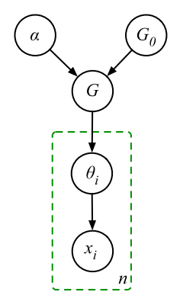
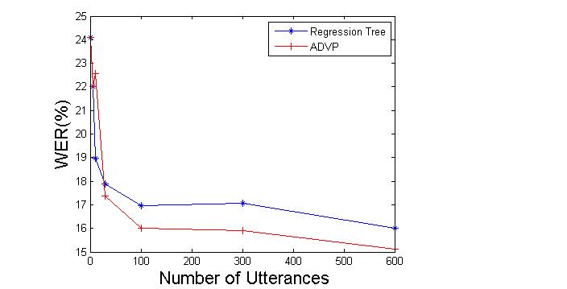
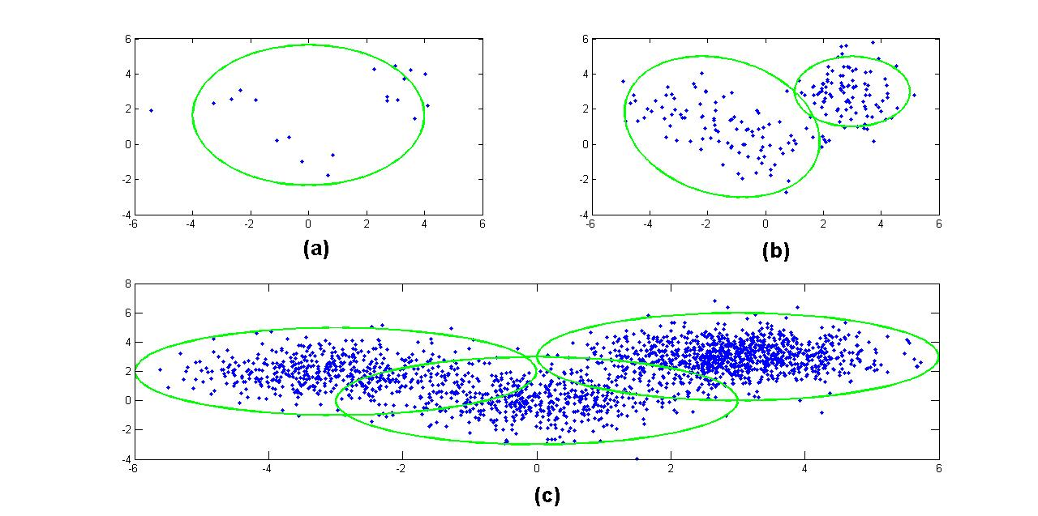
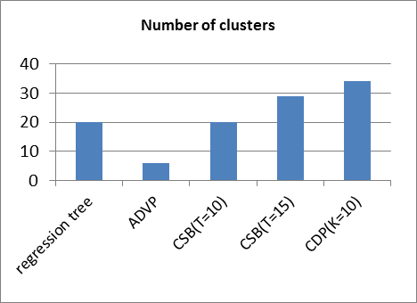
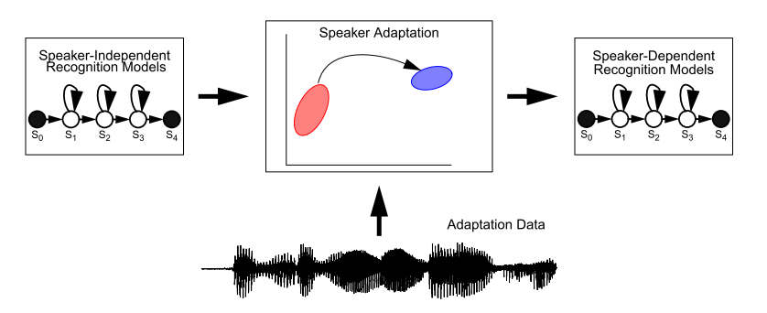
College of Engineering
Temple University
Applications of Dirichlet Process Mixtures to Speaker Adaptation
Amir H Harati Nejad Torbati, Joseph Picone and Marc Sobel Department of Electrical and Computer Engineering, Temple University, Philadelphia, Pennsylvania
Introduction
Performance of speaker independent acoustic models in speech recognition is significantly lower than speaker dependent models.
Training speaker dependent models is impractical due to the amount of data.
Solution is the speaker adaptation. One of the most popular forms is to transform mean and covariance of all Gaussian components.
Because of the huge number of components; we often need to tie (cluster) components together.
The complexity of the model should be adapted to available data.
Dirichlet Process Mixture (DPM)
One of the classical problems in clustering is determination of the number of clusters and complexity of the model.
A solution based on nonparametric Bayesian framework is the Dirichlet process mixture models in which we use a Dirichlet process to put a prior on the number of clusters.
DP induce a prior that number of
clusters can grow logarithmically with
The number of observations.
Results for Monophone Models
Monophone models using a single Gaussian mixture.
12 different speakers with 600 training utterances.
The Result of clustering resembles broad phonetic classes.
DPM finds 6 clusters in the data while regression tree can find 2 clusters.
Word error rate (WER) can be reduced by more than 10%.
Conclusion
It has been shown, having enough data, DPM can do a better job than regression tree and the resulted clusters have meaningful acoustical interpretation.
The reason for slightly worse performance in some cases could be related to our tree construction approach.
In this work we assigned each “distribution” to just one cluster. An obvious extension is to use some form of soft tying.
Resource Management (RM) dataset and models with one Gaussian per mixtures have been used in this research. In the future we can use more challenging datasets and with more mixtures per state. We can also use nonparametric Bayesian HMMs (HDP-HMM) in our training to further examine the applications of nonparametric methods in speech recognition.
Figure 1- Model Complexity as a Function of Available Data. (a) 20 (b) 200 (c) 2000 data points
Figure 4-Chinese Restaurant Process
Figure 3-Dirichlet Process Mixture
Figure 5-A comparison of regression tree and ADVP approaches for monophone models.
Adaption
Adjusting Model’s parameters for a new speaker.
Adjusting all parameters need a huge amount of data (impractical).
The solution is to cluster Models together and adjust all models in the same cluster together.
Clusters should be organized in a hierarchical form, so depending on available data proper clusters are selected.
The classical solution is to use binary regression tree. The tree is constructed using a centroid splitting algorithm.
In transform based adaption, for each cluster, a transformation is calculated.
In MLLR , transforms are computed using maximum likelihood criterion.
Algorithm
The basic idea is to replace the binary regression tree in MLLR with a DPM .
The procedure is as follow:
Train speaker independent (SI) models, collecting all mixture components and their frequency of occurrence.
Generate samples for each component and cluster them using a DPM model.
Construct a tree structure of the final result using a bottom up approach. In this approach we start from terminal nodes and merge them based on their Euclidean distance.
Assign clusters to each component using a majority vote scheme.
The resulted tree is used to compute transformation matrix using maximum likelihood approach.
Inference is accomplished using three different variational algorithms:
Accelerated variational Dirichlet process mixture (AVDP) .
Collapsed variational stick-breaking (CSB).
Collapsed Dirichlet priors (CDP)
Results for Cross word models
Cross word triphone models using a single Gaussian mixture.
12 different speakers with 600 training utterances.
The clusters generated using DPM have acoustically and phonetically meaningful interpretations.
ADVP works better for medium amount of data and CDP and CSB work better for more large amount of data
Reference
[1] E. Sudderth, “Graphical models for visual object recognition and tracking,” Ph.D. dissertation, Massachusetts Institute of Technology, May 2006.
[2] J. Paisley, “Machine learning with Dirichlet and beta process priors: Theory and Applications”, Ph.D. Dissertation, Duke University, May 2010.
[3] D. M. Blei and M. I. Jordan, “Variational inference for Dirichlet process mixtures,” Bayesian Analysis, vol. 1, pp. 121–144, 2005.
[4] C. J. Leggetter, “Improved acoustic modeling for HMMs using linear transformations,” Ph.D. Dissertation, University of Cambridge, February 1995.
[5] C. Bishop, Pattern Recognition and Machine Learning, Springer, New York, New York, USA, 2007.
[6] K. Kurihara, M. Welling, and N. Vlassis, “Accelerated variational Dirichlet process mixtures,” Advances in Neural Information Processing Systems, MIT Press, Cambridge, Massachusetts, USA, 2007 (editors: B. Schölkopf and J.C. Hofmann).
[7] K. Kurihara, M. Welling, and Y. W. Teh, “Collapsed variational Dirichlet process mixture models,” Proceedings of the 20th International Joint Conference on Artificial Intelligence, Hyderabad, India, Jan. 2007.
Figure 6-The number of discovered clusters
Figure 2- Mapping Speaker Independent Models to Speaker Dependent Models
Figure 7- comparison of WERs between regression tree-based MLLR and several DPM inference algorithms for cross-word acoustic models.

