Slide 1
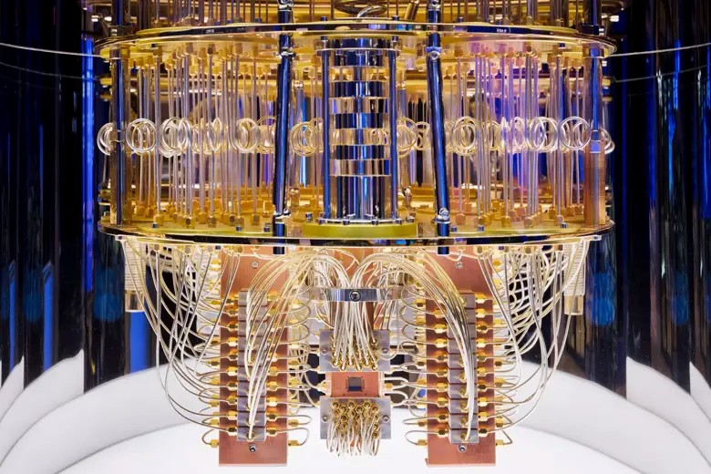
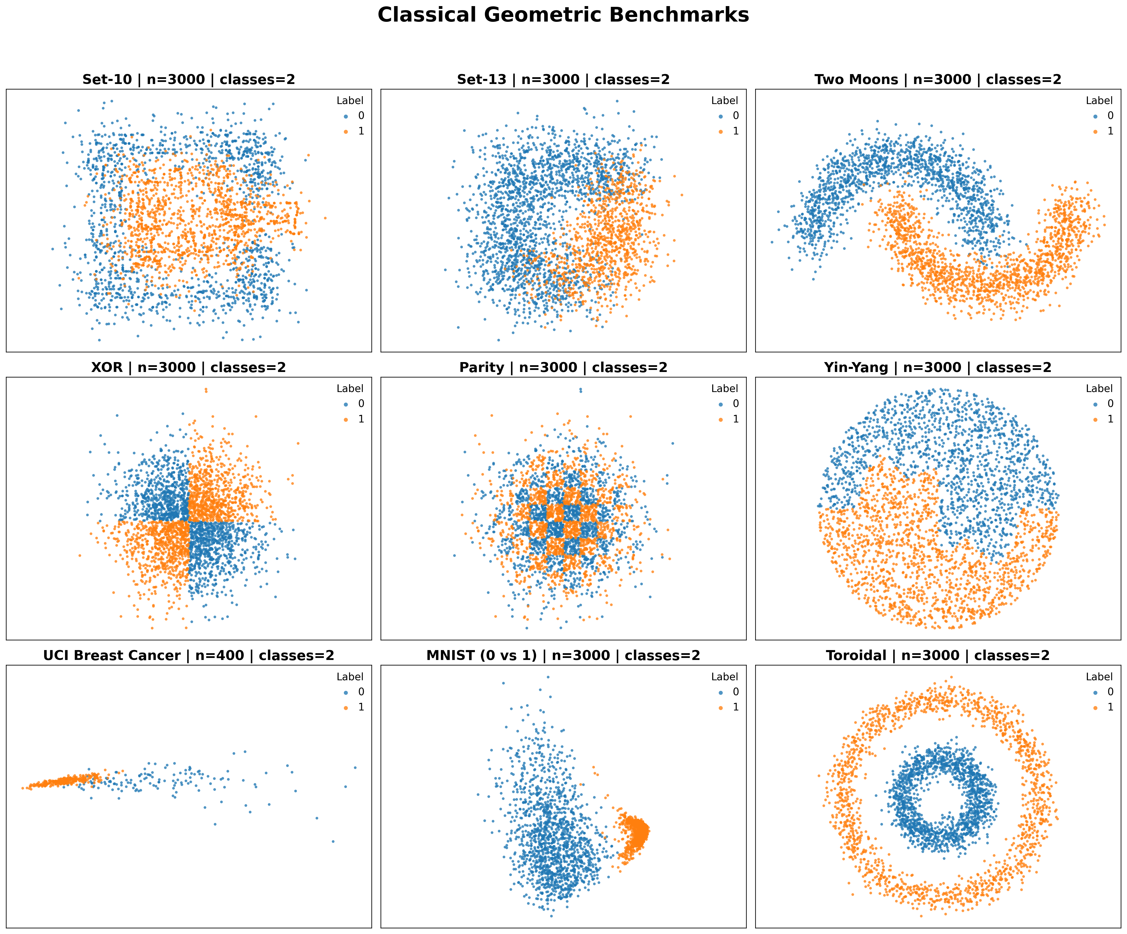
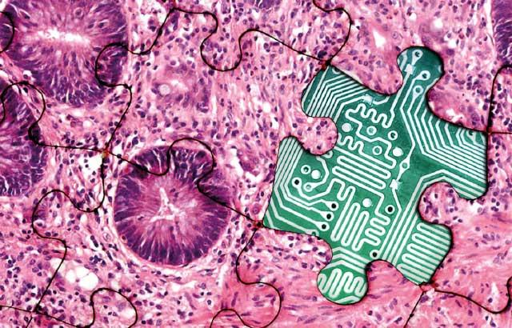
Exploiting Quantum Entanglement in Machine Learning
Joseph Picone and Iyad Obeid
Department of Electrical and Computer Engineering
College of Engineering
Temple University

Slide 2
Financial Reporting
Financials Reported Through: 08/31/2026
Project # | Project Total Budget | Monthly Costs (Since Prior Report) | Costs to Date | of Budget Expended
Project: 162232-24604 | $75,000.00 | $27,829.00 | 27,829.00 | 37.11%
Project: | $75.000.00 | $27,829.00
Notes: We were on track to spend the money by 8/31/2026. Unfortunately, the graduate student assigned to the project unexpectedly withdrew from our program in 12/31/2025 due to personal health issues. We have adjusted assignments accordingly, but now expect to expend the funds by 8/31/2027.

Slide 3
Team Members
Name | Team Role
Joseph Picone | Principal Investigator Professor, Department of Electrical and Computer Engineering
Iyad Obeid | Co-Principal Investigator Professor, Department of Electrical and Computer Engineering
Claudia Dumitrescu | Bioengineering Subject Matter Expert PhD Candidate, Department of Electrical and Computer Engineering
Abdullah Al Mamun | Quantum Computing Software Engineer MS Candidate, Department of Electrical and Computer Engineering
Sadia Purba | Quantum Entanglement in Quantum Machine Learning PhD Candidate, Department of Electrical and Computer Engineering
Anne-Mai Melles | Subject Matter Expert, Neuroscience BS Candidate, Department of Neuroscience
Data Annotation Team Software Tools Team | Data Annotation and Error Analysis, Software Development and Support Department of Electrical and Computer Engineering

Slide 4
Challenges and Solutions
Proposed solution: The goal of this proposed research is to enable a new generation of reduced complexity artificial intelligence-based technology that enables many applications for which large amounts of training data do not exist. ML algorithms have made tremendous advances on problems for which large amounts of annotated training data exist, and for which huge computing infrastructure is available. These kinds of well-resourced problems, which are typically limited to large-scale problems of great commercial interest (e.g., ChatGPT, Siri, Google Translate), do not often translate to a wide range of applications (e.g., healthcare) due to limitations in available annotated data. The development of systems that can segment and accurately classify microscale events when large amounts of training data doesn’t exist remains an elusive but important goal in ML. An important part of the solution to this problem lies in exploiting capabilities of quantum computing that do not exist in conventional ML systems.
Challenge: Problems in which humans excel at data interpretation and state of the art machine learning (ML) systems fail, are typically problems where integration and synthesis of information in a much different way than traditional spatial and temporal correlations is required. Quantum entanglement offers the potential to model data in ways not previously possible. Quantum superposition can be leveraged to process multiple states of data in parallel, amplifying the likelihood of getting the desired result when measured, potentially enhancing computational efficiency and problem-solving capabilities. However, there are significant computational challenges that must be overcome to make this practical.

Slide 5
Major Milestone Table:
Milestone Description | M | J | J | A | S | O | N | D | J | F | M | A | M | J | J | A | %
Project Kick-off
Application of COTS Quantum Machine Learning Algorithms |  |  |  |  |  |  |  |  |  |  |  |  |  |  |  |  | 100%
HilbertBench Toolbox Release 1.0
Characterization of the Impact of Quantum Entanglement
Practical Approaches to Integrating Quantum Entanglement
Assessment of Impact on Bioengineering Problems of Scale
IEEE QMLW 2026

Slide 6
Publications
Publications:
S. Purba, A. Al Mamun and J. Picone, “A Theorem Describing When Quantum Machine Learning Performance Will Exceed Classical Techniques,” to be submitted to Nature in Summer 2026 (in development).
S. Purba, A. Al Mamun and J. Picone, “Application of Quantum Machine Learning to State of the Art Bioengineering Problems in Machine Learning,” to be submitted to Nature in Summer 2026 (in development).
A. Al Mamun, S. Purba and J. Picone, “HilbertBench: Advancing Reproducible Science in Quantum Machine Learning.” to be submitted to IEEE Transactions on Quantum Engineering in Summer 2026 (in development).
S. Purba, A. Al Mamun and J. Picone, “Comparison of Quantum and Classical Machine Learning on Problems of Scale.” to be submitted to the IEEE Signal Processing in Medicine and Biology Symposium, Summer 2026 (in development).
Software:
S. Aji, S. Purba and A. Al Mamun, “Recent Enhancements to the ISIP Machine Learning Demo,” url: https://www.isip.piconepress.com/projects/imld. (an open source educational toolkit that has been enhanced with our latest quantum algorithms).
Workshops:
IEEE Quantum Machine Learning Workshop, August 14, 2026 (over 100 participants currently registered). url: https://isip.piconepress.com/conferences/ieee_qmlw/2026/.

Slide 7
Potential Issues/Challenges
Unexpected changes in graduate student staffing created a delay in our expenditures. We are back on track if we are allowed an NCE.
Verification of theoretical results on actual quantum computing hardware is costly and remains a challenge.
Solution: We have integrated a linear algebra approximation that runs very fast on our cluster and produces comparable results to actual quantum computer hardware. We are also leveraging several open source packages that allow us to run quantum computer simulations on conventional GPU chips.

Slide 8
External Funding
Picone, J., & Obeid, I. (Fall 2026). SCH: Hybrid Quantum-Classical Foundation Models for Data-Efficient Digital Pathology. Smart Health and Biomedical Research in the Era of Artificial Intelligence and Advanced Data Science, Directorate for Computer and Information Science and Engineering, National Science Foundation, $1.5M, July 1, 2027 - June 30, 2031.
Picone, J., & Obeid, I. (July 2026). Precision Breast Cancer Detection in High Resolution Digital Pathology Using Hierarchical Self-Attention and Lightweight Microsegmentation. Funding Level 2 - Population Science and Prevention Studies, Breast Cancer Research Program Breakthrough Award, Congressionally Directed Medical Research Programs (CDMRP), Department of Defense, $1.7M, January 1, 2027 - December 31, 2029.
(We expect to submit two more proposals on quantum computing-based machine learning in Fall 2026, most likely to NSF.)

