Slide 1
Annotations Guidelines Images
Glossary for all the different events identified in the TUH EEG Corpus

Slide 2
Figure 6. Posterior Dominant Rhythm normal EEG /gluster_volume/data/isip/data/tuh_eeg/v1.2.0/edf/01_tcp_ar/150/00015029/s001_2016_10_12

Slide 3
Figure 7. Alpha Waves of Youth (17 yo male) /gluster_volume/data/isip/data/tuh_eeg/v1.2.0/edf/01_tcp_ar/140/00014017/s001_2016_02_01

Slide 4
Slow alpha waves of youth (check age of patient) pt is 41, this is just alpha rhythm. /gluster_volume/data/isip/data/tuh_eeg_seizure/work/second_pass_set/edf/01_tcp_ar/023/00002322/s005_2013_09_19/00002322_s005_t000.edf

Slide 5
Figure 8. K-Complex + sleep spindle gluster_volume/data/isip/data/tuh_eeg/v1.2.0/edf/01_tcp_ar/113/00011345/s004_2016_07_19

Slide 6
K Complex /gluster_volume/data/isip/data/tuh_eeg/v1.2.0/edf/01_tcp_ar/113/00011362/s002_2016_05_04

Slide 7
K complex followed by sleep spindle. I don’t really like this example, the K-complex is tied into something else. The vertex wave is good though. /gluster_volume/data/isip/data/tuh_eeg_seizure/work/second_pass_set/edf/01_tcp_ar/034/00003437/s006_2014_10_20/00003437_s006_t003.edf

Slide 8
Sleep Spindle /gluster_volume/data/isip/data/tuh_eeg/v1.2.0/edf/01_tcp_ar/113/00011362/s002_2016_05_04

Slide 9
Figure 9. Vertex Wave /gluster_volume/data/isip/data/tuh_eeg/v1.2.0/edf/01_tcp_ar/113/00011345/s004_2016_07_19

Slide 10
Figure 10. FNSZ (single spike) /gluster_volume/data/isip/data/tuh_eeg_seizure/v1.5.0/edf/03_tcp_ar_a/115/00011580/s006_2014_05_06/00011580_s006_t004.edf

Slide 11
Figure 11. FNSZ (polyspike) /data/isip/data/tuh_eeg_seizure/v1.5.0/edf/train/03_tcp_ar_a/104/00010418/s016_2014_05_30/00010418_s016_t003.edf

Slide 12
Figure 12. FNSZ evolution (amplitude) /data/isip/data/tuh_eeg_seizure/v1.5.0/edf/train/02_tcp_le/036/00003636/s002_2007_01_12/00003636_s002_t003.edf

Slide 13
Figure 13. FNSZ evolution (frequency) /data/isip/data/tuh_eeg_seizure/v1.5.0/edf/train/02_tcp_le/036/00003636/s002_2007_01_12/00003636_s002_t003.edf

Slide 14
Figure 14. FNSZ post ictal slowing /data/isip/data/tuh_eeg_seizure/v1.5.0/edf/train/01_tcp_ar/118/00011869/s001_2014_08_12/00011869_s001_t004.edf

Slide 15
Figure 15. GNSZ /gluster_volume/data/isip/data/tuh_eeg_seizure/v1.5.0/edf/train/01_tcp_ar/044/00004456/s015_2014_06_19/00004456_s015_t002.edf

Slide 16
Figure 16. TCSZ atonic phase (we could get a better picture of this for sure) /gluster_volume/data/isip/data/tuh_eeg_seizure/v1.5.0/edf/train/03_tcp_ar_a/062/00006230/s006_2010_09_13/00006230_s006_t005.edf

Slide 17
Figure 17. TCSZ with artifact(report verified) /gluster_volume/data/isip/data/tuh_eeg_seizure/work/second_pass_set/edf/01_tcp_ar/006/00000630/s002_2003_05_28/00000630_s002_t001.edf

Slide 18
Figure 18. MYSZ /data/isip/data/tuh_eeg_seizure/v1.5.0/edf/dev/01_tcp_ar/065/00006546/s021_2012_02_22/00006546_s021_t006.edf

Slide 19
Figure 19. ABSZ

Slide 20
Figure 20. MUSC

Slide 21
Figure 21. SHIV (just 4 channels) /data/isip/data/tuh_eeg_seizure/v1.5.0/edf/train/01_tcp_ar/065/00006535/s004_2012_07_17/00006535_s004_t008.edf

Slide 22
Figure 22. Chewing (report verified) /gluster_volume/data/isip/data/tuh_eeg_seizure/work/second_pass_set/edf/01_tcp_ar/019/00001981/s007_2015_03_30/00001981_s007_t003.edf

Slide 23
Figure 23. Single Eye Movement /data/isip/data/tuh_eeg_seizure/v1.5.0/edf/train/01_tcp_ar/100/00010088/s005_2015_03_18/00010088_s005_t003.edf

Slide 24
Figure 24. Lateral Eye movement Run /gluster_volume/data/isip/data/tuh_eeg_seizure/v1.5.0/edf/train/01_tcp_ar/100/00010088/s005_2015_03_18/00010088_s005_t008.edf

Slide 25
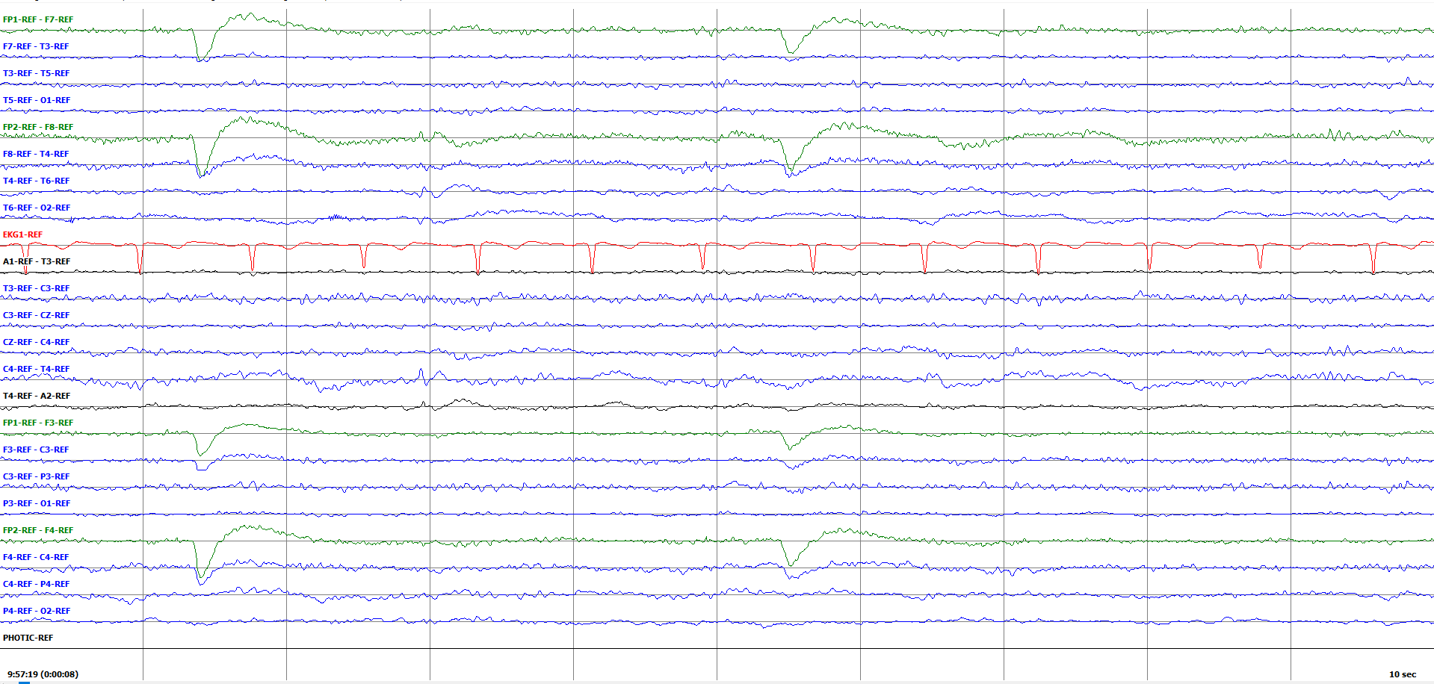
Figure 23. Eye Blink (Single events) /gluster_volume/data/isip/data/tuh_eeg_seizure/work/second_pass_set/edf/01_tcp_ar/030/00003005/s004_2010_06_18/ 030/00003005_s004_t001.edf

Slide 26
Figure 26. Multiple Eyeblinks (Eye fluttering?) /gluster_volume/data/isip/data/tuh_eeg_seizure/v1.5.0/edf/train/01_tcp_ar/100/00010088/s005_2015_03_18/00010088_s005_t003.edf

Slide 27
Figure 27. Electrode pop (single) /gluster_volume/data/isip/data/tuh_eeg_seizure/v1.5.0/edf/train/01_tcp_ar/087/00008738/s005_2013_06_05/00008738_s005_t003.edf

Slide 28
Figure 28. Electrode pop run /gluster_volume/data/isip/data/tuh_eeg_seizure/v1.5.0/edf/train/01_tcp_ar/100/00010088/s005_2015_03_18/00010088_s005_t008.edf

Slide 29
Figure 29. Electrostatic /gluster_volume/data/isip/data/tuh_eeg_seizure/work/second_pass_set/edf/01_tcp_ar/030/00003005/s004_2010_06_18/ 030/00003005_s004_t001.edf

Slide 30
Figure 30. EKG artifact /gluster_volume/data/isip/data/tuh_eeg_seizure/v1.5.0/edf/train/01_tcp_ar/125/00012526/s002_2015_01_09/00012526_s002_t000.edf

Slide 31
Figure 31. Lead Artifact /gluster_volume/data/isip/data/tuh_eeg_seizure/work/artf_ann/v0.0.0/edf/01_tcp_ar/096/00009668/s003_2012_12_07/ 00009668_s003_t000.edf

Slide 32
Figure 32. Jerk /gluster_volume/data/isip/data/tuh_eeg_seizure/v1.5.0/edf/train/01_tcp_ar/088/00008829/s002_2012_03_29/00008829_s002_t000.edf

Slide 33
Figure 33. Slow Waves /gluster_volume/data/isip/data/tuh_eeg_slowing/v1.0.1/edf/01_tcp_ar/082/00008295/s012_2012_07_27/00008295_s012_t006.edf

Slide 34
Figure 34. Hypnagogic Hypersynchrony /gluster_volume/data/isip/data/tuh_eeg_seizure/v1.5.1/edf/dev/01_tcp_ar/084/00008453/s003_2012_01_26/00008453_s003_t000.edf

Slide 35
Figure 35. HGHS vs ABSZ
Place holder slide, this image is a combined figure 19 + figure 32.

Slide 36
Figure 36. Triphasic Waves /gluster_volume/data/isip/data/tuh_eeg_seizure/v1.5.0/edf/train/01_tcp_ar/066/00006607/s001_2010_01_28/00006607_s001_t000.edf

Slide 37
Figure 37. TRPW vs FNSZ combined

Slide 38
Figure 38. GPED /gluster_volume/data/isip/data/tuh_eeg_seizure/v1.5.0/edf/train/02_tcp_le/026/00002614/s002_2007_12_26/00002614_s002_t001.edf

Slide 39
Figure 39. GPED run Third_pass_set/01_tcp_ar/088/00008817/s001_2012_03_25/00008817_s001_t000.edf

Slide 40
Figure 40. PLED /gluster_volume/data/isip/data/tuh_eeg_seizure/v1.5.0/edf/train/01_tcp_ar/104/00010418/s012_2014_05_30/00010418_s012_t002.edf

Slide 41
Figure 41. Spike(s) /gluster_volume/data/isip/data/tuh_eeg_seizure/work/v1.5.1/data_prep/data_prep/eval/01_tcp_ar/128/00012870/s004_2015_03_11/00012870_s004_t007.edf

Slide 42
Figure 42. Polyspike(s) /gluster_volume/data/isip/data/tuh_eeg_seizure/work/v1.5.1/data_prep/data_prep/eval/01_tcp_ar/128/00012870/s004_2015_03_11/00012870_s004_t007.edf

Slide 43
Figure 43. Sharp /gluster_volume/data/isip/data/tuh_eeg_seizure/work/third_pass_set/edf/01_tcp_ar/071/00007196/s003_2011_01_21/00007196_s003_t000.edf

Slide 44
Figure 44. Breach Rhythm (report verified) /gluster_volume/data/isip/data/tuh_eeg_seizure/v1.5.0/edf/train/01_tcp_ar/091/00009104/s005_2014_09_23/00009104_s005_t001.edf

Slide 45
Figure 45. Burst Suppression + Seiz /gluster_volume/data/isip/data/tuh_eeg_seizure/v1.5.0/edf/train/01_tcp_ar/065/00006563/s002_2010_02_08/00006563_s002_t000.edf

