Slide 1
Building an Imaging Library to Harness Community Data and AI to Predict Biofilm Behavior

Slide 2
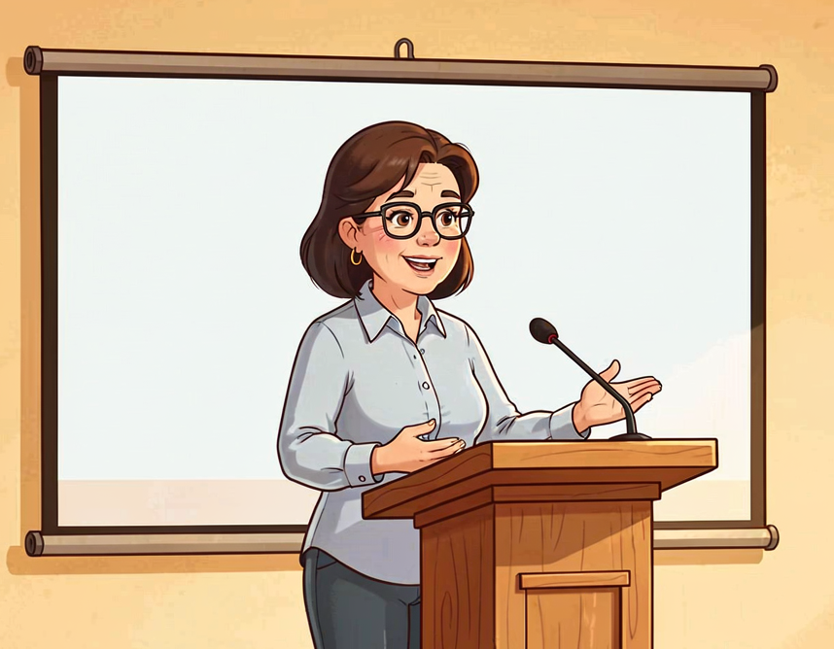
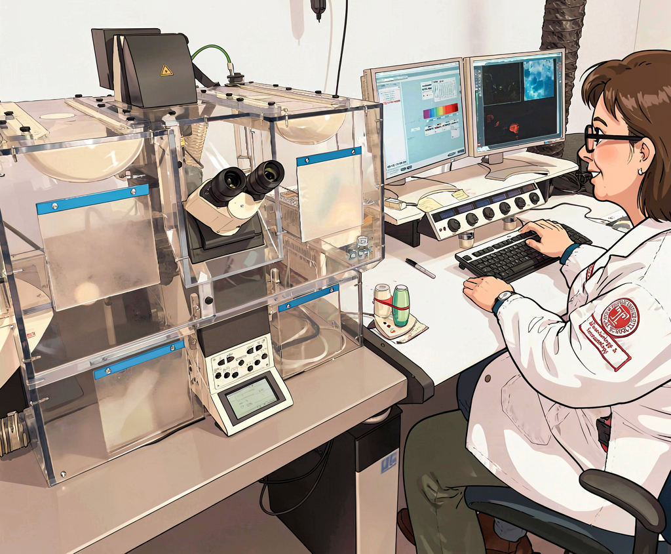
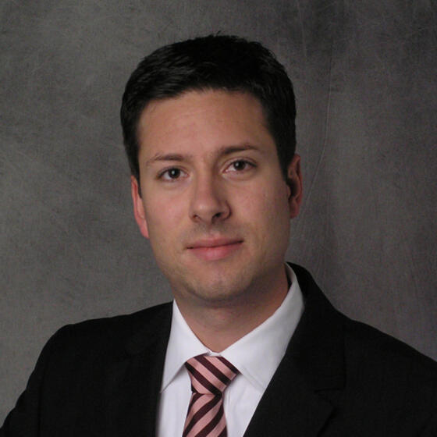
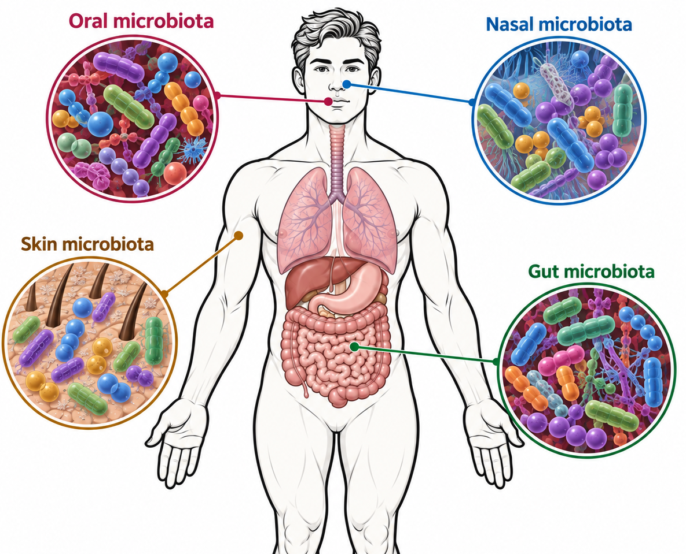
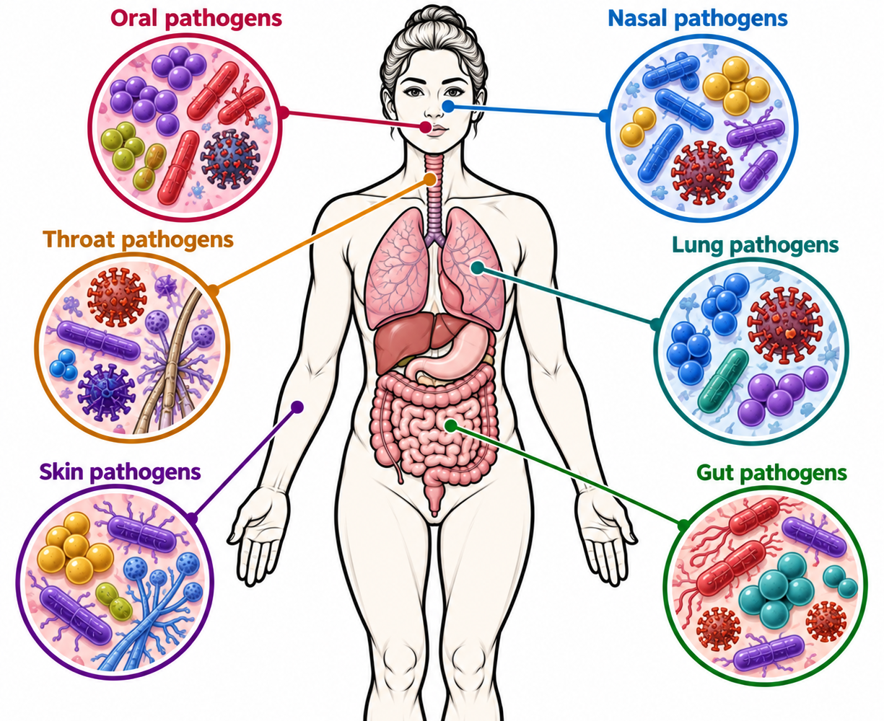
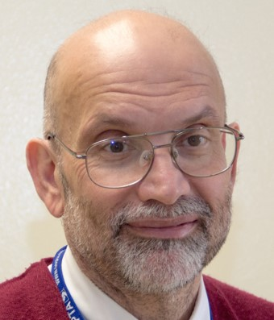
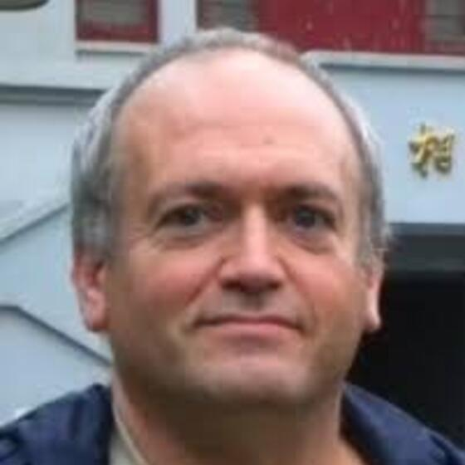
About me and the Temple Team
Microbiology - Bettina Buttaro, PhD
Mathematics
Gillian Queisser, PhD
Biofilms
Microbiota
Pathogens
How do they
work?
Education
Research
Isaac Klapper, PhD
Machine Learning (AI)
Joseph Picone, PhD

Slide 3
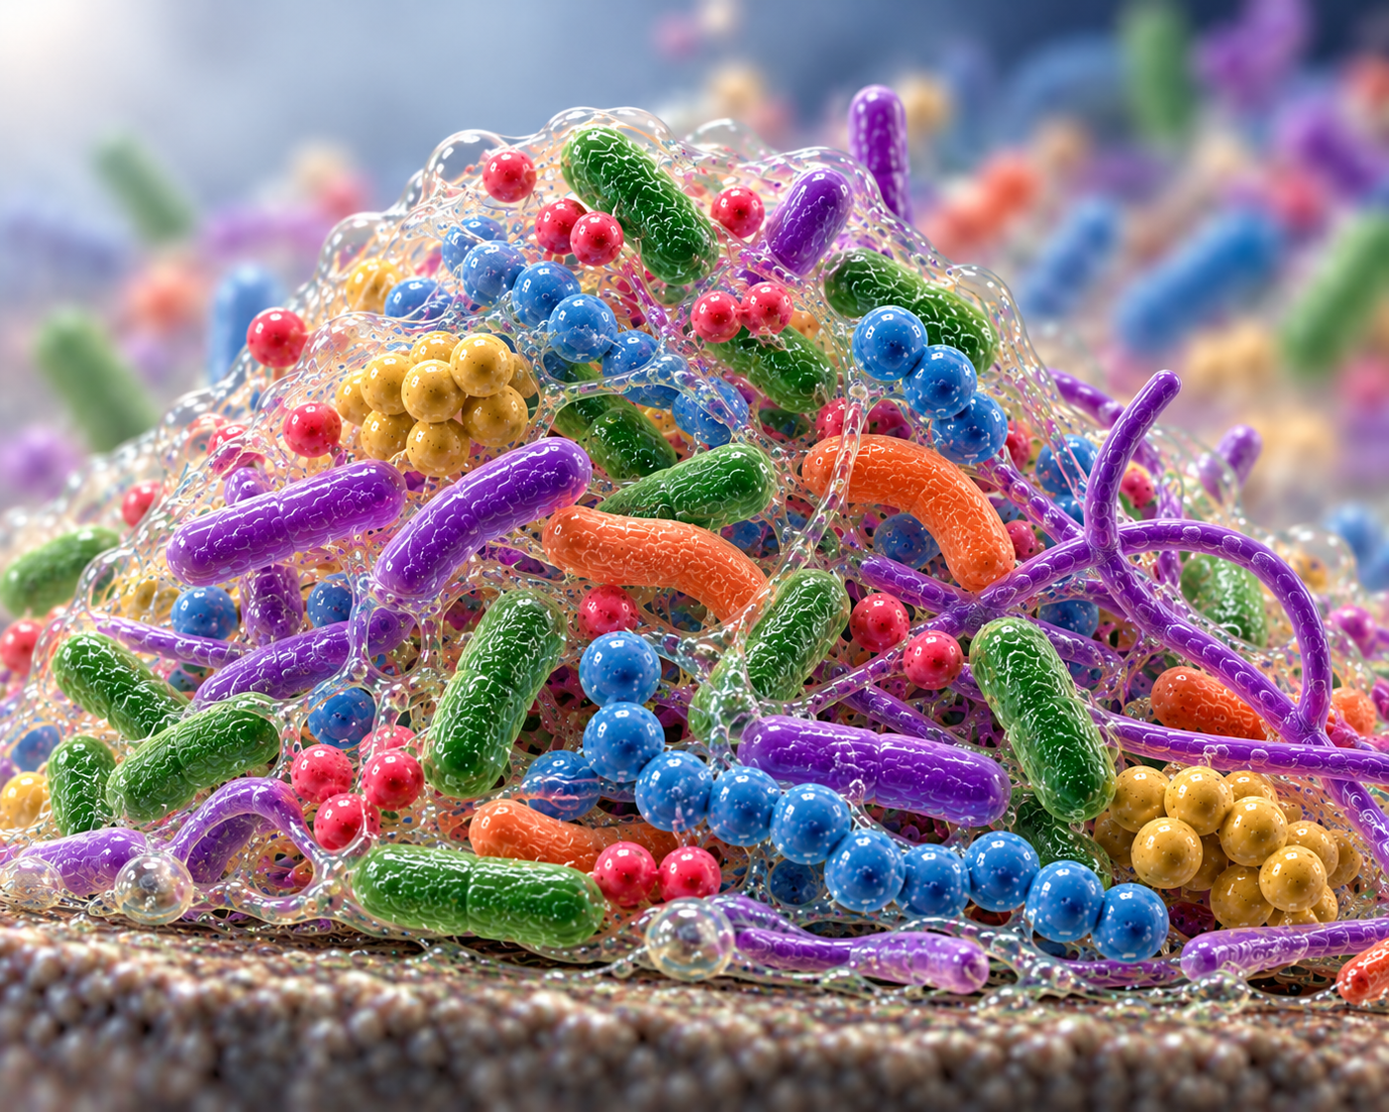
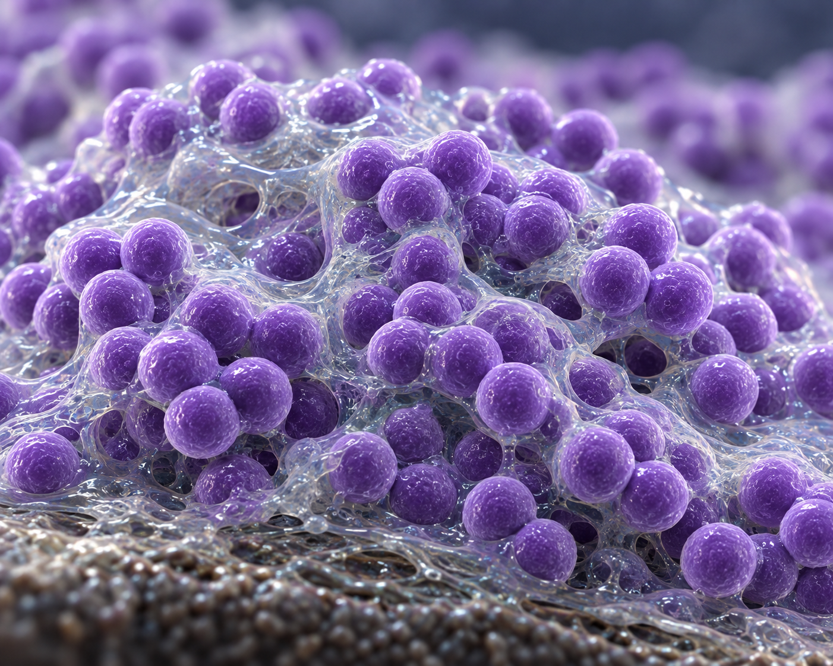
What Exactly is a Biofilm?
Communities of bacteria, fungi, and their viruses encased in extracellular polymeric substance
EPS is composed of sugars, proteins, and eDNA
Multispecies
Monospecies
EEPSW
Microbiota balanced ecology -> Health
Disease
Antibiotic Resistance
*Images generated by Chat GPT based on my descriptions

Slide 4
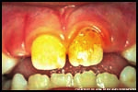
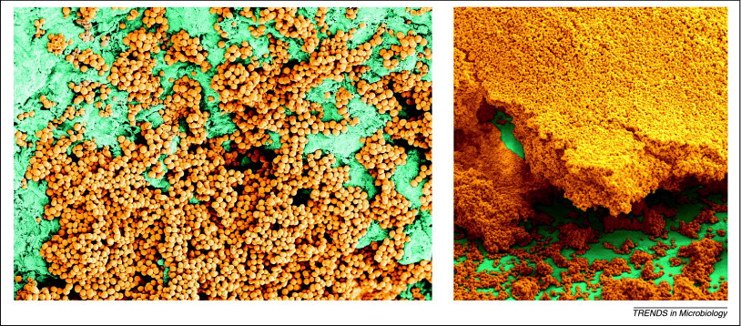
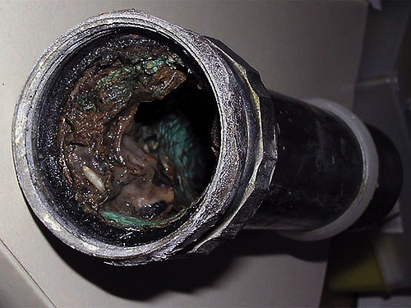
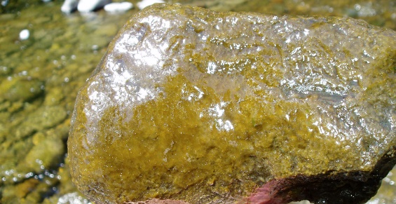
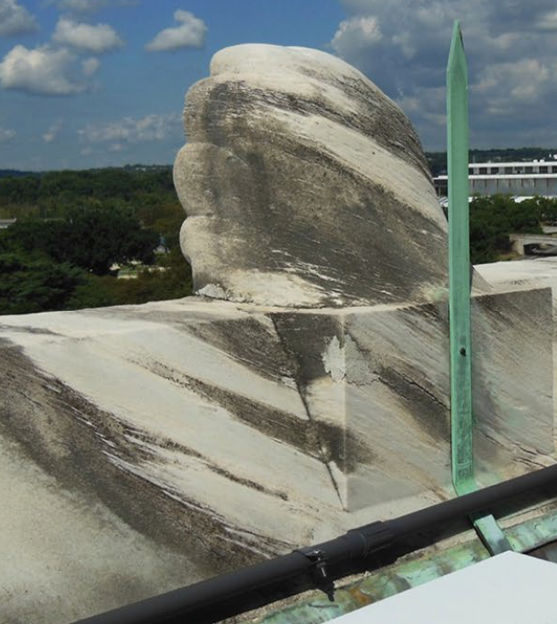
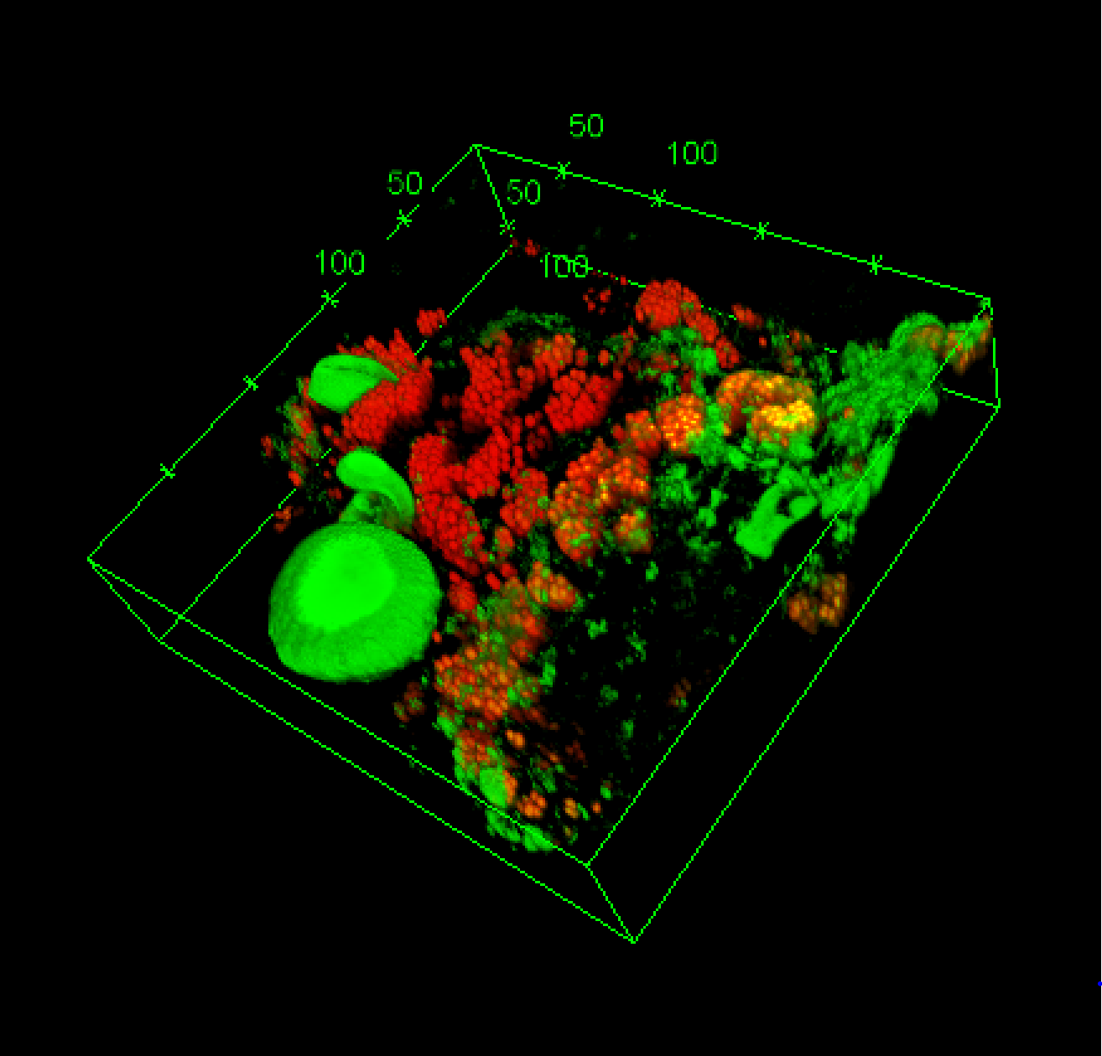
Biofilms are found everywhere
Dental Plaque
Kitchen Drainpipe
Heart -> Endocarditis
Marble Monument
Streams
Streams
Stone Monuments

Slide 5
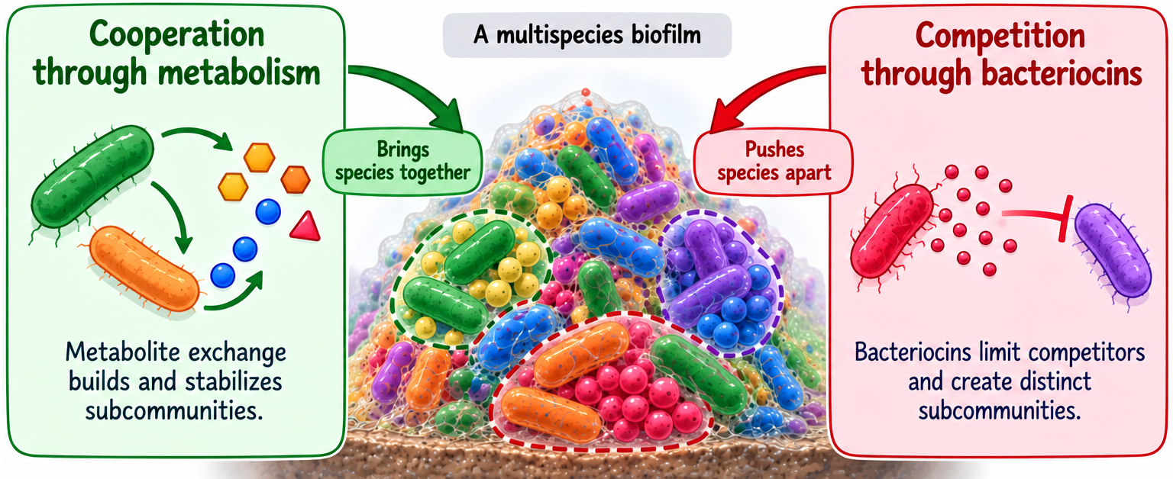
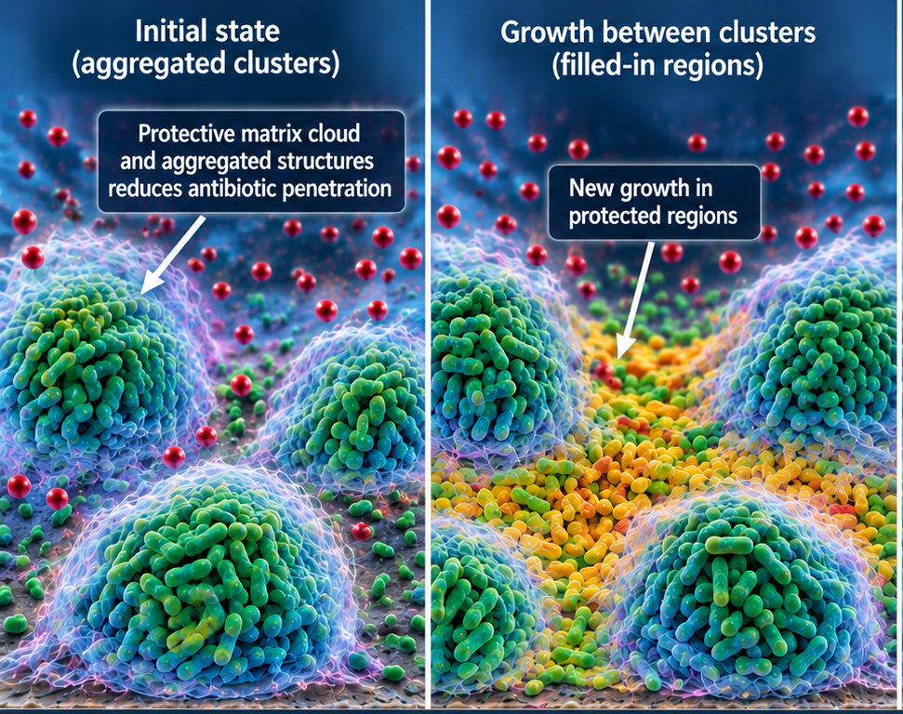
Some predictions we trying to make
How do pathogens organize themselves for protection from antibiotics?
How do multispecies microbiota organize themselves into subcommunities?
*Image generated by ChatGPT based on bullet points, data images, and edits

Slide 6
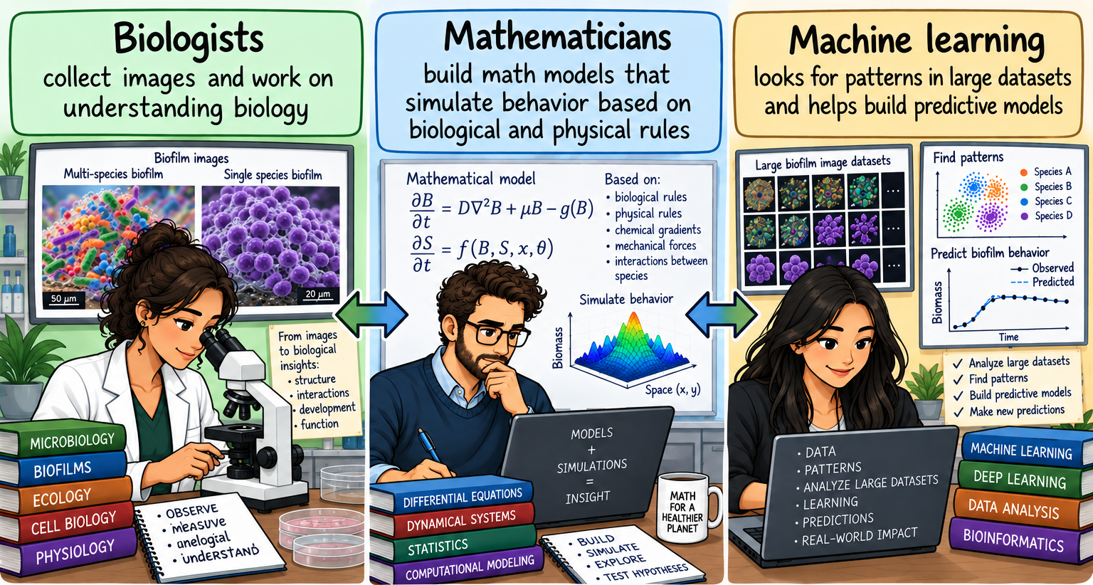
Working together to predict subcommunity organization and antibiotic resistance
*Image generated by ChatGPT based on bullet points and edits

Slide 7
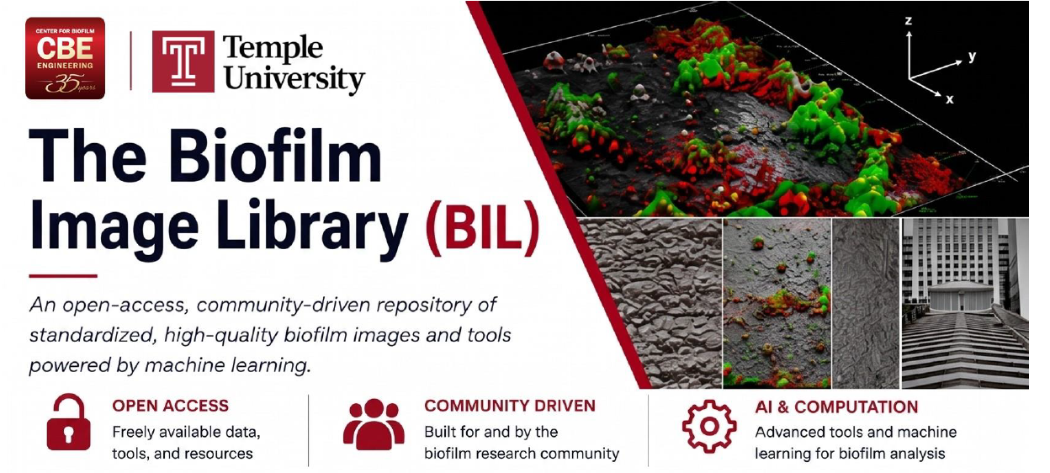

A large community needed for predictive models
Multiple systems for accurate predictive models
STEM and Outreach biofilm-based activities
Opportunities for undergraduate research
Cross train PhD students in Math/AI/Biology
Educate Medical Students about AI
Collaboration with the Center for Biofilm Engineering at Montana State University Dr. Parker (Statistician) and Dr. Smith (Biofilm Imaging Expert)
CIRC: Community Infrastructure for Research in Computer and Information Science and Engineering

