Slide 1
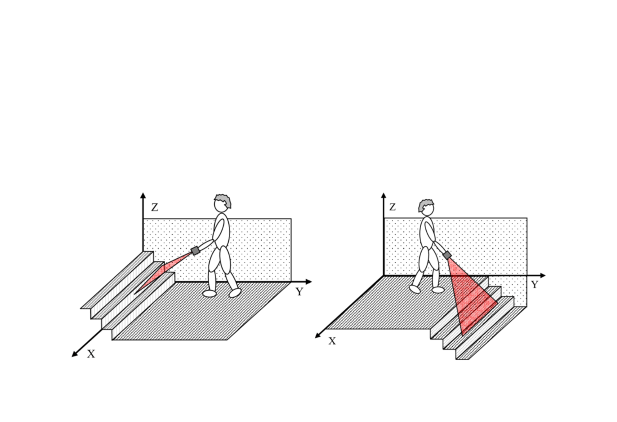
SafeStep
An Automatic Hazards Detection Blind Cane
Kevin Bui, Mohamad Charabi, Nathan Pervin, Mikita Piatsevich
Advisor: Dr. Joseph Picone
Instructor: Dr. Brian Thomson

Slide 2
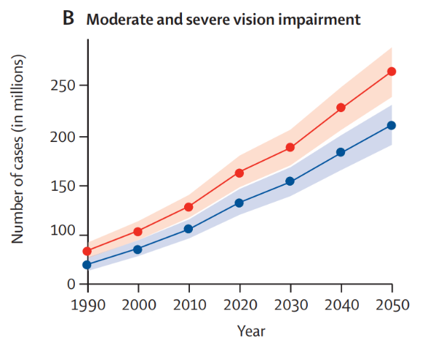
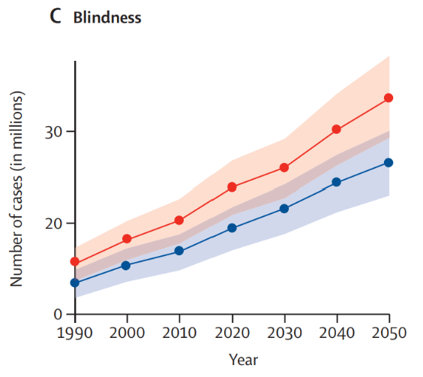

Blindness and vision impairment are increasing globally, increasing reliance on mobility aids.
Source:
https://www.sciencedirect.com/science/article/pii/S2214109X20304253

Slide 3
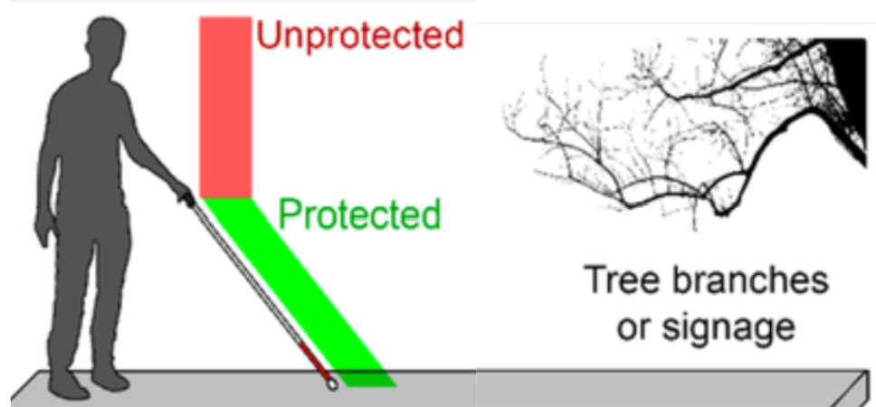
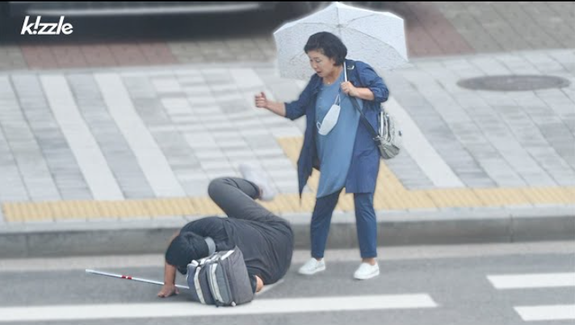
Automatic Hazards Detection Can Prevent User Injuries
Blind canes can’t detect all hazards.
As a result, collisions and falls can occur.
Source: https://www.researchgate.net/figure/Schematics-of-A-an-individual-with-the-white-cane-facing-daily-life-obstacles-the-cane_fig1_350820013
Source: https://youtu.be/S0n9UQ9eNrs?si=bu-2d58Qq2Apc4Jm
Notes:
EDIT 1

Slide 4
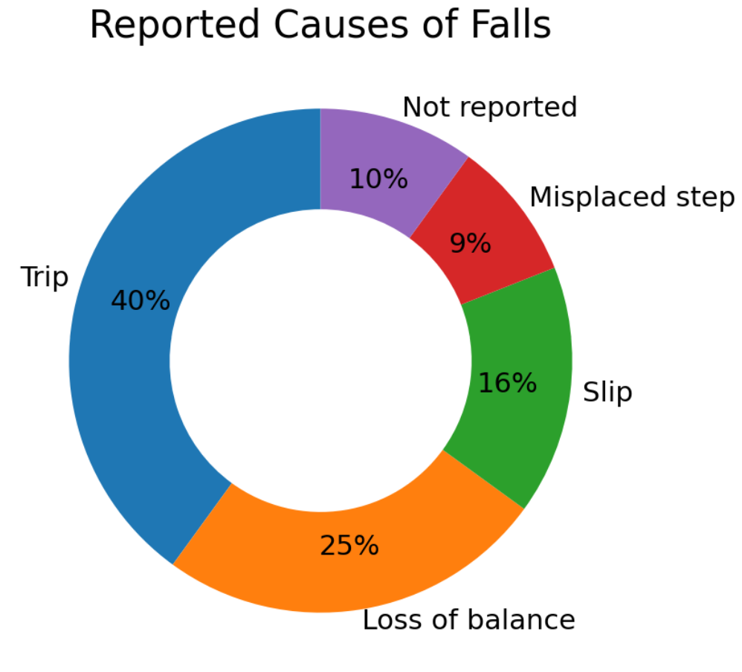
Fall and Injury Rates Among the Visually Impaired
76 people with visual impairment were studied over a 12-month period
63% of falls resulted in an injury
74% reported at least 1 fall or injury event
Our project aims to mitigate the trips and misplaced steps that are causes of falls.

Slide 5
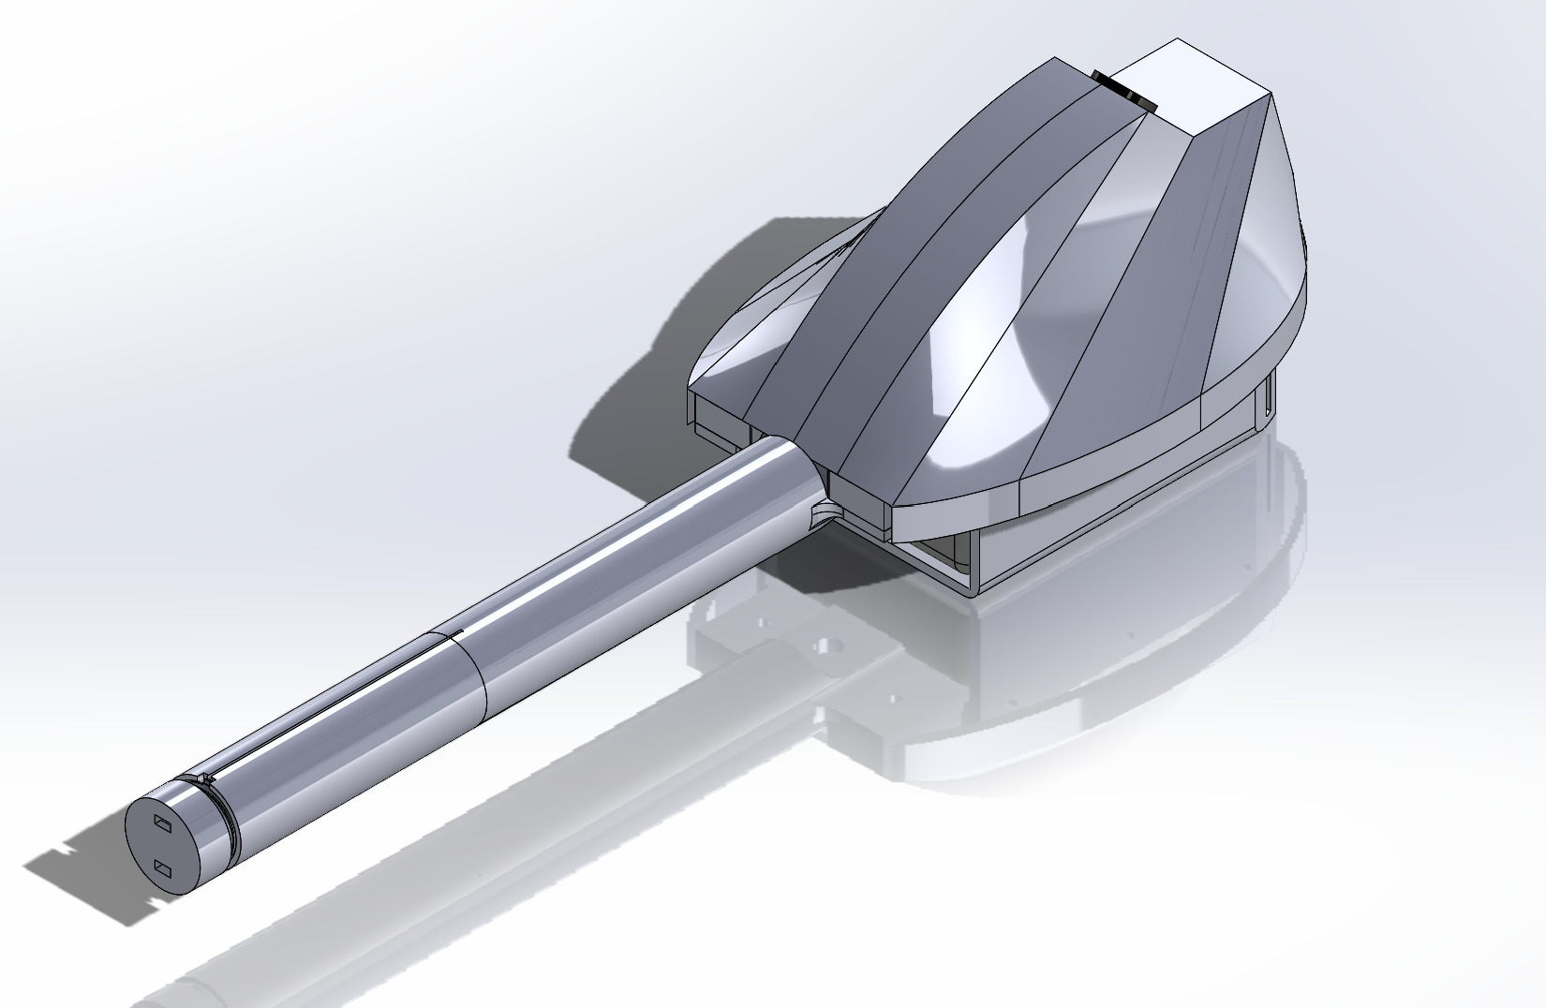
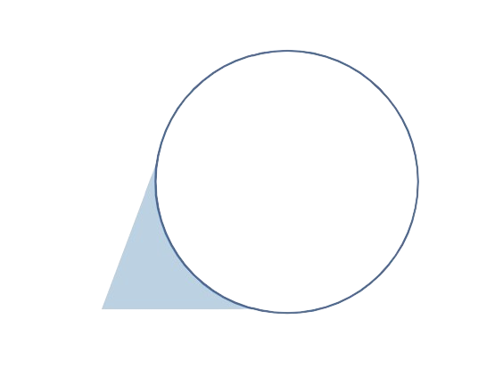

Proposed Solution: SafeStep, a smart blind cane
Ultrasonic Sensor
Camera
Vibration Warning

Slide 6
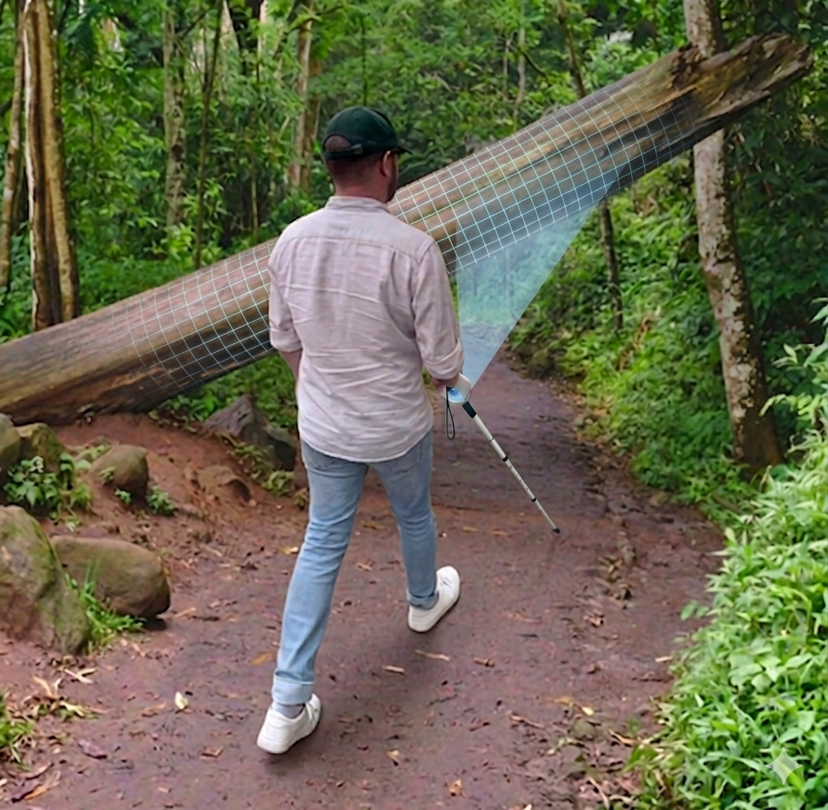
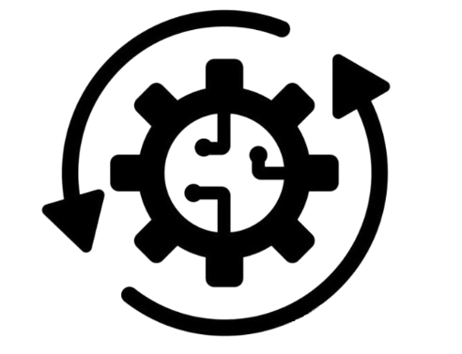

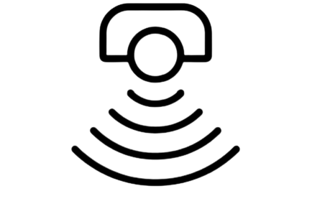
Proposed Solution: SafeStep, a smart blind cane
Scan environment for hazards
Alert user to hazards
Process data

Slide 7
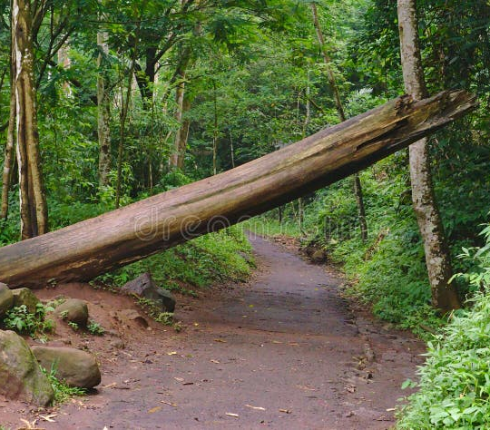
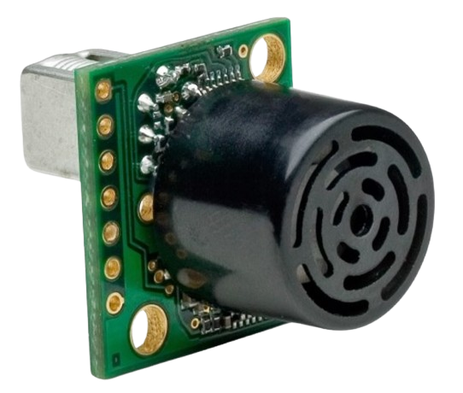
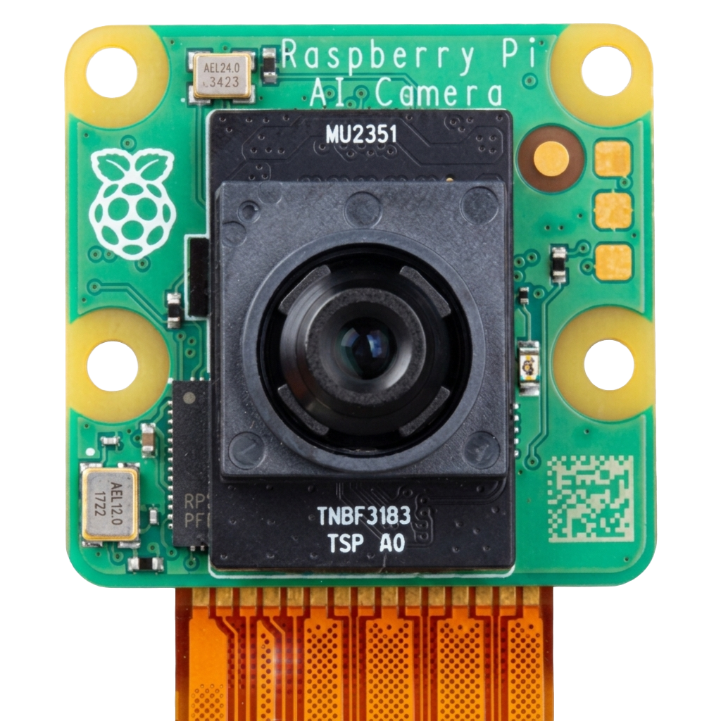
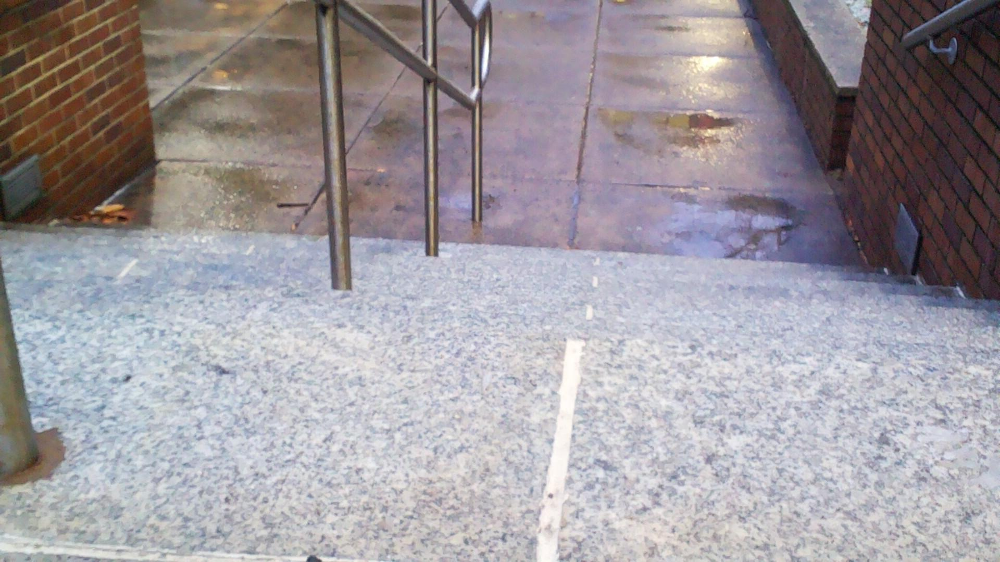
Sensing
Ultrasonic sensor detects obstacles in walking path
Camera Captures Image of Walking Path

Slide 8

Processing
Process Data
Sensing Data
Alert User

Slide 9
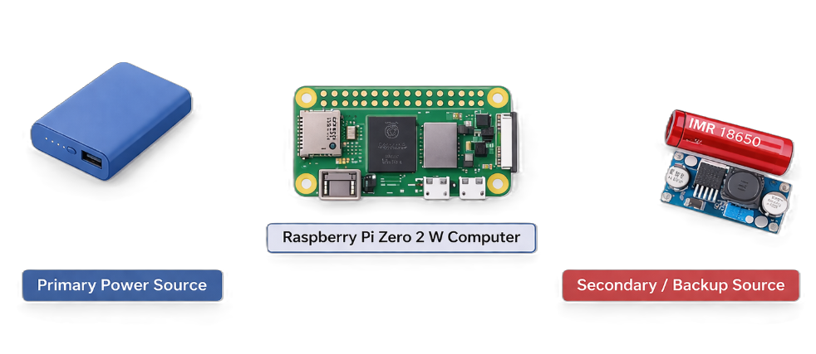



Battery
5V
5V $←$ 3.7V
$$→$$
$$←$$
5V regulated output (direct supply)
3.7V battery boosted to 5V
Both sources are designed to provide regulated 5V required for Raspberry Pi operation

Slide 10



Design Requirements
Hazard
Detection Latency
Detection
Distance
False Positive Rate
Constraint
Metric
Time
Distance
Percentage
Target Value
< 220 ms
6 ft
< 1%
Fast enough
For human response
Allows early
hazard detection
Prevents false alerts
Why?

Slide 11
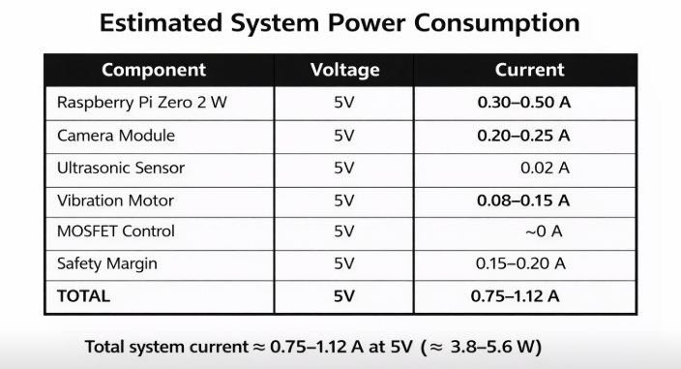
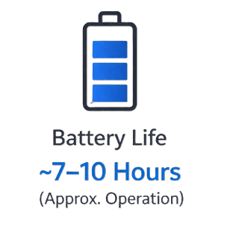
Design Requirements (Power System)
Runtime (hours) = (Battery Energy (Wh) × Efficiency) / Load Power (W)
System Load Power: P = V × I = 5V × 1.1A = 5.5W
Primary Battery (Power Bank): Runtime = 45Wh / 5.5W ≈ 8.2 hours (~7–10 hrs)
Backup Battery (18650 + Boost): Runtime = 9.95Wh / 5.5W ≈ 1.8 hours (~2 hrs)

Slide 12
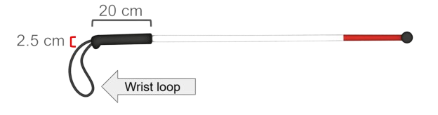
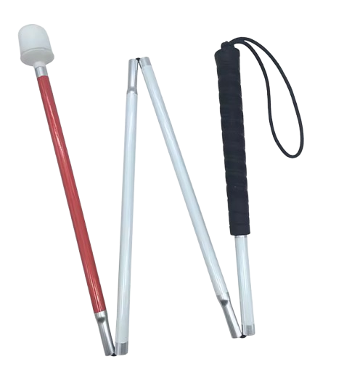
Design Constraints
Handle Diameter
Handle Length
Constraint
Portability
Metric
Physical Dimension
Physical Dimension
Operation
Target Value
Cane is foldable
2.5 cm
20 cm
Provides a comfortable grip
Improves control over cane
Why?
Easy to store and carry

Slide 13
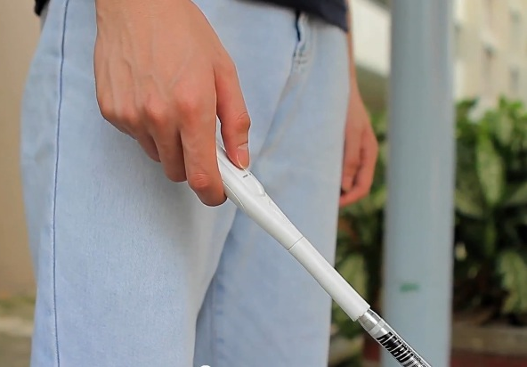
Proposed Solution: Ultrasonic Sensor
Ultrasonic sensor detects obstacles in walking path
Vibration Alerts User

Slide 14
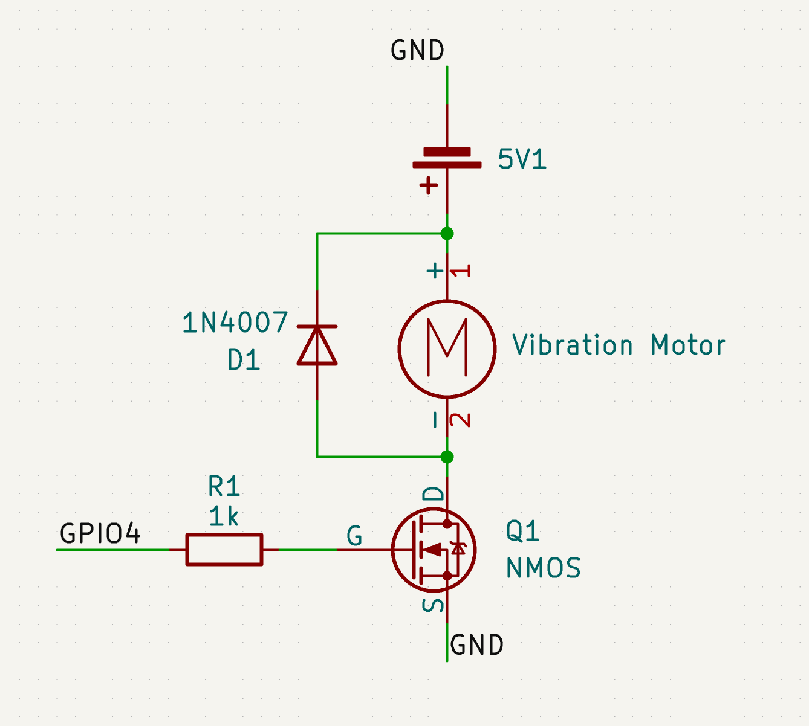
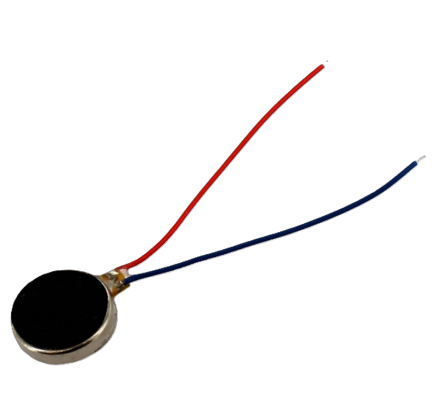
Proposed solution: Vibration motor

Slide 15
Proposed Solution: Machine Learning
Machine Learning Model Identifies Hazard
Camera Captures Image of Walking Path
Vibration Alerts User
Hazard: Stairs

Slide 16
Proposed Solution: Power System
5V
5V $←$ 3.7V
$$→$$
$$←$$
5V regulated output (direct supply)
3.7V battery boosted to 5V
Both sources are designed to provide regulated 5V required for Raspberry Pi operation

Slide 17
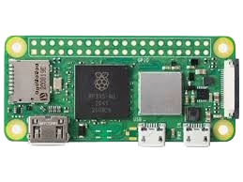
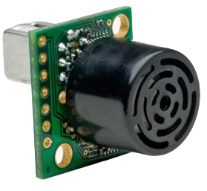

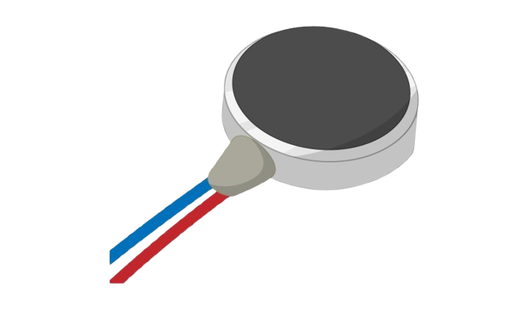
System Integration
Power
Data
Raspberry Pi AI Camera
Raspberry Pi Zero 2 W Computer
Ultrasonic Sensor
Live Camera Feed
1080p Images
Distance Measurement (cm)
5V
3.3V
Battery
ON/OFF
5V
5V
Vibration Motor

Slide 18
Engineering Design and Progress
Power
Data
Raspberry Pi AI Camera
Raspberry Pi Zero 2 W Computer
Ultrasonic Sensor
Live Camera Feed
1080p Images
Distance Measurement (cm)
5V
3.3V
Battery
ON/OFF
5V
5V
Vibration Motor

Slide 19
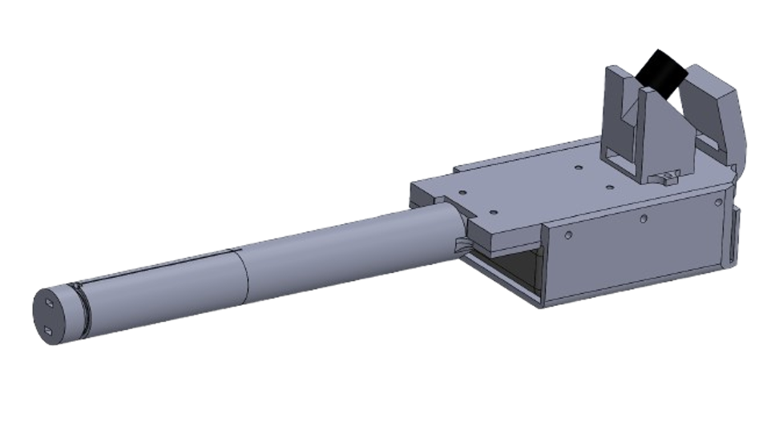
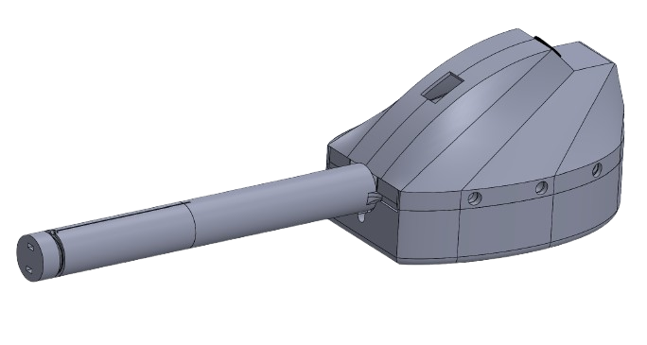
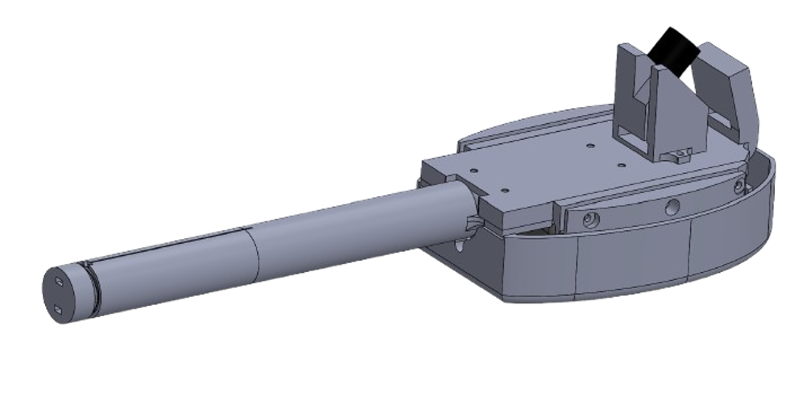

Engineering Design
Ultrasonic Sensor
Camera
Vibration Warning
Battery

Slide 20
Engineering Design
Ultrasonic Sensor
Camera
Vibration Warning
Battery

Slide 21

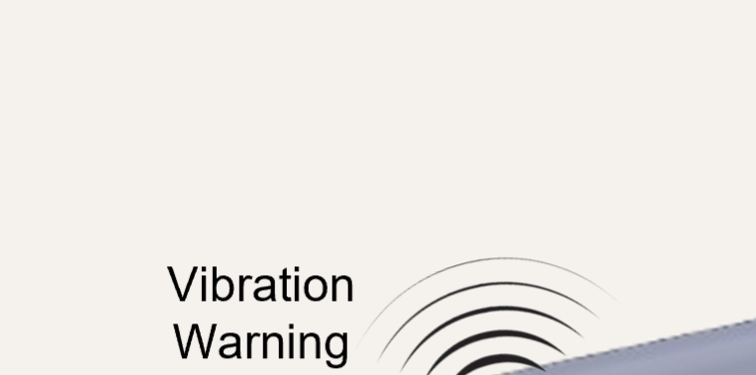
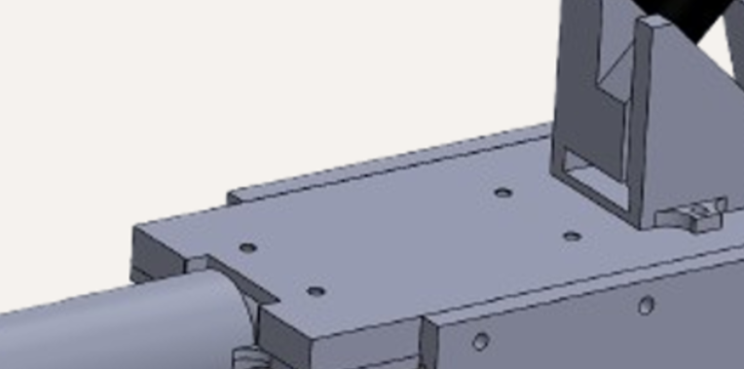

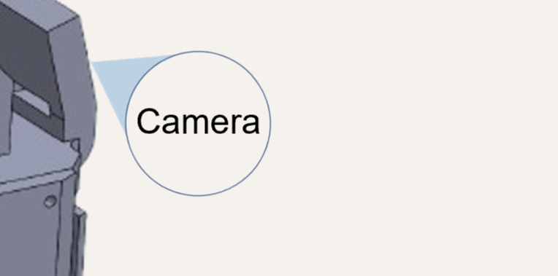
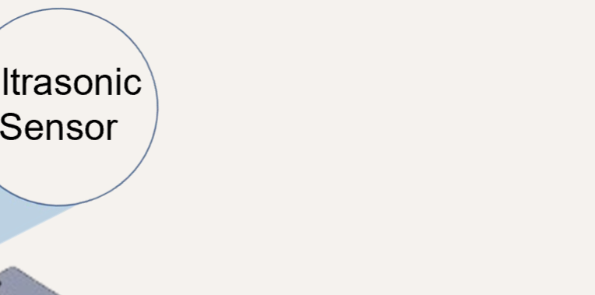
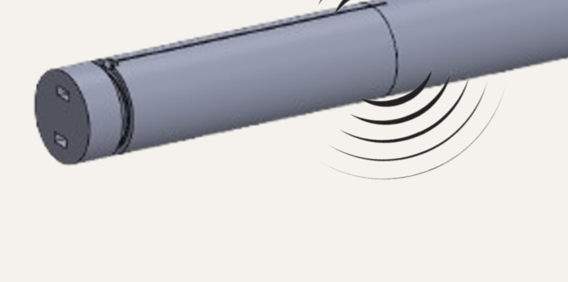
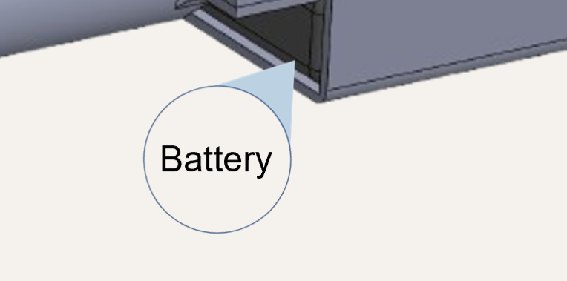
Engineering Design

Slide 22
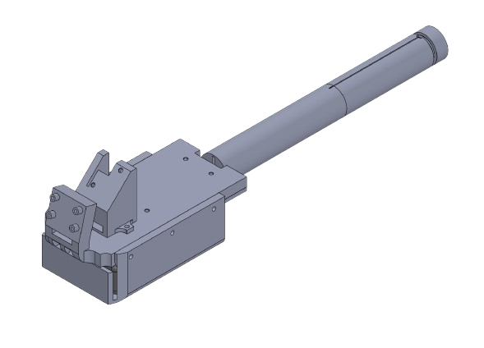

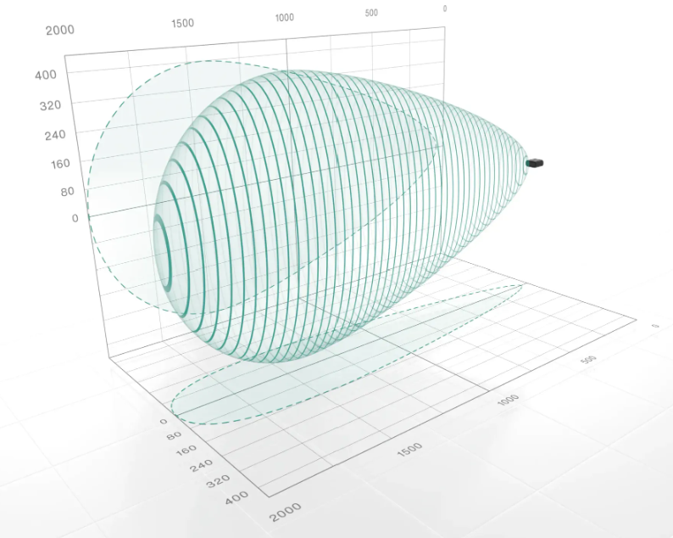



Engineering Design: Ultrasonic Sensor
GND to Pin 6
V+ to Pin 2
Pin 4 to (GPIO18)

Slide 23


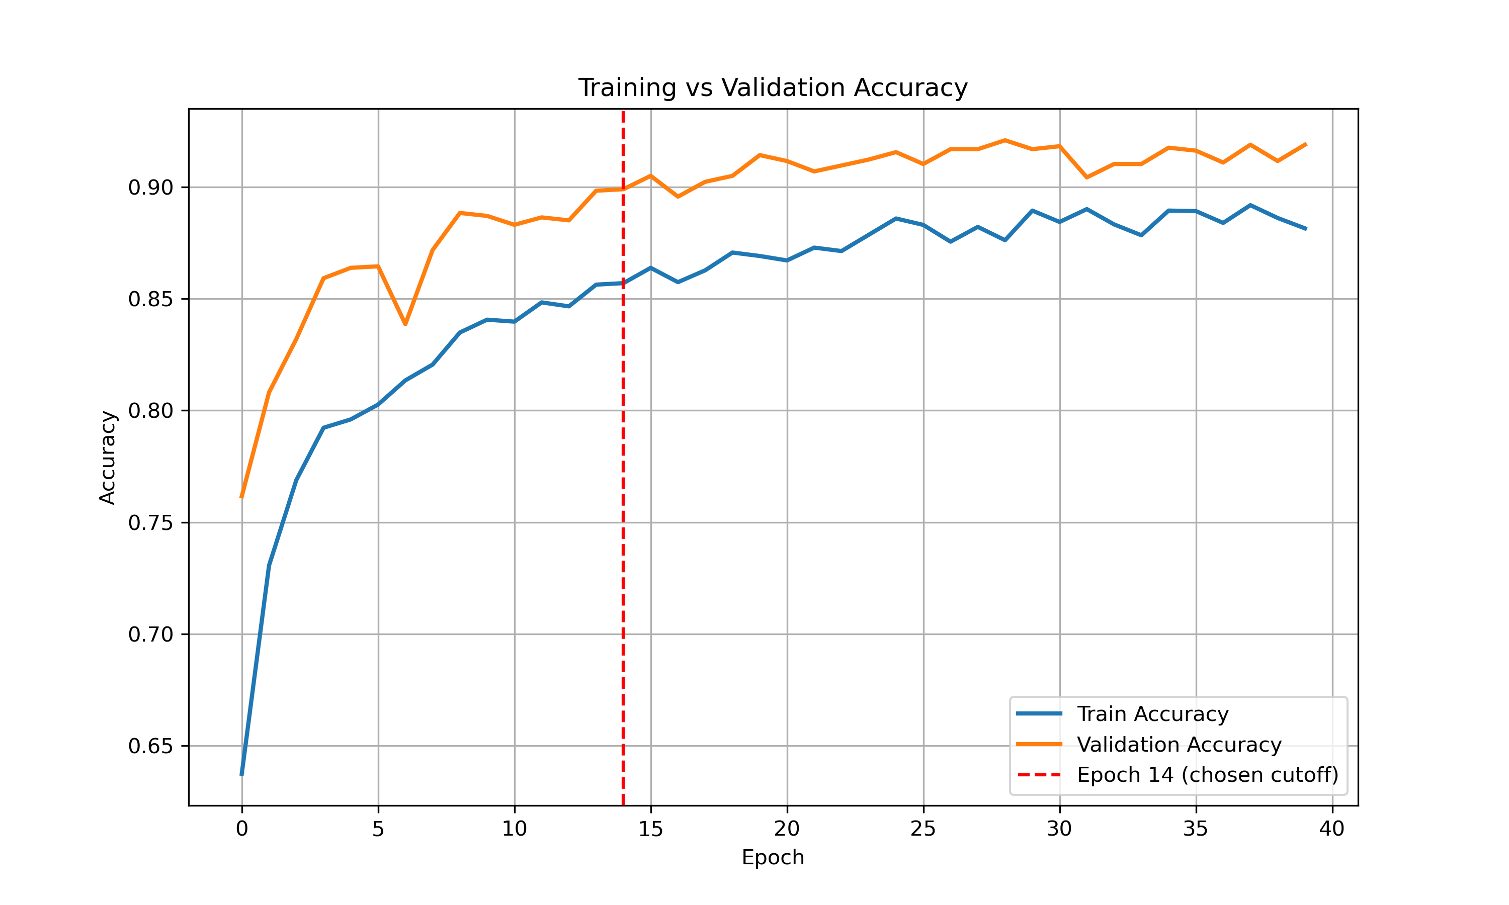
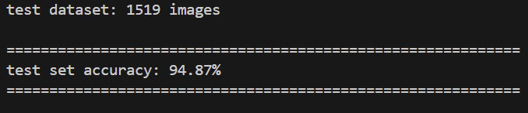
Engineering Design: Machine Learning

Slide 24
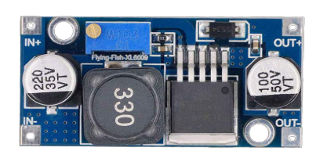
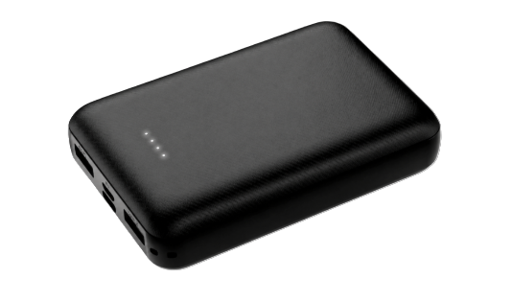
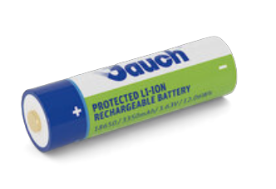
Engineering Design: Battery System
5V
5V
DC – DC Boost Converter
Low Voltage (3.7V)
Primary Voltage Source (fixed - 5V)
Secondary Voltage Source (3.7)

Slide 25

Engineering Design: Vibration Motor

Slide 26
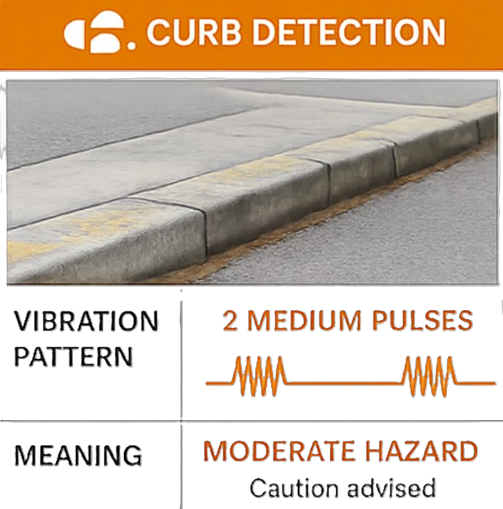
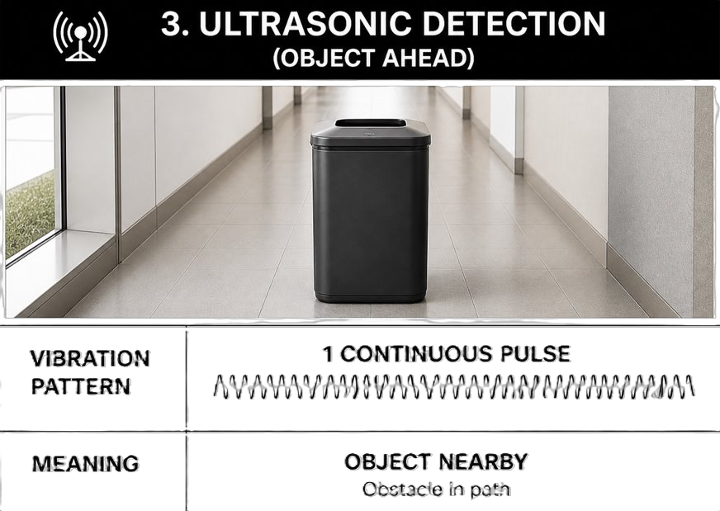
Alert

Slide 27
Engineering Design: Alert

Slide 28
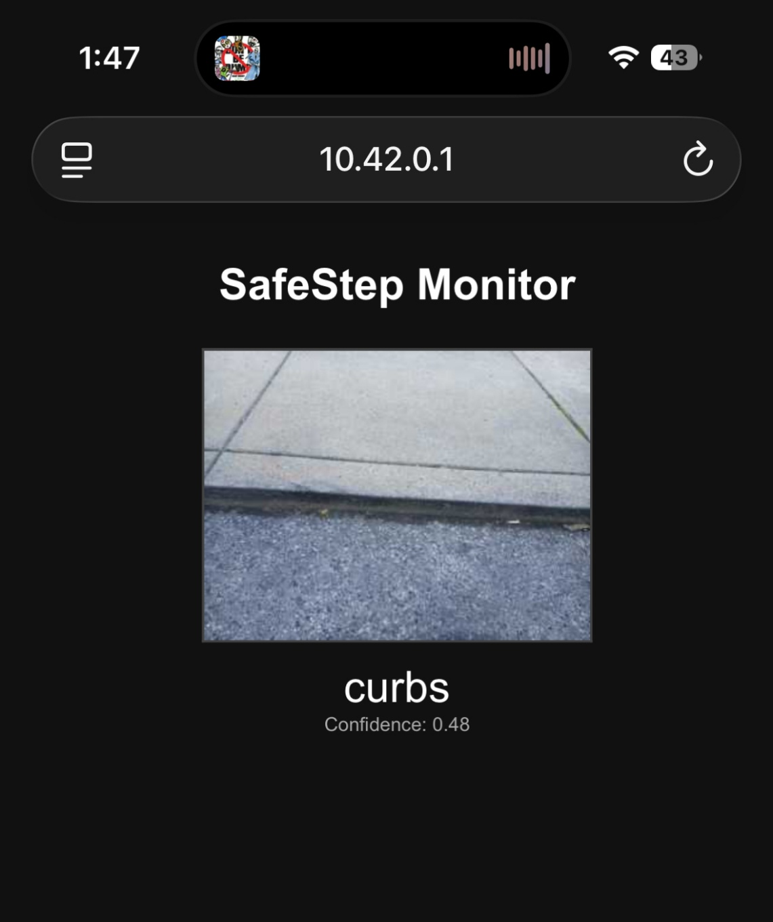
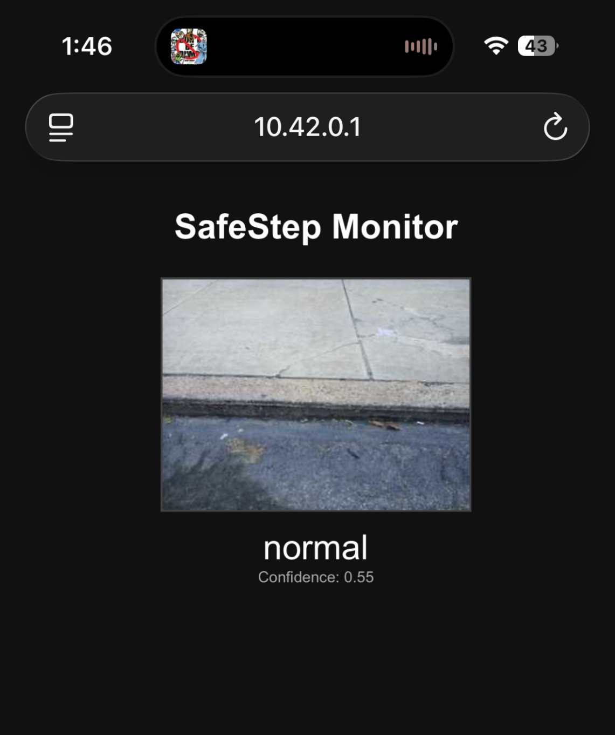
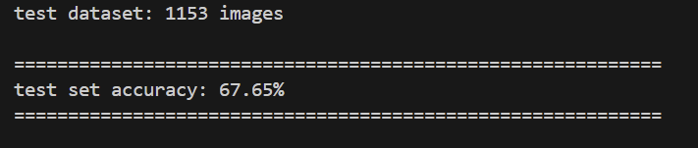

Engineering Design and Progress
Data Collection:
5729 total images
2650 normal
1641 stairs
1438 curbs

Slide 29
Engineering Design and Progress
The most optimal placement of the ultrasonic sensor will be at a 45-degree angle for the best view.
Programmed in Vs Code
Using Python.

Slide 30

Engineering Design and Progress
3D Model of handle segment with component mounting points
Data Collection:
5729 total images
2650 normal
1641 stairs
1438 curbs
SolidWorks was chosen for its accessibility to Temple Students and its extensive documentation.

Slide 31
Engineering Design and Progress

Slide 32
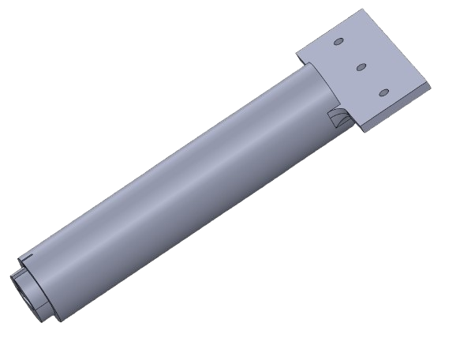
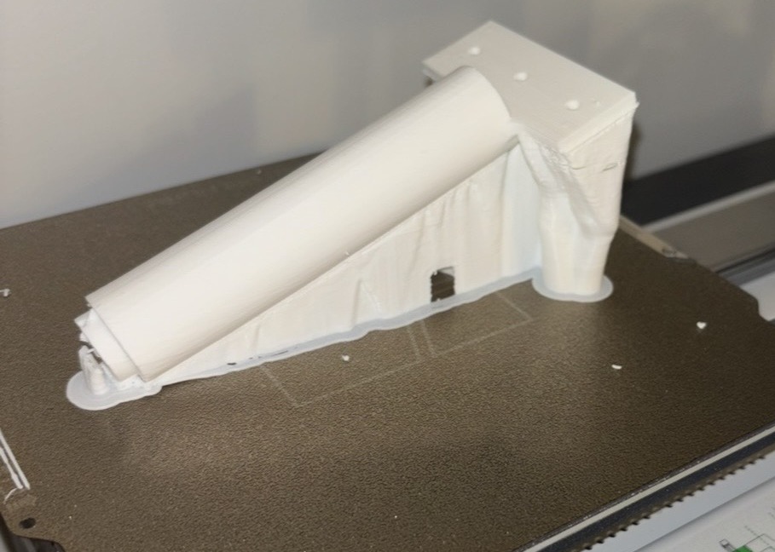

Testing Setup and Results
3D Model
3D Print Testing
Components Mounted

Slide 33


Testing Setup and Results

Slide 34


Testing Setup and Results
Integrated
Testing

Slide 35



Testing Setup and Results

Slide 36




Future Work
Standards
Increase training data set by collecting more images.
ISO 9999 code 12 39 03
Tactile sticks or white canes:
Cane dimensions, used for design constraints
Complete 3D model and prints of the protective component enclosure.
Write system-wide code
to integrate all inputs and vibration motor output
Test the ultrasonic sensor while it is integrated with the system.

Slide 37

Future Work
Standards
Increase training data set by collecting more images.
ISO 9999 code 12 39 03
Tactile sticks or white canes:
Cane dimensions, used for design constraints
Reduce enclosure size

Slide 38
Questions?

Slide 39
Design Requirements
Hazard
Detection Latency
Detection
Distance
False Positive
Rate
Metric: Time
Metric: Distance
Metric: Accuracy
Target: < 220 ms
Target: 6ft
Target: <1%
Why? Fast enough
For human reaction
Why: Allows early
hazard detection
Why: Prevents false alerts

Slide 40





Alert
Processing
Data Collection:
7550 total images
3168 normal
2233 stairs
2149 curbs
Battery
https://www.researchgate.net/figure/Up-left-and-down-right-stairs-detected-with-the-electronic-white-cane_fig5_51873006
Sensing

