Slide 1
SafeStep
An Automatic Hazards Detection Blind Cane
Kevin Bui, Mohamad Charabi, Nathan Pervin, Mikita Piatsevich
Advisor: Dr. Joseph Picone
Instructor: Dr. Brian Thomson

Slide 2
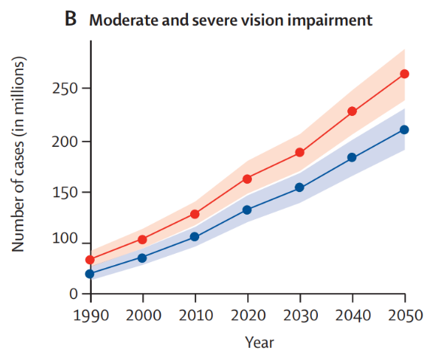
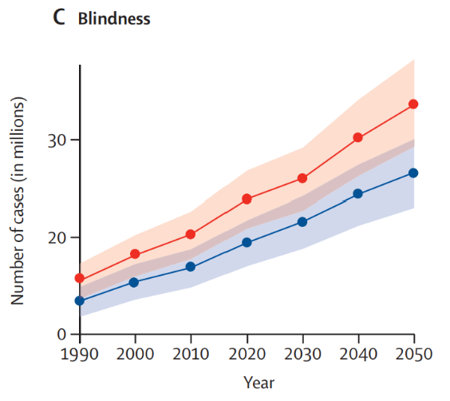

Blindness and vision impairment are increasing globally, increasing reliance on mobility aids.
Source:
https://www.sciencedirect.com/science/article/pii/S2214109X20304253

Slide 3
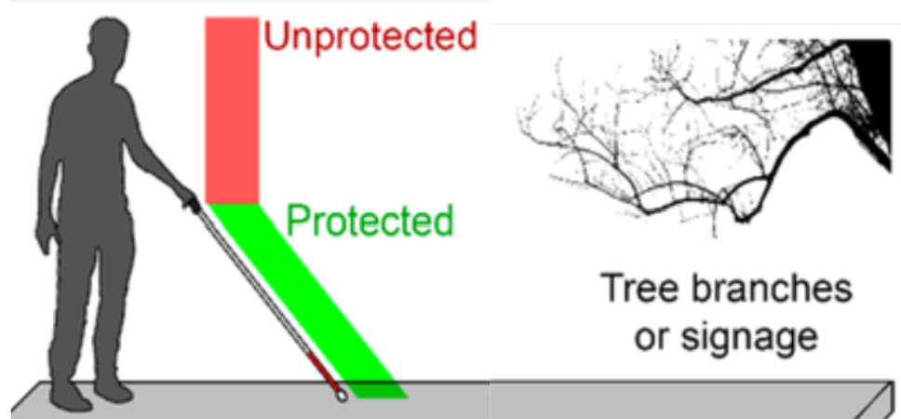
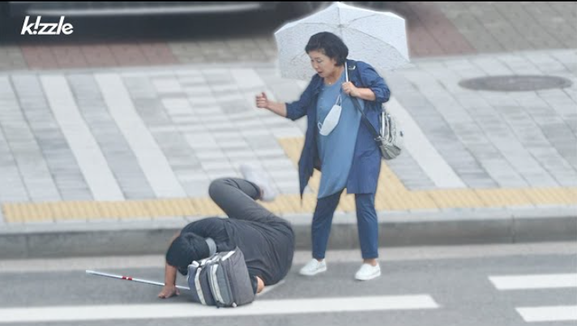
Automatic Hazards Detection Can Prevent User Injuries
Blind canes can’t detect all hazards.
As a result, collisions and falls can occur.
Source: https://www.researchgate.net/figure/Schematics-of-A-an-individual-with-the-white-cane-facing-daily-life-obstacles-the-cane_fig1_350820013
Source: https://youtu.be/S0n9UQ9eNrs?si=bu-2d58Qq2Apc4Jm
Notes:
EDIT 1

Slide 4
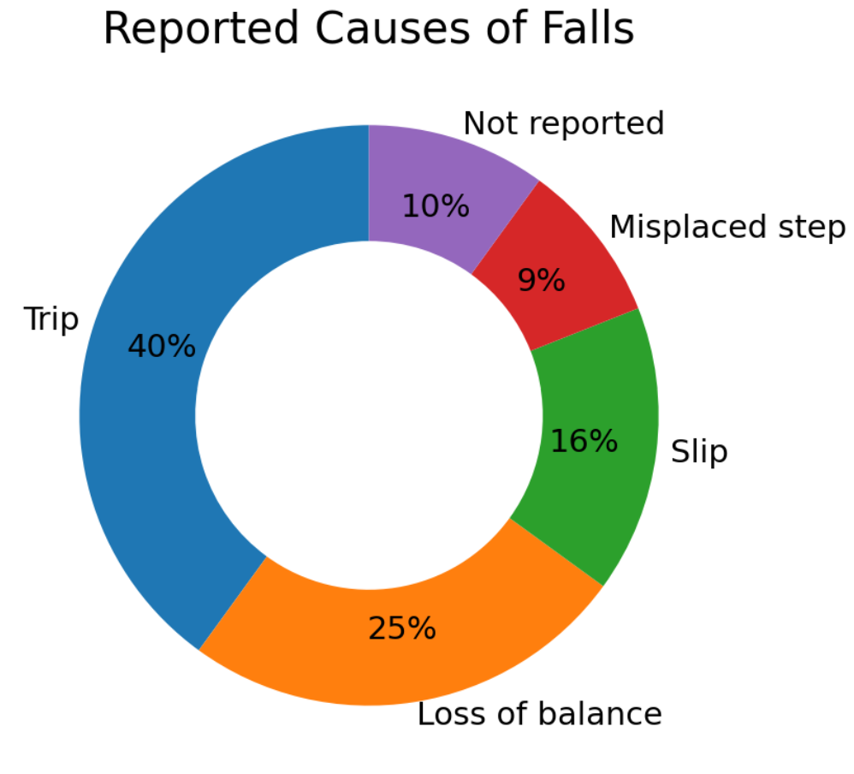
Fall and Injury Rates Among the Visually Impaired
76 people with visual impairment were studied over a 12-month period
63% of falls resulted in an injury
74% reported at least 1 fall or injury event
Our project aims to mitigate the trips and misplaced steps that are causes of falls.

Slide 5
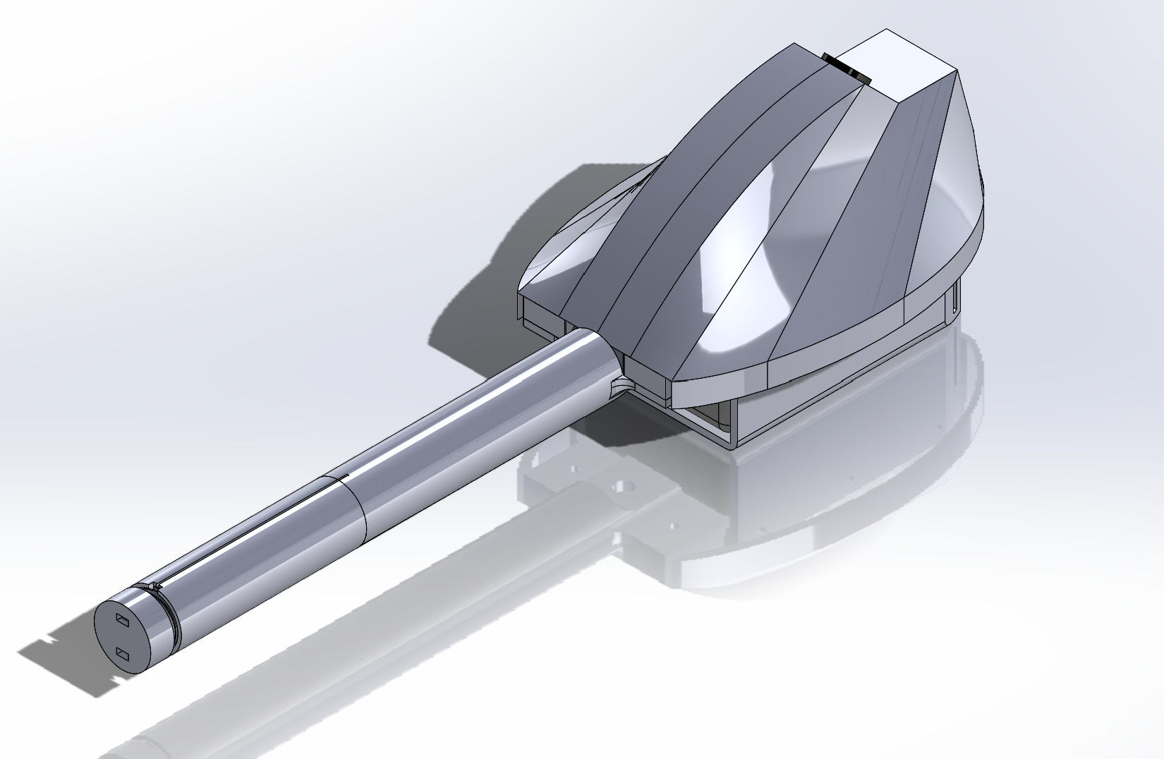


Proposed Solution: SafeStep, a smart blind cane
Ultrasonic Sensor
Camera
Vibration Warning

Slide 6

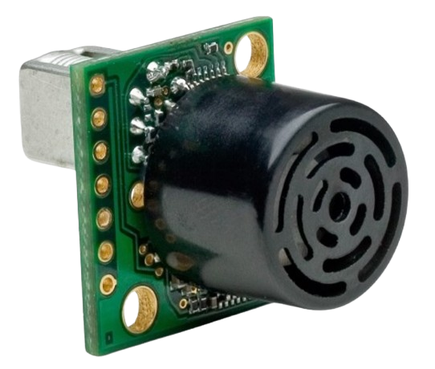
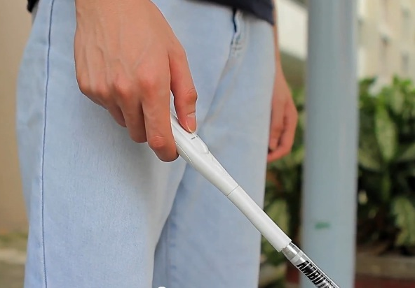
Proposed Solution: Ultrasonic Sensor
Ultrasonic sensor detects obstacles in walking path
Vibration Alerts User

Slide 7

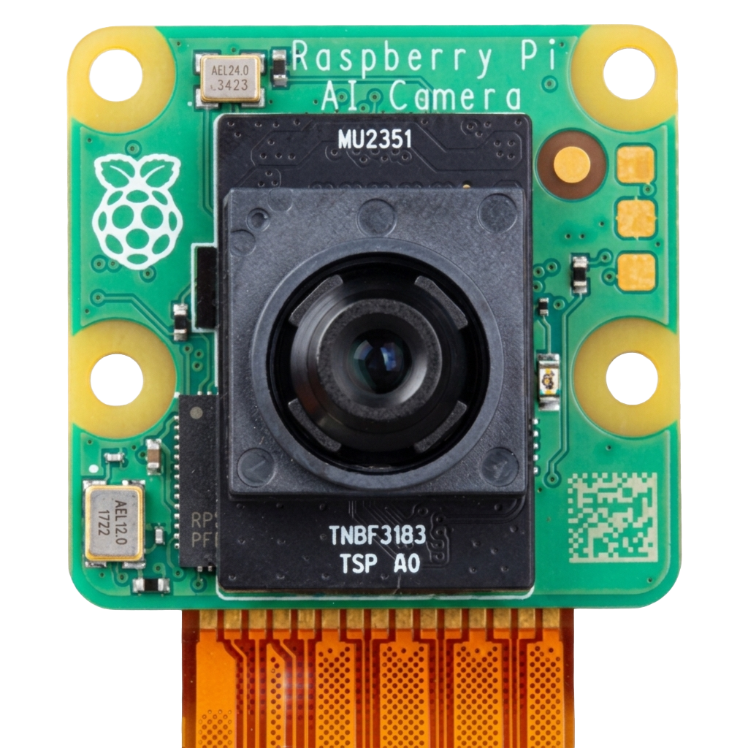
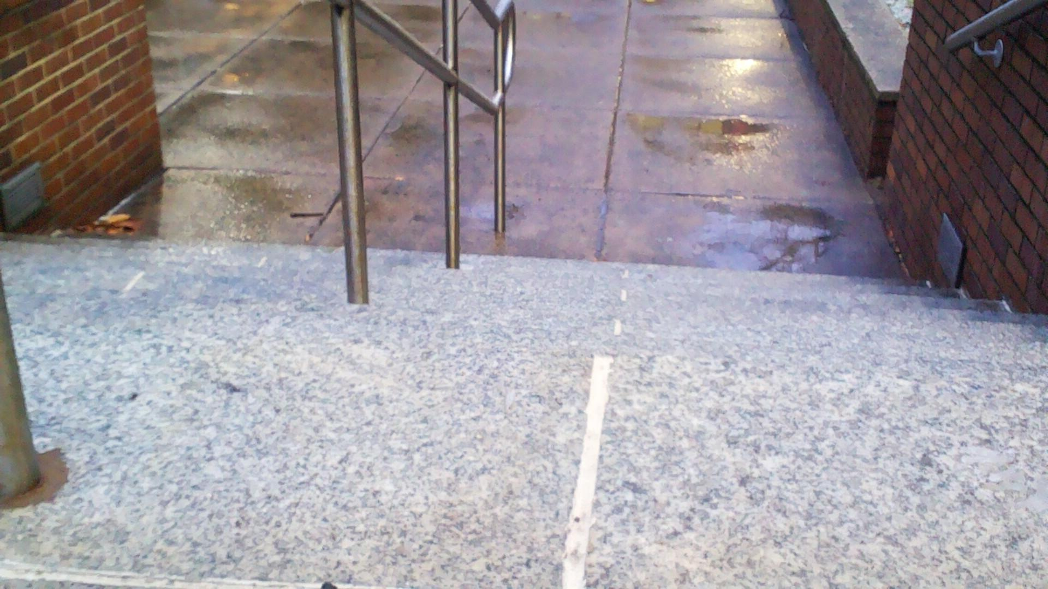
Proposed Solution: Machine Learning
Machine Learning Model Identifies Hazard
Camera Captures Image of Walking Path
Vibration Alerts User
Hazard: Stairs

Slide 8
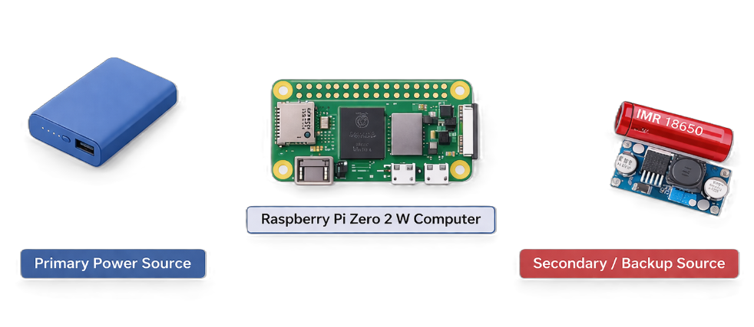



Proposed Solution: Power System
5V
5V $←$ 3.7V
$$→$$
$$←$$
5V regulated output (direct supply)
3.7V battery boosted to 5V
Both sources are designed to provide regulated 5V required for Raspberry Pi operation

Slide 9
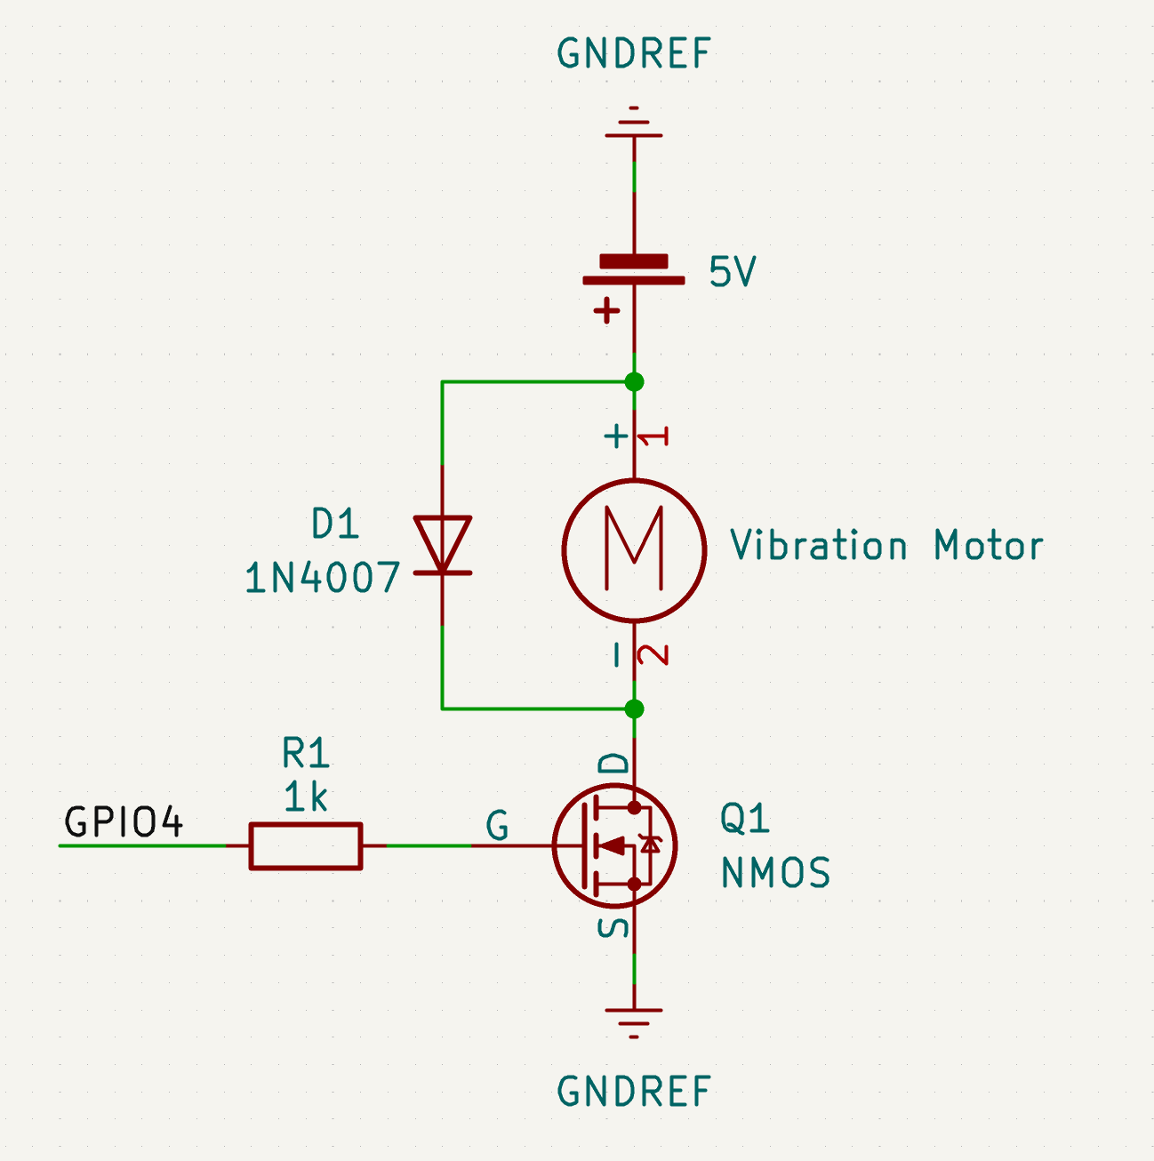
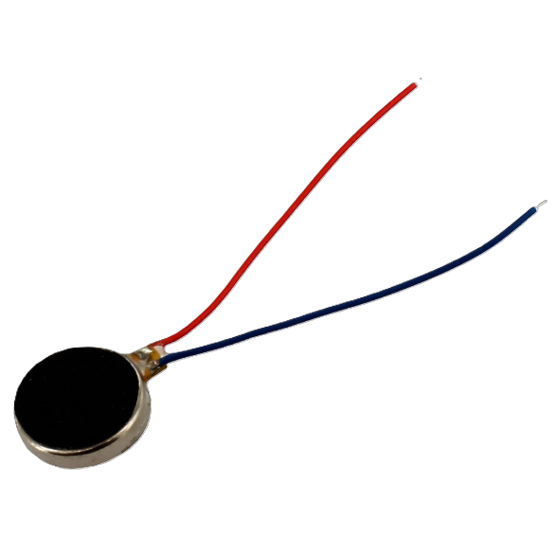
Proposed solution: Vibration motor

Slide 10
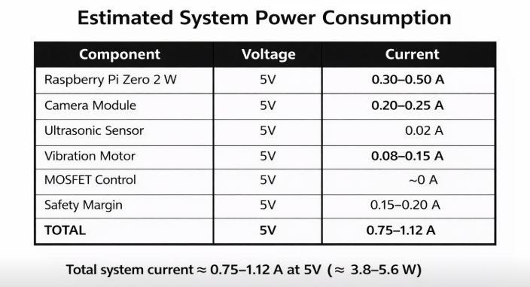
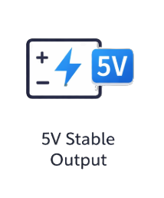
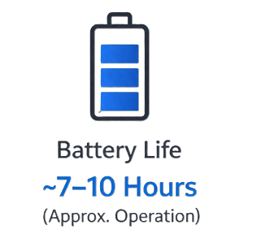
Design Requirements (Power System)

Slide 11
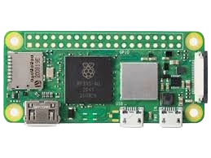
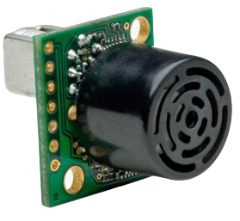

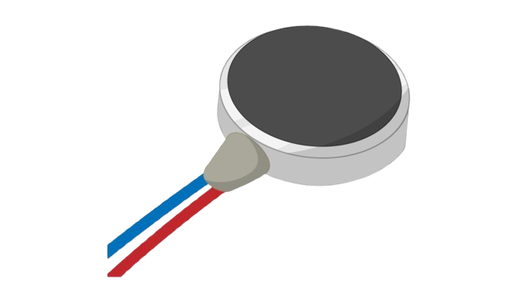
System Integration
Power
Data
Raspberry Pi AI Camera
Raspberry Pi Zero 2 W Computer
Ultrasonic Sensor
Live Camera Feed
1080p Images
Distance Measurement (cm)
5V
3.3V
Battery
ON/OFF
5V
5V
Vibration Motor

Slide 12



Design Requirements
Hazard
Detection Latency
Detection
Distance
False Positive Rate
Constraint
Metric
Time
Distance
Percentage
Target Value
< 220 ms
6 ft
< 1%
Fast enough
For human response
Allows early
hazard detection
Prevents false alerts
Why?

Slide 13
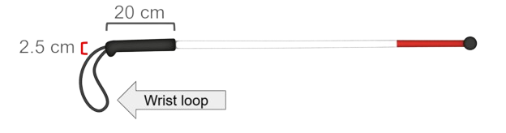
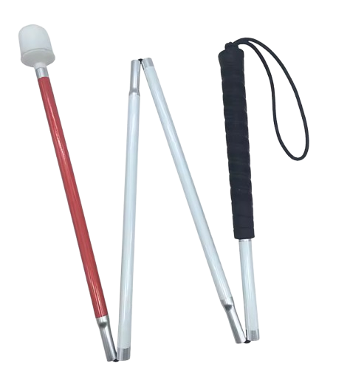
Design Constraints
Handle Diameter
Handle Length
Constraint
Portability
Metric
Physical Dimension
Physical Dimension
Operation
Target Value
Cane is foldable
2.5 cm
20 cm
Provides a comfortable grip
Improves control over cane
Why?
Easy to store and carry

Slide 14
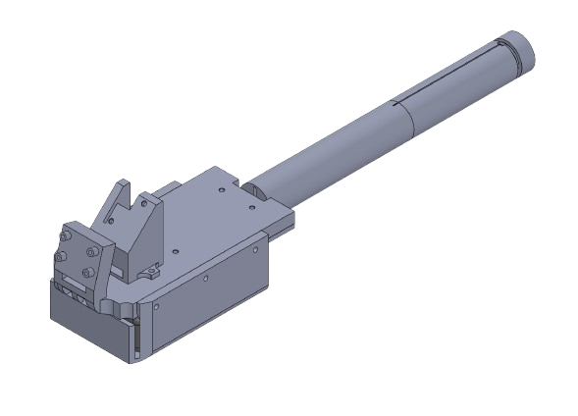


Engineering Design and Progress
3D Model of handle segment with component mounting points
Data Collection:
5729 total images
2650 normal
1641 stairs
1438 curbs
SolidWorks was chosen for its accessibility to Temple Students and its extensive documentation.

Slide 15
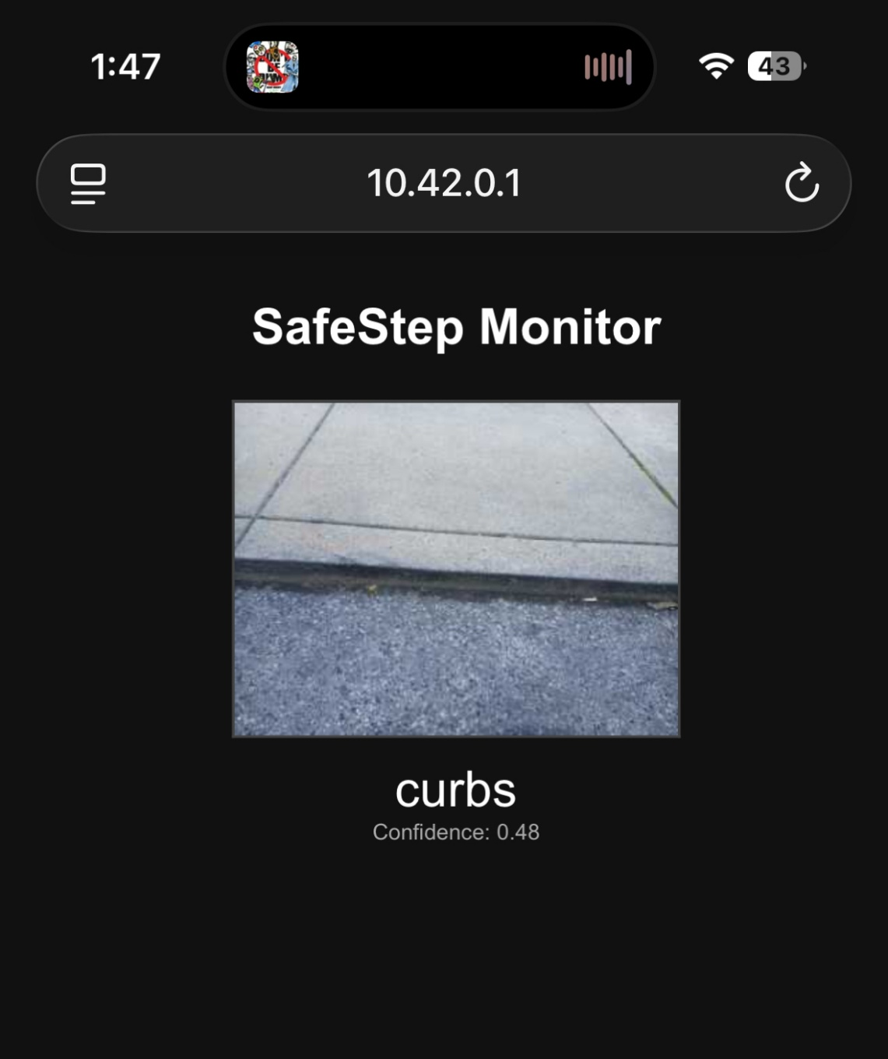
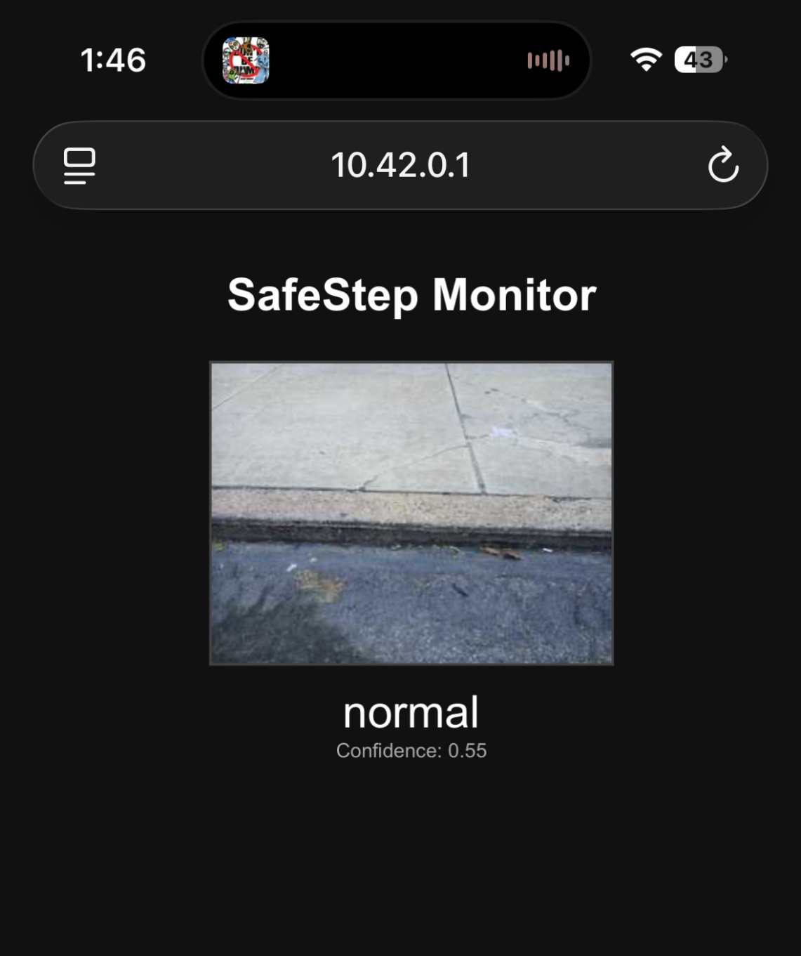
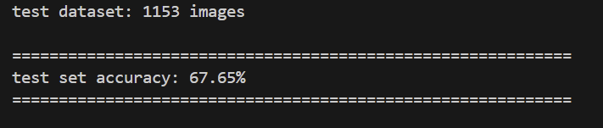

Engineering Design and Progress

Slide 16
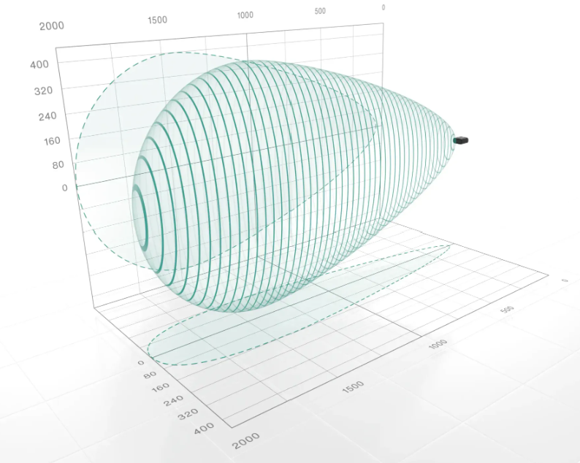

Engineering Design and Progress
The most optimal placement of the ultrasonic sensor will be at a 45-degree angle for the best view.
Programmed in Vs Code
Using Python.

Slide 17
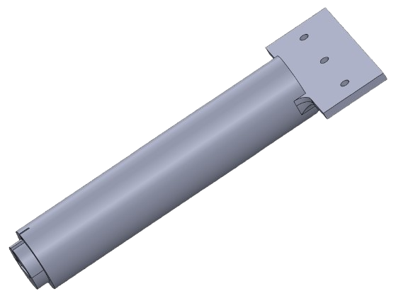
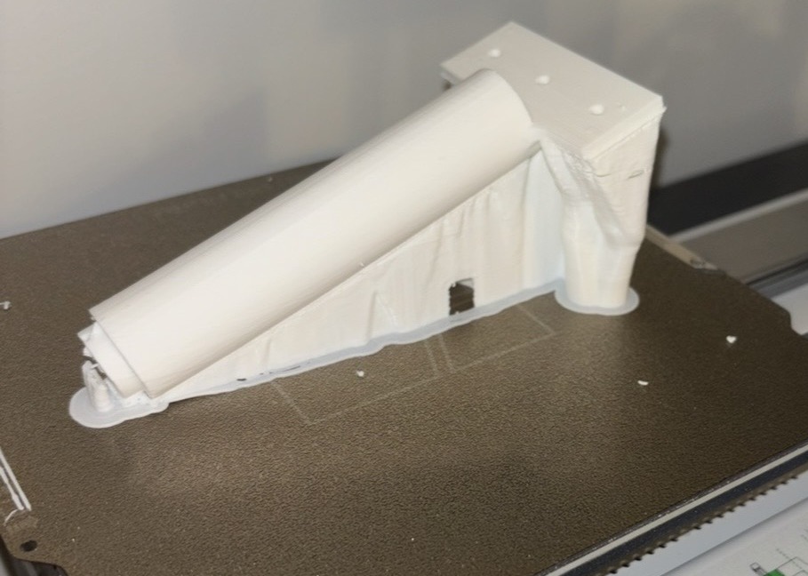
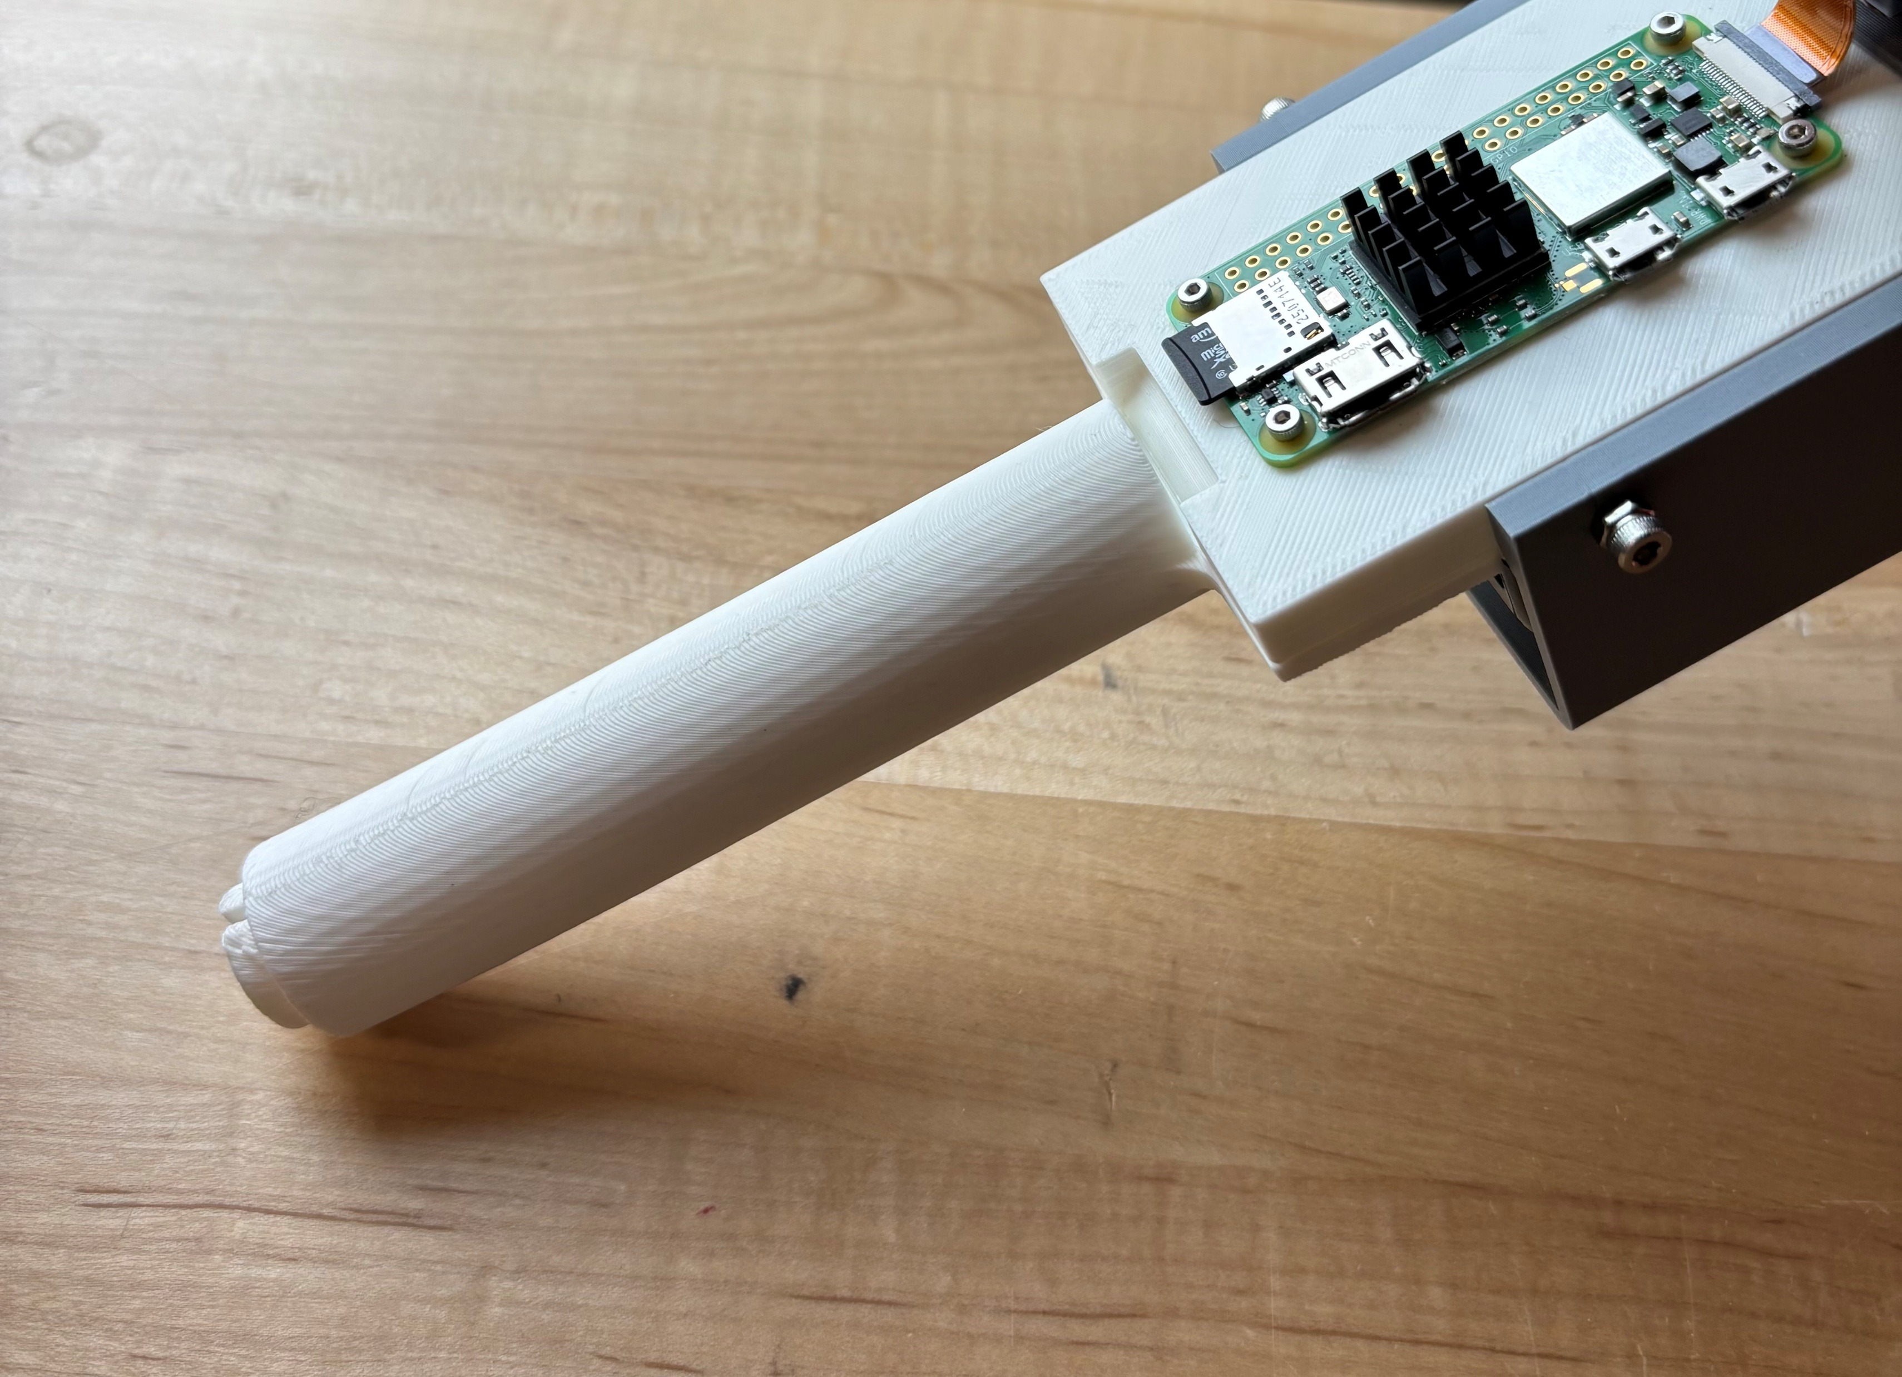
Testing Setup and Results
3D Model
3D Print Testing
Components Mounted

Slide 18
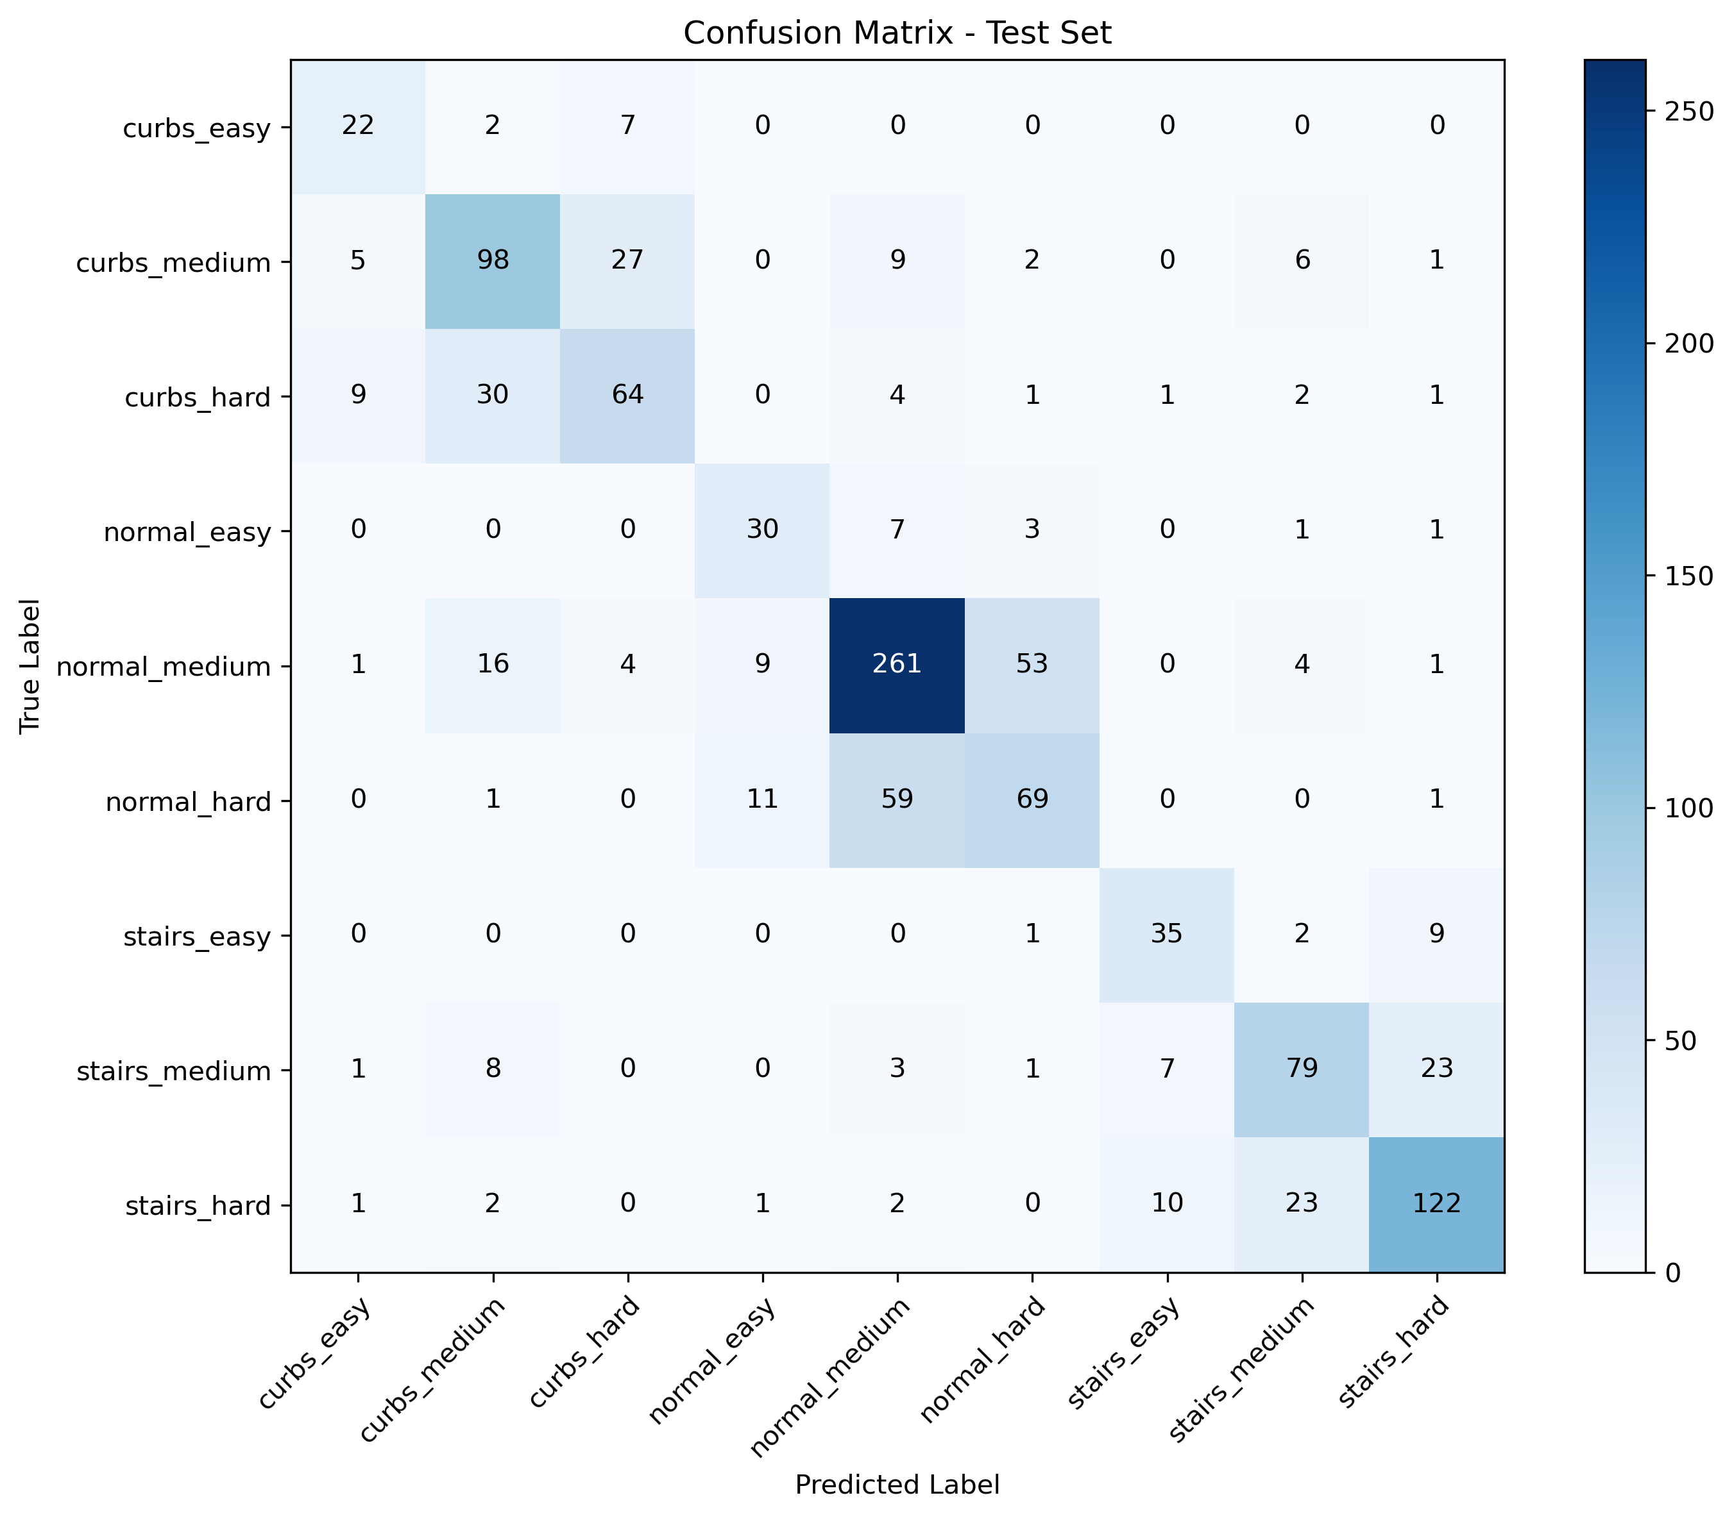
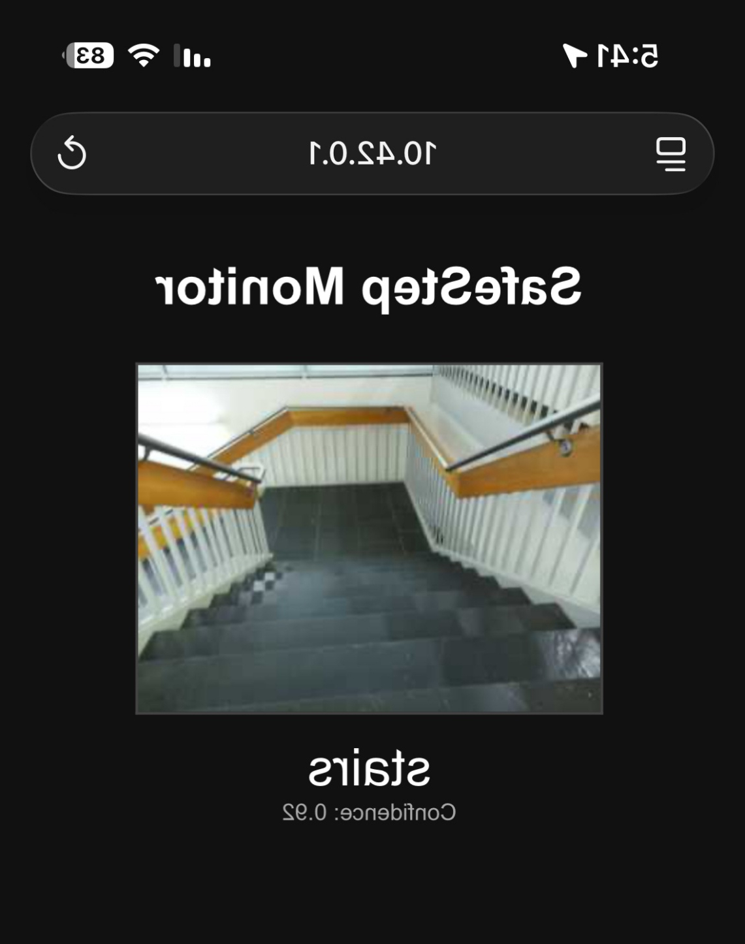
Testing Setup and Results

Slide 19
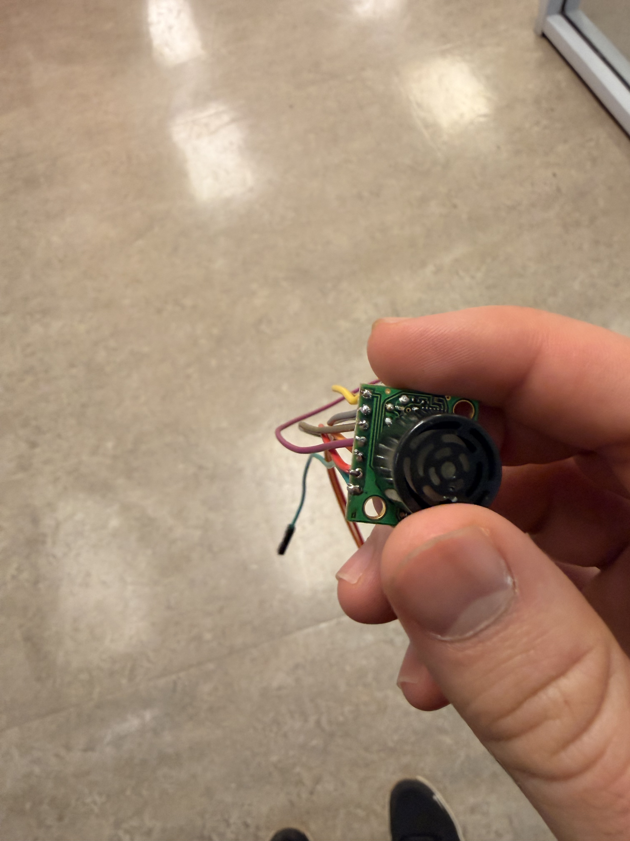
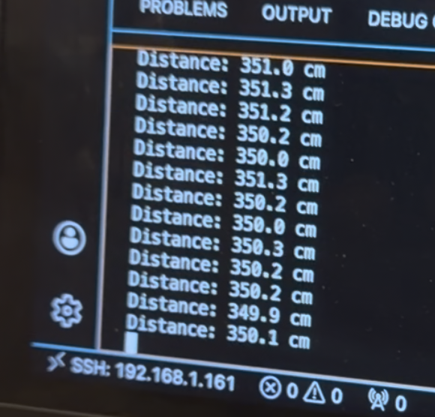
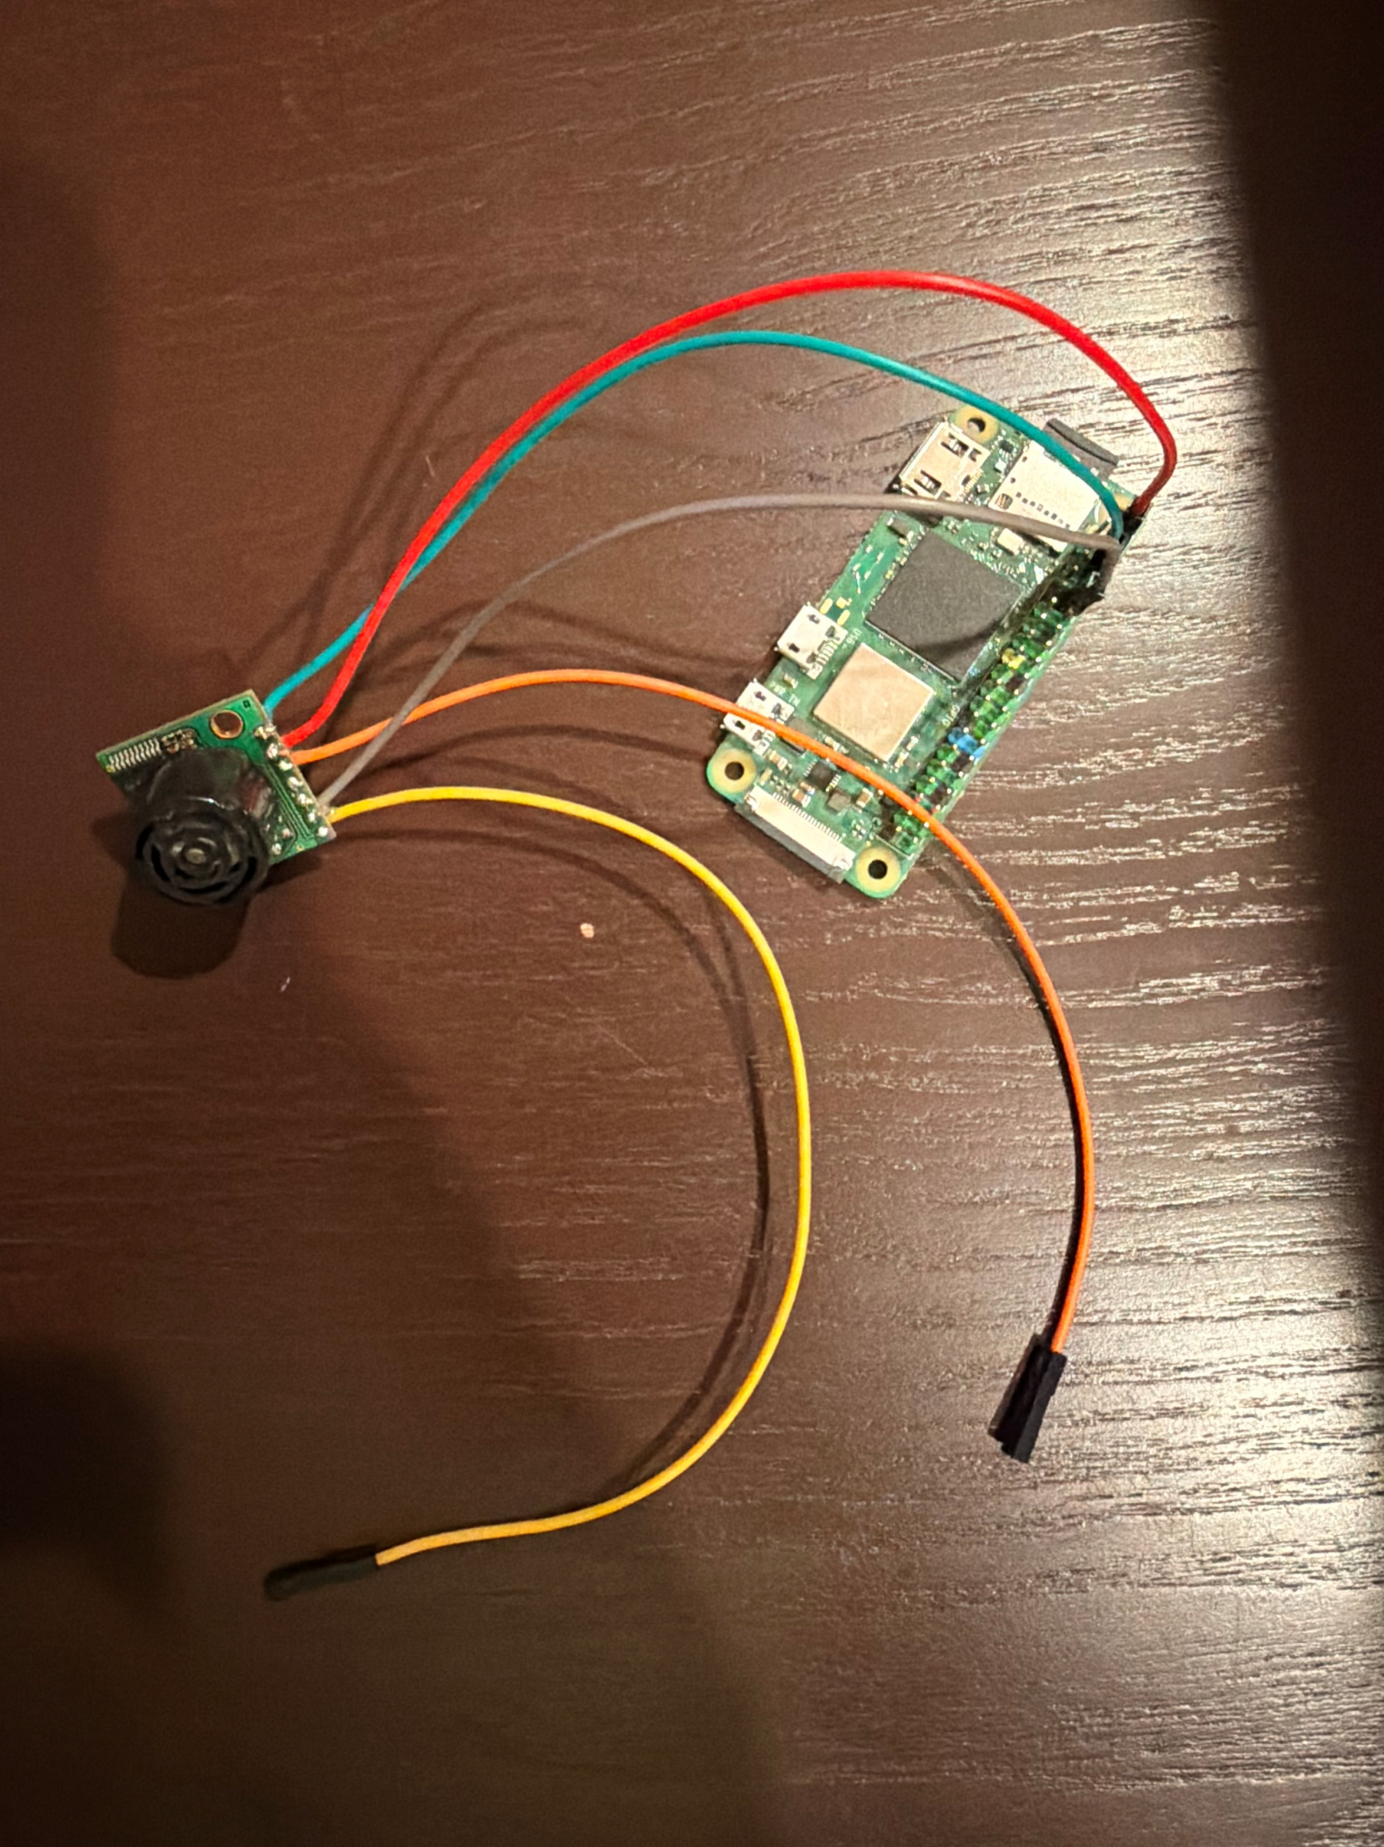
Testing Setup and Results
Solder Wires
Wired up
Testing Range

Slide 20
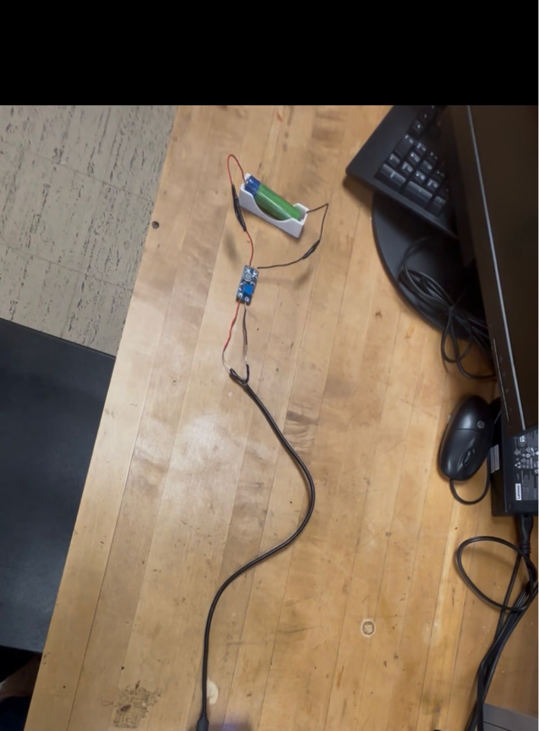
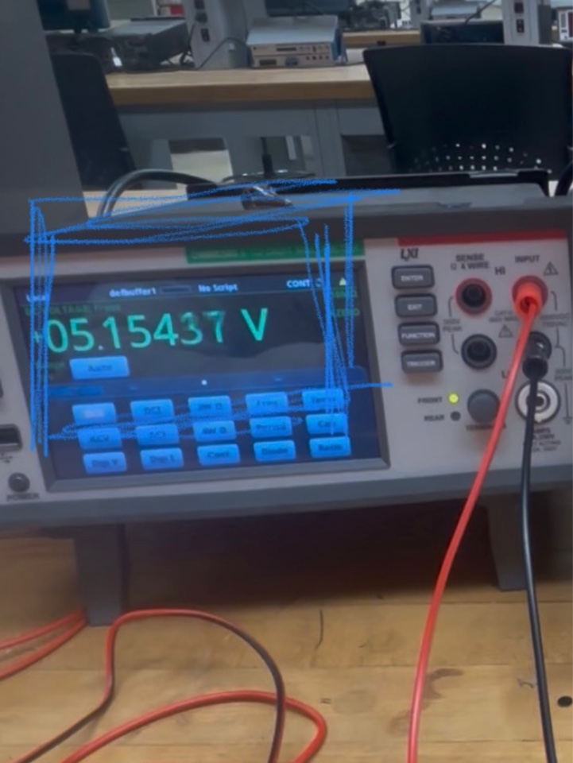
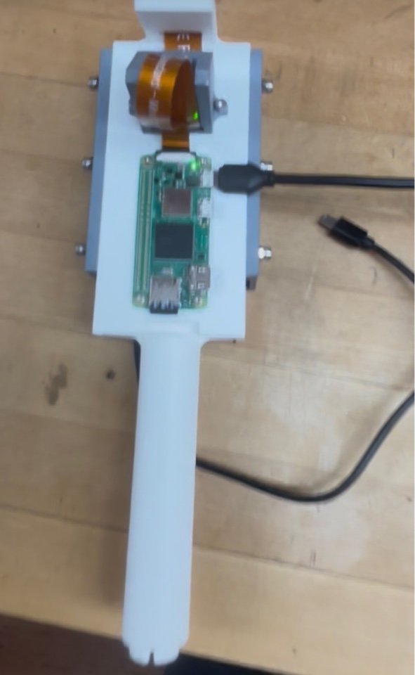
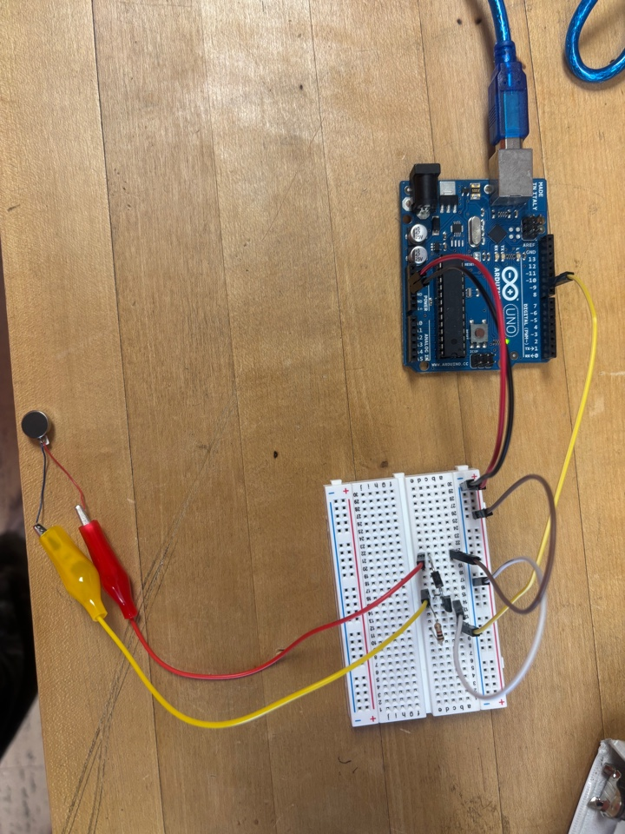
Testing Setup and Results

Slide 21




Future Work
Standards
Increase training data set by collecting more images.
ISO 9999 code 12 39 03
Tactile sticks or white canes:
Cane dimensions, used for design constraints
Complete 3D model and prints of the protective component enclosure.
Write system-wide code
to integrate all inputs and vibration motor output
Test the ultrasonic sensor while it is integrated with the system.

Slide 22
Questions?

Slide 23
Design Requirements
Hazard
Detection Latency
Detection
Distance
False Positive
Rate
Metric: Time
Metric: Distance
Metric: Accuracy
Target: < 220 ms
Target: 6ft
Target: <1%
Why? Fast enough
For human reaction
Why: Allows early
hazard detection
Why: Prevents false alerts

Slide 24
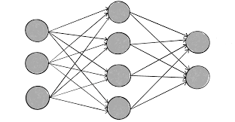
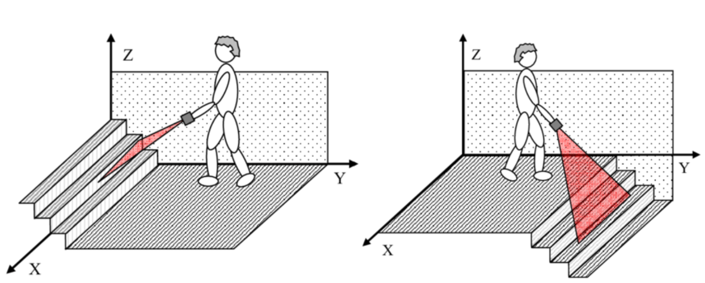
https://www.researchgate.net/figure/Up-left-and-down-right-stairs-detected-with-the-electronic-white-cane_fig5_51873006

