Slide 1
SafeStep
An Automatic Hazards Detection White Cane
Nathan Pervin, Mohamad Charabi, Kevin Bui, Mikita Piatsevich
Advisor: Dr. Joseph Picone
Instructor: Dr. Brian Thomson

Slide 2
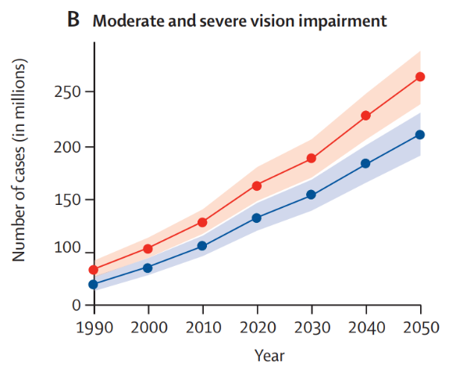
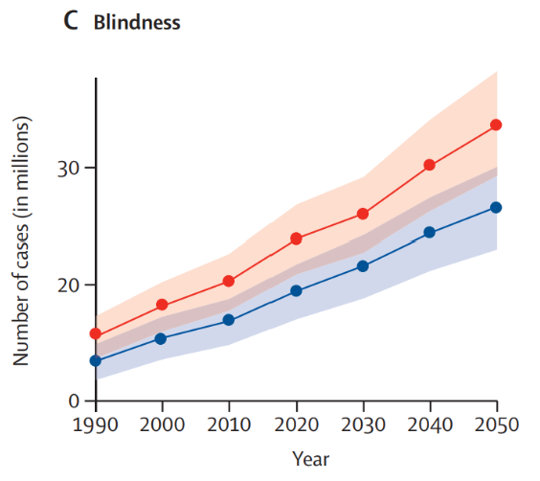

Blindness and vision impairment are increasing globally, increasing reliance on mobility aids.
Source:
https://www.sciencedirect.com/science/article/pii/S2214109X20304253

Slide 3
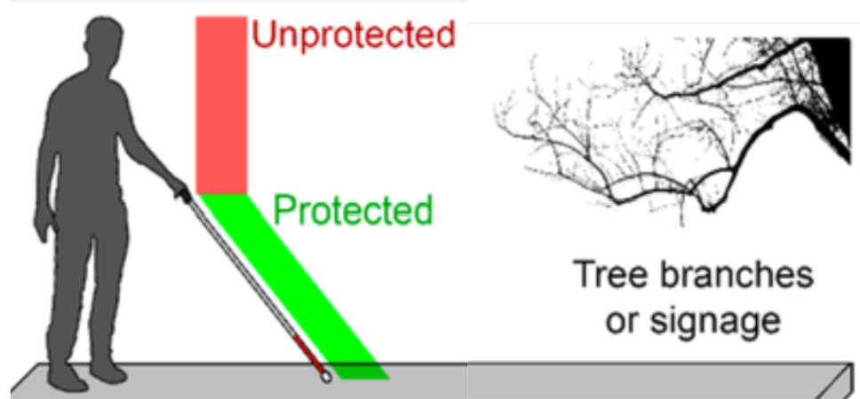

Automatic Hazards Detection Can Prevent User Injuries
Blind canes can’t detect all hazards.
As a result, collisions and falls can occur.
Source: https://www.researchgate.net/figure/Schematics-of-A-an-individual-with-the-white-cane-facing-daily-life-obstacles-the-cane_fig1_350820013
Source: https://youtu.be/S0n9UQ9eNrs?si=bu-2d58Qq2Apc4Jm
Notes:
EDIT 1

Slide 4
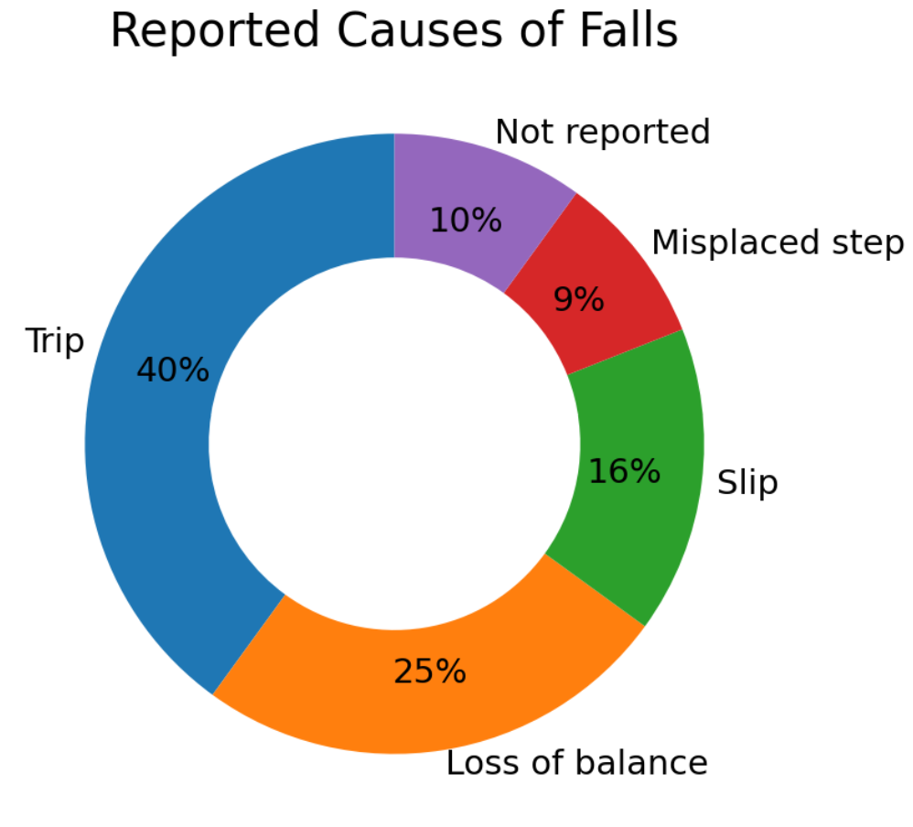
Fall and Injury Rates Among the Visually Impaired
76 people with visual impairment were studied over a 12-month period
63% of falls resulted in an injury
74% reported at least 1 fall or injury event
Our project aims to mitigate the trips and misplaced steps that are causes of falls.

Slide 5

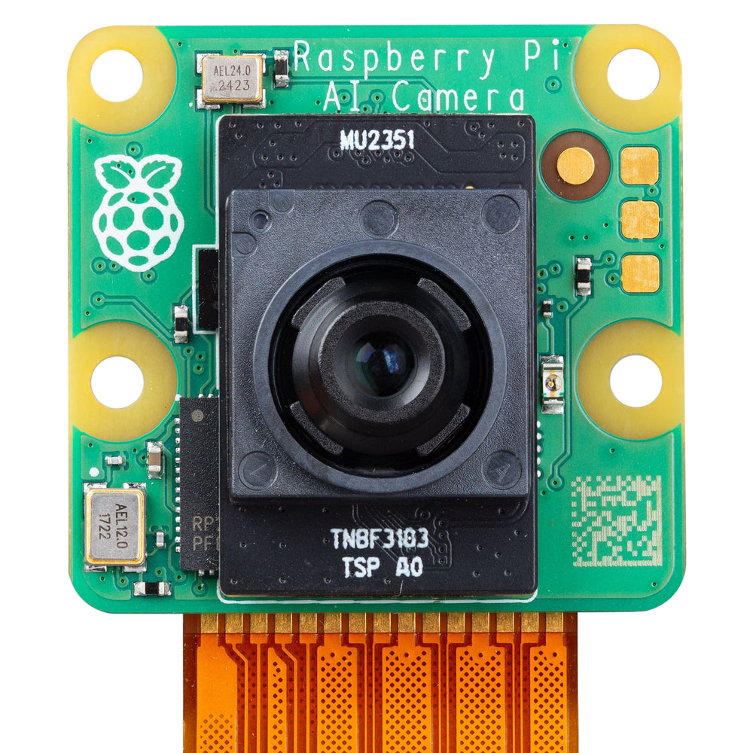

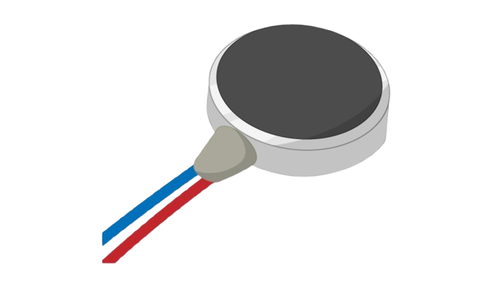
Proposed Solution
Camera Captures Walking Path
Machine Learning Model Identifies Hazard
Vibration Alerts User

Slide 6
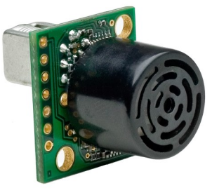
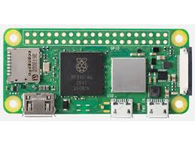

Proposed Solution
Power
Ultrasonic Sensor
Data
Raspberry Pi AI Camera
Battery
Raspberry Pi Zero 2 W Computer
Vibration Motor

Slide 7
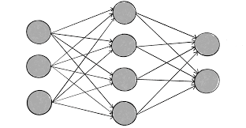
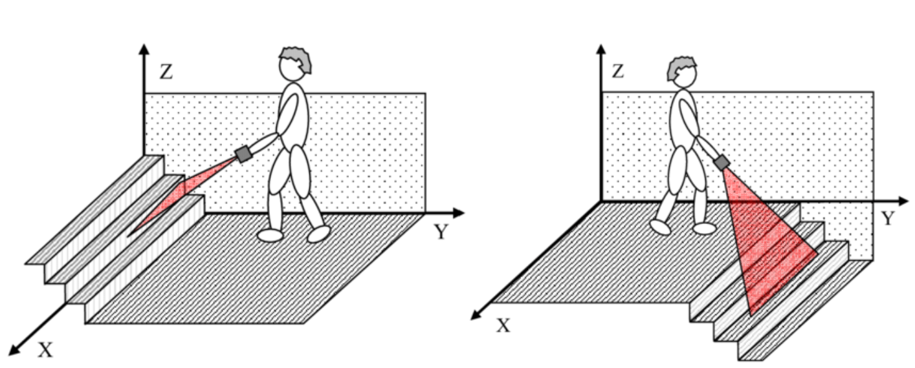
https://www.researchgate.net/figure/Up-left-and-down-right-stairs-detected-with-the-electronic-white-cane_fig5_51873006

