Slide 1
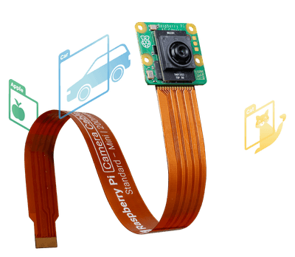
Raspberry Pi AI Camera Integration

Slide 2
What does this camera do?
The camera has a Sony IMX500 sensor, neural networks can run on the camera module.
It has a small Image Signal Processor (ISP) that converts raw data to input tensors.
Input tensor -> IMX500 on-board neural network accelerator.
Camera outputs normal image frames AND output tensors directly to the Pi.
The Pi DOES NOT need to run neural network on the CPU

Slide 3
What software/libraries are stated in docs
Libcamera – dequeues an image and inference data buffer from the IMX500 kernel. Can use specific controls to look at input/output tensors arrays and info about the tensors.
Rbicam-apps – runs IMX500 post-processing, provides a base class for any neural network model. Docs gives examples of object-detection and pose-detection
Picamera2 – Similar to rbicam-apps, gives functions to help read tensors and convert coordinates.

Slide 4
What Neural Networks can be used?
Out of the box, documentation says that you can run example pre-packaged demos.
MobileNetSSD for object detection
PoseNet for pose estimation
We can choose from an array of small convolution neural networks (CNN)
We can use MobileNetV2 or MobileNetV3-small
EfficientNet

Slide 5
How to deploy PyTorch onto the camera
This is the official flow on how to deploy a new neural network from the official Raspberry Pi Documentation
Provide a floating-point neural network model (PyTorch or TensorFlow)
Run the model through Edge-MDT (Edge AI Model Deployment Toolkit)
Quantise and compress the model so that it can run using the resources available on the IMX500 camera module
Convert the compressed model to IMX500 format
Package the model into a firmware file (.rpk) that can be loaded at runtime onto the camera
PyTorch uses ONNX for conversion to IMX500 format.

Slide 6
Hardware + Deployment Limitations
The IMX500 has 8 MB of on-sensor memory available.
This could be used for the model, firmware packaging, etc.
IMX500 deployment REQUIRES 8-bit uniform quantification
No FP32 inference on sensor
FP32 = 32-bit floating point
Train in FP32 -> Export to ONNX FP32 -> Quantize INT8 -> Deploy
IMX500 needs a fixed input size and no dynamic tensor shape
Power draw should be lower than running it on the CPU

Slide 7
Compatibility
Training (on the cluster)
Use *.list -> Dataset custom loader -> transforms -> PyTorch model Train
Deployment (on cane)
Camera produces image frames + inference tensors
Create an “app” that reads tensors (via Picamera2/libcamera) and interprets them.

Slide 8
Potential Future Workflow
1.) Continue data collection and sorting.
2.) I will continue with my own custom data loader.
3.) Choosing lightweight CNN model to train on.
4.) Begin training and hope for an error of less than 100%

