Slide 1
Automatic Interpretation of Electrocardiogram Signals
By Chernoh Barrie, Eric Lin, Giorgi Chubinidze

Slide 2
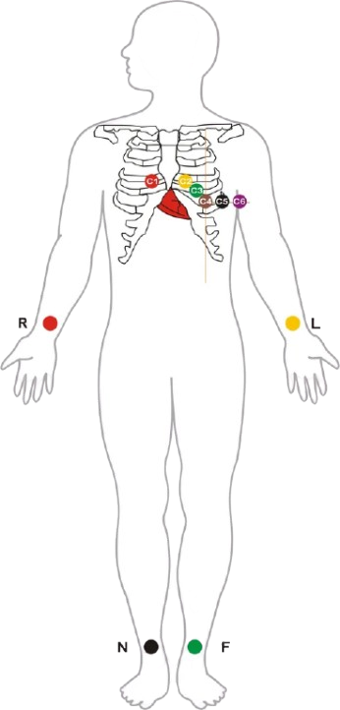
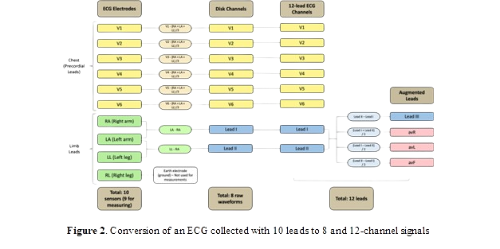
Short Overview for an ECG Machine
Doctors place 10 electrodes on your arms and legs and rib cages.
Each electrode measure between specific points on the body and provide clinician with spatial view to review the signals at 12 different angles at detect any anomalies.
While 8 leads show the raw signal waveform, the other 4 leads use math to combine 2 other leads.

Slide 3

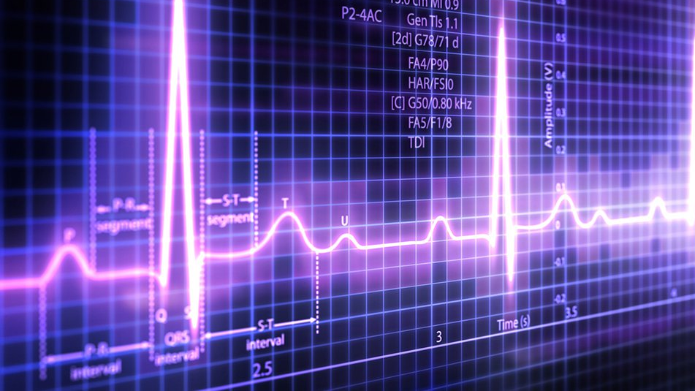
The Big Question?
Can we use machine learning to localize abnormalities in ECG signals?

Slide 4
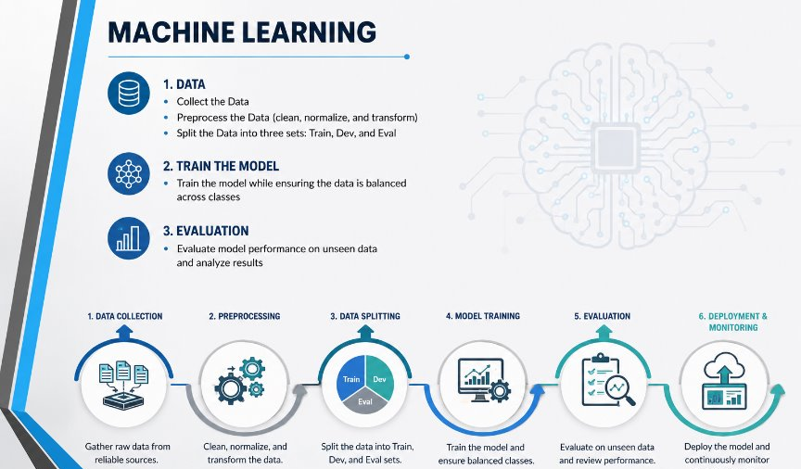

Slide 5
Methods
We spent first couple weeks trying to understand all the source code for the program. There was thousands of lines of code to read and understand.
We used resnet-18 to train the model which is a tool used for image classification, detection, and segmentation, following this we use a post processing algorithm to localize the abnormalities.
However, before begin training we preprocess all the data. Through resnet-18 the waveforms are transformed into 1024 x 1024 image by plotting the time series signal as a 2d image allowing the network to analyze the ECG Pattern.
The program consists of two main parts: training and decoding. Training trains the model by studying patterns in the data. Decoding tests this model using three datasets which are train, dev, and eval. Train sets the parameters for the model; dev is used for fine-tuning and eval is used for evaluating the model. Following the eval we use the NEDC (Neural Engineering Data Consortium) evaluation specifically focusing on the segmentation-quality overlap (OVLP) metric, which measures how well the predicted events align with the true event based on the overlap in time.
Materials
We mainly worked through the terminal (MobaXterm) which we then connected to Visual Studio Code
We used three main AI helpers as well, that being Claude, ChatGPT, and Copilot

Slide 6
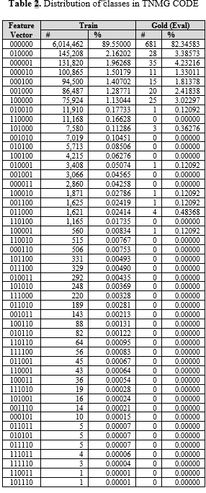
Data
The TNMG database contains over 8 million ecg scans coming from over 2 million patients.
Most of these scans are healthy, having no abnormalities
A big part of the scans also only involve 1 abnormality
And rest is people with 2 or more abnormalities in their cardiology signals
The lack of data for people with multiple abnormalities creates a huge problem for machine learning.

Slide 7
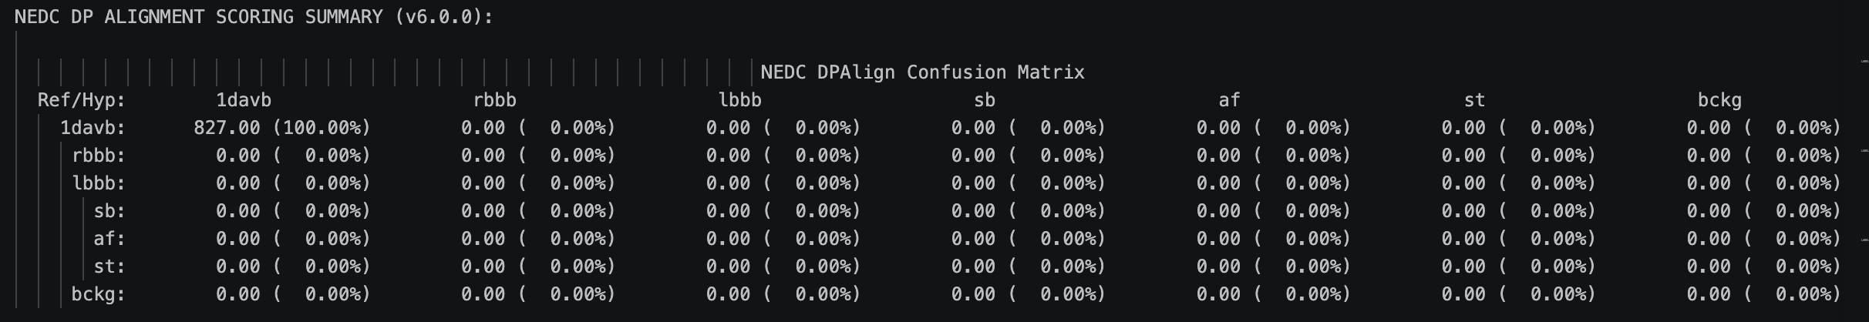
Results
These aren't intended results as although it looks to have determined everything corrected, the model in fact did the opposite as when looking at the data the model doesn't accurately reflect that and instead seems to have guessed the answer.
However, we were able to create the Multi-Label system and get the system running which is significant progress as it's difficult to have a model that can identify more than one abnormality so even if the system has errors, the foundation are there to fix them.

Slide 8
Conclusion
There is no exact conclusion that can be made yet due to the complexity of the issue, however that doesn't mean it isn't possible in the future.
The main issue that can be identified are the lack of data that is required to create such a complex system that needs a multitude of different data to assess different situation; the difficulty that comes with creating a model than can identify multiple abnormalities is something that can't be solved in six weeks.

Slide 9
Acknowledgement
Sadia was the biggest help when it came to understanding the ECG system and what was happening. When first starting out all of us were completely lost on what was going on and what anything meant. It wasn't until we had meeting about the system at what it did that everything changed. Following this meaning everything had finally clicked, and we were able to make major progress.
Abdullah was another major help in making progress in the project, he would come in from time to time and check in on us to assist us with any issue we would have and just talk to us about things such as the World Cup and just wanting to get to know us. He and Sadia had helped us figure out a major bug we were facing and with a combine effort we were able to fix it.
Dr. Picone was a great mentor who led us through this project at an amazing pace to where we never felt overwhelmed by the project. He had us do weekly reports to check up on us every week and assist us in issues that we faced throughout the program. His rules and regulation have most definitely prepared us for future experience that require focus.
Thank you, Sadia,
Thank You, Abdullah,
Thank you, Dr. Picone

Slide 10
Reflection
Overall, this overall an amazing experience that taught us many important lesson that will stick with us till the future
One of those lessons is the reality's of experiments, which is that for every for experiment that successful, there are a thousand more that either don't succeed or take a lot longer to and this one is an example of the latter
The second lesson is that the road of computer science and coding in general can take many different path then the typical creating website and other things.

