Slide 1
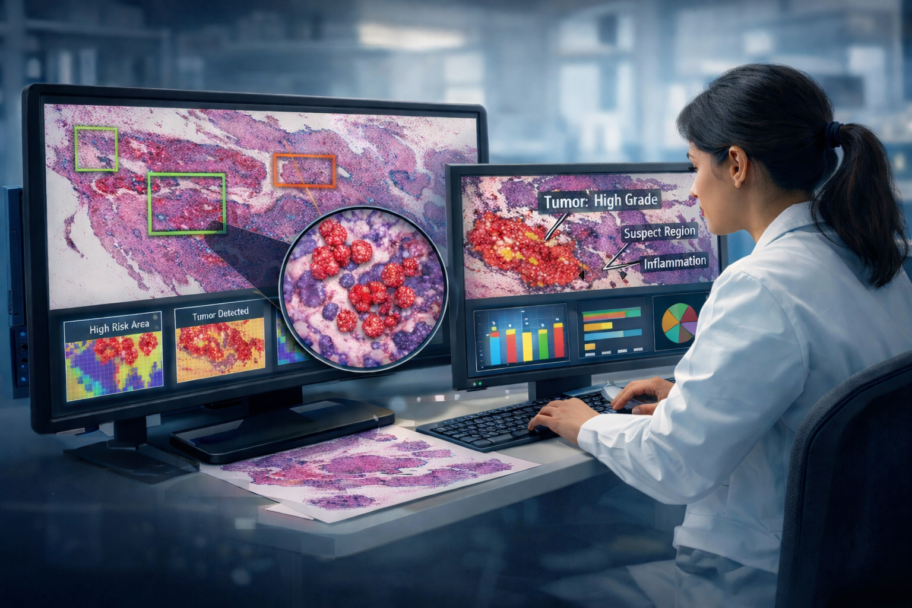

Rapid and Inexpensive Precision Breast Cancer Screening Using Machine Learning
M.A. Al Mamun, S. Purba, I. Obeid and J. Picone
The Neural Engineering Data Consortium
Temple University

Slide 2
Abstract
In this project, we developed deep learning methods to automatically detect and segment abnormal regions of high resolution digital pathology images. We detect six types of pathology:
A central component of the work is the public release of a large, carefully curated corpus of annotated pathology slides from Temple University Hospital (TUH) and Fox Chase Cancer Center (FCCC).
The framework leverages modern transformer-based architectures, transfer learning, and domain adaptation techniques.
We have released open source algorithms for region-of-interest detection and segmentation, along with an interactive visualization tool that can be used to support both research and clinical investigations.
The expected impact includes a substantial reduction in annotation burden, improved scalability of pathology AI systems and enhanced support for pathologist training.
Label | Description
Normal (NORM) | normal ducts and lobules
Ductal Carcinoma in Situ (DCIS) | ductal carcinoma in situ, and lobular carcinoma in situ
Invasive Ductal Carcinoma (INDC) | invasive ductal carcinoma, invasive lobular carcinoma, and invasive mammary carcinoma
Non-Neoplastic (NNEO) | fibrosis, hyperplasia, intraductal papilloma, adenosis, ectasia, etc.
Inflammation (INFL) | areas of inflammation
Background (BCKG) | stroma, no ducts or lobules, artifacts, indistinguishable tissue

Slide 3
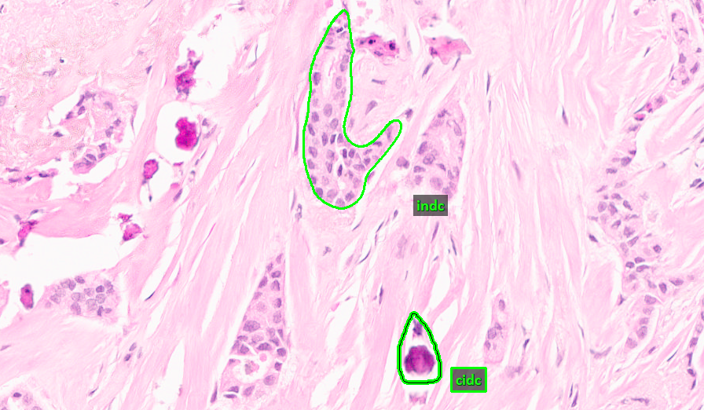
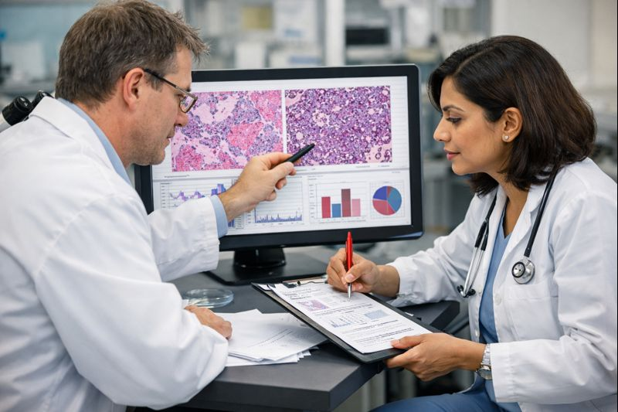
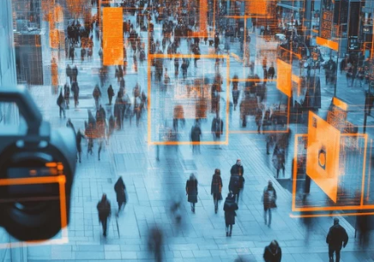
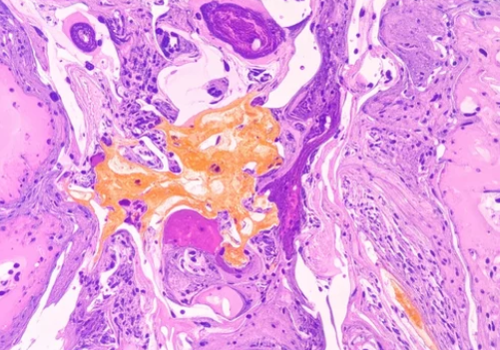
Project Goals
Data:
Create a large-scale, tissue-diverse digital pathology dataset consisting of tens of thousands of whole-slide images spanning multiple organs, stains, and disease types.
Produce high-quality annotations through a workflow that combines expert pathologist guidance with scalable student annotation, ensuring consistency and clinical relevance.
Curate and release the dataset as an open, well-documented resource with standardized formats and evaluation protocols.
Technology:
Develop models for abnormal region detection and segmentation that generalize across different tissues, stains, and acquisition settings.
Leverage state of the art transformer-based architectures and transfer learning to improve performance and robustness.
Develop computationally efficient models that are clinically relevant.
Develop a modular, open source framework that can easily incorporate new technology.

Slide 4
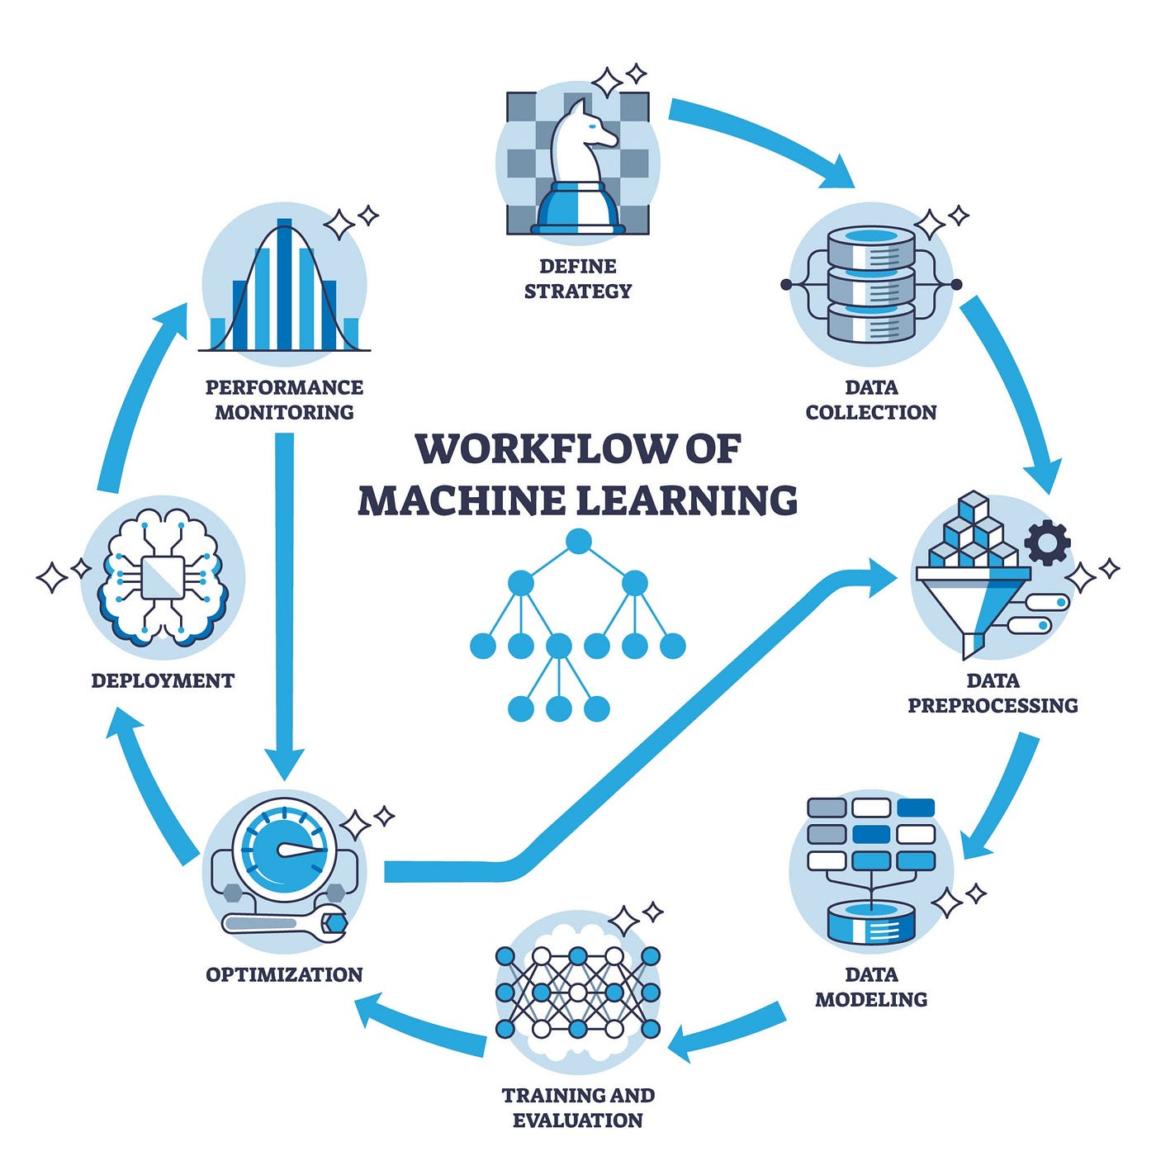
What is Machine Learning?
Machine learning (ML) develops algorithms to infer predictive or descriptive models from data.
ML formalizes learning as the estimation of functions or distributions under explicit loss functions and inductive biases.
Learning paradigms relevant to computational pathology:
Supervised: estimate mappings from image pixels or patches to labels (region masks, classes) using risk minimization from labelled data.
Weakly-/semi-supervised: learn from coarse, incomplete, or noisy labels (slide-level annotations), often via multiple-instance learning, pseudo-labeling, or consistency regularization.
Unsupervised and self-supervised: discover structure in unlabeled images by optimizing proxy tasks (contrastive objectives, masked prediction, rotation/patch-prediction), which yield transferable features for downstream segmentation or detection.
Domain adaptation and transfer learning: adapt models trained on one distribution (scanner, stain, institution) to perform robustly on another by minimizing distributional discrepancy or aligning feature spaces.
Modern architectures (convolutional networks, vision transformers) combine hierarchical representation learning with attention mechanisms to encode rich spatial context.

Slide 5

Why is Data Important?
High-quality, well-documented annotations are the substrate of rigorous ML research.
Annotation protocols (label definition, inter-rater training, adjudication, and QA checks) directly affect attainable model performance and interpretability.
A dataset must capture biologically and technically relevant variability (e.g., multiple tissue types, stains, scanners, slide preparation protocols, and disease presentations) to enable models to generalize.
Large labeled corpora increase statistical power for supervised tasks, while very large unlabeled collections are indispensable for pretraining representations via self-supervision; both reduce variance and mitigate overfitting to narrow cohorts.
Hybrid strategies (limited expert annotations, augmented by student annotators under adjudication, plus weak labels) can optimize the label-effort vs. performance frontier.
Standardized training/validation/test splits, cross-validation across institutions, pre-registered evaluation metrics, and reporting of confidence intervals are critical to reproduce and compare results.

Slide 6
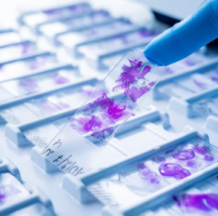
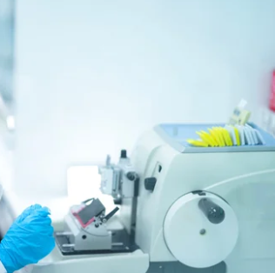
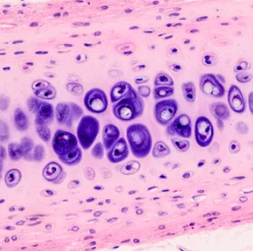
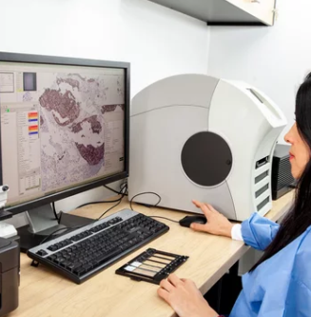
What is Digital Pathology?
Digital pathology (DP): the process of digitizing glass pathology slides into whole-slide images (WSIs) for viewing and analysis.
High Resolution Imaging: images are scanned at ultra-high resolution, then manually interpreted by clinically-trained pathologists using software to manage, share and visualize the images.
Manual Interpretation: is quite challenging compared to other medical disciplines.
Solution: use artificial intelligence (AI) and specifically machine Learning (ML) to automate diagnosis.
Challenges: localization of information supporting a diagnosis is very challenging.

Slide 7
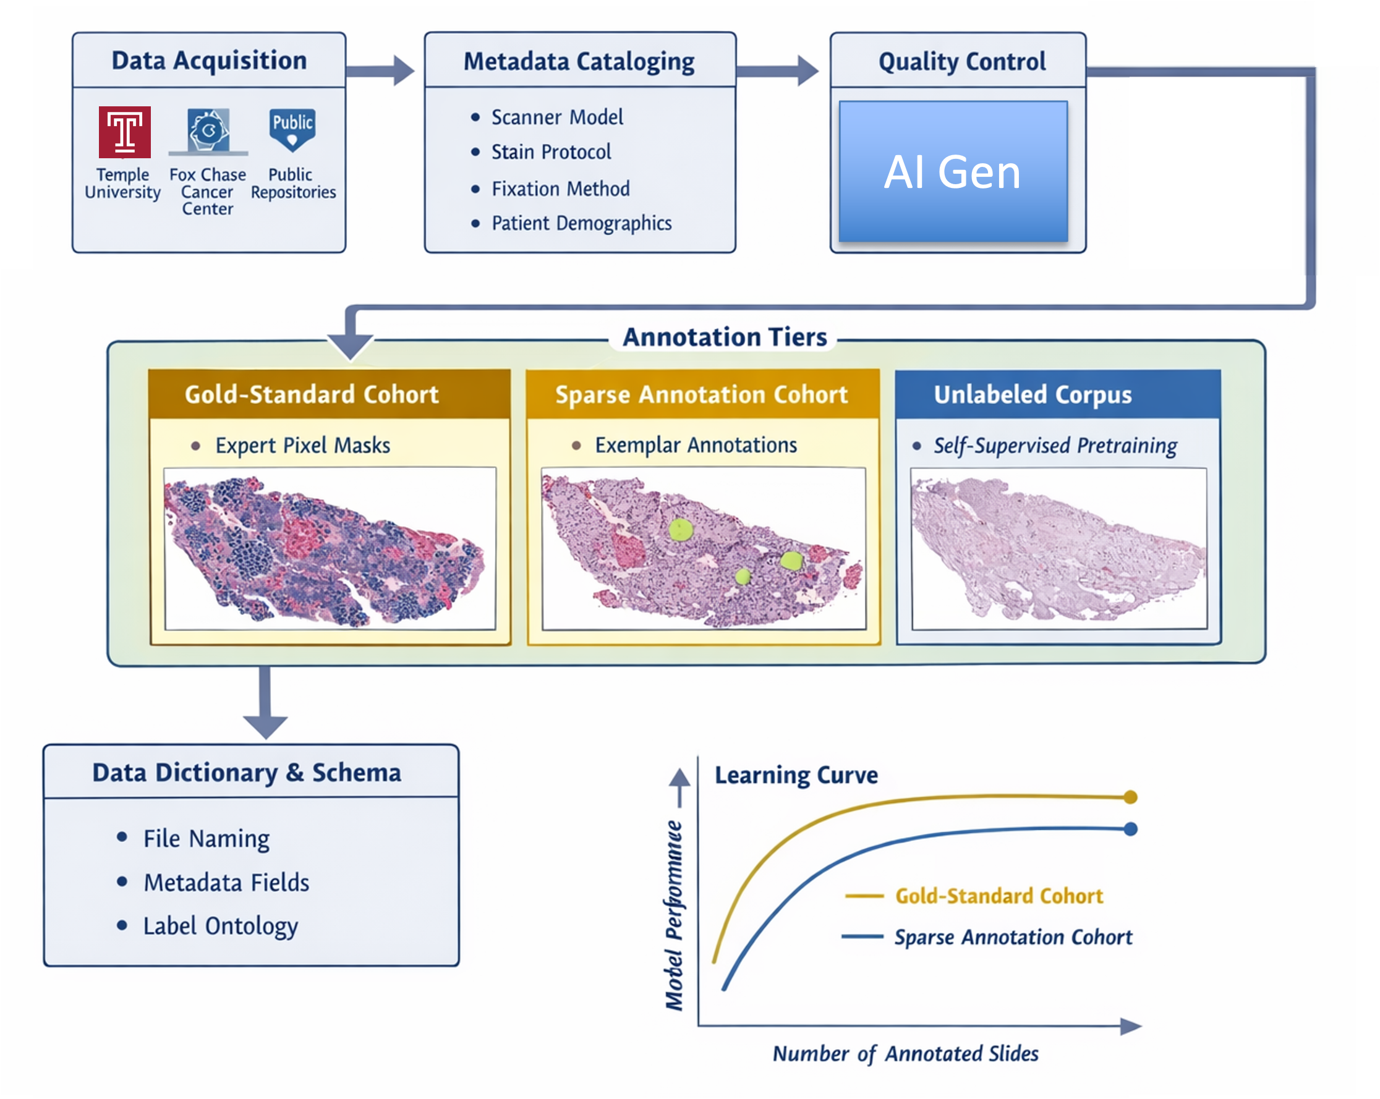
Dataset Creation and Annotation
Two institutions represented:
Temple University (TUH): a large urban public hospital serving an ethnically diverse population (~90,000 slides)
Fox Chase Cancer Center (FCCC): digitized the entire Biosample Repository (~15,000 slides)
Implemented standardized ingestion pipelines: anonymization, quality-control filters (e.g., focus)
catalog metadata (scanner model, stain protocol, fixation method, patient demographics) for provenance tracking
Developed dataset tiers to support multiple research needs:
metadata collected from expert pathologists
gold-standard evaluation data
easily accessible data using csv (and XML) formats
Maintaining a comprehensive set of documentation and software tools to support distribution of the data

Slide 8
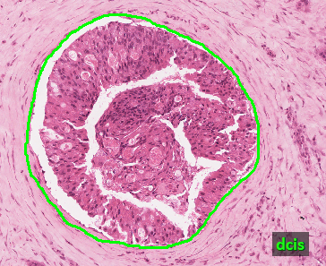
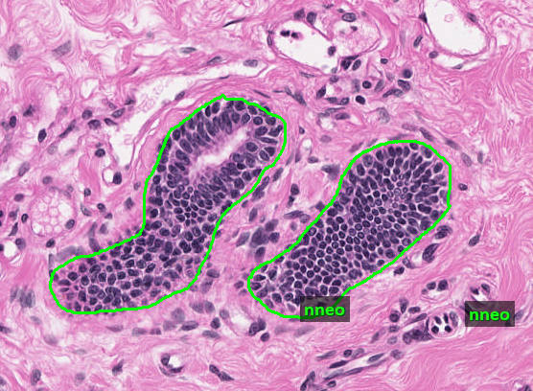
Annotation Protocol
Establish explicit label definitions, annotation guidelines, and class ontologies collaboratively with pathologists to ensure clinical relevance and reduce ambiguity in region boundary decisions.
Define annotation granularity:
full pixel-level segmentation for core regions of interest (e.g., tumors, significant lesions)
slide-level tags for global diagnoses to support weak supervision (e.g., cancer severity, tissue site, tumor site).
Use multi-rater annotation in which each case receives annotations from at least two independent annotators, with an adjudication step by a senior annotator in consultation with TUH and FCCC pathologists.
Train undergraduate (UG) students with backgrounds in relevant disciplines like bioengineering and biochemistry.
Provide annotator training materials and calibration tasks (example cases with feedback), plus routine inter-rater reliability assessments. Annotators train for about 6 months before they reach an expert level of accuracy.

Slide 9
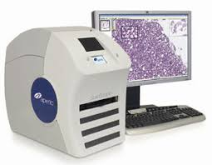
Annotation Workflow
Data Acquisition: Leica Biosystems Aperio AT2 high-volume scanner (400 slides per tray, 50K x 50K pixel resolution)
Data Annotation: Leica ImageScope (freely available)
Data Formats:
svs is used for images (a layered tiff format)
xml (defined by Leica/Aperio) and csv (an NEDC format) for annotations
Label Taxonomy:
Non-cancerous: normal (norm), background (bckg), null, artifacts (artf)
Cancerous: ductal carcinoma in situ (dcis), invasive ductal carcinoma (indc)
Neoplastic-associated/benign: non-neoplastic (nneo), inflammation (infl), suspicious (susp)
dcis
indc
nneo
infl
norm
susp

Slide 10
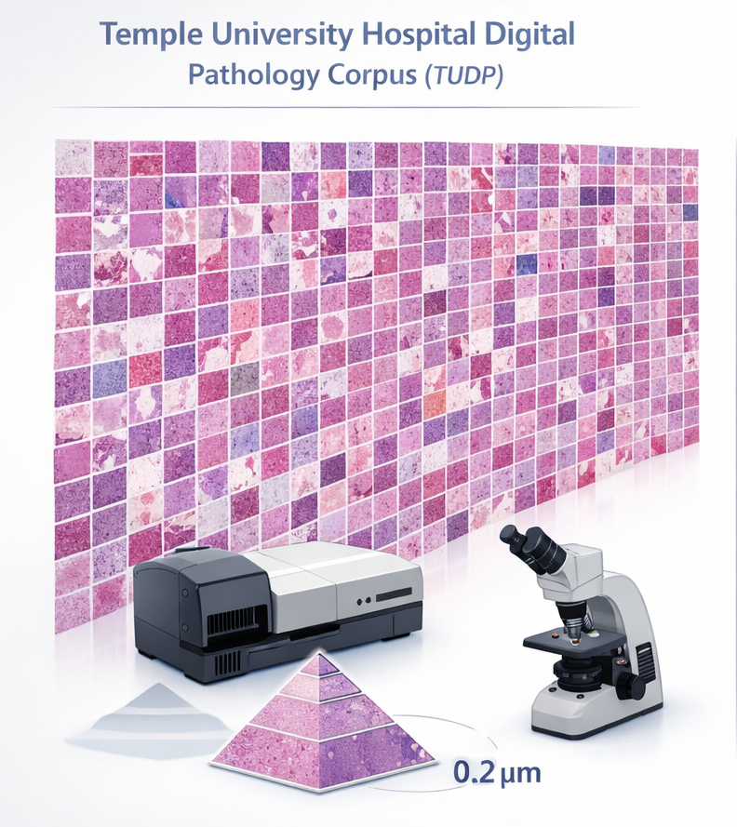
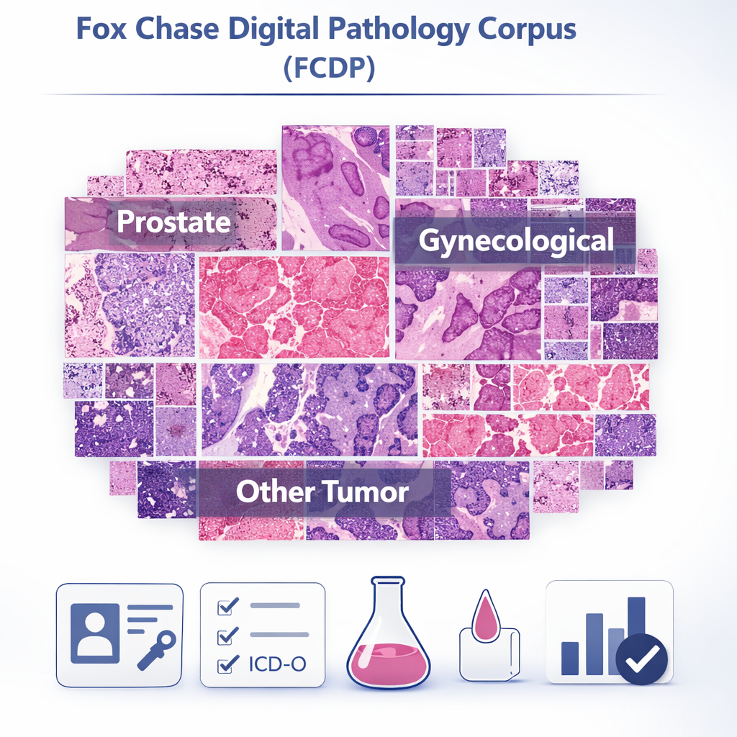
Publicly Available Datasets
Temple University Hospital Digital Pathology Corpus (TUDP):
~100K WSIs (45TB) from Temple University Hospital
Slides are H&E‑stained (plus some IHC) and scanned at 0.2 μm/pixel
Tissue samples span a broad range of organs: 16% kidney, 13% prostate, 10% lung, and 10% breast.
Fox Chase Digital Pathology Corpus (FCDP):
~14,300 WSIs (3.5 TB) from from the Biosample Repository at Fox Chase Cancer Center (FCCC), focused on cancer cases
Slides cover ~18 organ sites (39% prostate, 21% breast, 18% gastro and, 8% gyneco, and 14% other
scanned identically (0.2 μm/pixel on a Leica Aperio AT2, SVS format).
metadata (Excel) includes slide/specimen IDs, anonymized patient ID, ICD-O tissue/tumor codes, stain, grade, etc. for each image

Slide 11
Publicly Available Breast Tissue Subsets
Temple University Breast Tissue Subset - TUBR
3,505 annotated whole-slide images (WSI) from 296 patients; ~1.2 TB of H&E images.
8,035 non-cancerous, 6,222 carcinogenic, and 2,714 cancerous labeled regions → 22,241 total polygonal annotations (avg ~6.3 annotations/slide).
Partial, high-precision polygon annotations focused on clinically salient regions (only ~1.96% of slide area annotated).
Fox Chase Breast Tissue Subset - FCBR
1,463 oncology-focused WSI from ~1,397 patients; ~336 GB of image data.
12,164 non-cancerous, 1,967 carcinogenic, and 5,954 cancerous labeled regions → 20,086 total polygonal annotations (avg ~13.7 annotations/slide).
4,968 annotated WSI with the unified nine-label vocabulary used for training and fine-grained classification.
Fox Chase Breast Tissue Crystallization Subset – FCDP
Augmented FCBR with 439 detailed annotations of crystal deposits in tissue.
Described in more detail in the appendix.

Slide 12
What Can Machine Learning Do For Digital Pathology?
Evolution of Capabilities: Machine learning (ML) based analysis of digital pathology images has progressed from simple binary classification (e.g., cancer vs. non-cancer) to the detection of multiple cancer subtypes, precancerous lesions, and benign tissue patterns.
Microsegmentation at Full Resolution: A key challenge is microsegmentation: accurately identifying fine-grained anatomical and pathological regions (e.g., ducts, lobules, carcinoma) at whole-slide resolution. This task is computationally demanding due to extreme class imbalance, as only a small fraction (~2%) of tissue regions are typically annotated.
Advanced Diagnostic Insights: Beyond classification and segmentation, ML enables the discovery of subtle histopathological features and clinically relevant biomarkers. These approaches support more precise diagnosis and open pathways toward personalized treatment, with potential integration of molecular and genomic information.
Systems Explored: We explored a range of Common-Off-The-Shelf (COTS) algorithms to establish baseline performance benchmarks:
ResNet18: A deep convolutional neural network (CNN) utilizing residual connections.
EfficientNet (EB0/EB7): A CNN family optimized for accuracy and efficiency through principled scaling.
Vision Transformers (ViT-16/ViT-32): Transformer-based architectures using self-attention to model long-range spatial dependencies.
Swin V2: A hierarchical vision transformer adapted for dense prediction and segmentation tasks.
GigaPath: a deep learning system based on a vision transformer architecture.

Slide 13
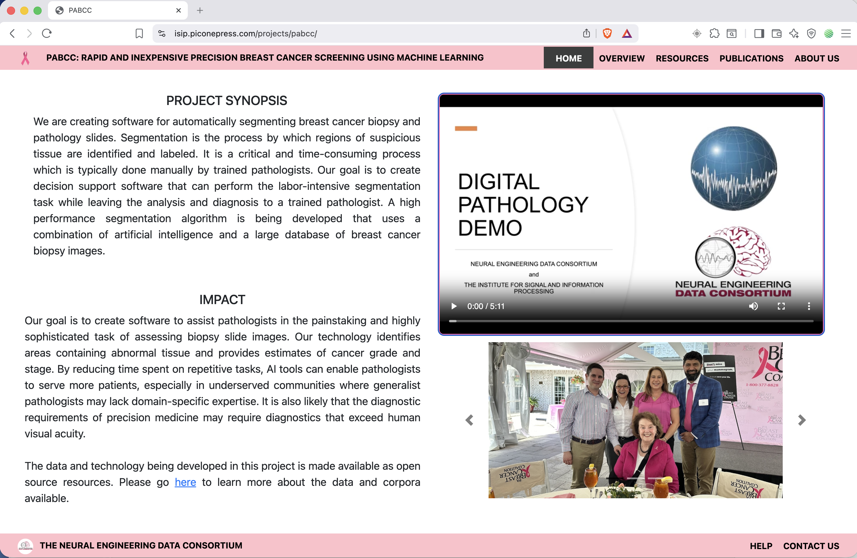
A Demonstration Video

Slide 14
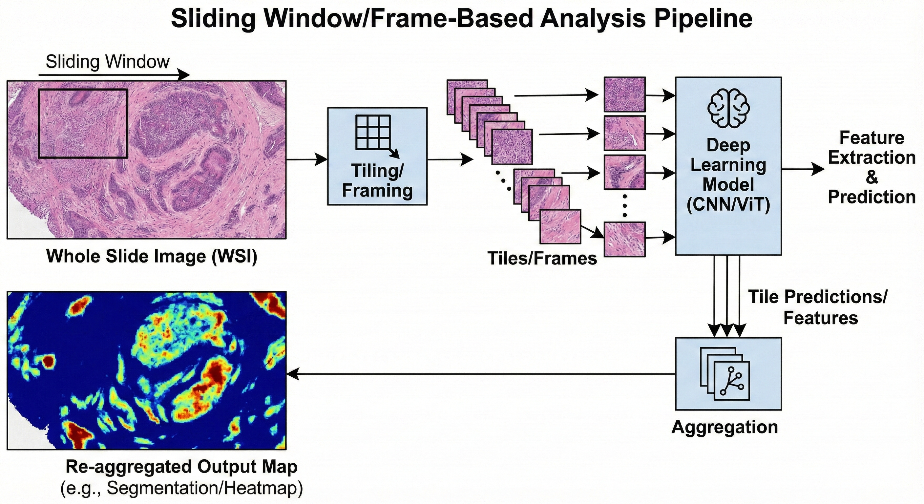
Microsegmentation At Full Resolution
Sequential Decoding
Clinical applications require localization of information. The system scans the whole-slide image frame-by-frame using a fixed analysis window (e.g., 1024×1024), independently classifying each frame.
Joint Segmentation and Classification
Modern approaches aim to jointly optimize segmentation and classification within a single framework. However, extending dense, fully convolutional segmentation architectures to gigapixel-scale pathology images remains computationally intensive and memory-limited.
Aggregation of Frame-Level Predictions
Frame-level outputs are aggregated into coherent region-level hypotheses to align with manual annotations. This step typically relies on heuristic post-processing methods, including spatial smoothing, majority voting, and morphological flood-fill operations.
Evaluation Metrics
Due to the dominance of ‘background’, standard pixel-wise metrics (e.g., DICE) are misleading. Instead, we use a modified DICE (MDICE) and F1 (MF1) measures that do not penalize predictions in unlabelled regions.

Slide 15
Preproccessing
Window and Sub-Image Selection
Selecting an appropriate analysis window is critical for capturing sufficient spatial context. Two strategies were evaluated:
Bounding Box (BBOX), which encloses irregular annotations but may include substantial irrelevant tissue, potentially degrading model performance; and
Center of Mass (COM), which centers a fixed-size window (e.g., 1024×1024) on the annotated region.
Empirically, a 1024×1024 COM-centered window without a guard band achieved the best performance.
Data Augmentation
To improve generalization and reduce overfitting, standard augmentation techniques were applied, including resized cropping, horizontal and vertical flipping, color jittering, random erasing, and normalization.
Handling Class Imbalance
Due to the dominance of background regions (e.g., white space and adipose tissue), an explicit background (BCKG) label was included to prevent confusion with tissue classes. For frame-based training, approximately 100,000 windows were sampled to balance data diversity and maintain appropriate class-to-background ratios.

Slide 16
Postprocessing
Motivation: Frame-level model outputs are often spatially fragmented, appearing as isolated predictions that obscure coherent histological structures such as stroma regions or tumor masses.
Objective: To convert fragmented frame-level predictions into anatomically meaningful regions, we designed a postprocessing framework that interpolates gaps, resolves boundary conflicts, and produces coherent polygonal representations.
Results: Smoothing-based methods were most effective. kNN Smoothing achieved the best performance (MDICE = 54.38 on TUBR), significantly outperforming morphological dilation (MDICE = 40.56), indicating that aggressive region expansion is less suitable for this task.
Algorithms Evaluated:
Label Priority: aggregates predictions using a predefined class hierarchy, ensuring high-priority structures are preserved first.
Confidence Priority: resolves spatial overlaps by assigning regions based on highest average model confidence.
Dilation: applies morphological expansion to grow dominant regions and merge neighboring predictions.
Mode Smoothing: performs local majority voting within 3×3 neighborhoods to suppress isolated noise.
k-Nearest Neighbors (kNN) Smoothing: refines predictions using similarity-weighted consensus among neighboring frames.

Slide 17
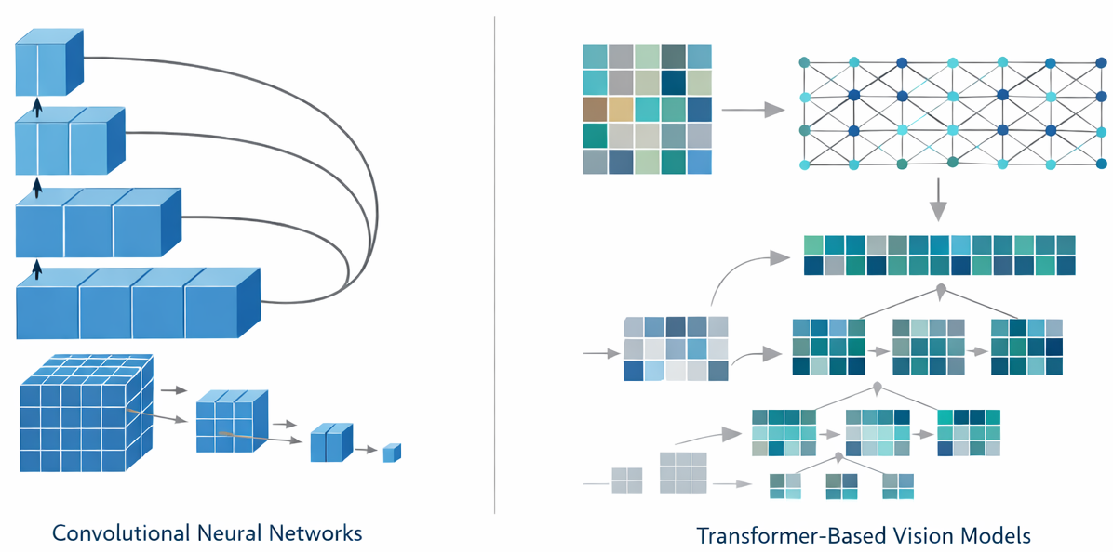
Deep Learning Models
Model Selection Criteria: evaluated a small set of robust and widely adopted common off-the-shelf (COTS) models to establish strong baseline performance.
Convolutional Neural Networks (CNNs)
ResNet-18: a residual network that leverages skip connections to mitigate vanishing gradients, enabling stable training of deeper models.
EfficientNet (B0 / B7): a family of models that jointly scale network depth, width, and input resolution to tradeoff accuracy and efficiency.
Transformer-Based Models
Vision Transformer (ViT-16 / ViT-32): processes images as sequences of fixed-size patches and applies self-attention to capture global context and long-range spatial dependencies.
Swin Transformer V2 a hierarchical, window-based Transformer that introduces shifted windows and improved normalization, enabling efficient modeling of both local and global structure while scaling effectively to high-resolution images.
Implementation Details: All models were fine-tuned from pretrained weights using standard PyTorch implementations. To reduce overfitting, we applied common data augmentation techniques.

Slide 18
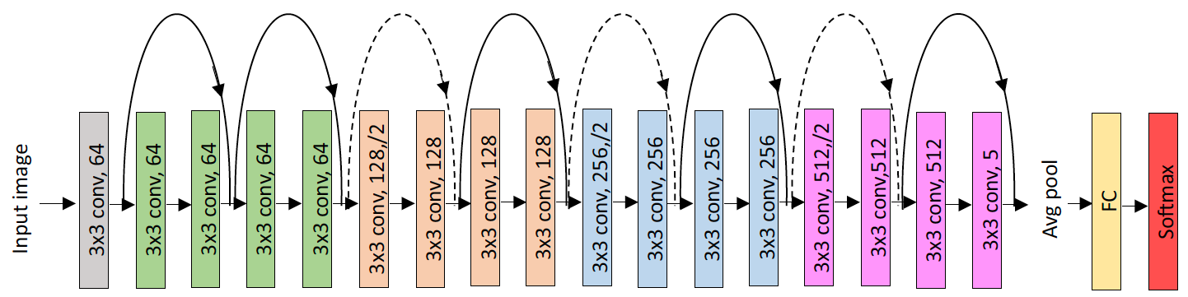
Deep Residual Networks (ResNet-18)
Architecture: ResNet-18 is a convolutional neural network that introduced residual (skip) connections, allowing gradients to bypass intermediate layers. Mitigates the vanishing gradient problem and enables stable training of deeper networks.
Impact: ResNet-18 is effective at capturing local texture patterns. However, modeling broader tissue architecture typically requires deeper networks, which can be less efficient.
Performance Summary: In baseline experiments, ResNet-18 provided stable and reproducible results but was generally outperformed by EfficientNet variants.
Performance (MDICE): 33.28 (TUBR) / 42.11 (FCBR)
Size: 11.69M parameters
Training: 2,356 secs/epoch
Decoding: 1,597 secs/image

Slide 19
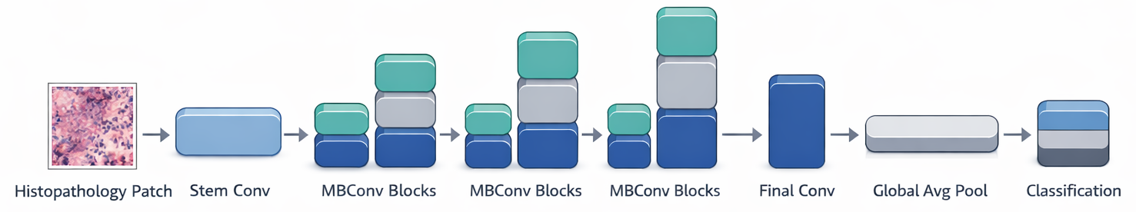
Rethinking Model Scaling for Convolutional Neural Networks (EfficientNet)
Architecture: EfficientNet is a family of convolutional neural networks designed to maximize accuracy while minimizing computational cost, optimizing the trade-off between performance, speed, memory usage, and power consumption.
Impact: EfficientNet’s scalable design is particularly effective for whole-slide images. Larger variants (e.g., EB7) provide high capacity at significant computational cost, while smaller variants (e.g., EB0) prioritize efficiency.
Performance Summary: Unlike architectures that scale a single dimension (e.g., depth alone), EfficientNet employs compound scaling to jointly and systematically scale network depth, width, and input resolution. In baseline experiments, EB0 provided an excellent tradeoff between performance and computational complexity.
Performance (MDICE): 51.10 (TUBR) / 46.02 (FCBR)
Size: 5.03M parameters
Training: 3,900 secs/epoch
Decoding: 1,520 secs/image

Slide 20
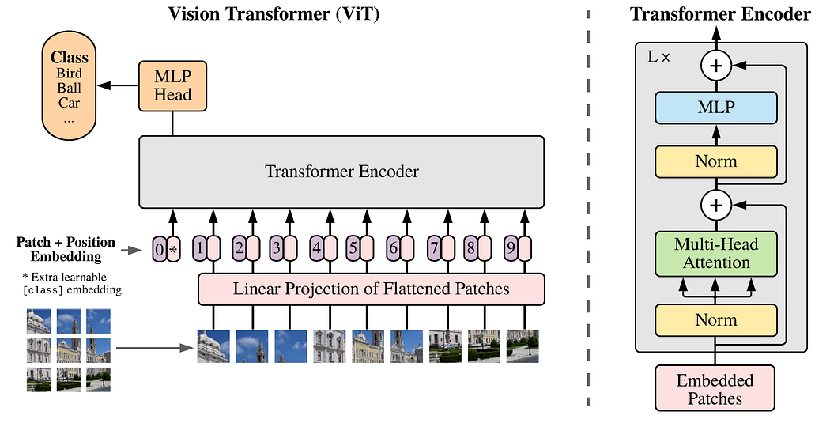
Vision Transformers (ViT)
Architecture: Through self-attention, Transformers can model long-range spatial dependencies and integrate information across the entire image.
Impact: Uses a powerful model, self-attention, that is the basis for modern generative AI (e.g., chatbots). This property is particularly attractive for histopathology, where clinically meaningful patterns often span large tissue regions beyond local texture.
Performance Summary: Evaluated ViT-16 (16x16 frames) and ViT-32 (32x32 frames). ViT-16 performed better though computational complexity for the two systems was comparable.
Performance (MDICE): 44.72 (TUBR) / 25.07 (FCBR)
Size: 86.60M parameters
Training: 3,713 secs/epoch
Decoding: 1,726 secs/image

Slide 21
A Comparison of Performance of Our Leading Deep Learning Systems
MDICE measures the percentage of an annotated region that was correctly classified, and ignores background.
MDICE scores are shown for TUBR and FCBR.
EB0, which is a smaller and more computationally efficient, is the highest performing model.
Results are statistically significant.
Arch | TUBR |  |  | FCBR
 | Train | Dev | Eval | Train | Dev | Eval
ResNet18 | 40.87 | 37.42 | 33.28 | 44.40 | 44.34 | 42.11
EB0 | 62.32 | 55.31 | 51.10 | 66.83 | 49.49 | 46.02
EB7 | 56.03 | 47.10 | 43.81 | 31.53 | 31.31 | 32.41
ViT-16 | 62.68 | 48.32 | 44.72 | 26.11 | 24.44 | 25.07
ViT-32 | 57.12 | 46.34 | 41.39 | 29.58 | 26.11 | 28.06
The complexity of each algorithm in terms of memory (no. of parameters) and compute times (secs) is shown.
EB0 has the smallest memory footprint and yet delivers the best performance. Its decoding time is comparable to ResNet18 while training time is reasonably close.
The ViT models are our most complex models, and expected to deliver best performance. However, on DPATH data they did not exceed the performance of EB0.
Arch | No. Parameters | Training Time | Decoding Time
ResNet-18 | 11.69M | 2,356 (1.0x) | 1,597 (1.0x)
EB0 | 5.30M | 3,900 (1.7x) | 1,520 (1.0x)
EB7 | 66.35M | 4,883 (2.1x) | 1,735 (1.1x)
ViT-16 | 86.60M | 3,713 (1.6x) | 1,726 (1.1x)
ViT-32 | 88.20M | 3,869 (1.6x) | 1,623 (1.0x)

Slide 22
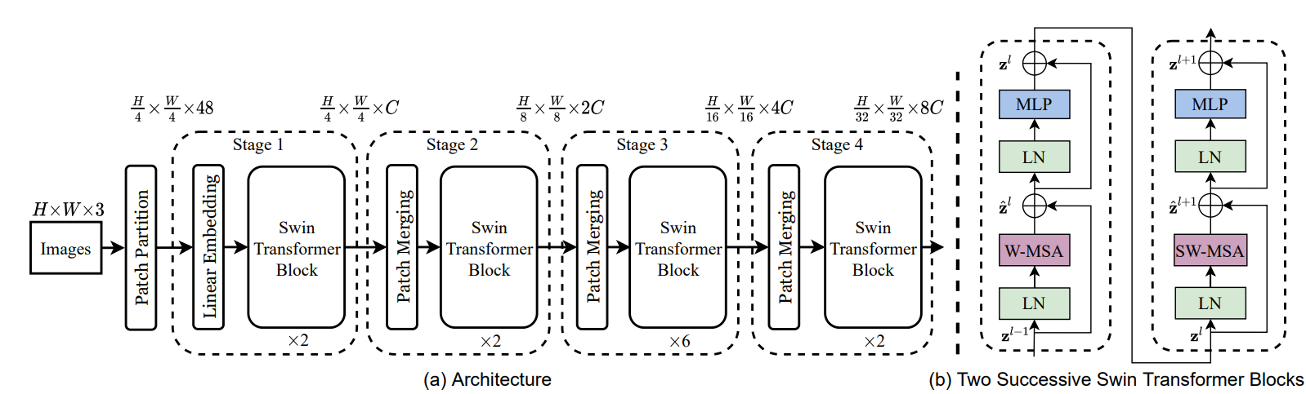
Shifted Window Transformer (Swin v2)
Architecture: Introduces a hierarchical representation similar to CNNs, constructed entirely from Transformer blocks. Swin progressively merges patches in deeper layers to produce multi-scale feature maps.
Impact: Enables efficient multi-scale feature learning and implicit contextual attention, supporting joint modeling of local tissue detail and broader histological structure within a fully Transformer-based framework.
Performance Summary: A core innovation is shifted window self-attention. By shifting the window partition between successive layers, the model enables cross-window information flow, capturing broader context without incurring the high cost of global self-attention.
Scales quadratically with image size. Achieves linear computational complexity, making it better suited for high-resolution images.
Performance: Inconclusive

Slide 23
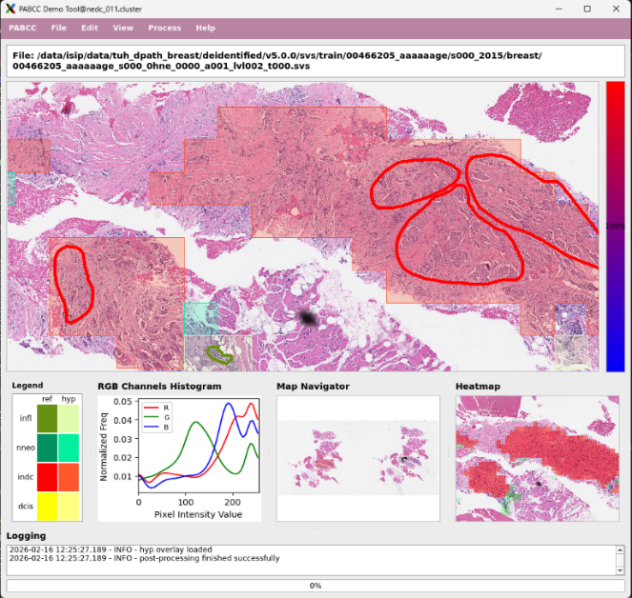
The DPATH Demonstration System

Slide 24
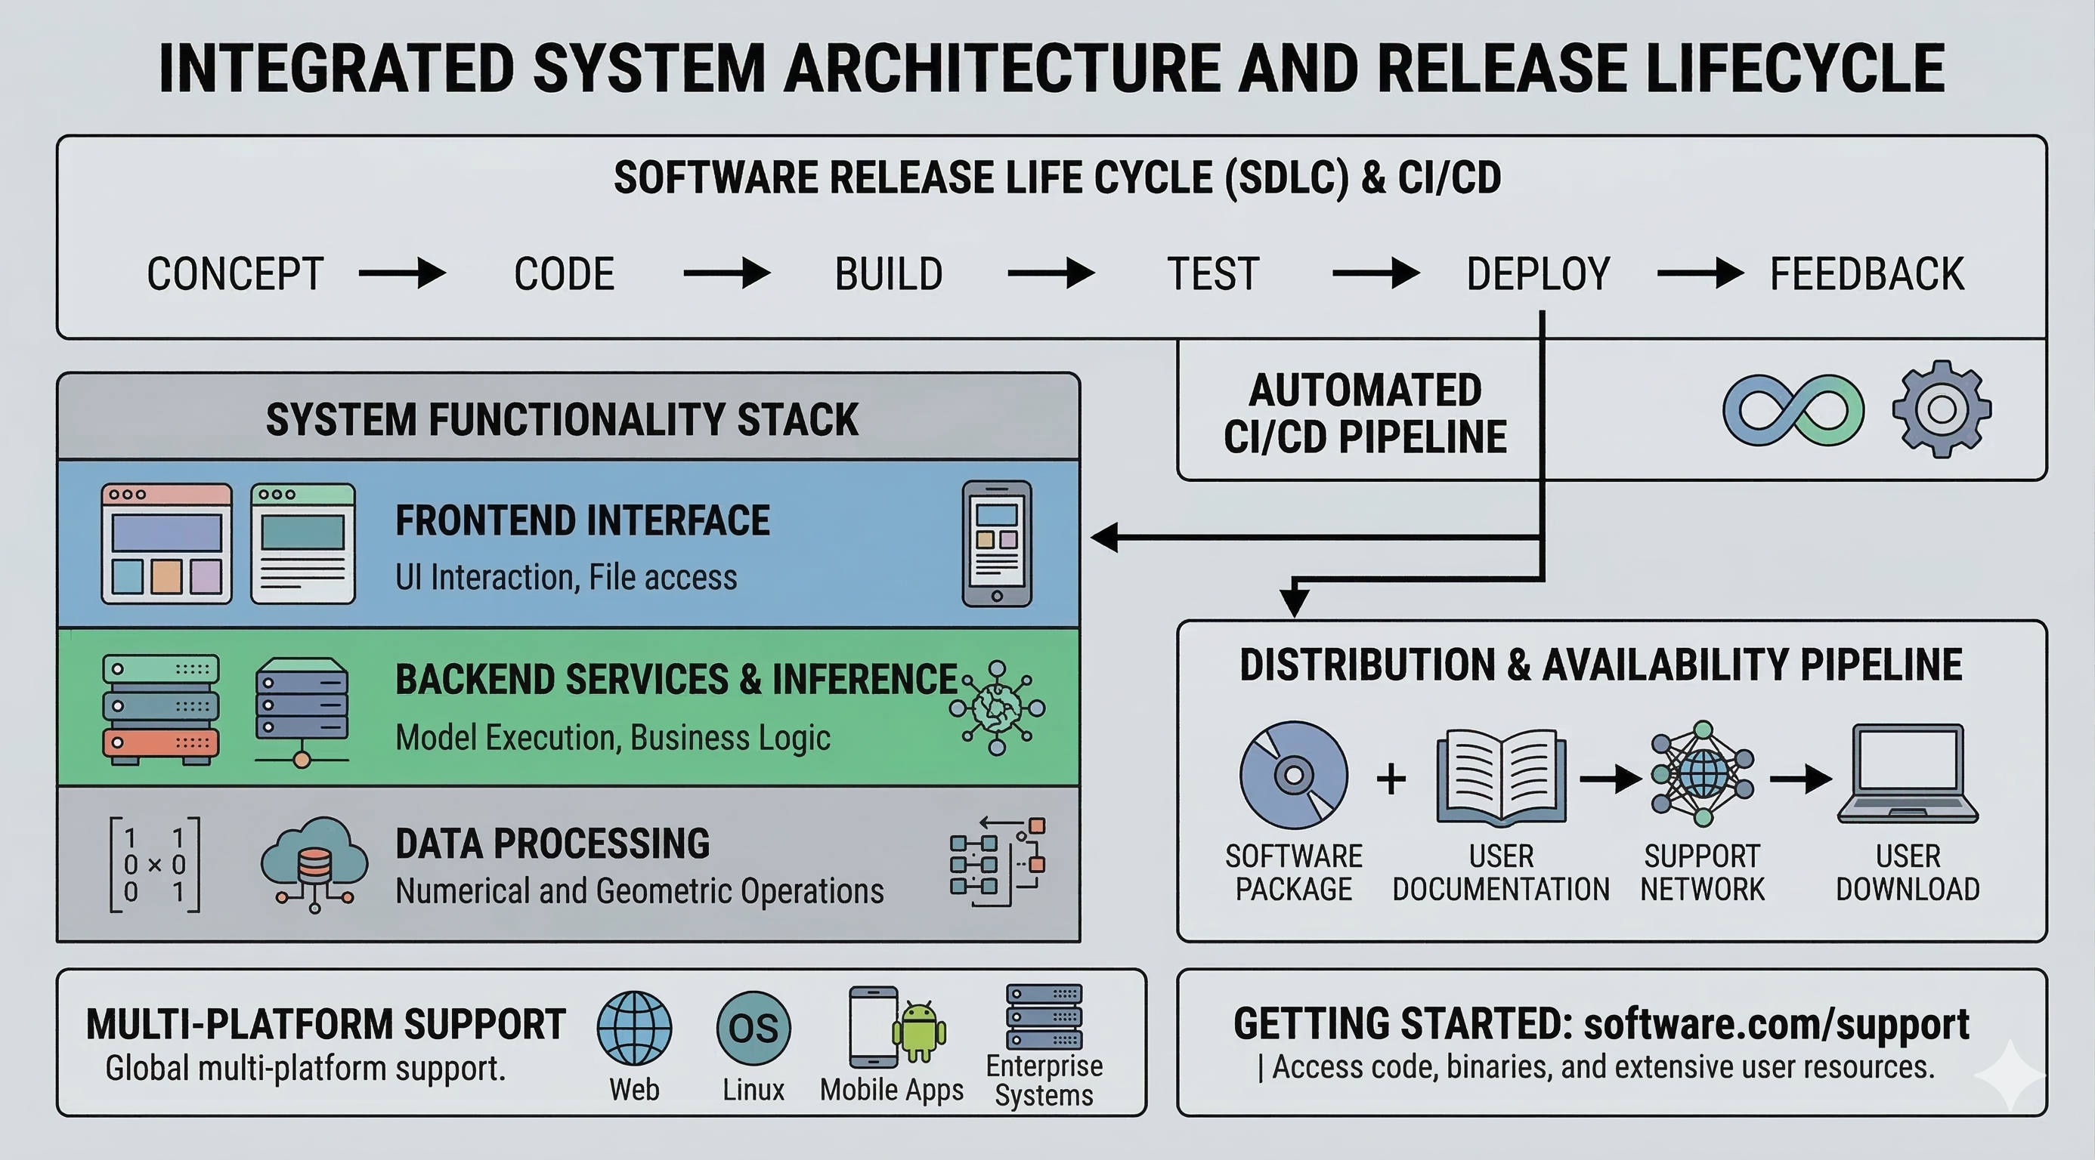
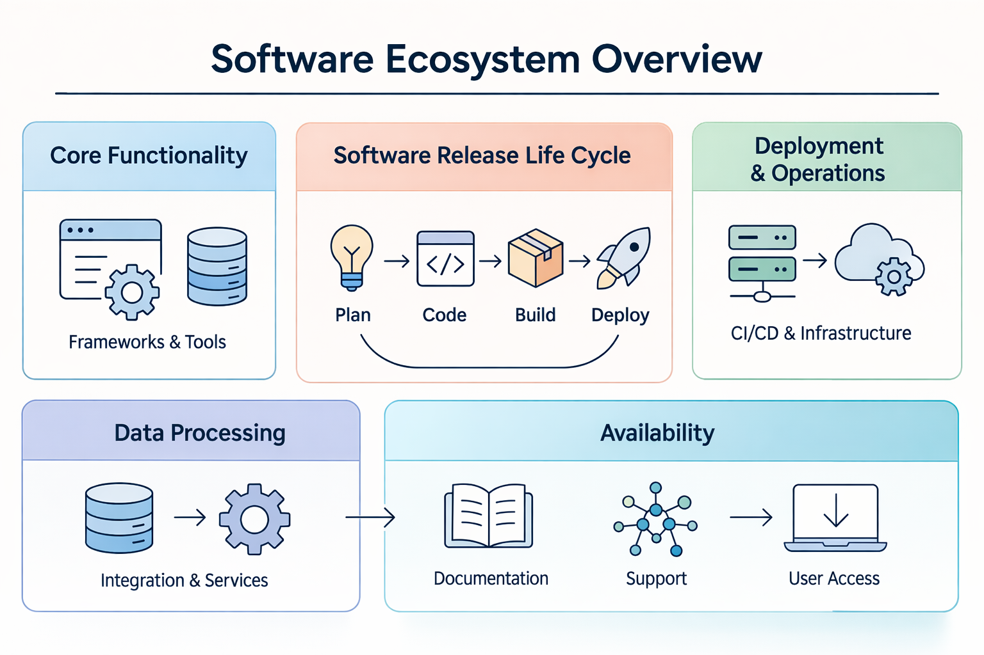
Software Releases
Technical Stack: Implemented in Python 3.11.x and leverages widely used open-source libraries for whole-slide image handling and deep learning inference:
Imaging: OpenSlide (v4.0.0.8), Pillow (v10.2.0) for SVS file access and tile manipulation
Inference: PyTorch (v2.2.2), Torchvision (v0.17.2) for model execution
Data Processing: NumPy, SciPy, and cuCIM for high-performance numerical and geometric operations
Release Overview: Version 1.0.0 of the NEDC DPATH Demo System, a lightweight software tool designed to demonstrate a complete digital pathology workflow.
Installation and Deployment: Includes a comprehensive requirements.txt for automated setup via pip. Is compatible with Windows, Linux, and macOS platforms.
Availability: The source code, pretrained model weights, and sample data are publicly available at www.nedcdata.org.

Slide 25
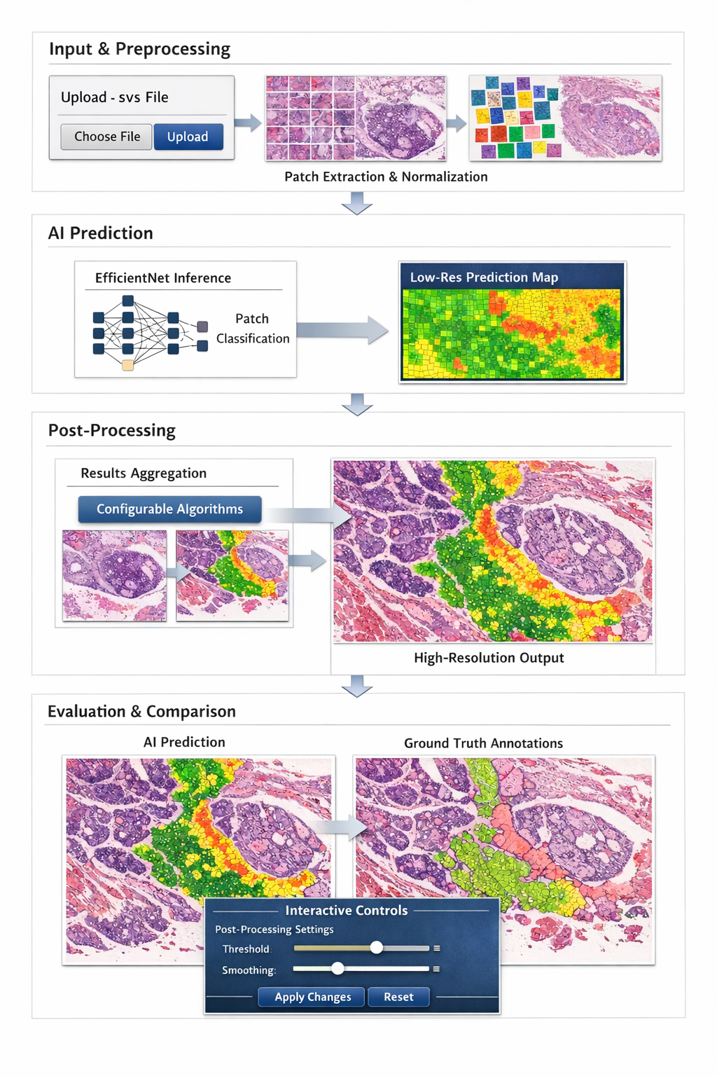
An Extensible Software Architecture
Objective: The primary goal of the software is to enable scientists and engineers to explore AI model outputs, compare predictions against manual annotations, and analyze complex histological structures in an intuitive and interactive manner.
Modular Architecture: The demo system is organized into distinct functional modules:
Visualization: Efficient rendering of gigapixel WSIs
Preprocessing: Partitioning slides into 1024×1024 patches and normalizing tissue regions by removing background
Prediction: Frame-level classification using EfficientNet models
Post-processing: Aggregation of low-resolution predictions (e.g., 1k×1k) back onto higher-resolution frames (e.g., 4k×4k) using configurable algorithms
Evaluation: Visual comparison of AI-generated hypotheses against ground-truth annotations
Interactive Workflow: Users can upload .svs files, adjust processing parameters via TOML configuration files, and immediately visualize how different post-processing strategies affect the final results.

Slide 26

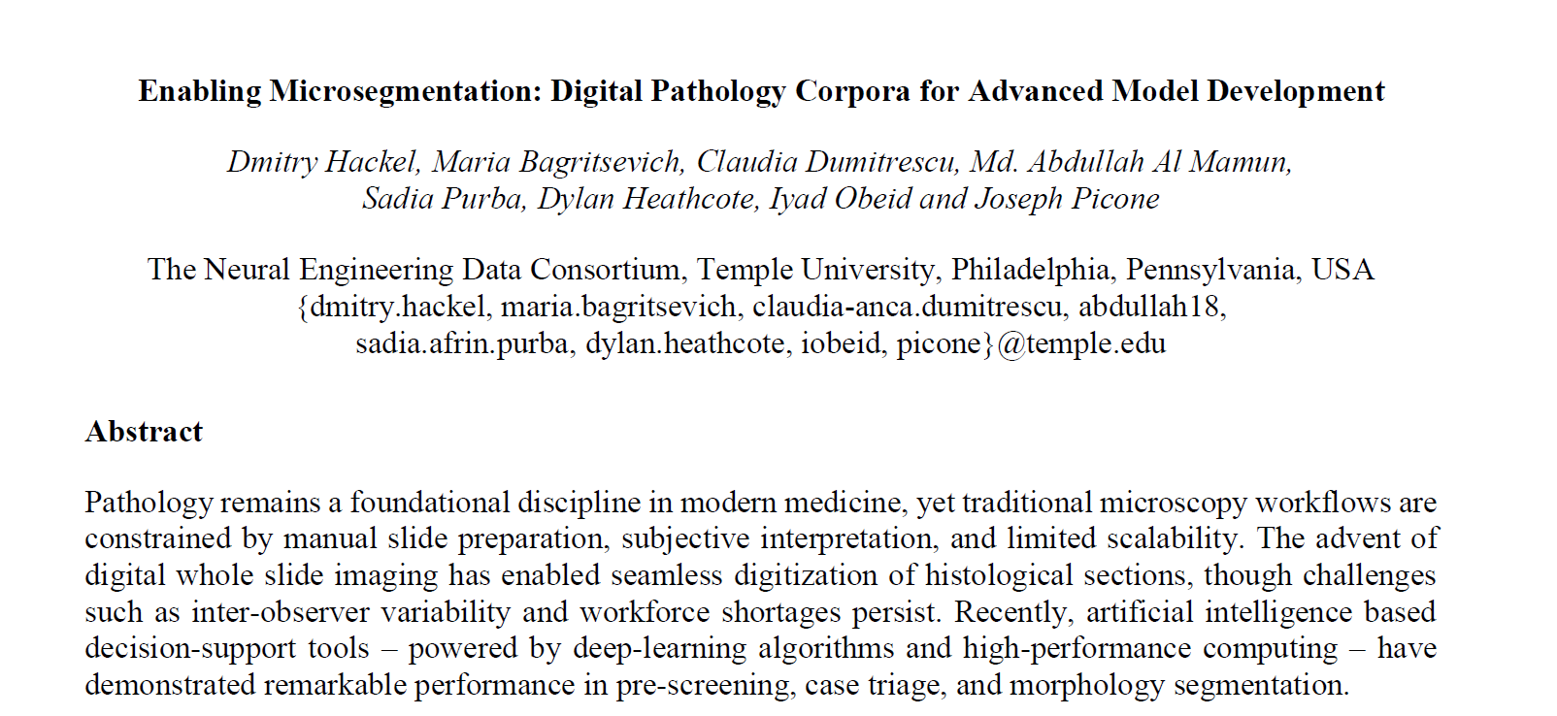
Book Chapter
Title:
Enabling Microsegmentation: Digital Pathology Corpora for Advanced Model Development
Publication:
Signal Processing in Medicine and Biology: Applications of Artificial Intelligence in Medicine and Biology Springer (2026)
Authors:
Dmitry Hackel, Maria Bagritsevich, Claudia Dumitrescu, Md. Abdullah Al Mamun, Sadia Purba, Dylan Heathcote, Iyad Obeid, Joseph Picone
Contribution:
This chapter serves as the foundational reference for the project. It details the construction of large-scale digital pathology corpora, the rigorous expert-driven annotation protocols, and baseline machine learning experiments that establish the dataset’s validity and suitability for advanced model development, including microsegmentation and downstream diagnostic tasks.

Slide 27
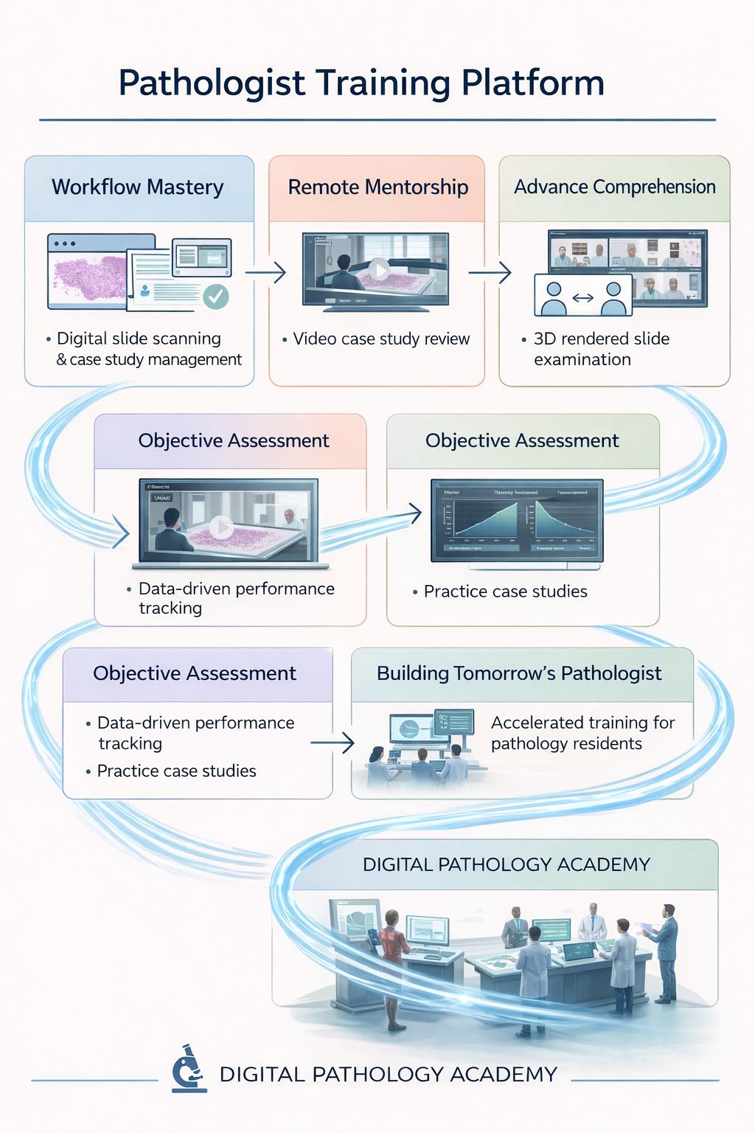
Impact
Mitigating Workforce Challenges: Cancer caseloads have risen 42%, creating a situation where the population of experts is aging, and the diagnostic workload is growing faster than the workforce.
By streamlining slide evaluation and prioritizing regions of interest, AI-based tools can alleviate workload pressures and improve sustainability in clinical practice.
Enhancing Diagnostic Consistency: Inter-observer variability remains a major challenge in pathology, with agreement rates for certain diagnoses (e.g., INDC vs. DCIS) reported as low as 48%.
Automated decision-support systems provide a standardized “second opinion,” helping reduce variability and improve diagnostic consistency.
Clinical Workflow Optimization: Enable automated slide triage by ordering cases based on predicted severity and generating confidence-weighted heatmaps. This allows pathologists to rapidly focus on clinically critical regions, improving efficiency in time-sensitive workflows.

Slide 28

Limitations
Partial Annotation and Class Imbalance: A core limitation is the microsegmentation nature of the data: only ~2% of each gigapixel slide is annotated. This extreme class imbalance heavily biases models toward background tissue, necessitating specialized training strategies such as weighted loss functions and careful sampling to preserve sensitivity to rare pathological regions.
Domain Shift and Generalization: Cross-institutional experiments demonstrate that models trained on one dataset (e.g., TUBR) often underperform when evaluated on another (e.g., FCBR). Differences in staining protocols, scanner hardware, and tissue preparation introduce domain shift, making robust generalization across clinical sites an unresolved challenge.
Computational Constraints: Although Transformer-based models offer improved global context modeling, their computational and memory requirements are substantial. Processing gigapixel WSIs often requires aggressive downsampling or window-based inference, which may discard diagnostically relevant contextual information.
Diagnostic Scope: Morphology-based analysis alone is insufficient for diagnosing certain disease subtypes (e.g., Triple-Negative Breast Cancer), which require molecular assays such as IHC or FISH. As a result, the current models are limited to patterns observable in standard H&E-stained images.

Slide 29

Future Work
Long-Term Spatial Context
Develop advanced Transformer-based architectures capable of modeling long-range spatial dependencies across entire whole-slide images. This will require rethinking inference and training workflows to support context lengths on the order of ~100,000 tokens.
Streaming Architectures
To overcome memory and scalability constraints, we are exploring streaming-based system designs that allow data to be incrementally loaded into the training pipeline. This enables end-to-end learning over full corpora without requiring all slide data to reside in memory.
Crystallization Analysis
Future work will extend the current framework to analyze microcalcifications, with a focus on distinguishing Type I and Type II mineralization. These features may serve as important prognostic indicators related to lesion grade and disease aggressiveness.
Multimodal Integration
Integrate digital pathology models with molecular and genomic data (e.g., hormone receptor status and other biomarkers), enabling a unified multimodal diagnostic framework that more closely reflects real-world clinical decision-making.

Slide 30
Summary and Conclusions
Research Foundation: By releasing open, standardized corpora (TUBR and FCBR) with rigorously defined baselines, this project significantly lowers the barrier to entry for new researchers and accelerates innovation in computational pathology.
Dual-Dataset Robustness: The integration of newly annotated breast tissue datasets from two independent sources (TUBR and FCBR) significantly improves model robustness by exposing learning algorithms to diverse tissue morphologies, staining variability, and disease presentations.
Scientific Foundation: This work emphasizes that meaningful progress in machine learning for pathology requires a deep understanding of the underlying biological and procedural foundations—including slide preparation, staining, and annotation protocols. The accompanying book chapter formalizes this knowledge for the ML community.
Baseline Establishment: We established rigorous performance baselines using COTS architectures (ResNet, EfficientNet, and ViT). While results demonstrate measurable progress, the models are not yet clinically autonomous. Notably, EfficientNet-B0 emerged as a strong balance between computational efficiency and segmentation performance.
The Path Forward: The combination of large-scale, high-quality open datasets and standardized benchmarking provides a durable foundation for advancing AI-driven pathology systems toward clinically acceptable performance.

Slide 31
Acknowledgements
This material is based on work supported by several organizations over the years, including the National Science Foundation (grants nos. CNS-1726188 and 1925494), the Temple University Catalytic Collaborative Funding Initiative and most recently by the Pennsylvania Breast Cancer Coalition Breast and Cervical Cancer Research Initiative. Any opinions, findings, and conclusions or recommendations expressed in this material are those of the author(s) and do not necessarily reflect the views of these organizations.
Many people have contributed to this work including (listed alphabetically):
Undergraduate Students: Maria Bagritsevich, Ben Doshna, Dmitry Hackel, Dylan Heathcote, Zoe Wevodau and several generations of annotators.
Graduate Students: Claudia Dumitrescu. Somayeh Seifi Shalamzari and Nabila Shawki
Medical Professionals: Many members of the Temple University Health System have contributed to this project including Denise Connolly, Tunde Farkas, Nirag Jhala, Yuri Persidsky and Chao Wu.

Slide 32
Selected References
Hackel, D., Bagritsevich, M., Dumitrescu, C., Al Mamun, Md. A., Purba, S. A., Heathcote, D., Obeid, I., & Picone, J. (2026). Enabling Microsegmentation: Digital Pathology Corpora for Advanced Model Development. In Signal Processing in Medicine and Biology: Applications of Artificial Intelligence in Medicine and Biology (Vol. 1, p. 50). Springer. url: https://isip.piconepress.com/publications/book_sections/2026/springer/dpath/.
Al Mamun, A., Purba, S., Obeid, I., & Picone, J. (2026). Automated Interpretation and Visualization in Digital Pathology. Proc. of the North-east Bioengineering Conf. (NEBEC), 1–3. url: https://isip.piconepress.com/publications/conference_presentations/2026/nebec/dpath.
Dumitrescu, C., Hackel, D., Obeid, I., & Picone, J. (2025). Crystallization Signatures as Predictive Biomarkers in Histopathology. Proceedings of the IEEE Signal Processing in Medicine and Biology Symposium (SPMB), 1, 1–6. doi: 10.1109/SPMB67169.2025.11345371.
Bagritsevich, M., Hackel, D., Obeid, I., & Picone, J. (2024). Annotation of the Fox Chase Cancer Center Digital Pathology Corpus. Proceedings of the IEEE Signal Processing in Medicine and Biology Symposium, 1–4. doi: 10.1109/SPMB62441.2024.10842255.
Shalamzari, S. S., Bagritsevich, M., Melles, Anne-Mai, Obeid, I., Picone, J., Connolly, D., Wu, C., Brown, B., James, J., Gong, Y., & Wu, H. (2023). Big Data Resources for Digital Pathology. Proceedings of the IEEE Signal Processing in Medicine and Biology Symposium (SPMB), 1–19. doi: 10.1109/SPMB59478.2023.10372721.
Simons, J., Wevodau, Z., Doshna, B., Obeid, I., & Picone, J. (2021). The Temple University Hospital DPATH Corpus: Annotation Guidelines (p. 18). Temple University. url: https://isip.piconepress.com/publications/reports/2021/tuh_dpath/annotations/.
Doshna, B., Wevodau, Z., Jhala, N., Akhtar, I., Obeid, I., & Picone, J. (2021). The Temple University Digital Pathology Corpus: The Breast Tissue Subset. In I. Obeid, I. Selesnick, & J. Picone (Eds.), Proceedings of the IEEE Signal Processing in Medicine and Biology Symposium (SPMB) (pp. 1–3). IEEE. doi: https://doi.org/10.1109/SPMB52430.2021.9672275.
Shawki, N., Shadhin, M. G. M., Elseify, T., Jakielaszek, L., Farkas, T., Persidsky, Y., Jhala, N., Obeid, I., & Picone, J. (2020). The Temple University Digital Pathology Corpus. In I. Obeid, I. Selesnick, & J. Picone (Eds.), Signal Processing in Medicine and Biology: Emerging Trends in Research and Applications (1st ed., pp. 67–104). doi: 10.1007/978-3-030-36844-9.
Hunt, I., Husain, S., Simons, J., Obeid, I., & Picone, J. (2019). Recent Advances in the Temple University Digital Pathology Corpus. I. Obeid & J. Picone (Eds.), Proceedings of the IEEE Signal Processing in Medicine and Biology Symposium (SPMB) (pp. 1-4). doi: 10.1109/SPMB47826.2019.9037859.

Slide 33
A
APPENDIX
A
Supplementary Materials
Supporting data, figures, and extended analysis

Slide 34
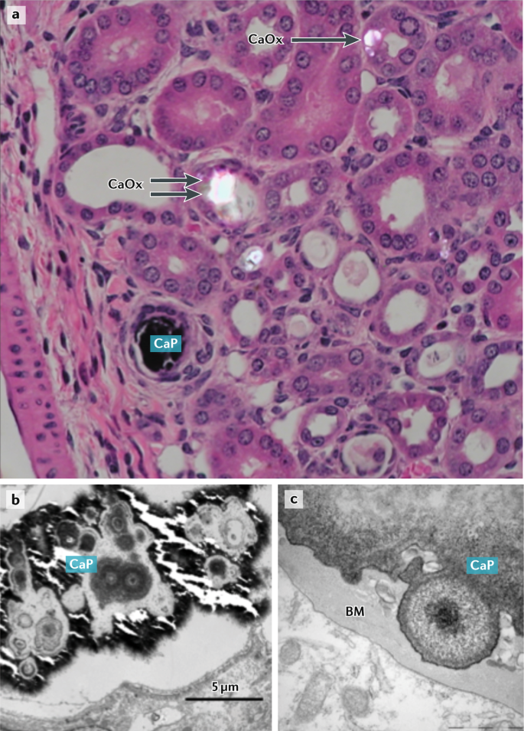
Why is Crystallization Important?
Crystallization refers to the formation and deposition of microscopic crystals (usually calcium-based) in tissues.
Healthy tissues, such as bone and teeth, naturally regulate these processes.
Intracellular Ca²⁺ signaling is central to both physiological mineralization and pathological calcification.
Calcification is a potentially treatable process.
Normal vs. Pathological: Normally regulated in hard tissues (bone, teeth), but ectopic calcification can occur under abnormal conditions.
Mechanisms: cell-driven mineralization, necrosis/apoptosis niches, osteogenic reprogramming in tumor microenvironment.
Types of Mineralization in Soft Tissues:
Type I (calcium oxalate)
Type II (calcium phosphate/hydroxyapatite)
Clinical relevance: composition and pattern correlate with lesion grade and aggressiveness in some studies.
(Source: https://www.nature.com/articles/s41581-020-00392-1)
Notes:
a | Light microscopy image of a kidney from a hyperoxaluric Npt2^{−/−} mouse (×40 magnification)⁵⁰. Intratubular calcium phosphate (CaP) and calcium oxalate (CaOx) crystals deposit in different sections of the nephron. CaOx is present both within the tubular lumen (double arrow) and intracellularly (single arrow). b | Transmission electron microscopic appearance of a CaP deposit in the kidney tubule of an Npt2^{−/−} mouse. The large deposit formed by aggregation and growth of spherulitic crystalline deposits has obliterated the kidney tubule. c | CaP deposit in the tubular epithelium basement membrane (BM) of a Umod^{−/−} mouse. https://www.nature.com/articles/s41581-020-00392-1

Slide 35
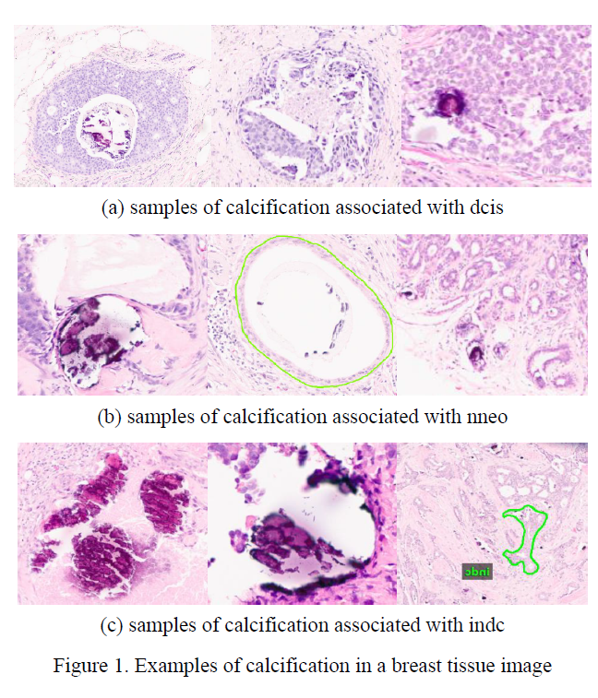
Calcification Annotation
FCBR Crystallization Subset (FCBR): Augmented FCBR with 439 detailed annotations of crystal deposits in tissue.
Annotation Criteria:
Classes are based on visual patterns of calcifications in different contexts.
The whole slide, as well as the proximity, is taken into consideration.
Background Tissue

Slide 36
Overview of Our Calcification Subset for FCBR
Label | Description / Features
Background (BCKG) | stroma, no ducts or lobules
Normal (NORM) | normal ducts and lobules
Artifact (ARTF) | grease pen marks, foreign bodies, etc.
Indistinguishable (NULL) | indistinguishable tissue, normally due to issues with the cut/stain
Suspected (SUSP) | regions that are at risk of developing into cancerous regions
Inflammation (INFL) | areas of inflammation
Ductal Carcinoma in Situ (DCIS) | ductal carcinoma in situ, and lobular carcinoma in situ
Non-Neoplastic (NNEO) | fibrosis, hyperplasia, intraductal papilloma, adenosis, ectasia, etc.
Invasive Ductal Carcinoma (INDC) | invasive ductal carcinoma, invasive lobular carcinoma, and invasive mammary carcinoma
Crystalline DCIS (CDCS) | small, loose calcific clusters in stroma
Crystalline NNEO (CNNO) | large, dense deposits of calcium in or close to invasive structures
Crystalline INDC (CIDC) | large, dense deposits of calcification in ducts
Original Database
DB | Non-Cancer | Carcinogenic | Cancerous | Anns/ Slide
FCBR | 12,164 | 1,967 | 5,954 | 13.7
TUBR | 8,035 | 6,222 | 2,714 | 6.3
Augmented Database
DB | NNEO | DCIS | INDC
FCBR | 728 | 1,209 | 10,955
DB | CNNO | CDCS | CIDC
FCBR | 51 | 168 | 220
Legend:
NNEO: Non-Neoplastic
DCIS: Ductal Carcinoma in Situ
INDC: Invasive Ductal Carcinoma
CNNO: Crystalline Non-Neoplastic
CDCS: Crystalline Ductal Carcinoma in Situ
CIDC: Crystalline Invasive Ductal Carcinoma

