Slide 1


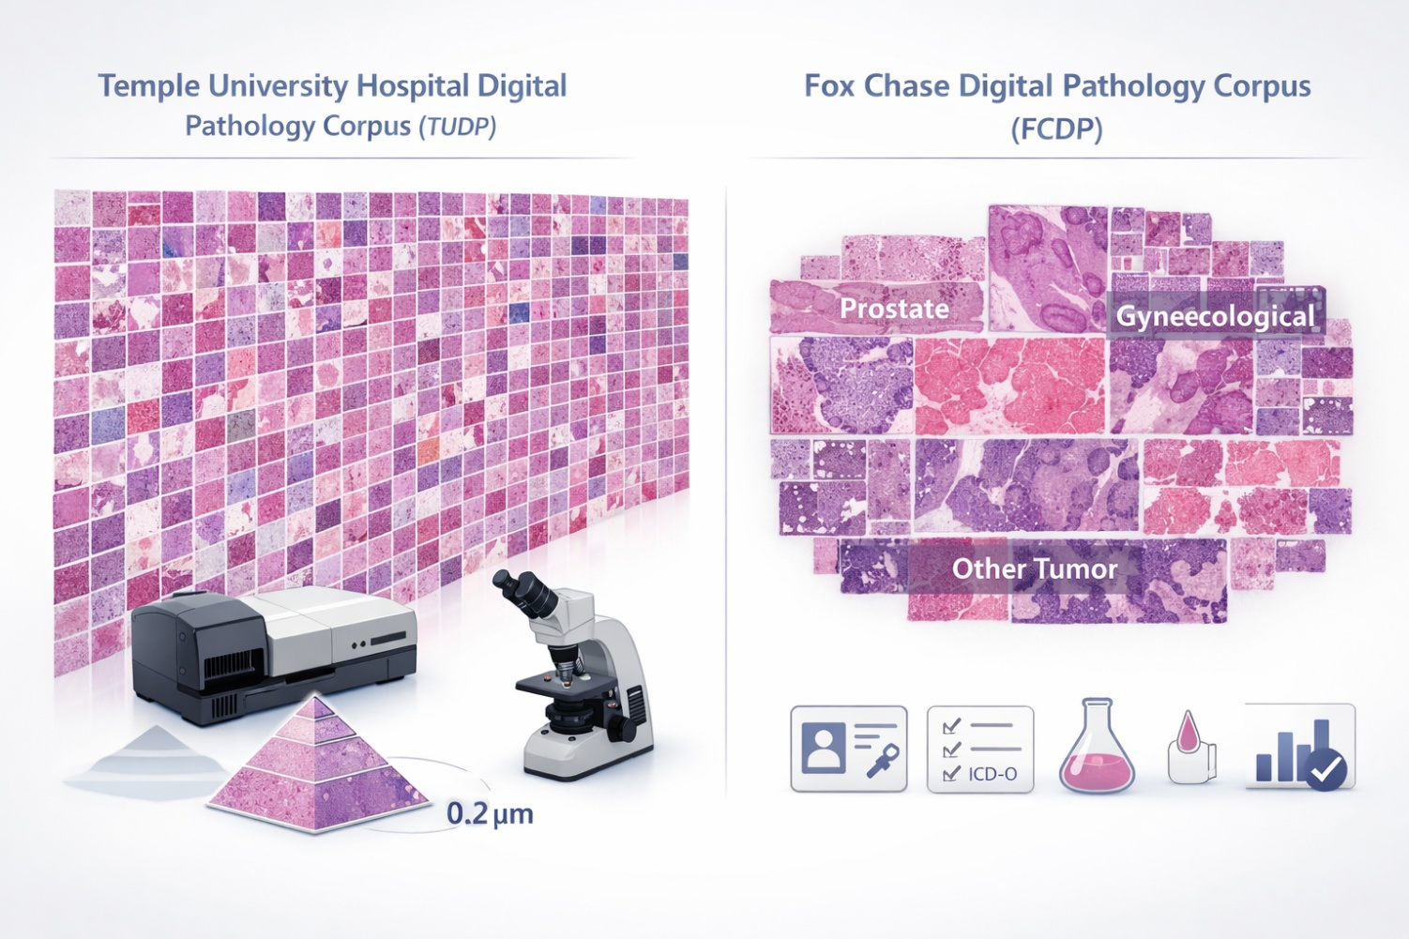
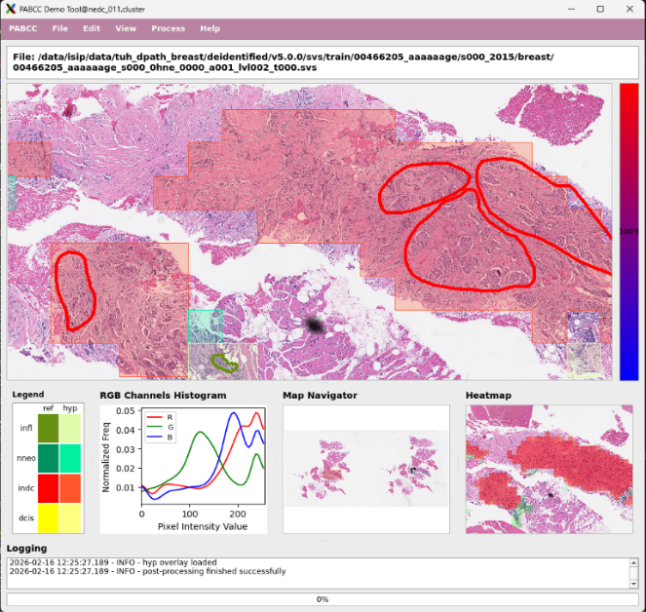
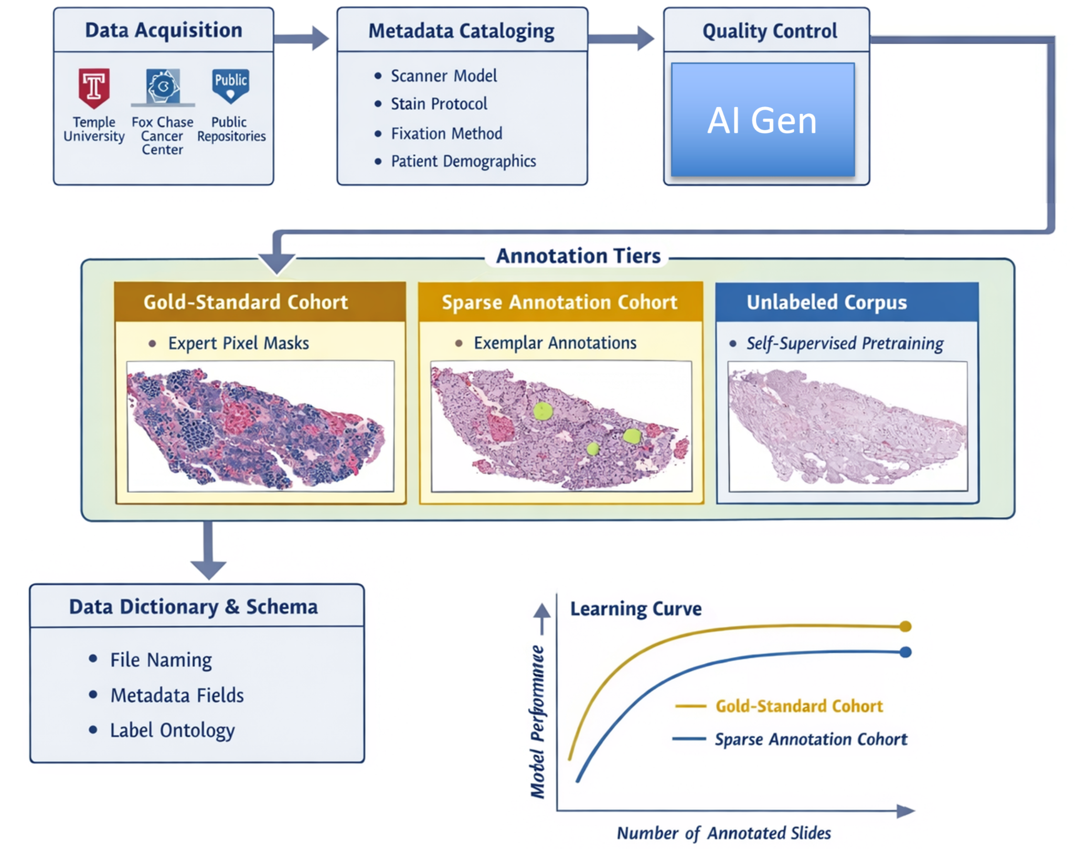
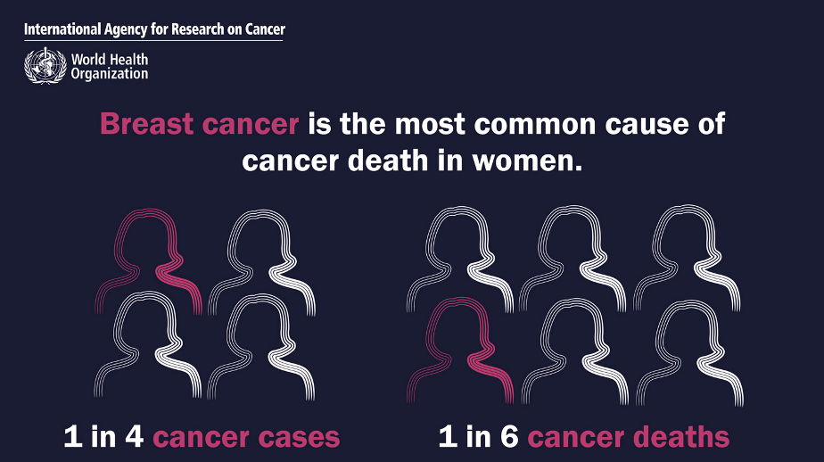
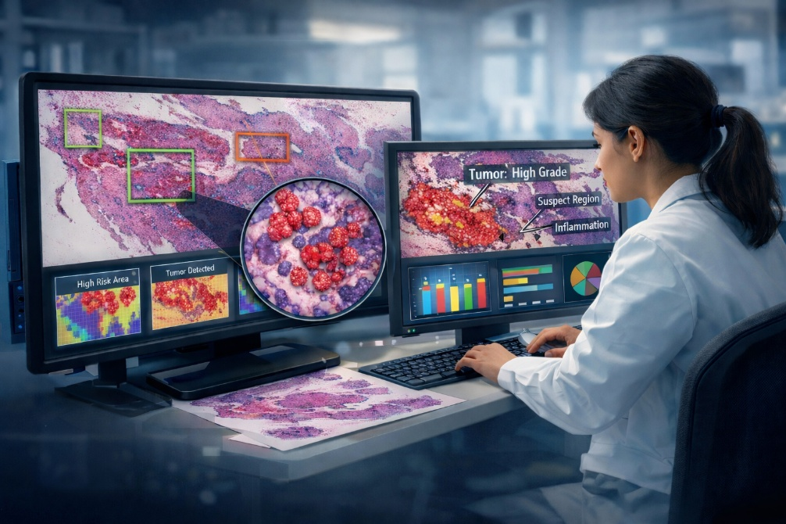
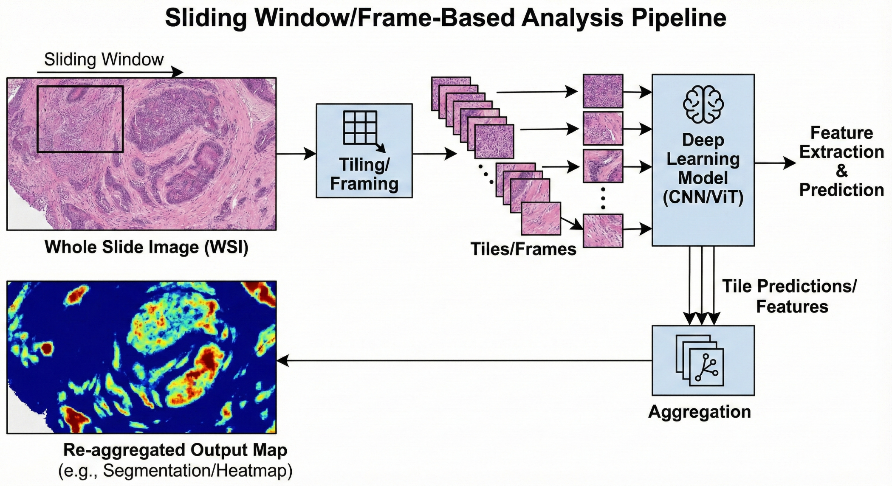
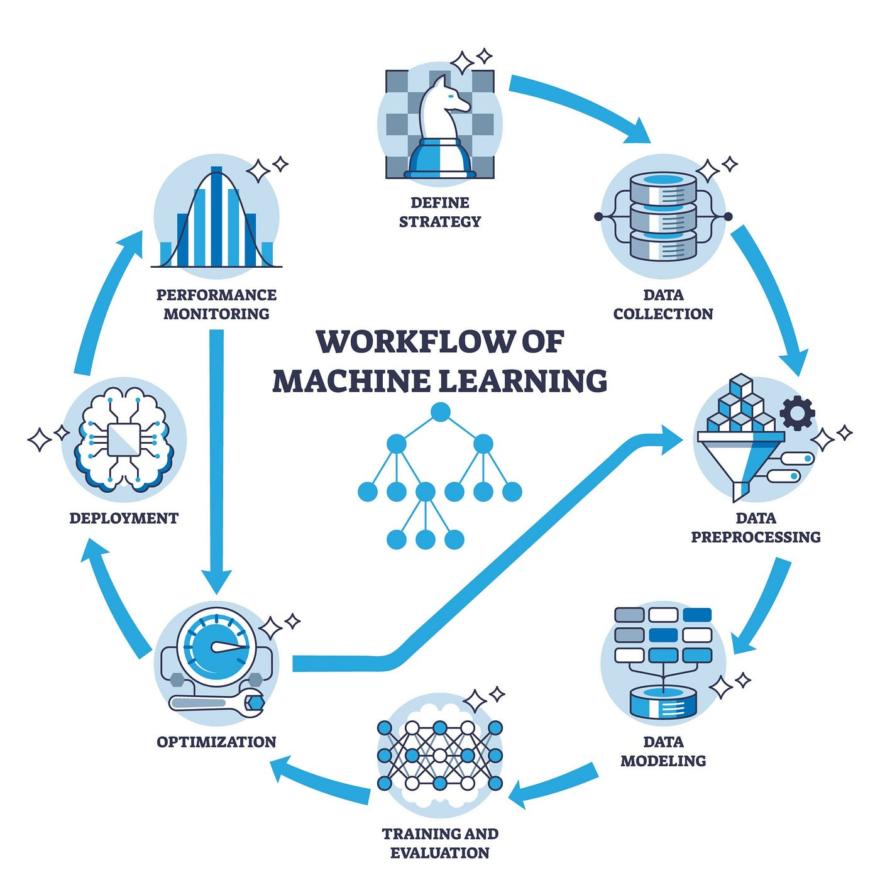
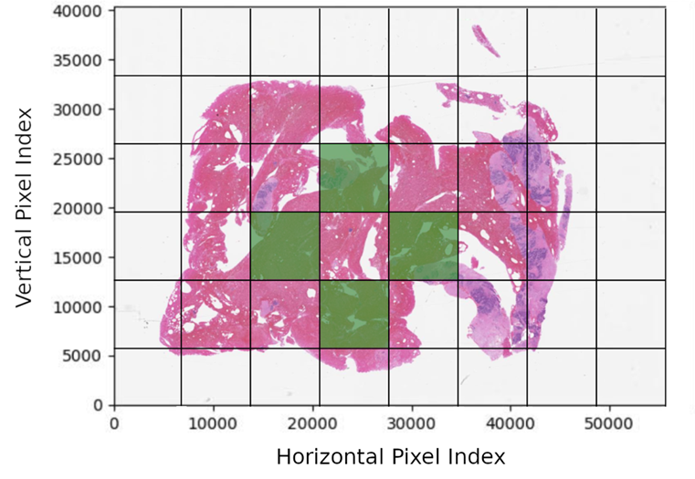
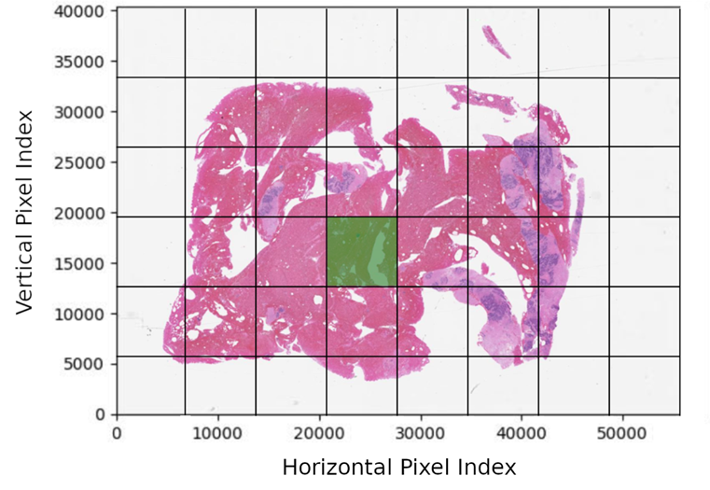
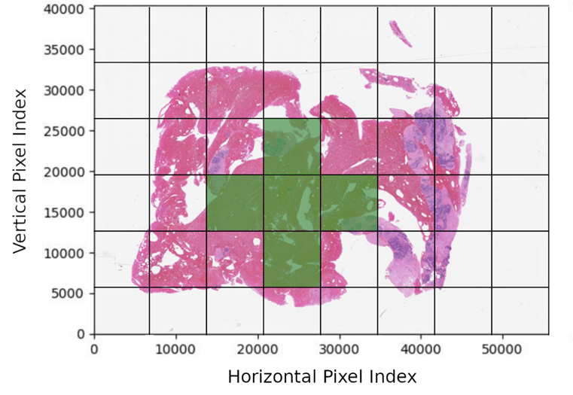
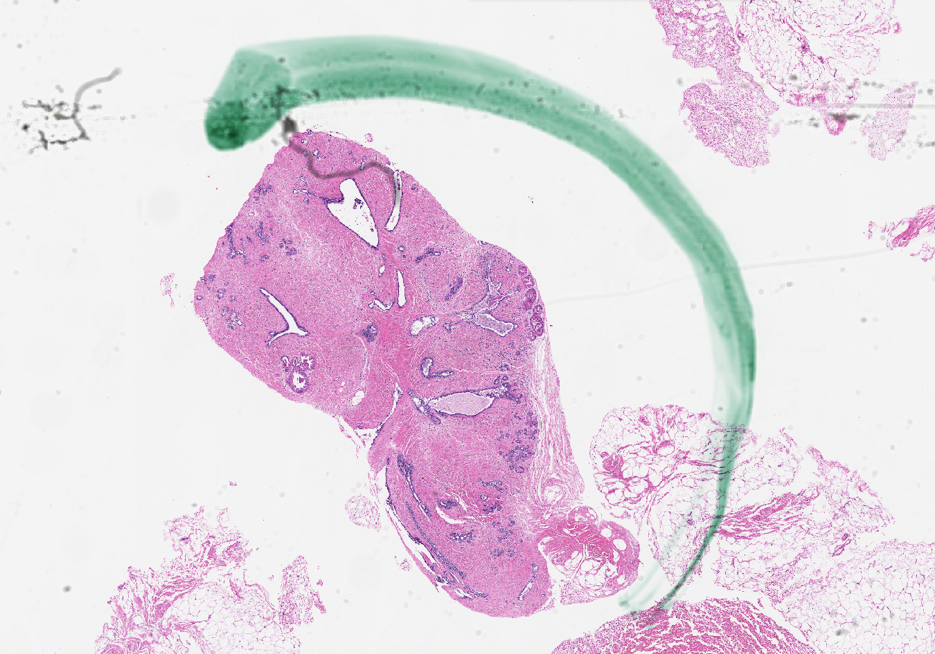



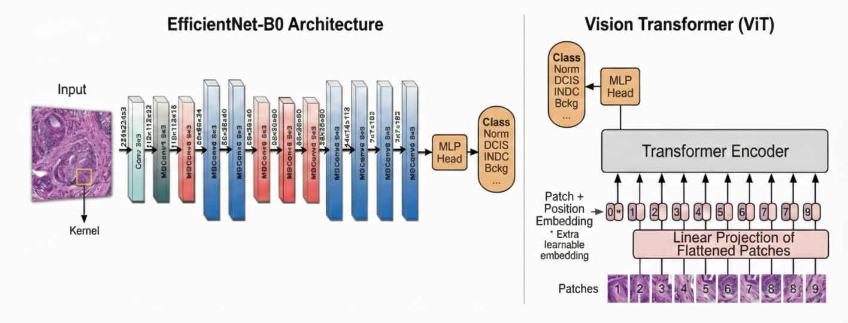
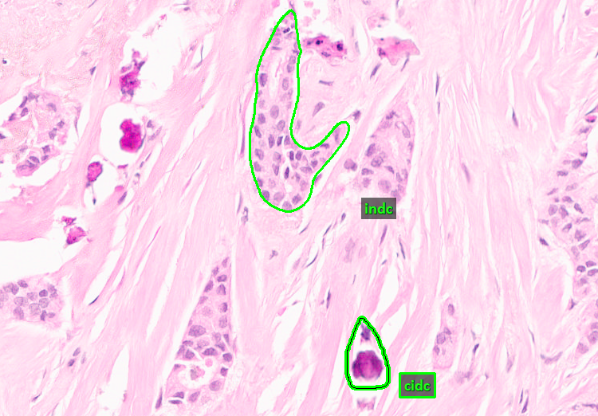
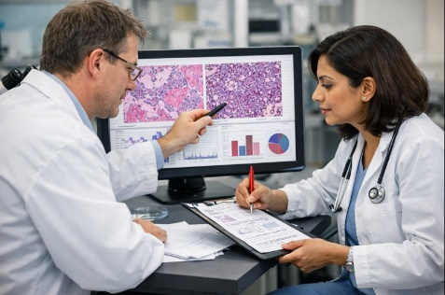
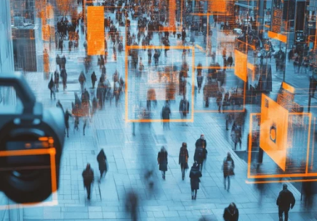
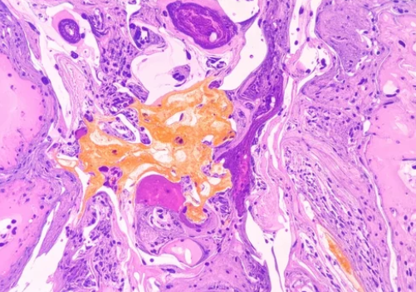

Automated Interpretation and Visualization in Digital Pathology
M.A. Al Mamun, S. Purba, I. Obeid, and J. Picone The Neural Engineering Data Consortium, Temple University
www.nedcdata.org
Abstract
There is a critical need for AI tools that support early screening and efficient tissue analysis in pathology. In this demonstration, we introduce a deep learning-based system that automatically interprets and visualizes digital pathology images. The proposed open-source system utilizes a modular architecture that includes four major steps: preprocessing, decoding, post-processing, and visualization. The inference engine is powered by EfficientNet, ResNet, and Vision Transformers trained on TUBR and FCBR corpora. On standard segmentation tasks, weighted errors of 25.5% (TUBR) and 25.0% (FCBR) were achieved using EfficientNet B7.
Datasets
The models were trained on two of the world’s largest open-source digital pathology resources.
TUBR (Temple University Hospital Breast Cancer Corpus): 3,505 high-resolution images from 296 patients, covering normal, benign, and pre-cancerous lesions.
FCBR (Fox Chase Cancer Center Breast Cancer Corpus): 1,463 oncology-focused slides from 1,397 patients, providing rich examples of invasive ductal carcinoma.
System Workflow
Preprocessing:
Splits gigapixels whole slide images (WSIs) into smaller tiles or frames.
Uses an empirically chosen window size (1024x1024) to balance context and localization.
Removes the white background to focus on the tissue region only.
Decoding:
The core inference engine acts as a decoder, utilizing a sliding window approach rather than processing the entire slide at once.
The decoder analyzes the preprocessed frames using a trained EfficientNet-B0 model.
The model is trained to recognize specific histological features, including normal ducts (NORM), ductal carcinoma in situ (DCIS), invasive ductal carcinoma (INDC), and non-neoplastic (NNEO).
Postprocessing:
Raw frame-level predictions often appear as scattered, independent points that lack spatial continuity.
Several frame aggregation algorithms were evaluated, including Label Priority, Confidence Priority, and k-Nearest Neighbors (kNN) smoothing.
kNN smoothing gave the best results, producing coherent regions and smoother boundaries via local neighbor consensus.
Visualization
An open-source Python analysis and visualization tool that features an extensible architecture and can manipulate extremely high-resolution images:
Assemble multi-institutional slide collections by coordinating data-sharing agreements with Temple University (TUH), Fox Chase Cancer Center (FCCC), and public repositories; catalogue metadata (scanner model, stain protocol, fixation method, patient demographics) for provenance tracking.
Define dataset tiers to support multiple research needs:
gold-standard cohort with pixelwise expert masks,
large-scale cohort with sparse/exemplar annotations,
massive unlabeled corpus for self-supervised pretraining.
Implement standardized ingestion pipelines: quality-control filters (focus, blur, artifacts), anonymization steps before annotation, WSI tiling.
Maintain a comprehensive schema (file naming, metadata fields, label ontology) to ensure reproducibility.
Introduction
Breast cancer is the most diagnosed cancer and the leading cause of cancer death among women.
While the demand for treatment continues to rise, diagnostic technology and the workforce have lagged, leading to longer diagnosis times.
Pathology teams face growing pressure to review increasing caseloads; manually reviewing every slide is highly labor intensive and fatiguing.
Summary and Future Work
The NEDC Digital Pathology (DPATH) Demo combines high-resolution imaging with robust deep learning models trained on large-scale, diverse corpora to deliver high-fidelity microsegmentations.
Localization of information allows clinicians to spend less time searching and more time interpreting images and diagnosing diseases.
Using a modified MDICE score, a weighted error of 25.5% was achieved on TUBR and 25.0% on FCBR using an EB7 model, marking the first published results on these tasks.
We have also developed three substantial corpora that can be used to develop high-performance machine learning (ML) systems.
We are investigated the use of alternative features, such as calcification, to improve performance.
We are developing more sophisticated classification systems based on long-term contextual models and unsupervised training methodologies.
We have also developed first generation approaches based on quantum computing.
Acknowledgments
The authors thank C. Dumitrescu, D. Heathcote, M. Bagritsevich, and D. Hackel for their contributions. Supported by the NSF (grants 2211841, 1726188, 1925494), Temple University (Catalytic Collaborative Funding, VP for Research, REU program), and the Pennsylvania Breast Cancer Coalition (PABCC). Opinions expressed do not necessarily reflect the views of the NSF, Temple University, or the PABCC.
Artificial Intelligence (AI) tools can ease this burden by prioritizing high-risk cases and analyzing tissue more efficiently, provided they are reliable and clinically relevant.
Machine learning (ML) is a branch of computational statistics and applied mathematics that develops algorithms to infer predictive or descriptive models from data.
Learning paradigms of particular relevance to computational pathology include:
Supervised: estimate mappings from image pixels or patches to labels (region masks, classes) using risk minimization from labelled data.
Semi-supervised: learn from coarse, incomplete, or noisy labels (slide-level annotations), often via multiple-instance learning, pseudo-labeling, or consistency regularization.
Unsupervised and self-supervised: discover structure in unlabeled images by optimizing proxy tasks (contrastive objectives, masked prediction, rotation/patch-prediction), which yield transferable features for downstream segmentation or detection.
Transfer learning: adapt models trained on one distribution (scanner, stain, institution) to perform robustly on another by minimizing distributional discrepancy or aligning feature spaces.
The system was evaluated using ResNet-18, EfficientNet (B0-B7), and Vision Transformers (ViT-16/32).
The baseline system utilizes an optimized EB0 to balance computational efficiency with high fidelity mirosegmentation.
Results with a Shifted Window (SWIN) transformer have been inconclusive.
To learn more about our resources, please use this URL:
https://www.nedcdata.org

