Slide 1
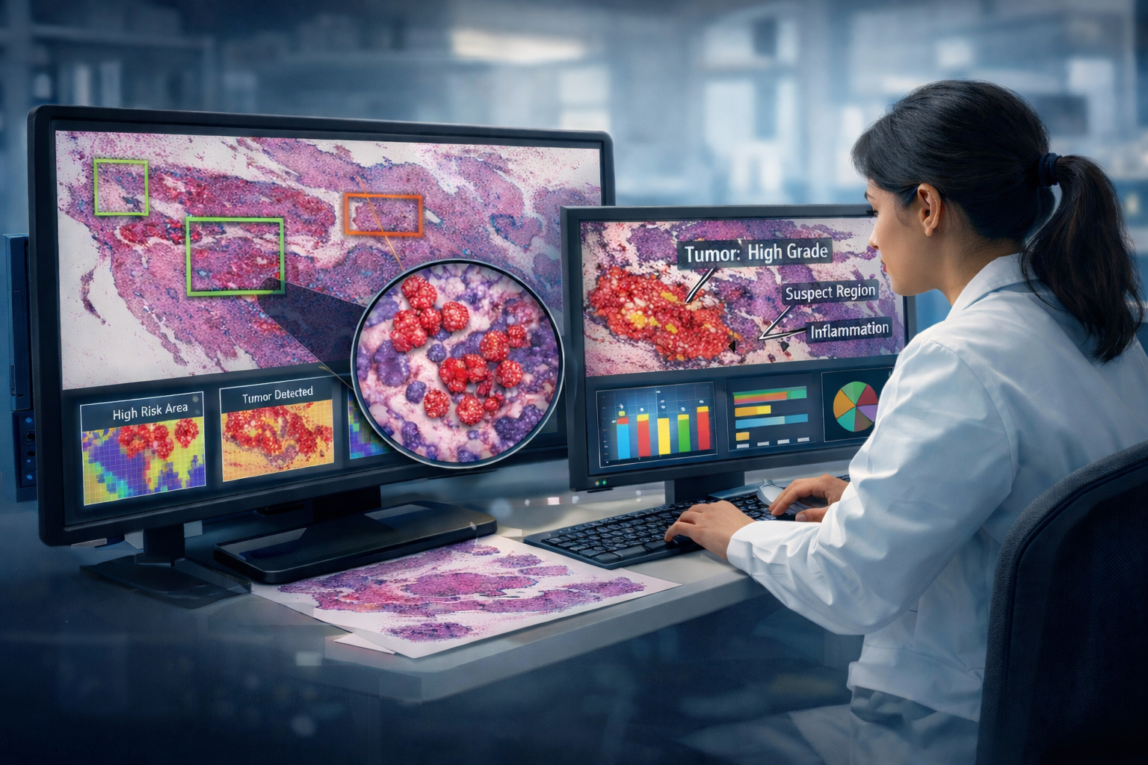

Rapid and Inexpensive Precision Breast Cancer Screening Using Machine Learning
M.A. Al Mamun, S. Purba, I. Obeid and J. Picone
The Neural Engineering Data Consortium
Temple University

Slide 2
Relevant Resources
Research Presentation:
https://isip.piconepress.com/publications/presentations_misc/2026/pabcc/dpath/
Video:
https://isip.piconepress.com/projects/pabcc/resources/videos/demo/video_v00.mp4
Demo System:
https://isip.piconepress.com/projects/nedc/data/tuh_dpath_software/nedc_dpath_demo_v1.0.0.tar.gz
Project Web Site:
https://isip.piconepress.com/projects/pabcc/
Software:
https://isip.piconepress.com/projects/nedc/data/tuh_dpath_software/
Data:
https://isip.piconepress.com/projects/nedc/html/resources.shtml
Direct Further Questions To:
Joseph Picone (picone@temple.edu –or- help@necdata.org)

