Slide 1

Statevector-Based Acceleration Strategies in Quantum Machine Learning
Md. Abdullah Al Mamun, PhD Student, ECE
The Neural Engineering Data Consortium
Temple University

Slide 2
Simulator Bottleneck in QSVM and QNN Research
Key Points:
Quantum simulators run on classical computers using linear algebra
State size grows exponentially:
n qubits→2^{n} amplitudes
Memory scaling:
Qubits | Statevector Size
10 | 16 KB
20 | 16 MB
30 | 16 GB
40 | 16 TB
Kernel computation cost in QSVM:
O(N² × circuit execution)
Shot-based simulation is slow due to repeated sampling

Slide 3
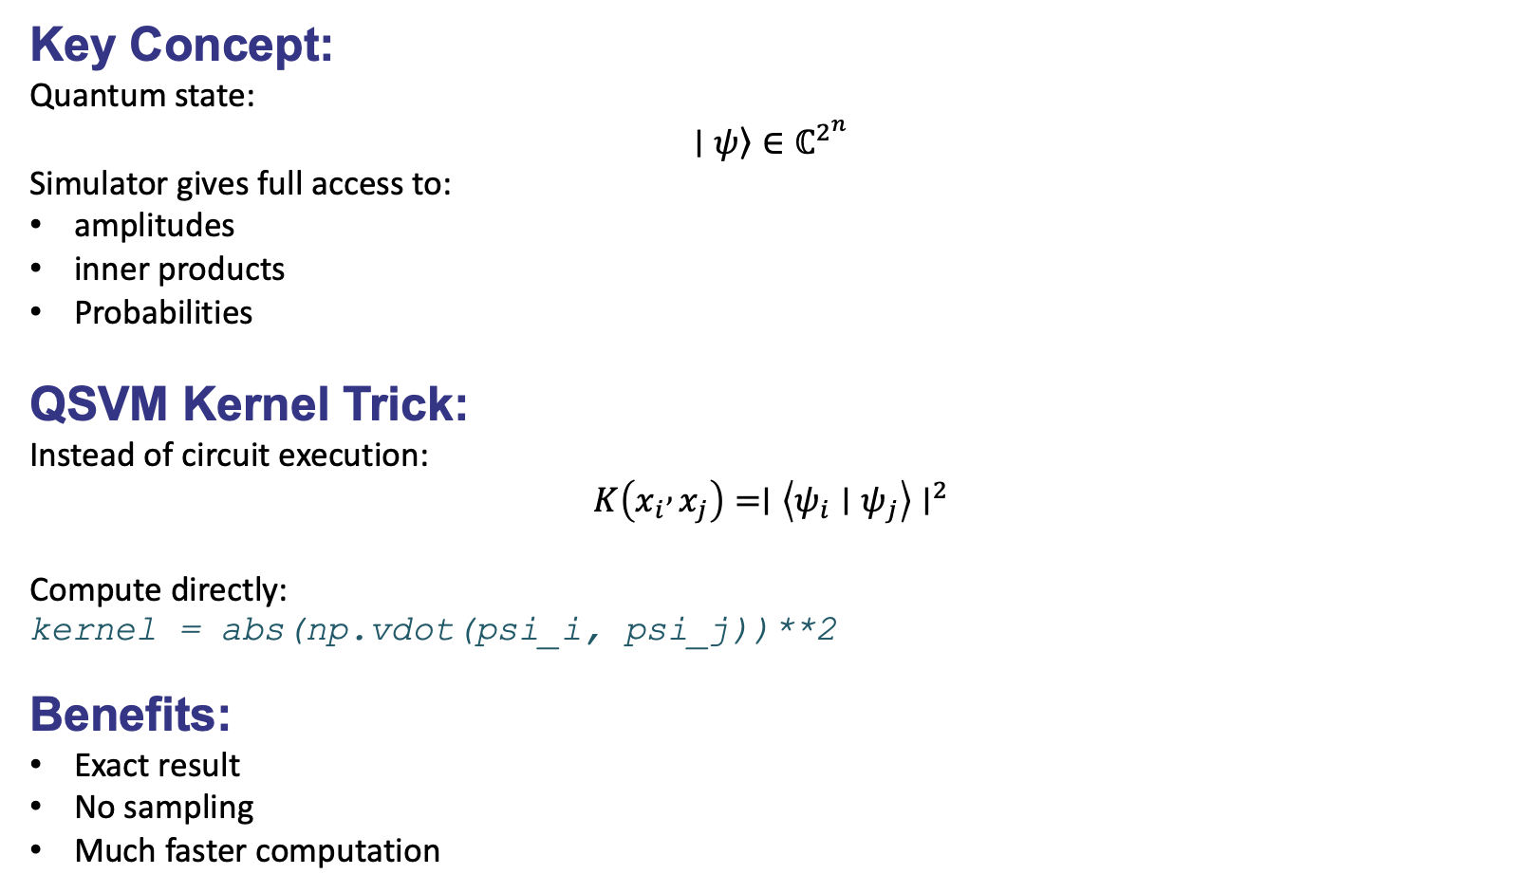
Statevector Simulator Enables Direct Linear Algebra Access
Key Concept:
Quantum state:
$$\left.∣ψ\right\rangle ∈ℂ^{2^{n}}$$
Simulator gives full access to:
amplitudes
inner products
Probabilities
QSVM Kernel Trick:
Instead of circuit execution:
$$K\left(x_{i} , x_{j}\right)=∣\left\langle ψ_{i}∣ψ_{j}\right\rangle ∣^{2}$$
Compute directly:
kernel = abs(np.vdot(psi_i, psi_j))**2
Benefits:
Exact result
No sampling
Much faster computation

Slide 4
Statevector vs Shot-Based Simulation
Feature | Statevector | Shot-based Simulator
Speed | Very fast | Slow
Accuracy | Exact | Statistical
Noise | No | Yes
Hardware realistic | No | Yes
Best use | Algorithm development | Hardware validation
Key Insight:
Statevector simulation = fast but ideal
Shot simulation = realistic but slow
Both are necessary.

Slide 5
Performance Comparison: Shot-Based Simulator vs Statevector Approach
Experimental Setup
Task: QSVM Kernel Computation and Decision Boundary Plotting
Frameworks: Qiskit and PennyLane
Comparison: Shot-based simulator vs Statevector approach
Framework | Shot Simulator | Statevector | Speedup
Qiskit | 228.11 s | 0.8 s | 500× faster
PennyLane | 316.82 s | 0.9 s | 600× faster

Slide 6
Efficient and Realistic QML Research Workflow
Step 1 — Fast Development
Use statevector simulator
Compute kernels using inner products
Rapid experimentation
Step 2 — Realistic Validation
Use shot-based simulator
Add noise model
Evaluate robustness
Step 3 — Hardware Deployment
Run on real quantum hardware
Final performance evaluation

