Slide 1

Proof of Concept
HilbertBench: A Non-Intrusive Diagnostic Framework for Evaluating Scientific Claims in Quantum Machine Learning
Md. Abdullah Al Mamun, PhD Student, ECE
The Neural Engineering Data Consortium
Temple University

Slide 2
The Problem: The "Black Box" of QML
Core Message
We currently judge QML models by accuracy, but accuracy doesn't explain mechanism.
Key Pain Points
High accuracy could be due to the ansatz, the encoding, or just luck—we don't know.
Observer Effect
Traditional debugging (print statements) is impossible or alters timing on real hardware.
The Solution
We need a "Flight Recorder" that observes the system without touching the model logic.

Slide 3
The Solution: 1:1 Execution Parity
Concept
HilbertBench operates at the "Execution Boundary" (between compiler and backend).
The Rule
We do not change the model architecture or the training loop. We only intercept the intent (circuit) and outcome (shots).
Visual: A comparison
Standard Benchmarking: "Did the model win?" (Output = Accuracy)
HilbertBench:
"Why did it behave that way?" (Output = Diagnostic Trace) .

Slide 4
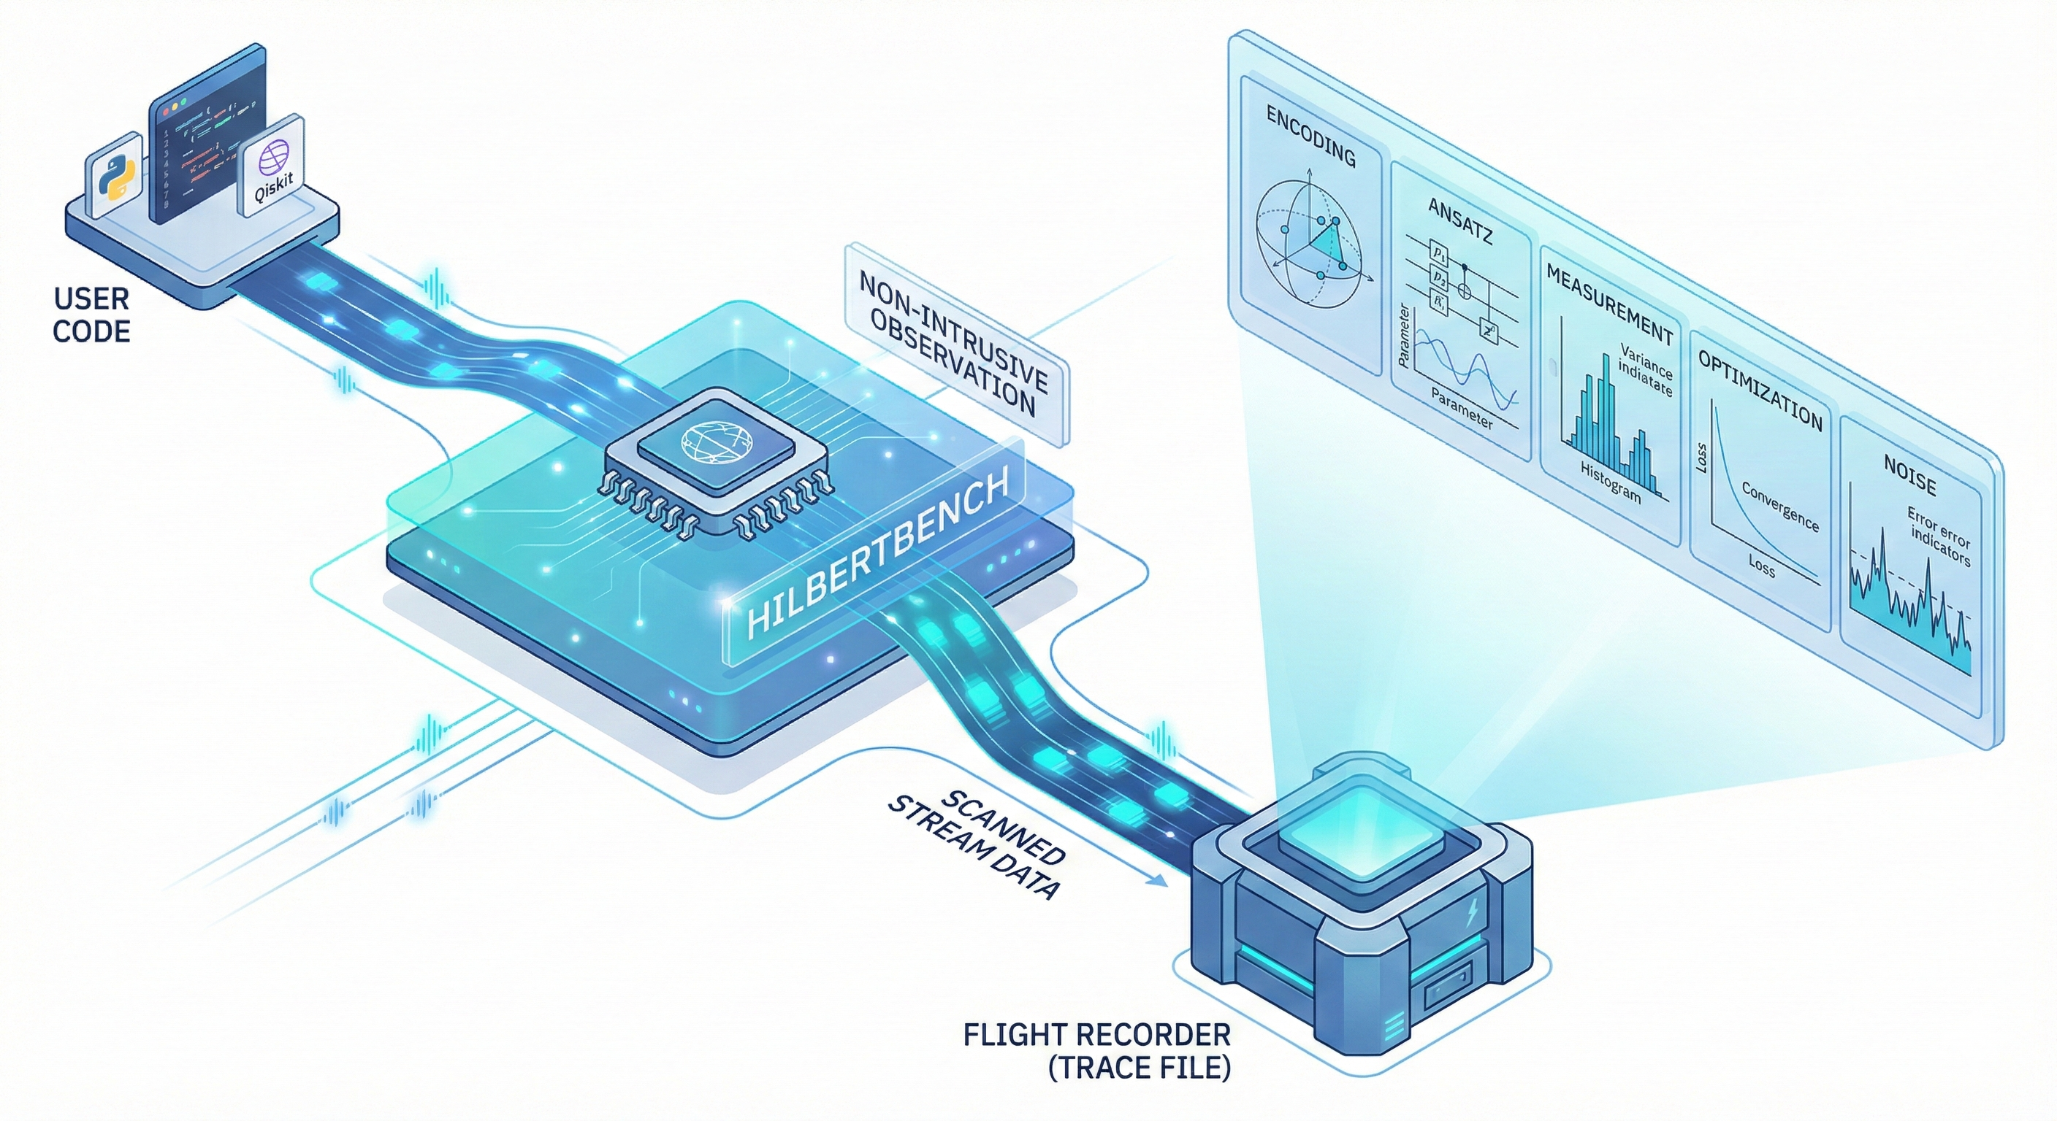
The Solution: 1:1 Execution Parity

Slide 5
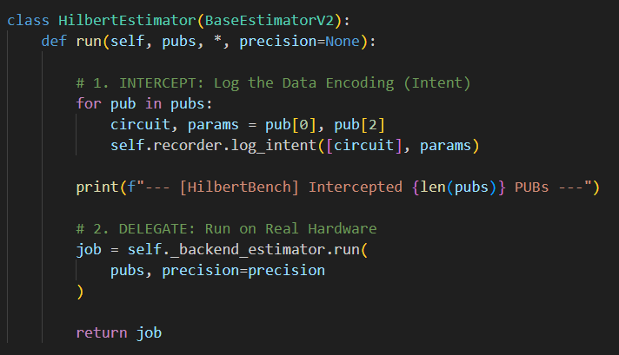
PoC Demo: The "Sidecar" Interception
Goal: Intercepting the execution without breaking the user's workflow.

Slide 6
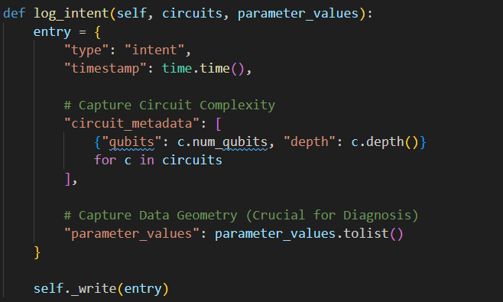
PoC Demo: The "Flight Recorder" Trace
Goal: Capturing the right data to solve the "Black Box" problem.

Slide 7
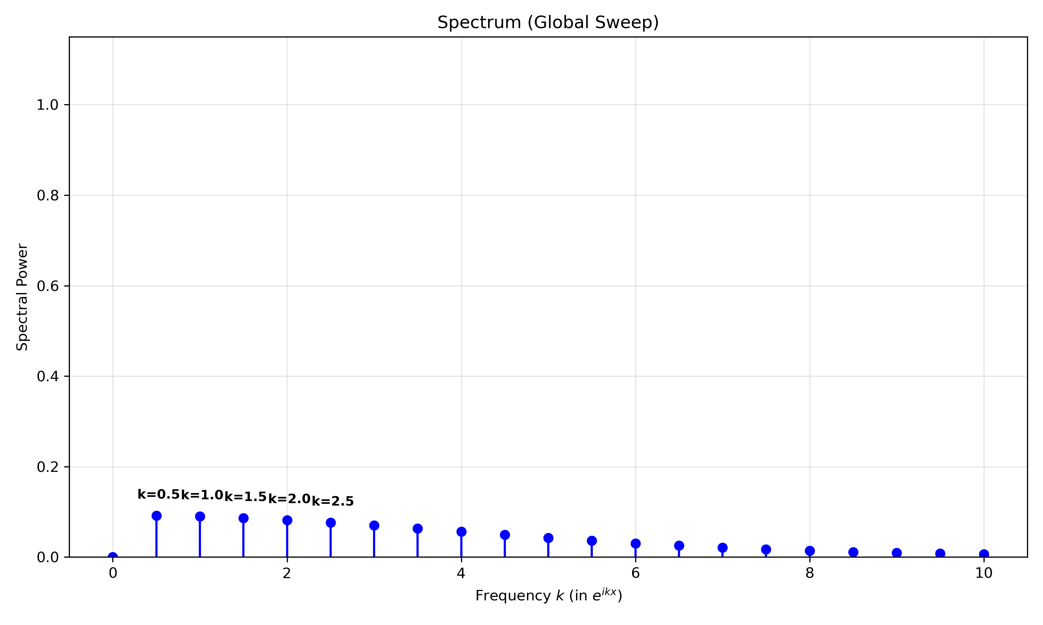
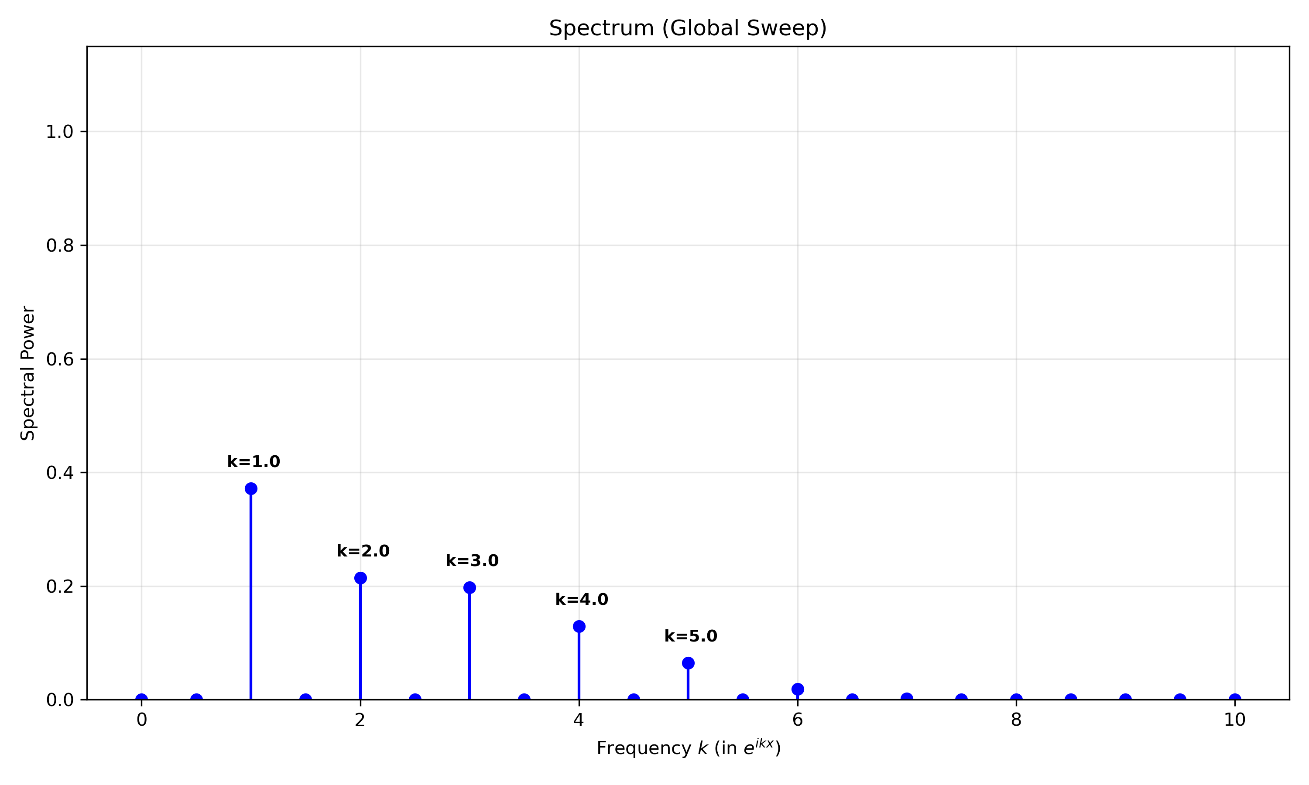
PoC Demo: Offline Diagnostic Analysis (Spectrum)
Spectrum Analysis on data encoding,
cosine encoding (left)
Data re-uploading (right)

Slide 8
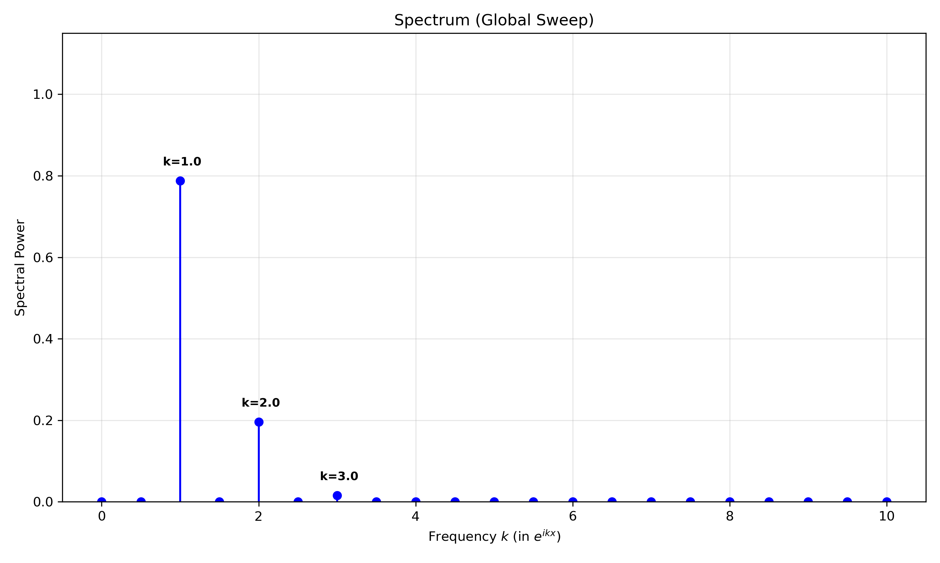
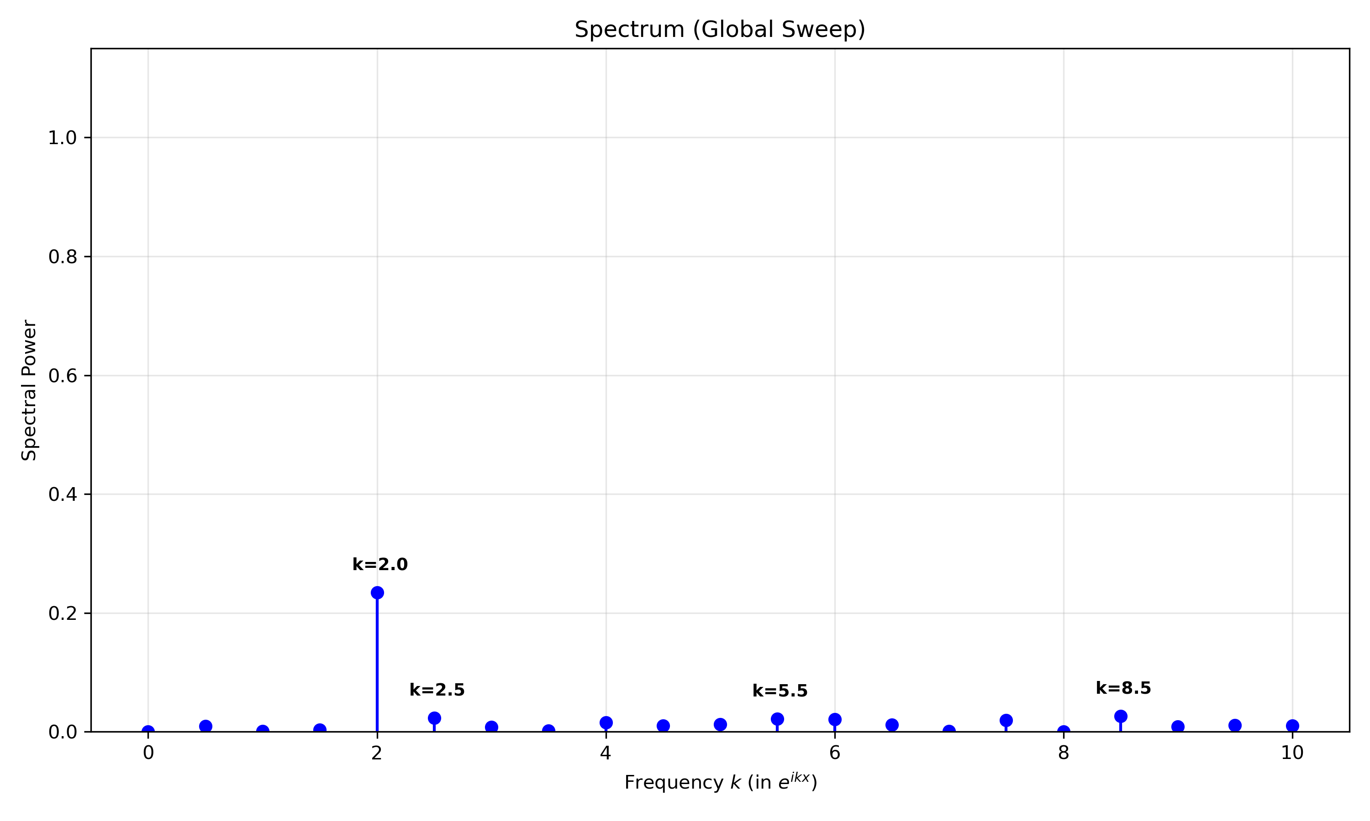
PoC Demo: Offline Diagnostic Analysis (Spectrum)
Spectrum Analysis on data encoding,
Angle encoding(left)
IQP encoding(right)

Slide 9
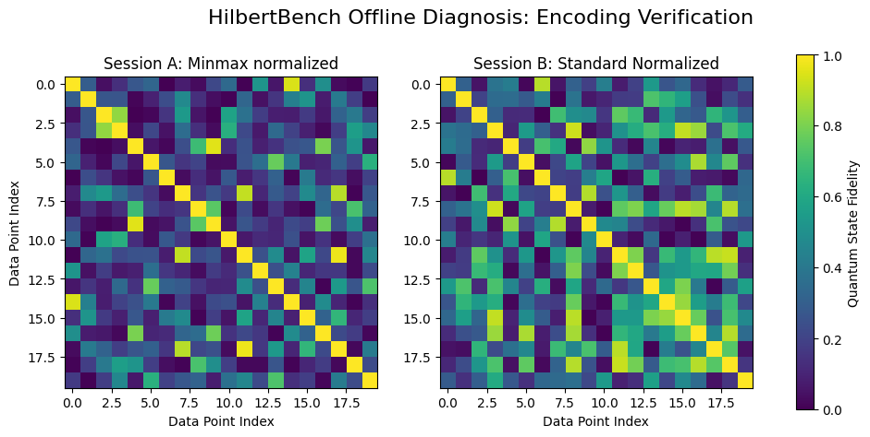
PoC Demo: Offline Diagnostic Analysis (Geometric)
Geometric Analysis on data encoding using fidelity matrix (Kernel)
Using Minmax normalization
Using Standard normalization

Slide 10
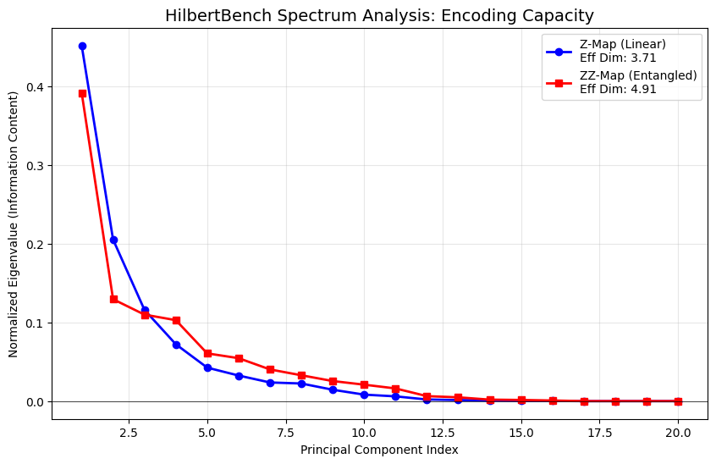
PoC Demo: Offline Diagnostic Analysis (Effective dimension)
Capacity Analysis on data encoding using effective dimension

