Slide 1

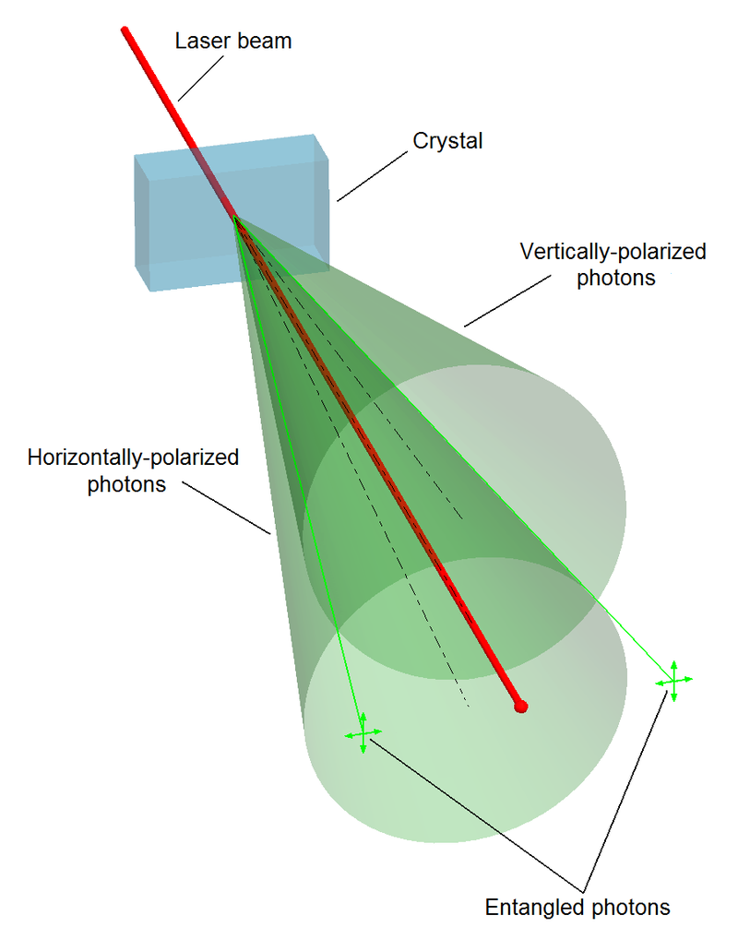
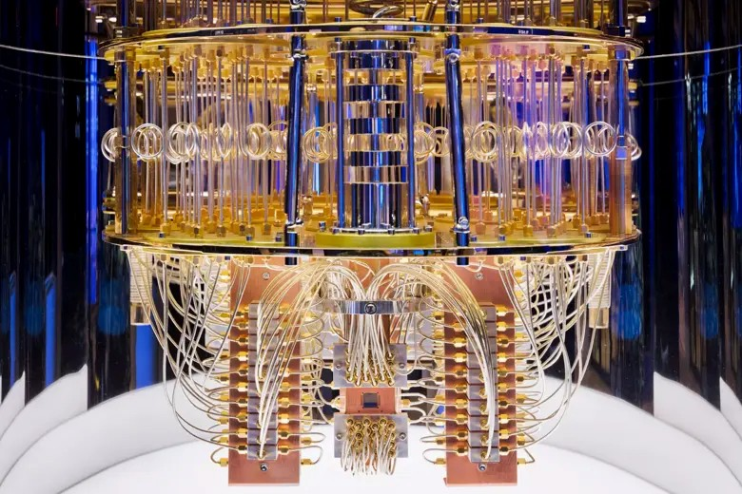
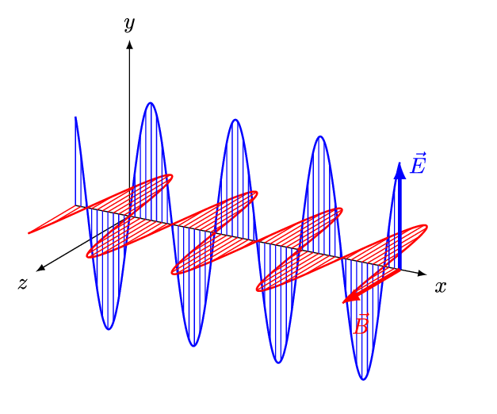
Quantum Machine Learning
Sadia Afrin Purba
Neural Engineering Data Consortium
Temple University

Slide 2
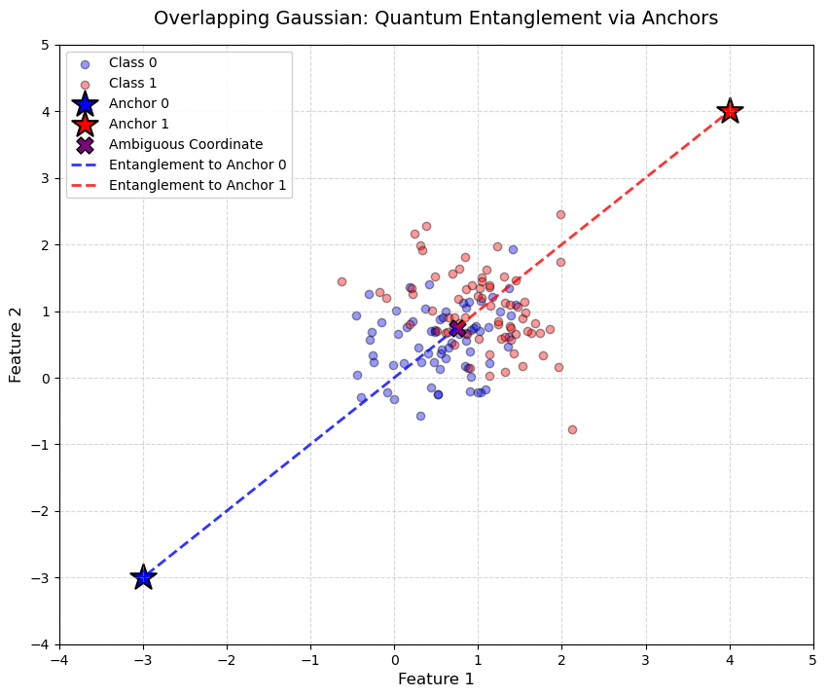
Experimental Setup

Slide 3
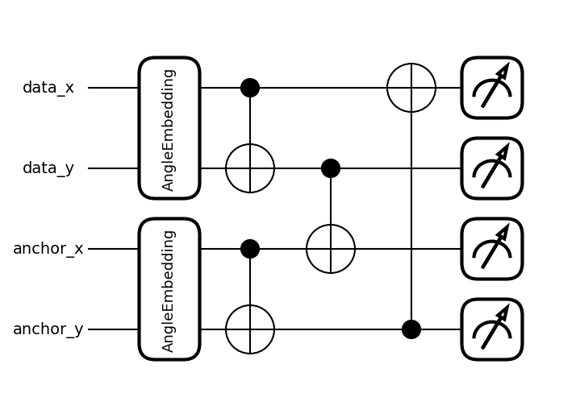
Experimental Setup

Slide 4
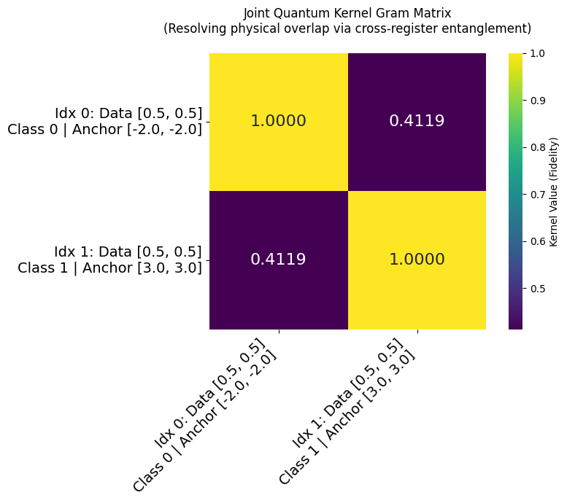
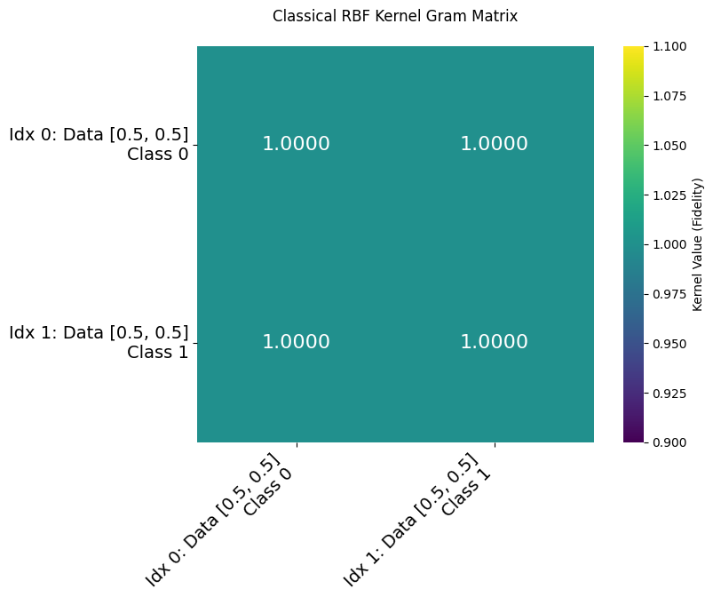
Results

Slide 5
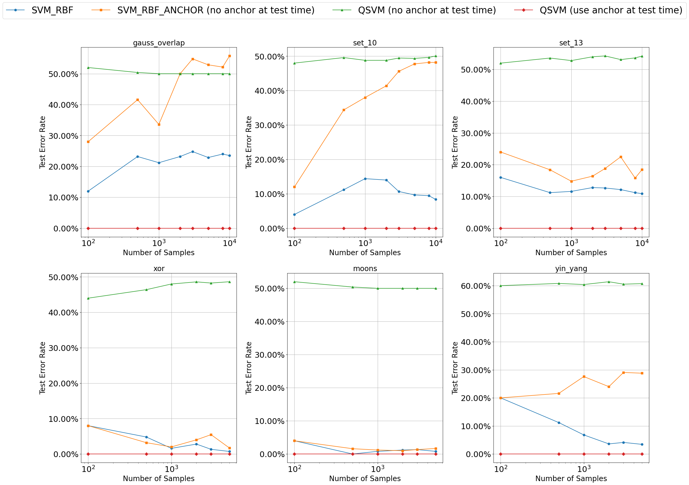
Results

Slide 6
Results
Alg (N=50) | MI (bits)
RBF-SVM | 0.09935
QSVM | 1.91350

