Slide 1
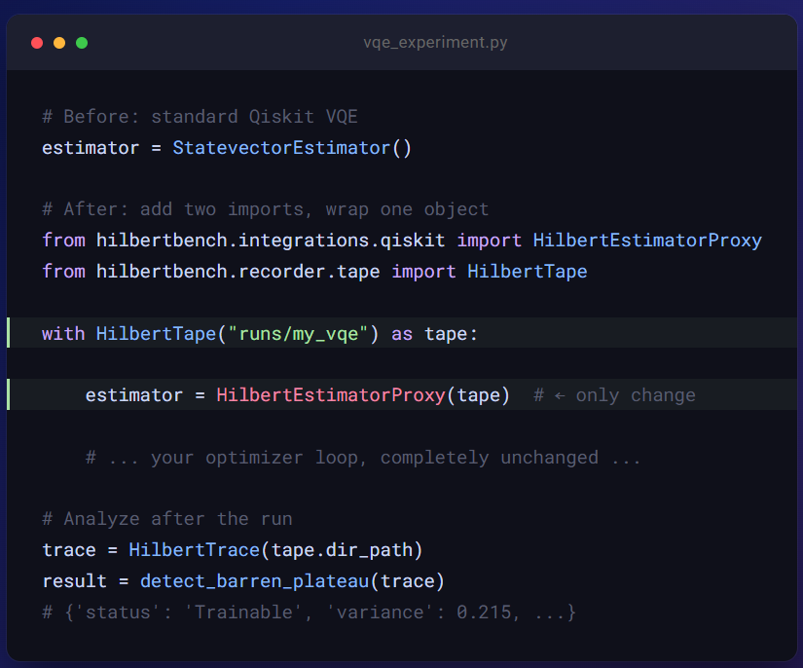

NEDC Discussion| June 12, 2026
HilbertBench: From Working Instrument to a PRX Quantum (APS Journal) Submission
M.A. Al Mamun
The Neural Engineering Data Consortium
Temple University, Philadelphia, PA

Slide 2
Why Did I choose PRX Quantum
Venue | Impact Factor | Realistic? | What’s needed
Nature (main) | ~70 | No | Paradigm-shifting discovery
Nature Communications | ~17 | Very hard | Real hardware + novel empirical finding
npj Quantum Information | ~7 | Possible | Strong empirical work + real hardware validation
PRX Quantum (APS) | ~7 | Yes, realistic | Real hardware + solid empirical validation
Quantum (community journal) | ~6 | Yes, strong fit | Empirical study + mature tool/framework
ACM Transactions on Quantum Computing | — | Yes | Systems-focused framing (software / infrastructure contribution)
SoftwareX / JOSS | Low | Easy | Tool-only paper (software description, reproducibility focus)
Venue strategy: PRX Quantum (scope explicitly covers methods & instrumentation) → npj Quantum Information → Quantum. The same experiments serve all three — only the template changes.

Slide 3
Why this paper gets accepted: three claims' reviewers haven't seen
1 Blinded instrument validation
2 Noise-shifted frontier (physics)
3 Quantitative recovery of theory
36 runs conducted with pre-planted failure modes
Answer key secured via SHA-256 cryptographic hash
Study protocol pre-registered on OSF before diagnosis
Blinded researcher evaluates data traces alone to prevent bias
Full performance transparency via a published confusion matrix
Evaluates expressibility vs. trainability (Holmes et al., PRX Quantum 2022)
Benchmarks performance on a real IBM quantum device vs. simulator
Quantifies frontier displacement caused by hardware noise
Delivers a new empirical, PRX-grade physics result
Recovers the McClean 2018 barren-plateau scaling exponent
Predicts circuit fidelity directly from hardware-validated calibration snapshots
Establishes the core calibration curves of the instrument
Formatted precisely to fit the structure of an instrument paper
Nothing like this exists in QML — it is standard in metrology and clinical research.

Slide 4
The protocol: diagnosis as a falsifiable experiment
1. Generate
Researcher A creates 36 runs — 9 each of healthy, barren plateau, shot-starved, noise-dominated. Seeded, neutral tags.
2. Blind
Tool copies each sealed run verbatim under a random ID and audits every tag for label leakage.
3. Commit
SHA-256 hash of the answer key is published (git + OSF) BEFORE anyone diagnoses.
4. Diagnose
Researcher B labels every run using analyzer outputs only — no contact with A, class balance undisclosed.
5. Score
Key verified against the commitment, then: confusion matrix, per-class precision/recall, 95% Wilson CIs.
Why it cannot be gamed:
Evidence is immutable
Answers are committed
Thresholds are frozen
Timestamps don't leak
traces are append-only and hash-sealed at creation — nobody can edit a run after the fact
changing the key after diagnosis breaks the published hash — verifiable by anyone
fixed on a disjoint 12-run dev corpus and pre-registered — we can't tune the detector to pass its own exam
generation order is shuffled, so trace metadata carries no label signal
Chance level is 25%. Whatever the accuracy, it publishes with error bars — and the dev corpus already separates 4/4 classes, so the floor is high. This protocol is the paper's Figure 5.

Slide 5
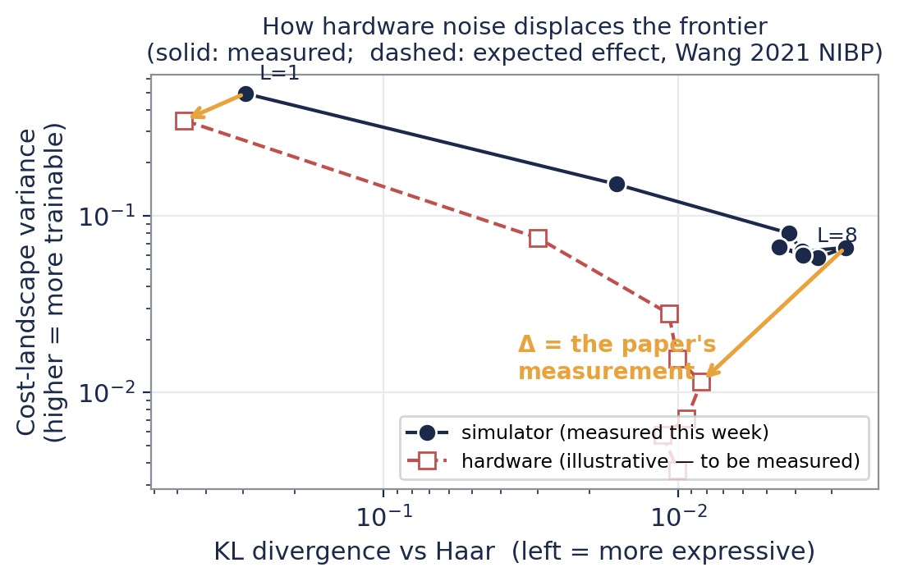
The physics: measuring how noise displaces the frontier
What theory says:
Holmes 2022: more expressive ansatze have provably flatter landscapes. Wang 2021: noise alone induces barren plateaus (NIBP).
What nobody had measured: how noise moves the frontier on a real device.
I measured the onset — on the free tier:
no suppression at depth ≤ 6; significant suppression at depths 8–16 (CIs exclude the simulator at every depth; ratio falls 0.47 → 0.22). The NIBP onset is bracketed between depths 6 and 8.
And the expressibility axis moved too:
first hardware KL pilot shows noise biasing the metric TOWARD Haar at depth 1 — 'fake expressibility'. Noise pushes frontier points down-and-left: models look more expressive and less trainable than they are.
The paid runs turn both pilots into publication-grade curves on one device: ≈5.5 QPU-min ≈ $550.

Slide 6
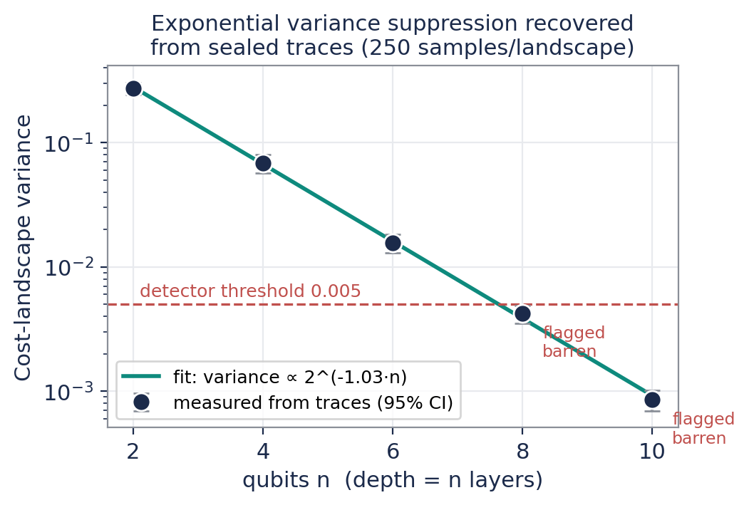
Calibrating the instrument against known theory
Already measured (left):
Five qubit widths, 250-point landscapes, analyzed blind from sealed traces: variance ∝ 2^(−1.03·n) — clean exponential suppression, exactly the McClean 2018 mechanism for local costs.
The detector flips to 'barren' precisely where planted (n ≥ 8), with bootstrap CIs that don't straddle the threshold.
Second calibration curve — real-device check done:
On ibm_marrakesh, the instrument predicted fidelity 0.518 from the trace's calibration snapshot; the device delivered 0.559 — within 8%, on unmitigated hardware.
Why reviewers care:
An instrument paper lives or dies on traceability. Every number is re-derivable from the public traces and seeds (two Zenodo DOIs).

Slide 7
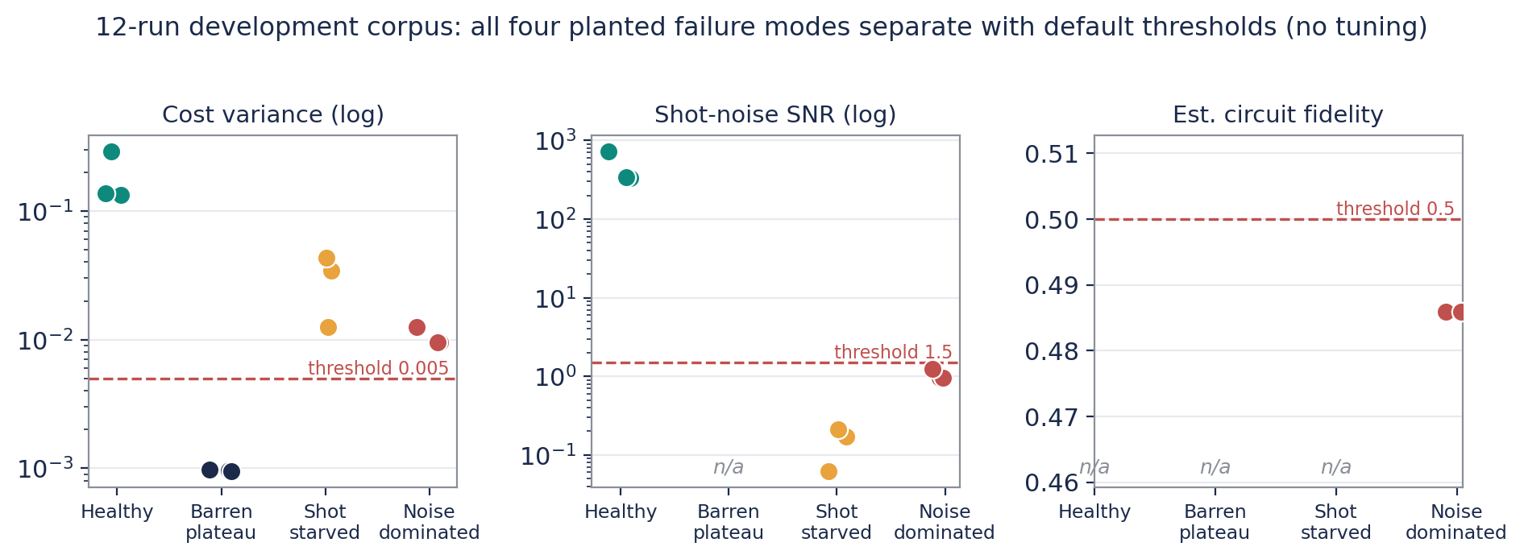
Measured this week: it works — including on real hardware
12-run development corpus, four planted failure modes:
every class separates using default thresholds — zero tuning. Thresholds now frozen and pre-registered.
Yesterday, on ibm_marrakesh (156-qubit Heron):
full pipeline passed 5/5 verification checks — on the FREE tier, using 33 QPU-seconds.
319 automated tests passing.

Slide 8
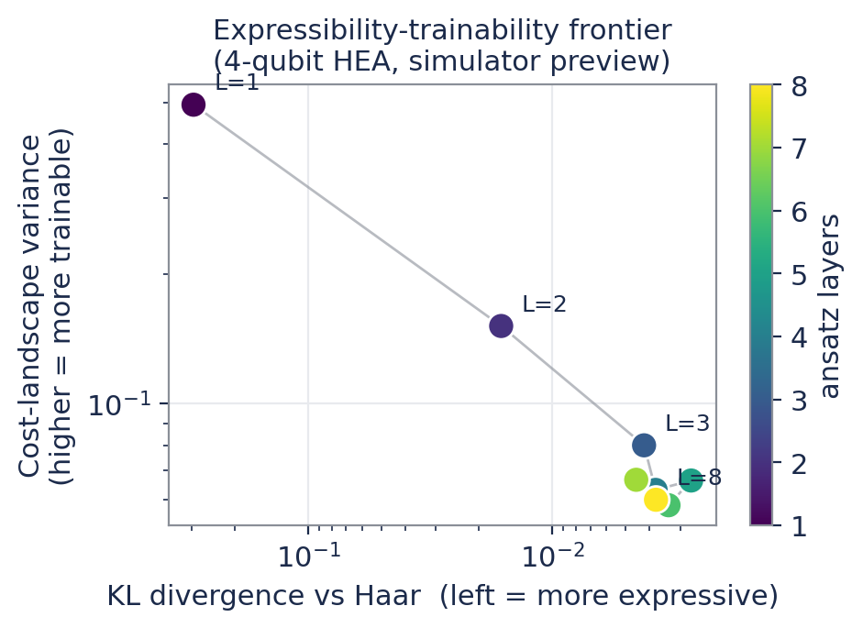
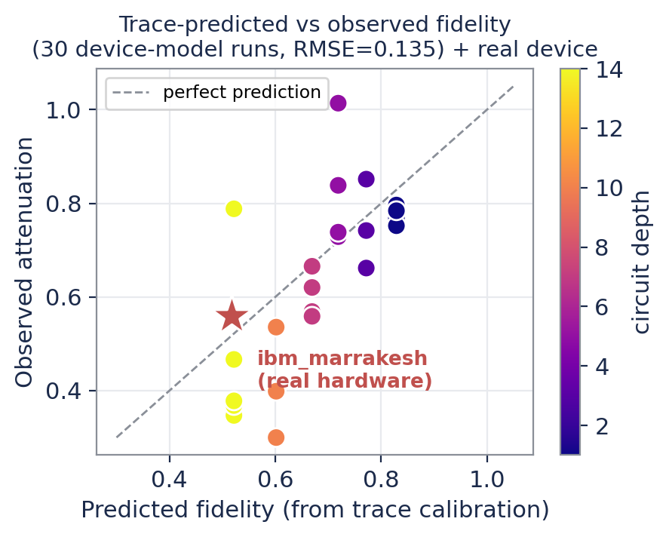
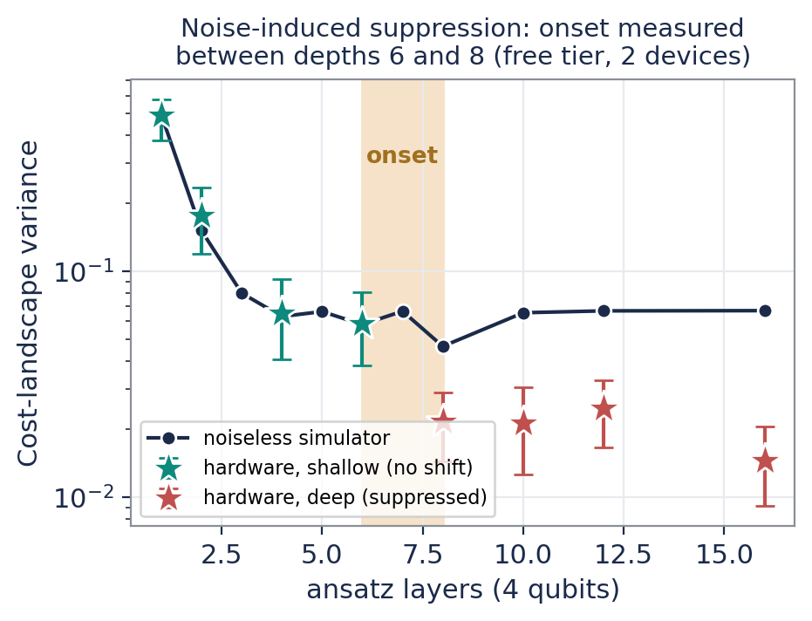
The science is already visible — simulator and real hardware
Expressibility-trainability frontier emerges exactly as Holmes 2022 predicts (simulator).
Fidelity prediction tracks observation — the red star is REAL hardware: predicted 0.518, observed 0.559 on ibm_marrakesh.
The NIBP onset, measured: hardware matches the simulator through depth 6, then drops significantly below it from depth 8 — noise-induced suppression, bracketed on the free tier.

Slide 9
What the $2,000 buys — every dollar maps to a figure
Component | Produces | QPU time | Cost
Pipeline smoke test | DONE — ran free on open access, 5/5 checks | 33 s | $0
Expressibility probes (depths 1–6) | Fig. 3 hardware frontier points | 3 min | $300
Variance landscapes (deep: 6–12) | Fig. 3 NIBP onset (target now locked) | 2.5 min | $250
Fidelity cross-validation | Fig. 4 hardware parity points | 30 s | $50
Blind-corpus hardware subset | Fig. 5 real-device credibility | 5 min | $500
Contingency / reruns | Queue failures, recalibration | 3 min | $300
Total (cap requested: $2,000) |  | ≈14 min | $1,400
Why hardware is non-negotiable:
PRX Quantum / npj QI will not accept simulator-only claims about hardware noise. Claims 2 and 3 need real-device points.
Why it's this cheap:
4–6 qubits, hundreds of parameter sets per job via broadcasting, batch mode, reduced shots where the statistics allow.
Spend gate: ALREADY PASSED.
The smoke test ran yesterday on ibm_marrakesh — free tier, 5/5 checks. The pipeline is proven before the first paid dollar. Hard stop at the $2,000 cap.

Slide 10
Thank you

