Slide 1
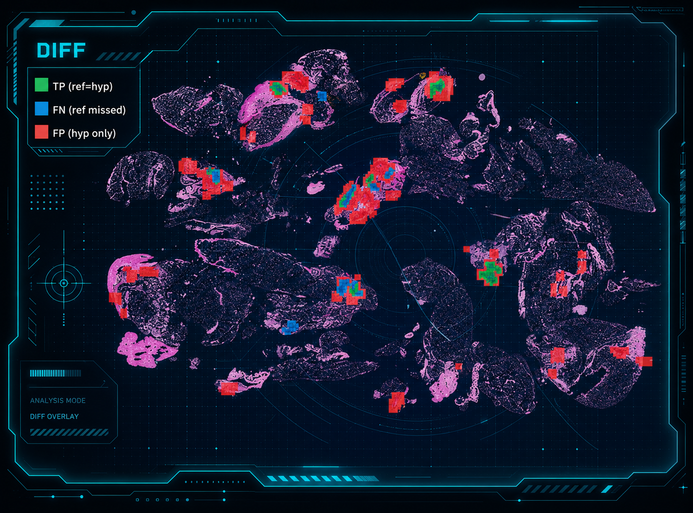

NEDC Discussion| July 03, 2026
The NEDC DPATH Visualizer
Seeing model predictions on the slide — ground truth, prediction, and error briefly
Md Abdullah Al Mamun
The Neural Engineering Data Consortium
Temple University, Philadelphia, PA

Slide 2
Scores tell you how much — not where
The problem
MDICE / F1 collapse a whole slide into one number.
They can't show WHERE a model is right, misses a lesion, or raises a false alarm.
Pathology is spatial — reviewers and clinicians think in regions on the tissue.
The tool
Renders annotation / prediction CSVs directly over the whole-slide thumbnail.
One command turns a decode output into a figure you can read.
Ground truth, prediction, or a direct comparison — with per-class colors.
Where it helps
QA of human annotations before training.
Error analysis: see false positives vs missed regions.
Compare models side by side.
Publication-ready figures from the same pipeline outputs.

Slide 3
HOW IT WORKS: A thin CLI over a reusable rendering engine
WSI slide
.svs / .tif
whole-slide image
DPATHVisualizer
engine
thumbnail + overlay · params-driven
PNG figure
style: overlay | grid
mode: single | side-by-side | blend | diff
ref / hyp CSV
regions or per-frame labels
Design: a ~200-line codebase, command-line front end that loads the parameter file and calls nedc_dpath_viz_tools.DPATHVisualizer — the same class can be imported by any other program.
Inputs accept a single CSV, a .list, or a directory — ref/hyp are matched to each slide by basename, so batch rendering is automatic.
Follows NEDC house conventions: installed binary, .help / .usage, a versioned parameter file.

Slide 4
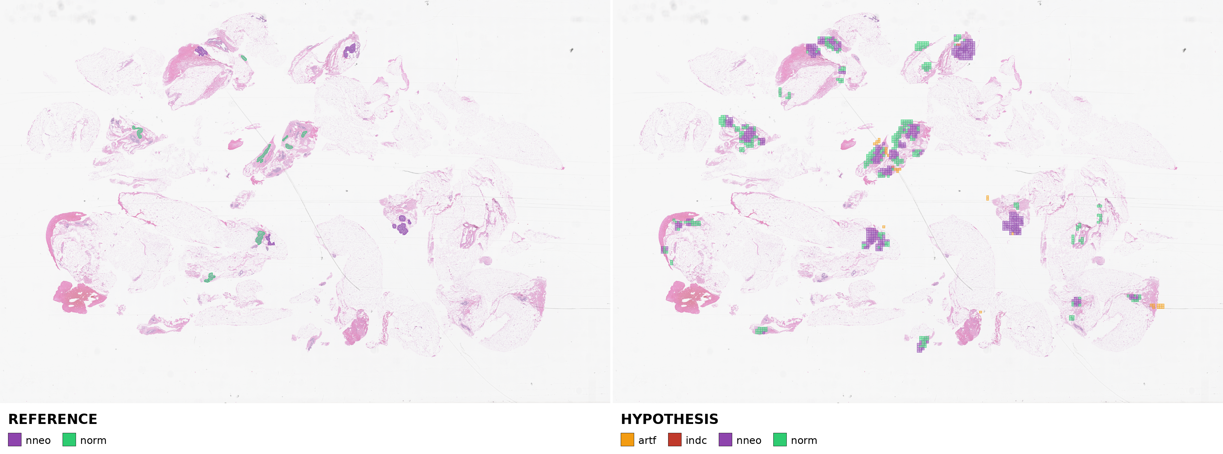
Side-by-side: ground truth vs. model prediction
Left — REFERENCE: pathologist regions drawn as smooth polygons. Right — HYPOTHESIS: the model's per-frame prediction grid.
Overlays sit on a lightened thumbnail, so tissue context stays visible; each class has a fixed clinical color with its own legend.

Slide 5
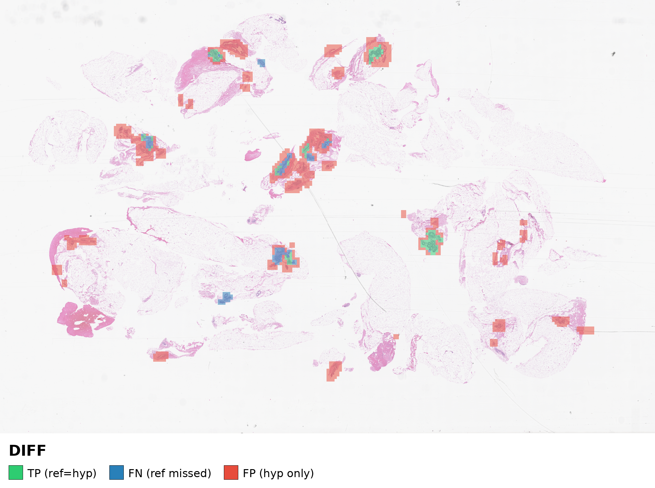
Diff mode: correct, missed, and false-alarm at a glance
Per-cell agreement
Green — true positive (model = reference)
Blue — false negative (reference region missed)
Red — false positive (predicted, not in reference)
Instantly separates 'misses' from 'false alarms' — the two errors a single score can never distinguish.

Slide 6
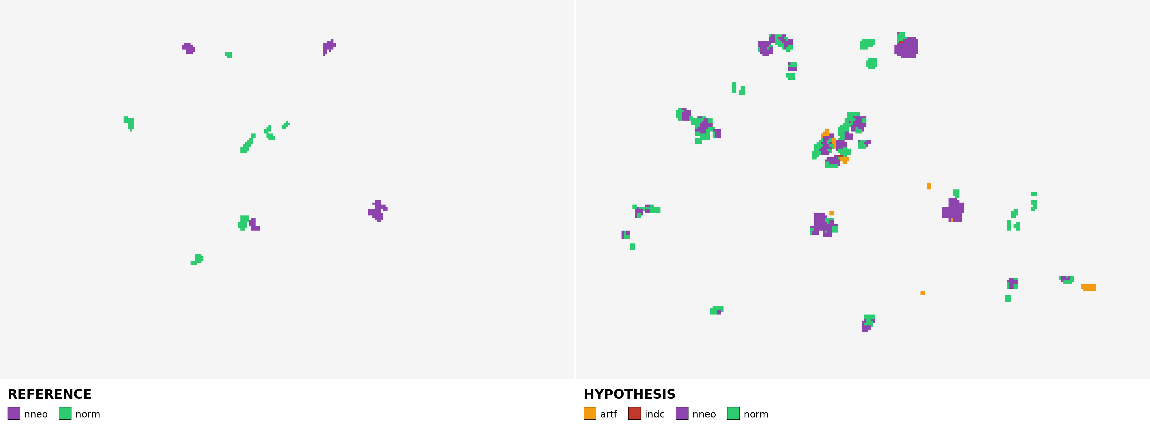
Grid style — the label map without the tissue
OVERLAY — previous examples
Regions on the tissue thumbnail — see WHERE a lesion sits in histological context. Best for pathologist review and figure panels.
GRID — this example
Pure frame-label heatmap, tissue removed — read the raw prediction map and spatial coverage, or when tissue texture clutters the labels.

Slide 7
Modes, styles, and per-class control
2 styles
overlay — regions over the slide thumbnail (see WHERE on tissue)
grid — pure frame-label heatmap, no background
Per-class visibility & color
Fixed clinical palette (dcis, indc, nneo, infl, norm, …).
show_classes = ["dcis","indc"] to focus on the target lesions only.
confidence_alpha — fade fills by model confidence for a true heatmap.
fill_alpha / dim — tune overlay opacity vs. tissue visibility.
Built for scale
thumb_max_size caps render resolution for fast, uniform figures.
Reads the same CSVs the decoder / post-processor emit — no conversion.
One .list renders a whole eval set to PNGs in a single call.
Everything set in one versioned .toml parameter file.
4 comparison modes
single — one source
side_by_side — ref | hyp panels
blend — hyp fills + ref outlines
diff — TP / FN / FP agreement

Slide 8
Three commands cover every workflow
Inspect ground truth
overlay the annotation on the slide
$ nedc_dpath_visualizer -r ref.csv image.svs
Compare a prediction
mode (side_by_side / blend / diff) is set in the params file
$ nedc_dpath_visualizer -r ref.csv -y hyp.csv image.svs
Batch a whole set
auto-matches ref/hyp to each slide by basename → one PNG each
$ nedc_dpath_visualizer -r ref_dir -y hyp_dir eval.list
Options: -p parameters -o output-dir -r reference -y hypothesis. Output: one <slide>.png per input.

Slide 9
Drop-in for software and pipelines
As a library
Import DPATHVisualizer from nedc_dpath_viz_tools and call render(wsi, ref, hyp, mode, style).
Returns a PIL image → embed in a GUI, a web service, or a report generator.
Configurable, not coded
Colors, modes, styles, opacity, and class filters all live in one .toml.
New color schemes or focus classes need no code change.
As a CLI stage
Reads decoder / post-processor CSVs directly — bolt on after decode with no glue code.
PNG-per-slide output drops into papers, dashboards, or QA folders.
NEDC-native
Installed as a standard binary with .help / .usage and a versioned param file.
Uses the shared NEDC image, file, and annotation libraries — consistent with the rest of the dpath toolset.

Slide 10
Summary
Turns any dpath annotation / prediction CSV into a readable figure on the slide.
Two styles (overlay / grid) and modes: single, side-by-side, blend, TP/FN/FP diff.
Params-driven, batch-ready, and importable as a class for other software.
Shipped v1.0.0 in the NEDC master tools, alongside post-proc and eval.

Slide 11
Thank you

