Slide 1
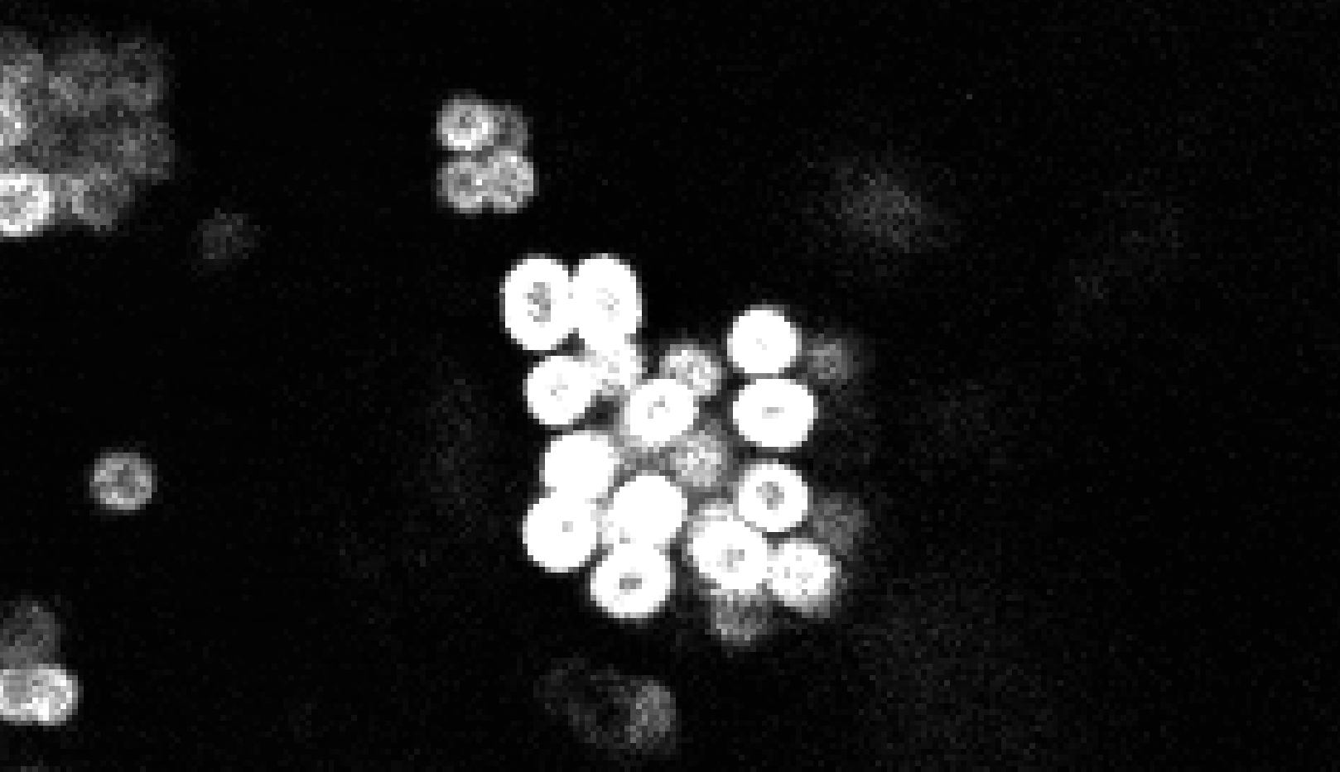
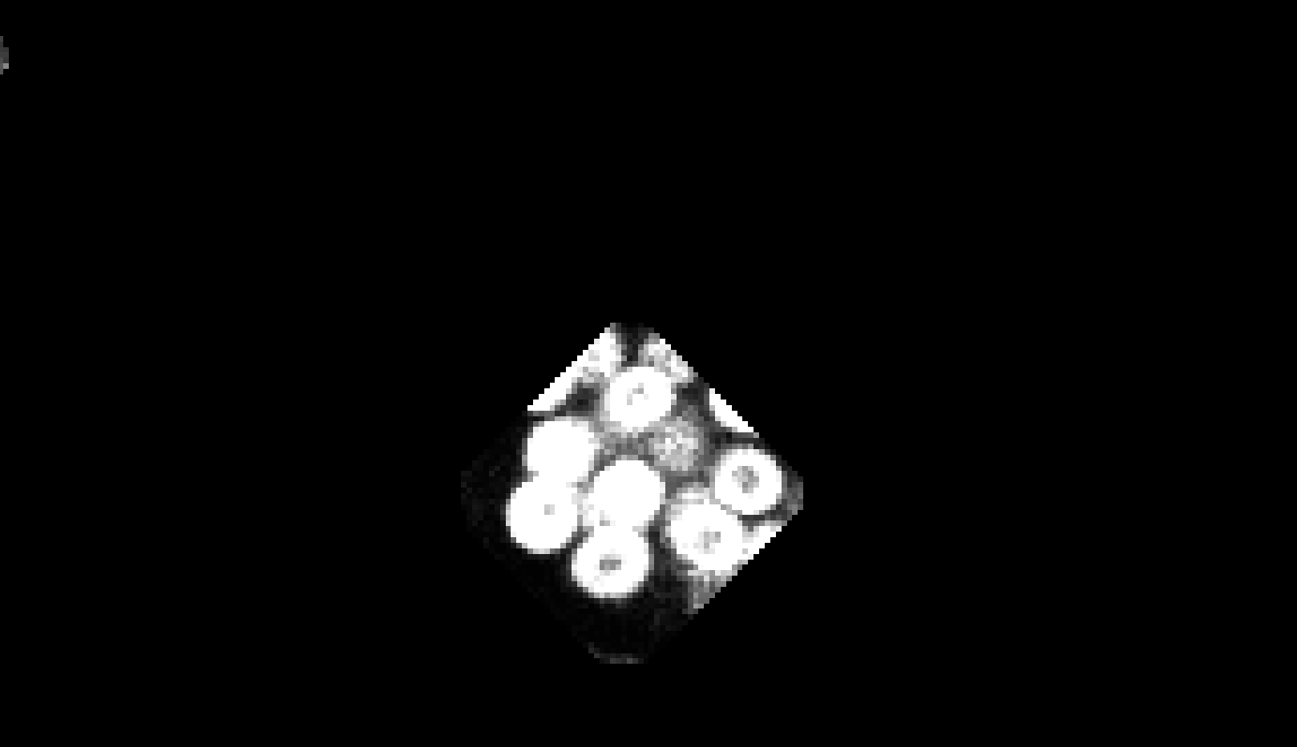
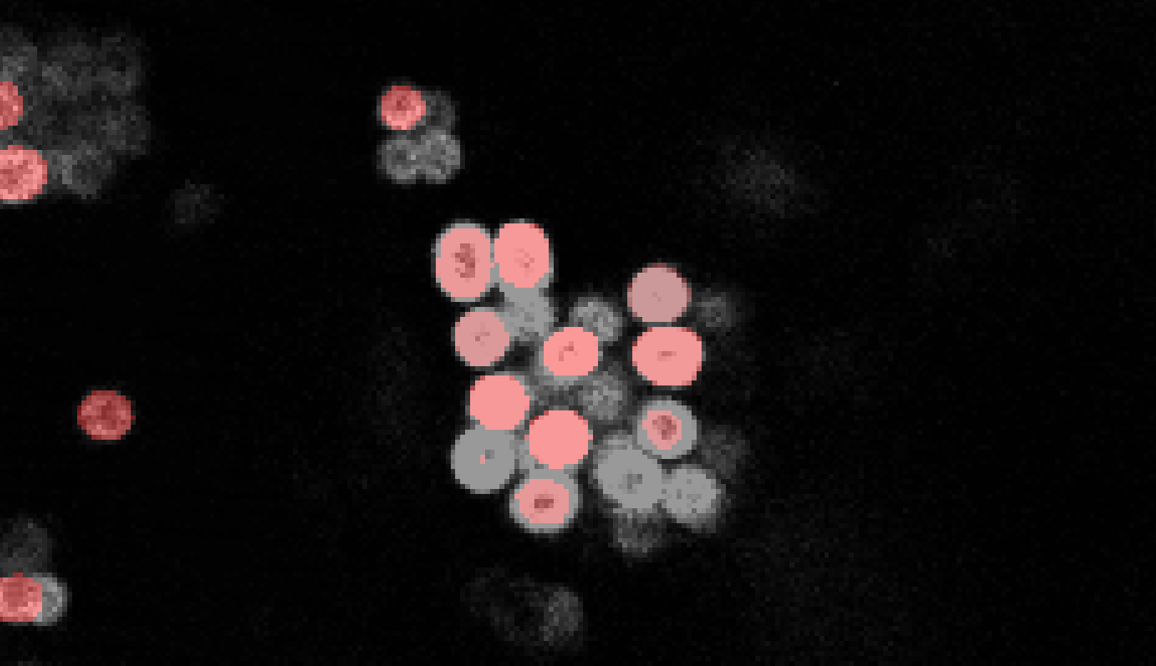
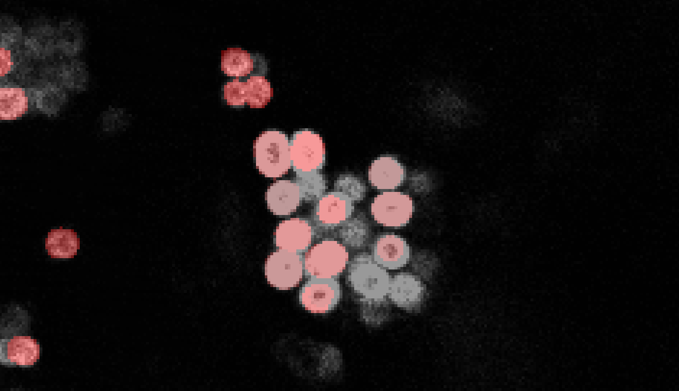
Original Image
s007a layer 95
Processed image
stardist4.3
stardist4

Slide 2



Original Image
s007a layer 95
Original Masks
stardist4.3
stardist4

Slide 3
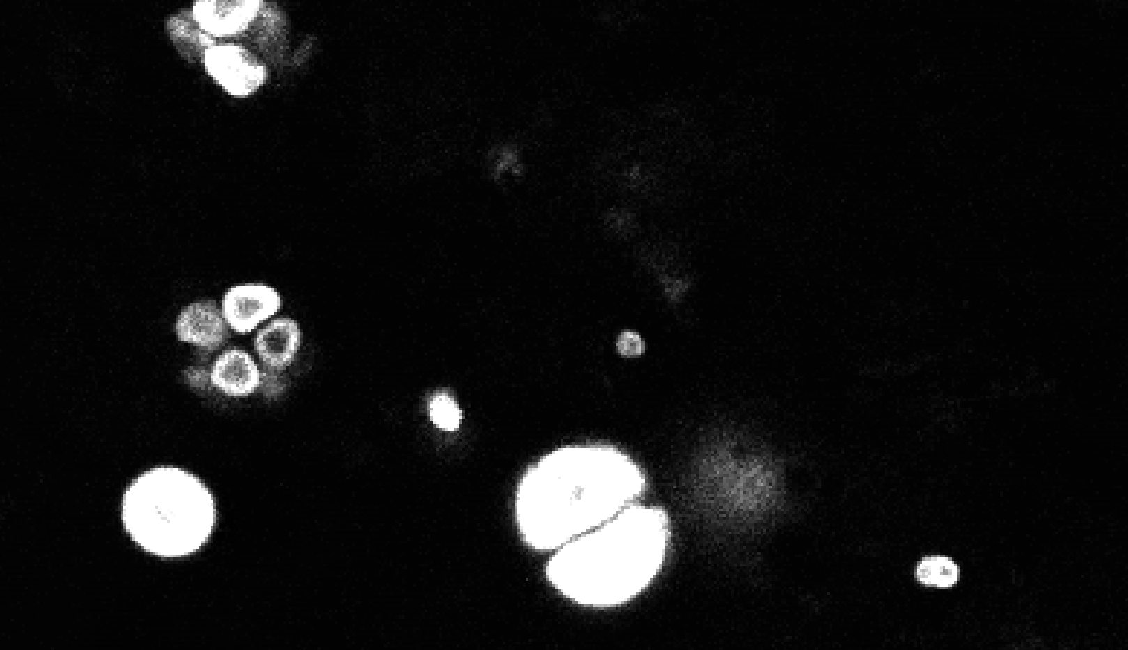



Original Image
s011 layer 25
Original Masks
stardist4.3
stardist4

