Slide 1
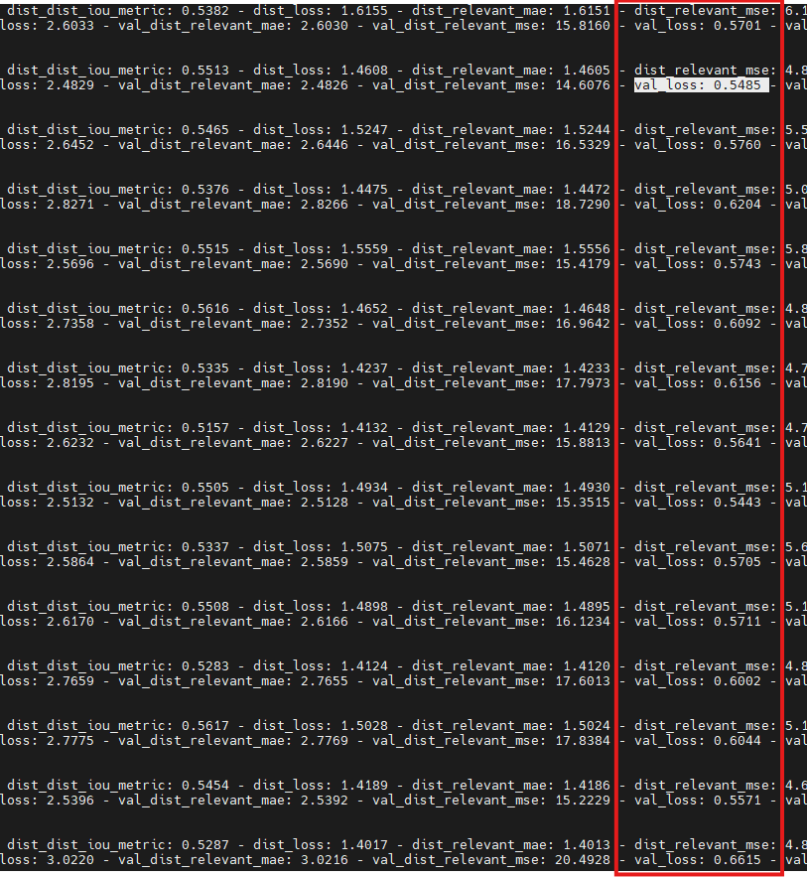
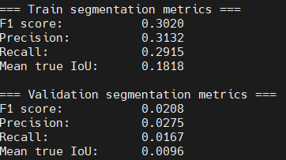
StarDist 4
Same parameters as before
Trained on 3 images, validated on 1
epoch 87
20262302 (DB): Initial Version
epoch100

Slide 2

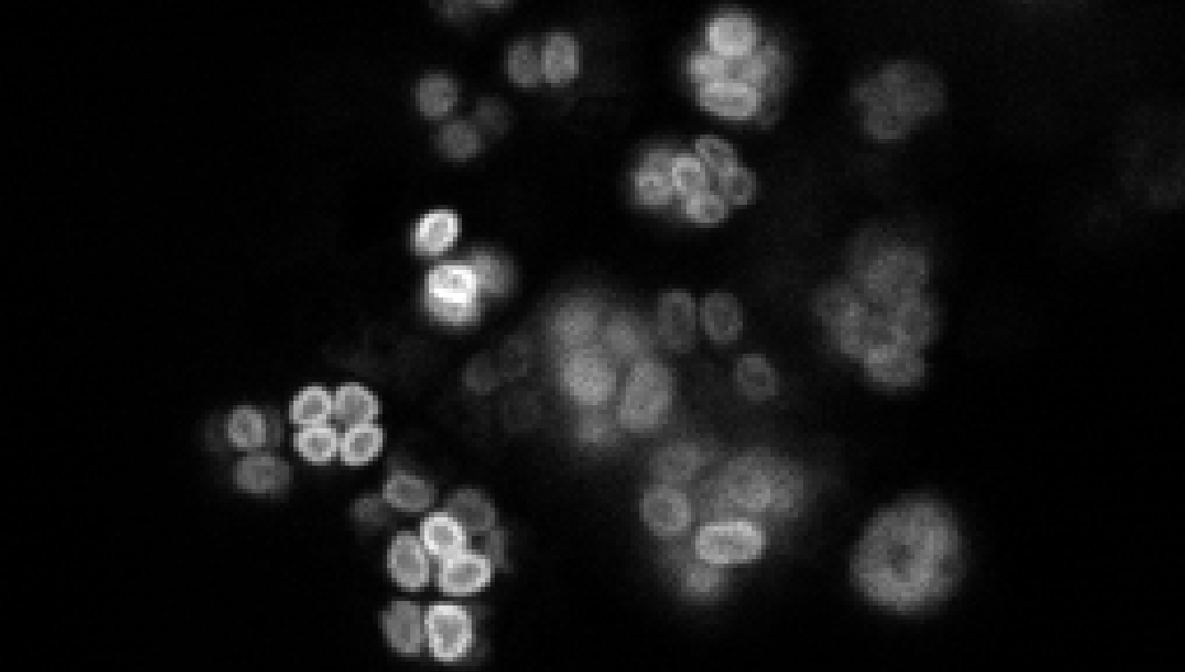
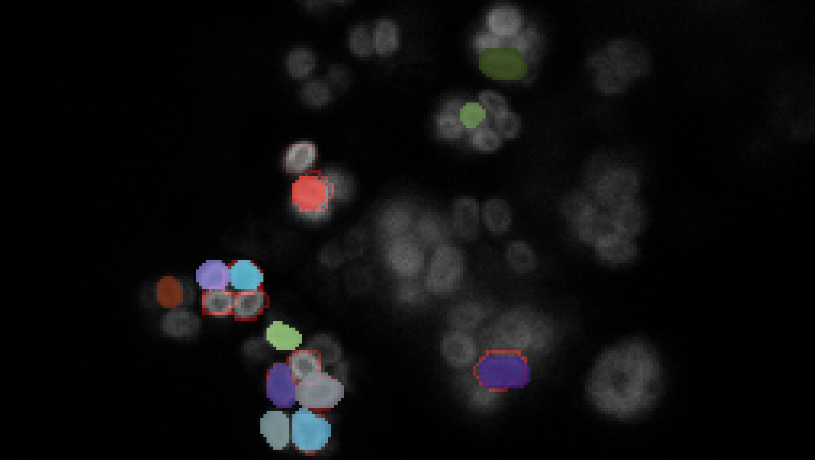
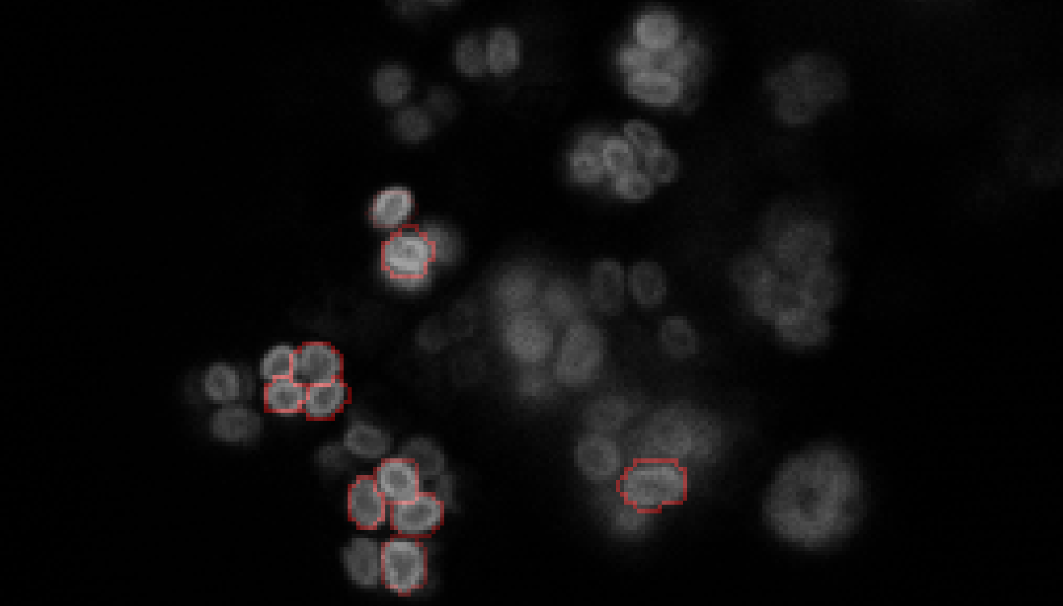
Annotation
Image 071 layer 125
Original Image
Annotation + Original + Prediction outline
Prediction +
Original

Slide 3

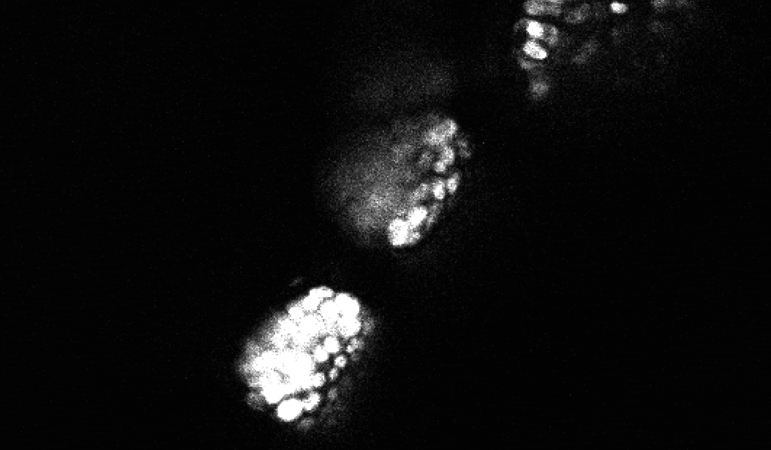
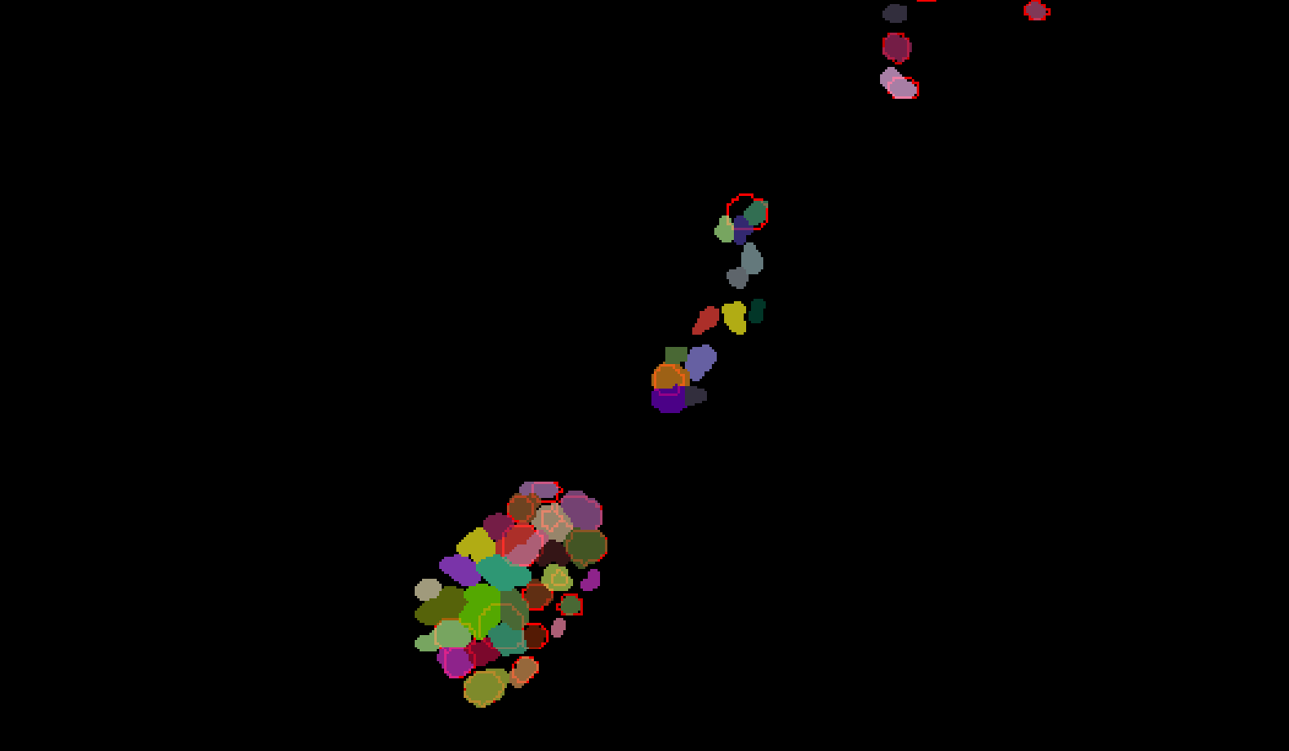
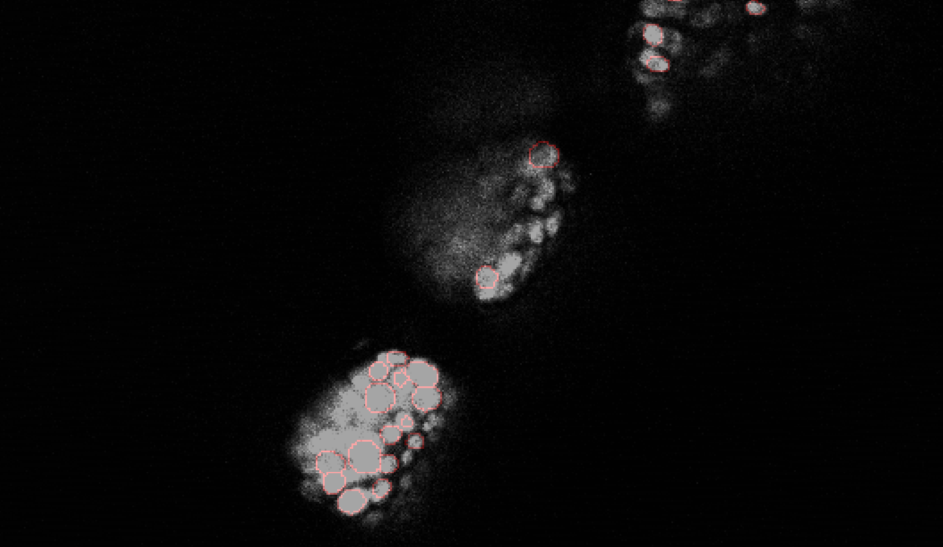
Annotation
Image 032 layer 120
Original Image
Annotation + Prediction outline
Prediction +
Original

