Slide 1
Configurations
Both models were trained on 3 images and validated on 1
Same parameters
Both used interpolated masks
stardist4 was trained on original images
stardist4PARTIALLY was trained on modified images that only had areas around masks

Slide 2
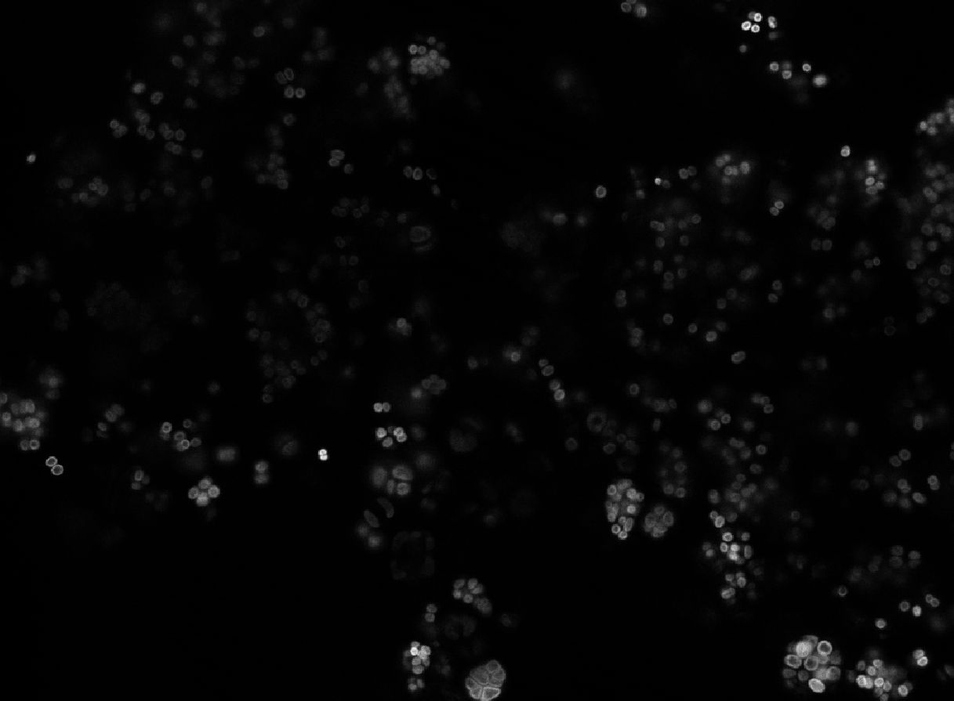
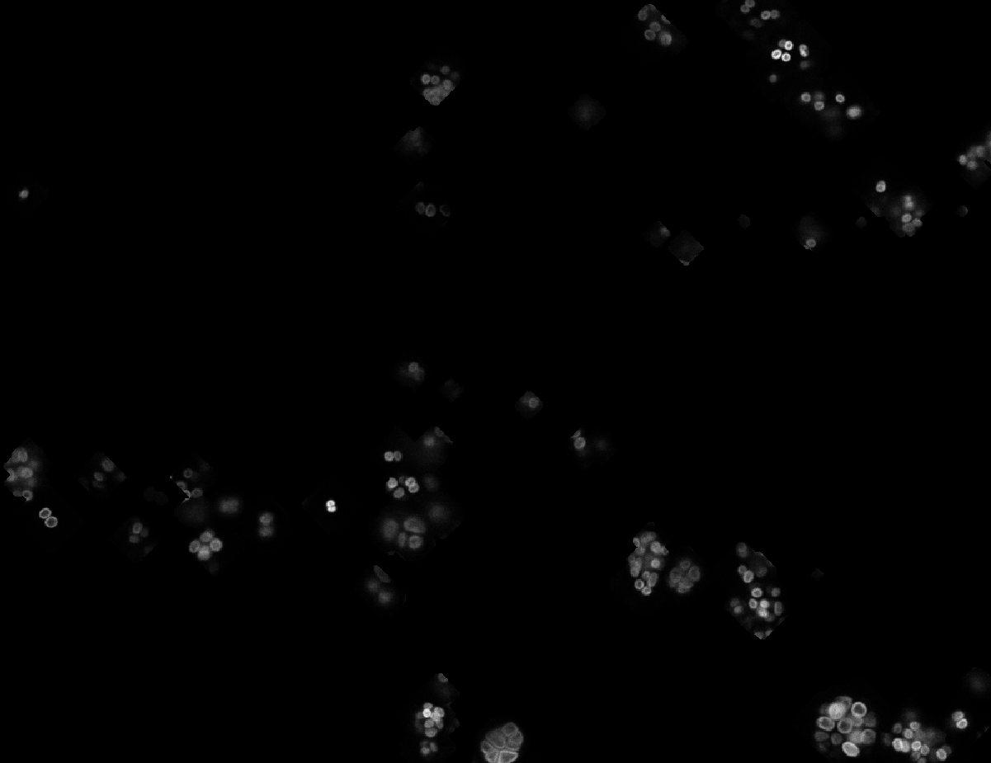
Original Image
Only annotated areas

Slide 3
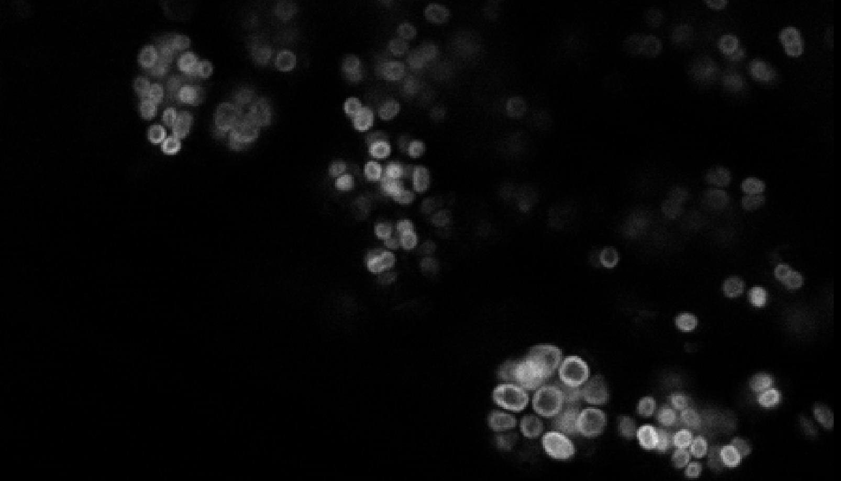
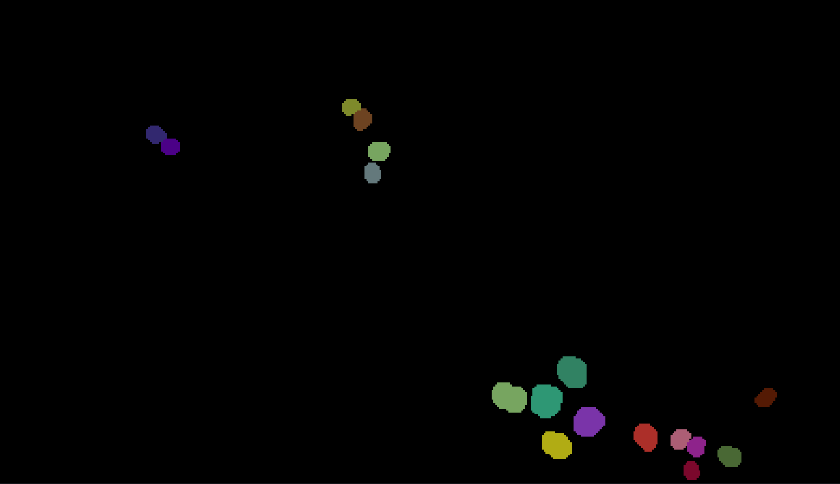
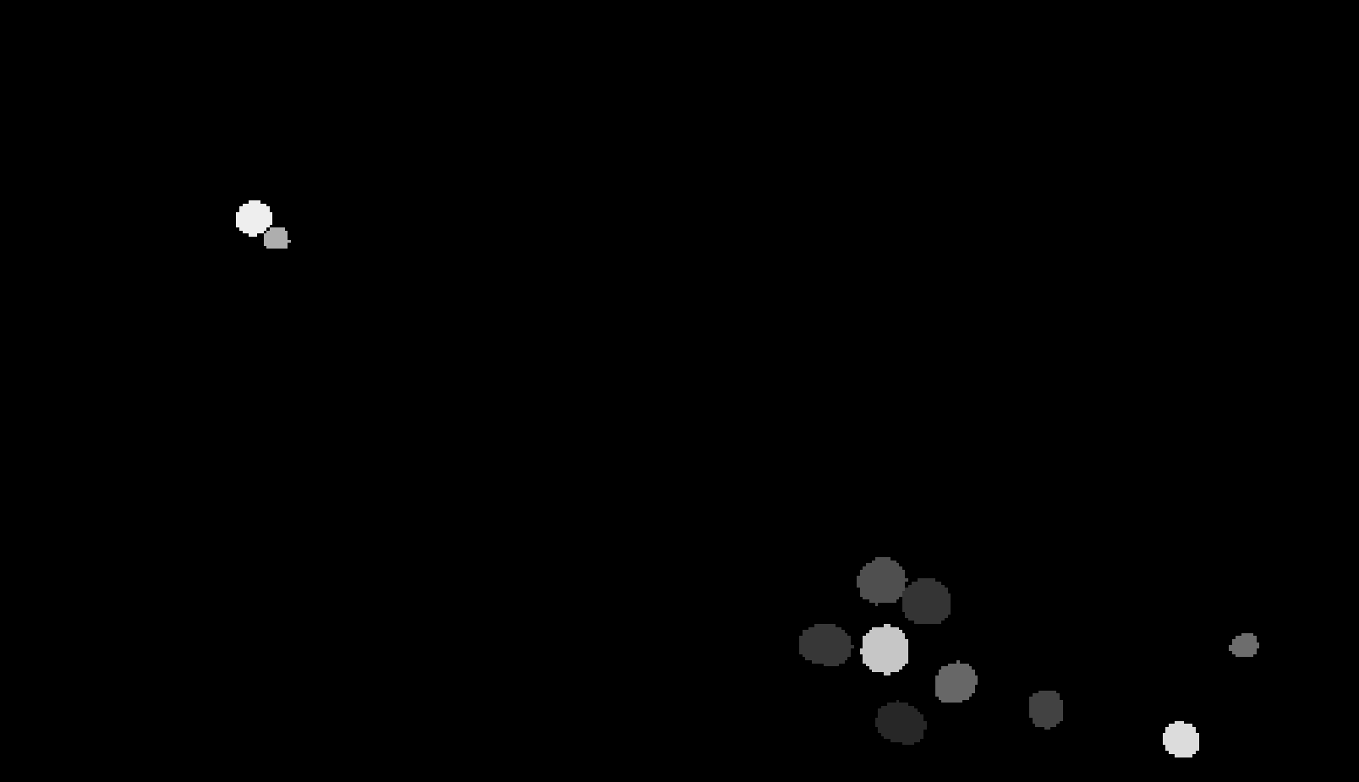
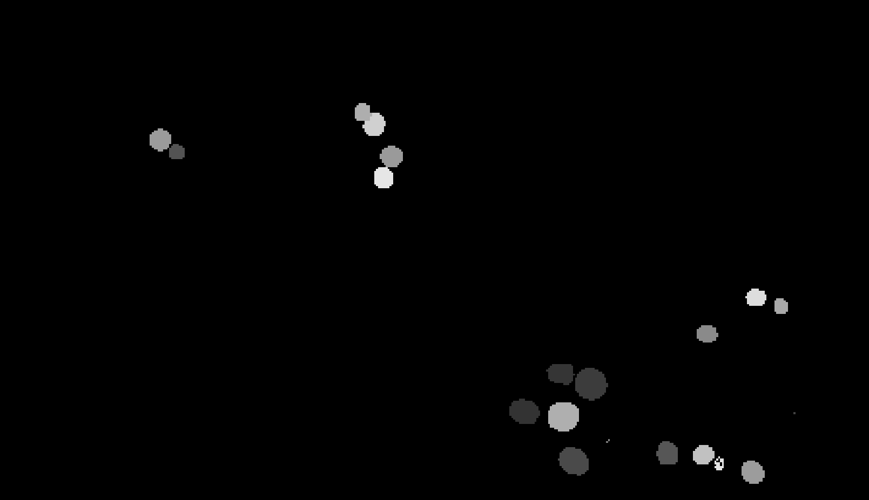
Original Image
s071 layer 70
Original Masks
stardist4 prediction
stardist4PARTIALLY
prediction

Slide 4
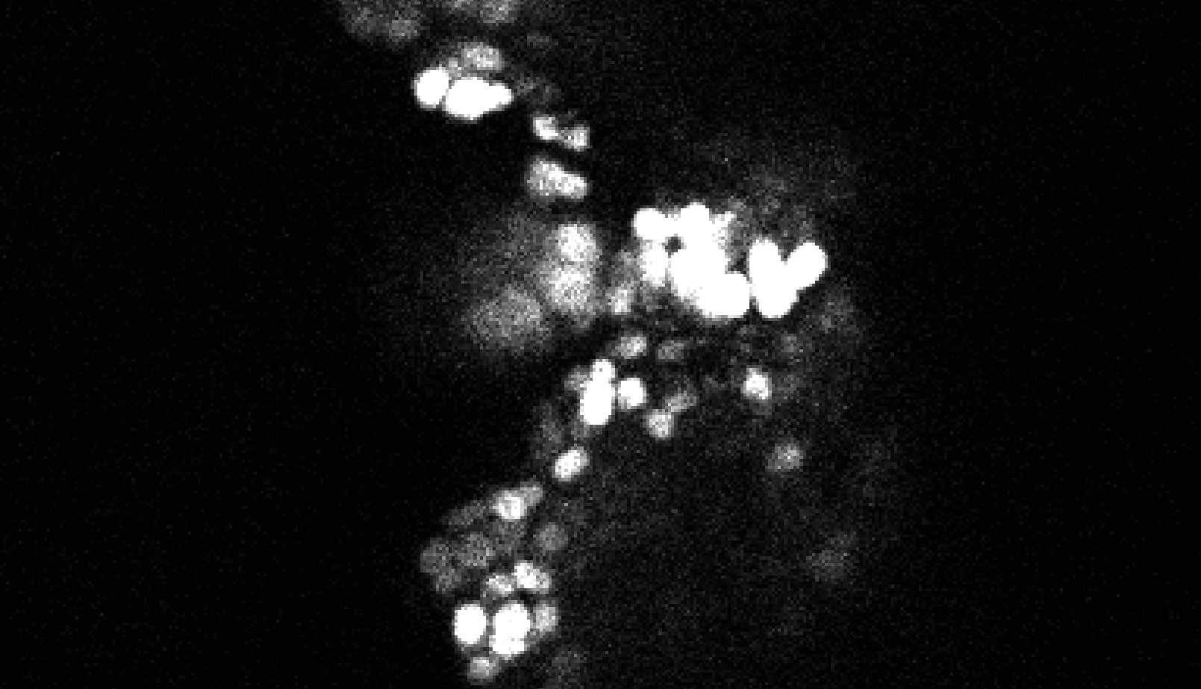
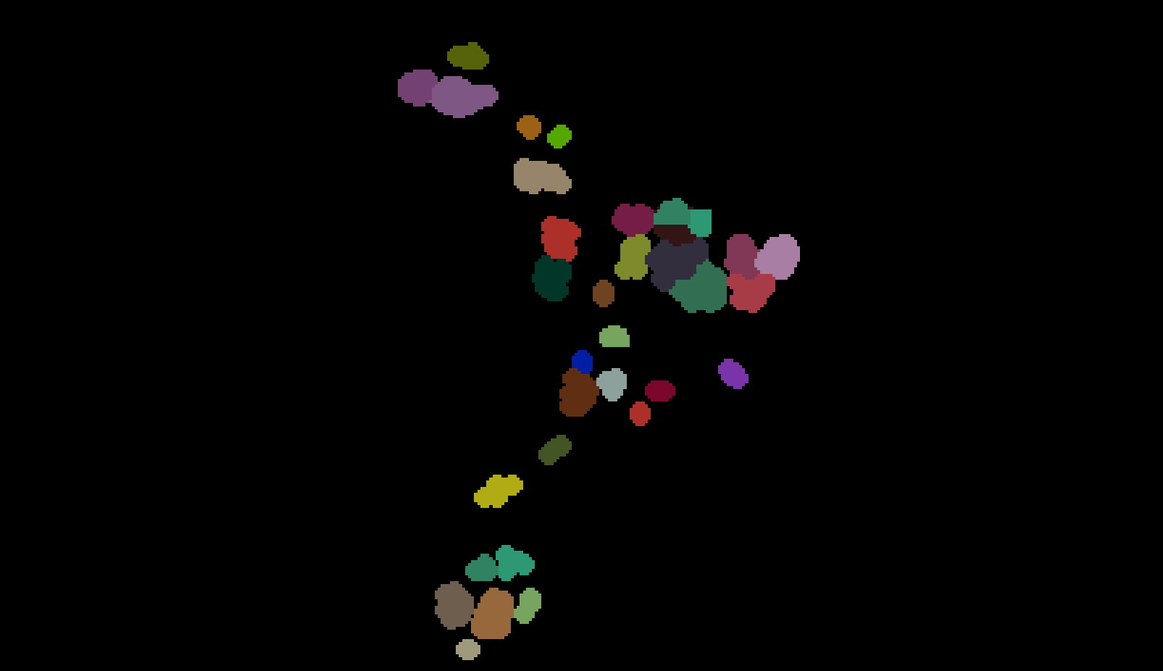
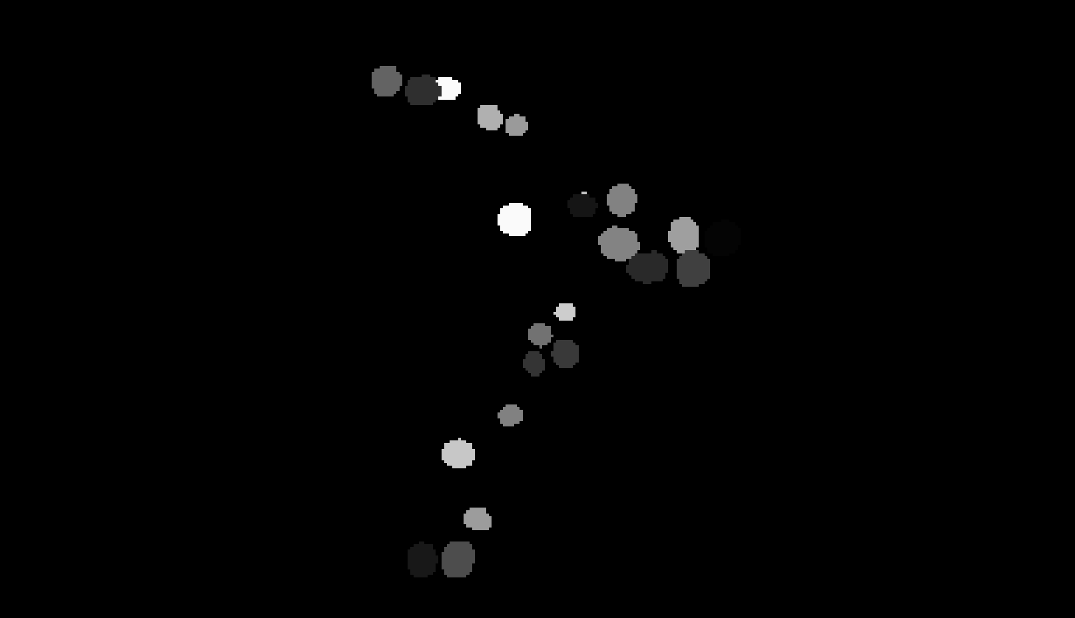
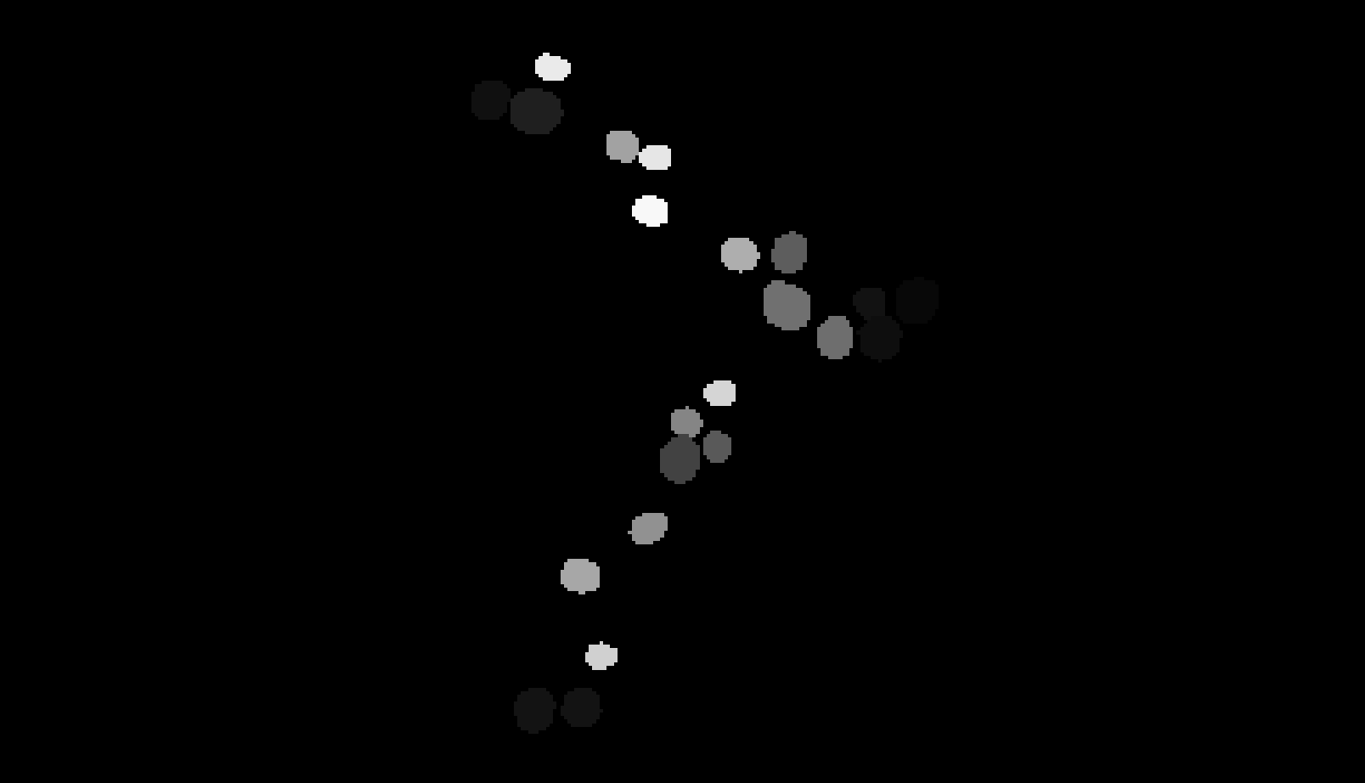
Original Image
s032 layer 45
Original Masks
stardist4PARTIALLY
prediction
stardist4 prediction

Slide 5
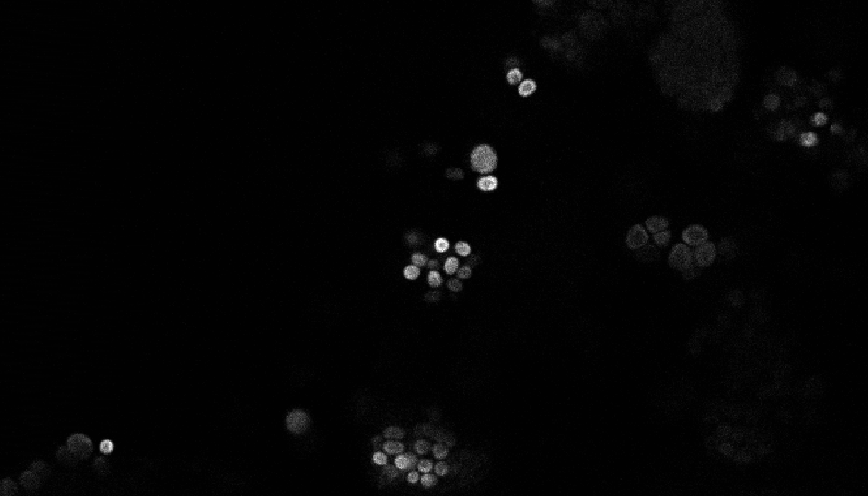
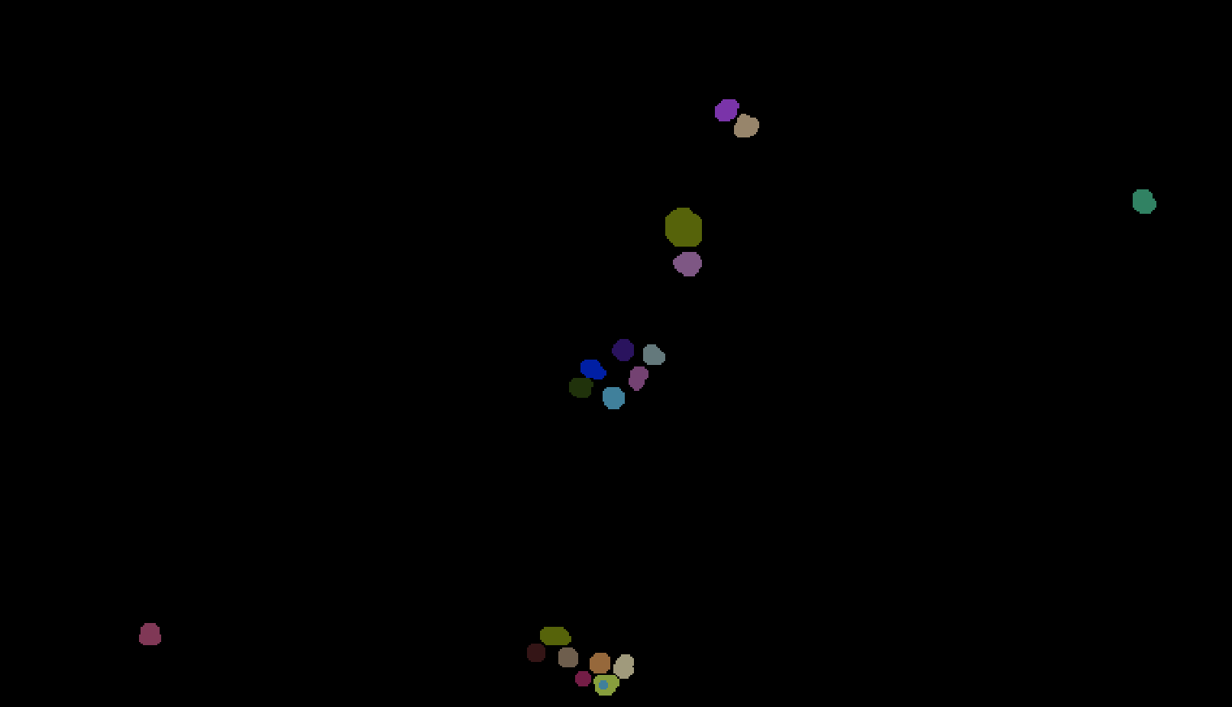
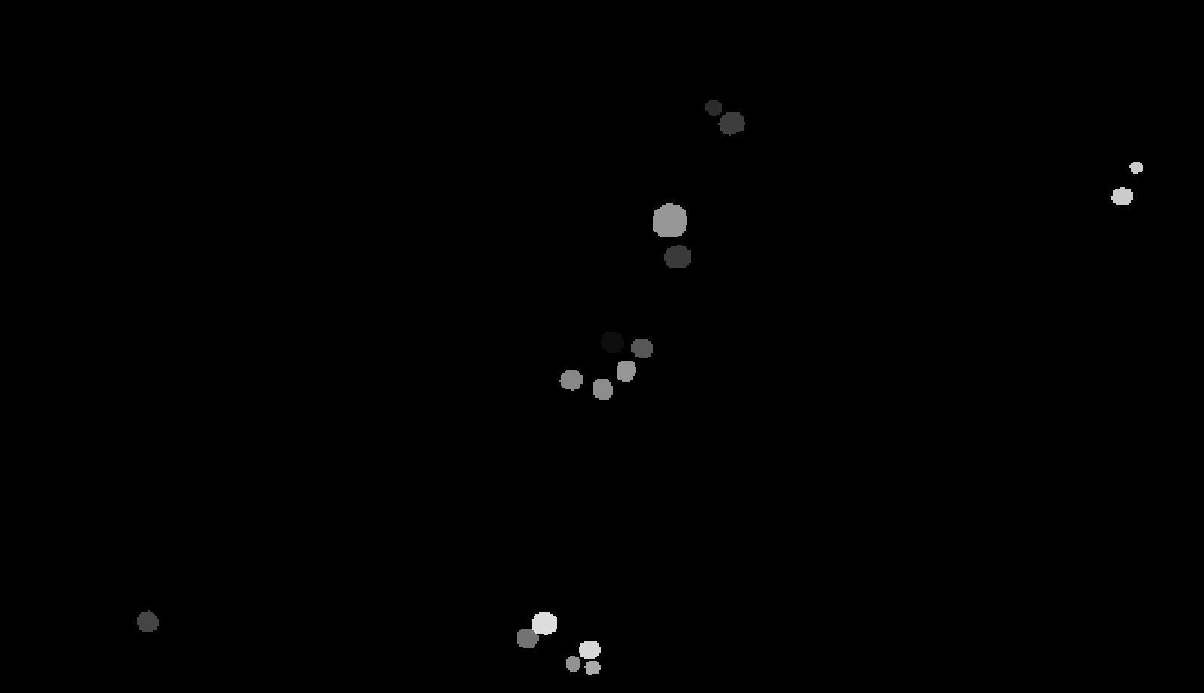
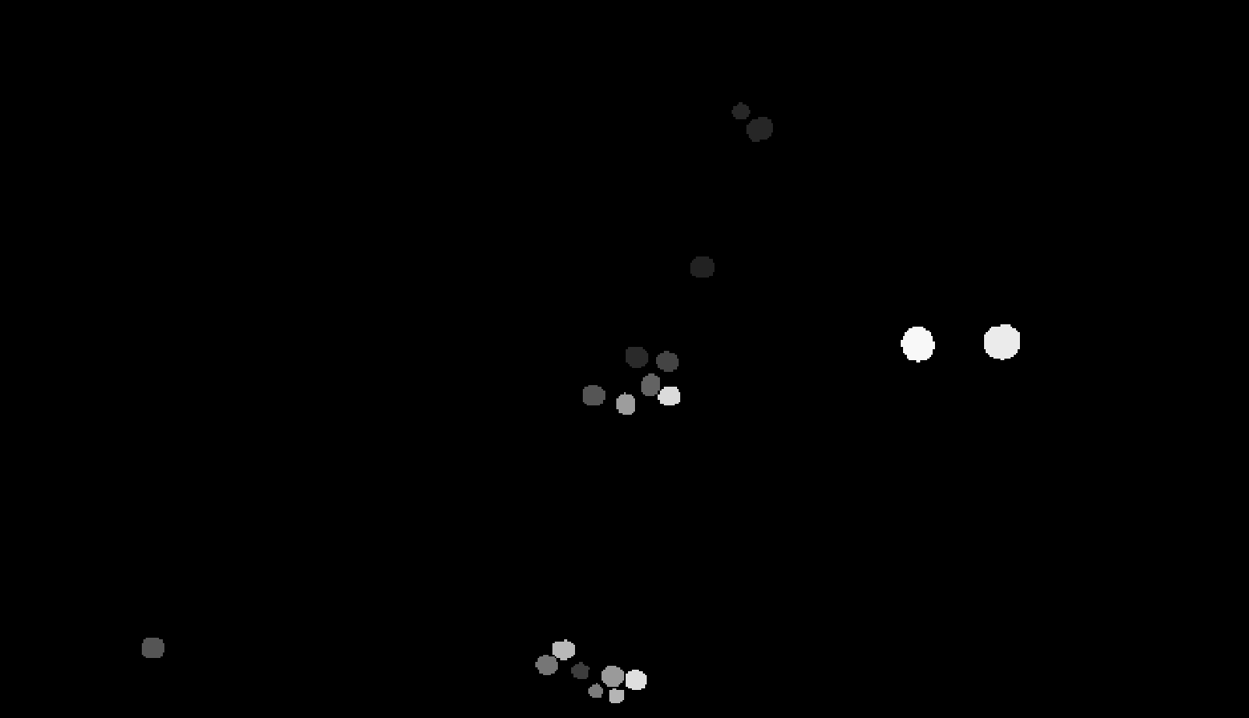
Original Image
s021 layer 30
Original Masks
stardist4PARTIALLY
prediction
stardist4 prediction

