Slide 1
Configurations
Trained on 2 images, validated on 1. Annotations were interpolated using nearest z-slice approach
training time: 30 epochs. Started overfitting after ~25th epoch
rays: 192
unet depth: 5
patch size: 96, 128, 128
batch size: 1
trained on gpu and cpu. Gpu took 19s/step vs 16s/step for CPU
20260802 (DB): Initial Version

Slide 2
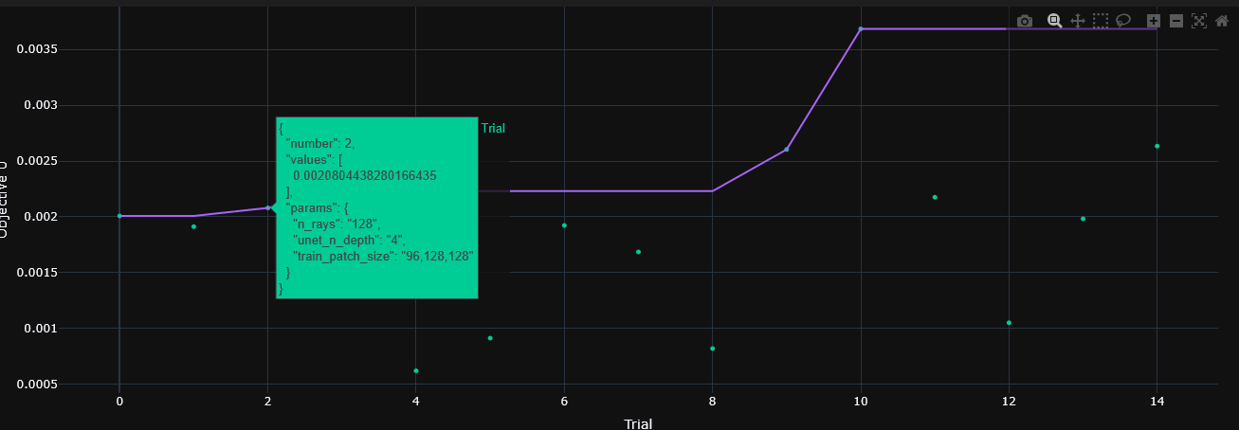
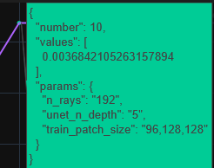
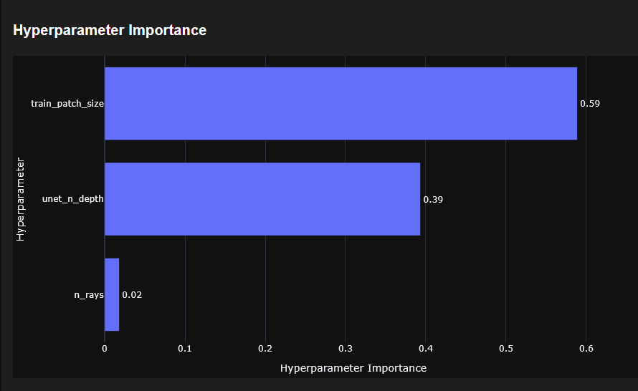
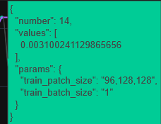
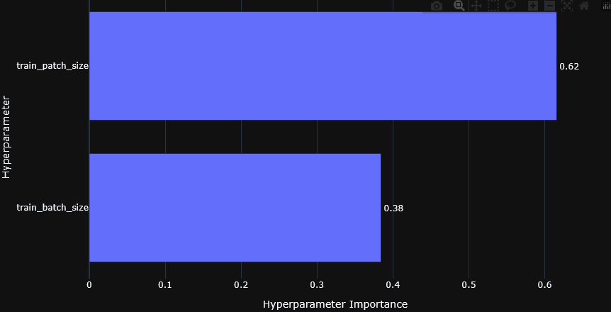
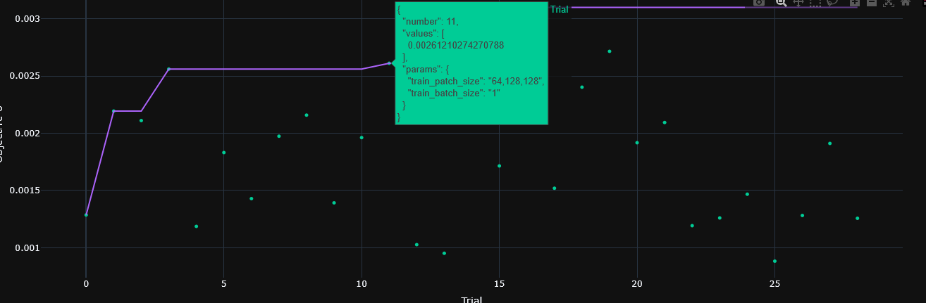
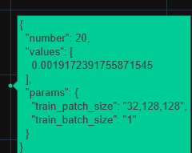
Hyperparameter tuning
Tuning 1
Tuning 2

Slide 3
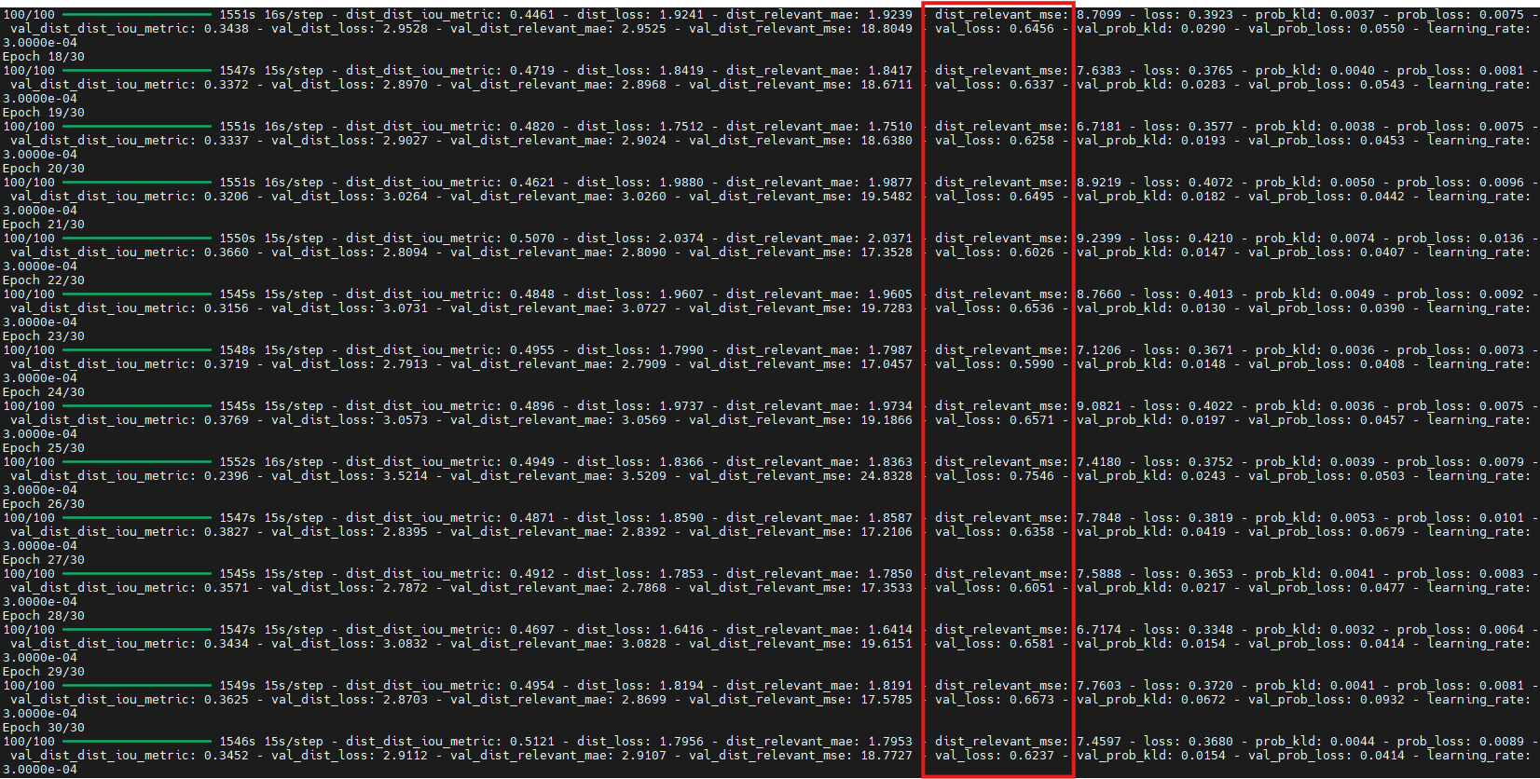
Early overfitting

Slide 4
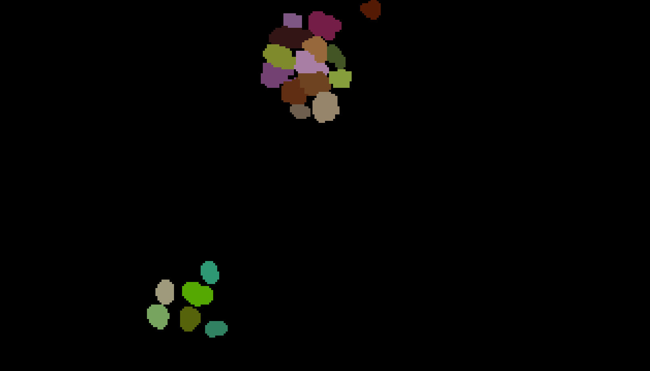
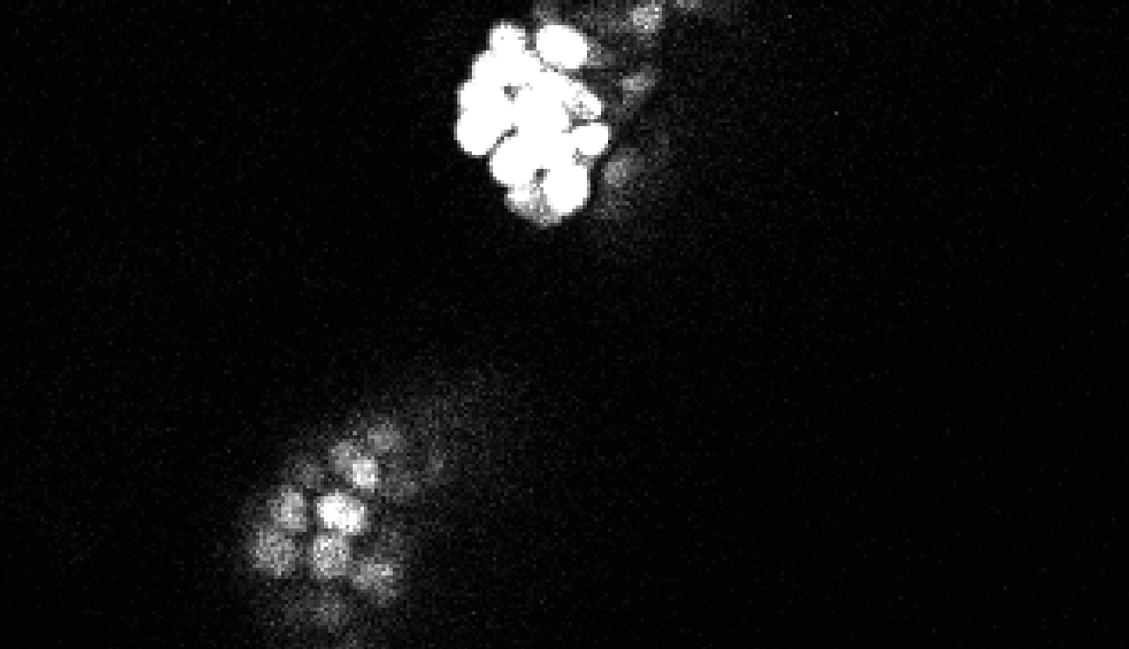
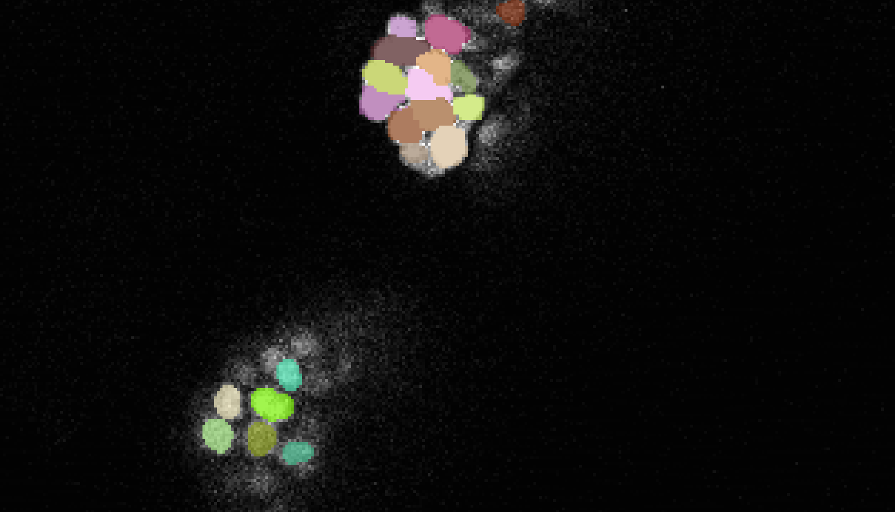
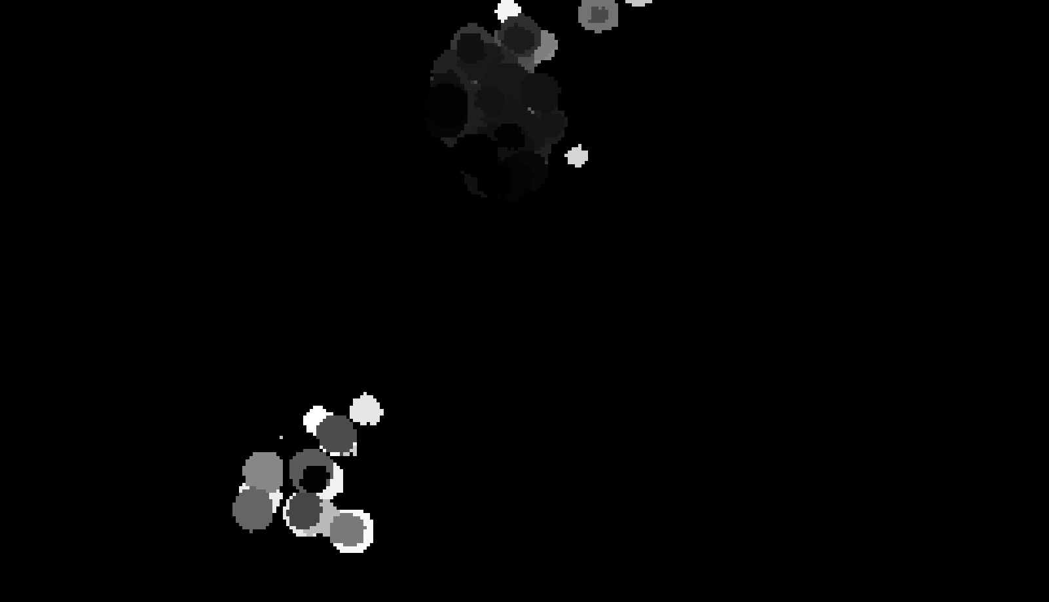
Annotation
Image 1 layer 75
Original Image
Annotation over original image
Prediction
(only CPU)

