Slide 1
Configurations
Trained on all 3 images, skipping validation step
training time: 200 epochs
rays: 128
grid: 1, 2, 2
unet depth: 4
patch size: 64, 128, 128
batch size: 1
data augmentation: flipped around yx axis, gaussian filter
20262601 (DB): Initial Version

Slide 2
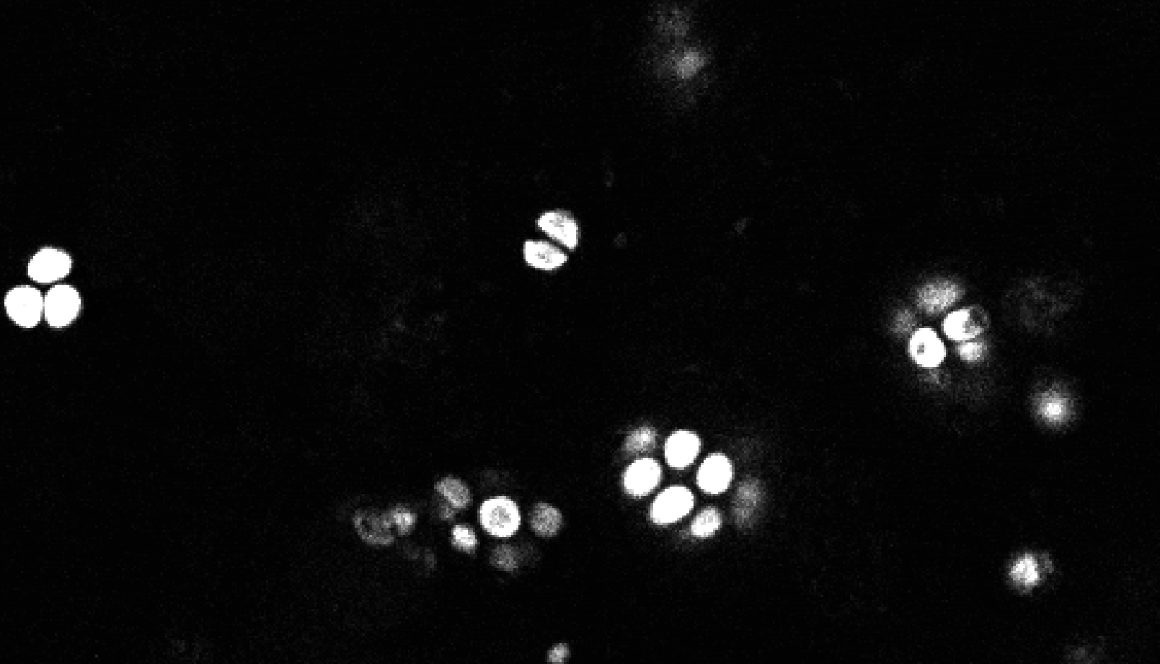
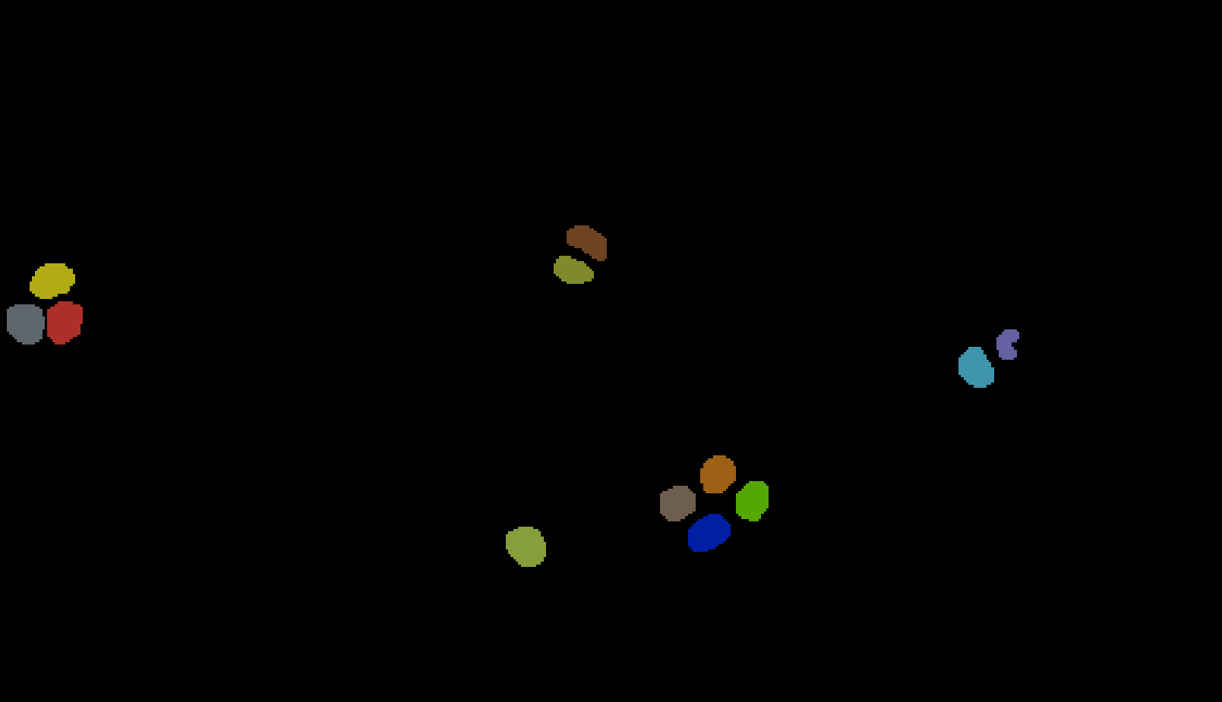
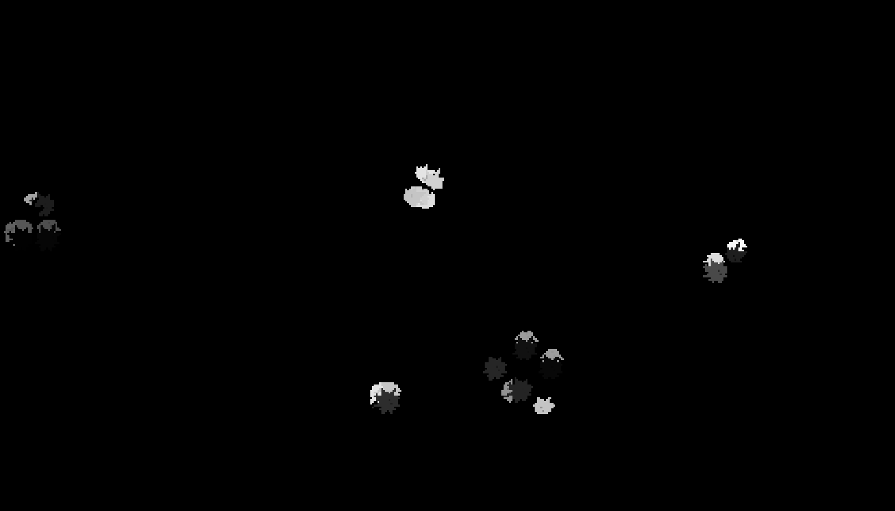
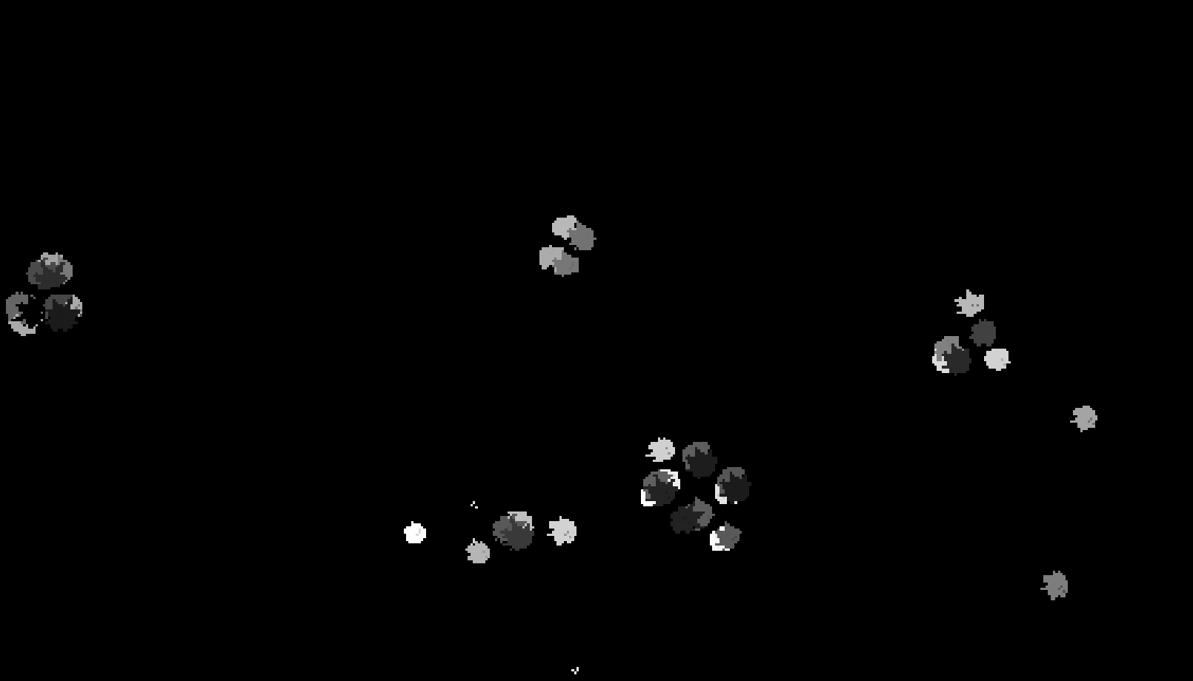
Original Image 1
Layer 20
Annotated Image 1
Layer 20
GPU
CPU

Slide 3
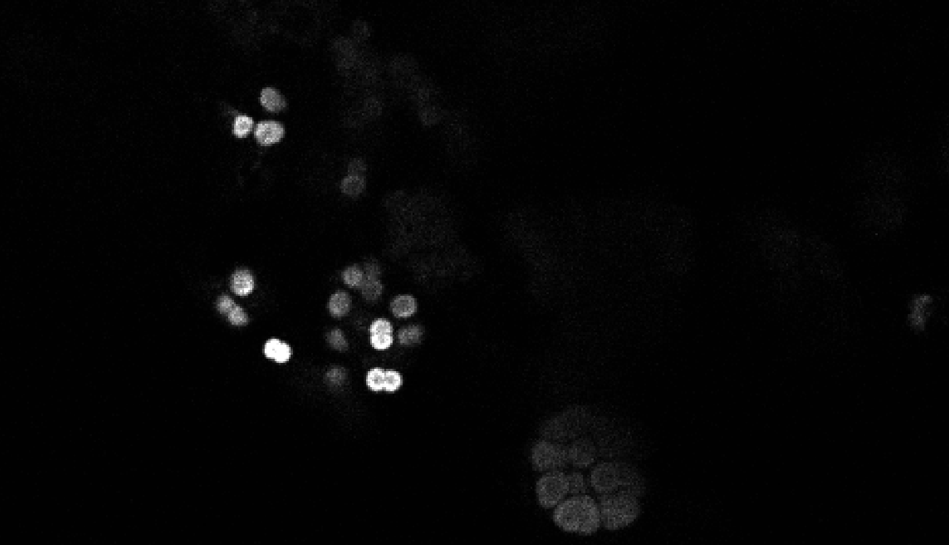
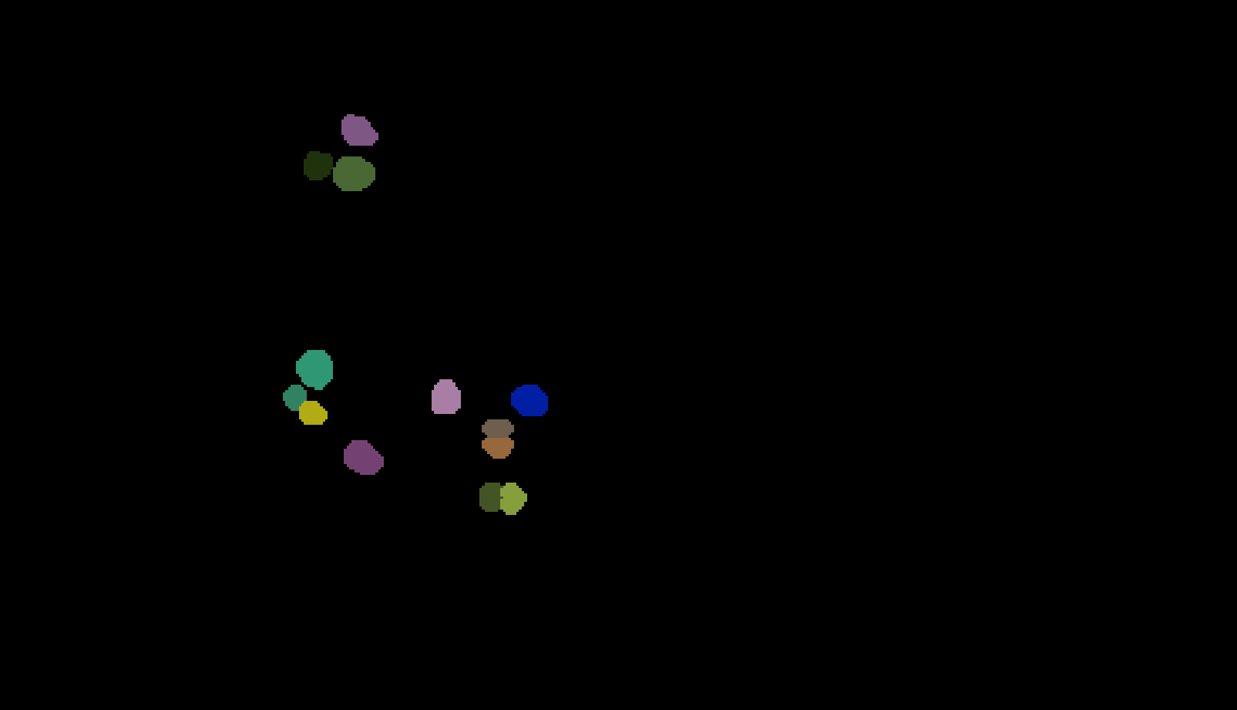
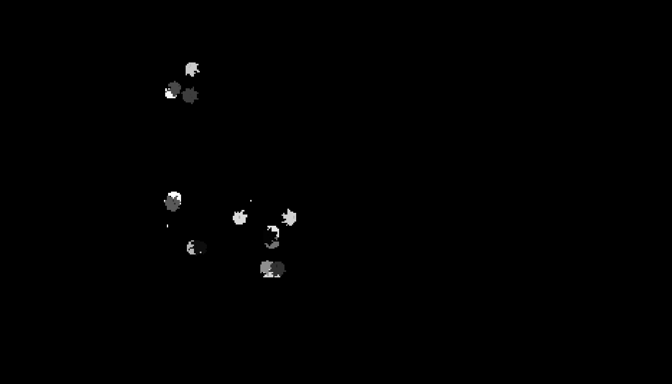
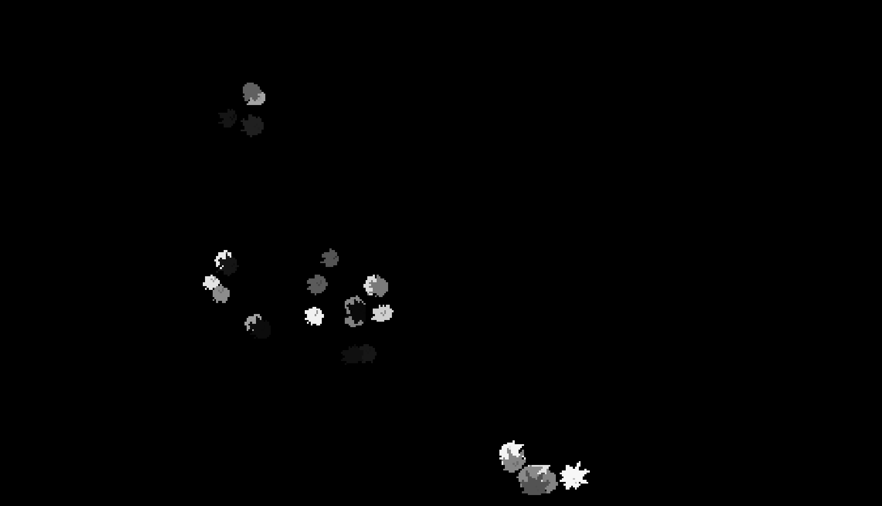
Original Image 2
Layer 10
Annotated Image 2
Layer 10
CPU
GPU

Slide 4
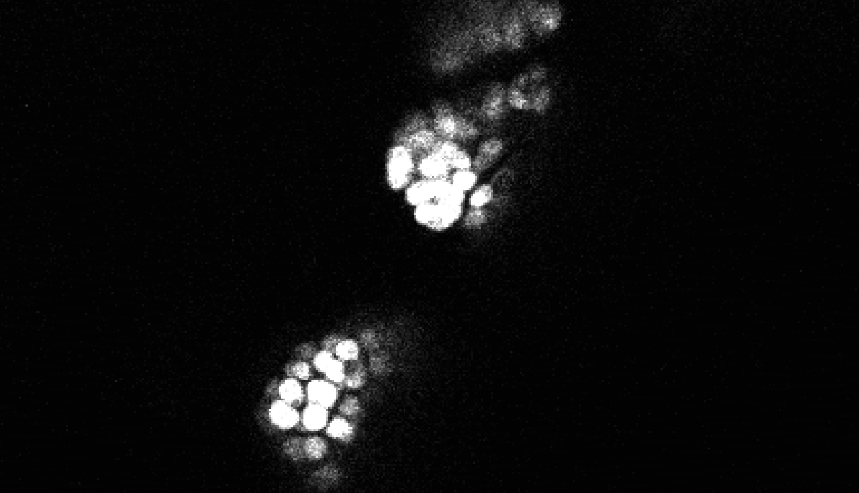

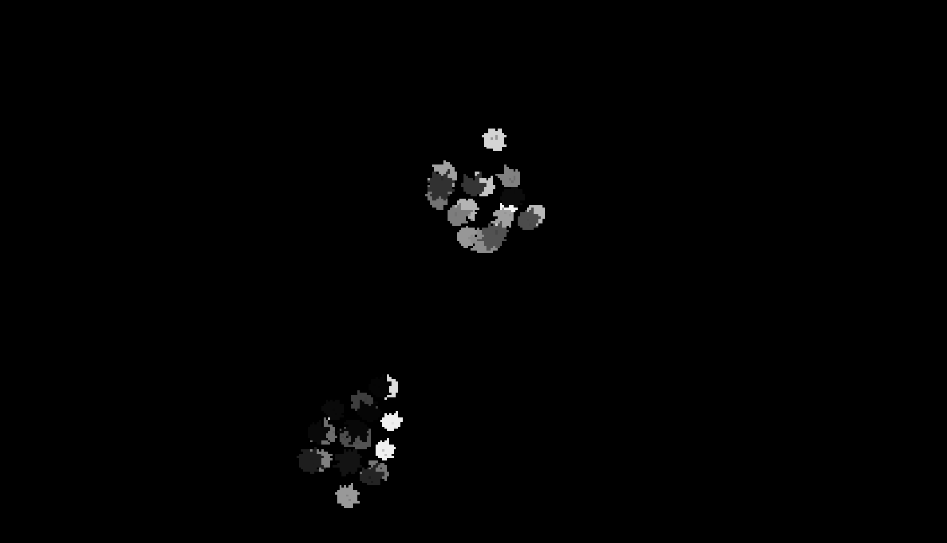
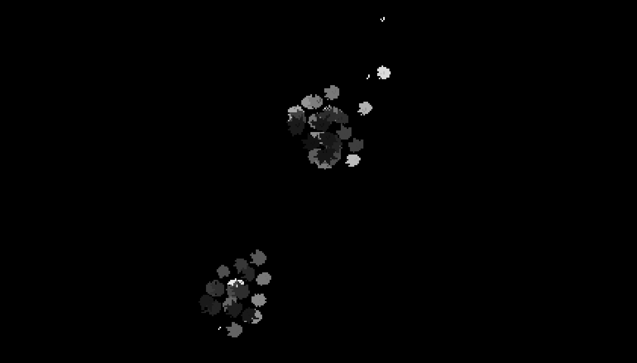
Original Image 3
Layer 85
Annotated Image 3
Layer 85
CPU
GPU

