Slide 1
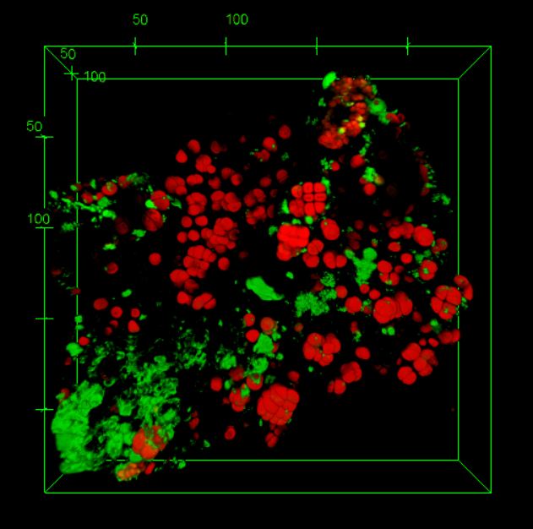
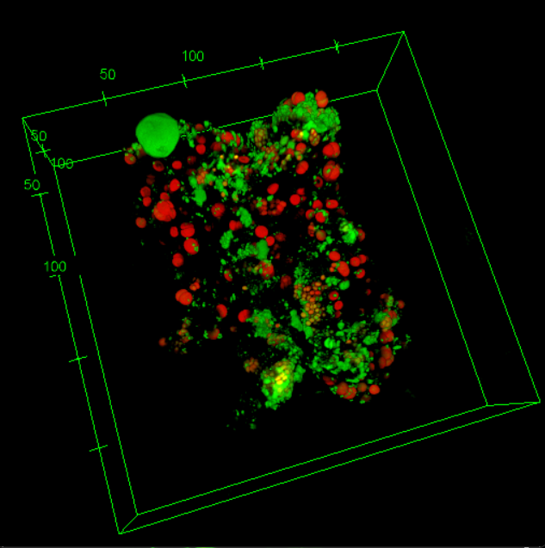
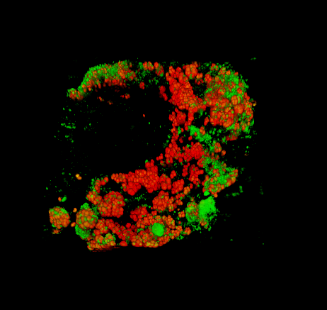
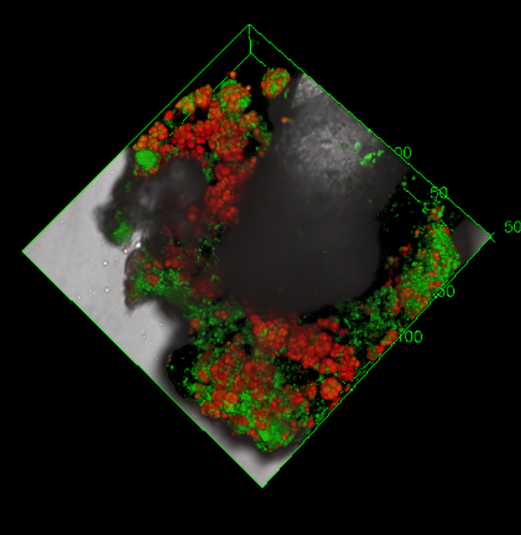
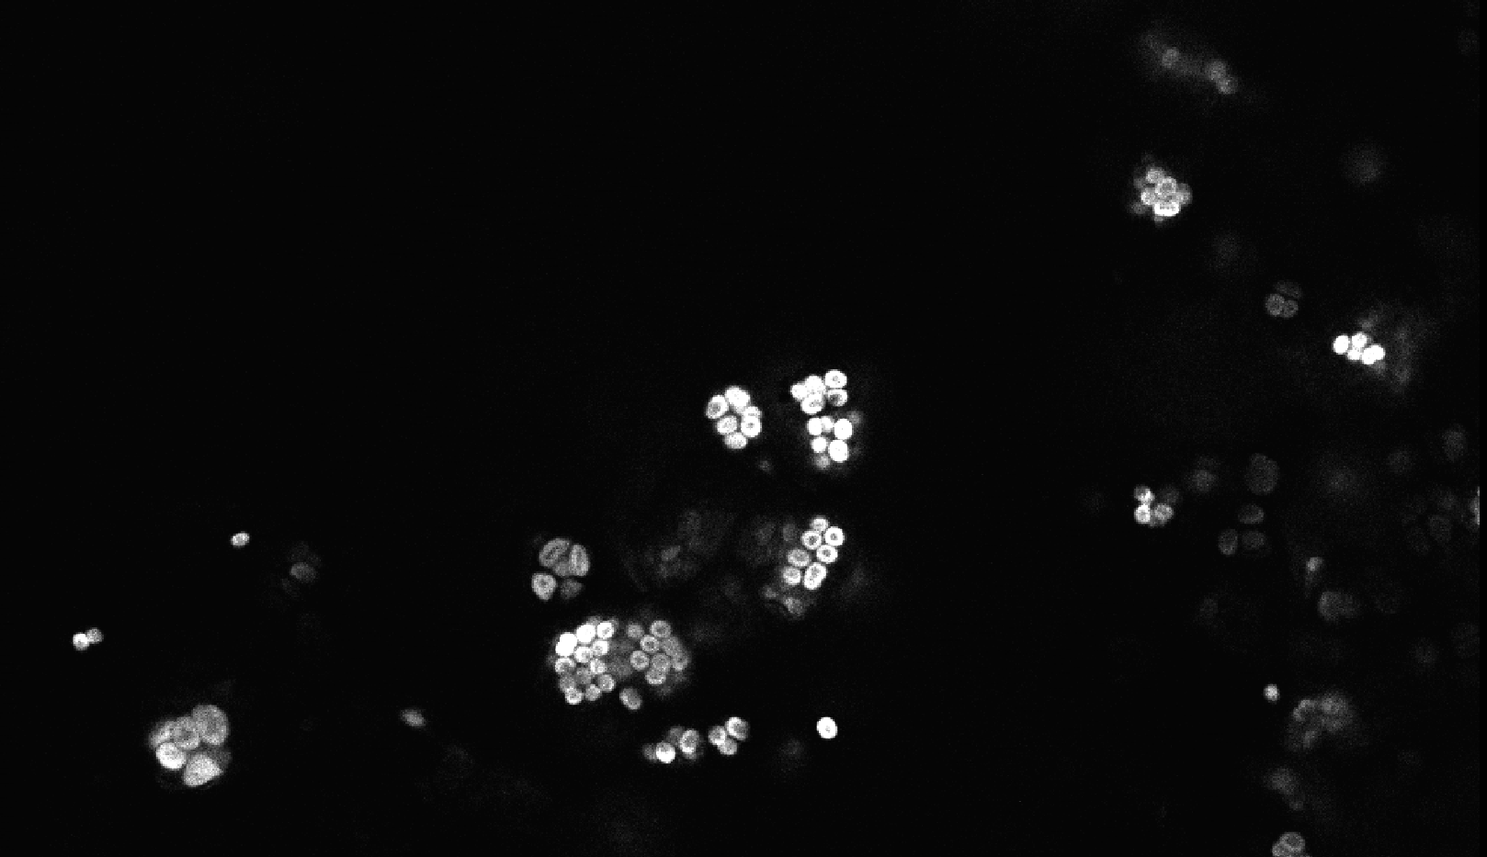
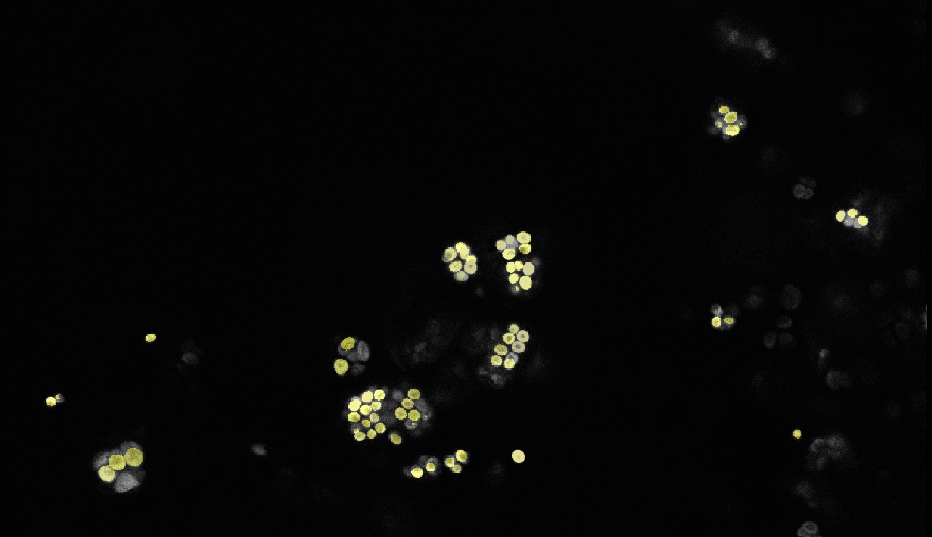
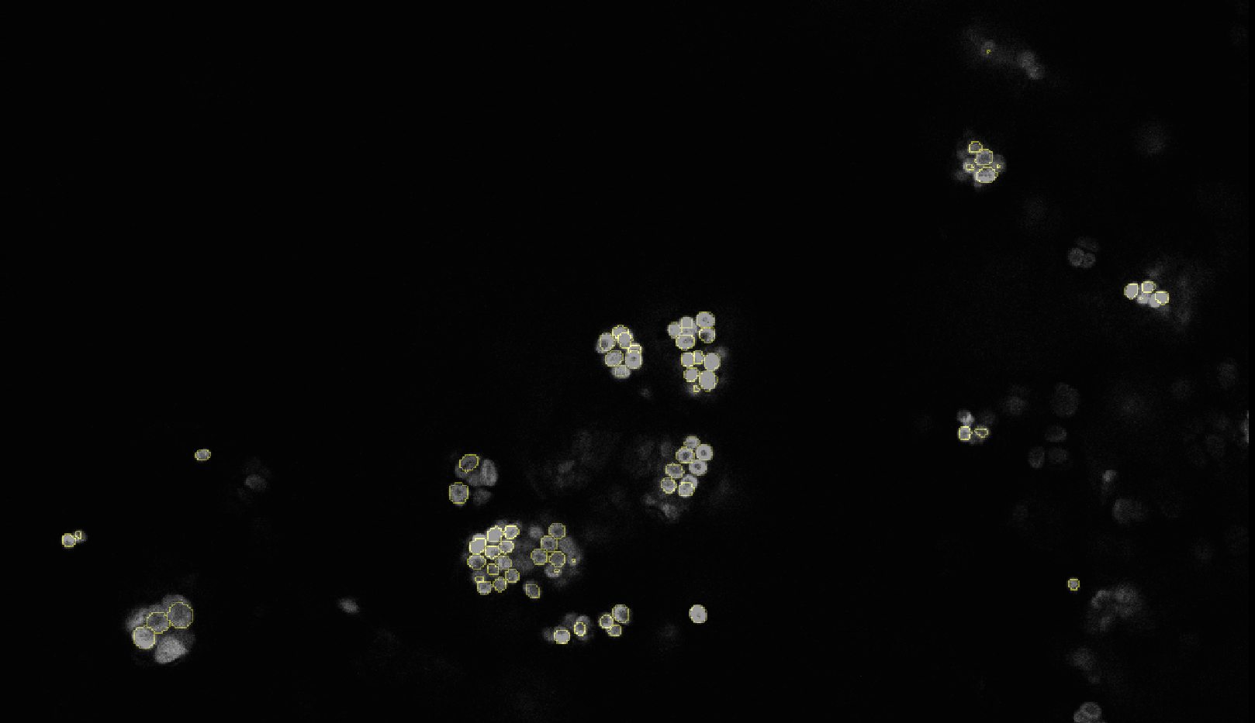
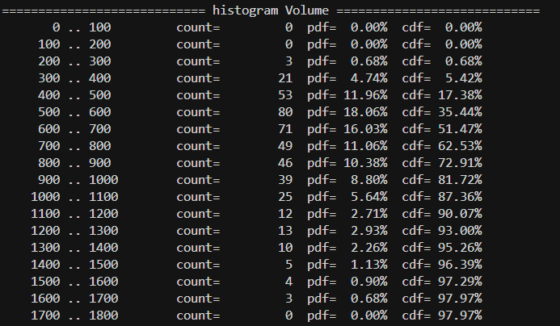
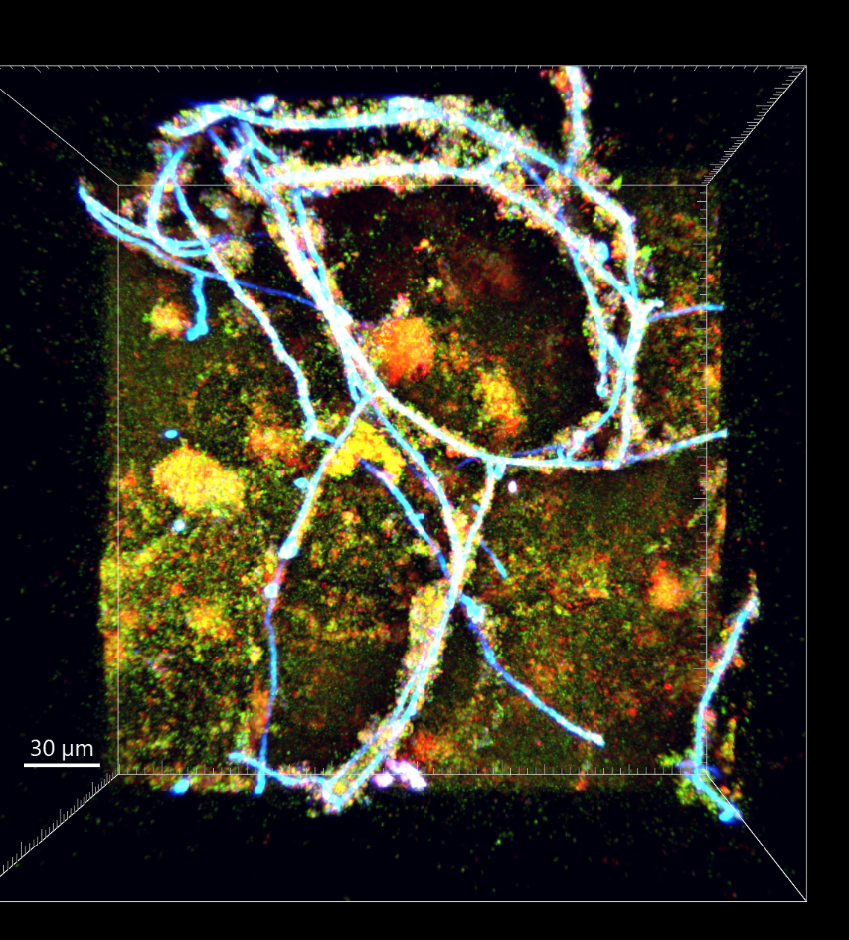
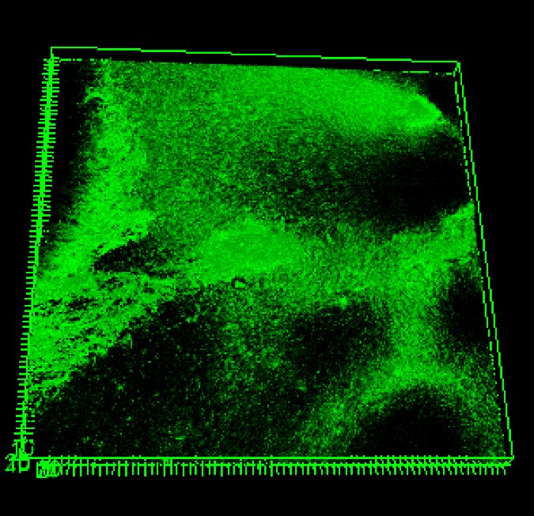
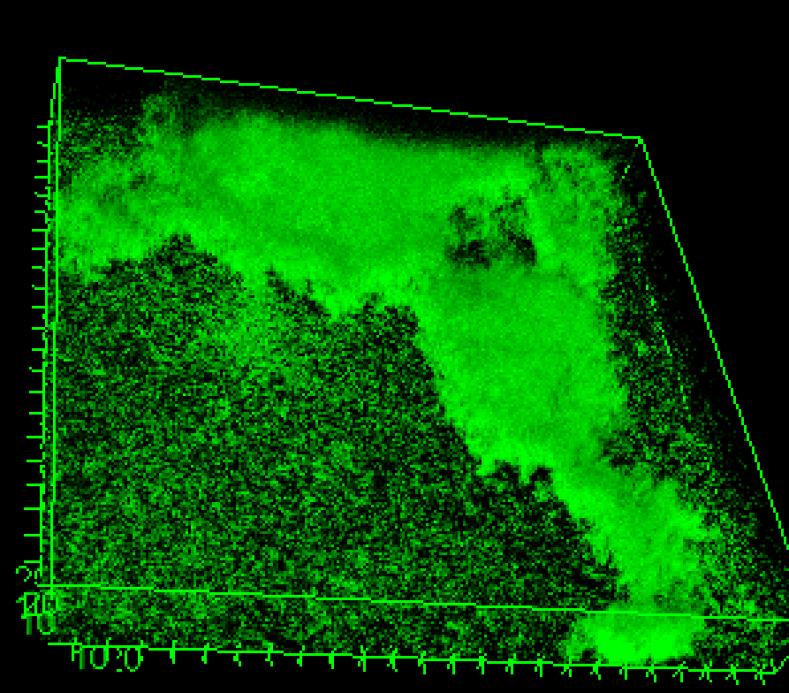
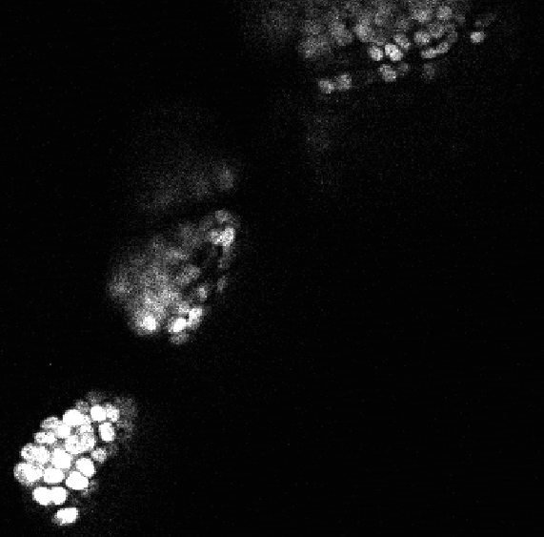
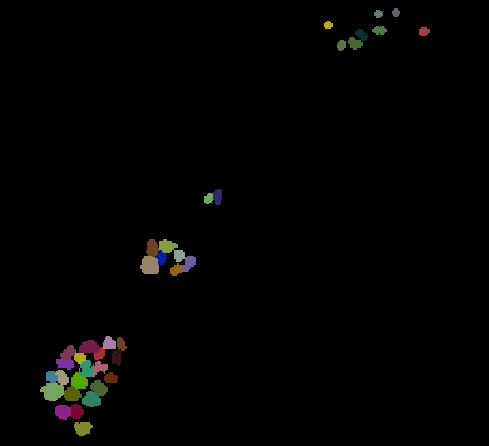
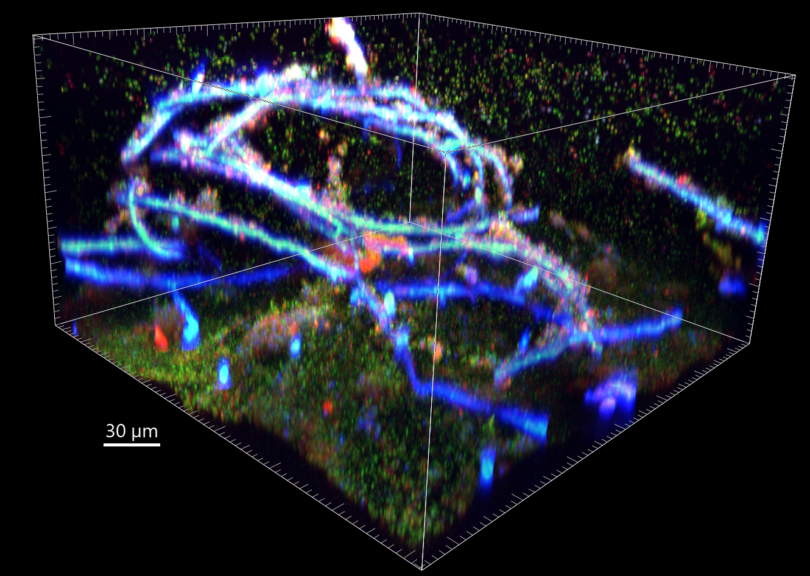
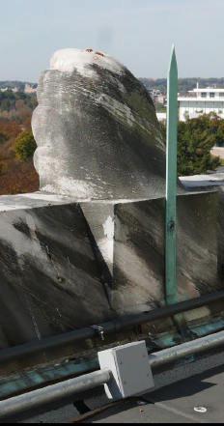
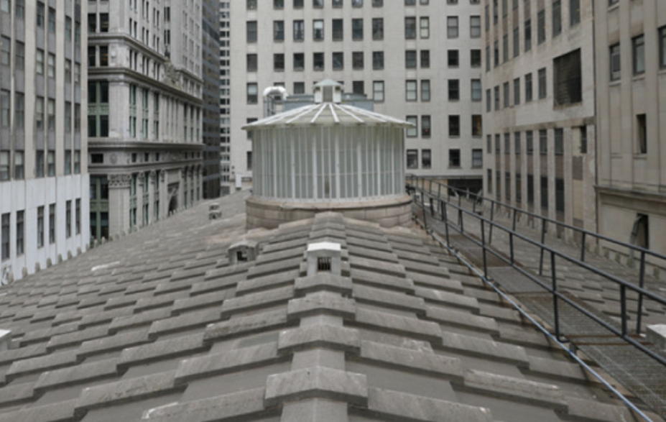
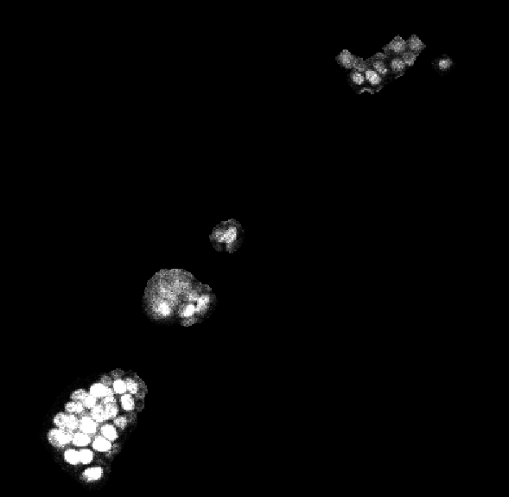
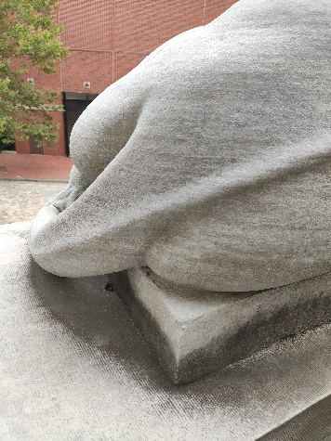
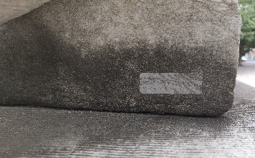
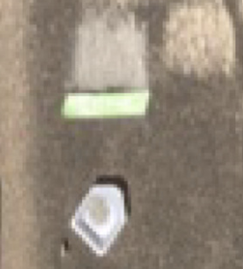
Biofilm Imaging Library: Single Cell Segmentation
Denys Byrchak¹, B. Buttaro², and J. Picone¹
¹ Department of Mathematics and ²Lewis Katz School of Medicine
Abstract
Cyanobacteria are essential to survival
Results
Microbial biofilms can be found in diverse environments, including industrial facilities, natural ecosystems, and the human body, where they contribute to persistent infections, equipment degradation, and agricultural losses. The Biofilm Imaging Library is an ongoing project designed to support researchers in studying microbial biofilms across these varied contexts. As part of this research, I am developing a machine learning-based tool to automatically segment bacteria in microscopy images that can be used to quantitate the bacteria and, eventually, look for higher order organizational patterns. I am using existing 3D machine learning model segmentation architecture called StarDist, which has been adapted to suit our specific dataset. I have trained and evaluated multiple model configurations to optimize performance. In parallel, I have developed a conversion tool capable of extracting object outlines from model predictions and exporting them as structured CSV files for further analysis. In its current state, the model successfully detects approximately 48% of the target objects and demonstrates strong shape resemblance in its predictions. The conversion tool is fully functional, reliably extracting and recording object contours. While the model's performance is promising, there remains meaningful room for improvement. In the coming months, I plan to explore the full potential of the StarDist architecture before transitioning to the development of a custom model architecture tailored to the unique characteristics of our data.
3D LSCM images visualized with ImageJ
Fed Hall
n=50
MEB
n=71
Cyanobacteria (red cells) fix all the carbon for the system.
Heterotrophs (green cells) help the community in two ways:
Heterotrophs can get carbon from small organic acids released from Cyanobacteria when they are growing rapidly. Heterotrophs use of the organic acids for carbon. This buffers the pH allowing continued growth of the Cyanobacterial communities.
Heterotrophs surround the communities and help maintain water activity necessary for growth
Both these activities are supported by mathematical models developed by the Klapper group.
Accurate cellular quantitation enables more precise modeling including the ability to scale the carbon fixation activity and ultimately estimate how much carbon these massive communities may remove from the atmosphere.
The model reached 48% recall rate with only 7 images.
Demonstrates strong shape resemblance.
Developed utility tools for extracting outlines and displaying general statistics.
Single Cell Counting Methods
StarDist3D is a deep-learning-based method for 3D object detection and segmentation.
Predicts the center probability of each object.
Estimates distances along multiple 3D rays from the center to the object boundary.
BIL
Biofilms are communities of bacteria encased in a matrix material. They can be one species of bacteria or multiple species of bacteria and even multidomain with eukaryotic fungal cells mixed with bacteria.
Discussion
BIL pipeline supports multiple input types, both fully and partially annotated data, enabling robust cell segmentation. The model is adaptable and can be trained and applied to a broad range of biofilm types. Compared to widely used tools such as BiofilmQ, StarDist3D produces tight bounding polygons rather than cubic approximations, more accurately capturing true cell shape.
Biofilm Imaging Library
Conclusion
The StarDist3D model provides a lightweight and effective solution for Cyanobacteria cell segmentation that could replace existing tools. Its primary advantage over current methods is the use of bounding polygons that more accurately reflect true cell morphology. To date, StarDist3D has demonstrated strong performance in both shape accuracy and overall segmentation quality. Further improvements are anticipated with the availability of additional training data.
The Biofilm Imaging Library (BIL) is an ongoing collaborative project between Temple University PIs Picone and Buttaro and the Center for Biofilm Engineering at Montana State University PIs Parker and Smith. The BIL will be an open-access, community-driven repository of standardized, high-quality biofilm images and the development of open-source easy-to-use computationally efficient tools aided by machine learning.
Manual annotations for individual cells are done on every 5th layer.
Interpolate manual annotations to appear on every slice using nearest z-slice approach.
Extract only those area from original image that have been annotated.
MEB all same image
Acknowledgments
This material is based on work supported by the National Science Foundation (grants no. 2450549) and the Temple University Catalytic Collaborative Funding Initiative. Any opinions, findings, and conclusions or recommendations expressed in this material are those of the author(s) and do not necessarily reflect the views of these organizations.
Biological System
The biological model is biofilms growing on marble monuments (Federal Hall in NYC, Merchant’s Exchange Building in Philadelphia and Lincoln Memorial in DC.
The blackened areas contain biofilms that produce a black pigment.
Samples are taken by scrapping the small stone particles off the monument and imaging the biofilms on the rock particles using Laser Scanning Confocal Microscopy.
References
Parker, A.E., Smith, H., Buttaro, B., & Picone, J. (2025). Why do we need a Biofilm Imaging Library? Current limitations when analyzing confocal 3D images. Proceedings of the IEEE Signal Processing in Medicine and Biology Symposium (SPMB), 1. doi: 10.1109/SPMB67169.2025.11345414.
Buttaro, B., Smith, H., Parker, A., & Picone, J. (2025). Why do we need a Biofilm Imaging Library? (A Community Discussion—What to study?). Montana Biofilm Meeting, 1.
Buttaro, B. (2022). Playing by the Rules: Structural and Spatial Organization of Biofilm Communities. 2022 IEEE Signal Processing in Medicine and Biology Symposium (SPMB), 1. doi: 10.1109/SPMB55497.2022.10014799.
Scrapping

