Slide 1
Egg Cracker Reverse Engineering
Senior Design 2
Group 9
Hollie Wolfenden, Britney Lourng, Sheryl Korah, Misa Won

Slide 2
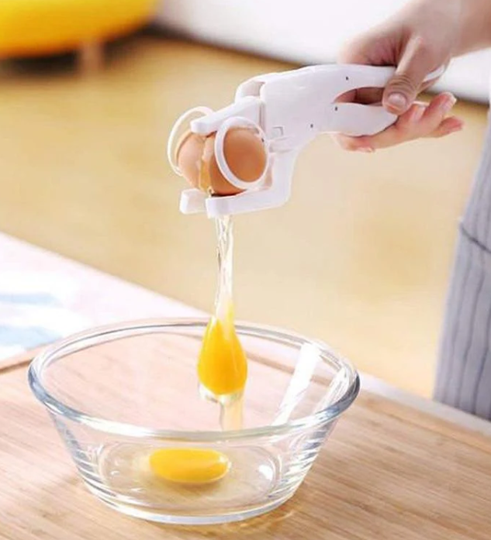
Background
2
Cracking an egg can be
difficult for people with
certain disabilities
Fine motor disability is seen as a symptom for adults suffering in conditions like below and more: (Burr and Choudhury, 2022)
Stroke – 2.8% of US population – 50% which had hemiparesis (weakness of one side of the body) ~4.6M people
Rheumatoid arthritis – 2% of North America – 30% require assistance for personal care ~3M people
Traumatic brain injury – 1.1% of the US population – 43% which have a lasting disability ~1.6M people
For adults living alone with this condition, assistive products are needed
Image of Emerson EZCracker from kitchengroups.com
Notes:
Delete?

Slide 3
Overview
3
Problem
Needs Statement
Over-engineered current design
Reverse engineer and re-design a handheld egg cracker
A detailed analysis of the device including an understanding of all motion
Design equations with respect to all force and motion must be solved for
This project is going to take an existing product, a handheld egg cracker, and reverse engineer it while studying the design equations and possible areas of improvement for a final prototype.

Slide 4
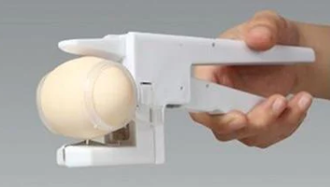
Chosen Solution
4
Will base the design off the exact product received but consider changes to improve efficiency.
The original patent doesn’t have enough details or figures.
The current device is very bulky and seems to be overengineered
New changes are necessary, but a complete redesign is not.
Image of Emerson EZCracker from kitchengroups.com
Notes:
Remove highlighted part for now? + include in our next presentation?

Slide 5

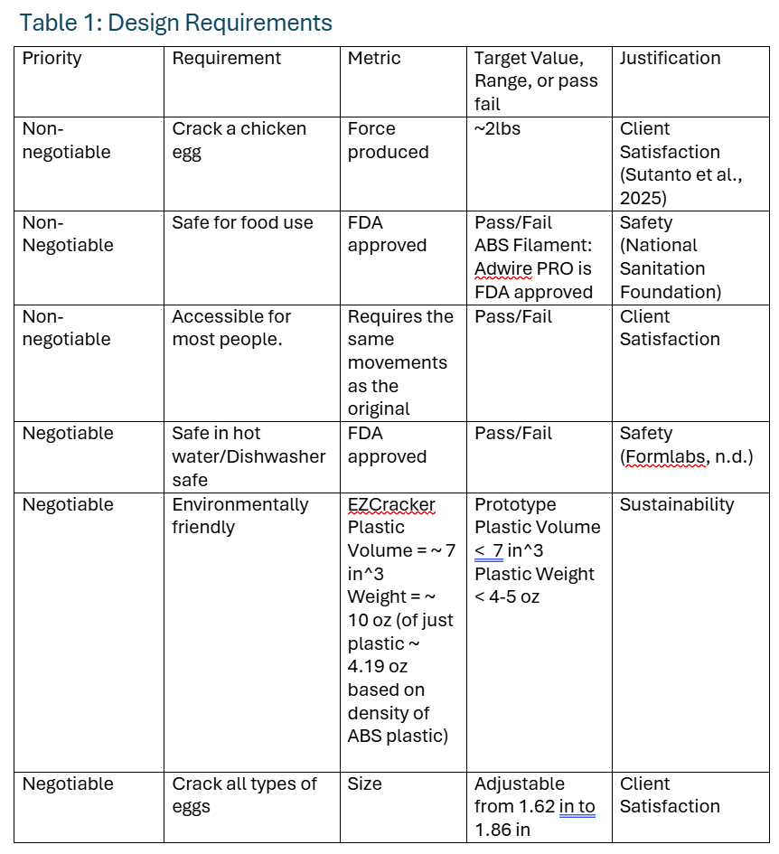
5
Design Criteria Table

Slide 6
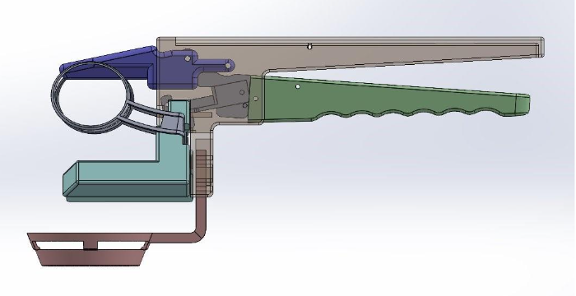
Design that Will Be Built
6
First iteration is fully designed in SolidWorks.
Currently
Working on FEA analysis to get values for the stresses acting on the egg.
Figure 1: Initial SolidWorks Assembly Design
Notes:
Solution 4 – reverse engineering process again, knowing what we know now – optimized process?

Slide 7
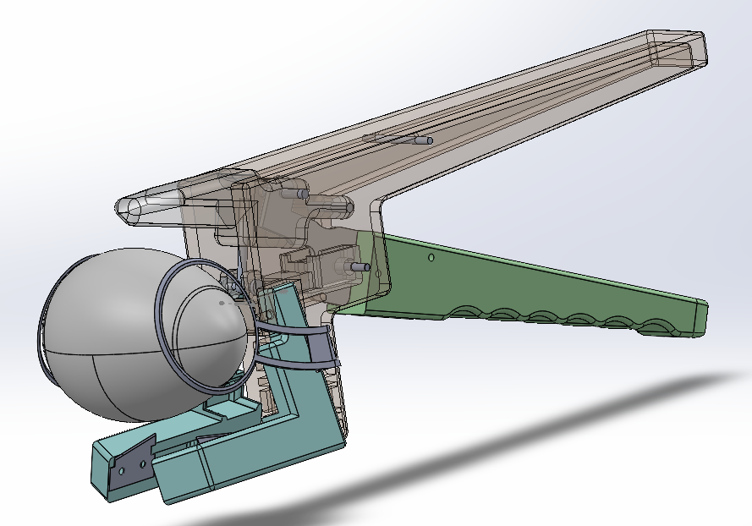
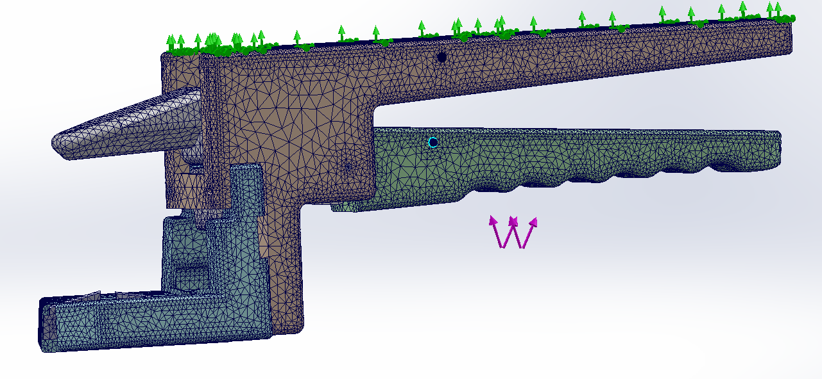
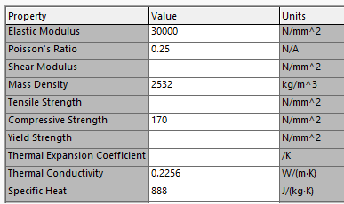
SolidWorks Analysis Progress
7
Figure 2: First attempts at accurate static study in SolidWorks
Figure 3: SolidWorks assembly with eggshell with custom material properties

Slide 8
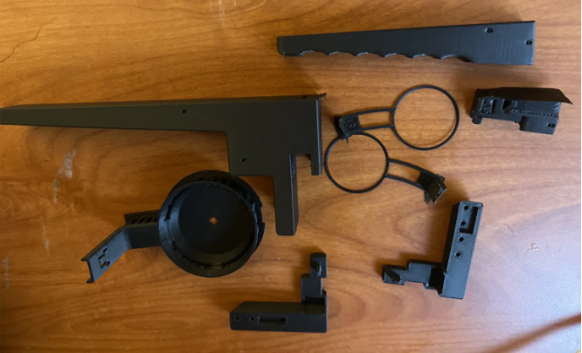
Design that Will be Built
8
Initial SolidWorks design is 3D printed
Printed with PLA filament
15% infill
Currently
Making the assembly to test the fit of all the parts and make necessary adjustments.
Testing and researching different filaments
Considerations: final epoxy resin or polyurethane coating
Figure 4: 3D Printed Parts for Initial Design
Notes:
Infill % in slicing software

Slide 9
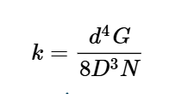
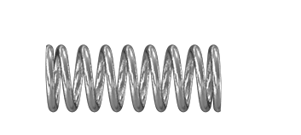
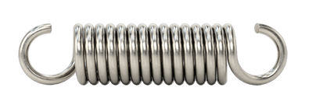
Engineering Design
9
Calculated Spring Constants based on the spring dimensions of the original design.
Spring Constant can be used to determine the springs needed to order.
Compression Spring
K = 27.59 lbf/in
Tension Spring
K = 18.78 lbf/in
Equation 1: Spring Constant Equation
Figure 5: 9434K43 Compression and 9433K443 Extension Springs from McMaster-Carr

Slide 10
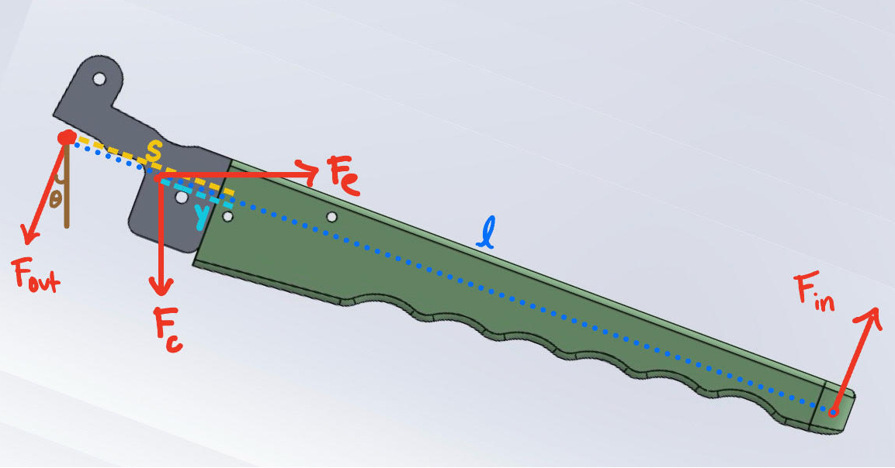
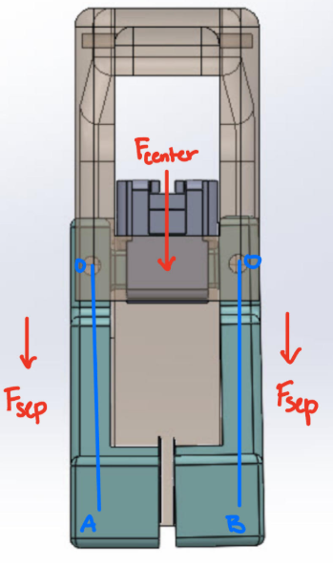
Engineering Design
10
Force Diagrams to calculate the force needed to separate the egg.
Can be used to evaluate the success of the design and make necessary changes.
Will evaluate after completing each design.
Figure 6: Force Diagram for Bottom Handle
Figure 7: Force Diagram for Egg Separator
Notes:
FEA - Fatigue testing,

Slide 11

Egg Shell Force to Crack
11
Equation 1:
Table 3.
Variable | Value
Fracture stress, σ | 15.2 - 27.3 MPa* (2.2 - 3.9 ksi)
Stress area, A | 0.02 mm (~9 x 10^ -4 in)
Force, F | ~1.98 lbf
For Comparison on Forces (Riddle et al., 2020)
Healthy (thumb force) | 34.8 N = 7.82 lbf
Osteoarthritis (thumb force) | 30.7 N = 6.9 lbf
*(Taylor et al., The fracture toughness of eggshell 2016)
Notes:
Sensors on fingers measured force and thumb forces shown is from test where participants plugged cord into outlet

Slide 12
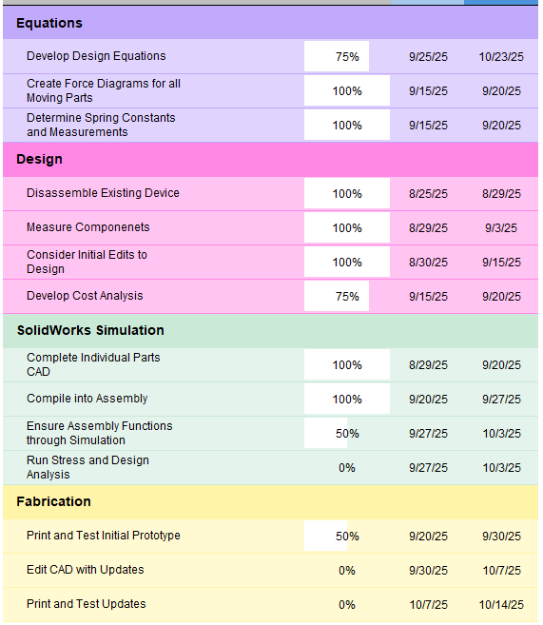
Timeline to Reach Intermediate Design
12
Table 2: Timeline with Tasks to Reach End Goal ​

Slide 13
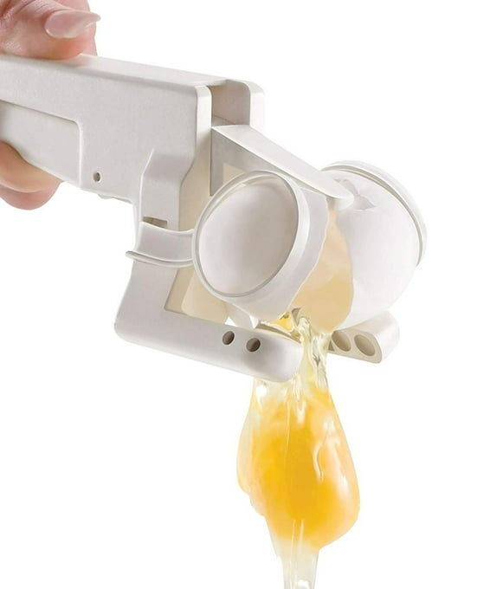
Engineering Design Immediate Goals
13
Finish building our budgeting Excel.
Deciding the filaments for our printed parts, screws, pins, and a blade.
Assemble the 3D printed parts, test, then make changes.
Simulations are being run in SolidWorks such as stress analysis and finite element analysis.

Slide 14
References
14
Budynas, R.G. and Nisbett, J.K., 2019. Shigley's Mechanical Engineering Design. 11th ed. New York: McGraw-Hill
Giuliodori, M.J., Lujan, H.L., Briggs, W.M., Palani, A., DiCarlo, S.E. (2009) ‘Hooke’s law: applications of a recurring principle’, Advances in Physiology Education, 33(1), pp. 8‑14. https://doi.org/10.1152/advan.00045.2009
Riddle, M. et al. (2020) ‘Evaluation of individual finger forces during activities of daily living in healthy individuals and those with hand arthritis’, Journal of Hand Therapy, 33(2), pp. 188–197. doi:10.1016/j.jht.2020.04.002.
Taylor, D. et al. (2016) ‘The fracture toughness of eggshell’, Acta Biomaterialia, 37, pp. 21–27. doi:10.1016/j.actbio.2016.04.028.
Music-Wire Steel Compression Springs, 0.625" Long, 0.24" OD, 0.176" ID | McMaster-Carr
302 Stainless Steel Extension Spring with Hook Ends, Corrosion-Resistant, 1" Long, 0.25" OD, 0.040" Wire Diameter | McMaster-Carr
One Handed Egg Cracker Tool, Best Egg Cracker Egg Yolk Separator – Kitchen Groups

