Slide 1
Egg Cracker
Reverse Engineering
Senior Design 2
Group 9
Hollie Wolfenden, Britney Lourng, Sheryl Korah, Misa Won

Slide 2
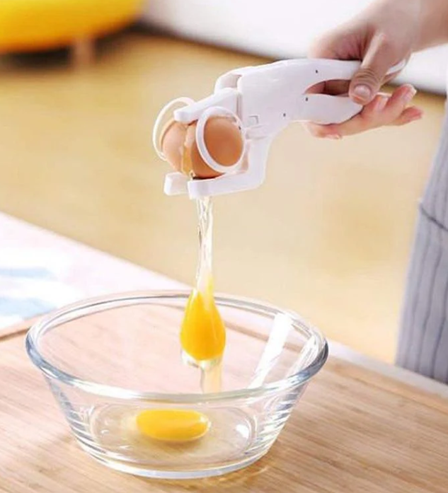
Background
2
Cracking an egg can be
difficult for people with
certain disabilities
  Fine motor disability is seen as a symptom for adults suffering in conditions like below and more: (Burr and Choudhury, 2022)
    Stroke – 2.8% of US population – 50% which had hemiparesis (weakness of one side of the body) ~4.6M people
    Rheumatoid arthritis – 2% of North America – 30% require assistance for personal care ~3M people
    Traumatic brain injury – 1.1% of the US population – 43% which have a lasting disability ~1.6M people
  For adults living alone with this condition, assistive products are needed
Image of Emerson EZCracker from kitchengroups.com

Slide 3
Overview
3
Problem
Needs Statement
Over-engineered current design
  Reverse engineer and re-design a handheld egg cracker
A detailed analysis of the device including an understanding of all motion
  Design equations with respect to all force and motion must be solved for
This project is going to take an existing product, a handheld egg cracker, and reverse engineer it while studying the design equations and possible areas of improvement for a final prototype.

Slide 4

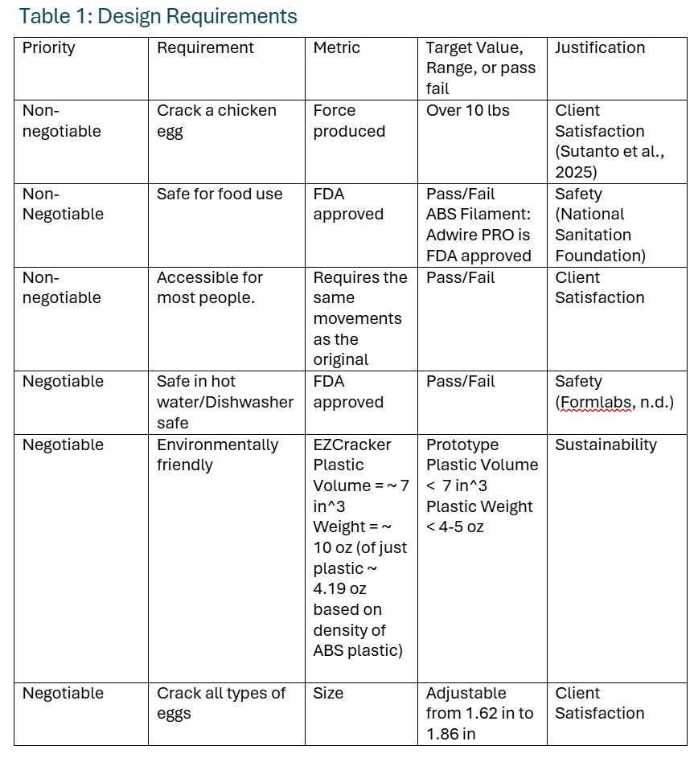
4
Design Criteria Table

Slide 5
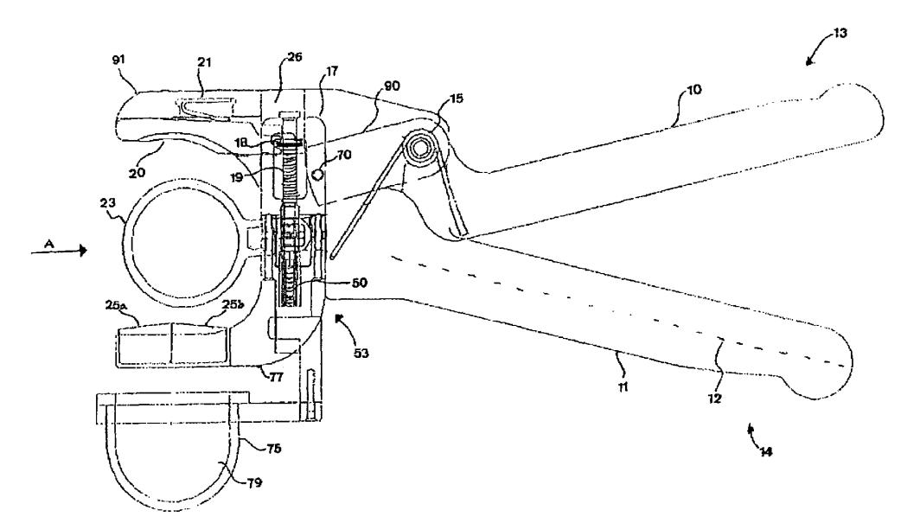
Solution 1
5
Original Patent design
Patent no. US 7,363,853 B2 referenced on product box
Main difference is the larger pressure piece
Instead of 2 helical springs like current product, this design shows 1 helical and 1 torsion spring
Fig 1. Image from Patent US 7,363,853 B2 (Dolub, 2008)

Slide 6
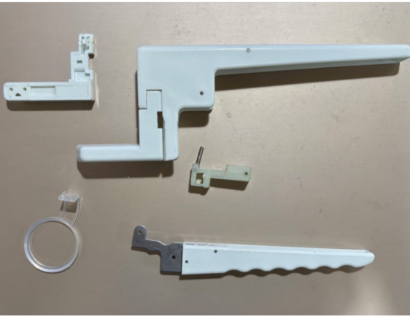
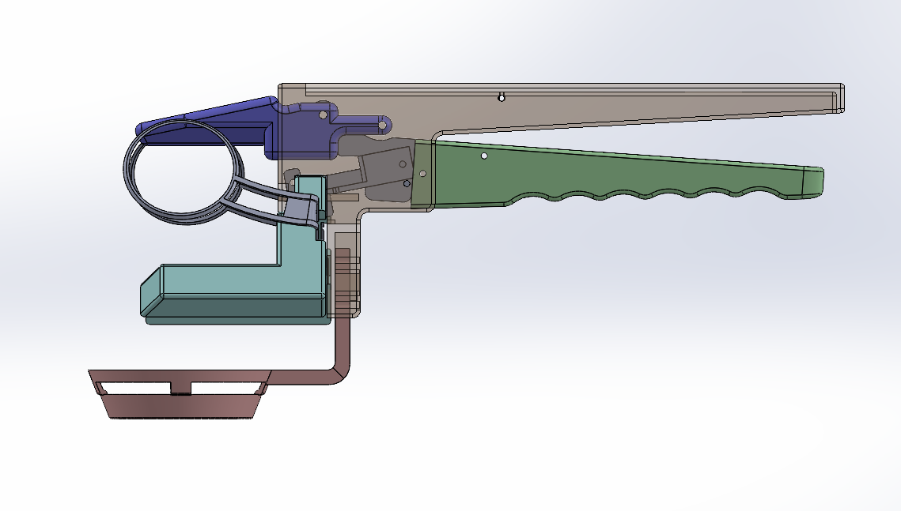
Solution 2
6
Current Consumer Product Design
Plastic Volume = ~ 7 in^3
Weight = ~ 10 oz (of just plastic ~ 4.19 oz based on density of ABS plastic)

Slide 7
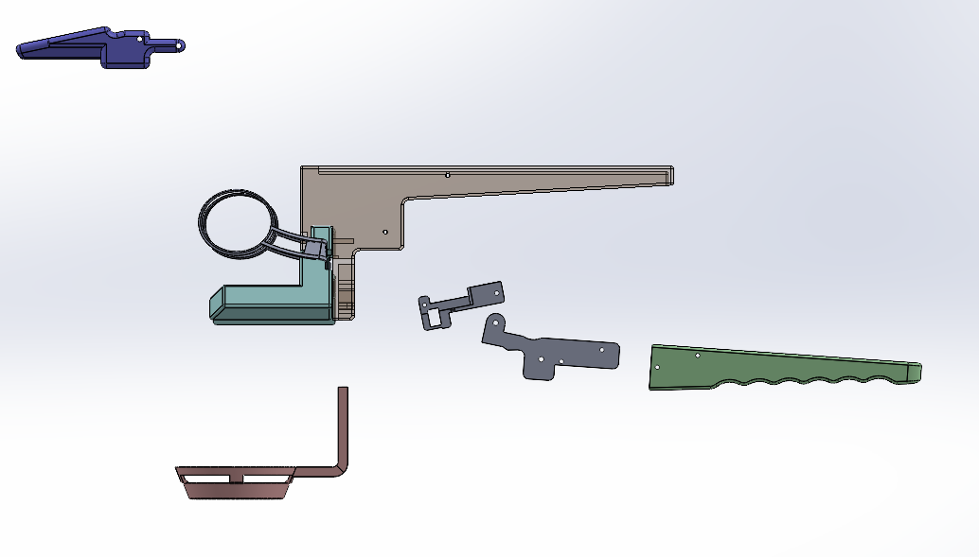
Solution 3
7
Adjusted design
Based on analyzing the reverse engineered prototype, adjustments will be made
Main goals:
  Reduce % of plastic
  Keep parts simple to lower potential manufacturing costs

Slide 8
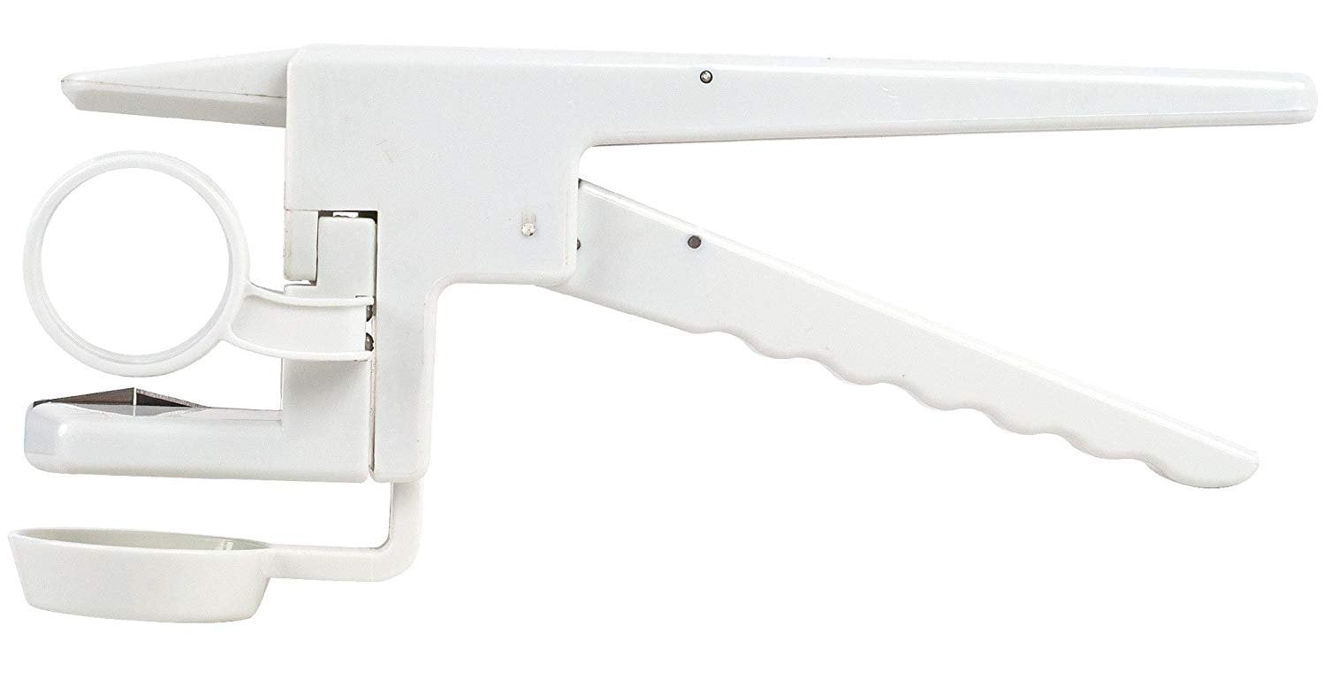
Chosen Solution
8
The best course of action is to combine solutions two and three. This will base the design off the exact product received but consider changes to improve efficiency.
  The original patent doesn’t have enough details or figures.
  The current device is very bulky and seems to be overengineered
  New changes are necessary, but a complete redesign is not.
Notes:
Remove highlighted part for now? + include in our next presentation?

Slide 9
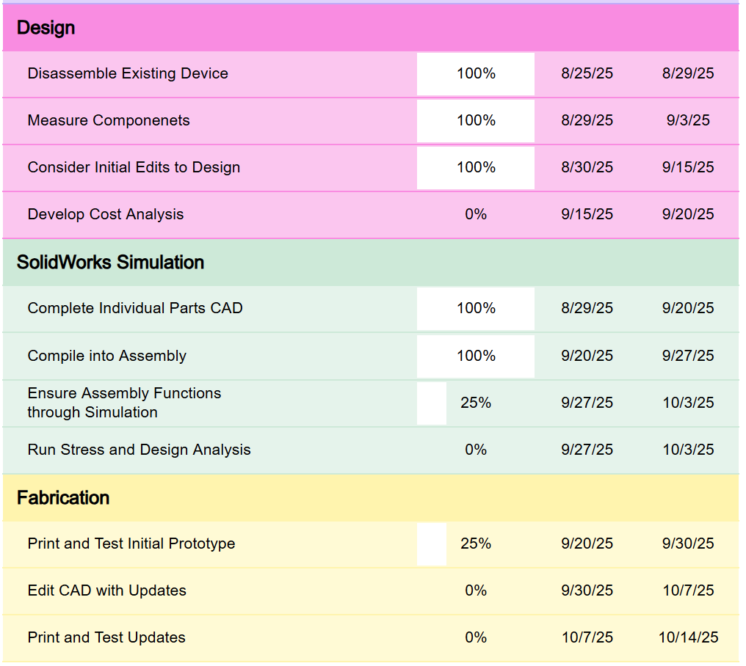
Timeline to Reach
Intermediate Design
9
Table 2: Timeline with Tasks to Reach End Goal ​

Slide 10
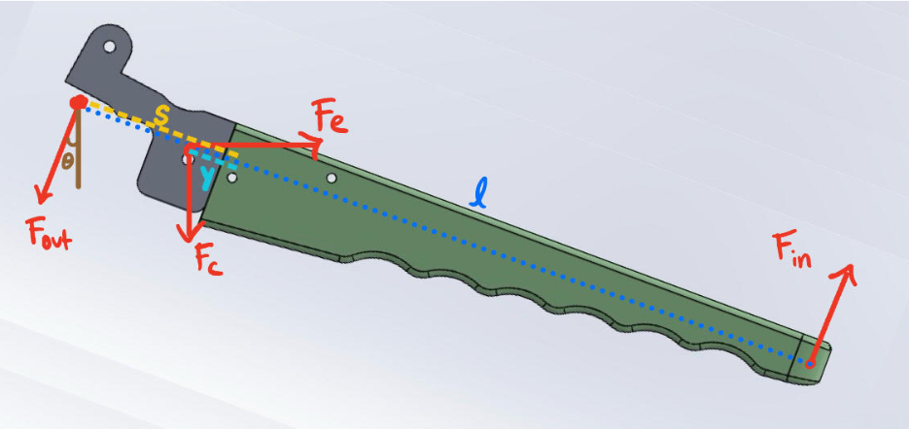
Engineering Design Plan
10
Figure 2: Force Diagram for Bottom Handle
Hooke's Law and the Moment equation will be used to find the force on the egg (F_out).
  Knowns: Spring Constants, Force on the Handle, Distances, Angle
  Unknowns: Force on the Egg

Slide 11
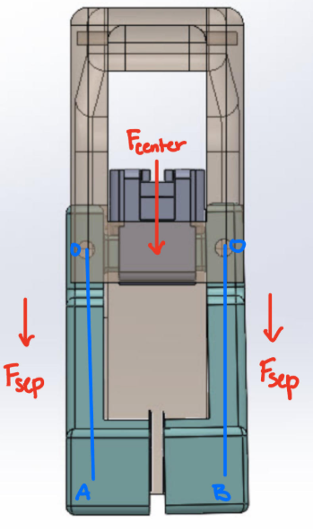
Engineering Design Plan
11
F_center can be found using the theta in Figure 1.
The F_separate the egg can be calculated with the angle that separates the eggs and the distance of the arms.
The F_in and F_sep can be used to evaluate the success of the final design.
Figure 3: Force Diagram for Egg Separator

Slide 12
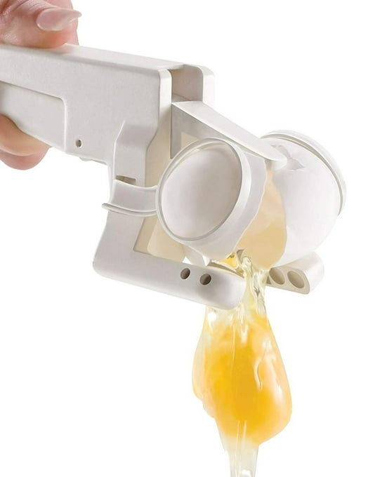
Engineering Design Immediate Goals
12
Develop a working prototype through the combination of SolidWorks and 3D printing.
  Misa and Britney are currently focused on developing individual CAD models.
  Sheryl and Hollie are focused on creating the necessary figures and finding the design equations.
Simulations will be run in SolidWorks such as stress analysis and finite element analysis.
Developing the design equations to understand the motion and forces of the device.
  Spring constants and forces need to be found
Notes:
Remove highlighted part for now? + include in our next presentation?

Slide 13
References
13
https://kitchengroups.com/products/handheld-egg-cracker-kitchen-helper?currency=USD&variant=35705083363484&utm_source=google&utm_medium=cpc&utm_campaign=Google%20Shopping&stkn=12e74ca5e7cb&utm_campaign=All%20Store%20Standard%20Low%20ROAS&utm_adset_name=Ad%20Group%201&utm_source=google&utm_medium=g&utm_placement=&utm_extensionid=&utm_content=675794001480&utm_feeditemid=&utm_devicemodel=&utm_targetid=pla-296303633664&utm_term=&utm_adposition=&utm_gclid=EAIaIQobChMI0N7z89zqjwMVy2VHAR2MVB0NEAQYAyABEgK_2_D_BwE&utm_device=c&utm_matchtype=&utm_ad_id=675794001480&utm_adset_id=159432753772&utm_campaign_id=20604627027&tw_source=google&tw_adid=675794001480&tw_campaign=20604627027&tw_kwdid=pla-296303633664&gad_source=1&gad_campaignid=20604627027&gclid=EAIaIQobChMI0N7z89zqjwMVy2VHAR2MVB0NEAQYAyABEgK_2_D_BwE
Dolub, C.A. (2008). DEVICE FOR CRACKING OPEN AND SEPARATING AN EGG. [online] Available at: https://ppubs.uspto.gov/api/pdf/downloadPdf/7363853?requestToken=eyJzdWIiOiJjNmE0OTIxZi1mMDU2LTQ0MDctYWFiOS02NWM1MjY5OGUwMjciLCJ2ZXIiOiJmOGRlNTNhZS02YzgzLTQ2MzYtOWIwNC00Y2JhMTkzMDRjZmMiLCJleHAiOjB9 [Accessed 29 Aug. 2025].

