Slide 1
Egg Cracker
Reverse Engineering
Senior Design 2
Group 9
Hollie Wolfenden, Britney Lourng, Sheryl Korah, Misa Won

Slide 2
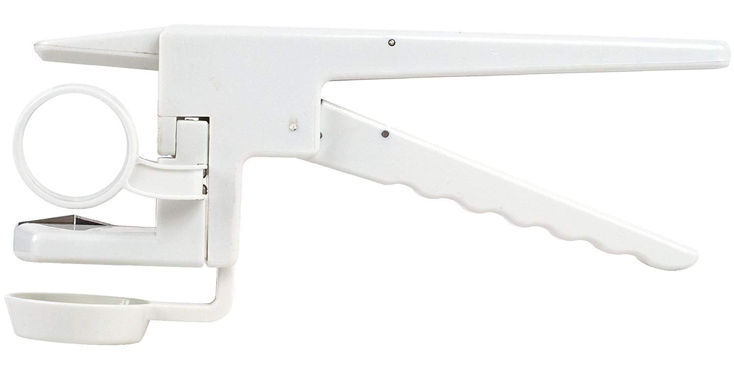
Background
2
Cracking an egg can be difficult for people with certain disabilities
  Seen as a symptom in neurological conditions ranging from adults recovering from a stroke or brain injury to developing diseases including rheumatoid arthritis and dyspraxia (Burr and Choudhury, 2022)
This handheld egg cracker allows for the user to squeeze handles together in one movement instead of the finer motor coordination needed when just using our hands
There are previous iterations such as the use of bamboo skewers to break the shell, but the durability is not ideal, and it still does not work for some people
A model will be created backed on Emson EZCracker (Dolub, 2008)
  Improvements will be considered based on our analysis and research
  A possible new design we can consider is one loaded vertically and punctured at the base or top area
Notes:
Remove highlighted part for now? + include in our next presentation?

Slide 3
Objective
3
Problem
Deliverables
Over-engineered current design
  Reverse engineer and re-design a handheld egg cracker
A detailed analysis of the device including an understanding of all motion
  Design equations with respect to all force and motion must be solved for
Finalized design equations of the motion of the device
A functional SolidWorks assembly and simulation
A complete working 3D printed prototype
Cost analysis of manufacturing product and engineering time
Needs Statement
This project is going to take an existing product, a handheld egg cracker, and reverse engineer it while studying the design equations and possible areas of improvement for a final prototype.

Slide 4
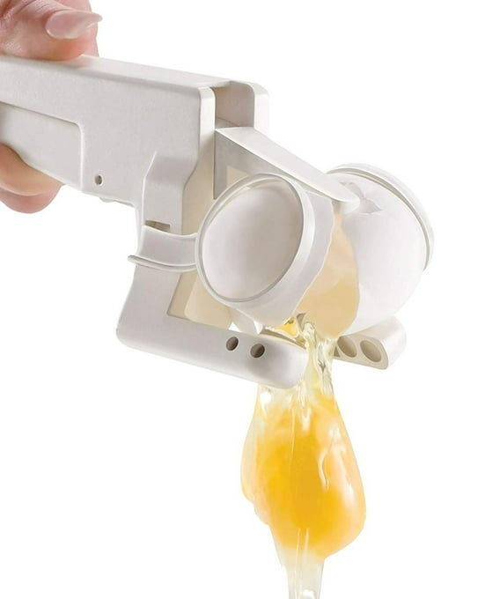
Design Criteria
4
4
Able to crack an egg – Can exert a force of 10 lbfs
Accessible for most people - Functional using just thumb and index finger (w/ handle of device with 1 DOF)
  ISO 20282-1:2006 - Main standard for assistive products.
Food safe and FDA approved material
  NSF Protocol P400 – Establishes minimum food protection and safety requirements for materials.
Dishwasher safe
Environmentally friendly – less plastic than original model
Crack different sized eggs
Notes:
Remove highlighted part for now? + include in our next presentation?

Slide 5

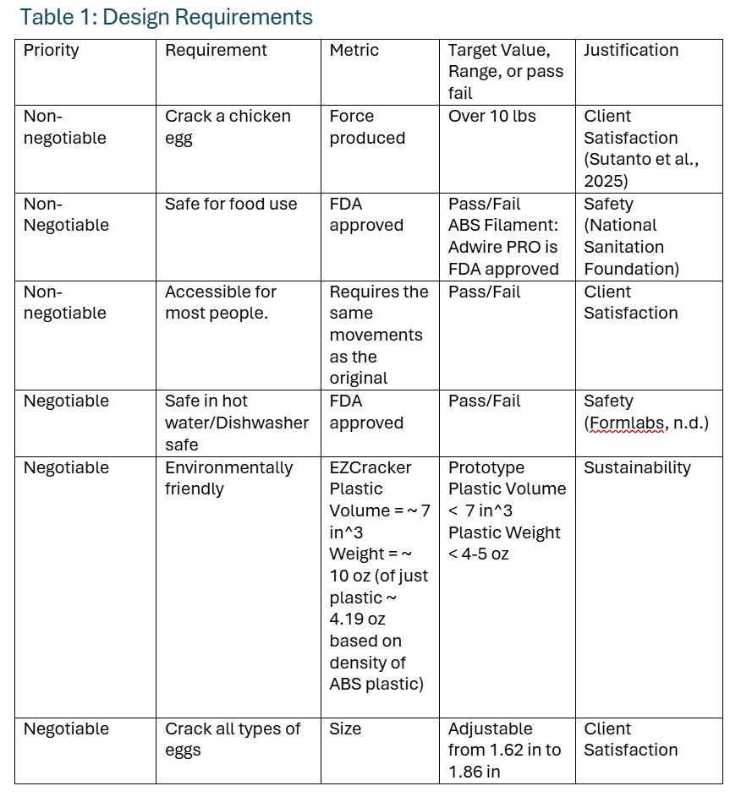
5
Design Criteria Table

Slide 6
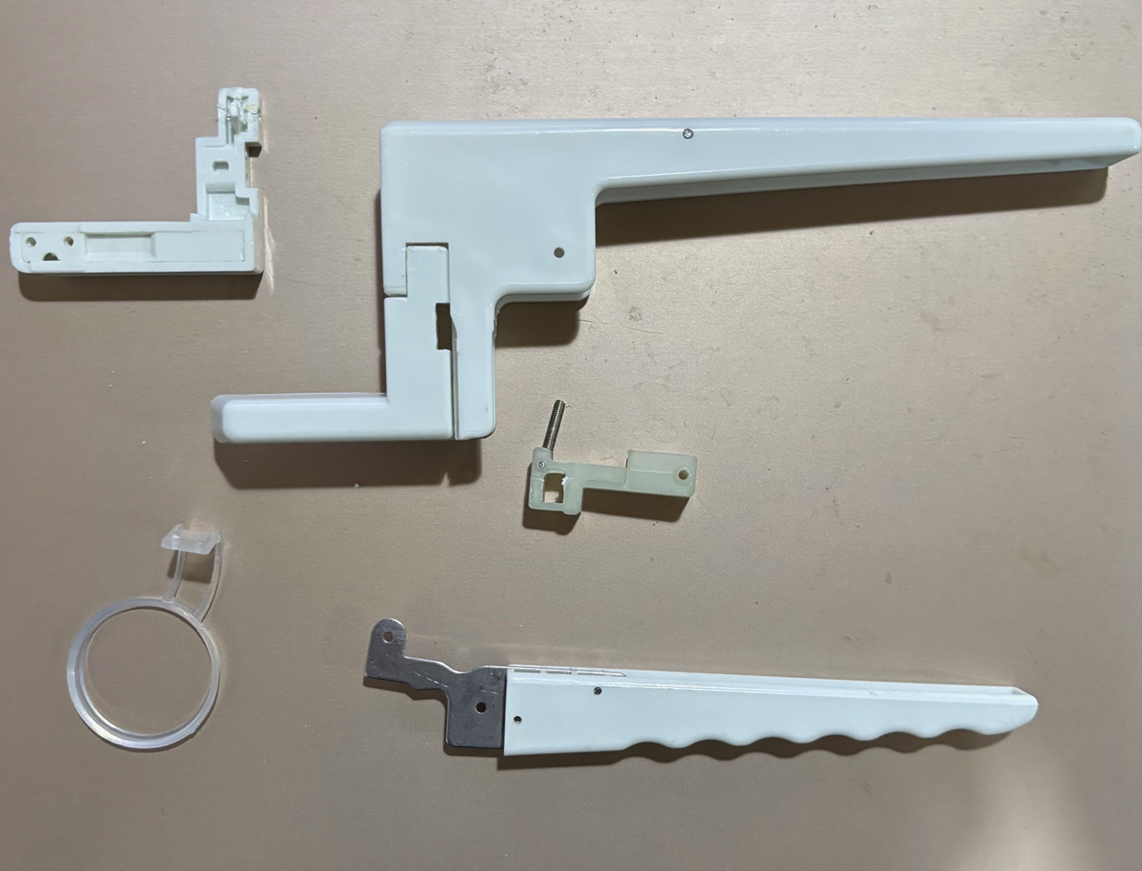
Current Progress
6
Inspect parts individually
  Analyze mechanics
Measure parts
  Start CAD model in SolidWorks

Slide 7
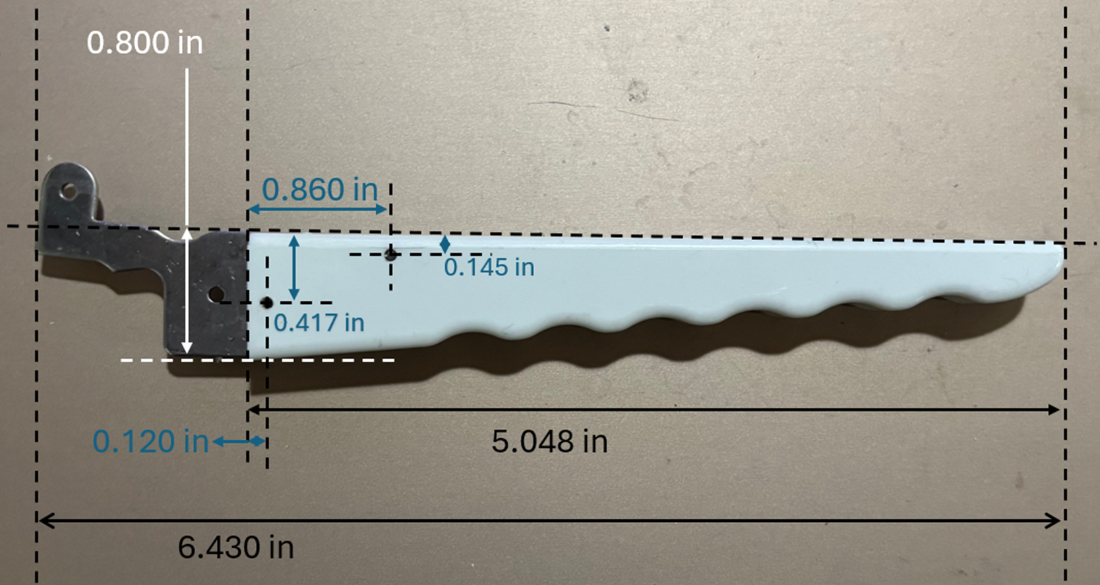
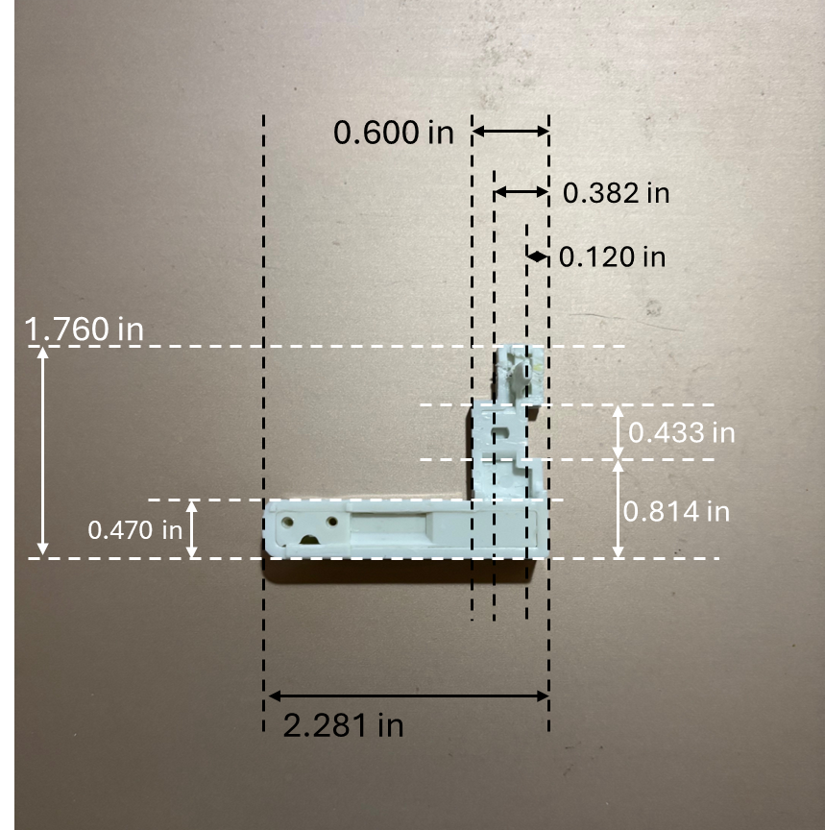
Measurement Examples
7
Egg Cracker handle
Egg Holder, outer dimensions

Slide 8
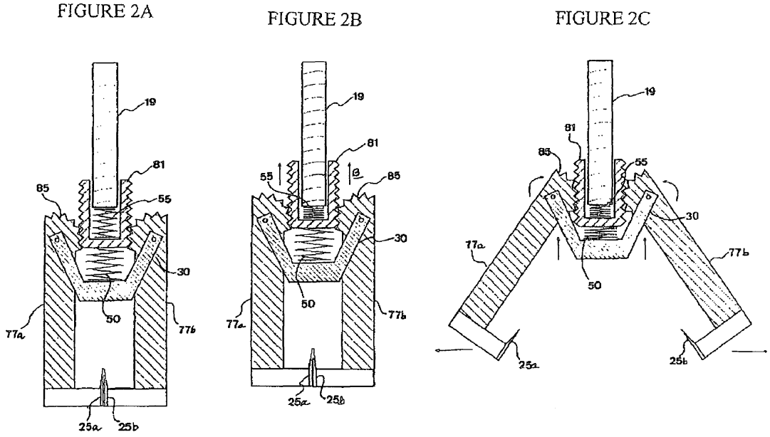
Next Steps
Inspect parts individually
  Analyze mechanics
  Review then order parts(screws, springs, blades, steel in McMaster-Carr)
Measure parts
  Start CAD model in SolidWorks
Research the cost of Professional Engineering work for this design and build

Slide 9
References
Formlabs. (n.d.). The Essential Guide to Food Safe 3D Printing. [online] Available at: https://formlabs.com/blog/guide-to-food-safe-3d-printing/.
Muthu, P., Tan, Y., Latha, S., Dhanalakshmi, S., Lai, K.W. and Wu, X. (2023). Discernment on assistive technology for the care and support requirements of older adults and differently-abled individuals. Frontiers in Public Health, 10(1). doi:https://doi.org/10.3389/fpubh.2022.1030656.
Narushin, V.G. (2005). Egg geometry calculation using the measurements of length and breadth. Poultry Science, [online] 84(3), pp.482–484. doi:https://doi.org/10.1093/ps/84.3.482.
National Sanitation Foundation [NSF] NSF Protocol P400: Food Contact Utensils for Home Use, NSF [Online]. Available at https://www.nsf.org/nsf-standards/standards-portfolio/home-products-protocols-standards (Accessed September 4, 2025).
The International Organization for Standardization [ISO] (2006) ISO 20282-1:2006 Ease of operation of everyday products: Part 1 Design requirements for context of use and user characteristics, ISO [Online]. https://www.iso.org/standard/34122.html (Accessed September 4, 2025)
Burr, P. and Choudhury, P. (2022). Fine Motor Disability. [online] PubMed. Available at: https://pubmed.ncbi.nlm.nih.gov/33085413/.
Dolub, C.A. (2008). DEVICE FOR CRACKING OPEN AND SEPARATING AN EGG. [online] Available at: https://ppubs.uspto.gov/api/pdf/downloadPdf/7363853?requestToken=eyJzdWIiOiJjNmE0OTIxZi1mMDU2LTQ0MDctYWFiOS02NWM1MjY5OGUwMjciLCJ2ZXIiOiJmOGRlNTNhZS02YzgzLTQ2MzYtOWIwNC00Y2JhMTkzMDRjZmMiLCJleHAiOjB9 [Accessed 29 Aug. 2025].
Instructables (2024). Handcrafted Egg Breaker. [online] Instructables. Available at: https://www.instructables.com/Handcrafted-Egg-Breaker/ [Accessed 30 Aug. 2025].
Jung, E. (2021). Egg Crackers. [online] Google.com. Available at: https://patents.google.com/patent/KR20220132221A/en?q=(egg+cracker)&oq=egg+cracker.

