Slide 2
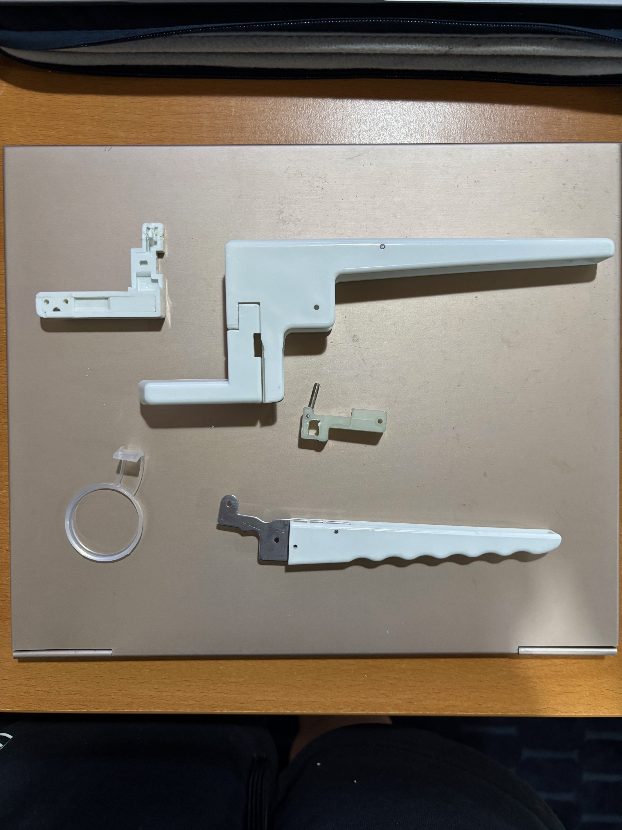

Slide 3
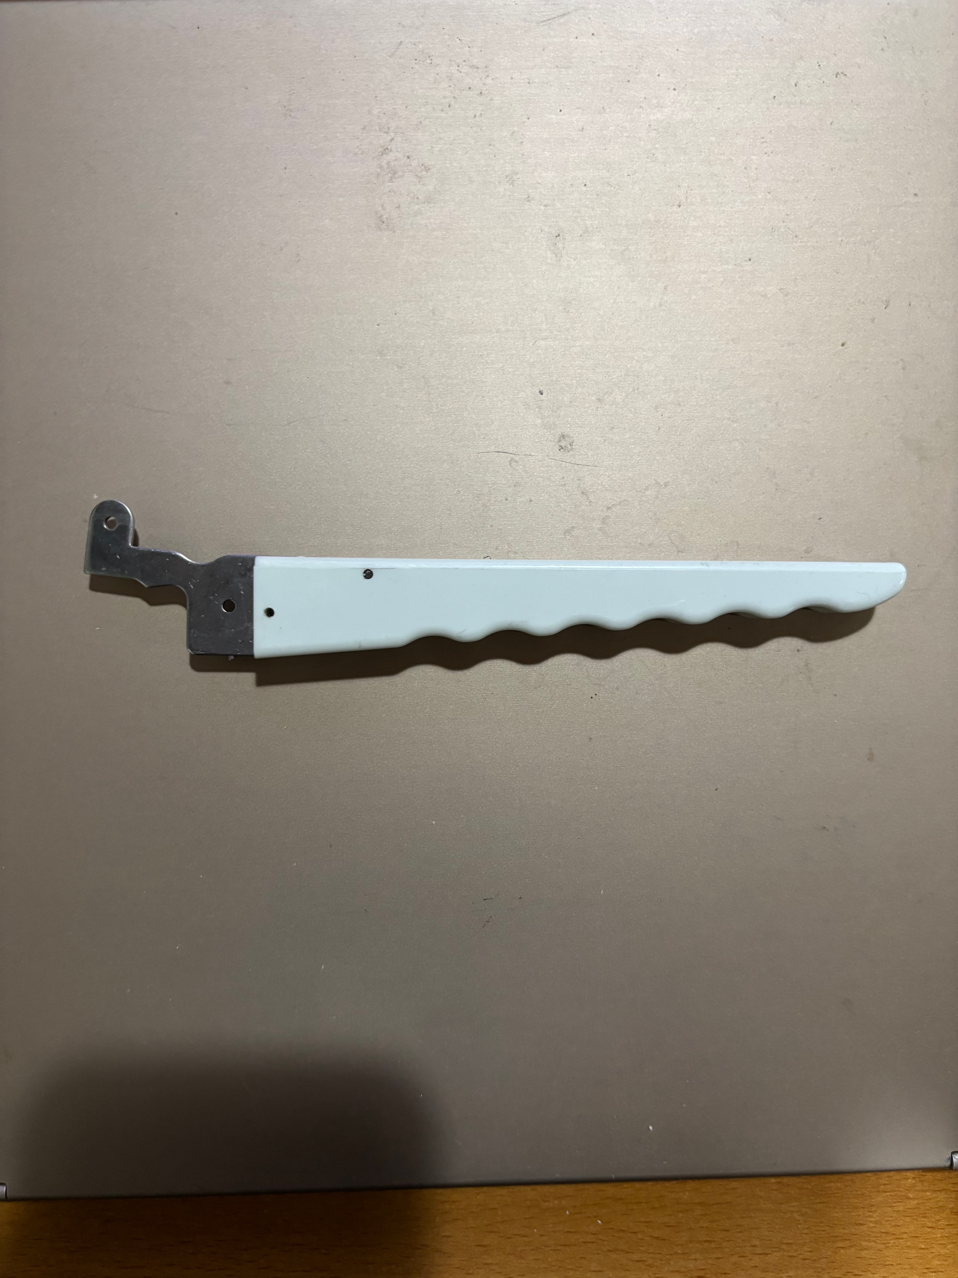
Handle
0.800 in
0.860 in
0.145 in
0.417 in
0.120 in
5.048 in
6.430 in

Slide 4
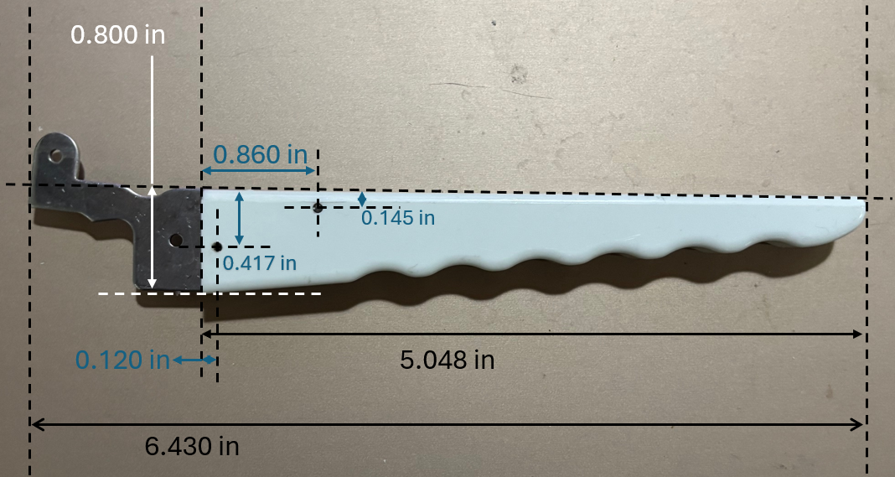

Slide 5
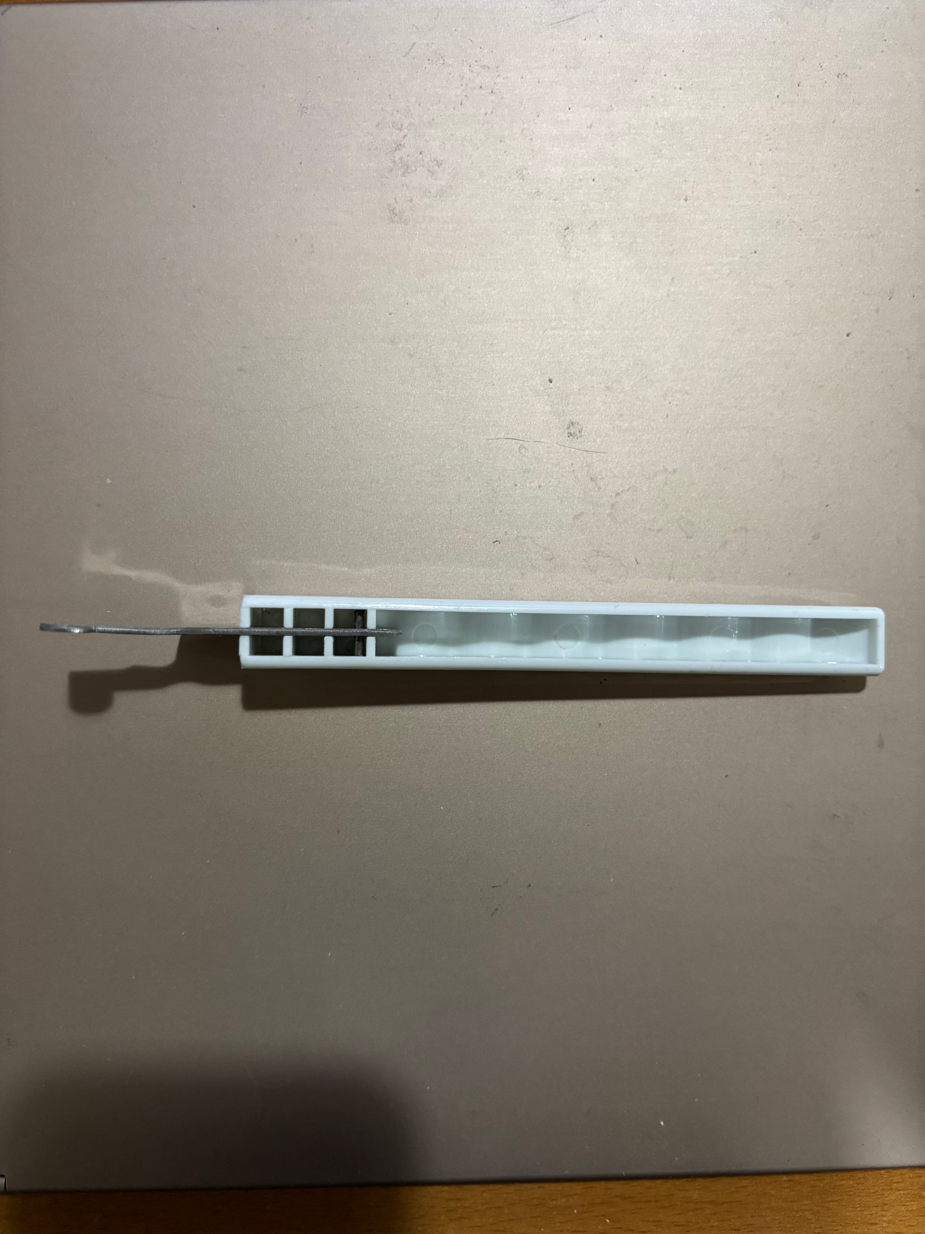
0.55 in
3.928 in
~0.245 in for each
t, all around = ~0.1 in

Slide 6
Metal part
1.2 in
0.570
0.06
0.595
0.110
1.19
0.513
0.577
0.300

Slide 7
Metal part
2.581 in
0.057

Slide 8
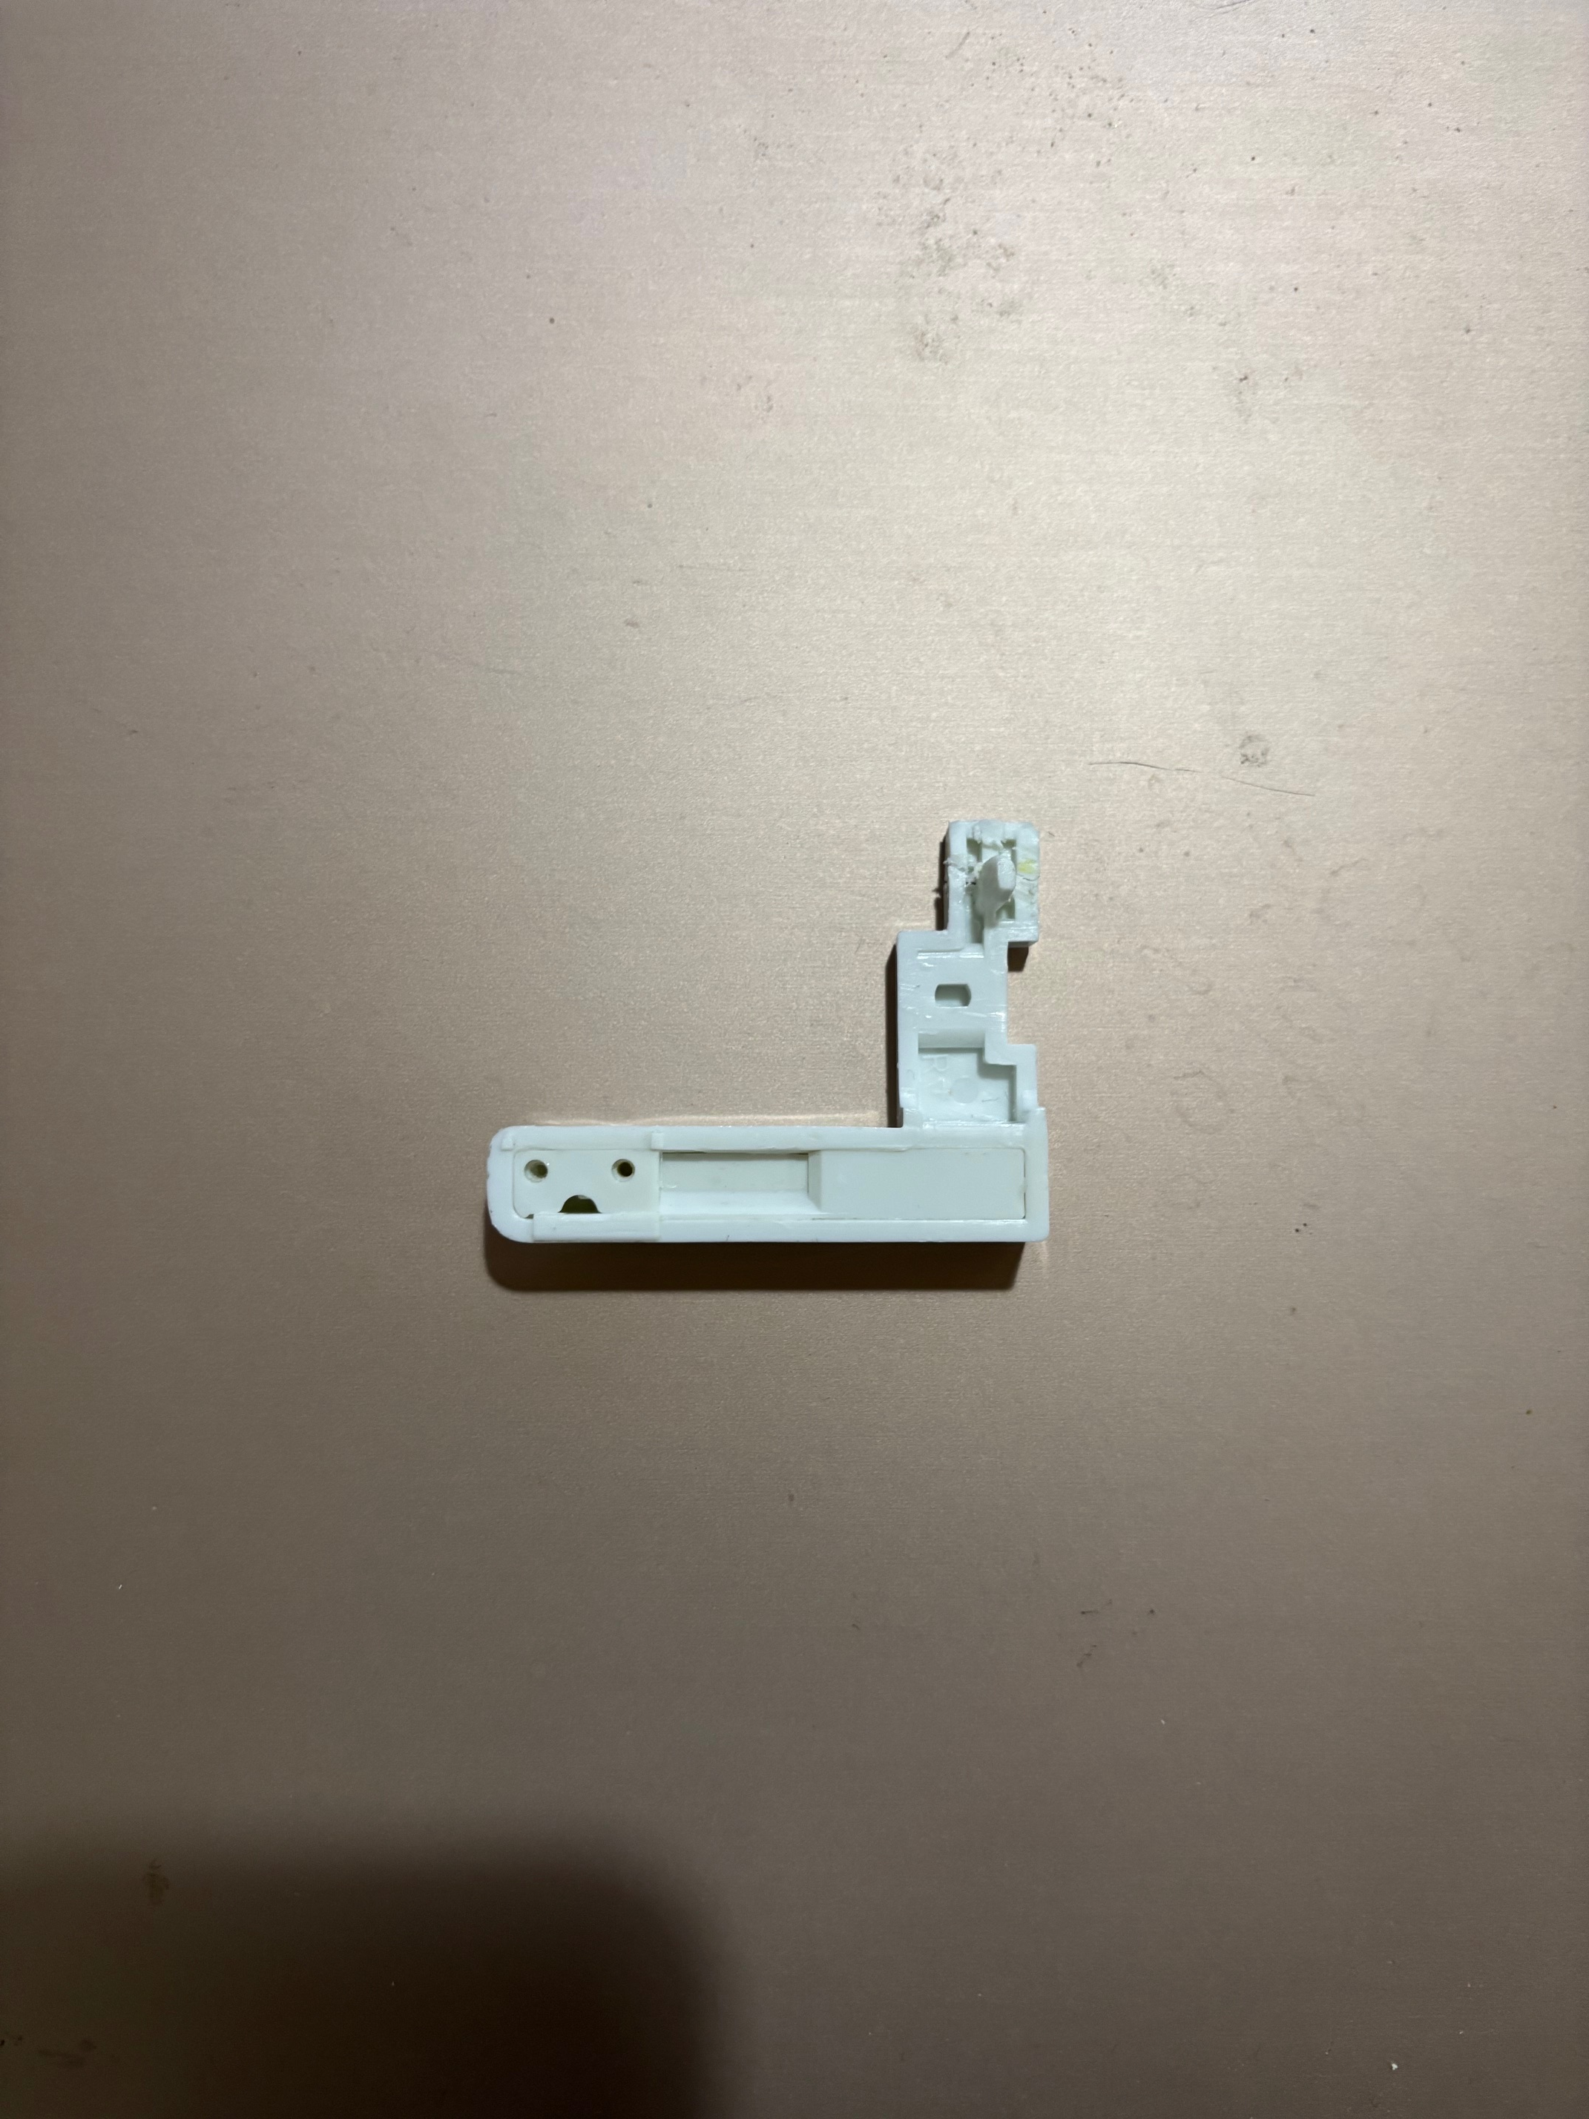
Egg holder outer
0.600 in
0.382 in
0.120 in
1.768
1.760 in
0.433 in
0.814 in
0.470 in
2.281 in

Slide 9
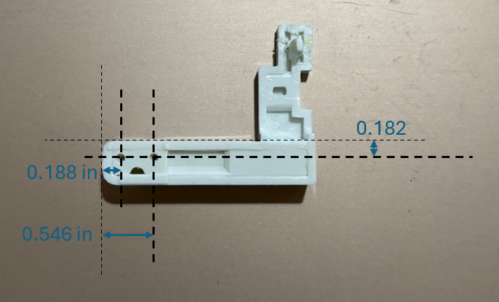
Egg holder inner
0.182
0.188 in
0.546 in

Slide 10
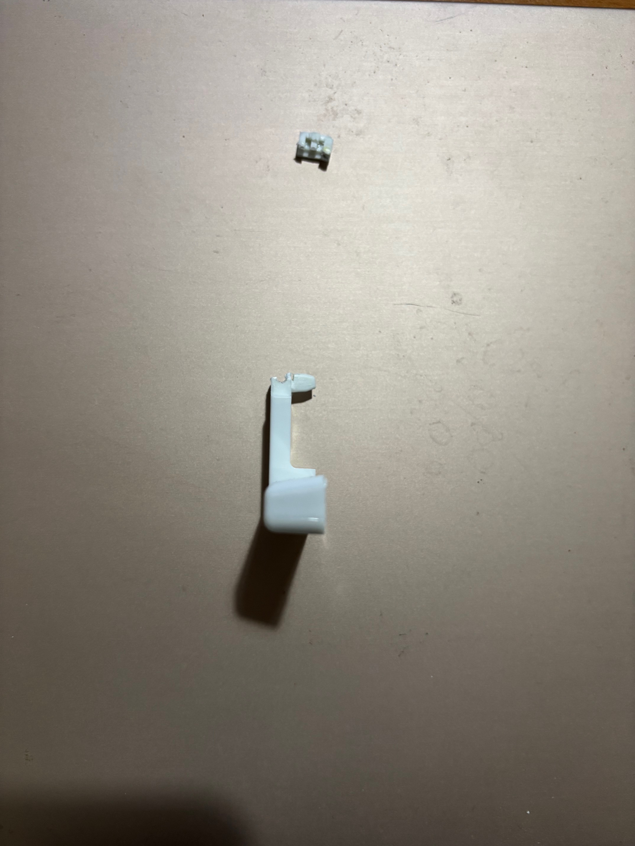
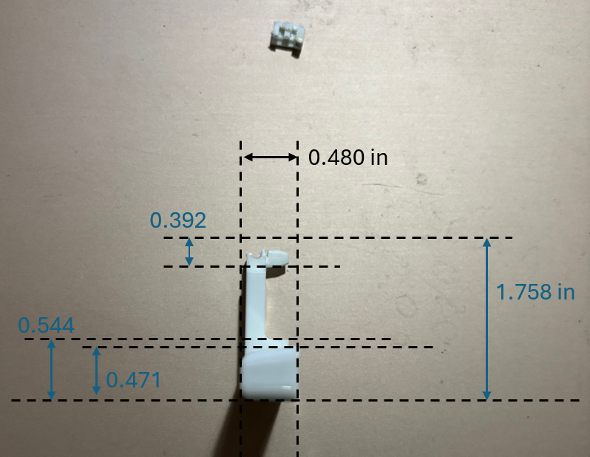
Egg holder
0.480 in
0.392
0.216 in
1.758 in
1.779
0.544
0.471
1.779

Slide 11
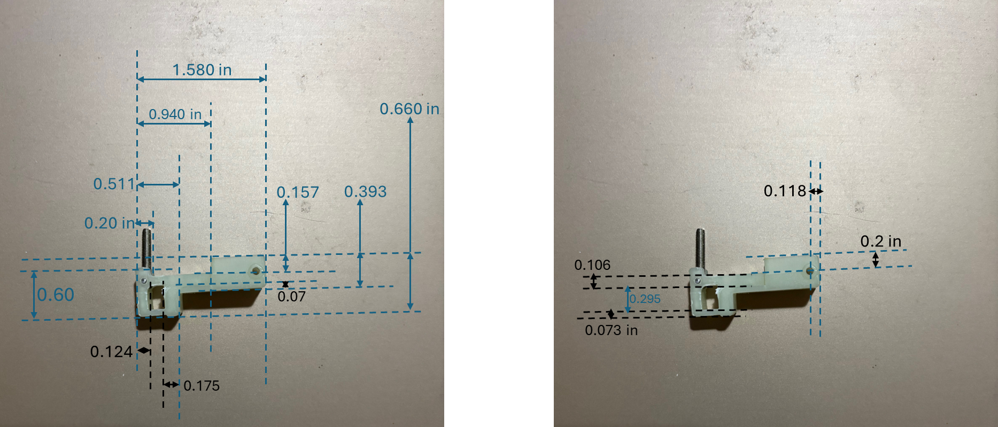

Slide 12
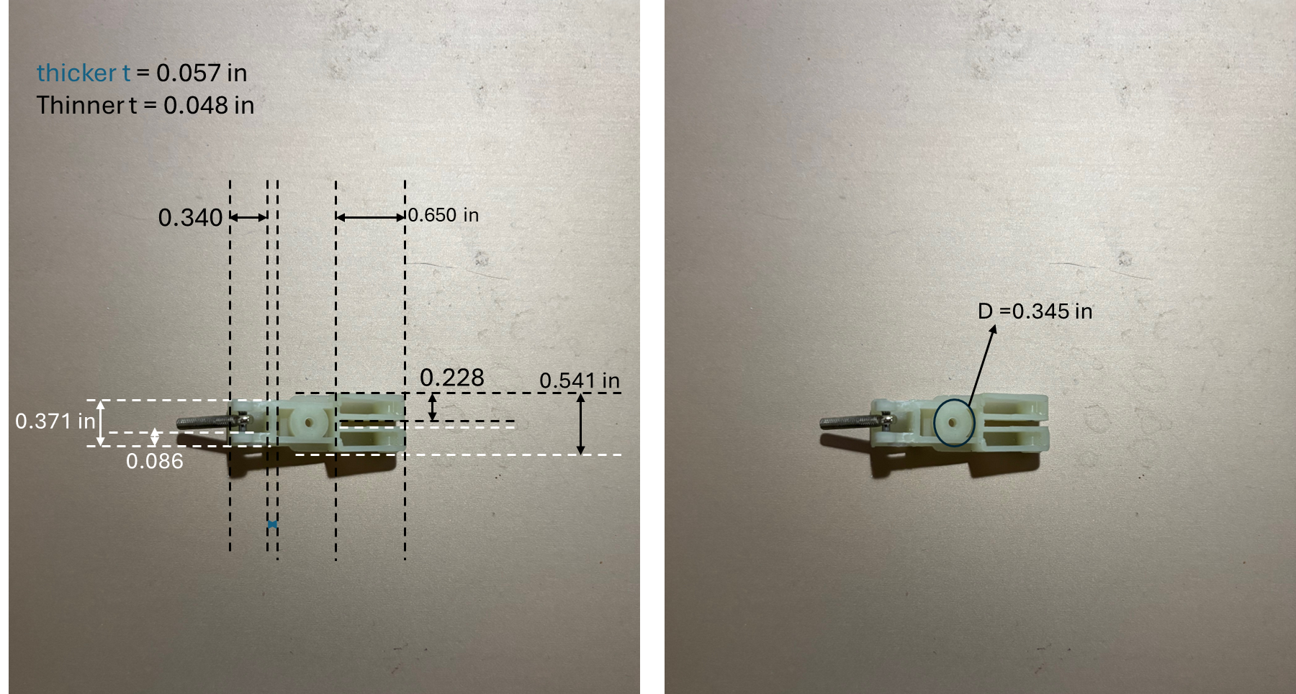

Slide 13
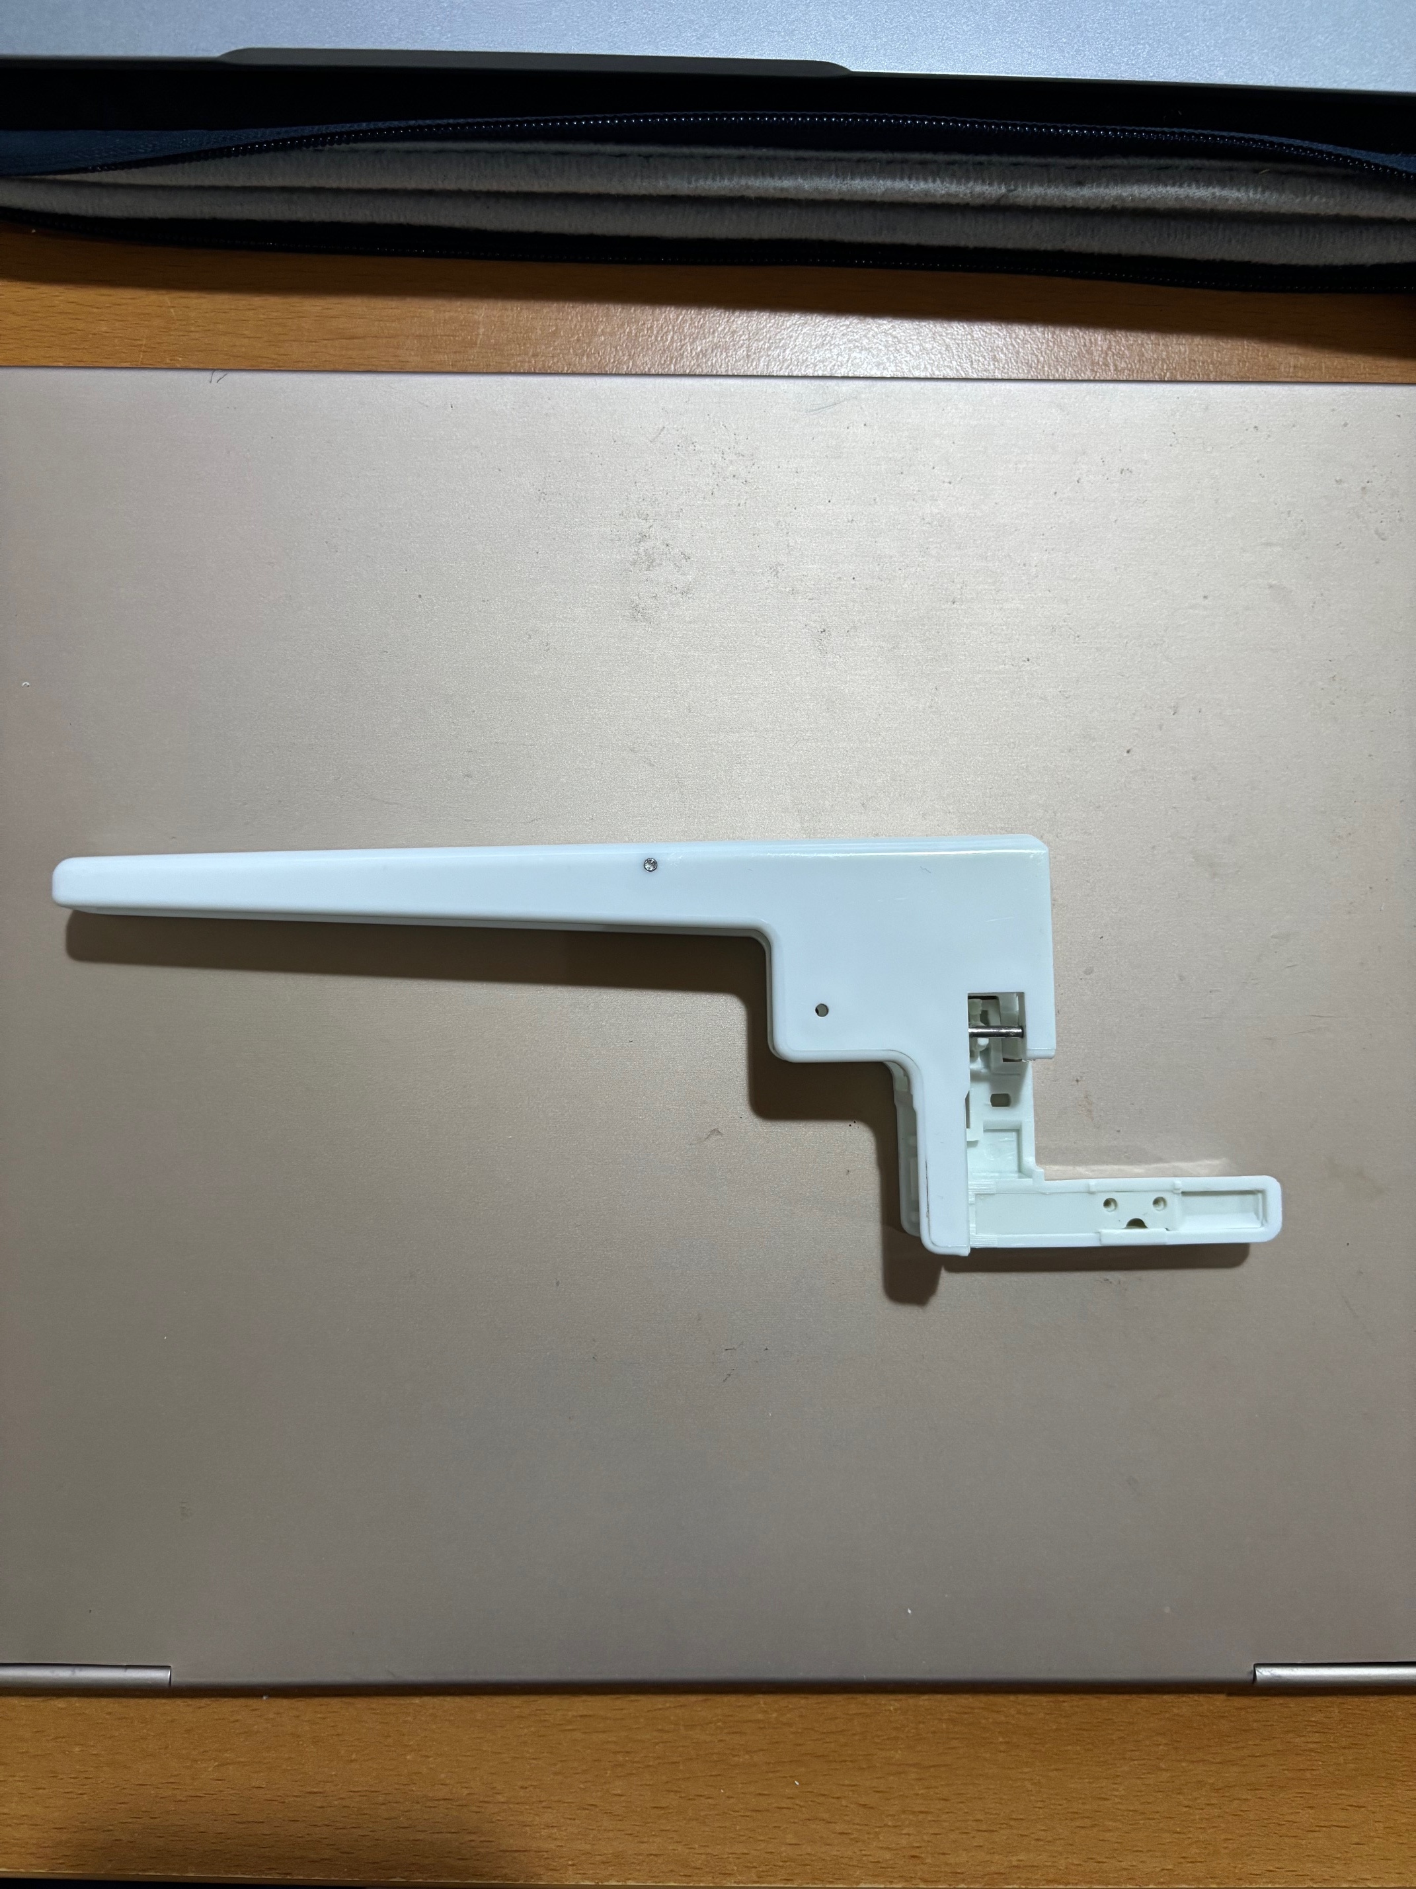
Base outer
6.985 in
0.92 in
1.02 in
0.358 in
2.893 in
2.255 in
1.310 in
0.609 in

Slide 14
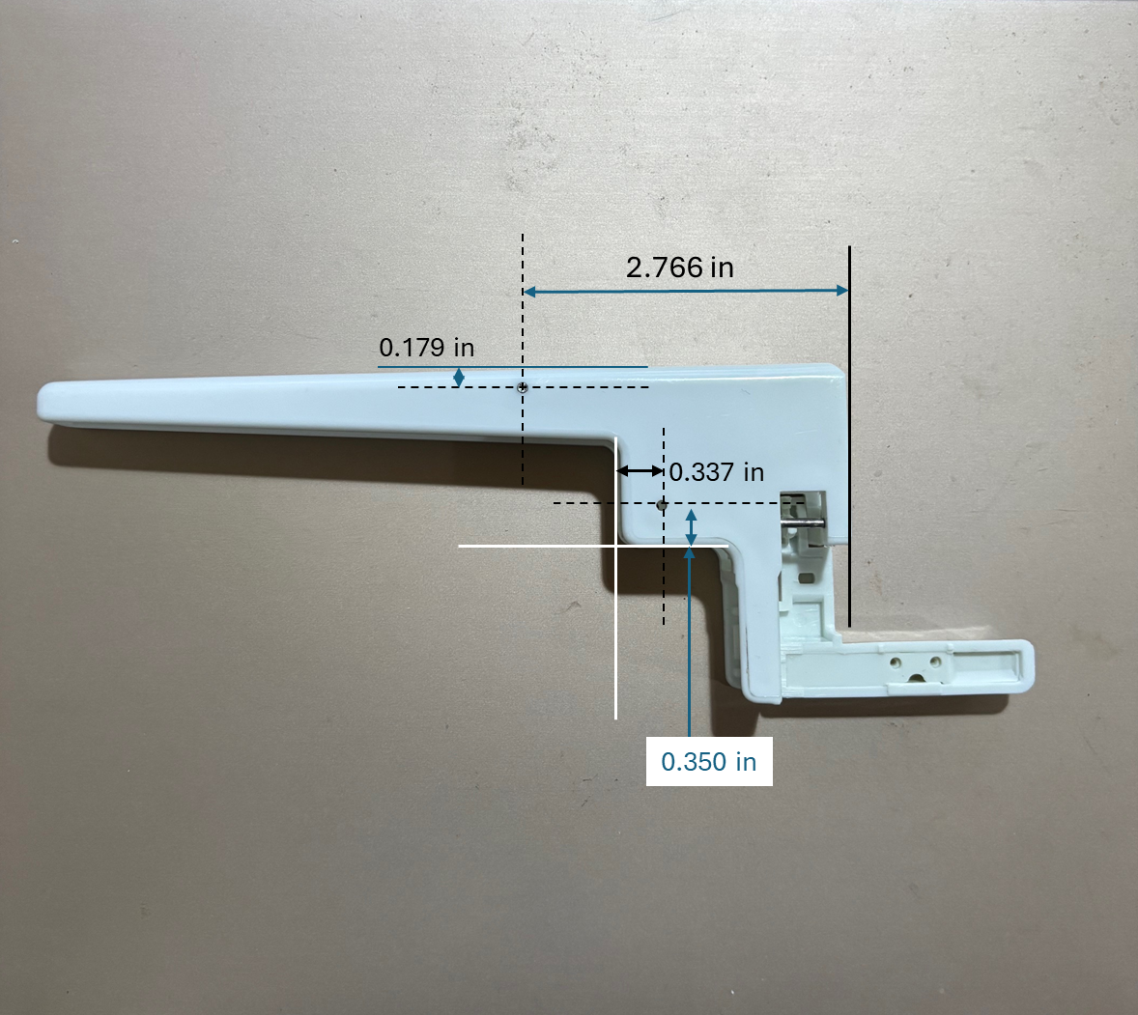
Base inner

Slide 15
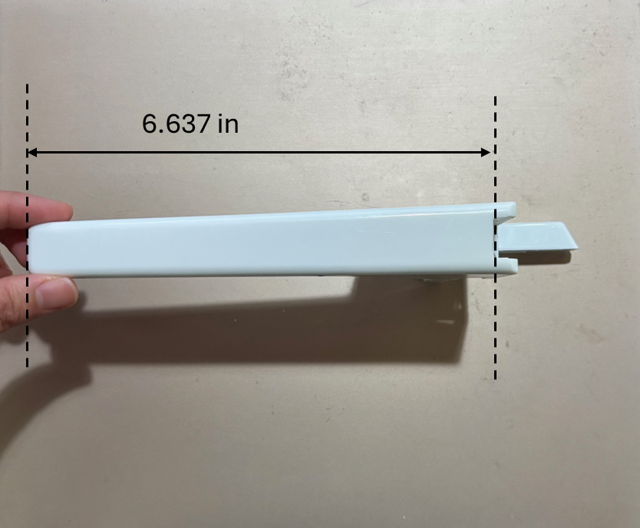

Slide 16
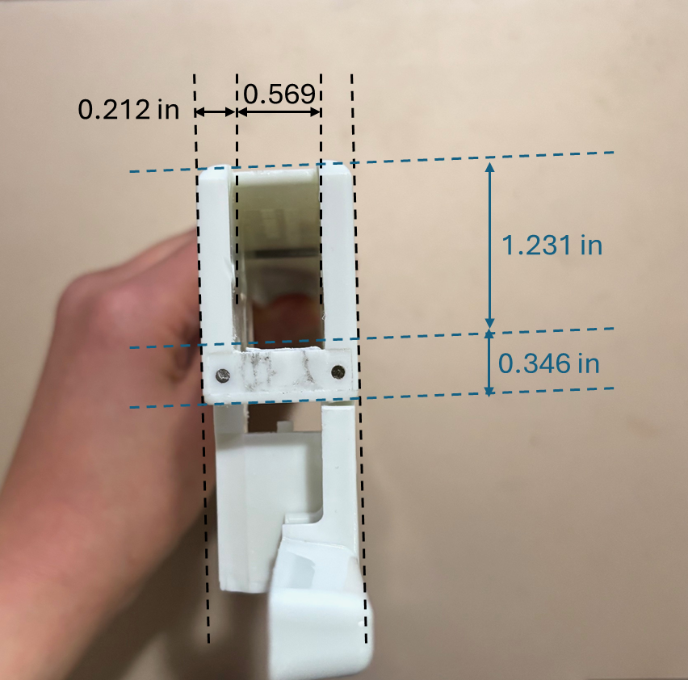
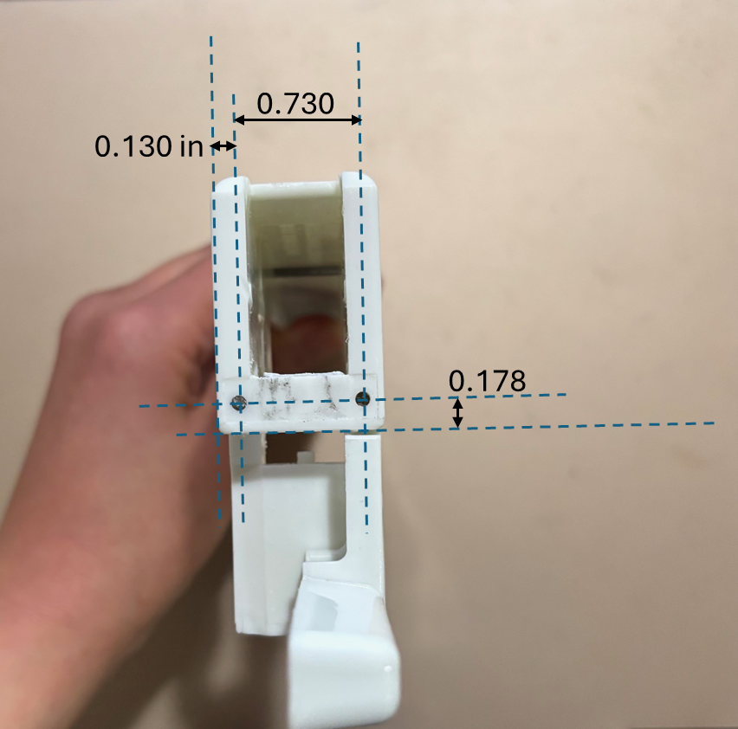
Notes:
Not sure of positioning of pin holes in picture

Slide 17
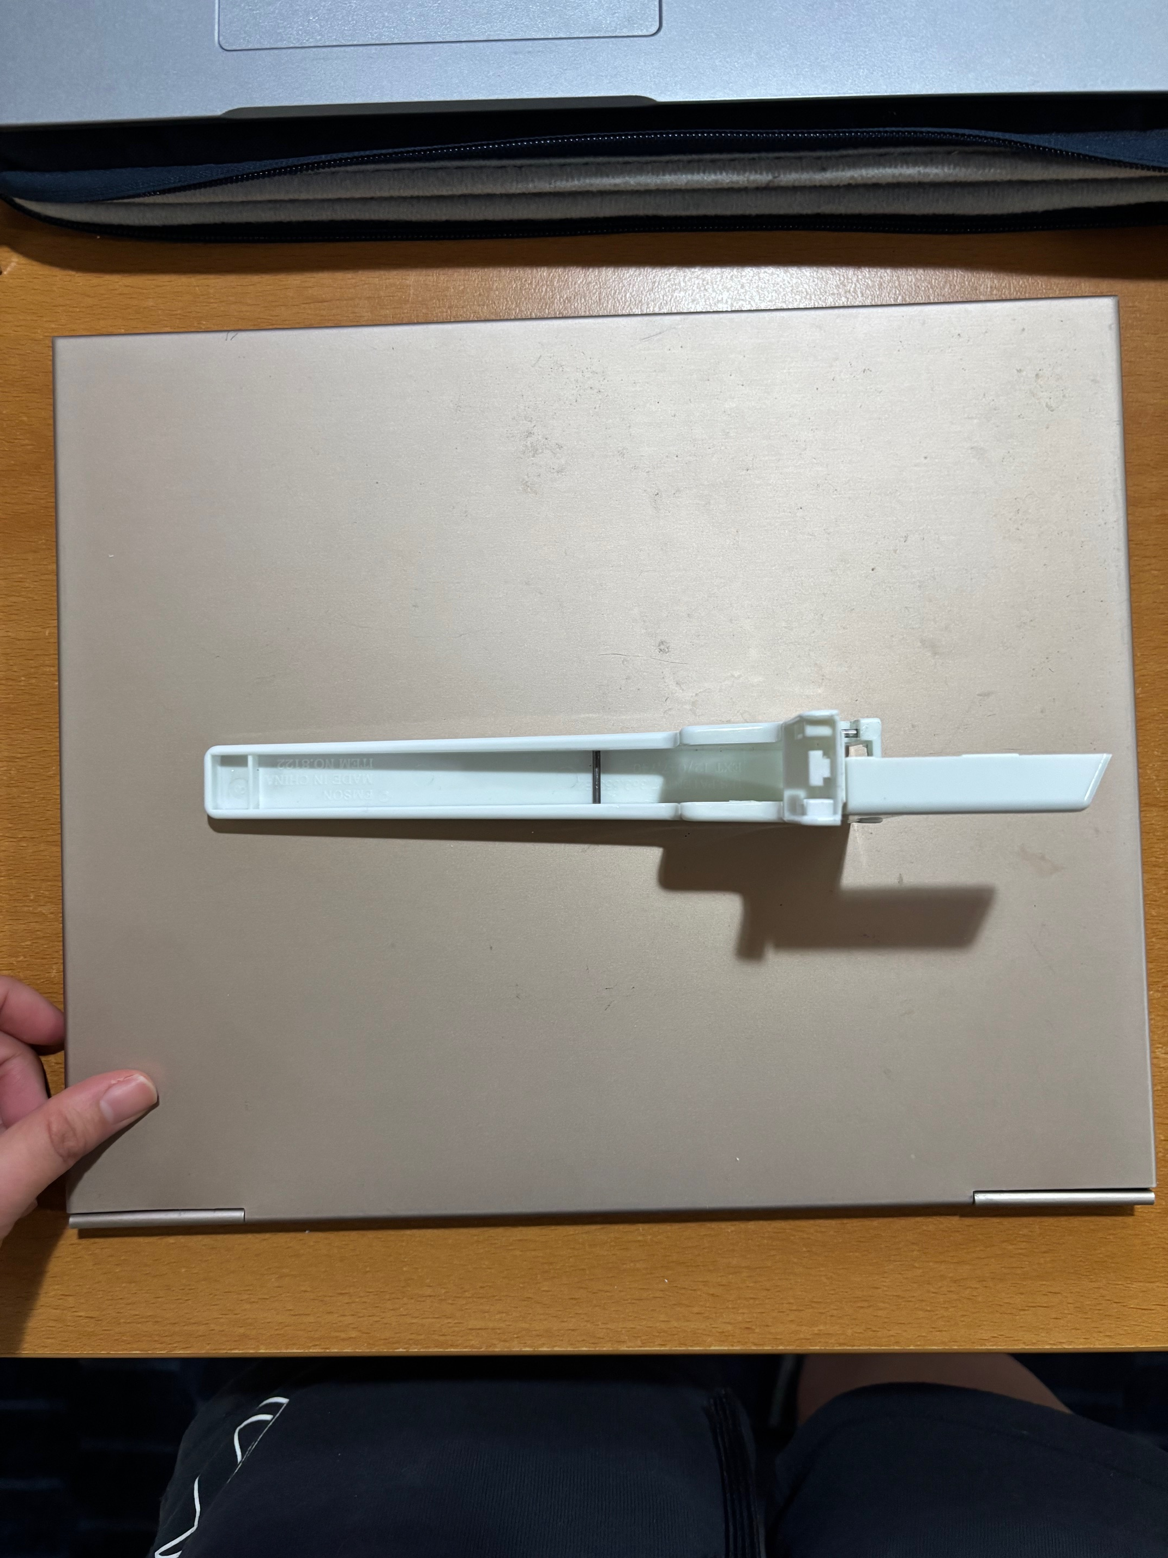
0.272
0.170
t = 0.110 in
0.993 in
0.313
0.8 in
Thickness – 0.071 in
0.65
0.340
0.224
0.086

Slide 18
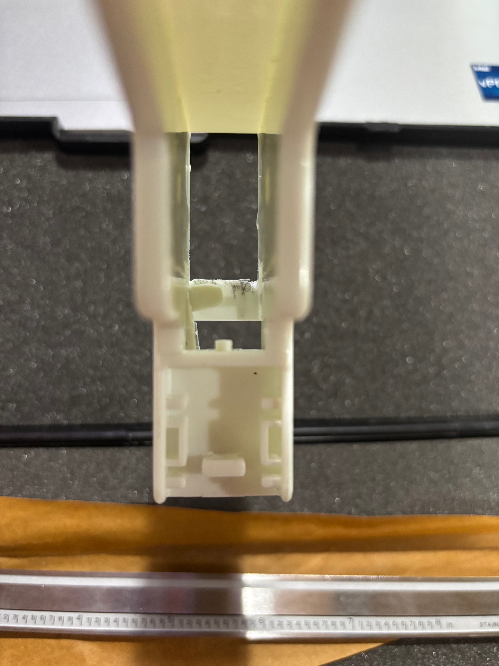
Thickness – 0.05 in
0.08
0.678
0.120
0.338
0.55
0.330
0.125
Both from inside square

