Slide 1
Advisor Meeting

Slide 2
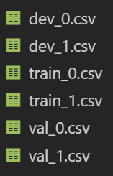
Training has begun
Parallel dataset with faces
Files ending with *_0.jpg -> real
Files ending with *_1.jpg -> fake
Paths to faces were stored in csv for training under
 | 0 | 1 | Total
Train | 85006 | 65860 | 150866
Dev | 21048 | 28670 | 49718
Val | 4782 | 10563 | 15345
 |  | Total Faces | 215929

Slide 3
CNN model
Simple Model architecture started as baseline

Slide 4
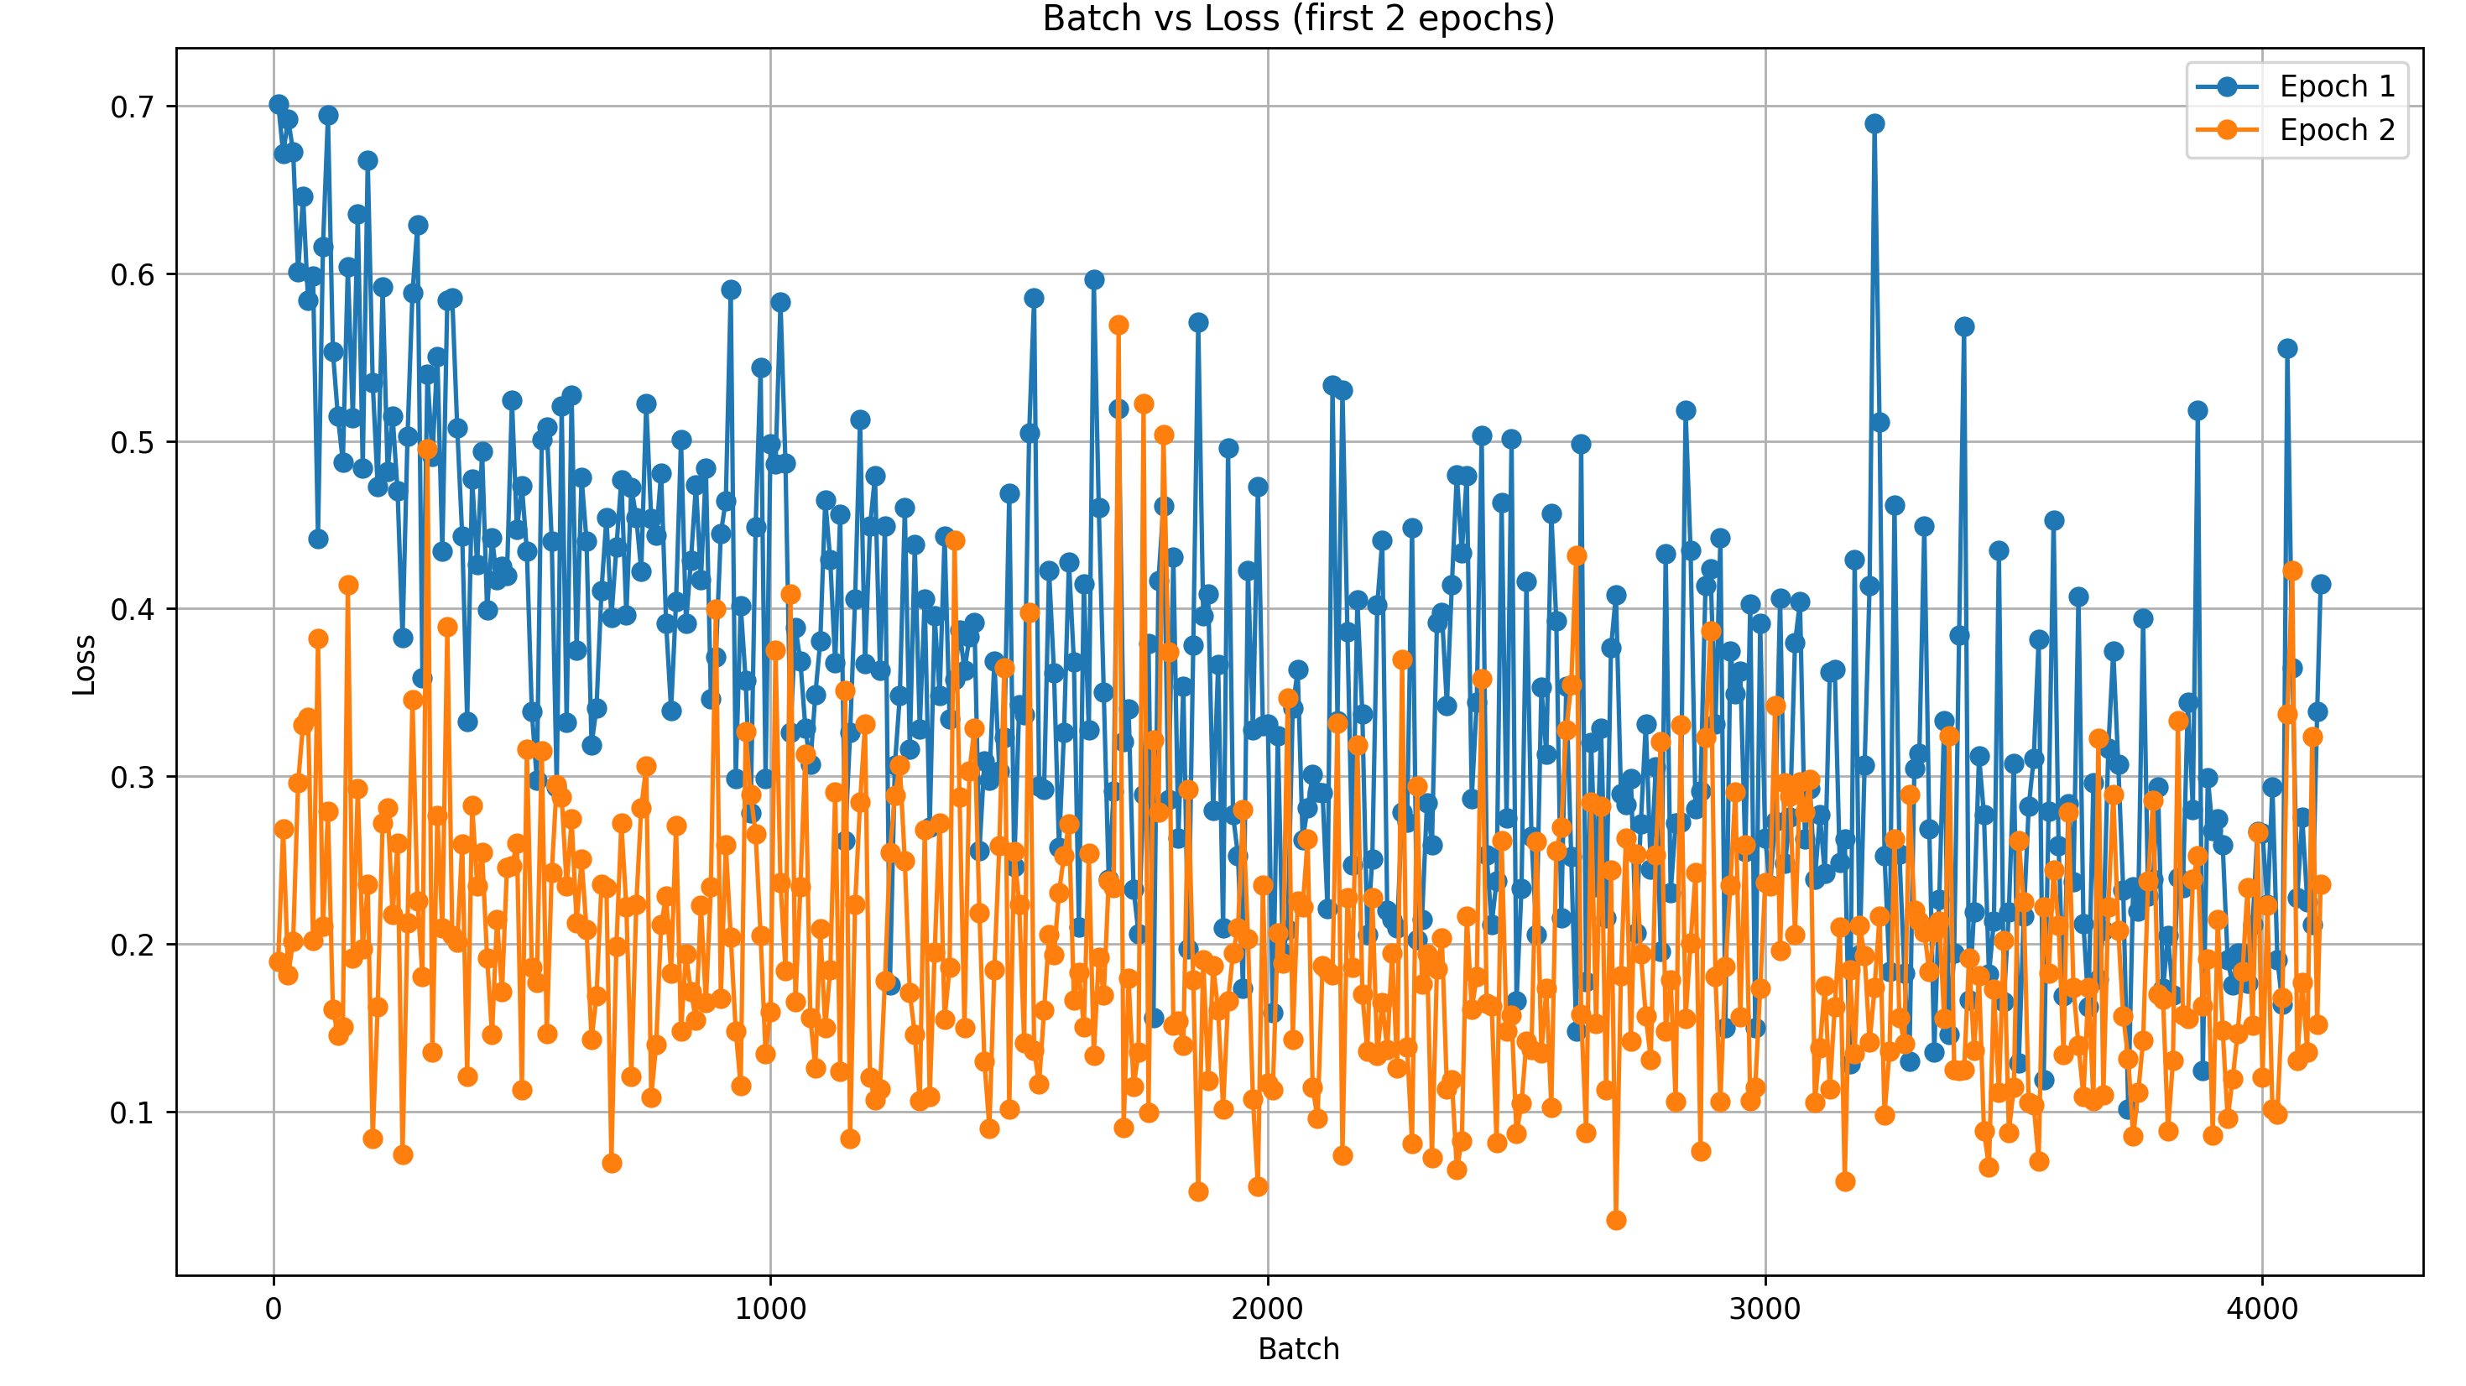
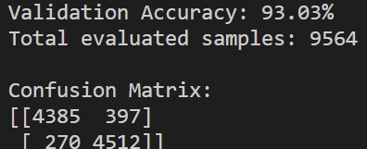
CNN Model Evaluation
Equal number of 0 and 1 when training and evaluation
4782 * 2 = 9564 eval samples
65860 * 2 = 131720 train samples
Over 2 epochs

Slide 5
Tuning Parameters
Tuned Layers and Kernal size from 2 – 8
10 epochs
Using same model as before – tuned parameters
Trained on 2000
Evaluated on 1k image at the end of each epoch
Created a new model and repeated
Confusion matrix saved at each round with naming convention
ConfusionMatrix/confusion_layers#_kernel#_epoch#.csv
Calculated accuracy, F1, Precision, Recall

Slide 6
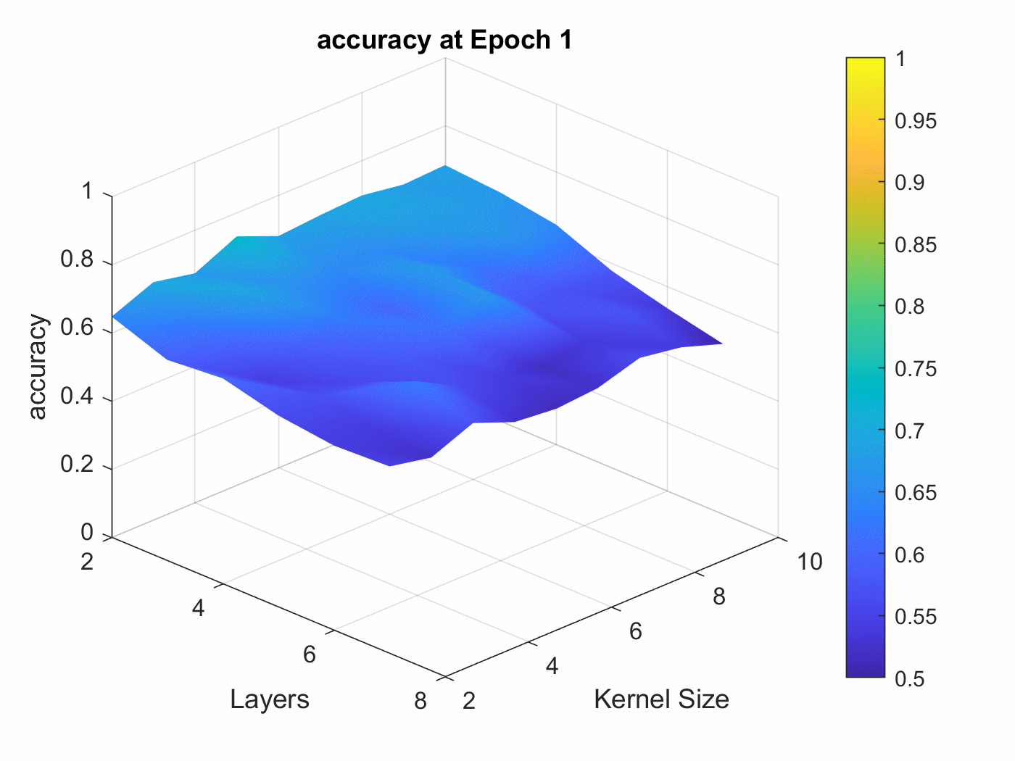
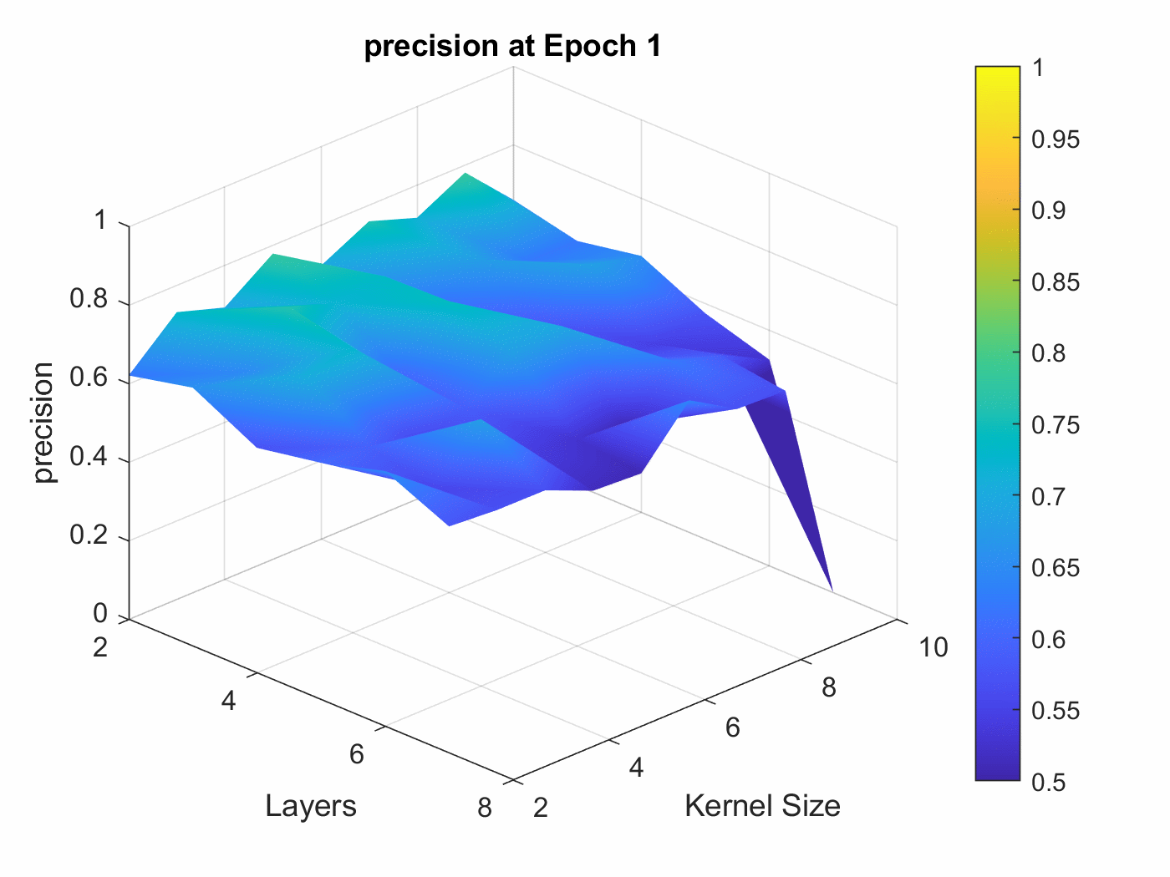
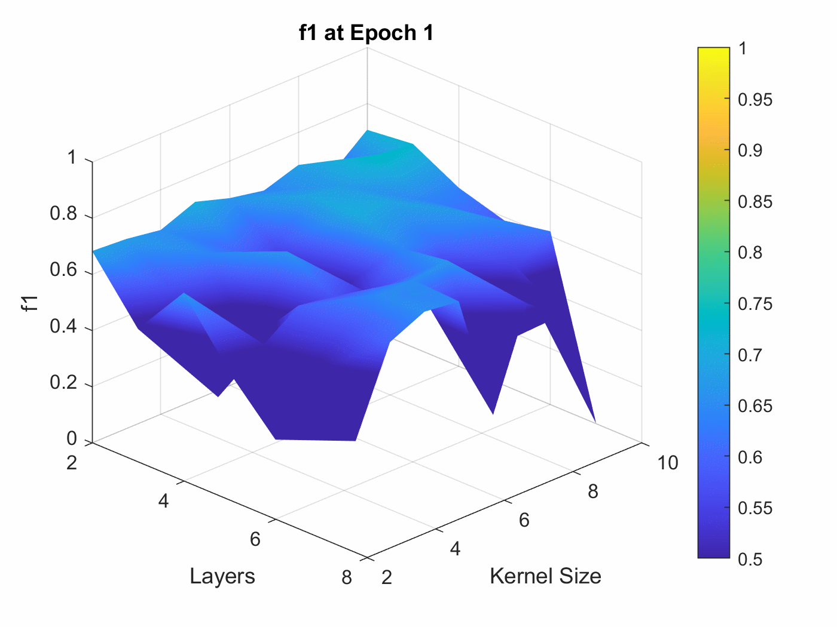
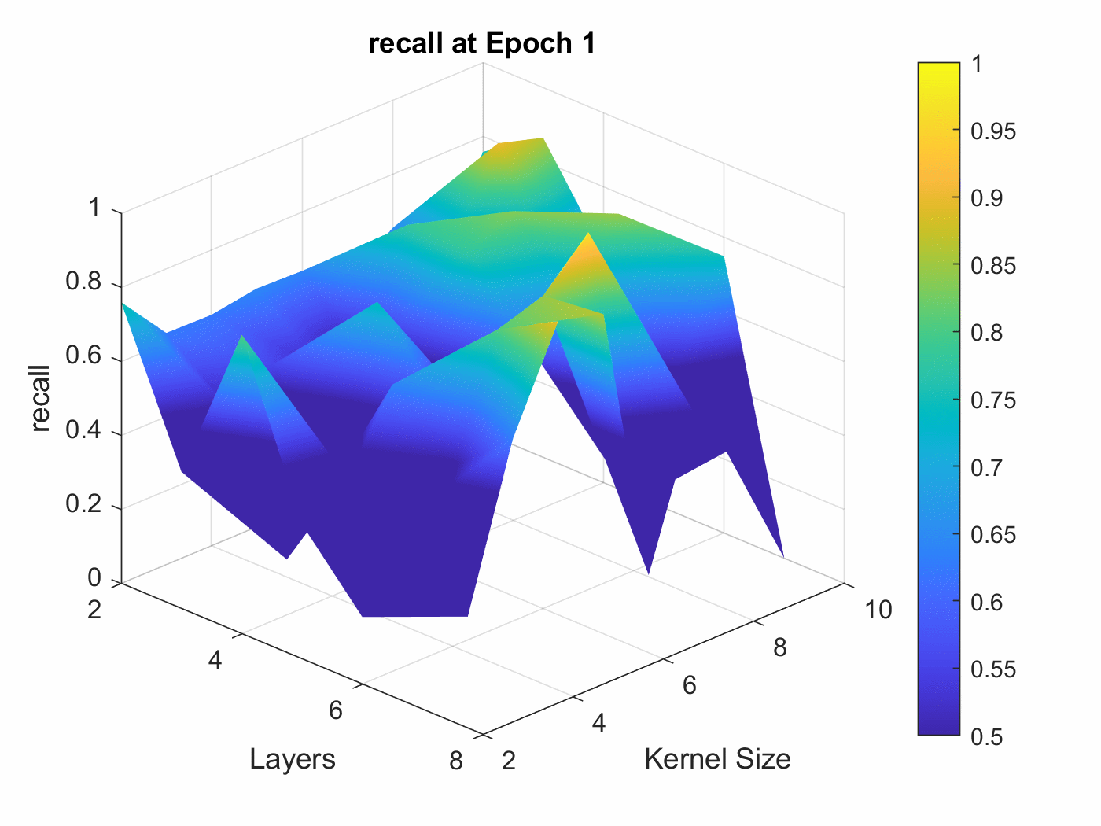
500+ Separate experiments
Used MATLAB
[will fix animations later]
Exploring methods of data visualization
Any suggestions?

Slide 7
Summary data
BEST ACCURACY: 0.898
(Layers=5, Kernel=7, Epoch=10)
[[453 47]
[ 55 445]]
WORST ACCURACY: 0.5 (Layers=6, Kernel=10, Epoch=2)
[[ 0 500]
[ 0 500]]
BEST PRECISION: 0.959
(Layers=7, Kernel=4, Epoch=8)
[[485 15]
[150 350]]
WORST PRECISION: 0.0 (Layers=7, Kernel=10, Epoch=1)
[[500 0]
[500 0]]
BEST RECALL: 1.0
(Layers=6, Kernel=10, Epoch=2)
[[ 0 500]
[ 0 500]]
WORST RECALL: 0.0
(Layers=7, Kernel=10, Epoch=1)
[[500 0]
[500 0]]
BEST F1: 0.897
(Layers=5, Kernel=7, Epoch=10)
[[453 47]
[ 55 445]]
WORST F1: 0.0
(Layers=7, Kernel=10, Epoch=1)
[[500 0]
[500 0]]

Slide 8
Summary data
BEST ACCURACY: 0.898
(Layers=5, Kernel=7, Epoch=10)
[[453 47]
[ 55 445]]
Confusion Matrix: [[453, 47], [55, 445]]
Accuracy : 0.898
Precision: 0.904
Recall : 0.890
F1 Score : 0.897

Slide 9
Next Steps in training
Create a systematic method to train and tune parameters
Alternate which variables for best outcome?
Improve Visualizations

Slide 10
One more thing…..

