Slide 1
SD ADVISOR MEETING 4
DeepTRUTH
Advisor: Dr. Picone
Team: Jouri, Jahtega, Zacary, Ashton

Slide 2
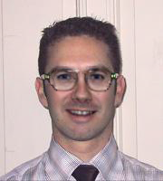
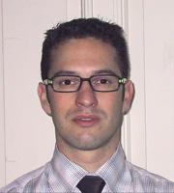
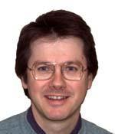
Dataset
30 / 50 photoshop
Documentation Started

Slide 3
Dataset File Structure
Photoshop (000-049)
Fake
Root Files
Deep Website (050-099)
Real
Reals (100-199)

Slide 4
Dataset Annotations
Image | Method | Original Image | Face 0 | Image 0 | Face N | Image N

Slide 5
Steps:
Scale up
Detect Face using Haar Cascade
What if we changed the HC
DCT
RNF
Different File formats

Slide 6
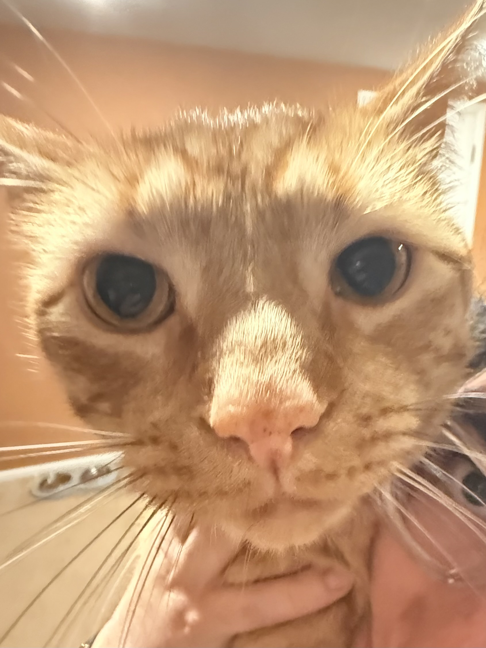
scale | file_size_mb | Face Detection | DCT | RF Classification | avg_total_time | Faces Detected
1 | 0.242 | 0.4724 | 0.0606 | 0.1547 | 0.6877 | 2
1.1 | 0.281 | 0.5409 | 0.0754 | 0.0967 | 0.713 | 2
1.21 | 0.323 | 0.5899 | 0.0823 | 0.0896 | 0.7618 | 2
1.33 | 0.37 | 0.7216 | 0.0966 | 0.096 | 0.9143 | 2
1.46 | 0.423 | 0.8188 | 0.111 | 0.0875 | 1.0173 | 3
1.61 | 0.487 | 0.9024 | 0.1183 | 0.0812 | 1.1019 | 2
1.77 | 0.559 | 1.1232 | 0.1631 | 0.0869 | 1.3732 | 6
1.95 | 0.645 | 1.2001 | 0.1482 | 0.0853 | 1.4336 | 1
2.14 | 0.739 | 1.423 | 0.1886 | 0.0898 | 1.7014 | 4
2.36 | 0.857 | 2.127 | 0.2891 | 0.1107 | 2.5268 | 2
2.59 | 0.985 | 2.0597 | 0.2823 | 0.0885 | 2.4305 | 5
2.85 | 1.136 | 2.3434 | 0.3228 | 0.0894 | 2.7556 | 4
3.14 | 1.317 | 2.6685 | 0.3628 | 0.0855 | 3.1168 | 1
3.45 | 1.521 | 4.2307 | 0.5884 | 0.1114 | 4.9305 | 5
3.8 | 1.768 | 16.9765 | 1.5529 | 0.2169 | 18.7462 | 4

Slide 8
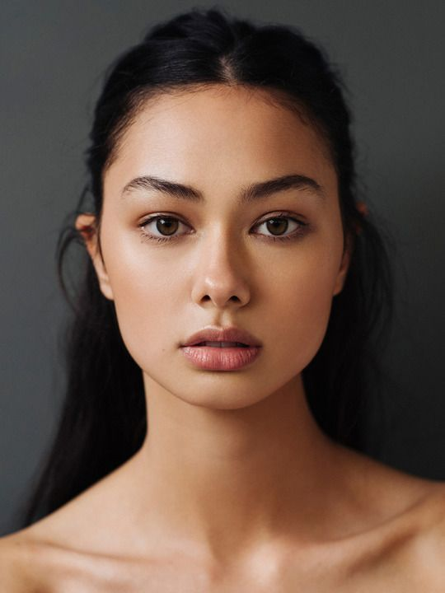
scale | file_size_mb | Face Detection | DCT | Classification | avg_total_time | avg_num_faces
1 | 0.029 | 0.1298 | 0.0121 | 0.0433 | 0.1851 | 1
1.5 | 0.049 | 0.1507 | 0.0171 | 0.0441 | 0.2119 | 1
2 | 0.069 | 0.2169 | 0.0255 | 0.0472 | 0.2895 | 1
2.5 | 0.102 | 0.298 | 0.035 | 0.0424 | 0.3754 | 1
3 | 0.129 | 0.3701 | 0.0482 | 0.0435 | 0.4617 | 1
3.5 | 0.17 | 0.4751 | 0.0614 | 0.0454 | 0.582 | 1
4 | 0.203 | 0.5575 | 0.0789 | 0.0433 | 0.6797 | 1
4.5 | 0.25 | 0.6831 | 0.0999 | 0.0419 | 0.8248 | 1
5 | 0.293 | 0.7693 | 0.1199 | 0.0426 | 0.9318 | 1
5.5 | 0.346 | 0.904 | 0.148 | 0.0432 | 1.0953 | 1
6 | 0.392 | 1.0181 | 0.1722 | 0.0443 | 1.2346 | 1
6.5 | 0.452 | 1.151 | 0.2005 | 0.0427 | 1.3941 | 1
7 | 0.509 | 1.2785 | 0.233 | 0.0422 | 1.5537 | 1
7.5 | 0.572 | 1.3818 | 0.2567 | 0.0408 | 1.6793 | 1
8 | 0.608 | 1.5157 | 0.2953 | 0.0415 | 1.8525 | 1
8.5 | 0.704 | 1.6949 | 0.3301 | 0.042 | 2.0671 | 1
9 | 0.776 | 1.8562 | 0.3631 | 0.0427 | 2.2619 | 1
9.5 | 0.853 | 1.9771 | 0.4041 | 0.0408 | 2.422 | 1
10 | 0.929 | 2.2091 | 0.4519 | 0.0457 | 2.7067 | 1

Slide 10
Jahtega Update
Working on NEDC tools with Dylan
Ashton Update
Halfway through the dataset generation
Zacary Update
Working with Korey to deploy website

