Slide 1
Meeting 3

Slide 2
Performance
Project Criteria
Performance
Efficiency
Scalability
Code Maintainability
Usability
Ethical & Security
Name | Require or Constraint | Priority
Accuracy | Requirement | Negotiable
Precision & Recall | Requirement | Negotiable
F1-Score | Requirement | Negotiable
Efficiency
Name | Require or Constraint | Priority
ML processing time | Requirement | Negotiable
Website Boot Time | Requirement | Negotiable
Resource Usage | Constraint | Non-Negotiable

Slide 3
Scalability
Name | Require or Constraint | Priority
Dataset Generalizability | Requirement | Negotiable
Accessible for Public Use | Requirement | Non-Negotiable
Code Maintainability
Name | Require or Constraint | Priority
Code complies with ISIP standards | Constraint | Non-Negotiable
Documentation | Requirement | Non-Negotiable

Slide 4
Usability
Name | Require or Constraint | Priority
Interpretability | Requirement | Negotiable
Accessibility | Requirement | Negotiable
User Interface | Requirement | Negotiable
Ethical & Security
Name | Require or Constraint | Priority
Algorithmic Transparency | Constraint | Non-Negotiable
Data Privacy | Constraint | Non-Negotiable
Website Security | Requirement | Negotiable

Slide 5
Website Speed Test
Size | Face Count | Haar Cascade | DCT | ML Model
0.019 MB | 1 | 0.75s | 0.015s | 0.066s
0.006 MB | 2 | 0.053s | 0.16s | 0.065s
0.024 MB | 5 | 0.256s | 0.031s | 0.063s
0.156 MB | 10 | 0.564s | 0.092s | 0.075s
0.09 MB | 33 | 0.299s | 0.195s | 0.083s
3.379 MB | 52 | 2.259s | 0.62s | 0.079s
Size | Haar Cascade | DCT | ML Model
0.006 MB | 0.084s | 0.21s | 0.069s
0.014 MB | 0.165s | 0.25s | 0.06s
0.036 MB | 0.442s | 0.58s | 0.058s
0.104 MB | 1.478s | 0.11s | 0.064s
0.328 MB | 3.205s | 0.254s | 0.069s

Slide 6
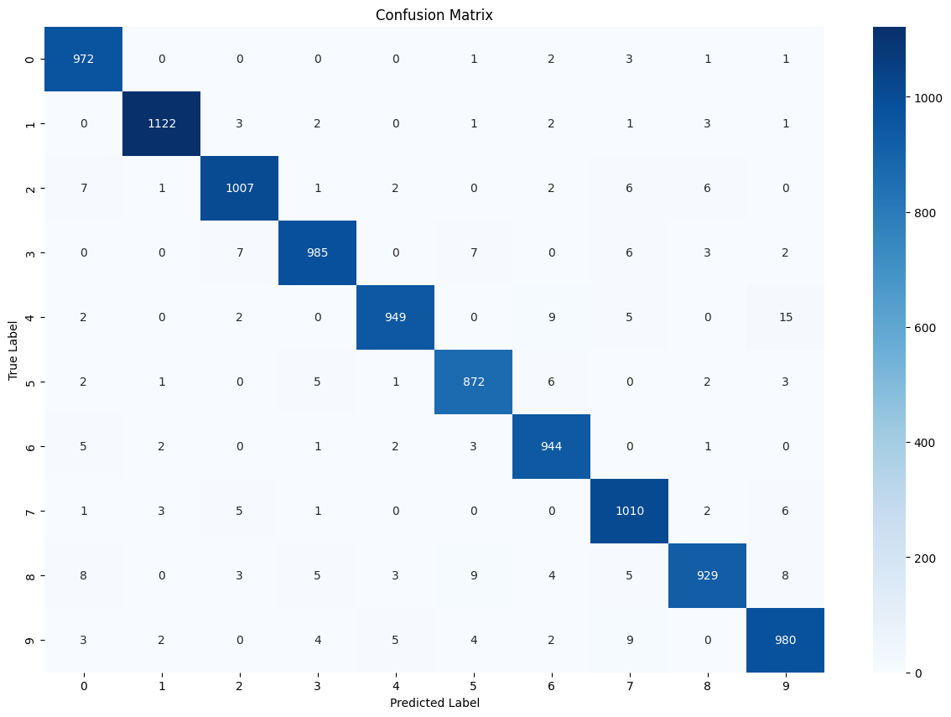
MNIST CNN tutorial results

Slide 7
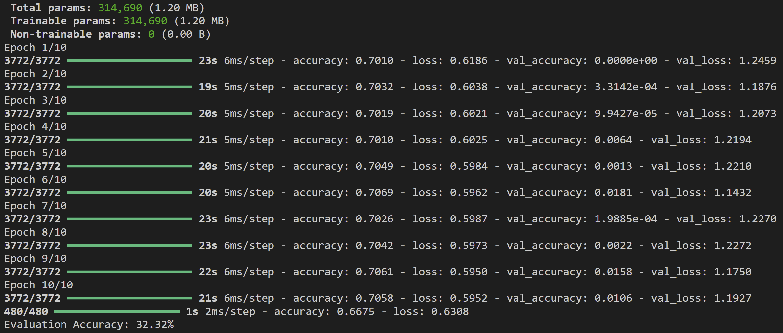
CNN results using DCT Values

Slide 8
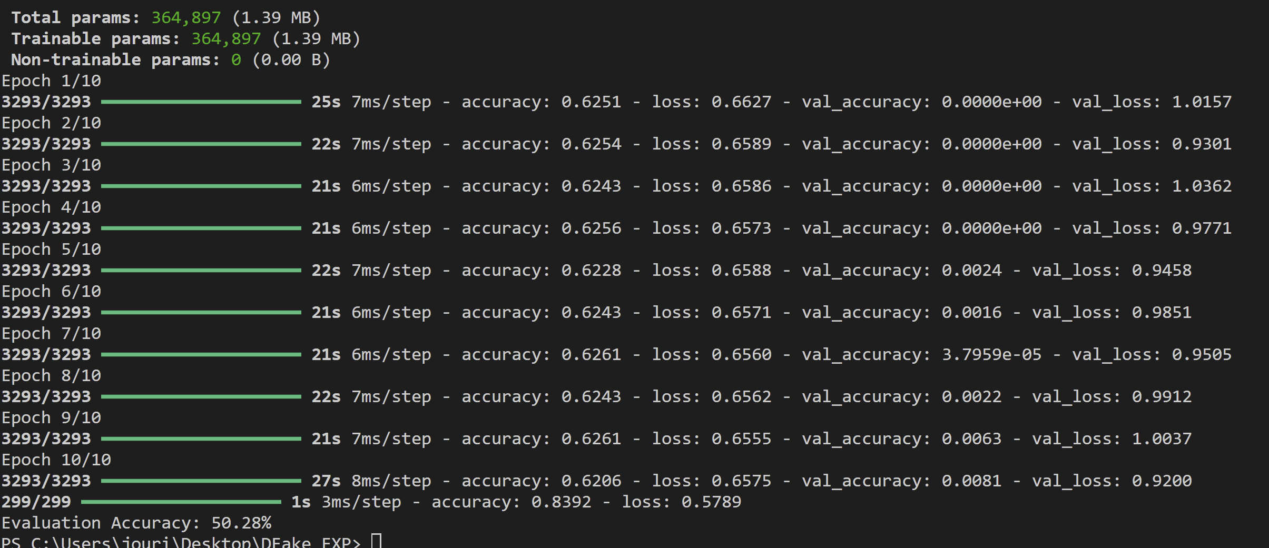
CNN PT2 using DCT Values

