Slide 1
Meeting 2: DeepFake Detection
9/3/2025
Team no.5: Jouri Ghazi,

Slide 2
Team Updates
Wrote Problem statement introducing our project
CNN: Working on finding code to take bounding box from image
Working on website deployment

Slide 3
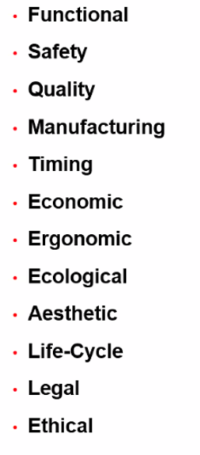
Design Requirements
Quantitative & Qualitative Design requirements
Design constraints
What should the product achieve?
What is the purpose of the product
Negotiables/non-negotiables

Slide 4



Requirements
Runtime
Image Size
Performance Accuracy
Requirement
Metric
Seconds/pixel²
Types
Accuracy %
Normalized ratio
(1500 ms / 1K x1K)
Target Value
PNG, JPEG, WEBP
At least 95%
Allows for real time image processing and classification
Create a wide range of useable
Why?
Ensuring reliable model performance
Notes:
Zac

Slide 5



Engineering Design
Constraints
Server Environment
Dataset Availability
Constraint
Scalability
Metric
Status
Statuses
% of Datasets Available
Target Value
Pass/Fail
Python 3.9.16, Rocky Linux 8.1, Flask 3.1.0
Pass/Fail
Website UI must scale with the number of faces in the image.
All software must be compatible with Neuronix Cluster
Why?
Used for training deepfake detectors
Dataset Annotation
The process of labeling data to train AI models
Notes:
Zac

Slide 6
Ashton Bryant
Facebook Dataset
https://ai.meta.com/datasets/facet-downloads/
CelebFaces Attributes (CelebA) Dataset
https://www.kaggle.com/datasets/jessicali9530/celeba-dataset
Caltech Dataset
https://data.caltech.edu/records/1n643-gep93
ForgeryNet: Face Forgery Analysis Challenge 2021
https://competitions.codalab.org/competitions/33386
DeepFake Methods
Photoshop Autoblend
Deepfakemaker.io

Slide 7
Jahtega Updates
Version 0 of our user guide has been created
Content for the introduction section has started production

