Slide 1
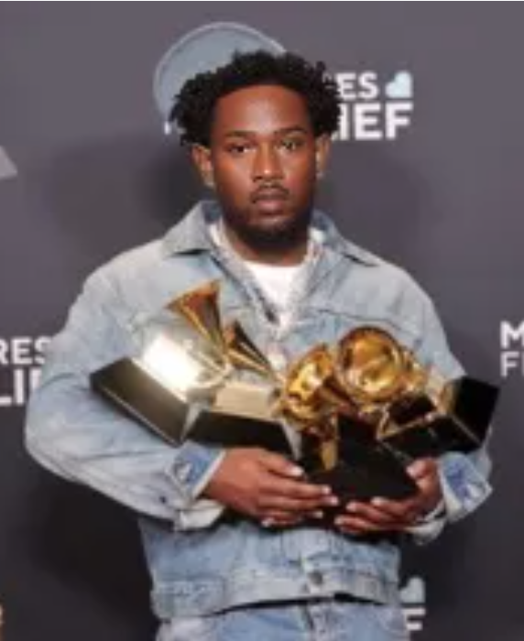
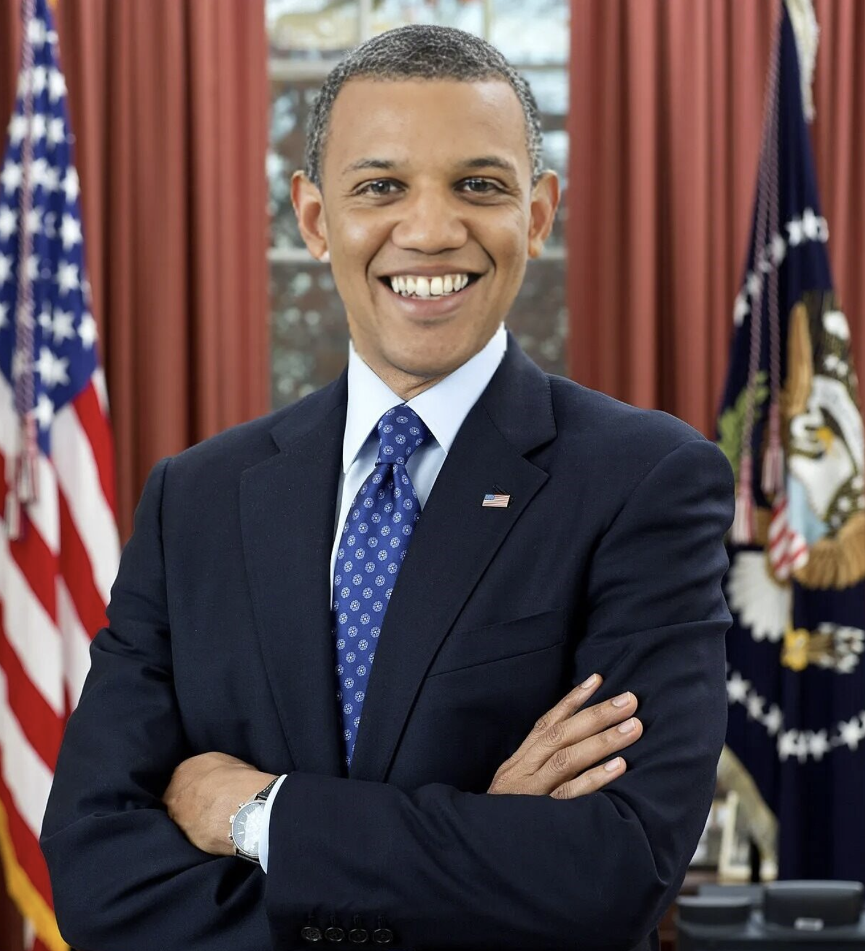
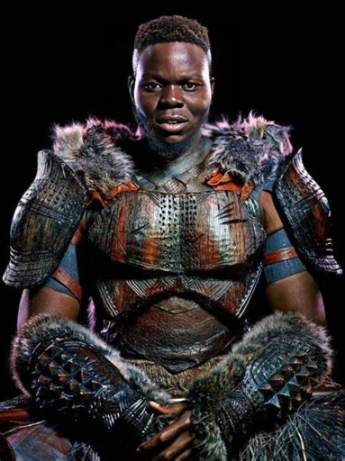
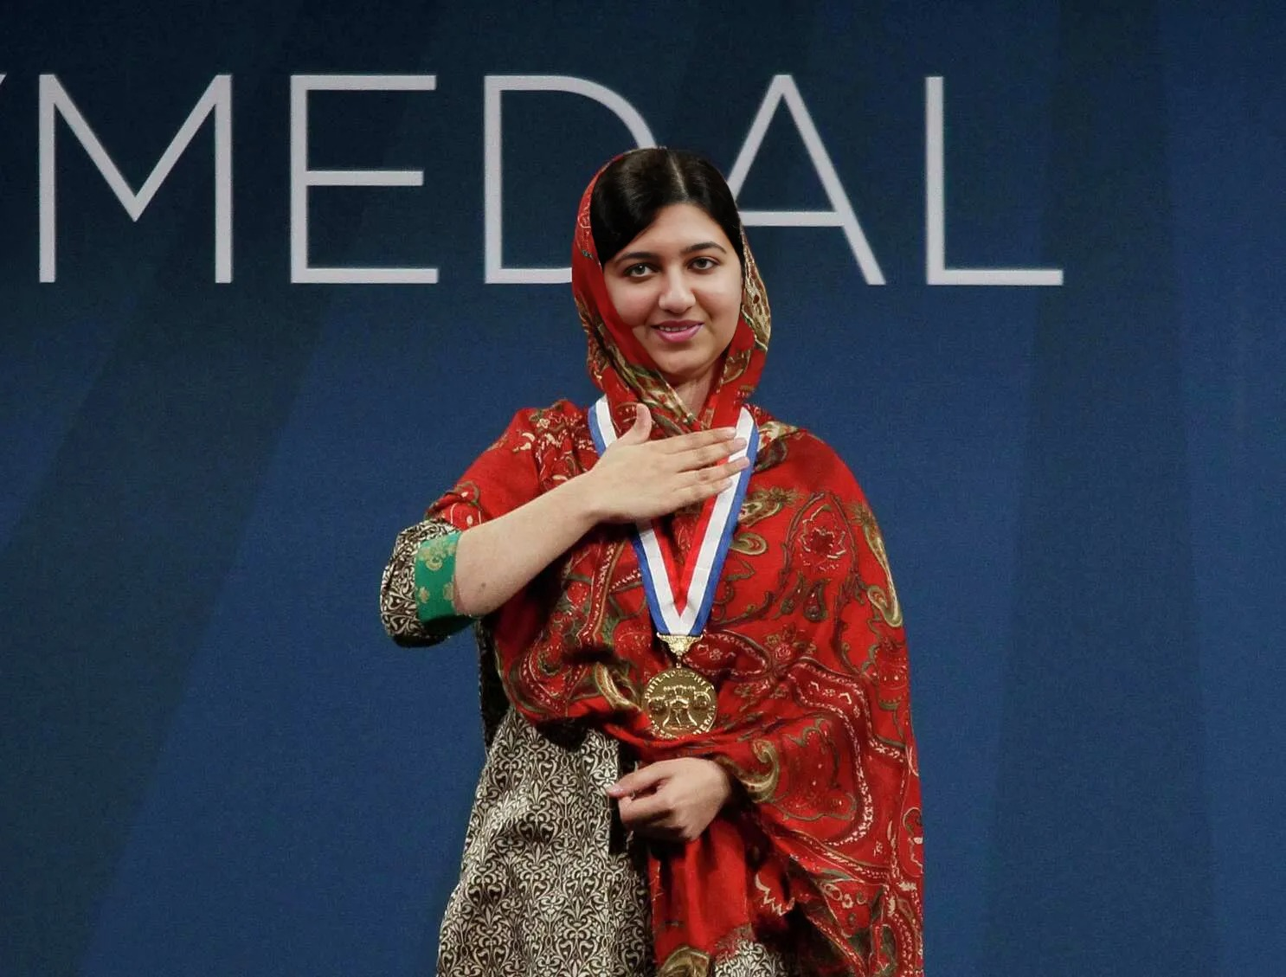

DeepFake Detection
Advised by Dr. Picone
Jouri Ghazi
Jahtega Djukpen
Ashton Bryant
Zacary Louis
A Nobel Peace Prize winner
An Oscar Winning Actor
The 44th President of the United States
A Multi-Grammy award Artist
A Nobel Peace Prize winner
An Oscar Winning Actor
The 44th President of the United States
A Multi-Grammy award Artist
These are synthesized images, we will be developing a DeepFake detection method.
Notes:
Jouri

Slide 2
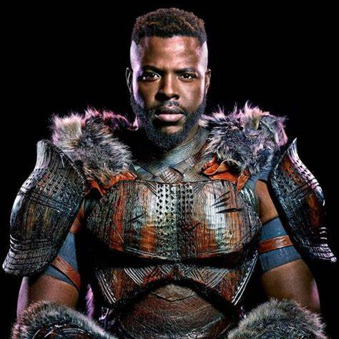
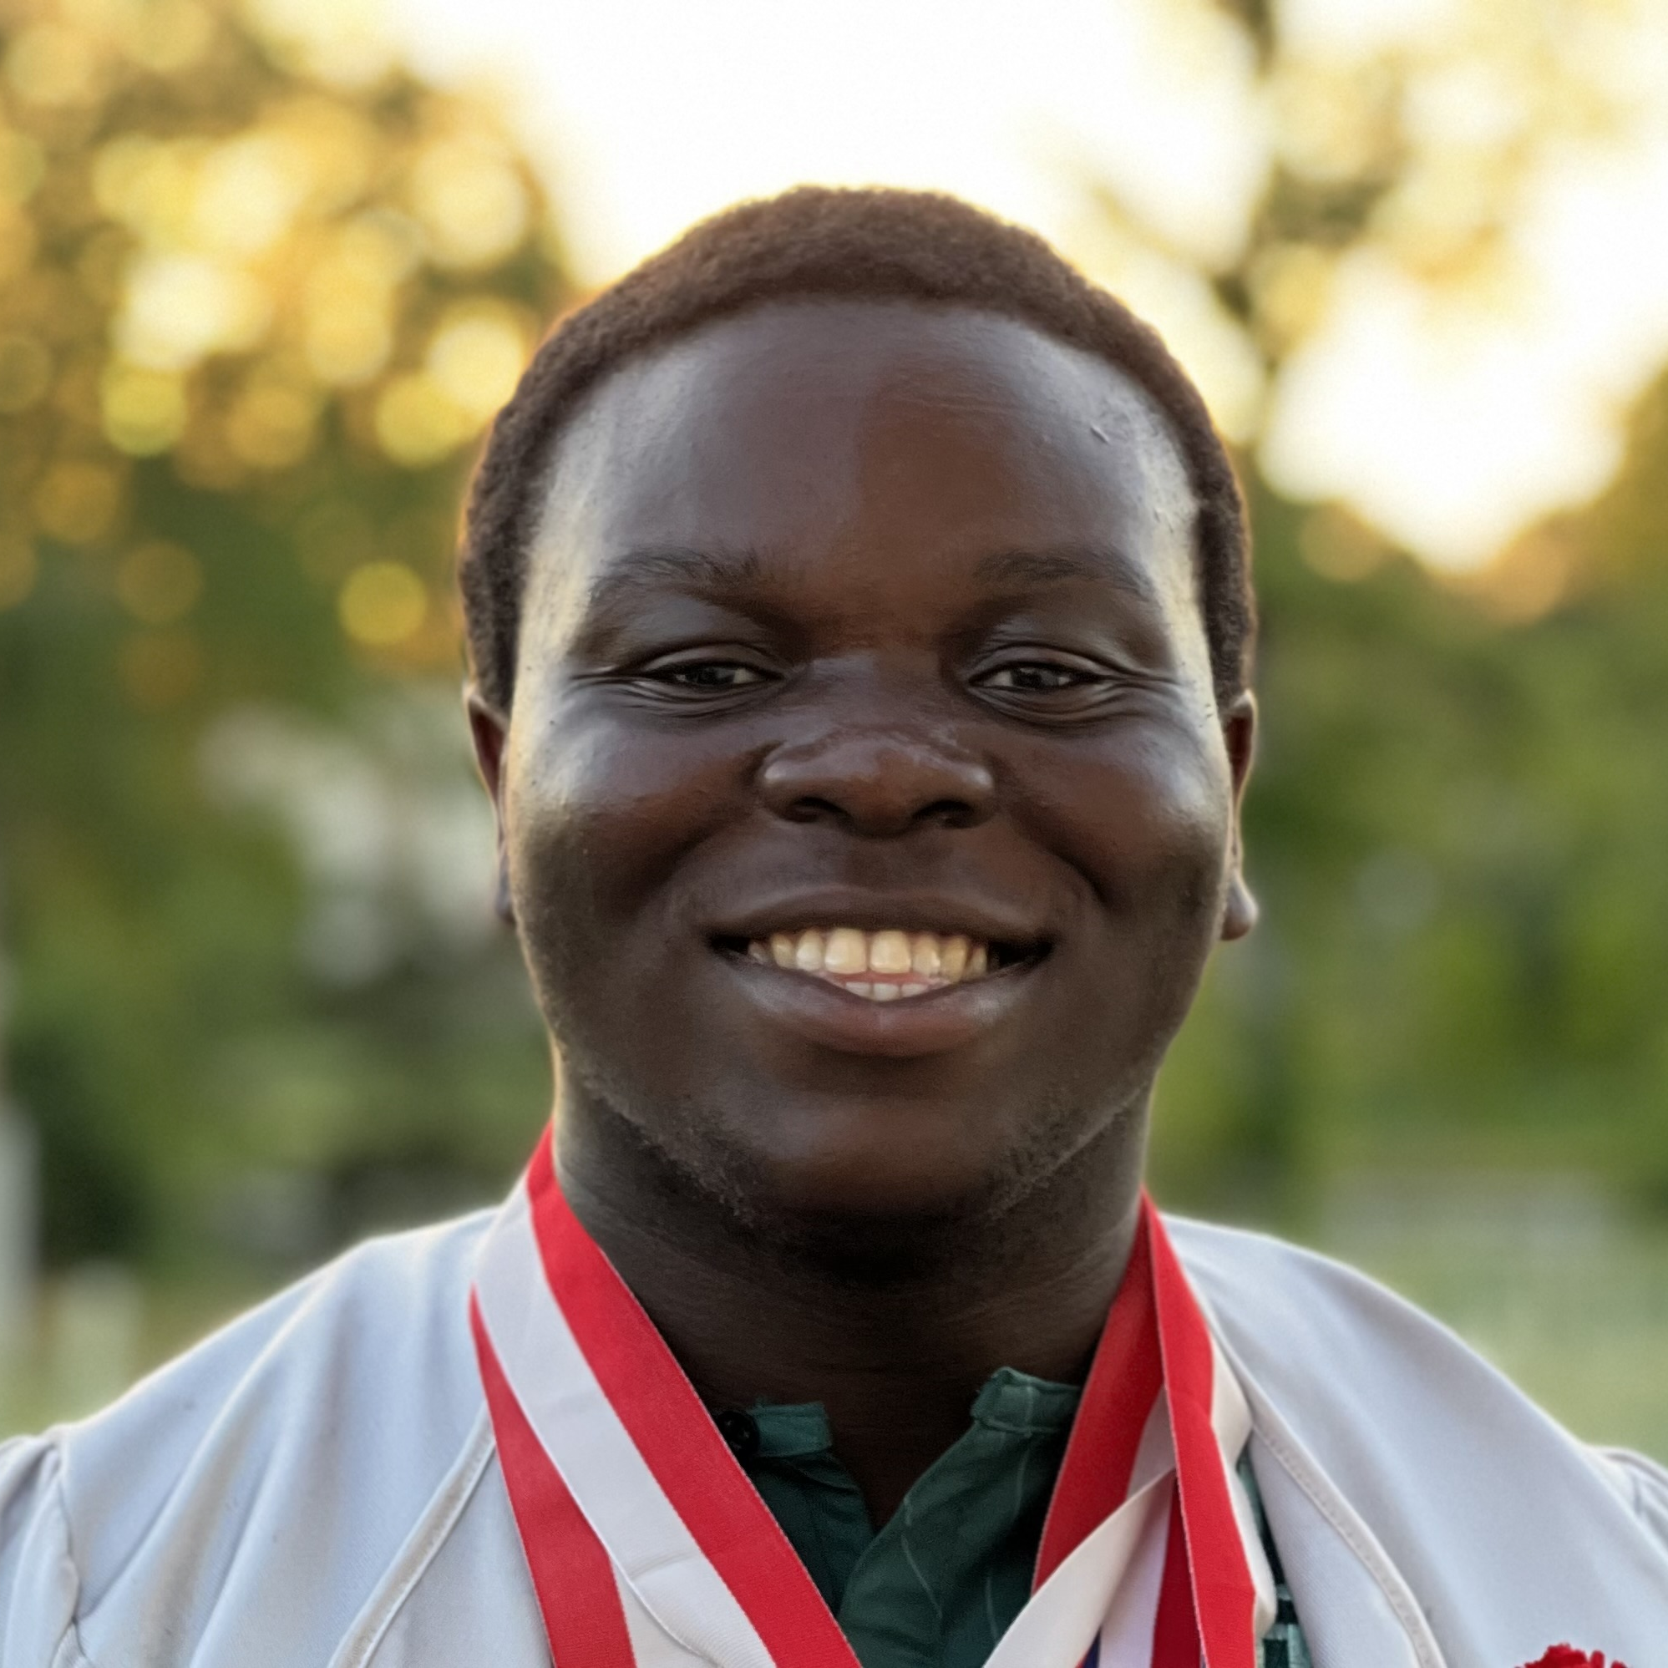
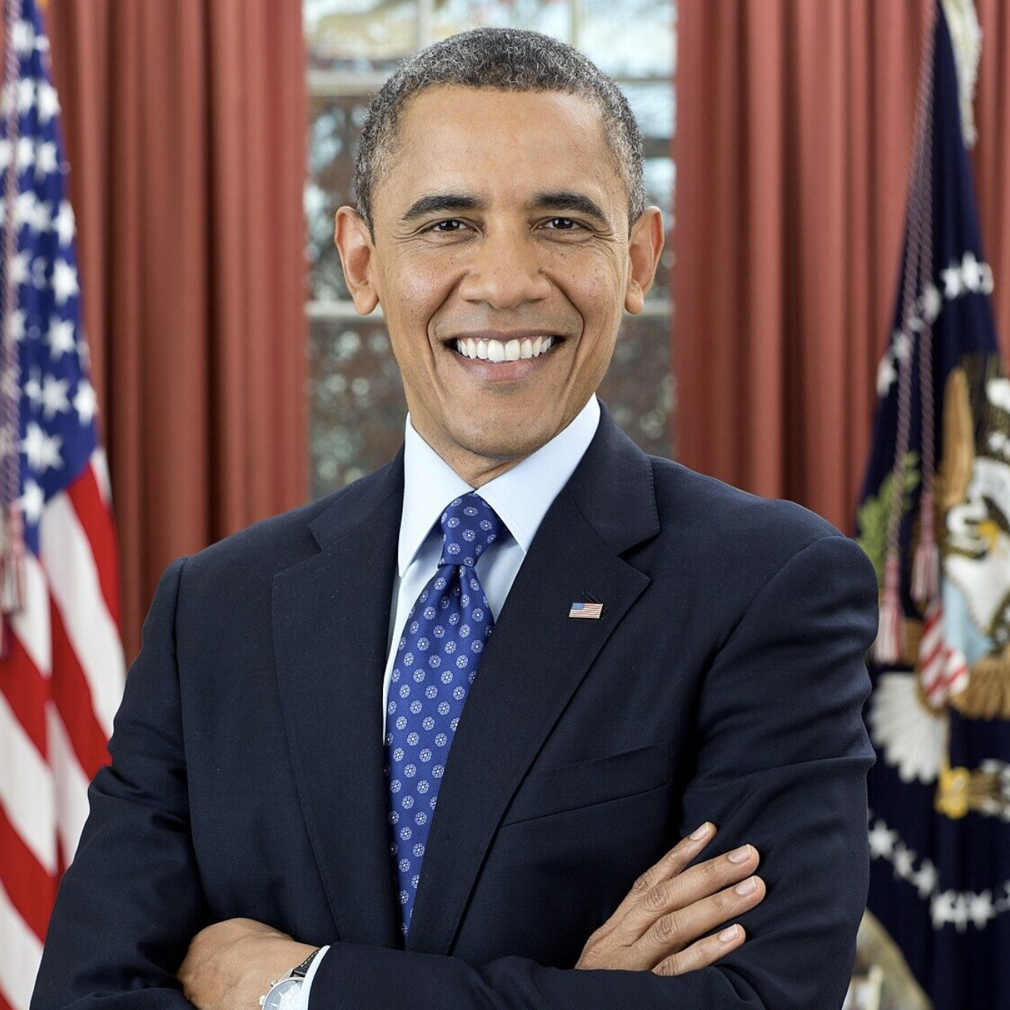
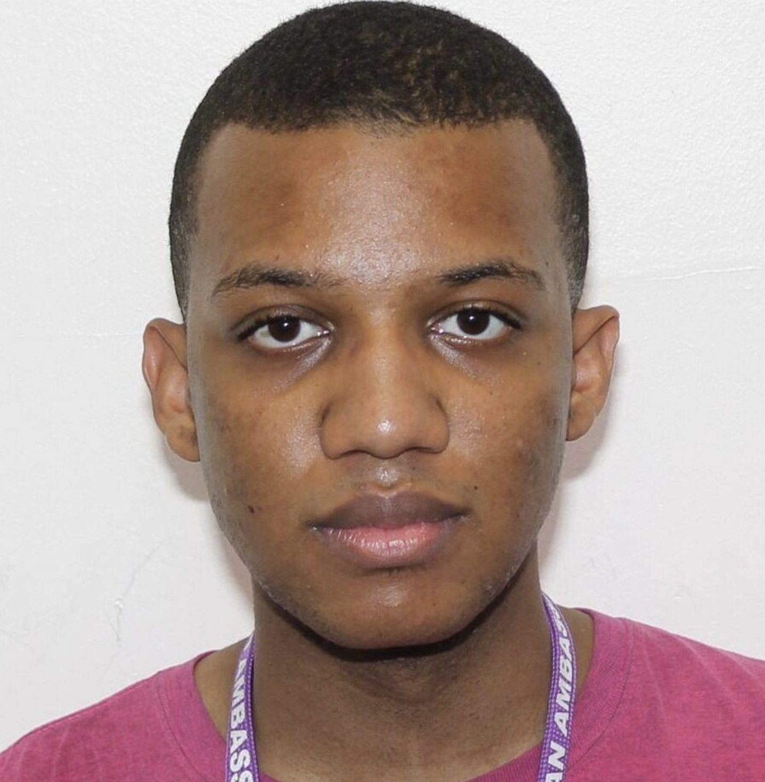
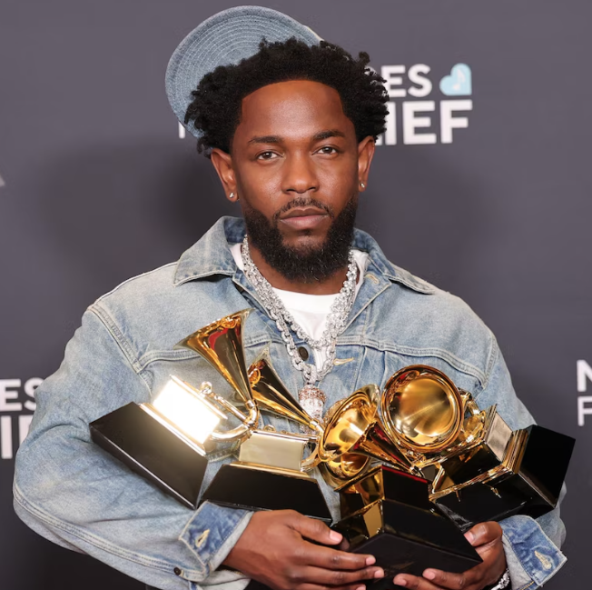
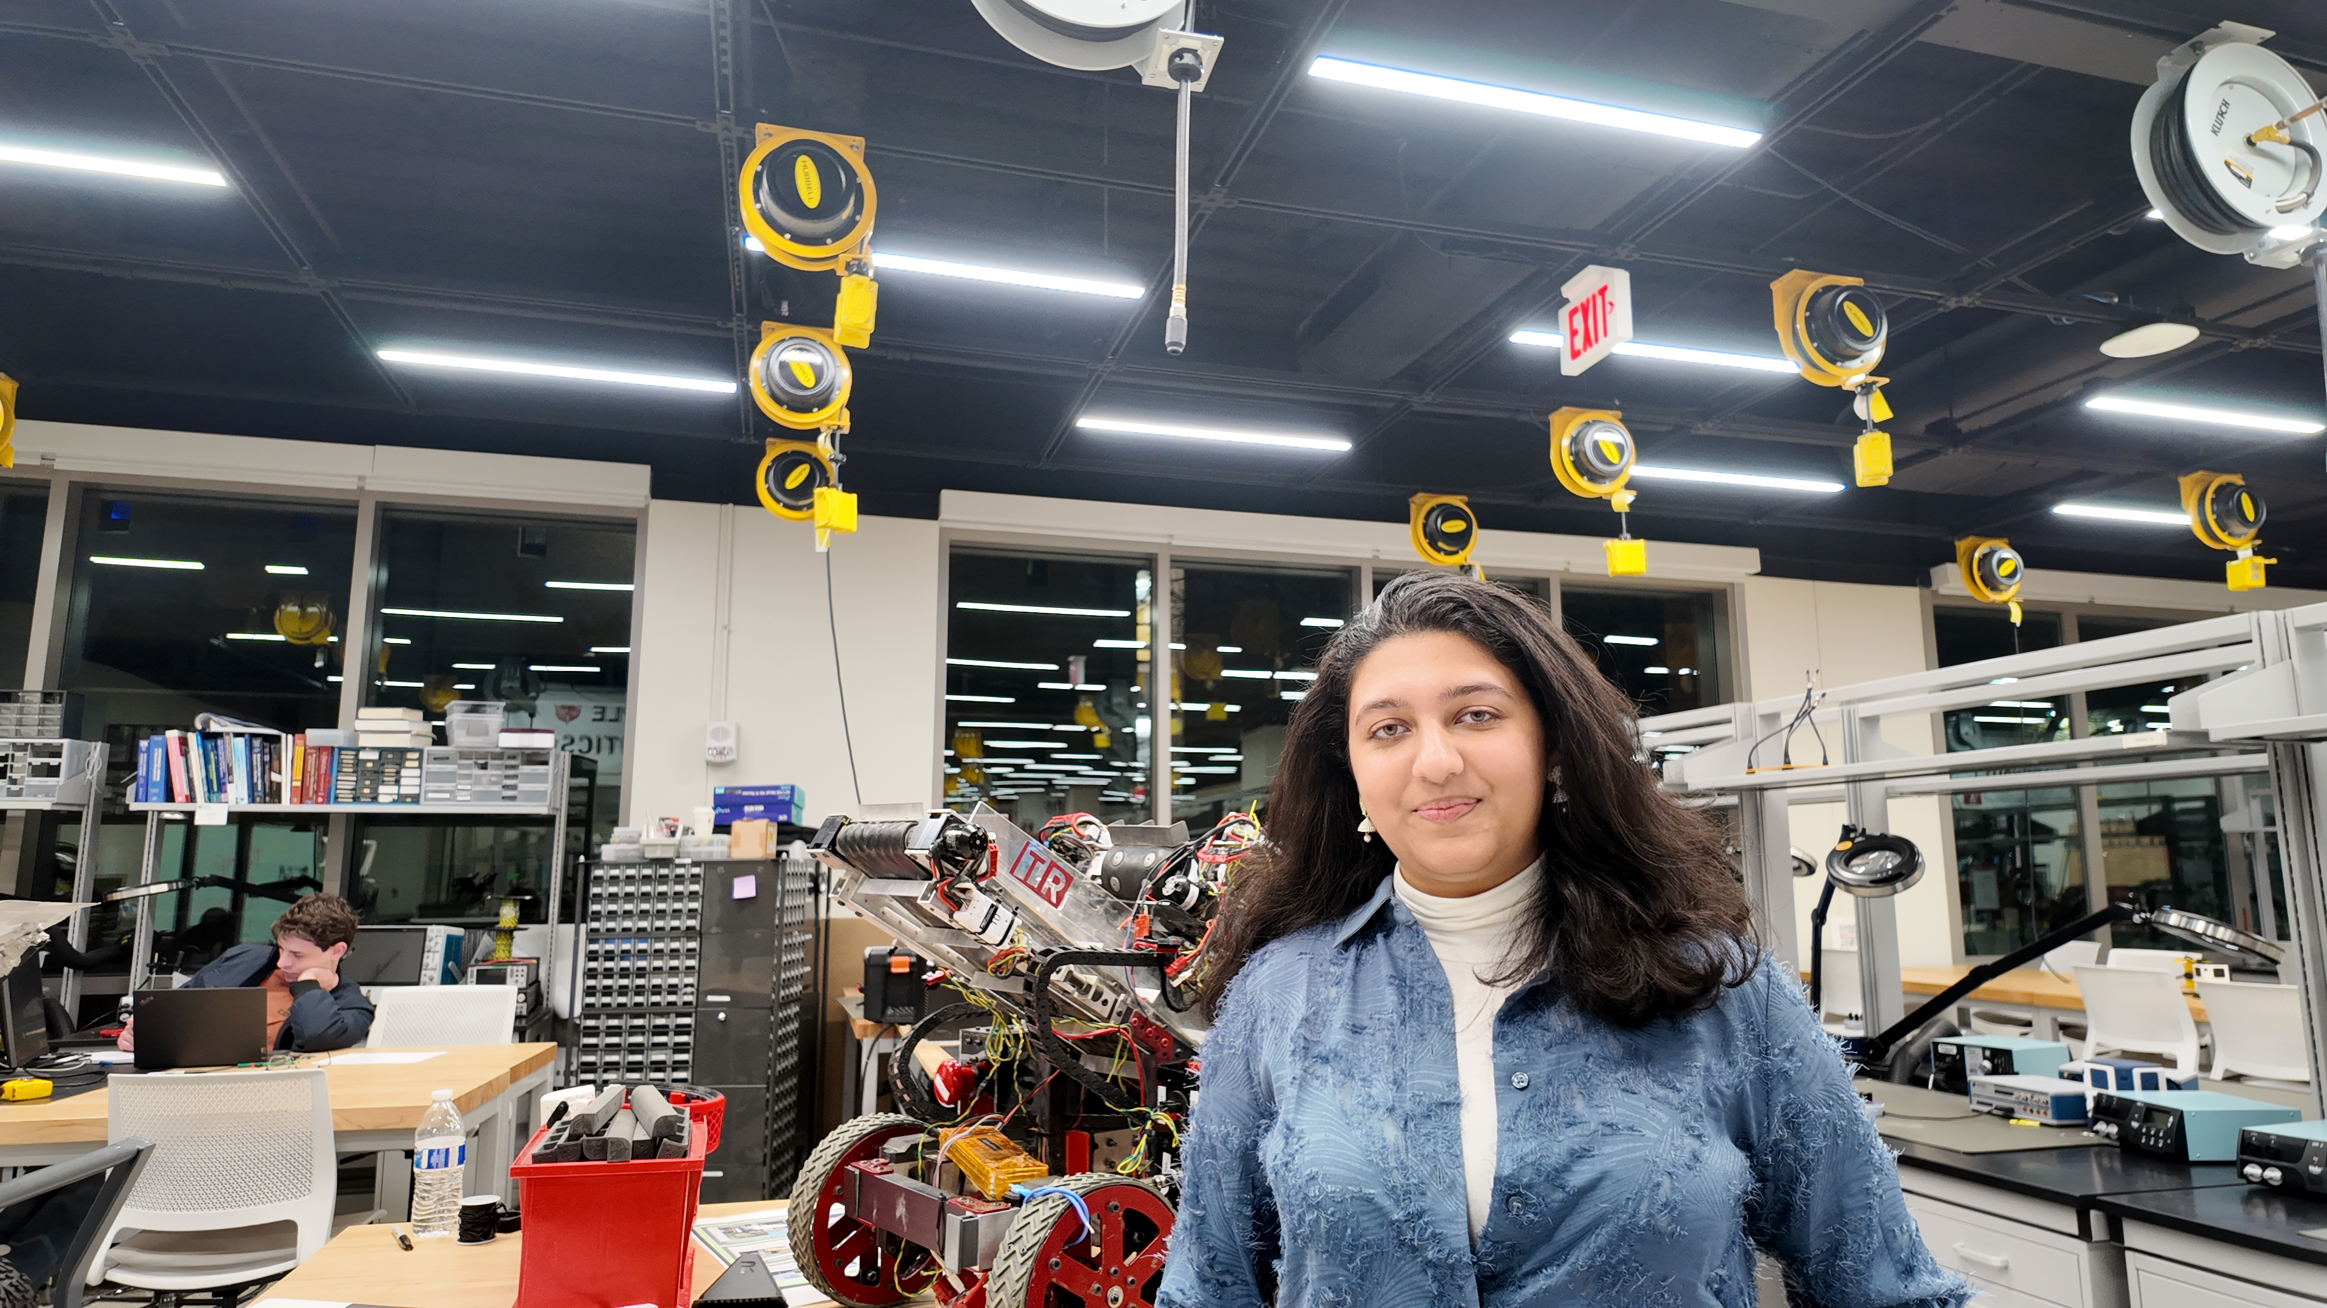
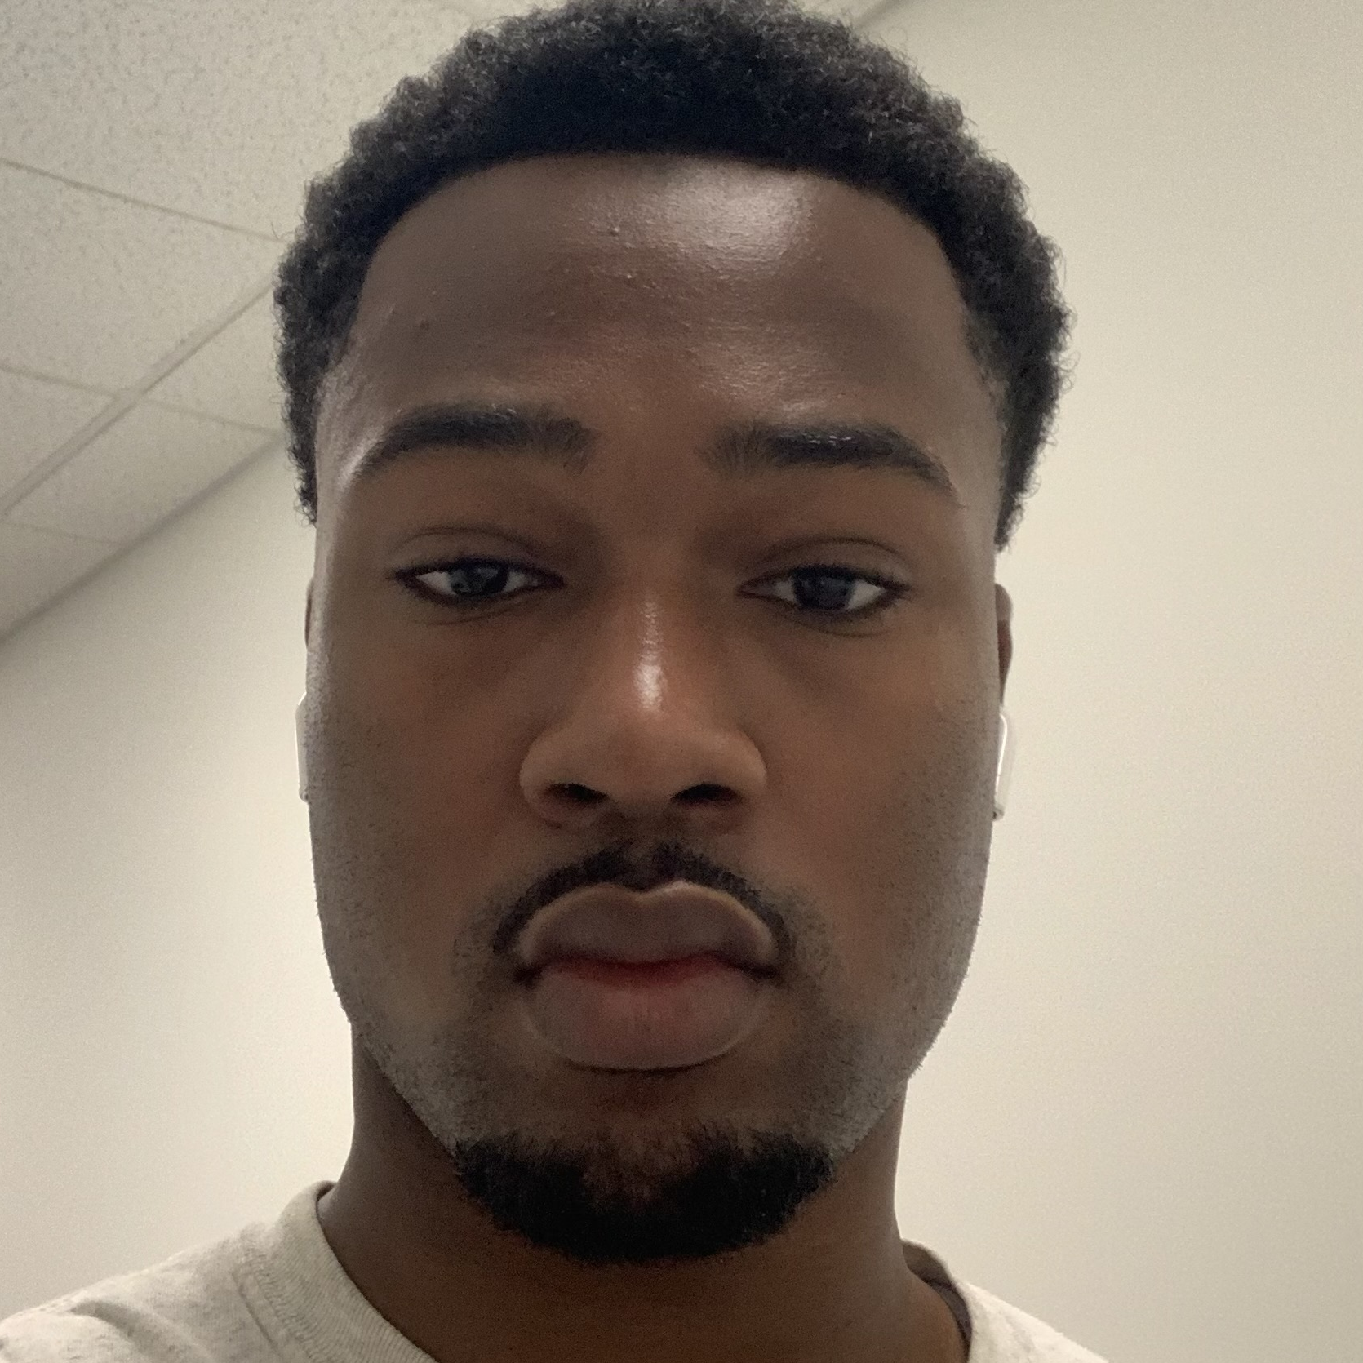
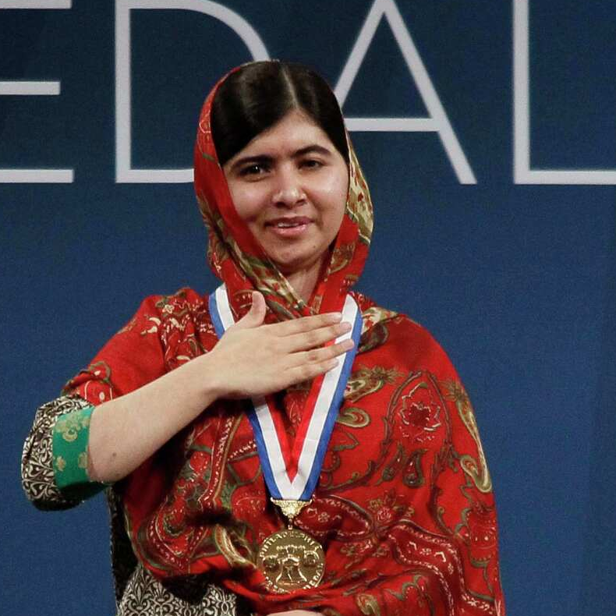
What is a DeepFake?
A form of AI-Generated content
Target
Source
Face Swap
These images were created within a few minutes using https://deepfakemaker.io/
Notes:
Jahtega

Slide 3
DeepFake News
Watch out – even small businesses are now now facing threats from deepfake attacks
Laws Struggle to Address Students Making Deepfakes
GovTech Tues September 23 2025 8:33 EDT
TechRadar Wed 24 September 2025 12.26 EDT
She thought she was flirting with her favorite celebrity. A heartbreaking deepfake scam cost her everything
Friend stole my face for deepfake nudes – now I want tougher laws
BBC Fri September 19 2025 12:00 EDT
Daily Mail Wed 24 September 2025 10:22 EDT
Taylor Swift And Travis Kelce’s
Engagement Sparks Wave Of Scams And Deepfakes
Actress Angel Aquino calls for stronger laws after falling victim to deepfake
The Blast Fri September 5 2025 11:30 EDT
CBN News Tues September 4 2025 5:18 EDT
Notice the
Victims
News Source
Date
Problem Statement
Artificially generated and manipulated images such as DeepFakes, have become easier to create, and harder to detect. These images pose a serious risk to the credibility of public figures, resulting in great emotional, financial and political turmoil.
Needs Statement
An accurate and reliable DeepFake detector is needed to protect individuals such as celebrities, politicians, and even corporations who are frequent victims of DeepFake misuse.
Notes:
Jahtega

Slide 4
DeepFake News
Watch out – even small businesses are now now facing threats from deepfake attacks
Laws Struggle to Address Students Making Deepfakes
GovTech Tues September 23 2025 8:33 EDT
TechRadar Wed 24 September 2025 12.26 EDT
She thought she was flirting with her favorite celebrity. A heartbreaking deepfake scam cost her everything
Friend stole my face for deepfake nudes – now I want tougher laws
BBC Fri September 19 2025 12:00 EDT
Daily Mail Wed 24 September 2025 10:22 EDT
Taylor Swift And Travis Kelce’s
Engagement Sparks Wave Of Scams And Deepfakes
Actress Angel Aquino calls for stronger laws after falling victim to deepfake
The Blast Fri September 5 2025 11:30 EDT
CBN News Tues September 4 2025 5:18 EDT
Notice the
Victims
News Source
Date
Problem Statement
Artificially generated and manipulated images such as DeepFakes, have become easier to create, and harder to detect. These images pose a serious risk to the credibility of public figures, resulting in great emotional, financial and political turmoil.
Needs Statement
An accurate and reliable DeepFake detector is needed to protect individuals such as celebrities, politicians, and even corporations who are frequent victims of DeepFake misuse.
DeepFakes pose a risk to everyone, making us all stakeholders in their detection and mitigation.
Notes:
Jahtega

Slide 5









Problem Statement
Artificially generated and manipulated images such as DeepFakes, have become easier to create, and harder to detect. These images pose a serious risk to the credibility of public figures, resulting in great emotional, financial and political turmoil.
Needs Statement
An accurate and reliable DeepFake detector is needed to protect individuals such as celebrities, politicians, and even corporations who are frequent victims of DeepFake misuse.
DeepFakes poses a risk to everyone, making us all stakeholders in their detection and mitigation.
Requirement & Constraints Criteria
Project Progress
Web Application
Upload Image
Find Faces
Find Bounding Box
Is this image real?
User uploaded image
Haar Cascade Model
(x, y, width, height)
Present Results
Classify
Data to DCT
This Semester:
Develop Detection Model
User Interface (UI)
Our three solutions lie here
Identify Face
Using developed RF Model
Output to UI
Extract features
Feature Extraction
Classification
Requirement & Constraints Criteria
Performance
Measuring how correctly our solution distinguishes real from fake content across datasets.
Notes:
Zacary

Slide 6




Project Progress
Web Application
Upload Image
Find Faces
Find Bounding Box
Is this image real?
User uploaded image
Haar Cascade Model
(x, y, width, height)
Present Results
Classify
Data to DCT
This Semester:
Develop Detection Model
Our three solutions lie here
User Interface (UI)
Using developed RF Model
Output to UI
Extract features
Identify Face
Feature Extraction
Classification
Requirement & Constraints Criteria
Performance
Efficiency
Code Maintainability
Measuring how well our solution classifies real from fake content across datasets.
Delivering fast, results while minimizing resource usage, ensuring smooth performance.
Ease in which a codebase can be understood, modified, tested, and developed over time.
Usability
Ethic & Security
Demonstration app is intuitive, accessible, offering results with low user effort.
Ensuring user privacy, protecting data, and promoting responsible detection with fairness and transparency.
Notes:
Ashton

Slide 7








Requirement & Constraints
Criteria | Requirement Constraint | Unit | Goal Value | Negotiable / Non-Negotiable | Standard
Accuracy | Requirement | % | 95% | Negotiable | N/A
Precision | Requirement | % | 90% | Negotiable | N/A
Recall | Requirement | % | 85% | Negotiable | N/A
F1 Score | Requirement | % | 85% | Negotiable | N/A
Performance
Measuring how correctly our solution distinguishes real from fake content across datasets.
Actual / Predicted | Predicted Real | Predicted Fake
Actual Real | TP | FN
Actual Fake | FP | TN
True (T)
False (F)
Positive (P)
Negative (N)
correct
incorrect
real
fake
classification
classification
image
image
Accuracy
Precision
Recall
F1 Score
$$\frac{ TP+TN }{TP+FP+TN+FN}$$
$$\frac{ TP}{TP+FP}$$
$$\frac{ TP}{TP+FN}$$
$$2×\frac{ Precision×Recall}{Precision+Recall}$$
How often the model classifies an image correctly
Proportion of correct positive predictions to all positive cases
Proportion of positive cases correctly identified
Combines precision and recall into a balanced metric
Notes:
Jouri

Slide 8
Requirement & Constraints
Criteria | Requirement Constraint | Unit | Goal Value | Negotiable / Non-Negotiable | Standard
Algorithm Process Time | Requirement | ms/pixel | 2500 | Negotiable | N/A
Website boot time | Requirement | Sec | 5 | Negotiable | N/A
Resource Usage | Constraint | Gb | < 128 | Non-Negotiable | ISIP
Dataset Generalizability | Requirement | % | 60% | Negotiable | N/A
Efficiency
Delivering fast, results while minimizing resource usage and ensuring smooth performance.
Algorithm Process Time
Website boot time
Resource Usage
Dataset Generalizability
Our final algorithm classification time should below 2500 ms. This lets our model return immediate results.
Our website remains continuously live as it is hosted on the ISIP server. This ensures high availability and minimal downtime
Our website and models are constrained by the amount of RAM on the Neuronix Cluster. To avoid issues, our final product should stay below 128 GB of RAM.
Our final model should be capable of evaluating a wide range of images, made with different Deepfake generation techniques. This metric measures performance in these cases.
Notes:
Ashton

Slide 9
Requirement & Constraints
Criteria | Requirement Constraint | Unit | Goal Value | Negotiable / Non-Negotiable | Standard
ISIP Guideline | Constraint | Pass/Fail | Pass | Non-Negotiable | ISIP
Documentation | requirement | Pass/Fail | Pass | Non-Negotiable | ISO 12207
Code Maintainability
Ease with which a codebase can be understood, modified, tested, and extended over time.
ISO 12207
ISIP Guideline
In compliance with section 6.3.6.3.2.2 and 6.3.6.3.3, we have developed documentation (e.g. AAREADME files, user guide, etc.) in accordance with ISIP requirements and have made these items available for viewing to the appropriate parties
To conform to these guidelines, we follow ISIP’s naming conventions and commenting style
Notes:
Jahtega

Slide 10
Requirement & Constraints
Criteria | Requirement Constraint | Unit | Goal Value | Negotiable / Non-Negotiable | Standard
Algorithmic Transparency | Constraint | Pass/Fail | Pass | Non-negotiable | IEEE7003- 2024 Standard
Website Security | Requirement | Pass/Fail | Pass | Non-Negotiable | ISO 27001
Ethic & Security
Ensuring user privacy, protecting data, and promoting responsible detection with fairness and transparency.
IEEE 7003
ISO 27001
This standard calls for the establishment of algorithmic bias profiles. This profile is meant to document known race or gender biases in machine learning models. The requirement provides auditors the ability to assess whether the system behaves as intended.
This standard has been inherently met as our website is hosted on the ISIP server, which complies with ISO 27001 security requirements. Additionally, we have ensured that our code does not store or retain any photos provided to it, maintaining data confidentiality and privacy.
Notes:
Zacary

Slide 11
Requirement & Constraints
Criteria | Requirement Constraint | Unit | Goal Value | Negotiable / Non-Negotiable | Standard
Interpretability | Requirement | Pass/Fail | Pass | Negotiable | WACG
Accessibility | Requirement | Pass/Fail | Pass | Negotiable | WACG
User Interface | Requirement | Pass/Fail | Pass | Negotiable | WACG
Usability
Demonstration app is intuitive, accessible, offering results with minimal user effort.
Web Content Accessibility Guidelines
Interpretability
Accessibility
User Interface
Our website ensures that all visual and textual content is clearly interpretable by users. This includes maintaining appropriate color contrast, and using descriptive text for images
The website is navigable via both mouse and keyboard inputs and maintains compatibility with screen readers and assistive technologies.
Designed to be intuitive, consistent, and easy to navigate. Interactive components are clearly labeled, and layouts remain responsive across devices.
Notes:
Zacary

Slide 12



Dataset Breakdown
Number of Real Images
Source of Real Images
Number of Fake Images
Source of Fake Images
Dataset Name
OpenForensics
45,473
Google Images
70,325
GAN (AI-Generated)
The dataset is split into 3 parts:
Training
Development
Evaluation
44,097 images
63,885 images
7,308 images
Used to teach a machine learning model to learn patterns
Used during training to fine tune model to prevent overfitting
Used to assess a model's performance metrics
Notes:
Ashton

Slide 13



Test Plan
dataset 1
(evaluation)
Train Model
dataset 1
(training)
dataset 2
(evaluation)
Evaluate Model
Revise Model
Update:
Accuracy
Confidence Score
Confusion Matrix
dataset 1
(development)
Notes:
Ashton

Slide 14
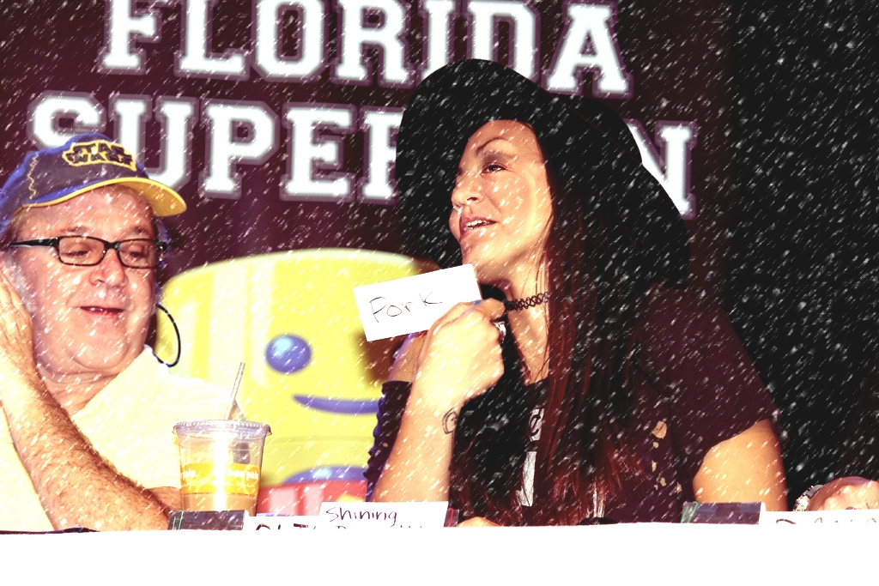
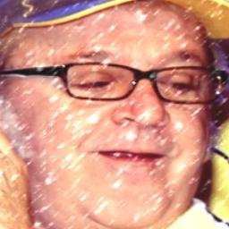
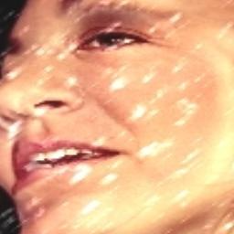
Parallel Dataset
A parallel dataset is created to better train and develop the CNN architectures
This dataset will be made up of images that contain one face each
- Images sourced from our original OpenForensics dataset
- Faces extracted using the nedc_dpath_gen_images tool
Original Image
Face 1
Face 2
Notes:
Jahtega

Slide 15
Parallel Dataset Breakdown
Number of Real Images
Source of Real Images
Number of Fake Images
Source of Fake Images
Dataset Name
OpenForensics
159,996 images
Google Images
173,528 images
GAN (AI-Generated)
The dataset is split into 3 parts:
Training
Development
Evaluation
150,866 images
167,313 images
15,345 images
Used to teach a machine learning model to learn patterns
Used during training to fine tune model to prevent overfitting
Used to assess a model's performance metrics
Notes:
Jahtega

Slide 16
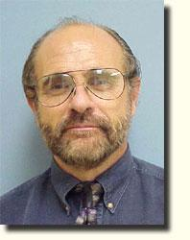
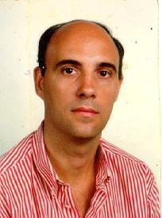
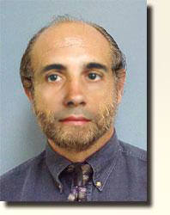
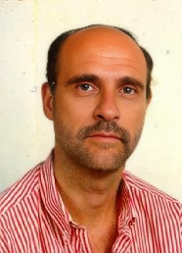
Evaluation Dataset
A secondary evaluation dataset is created to assess generalization, testing the model's performance on new and unseen data
This dataset will be 100 Fake images and 100 Real images
Images Sourced form Caltech
Images made from Photoshop and DeepfakeMaker
Original Images
DeepFake Maker
Photoshop
Notes:
Ashton

Slide 17
Proposed Solutions
Dataset
Input Layer
Input
+
Tree 1
Tree 2
Tree N
Entry Flow
Convolution Layer
Pooling Layer
+
+
Result 1
Result 2
Result N
+
Middle Flow
Inner Layer
+
Averaging
+
Exit Flow
Classification
Outer Layer
Classification
Random Forest
CNN
Xception

Slide 18






Random Forest
Dataset
Tree 1
Tree 2
Tree N
Each tree is trained on a random subset of the training data
Based on the principle of “wisdom of the crowd”
Trained on extracted statistical features of the images
Result 1
Result 2
Result N
Features Extracted using DCT
$$\left[\begin{matrix}{RGB}_{11} & ⋯ & {RGB}_{1n} \\ ⋮ & ⋱ & ⋮ \\ {RGB}_{m1} & ⋯ & {RGB}_{mn}\end{matrix}\right]$$
$$\left[\begin{matrix}C_{11} & ⋯ & C_{1n} \\ ⋮ & ⋱ & ⋮ \\ C_{m1} & ⋯ & C_{mn}\end{matrix}\right]$$
Averaging
Classification
RGB Values
Cosine coefficients
Machine Learning
This method was our baseline, achieving 55%

Slide 19







Proposed Solutions: CNN
Input Layer
Convolution Layer
Pooling Layer
Deep Learning model that processes grid data like images.
Automatically learns features such as edges.
Uses convolution for image detection and pooling for feature reduction.
Inner Layer
Convolution Layer
Pooling Layer
Input Layer
Inner Layer
Outer Layer
Outer Layer
Feeds image into model
Extracts features from image
Down samples information
Learn complex patterns
Outputs final classification

Slide 20





Proposed Solutions: Xception
Input
+
Entry Flow
Similar to CNN but looks at image details more carefully.
Studies each feature separately, then combines features.
Faster and more accurate in classifying images.
+
+
+
Middle Flow
+
+
Exit Flow
Entry Flow
Middle Flow
Depth wise Separable Convolution
Pointwise Convolutional
Classification
Extracts basic image features
Learns complicated patterns extracted from entry flow
Analyze each channel
Combines meaningful features from depth wise
Notes:
Jouri

Slide 21
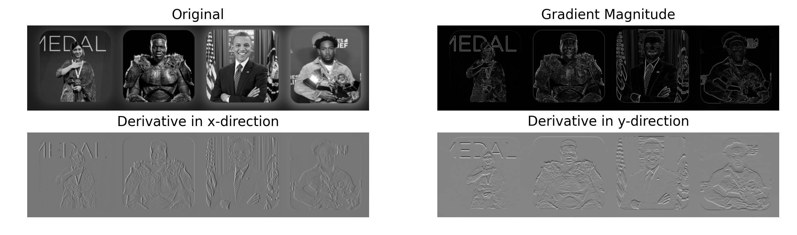
Convolutional Neural Network
CNNs are effective in analyzing images, automatically extracting features from pixels. This model was chosen as our Preliminary Design solution.
Extract hierarchical features in convolutional layer:
Lower Layers: edges, lines, colors
Input Layer
Middle Layers: patterns, shapes, textures
Higher Layers: faces objects signs of manipulation
Convolution Layer
Pooling Layer
Original
Gradient Magnitude
Inner Layer
Outer Layer
X-Direction Derivative
Y-Direction Derivative
Prewitt filter: A manual example of lower Convolutional layers
Notes:
Explain CNN

Slide 22

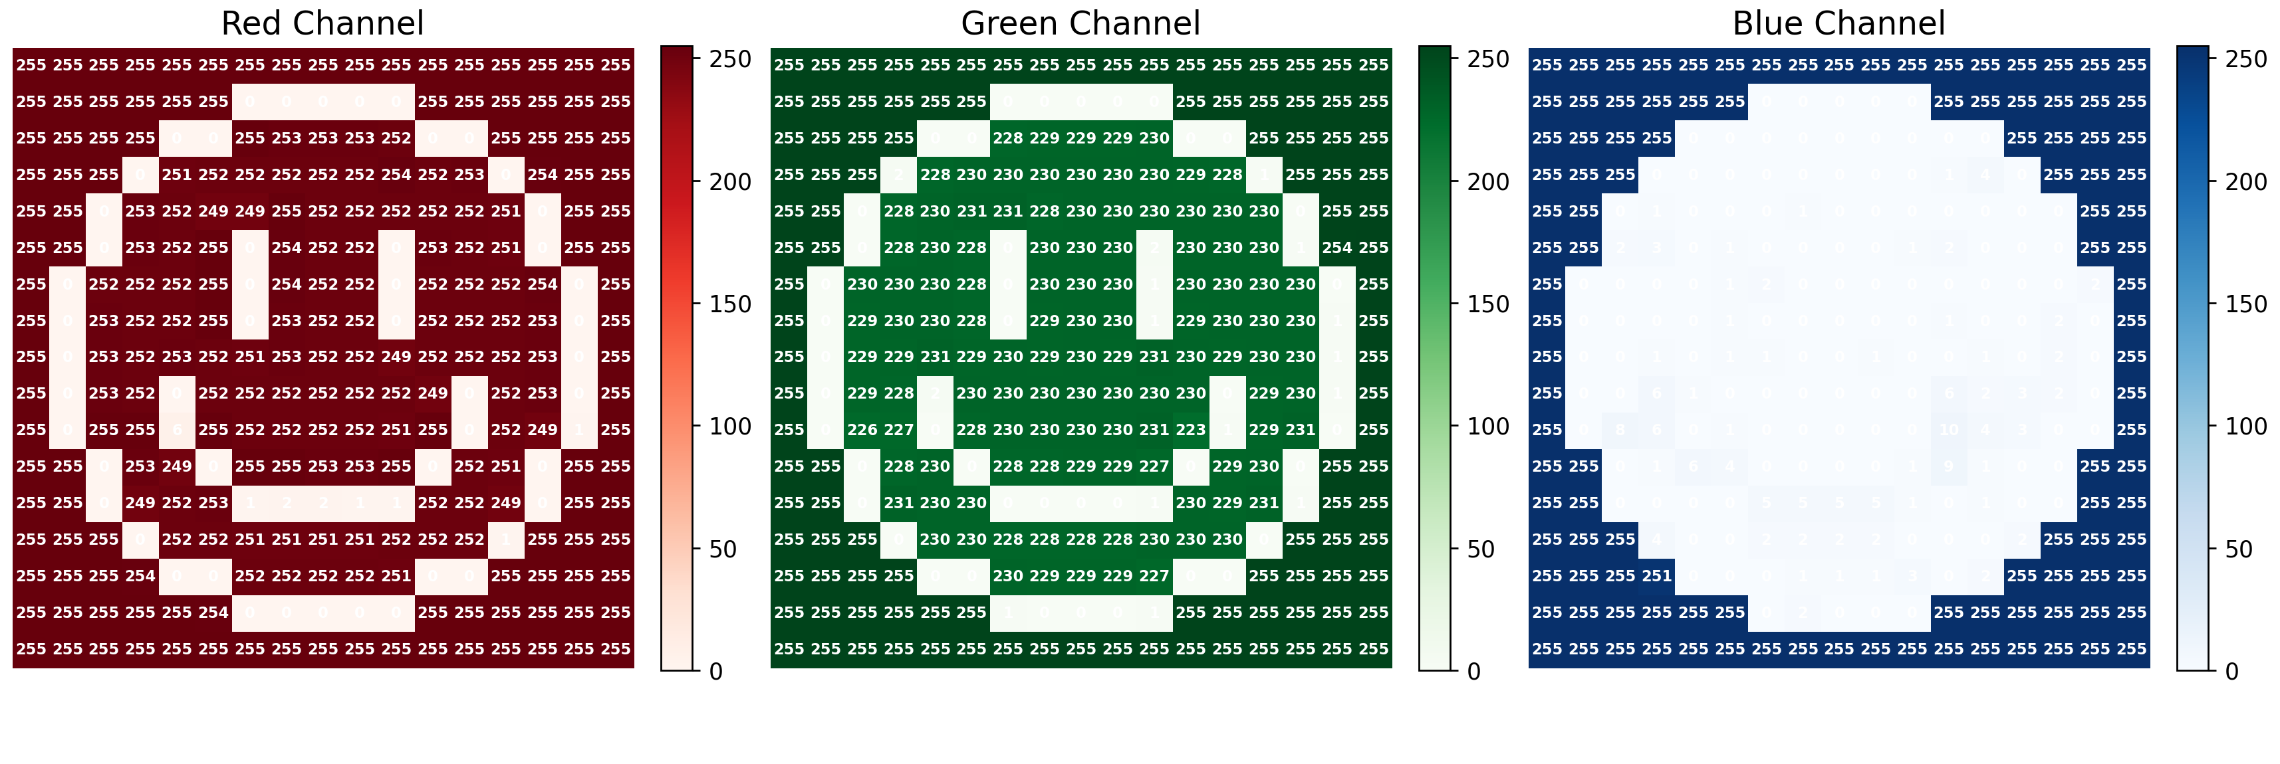







Tensors
Tensors are multi-dimensional arrays used by CNNs to process images
$$\left[\begin{matrix}1 & 2 \\ 3 & 4\end{matrix}\right]$$
$$\left[\begin{matrix}1 & 2 \\ 3 & 4\end{matrix}\right]$$
$$\left[\begin{matrix}1 & 2 \\ 3 & 4\end{matrix}\right]$$
$$\left[\begin{matrix}1 & 2 \\ 3 & 4\end{matrix}\right]$$
$$\left[1]\right.$$
$$\left[1, 2, 3, …, N]\right.$$
$$,$$
$$,$$
Scalars
Vectors
Matrix
Tensors
Single value
List of values
Grid of values
Multiple grids
The values could be mapped to a matrix to form a tensor
Each color is quantified by a vector of RGB
RGB(253 229 0)
The dimension of this tensor is
(row, column, color channel)
RGB(255 255 255)
RGB(255 255 255)
Now scale this up to thousands of images
Notes:
Jouri

Slide 23
Training Process
Dataset
Batch
Loss Rate
A subset of the data can be fed model at once
Measures how far predictions are from the true labels
Lets say we have a large dataset
Image 1
Image 2
Image 3
Image 1
Image 2
Image 3
0.5
Into Model
Image 4
Image 5
Image 6
Image 4
Image 5
Image 6
0.25
Image 7
Image 8
Image 9
Image 7
Image 8
Image 9
0.15
…..
…..
…..
Image N
Image N+1
Image N+2
Image N
Image N+1
Image N+2
~ideally close to 0.0
Epochs are complete pass throughs in the entire training dataset within the model.
The models performance should increase with more epochs
Notes:
Jouri

Slide 24
Training Process
Dataset
Batch (Bn)
Loss Rate
Into Model
A subset of the data can be fed model at once
Measures how far predictions are from the true labels
Lets say we have a large dataset
Image 1
Image 2
Image 3
B1
Image 1
Image 2
Image 3
0.5
Image 4
Image 5
Image 6
B2
Image 4
Image 5
Image 6
0.25
Image 7
Image 8
Image 9
B3
Image 7
Image 8
Image 9
0.15
…..
…..
…..
Image N
Image N+1
Image N+2
BN
Image N
Image N+1
Image N+2
~ideally close to 0.0
Epochs are complete pass throughs in the entire training dataset within the model.
The models performance should increase with more epochs
Notes:
Jouri

Slide 25



Comparing 3 CNN Models
DeepTRUTH Custom Model
EfficientNet-B0 (EB0)
Vision Transformer (ViT)
Learns local image features using convolution, ReLU, and pooling layers.
Balances depth, width, and resolution for efficient and accurate classification.
Treats images as patches, learns global relationships and self-attention
Notes:
Jouri

Slide 26
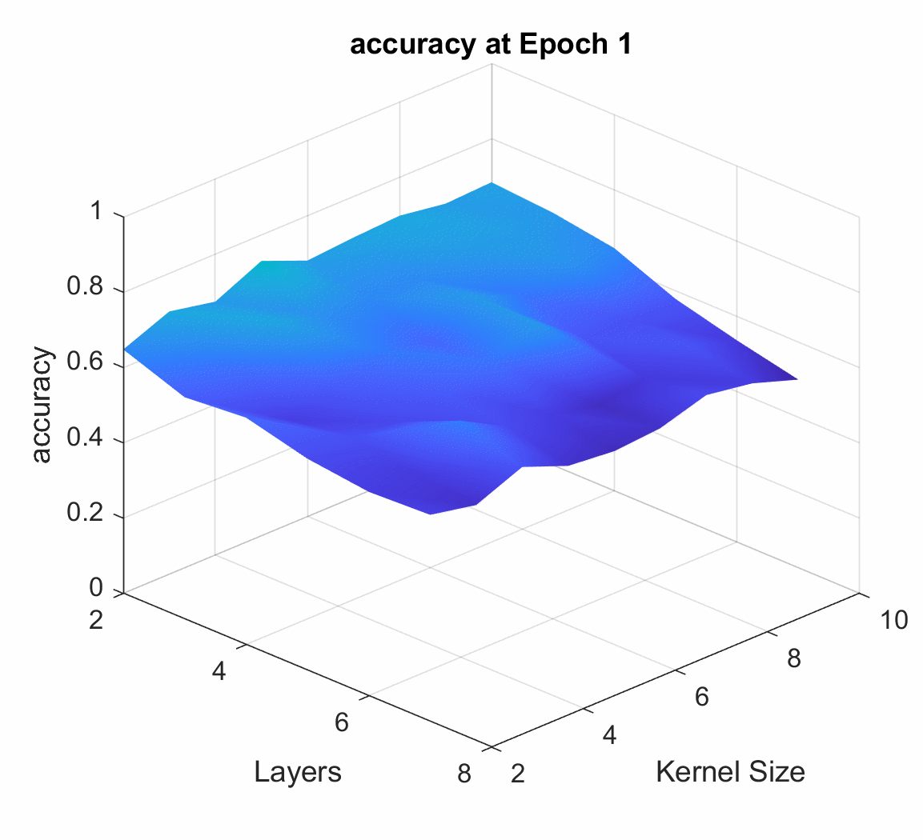
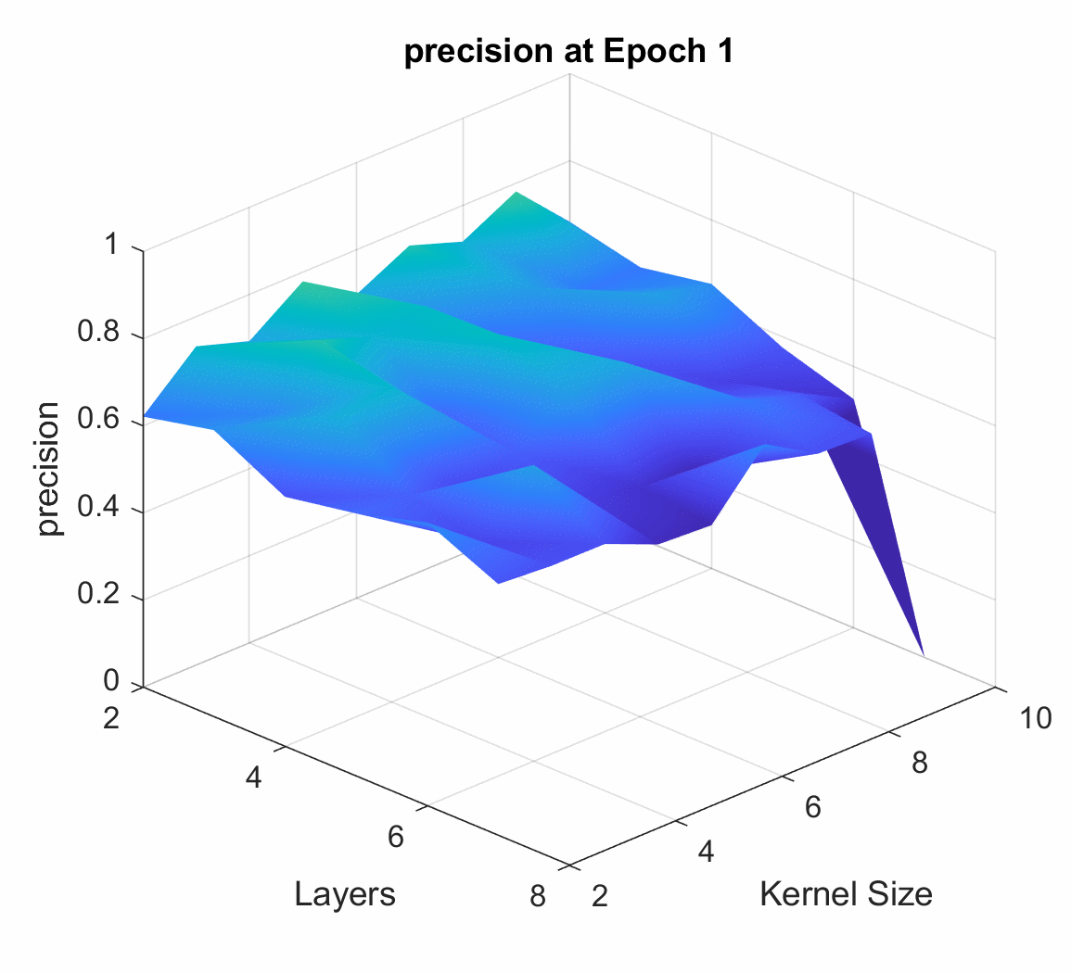
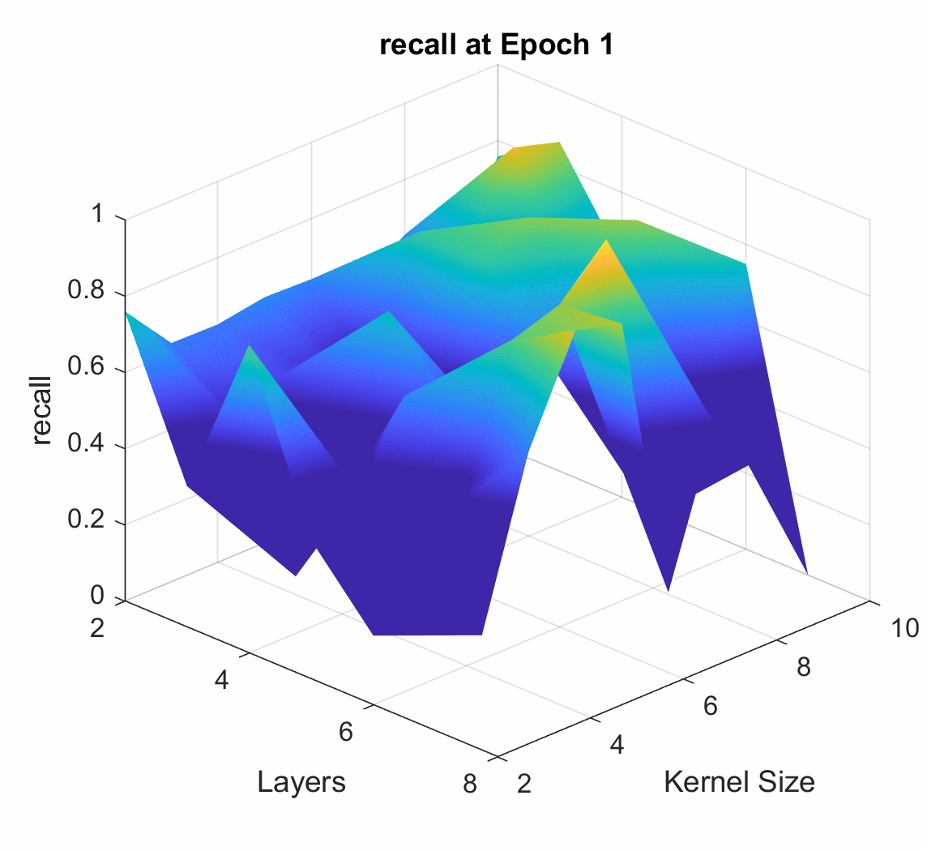
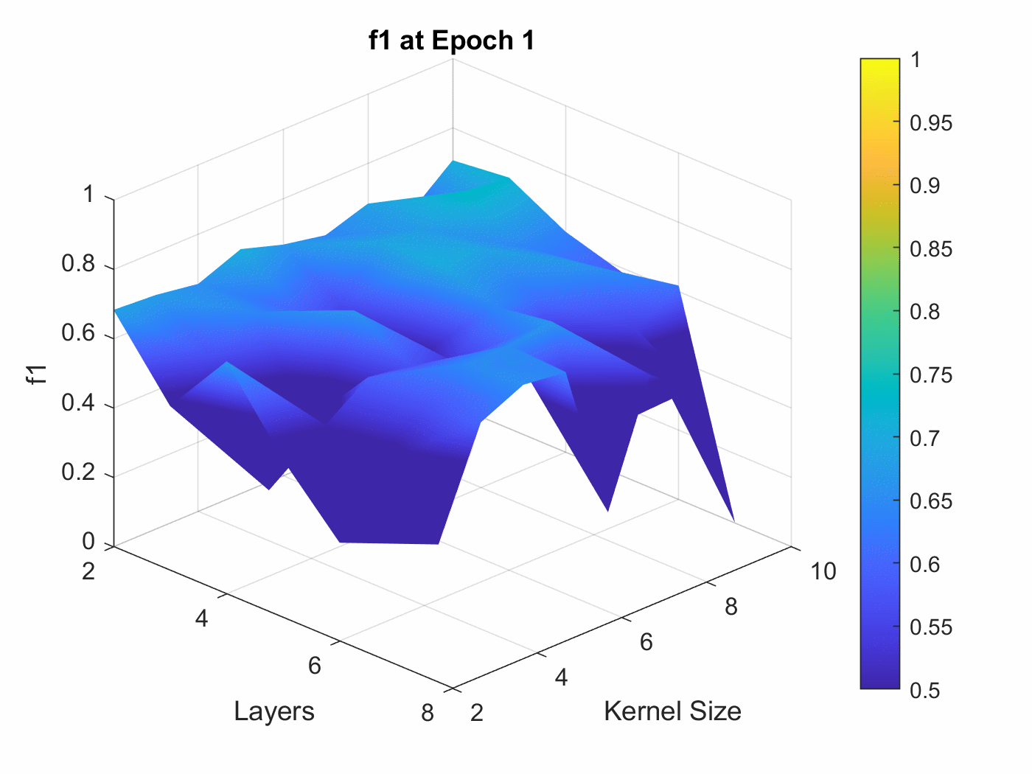
CNN 2 - DeepTRUTH Performance
Models layers and kernel size were iterated.
Kernel: A filter in the form of a small matrix
Layer: level of processing to learn and represent features the data
Accuracy
Precision
Recall
F1 Score
How often the model classifies an image correctly
Proportion of correct positive predictions to all positive cases
Proportion of positive cases correctly identified
Combines precision and recall into a balanced metric
The models performance should increase with more epochs.
Notes:
Jouri

Slide 27
CNN 2 - DeepTRUTH Performance
Models layers and kernel size were iterated.
Kernel: A filter in the form of a small matrix
Layer: level of processing to learn and represent features the data
Accuracy
Precision
Recall
F1 Score
How often the model classifies an image correctly
Proportion of correct positive predictions to all positive cases
Proportion of positive cases correctly identified
Combines precision and recall into a balanced metric
The models performance should increase with more epochs.
Notes:
Jouri

Slide 28
CNN 1 - DeepTRUTH Model
The dataset is split into 3 parts, when model is trained and each subsection is tested on
Training
Development
Evaluation
Used to teach a model patterns
Used to fine tune model to prevent overfitting
Used to assess a model's performance metrics
Model | Dataset | Metrics |  |  |  | Confusion Matrix
 |  | Accuracy | Precision | Recall | F1 | R (0) | F (1)
DeepTRUTH | Train | 98.54% | 99.46% | 97.97% | 98.71% | 84548 | 458
 |  |  |  |  |  | 1749 | 64111
 | Development | 96.41% | 95.01% | 96.46% | 95.73% | 19997 | 1051
 |  |  |  |  |  | 733 | 27937
 | Evaluate | 94.44% | 89.84% | 92.13% | 90.97% | 4296 | 486
 |  |  |  |  |  | 367 | 10196
Notes:
Jouri

Slide 29



CNN 2 - EfficientNet
Within the development of a model there are parameters that determine its performance
Depth - Resolution - Width
How many layers
Layer 1: Detects simple stuff edges, colors
Layer N: Combines learned patterns into complex features
Network learns more complex patterns
Depth
Size of the image
Low resolution: 224x224 pixels (small, blurry)
Med. resolution: 300x300 pixels (moderate, detailed)
High resolution: 600x600 pixels (big, detailed)
More detail for the network to learn
Resolution
Number of filter in layer
Having multiple detectors. One detector might look for edges, another looks for curves, another looks for colors, another looks for textures
Can notice more features
Width
Notes:
Jouri

Slide 30








CNN 2 - EfficientNet
EfficientNet family is a series of CNN models that increase in depth, width, and resolution, achieving higher accuracy while optimizing efficiency.
Layers
Channels
Image Size
Params
Speed
depth of network
feature map width
input resolution scale
learnable model weights
inference execution time
EB
Fewer
Narrow
224×224
~5M
Fast
EB
Deeper
Wider
600×600
~66M
Slow
Notes:
Jouri

Slide 31
CNN 2 - EfficientNet
The dataset is split into 3 parts, when model is trained then each subsection is decoded
Training
Development
Evaluation
Used to teach a model patterns
Used to fine tune model to prevent overfitting
Used to assess a model's performance metrics
Model | Dataset | Metrics |  |  |  |  | Confusion Matrix
 |  | Accuracy | Precision | Recall | Specificity | F1 | R (0) | F (1)
EB0 | Train | 98.97% | 99.89% | 98.31% | 99.86% | 99.10% | 84914 | 92
 |  |  |  |  |  |  | 1457 | 64403
 | Development | 99.36% | 99.33% | 99.16% | 99.51% | 99.25% | 20908 | 140
 |  |  |  |  |  |  | 177 | 28493
 | Evaluate | 98.90% | 98.10% | 98.36% | 99.14% | 98.23% | 4691 | 91
 |  |  |  |  |  |  | 78 | 10485
Notes:
Ashton

Slide 32
CNN 3 - Vision Transformer
An OpenSource Transformer-based model
Processes Images as Sequential Patches
Advantages:
Understands relationships across the entire image
Image is split into fixed size patches
Position embeddings added to retain spatial information
Transformer encoder learns global relationships
Scales efficiently with larger parameters
Learns features automatically without built-in assumptions
Notes:
Zacary

Slide 33
Requirement & Constraints
Criteria | Requirement Constraint | Unit | Goal Value | Negotiable / Non-Negotiable | Standard
Accuracy | Requirement | % | 95% | Negotiable | N/A
Precision | Requirement | % | 90% | Negotiable | N/A
Recall | Requirement | % | 85% | Negotiable | N/A
F1 Score | Requirement | % | 85% | Negotiable | N/A
Performance
Measuring how correctly our solution distinguishes real from fake content across datasets.
Model | Dataset | Metrics
 |  | Accuracy | Precision | Recall | F1
DeepTRUTH | Evaluate | 94.44% | 89.84% | 92.13% | 90.97%
EB0 | Evaluate | 98.90% | 98.10% | 98.36% | 98.23%
Both models have reached our specified requirements!
Notes:
Jouri

Slide 34




Design Plan Overview
DATASET RESEARCH & SPECIFICATION
DATASET EXTRACTION & COLLECTION
I/O SETUP
IMAGE PROCESSING
MACHINE LEARNING TRAINING
MACHINE LEARNING REVISION
INTERFACE DESIGN & OPTIMIZATION
Notes:
Zac

Slide 35
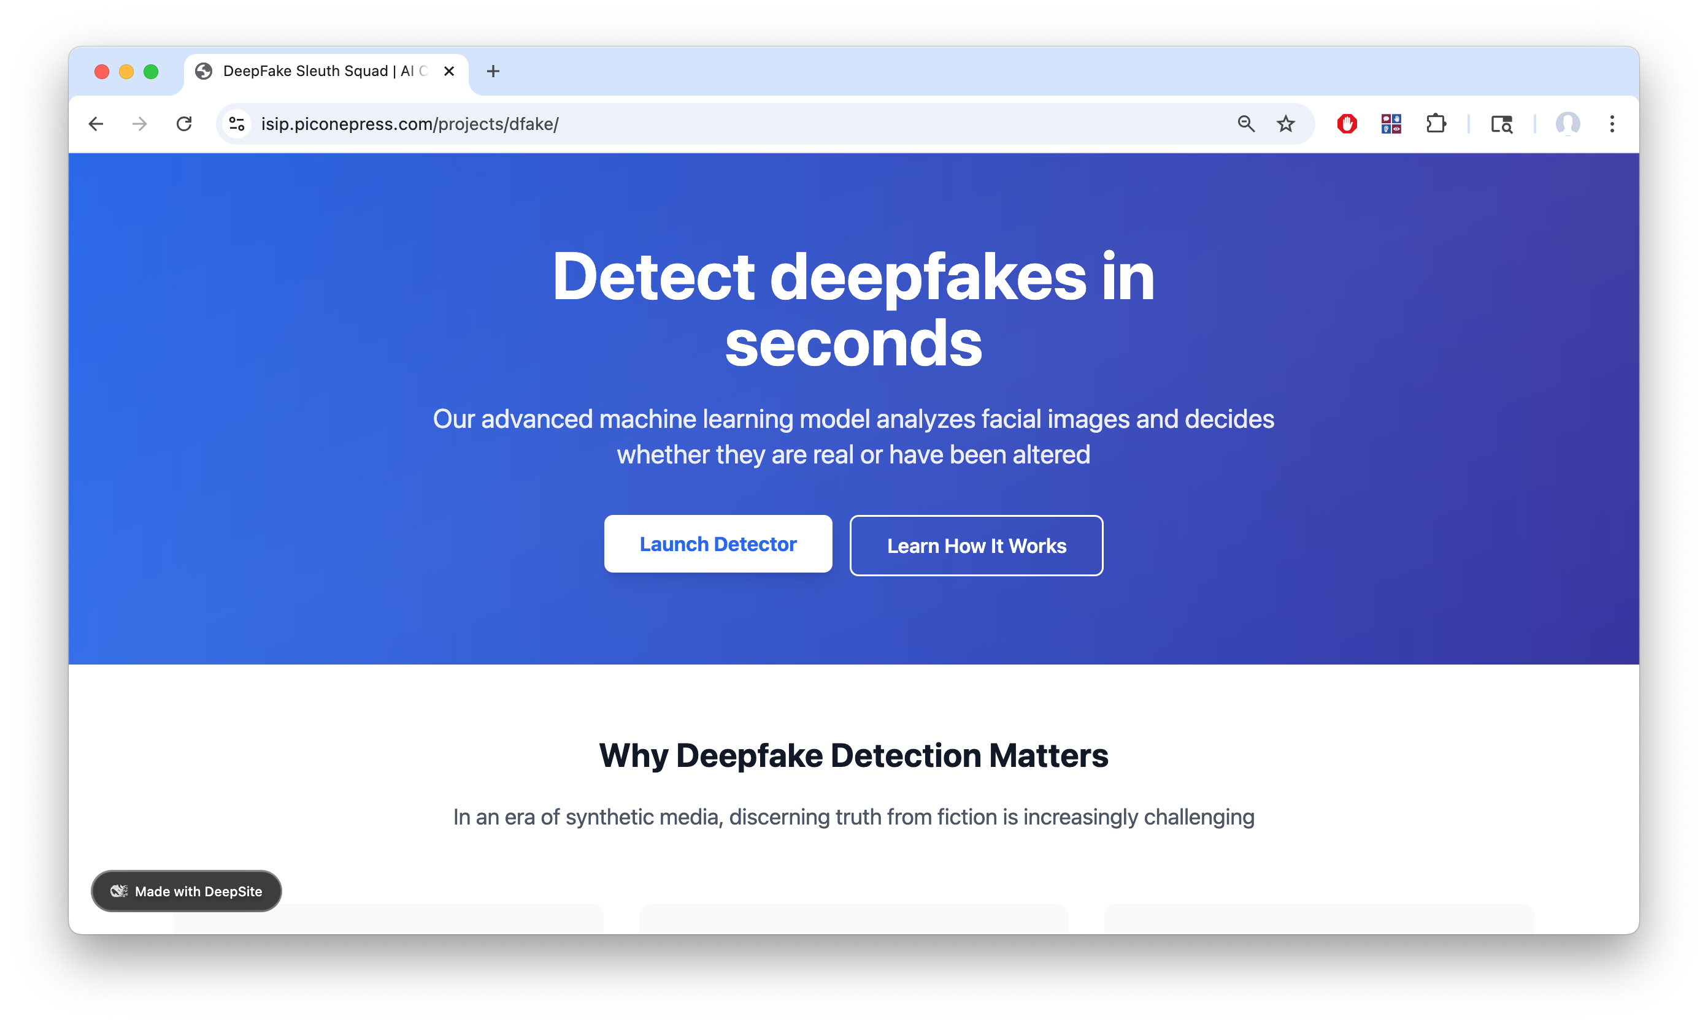
Current Overview Page

Slide 36
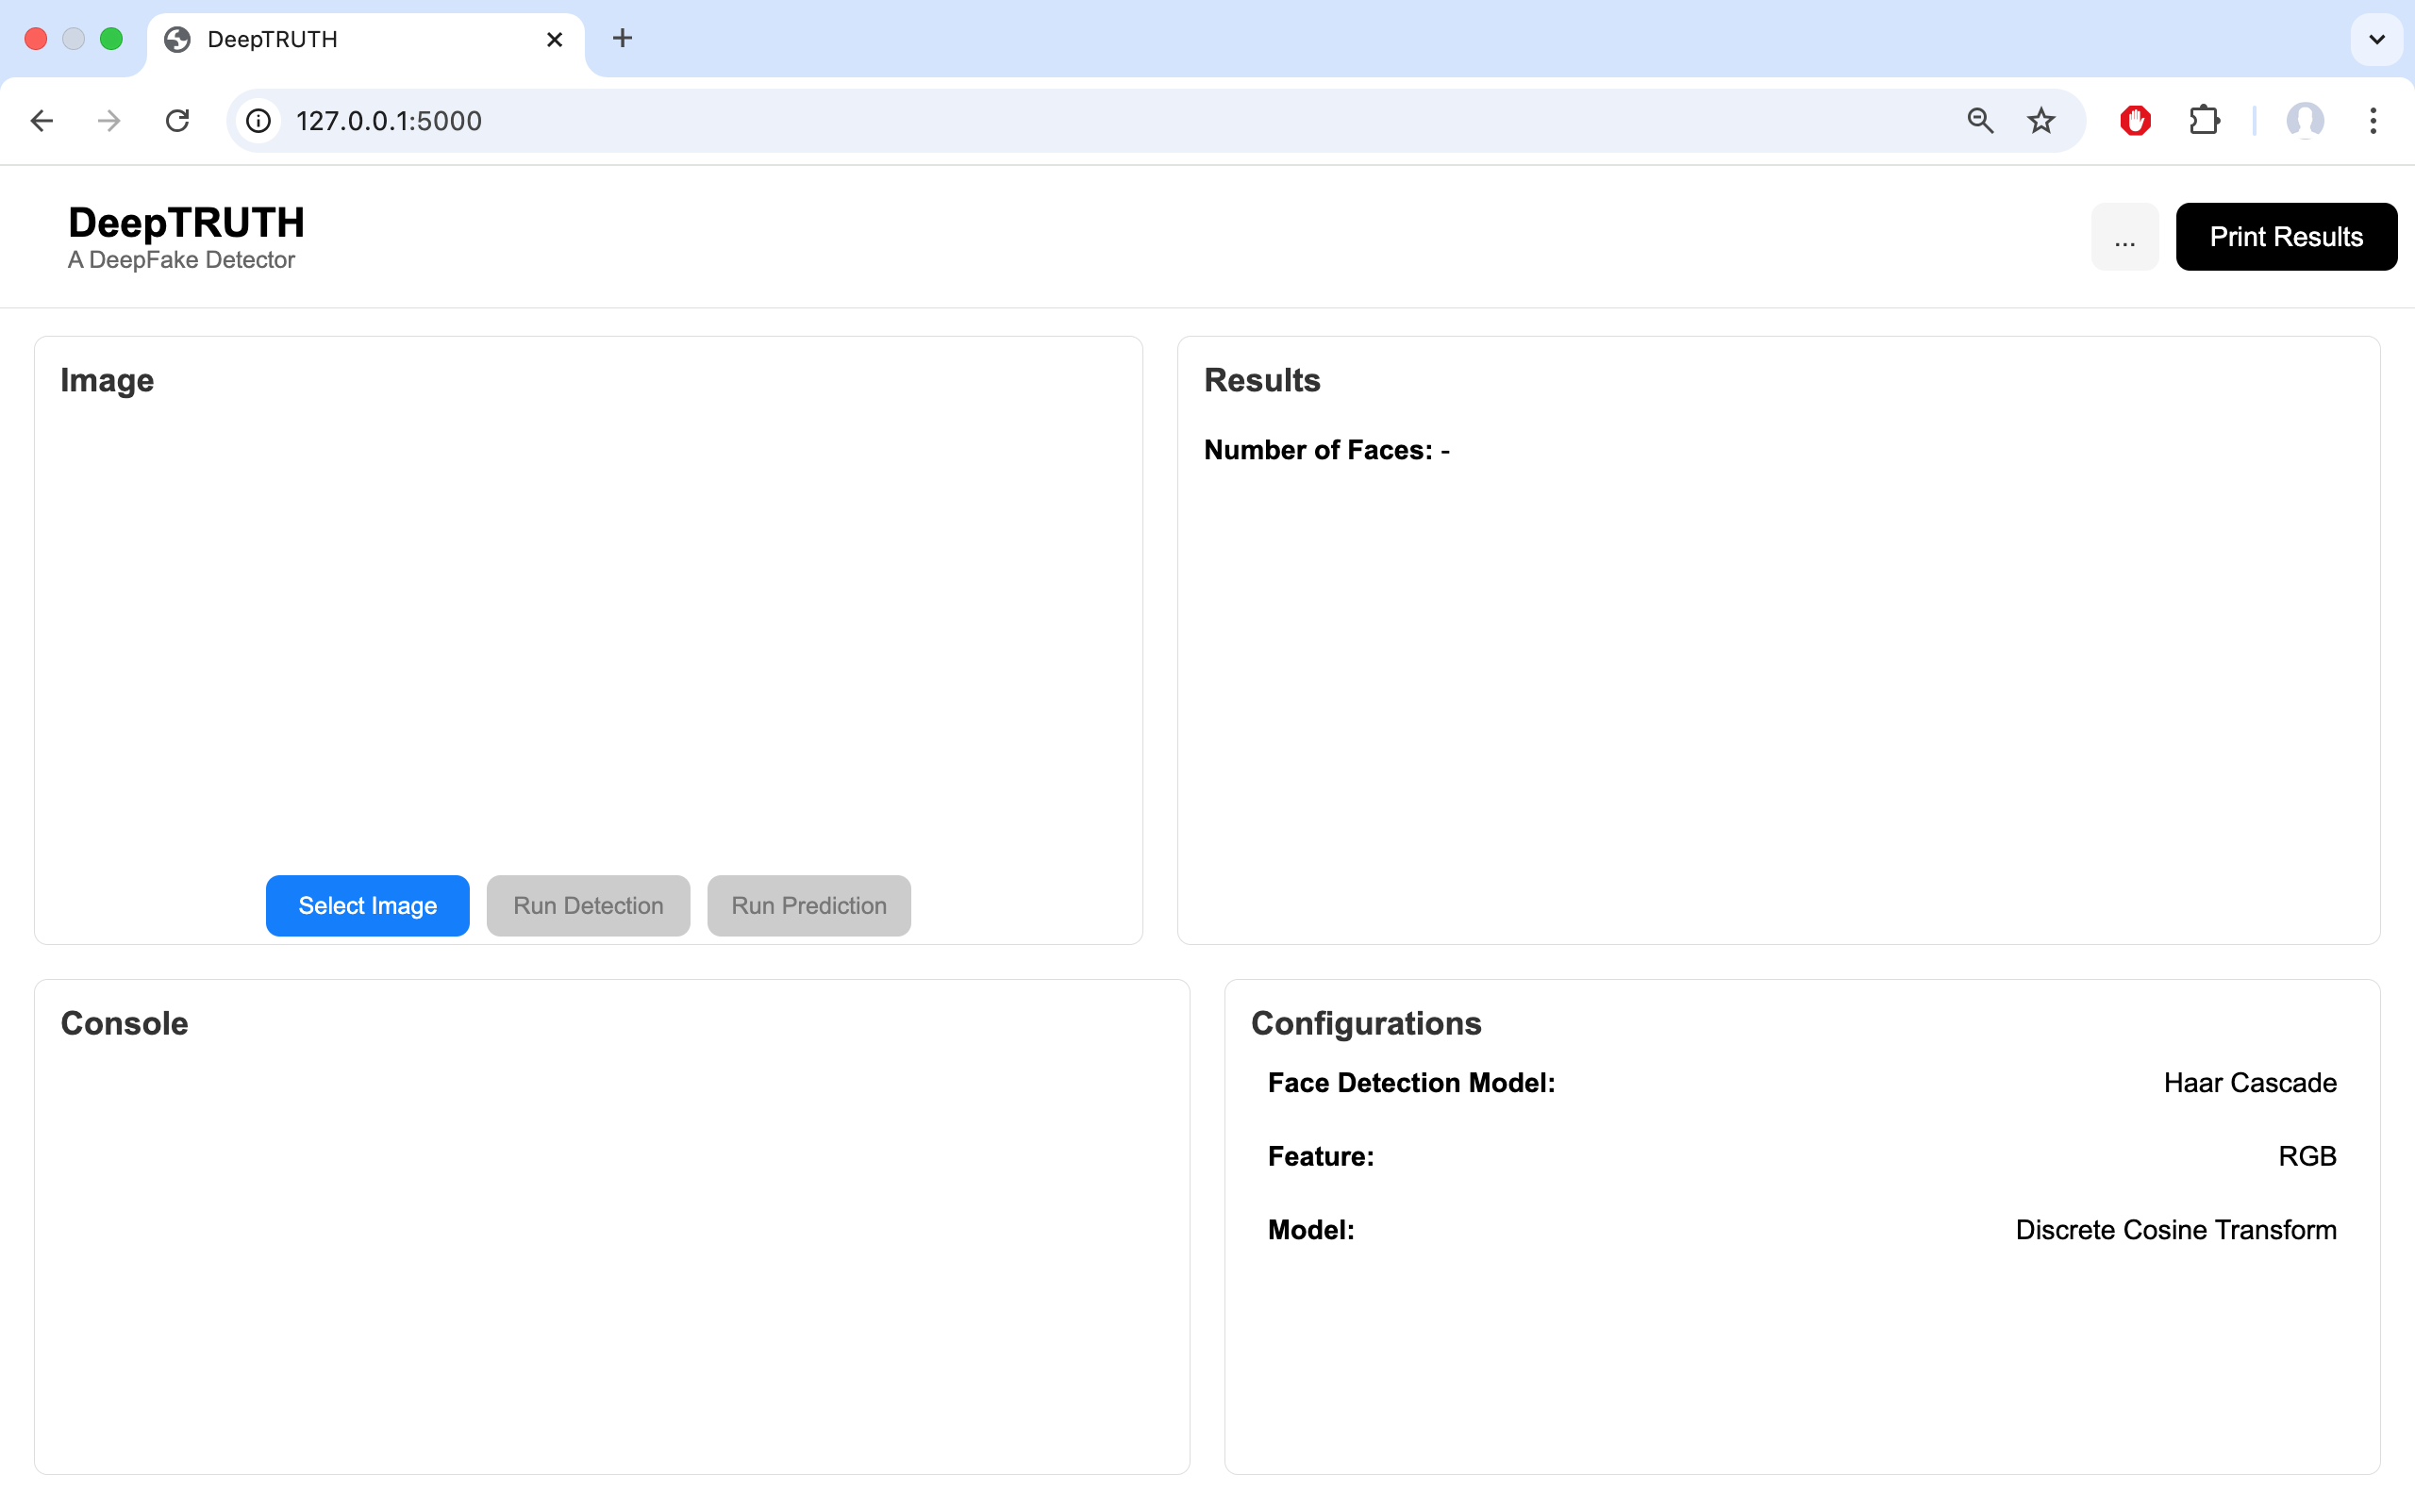
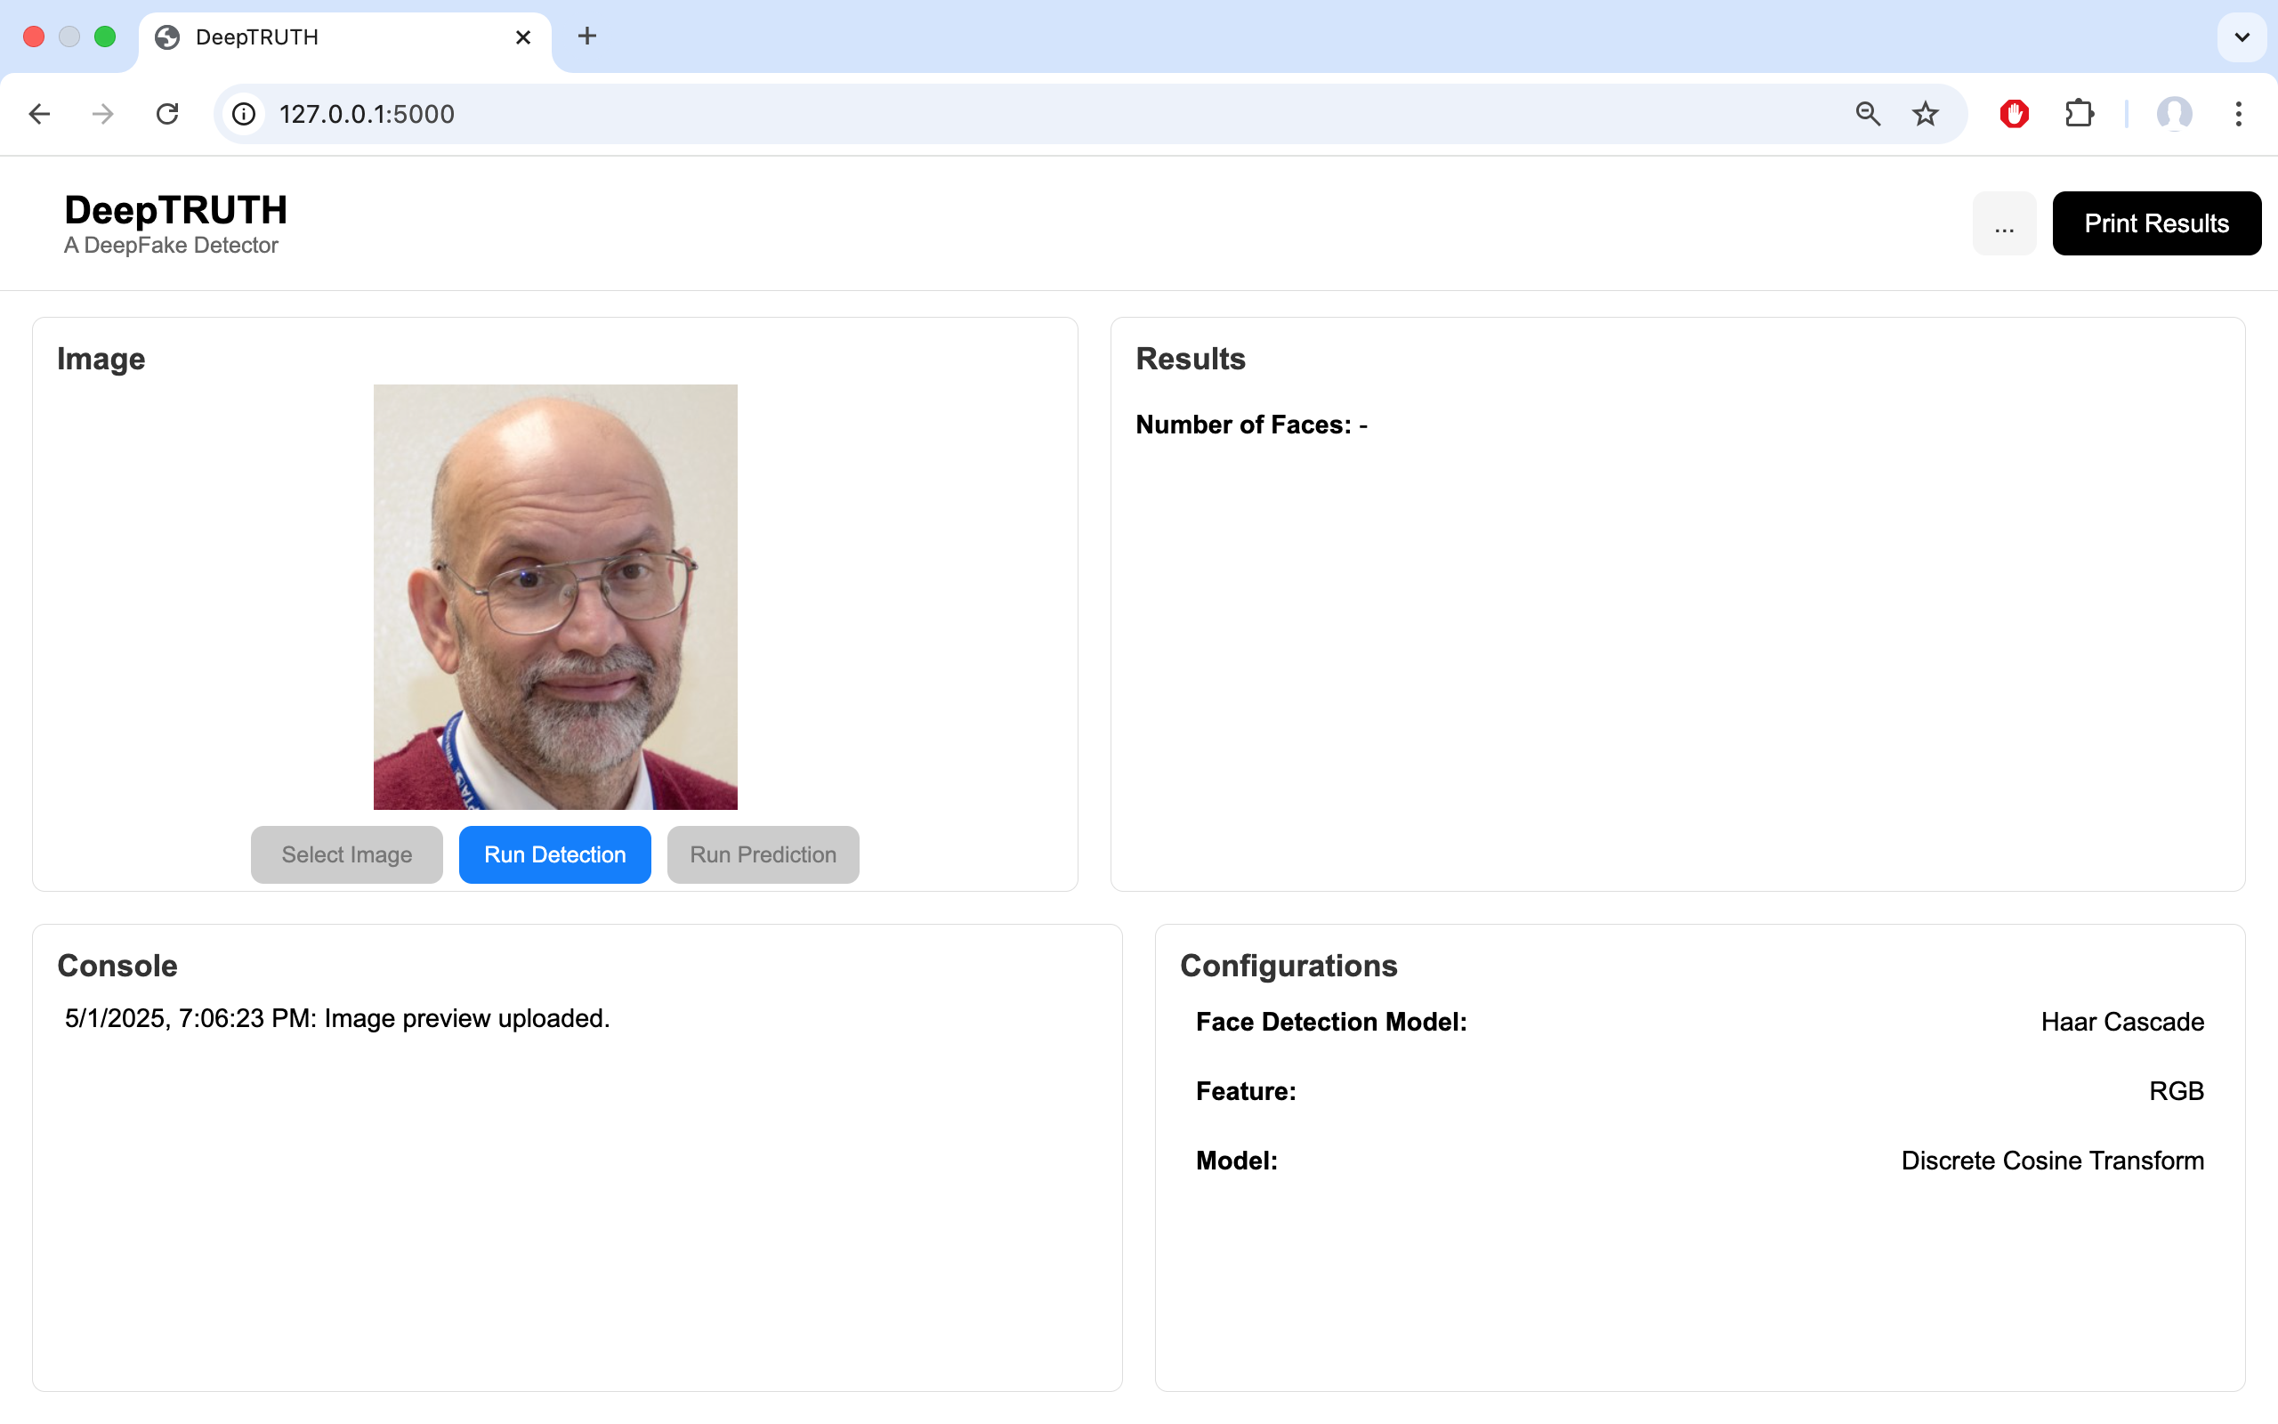
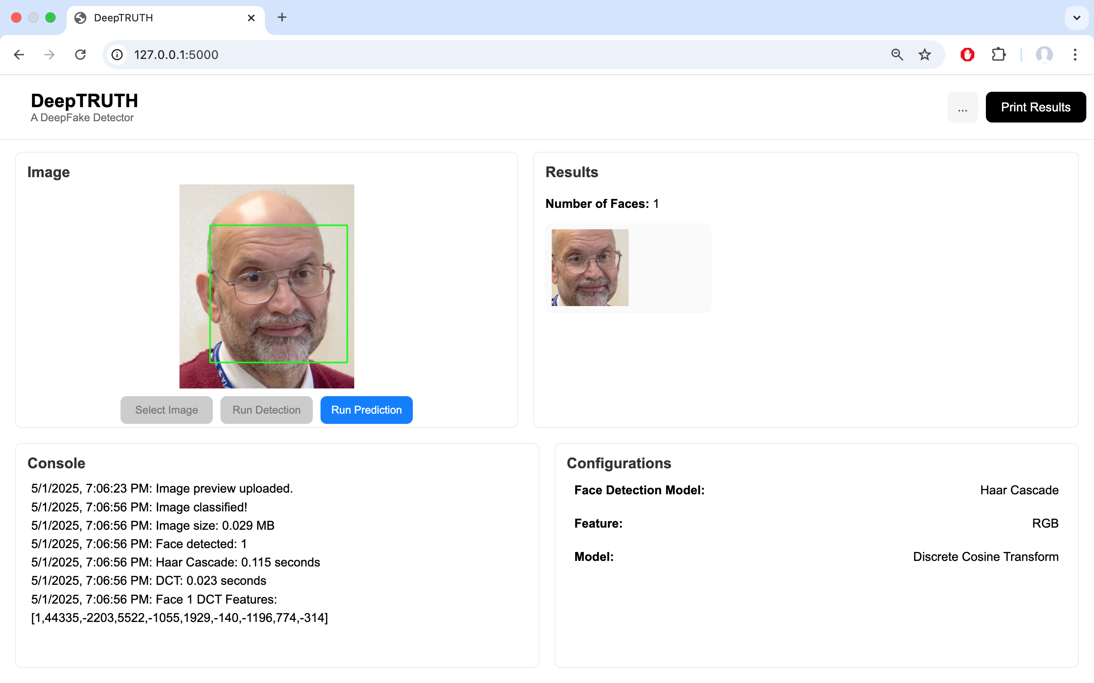
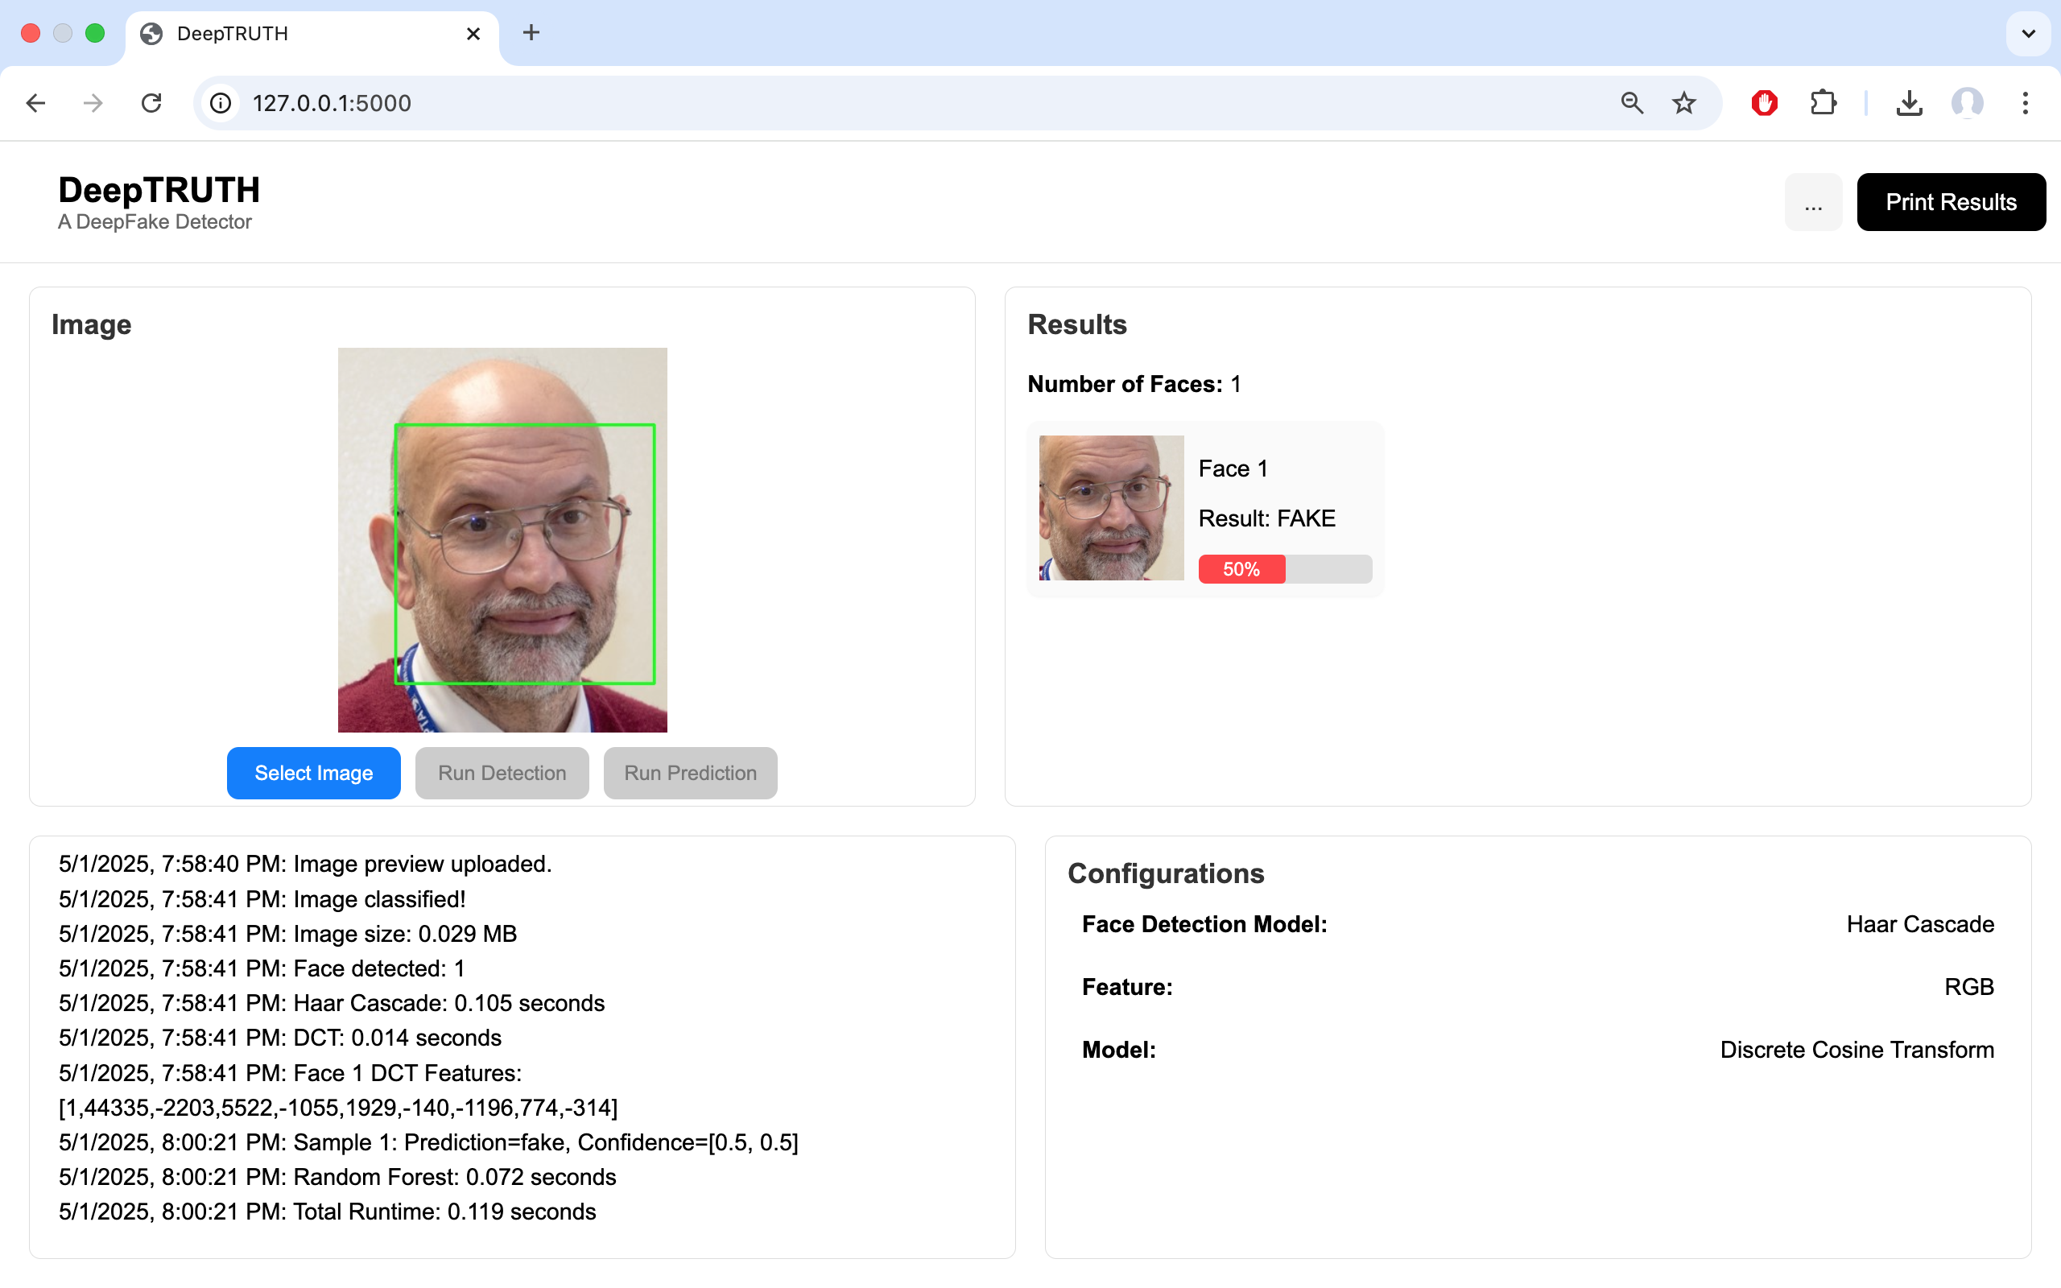
Current Functioning Prototype
User Uploads Image
Face Identified
Prediction Made
Notes:
Zacary

Slide 37
GANT Milestones
Milestones | 25-Aug | 1-Sep | 8-Sep | 15-Sep | 22-Sep | 29-Sep | 6-Oct | 13-Oct | 20-Oct | 27-Oct | 3-Nov | 10-Nov | 17-Nov | 24-Nov | 1-Dec | 8-Dec | 15-Dec
Problem Statement
Design Citeria
Research Evaluation Dataset
Host Website on Web
Research CNNs
Presentation 1
Create Parallel Dataset
Create Evaluation Dataset
Requirement and Constraints
Potential Solutions
Preliminary Design
Presentation 2
Train CNN Model
Design Document
Presentation 3
Explore ViT & EB0 Models
Testing Methods
Preliminary Results
Final Presentation
Poster Day
Notes:
Jahtega

Slide 38
Team DeepTRUTH
Thanks you for your attention
Jouri Ghazi
Jahtega Djukpen
Ashton Bryant
Zacary Louis
Questions & Comments?

